Slide 1
How To Play This Presentation:
OPEN presentation in PowerPoint
GO to slideshow
CLICK on from beginning
NOTE: If playing on TEAMS, if you talk, the sound will cut out
Use the mouse to click through presentation
Please click on the megaphone symbol to play sound
Notes:
kellie

Slide 2
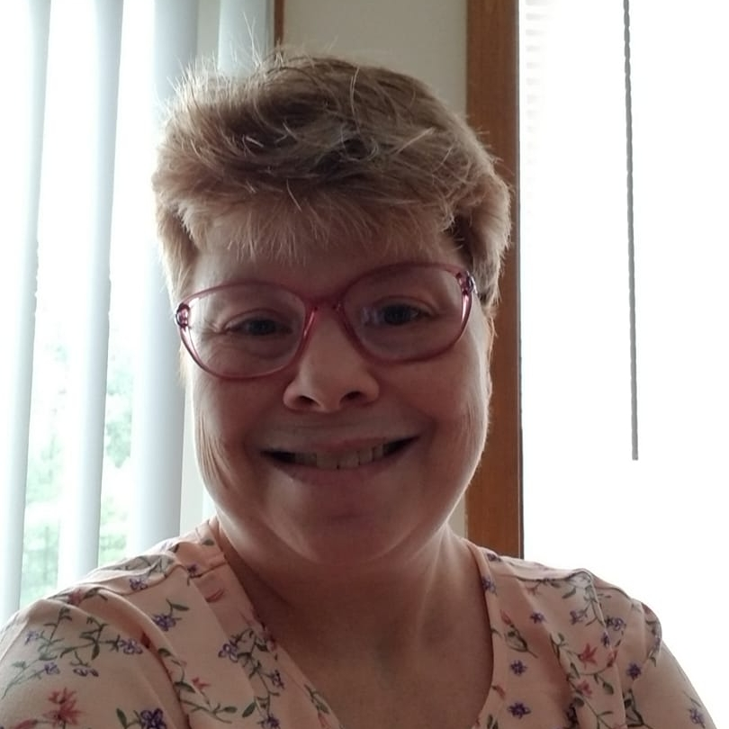
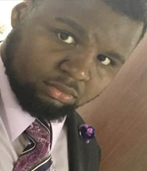
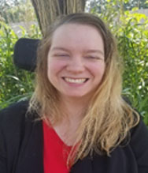
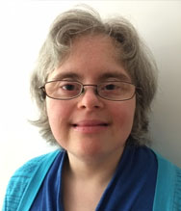
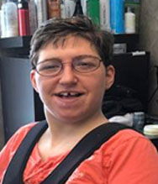
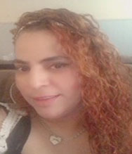
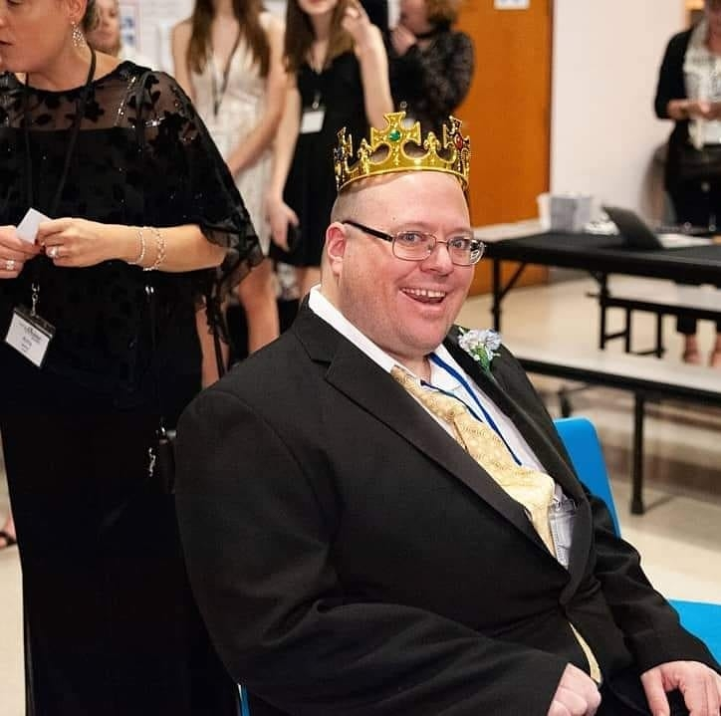
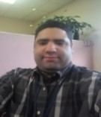

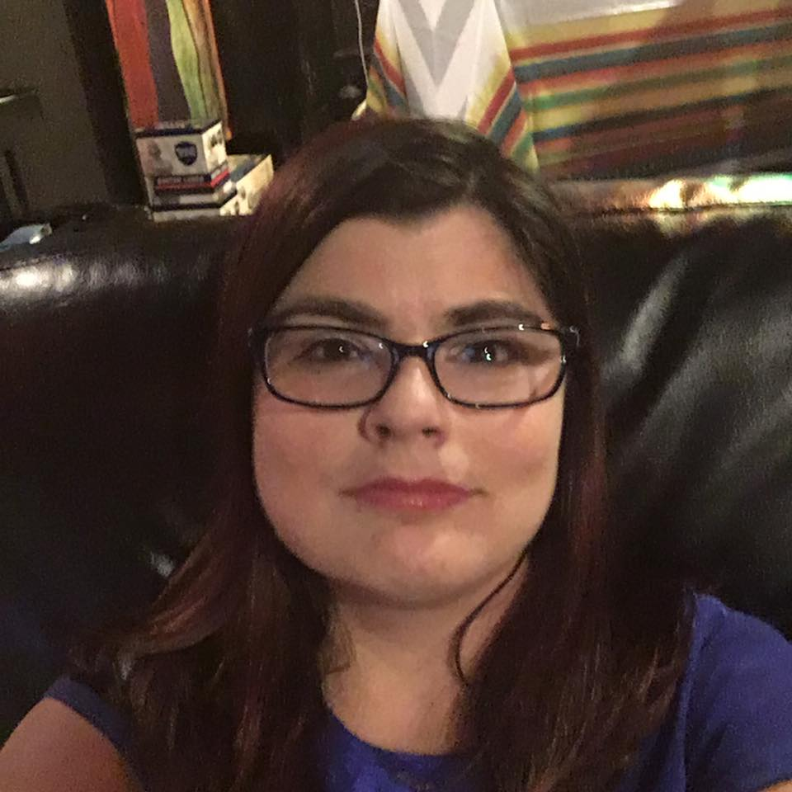
Together We Are One

Slide 3
In the beginning
2020 started off as a typical year for the SACS.
Our lives had a normal, predictable rhythm to it.
We:
  Traveled to our providers to run SA groups
  Went to the office as usual
  Visited with providers to promote self advocacy
  Had our usual in person statewide and regional SAC meetings.
These are seemingly simple things that we took for granted before they were taken from us.

Slide 4
Then Everything Changed….

Slide 5


Covid-19 declared a public health emergency in the USA- February 2020

Slide 6


March 2020- COVID 19 officially declared a pandemic by the WHO

Slide 7


COVID comes to CT- March, 8-2020
(HARTFORD, CT) – Governor Ned Lamont today announced that the Connecticut Department of Public Health (DPH) State Laboratory has confirmed the first presumptive positive case of coronavirus disease (COVID-19) involving a Connecticut resident. The patient, a resident of Wilton who is 40 to 50 years of age, is being treated at Danbury Hospital. The person most likely became infected with the virus that causes COVID-19 during a recent trip to California and sought medical care shortly after returning to Connecticut.

Slide 8

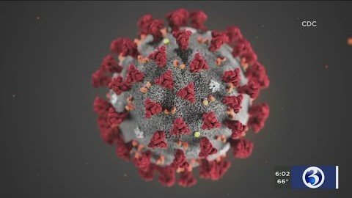
March 10, 2020- Governor Lamont declares state of emergency

Slide 9
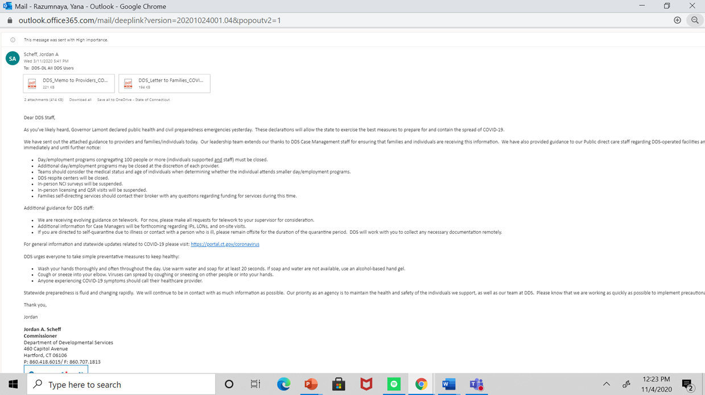
March 11, 2020- Commissioner Scheff announces closure of DDS Day programs.

Slide 10

March, 12, 2020- Final in person statewide SAC meeting

Slide 11

March 20, 2020- Gov Lamont signs Stay safe, stay home order

Slide 12
Question time: when did things get real for you?
In the second week of March my family was exposed to someone who was sick for a month but could not be tested because the individual did not fit the exact criteria. At that time, tests were limited and somewhat unreliable, it became frustrating and worrisome. - Kate Desjardins, North Region
I began to realize that things were getting serious in mid March when schools were closing and places like DDS were requiring their employees to work from home.
- Ellen Hadad-Blazys, West Region
I knew it was serious when I was one of only a few people in the office and finally was released to telework on the March 25th.
- Sandi Geer, West Region
when businesses shut down & people started losing their jobs & when we started getting calls at home from my husband's work saying that there are cases in manufacturing & traffic center.
- Kim Butts, North Region

Slide 13

Interview with Varian Salters, SAC north region

Slide 14
Question Time: how long did you think this would last?
As far as working from home no I did not think it was going to be a few weeks but knowing what we know now I am happy to be working from home & not being in the office & that I still have a job.
- Kim Butts, North Region
My projected outcome was that we would be returning back to our offices in June.
- Ellen Hadad-Blazys, West Region
When I first left work, I thought it would be temporary
- Sandi Geer, West Region
Yes , but as we began to get a handle on the situation the goal became; how do we do this right, gain productivity, work cohesively -yet apart...
- Kate Desjardins, North Region

Slide 15
AT DDS…We are at war with an invisible enemy.

Slide 16


Interview With Kevin Arce, SAC

Slide 17


Slide 18

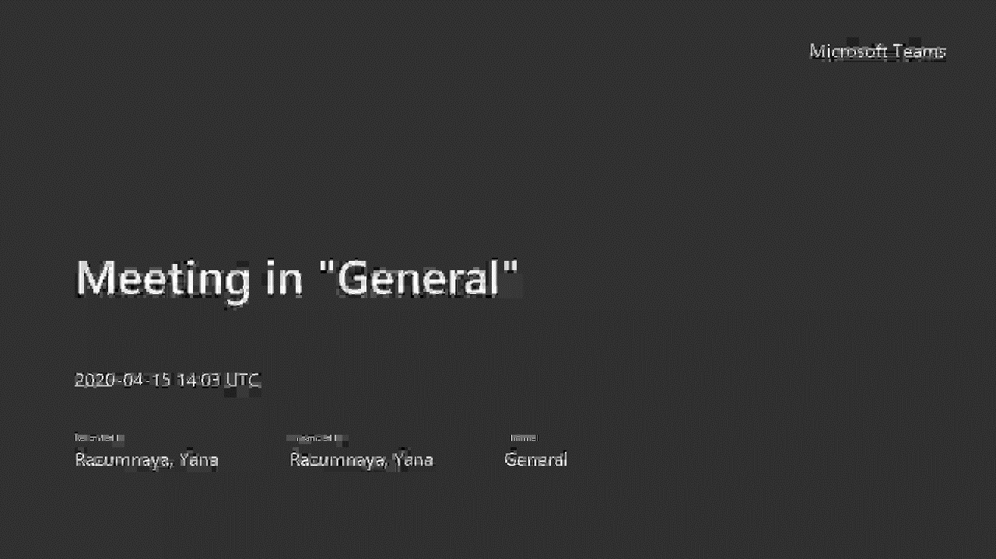
Interview With Natasha Cole, West Region SAC

Slide 19


Thank you, Frontline heroes,!

Slide 20
. As skills increased, they found they were capable of doing what they did before and a whole lot more...Mastering TEAMS, virtual Advocacy groups, creating tutorials to get participants connected, Virtual Boards, the Art of the Voice Over added to their sense of accomplishment. They have all given it their best and really excelled. It’s a pleasure working along side and a privilege to be on the inside track witnessing their growth in confidence and accomplishments.
-Kate Dejardins

Slide 21

Dedicated to Jossie Torres and Commissioner SCheff

Slide 22

Notes:
Click to play video

Slide 23


