Slide 1
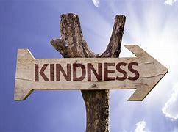

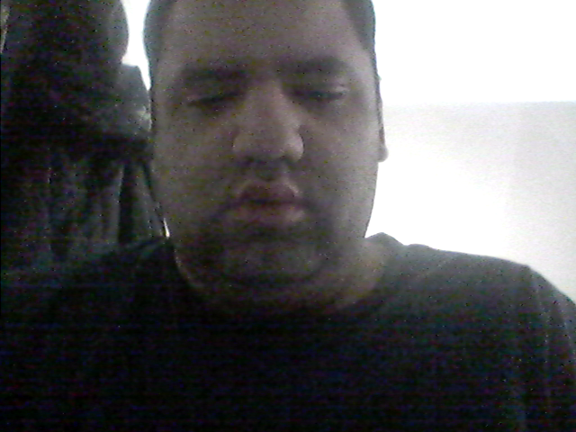
Connecting with Kindness
By Kevin Arce, and Varian Salters

Slide 2
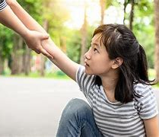
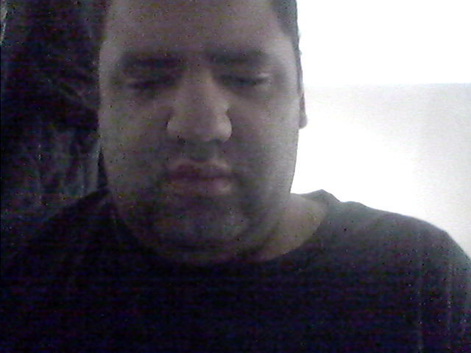
Why Should we be kind?

Slide 3
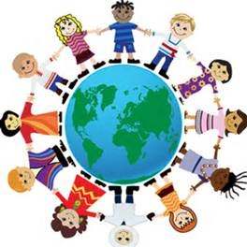
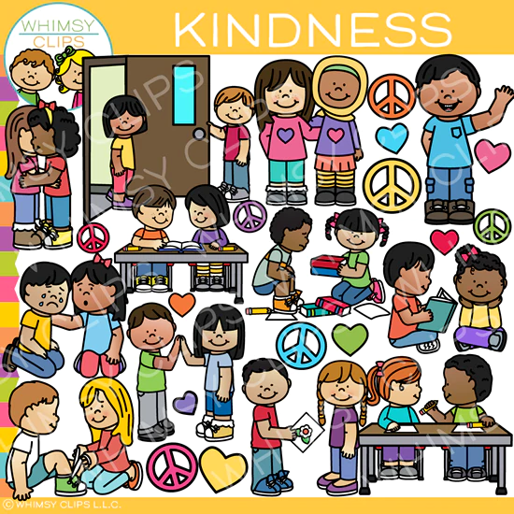
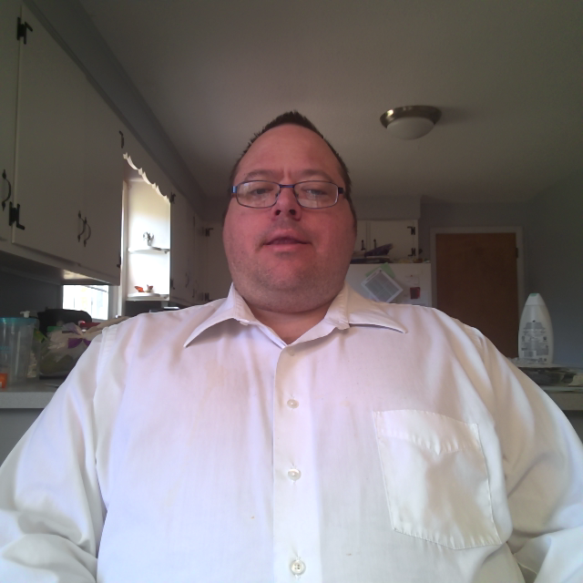
Connecting with Kindness!

Slide 4

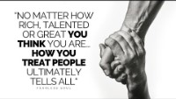
How do people notice kindness?

Slide 5
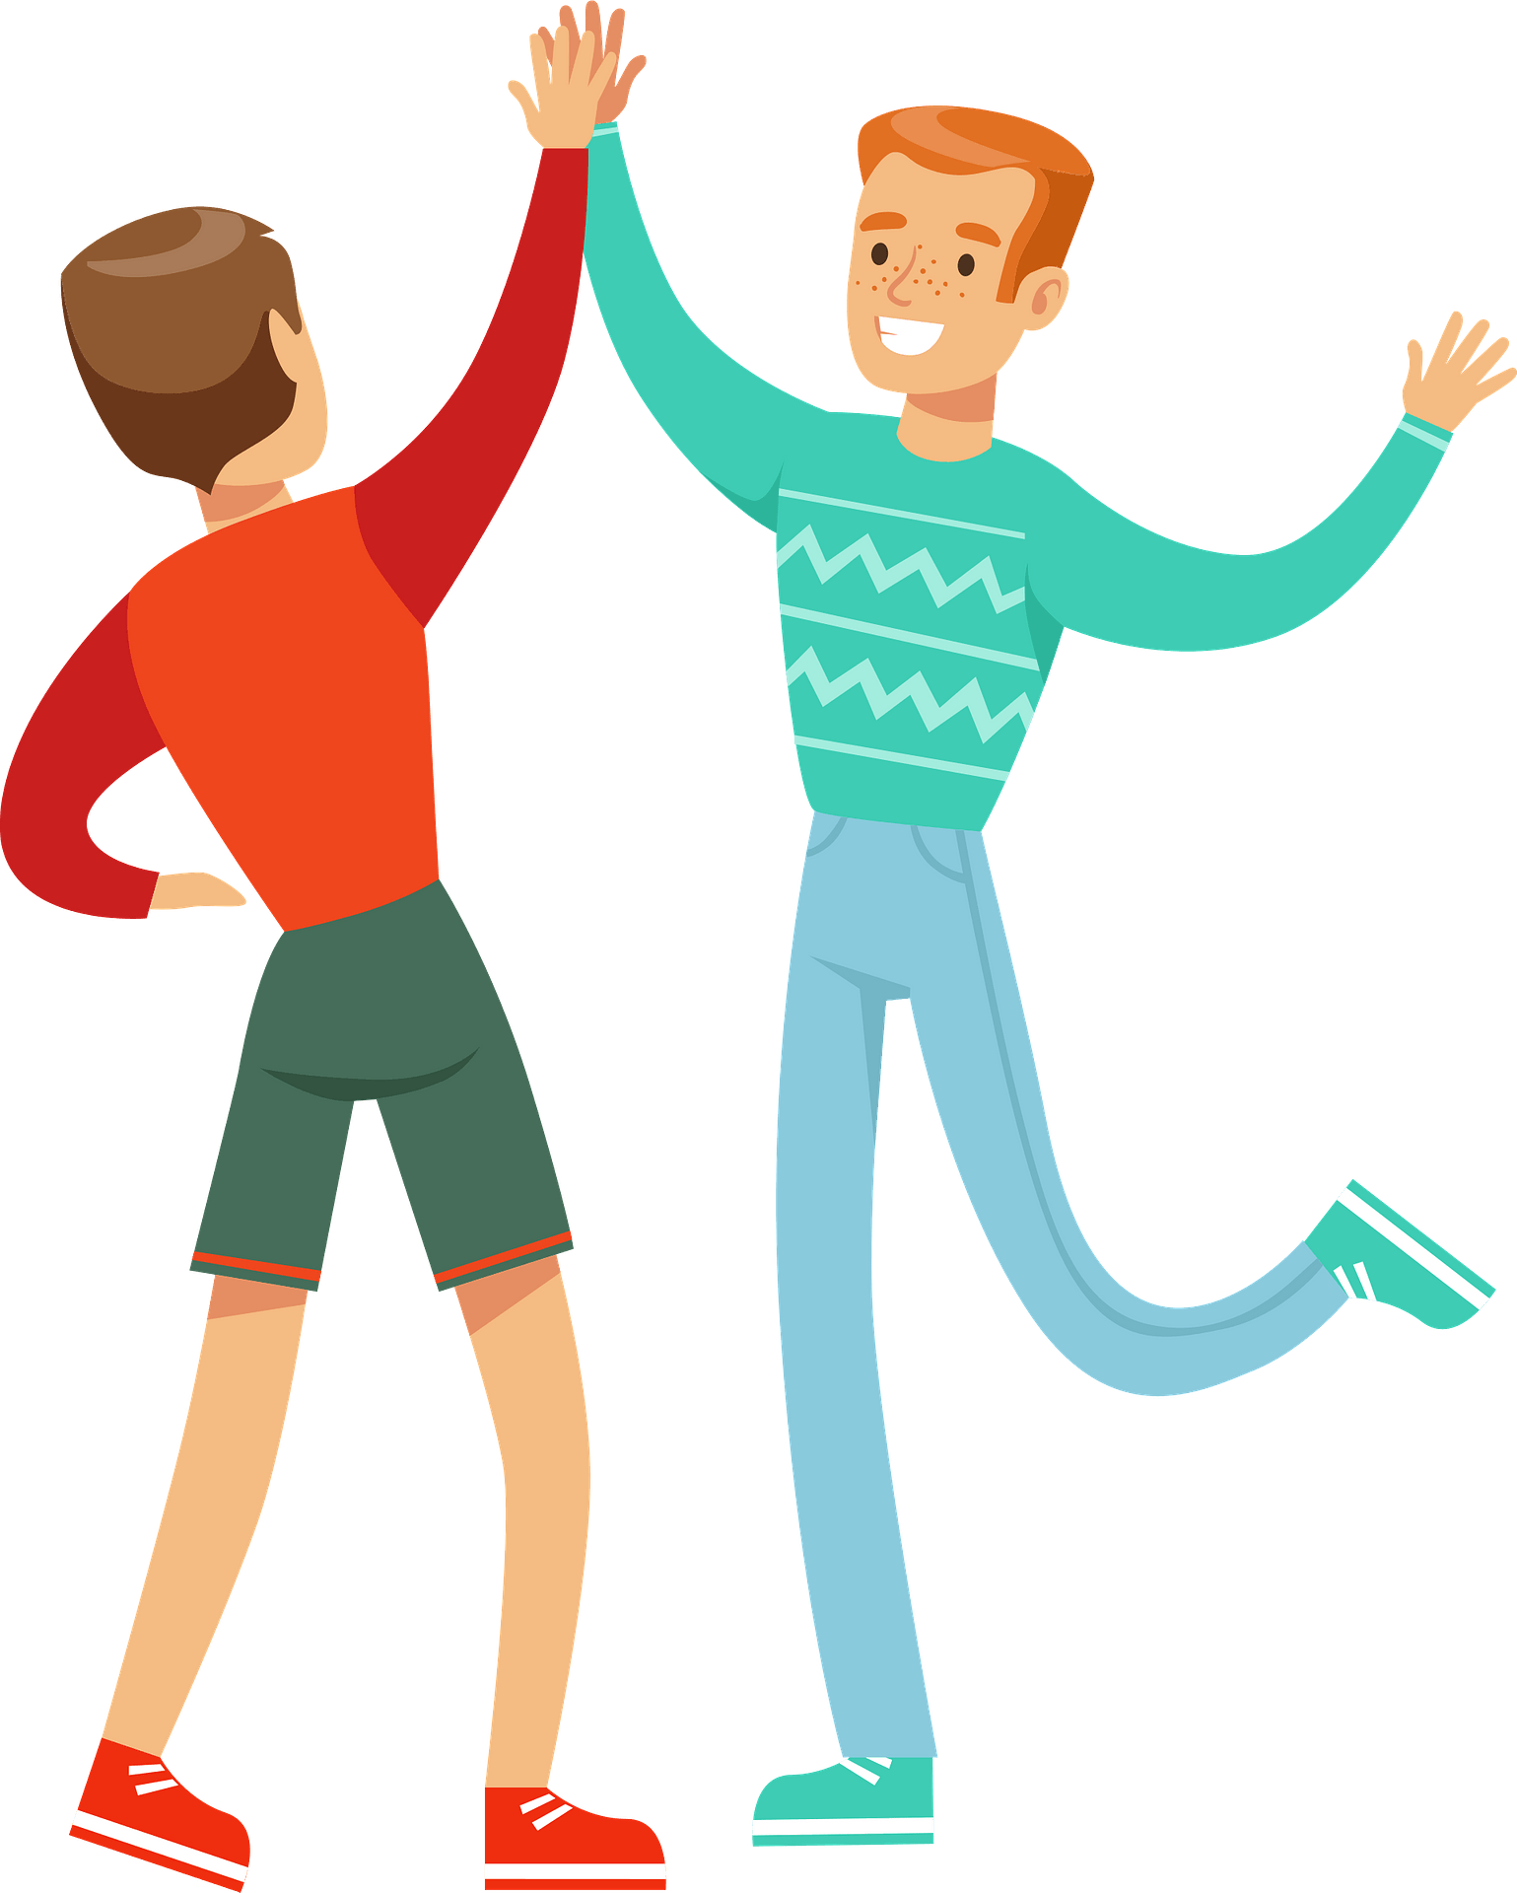
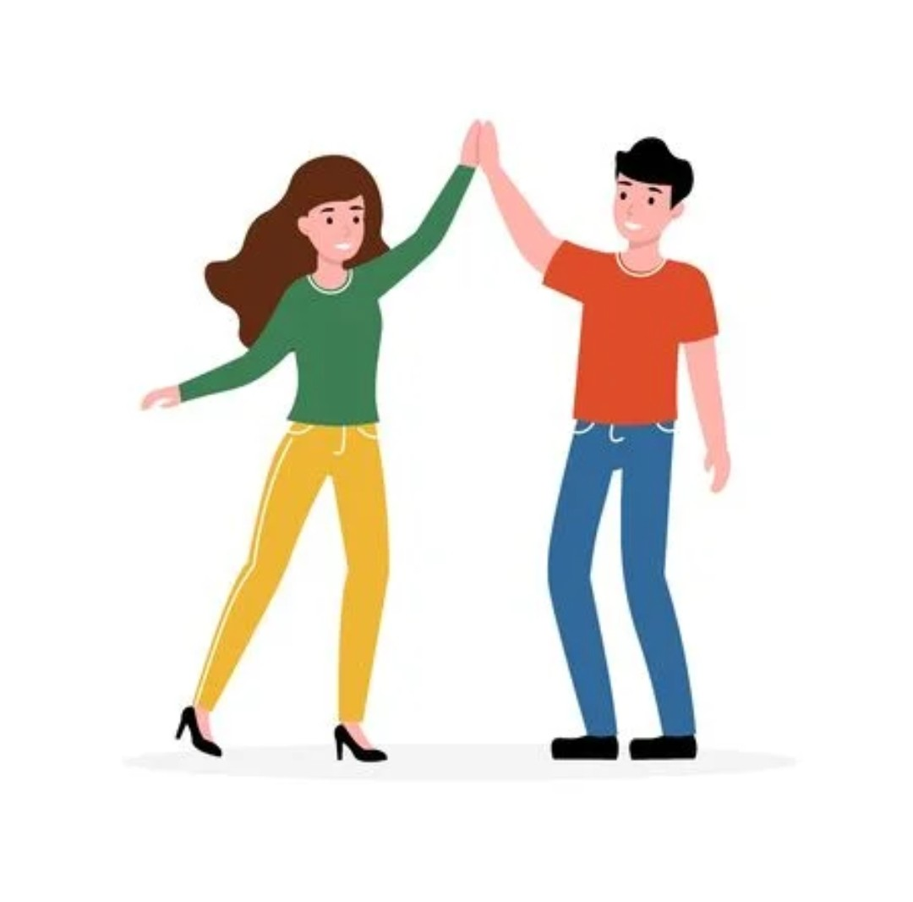
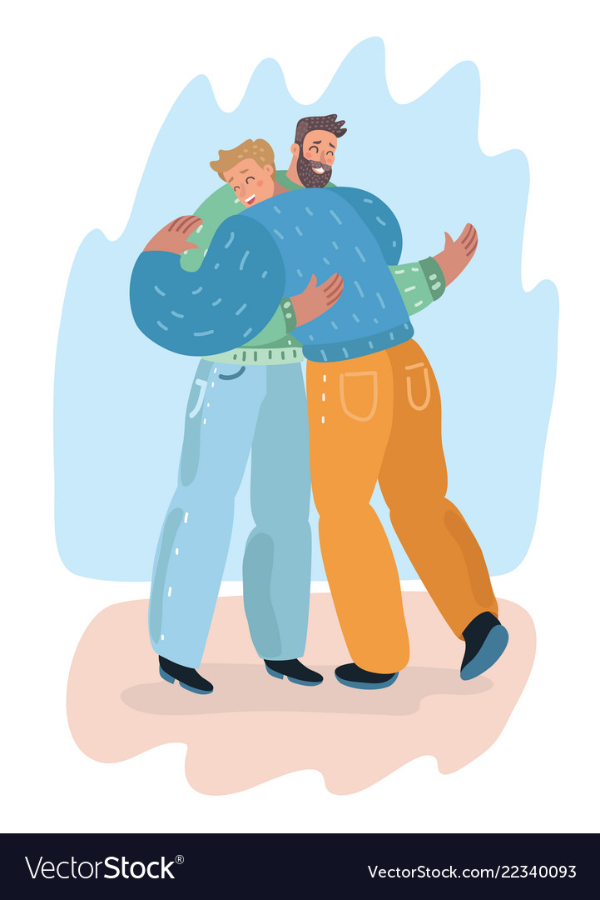
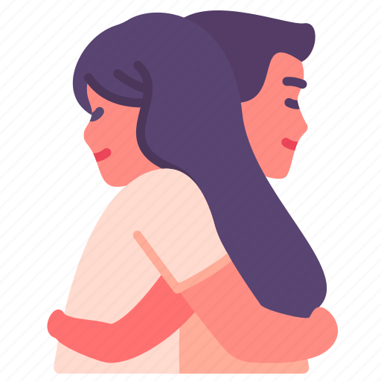
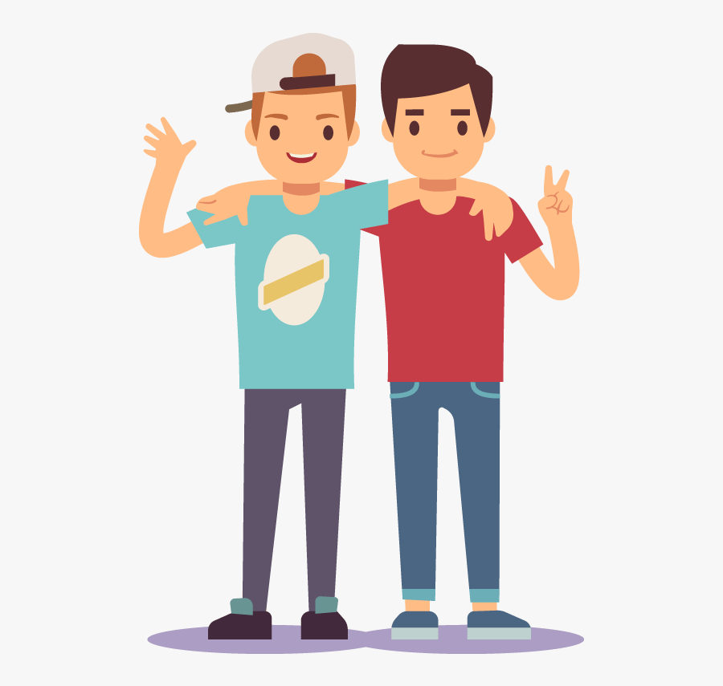
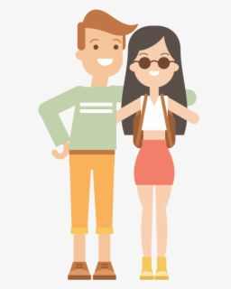
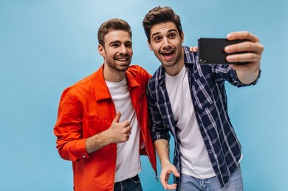
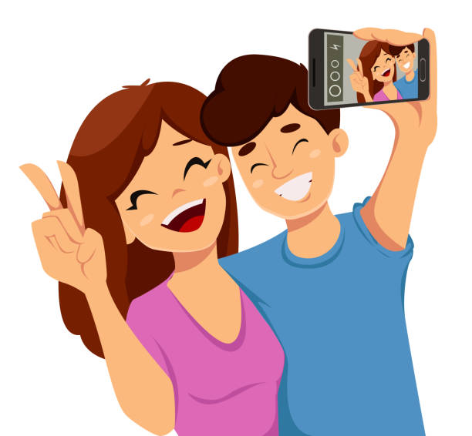
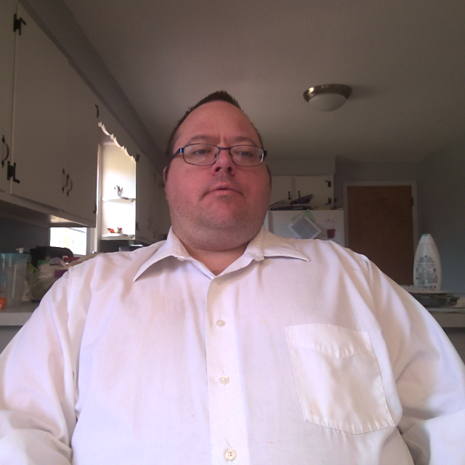
appropriate physical contact, appropriate touch & Boundaries.
Give your Friends a High 5!
If your friend is sad ask if it is ok to give them a hug!
Ask your friend if it’s ok to take a selfie or picture with them!

Slide 6
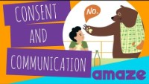
Appropriate Touch!

Slide 7
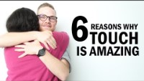
Reasons why Touch is Amazing!

Slide 8
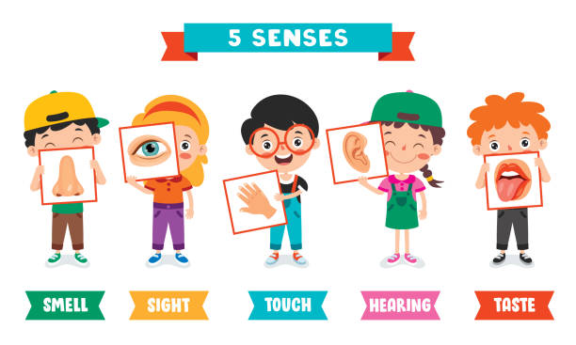

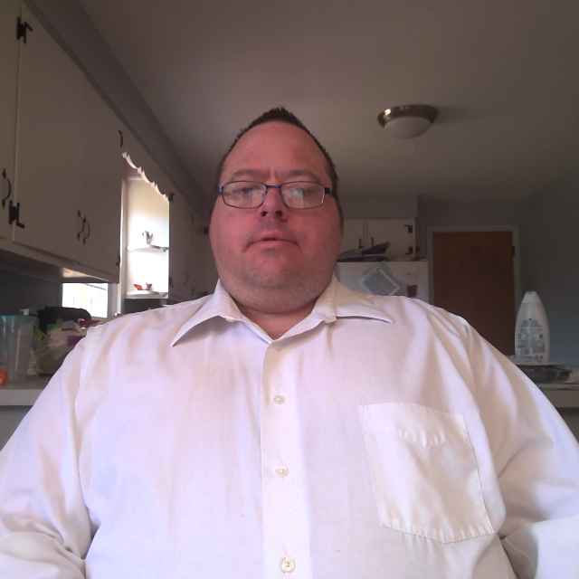
What is your favorite sense and why?

Slide 9
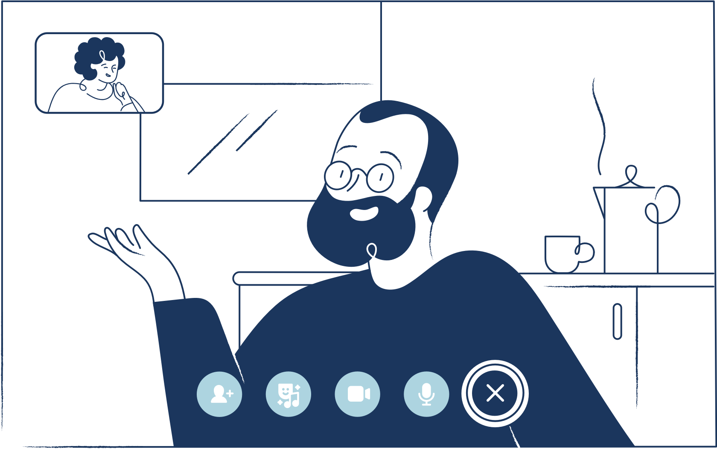
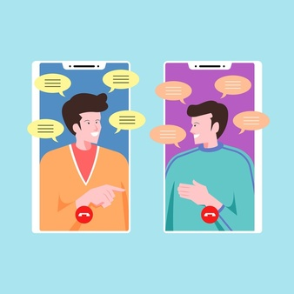
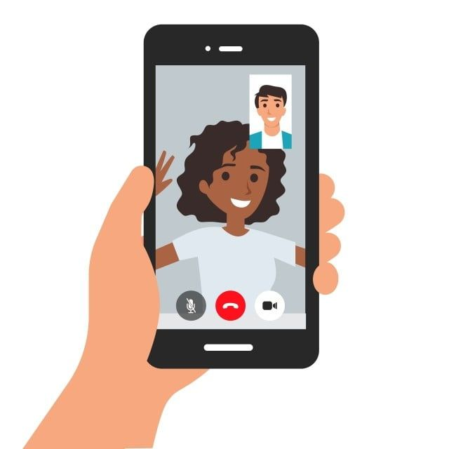
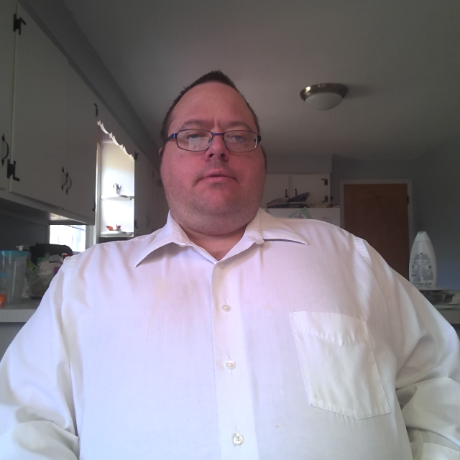
How to maintain Friendship during the pandemic!

Slide 10

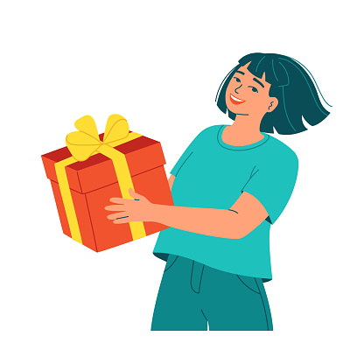
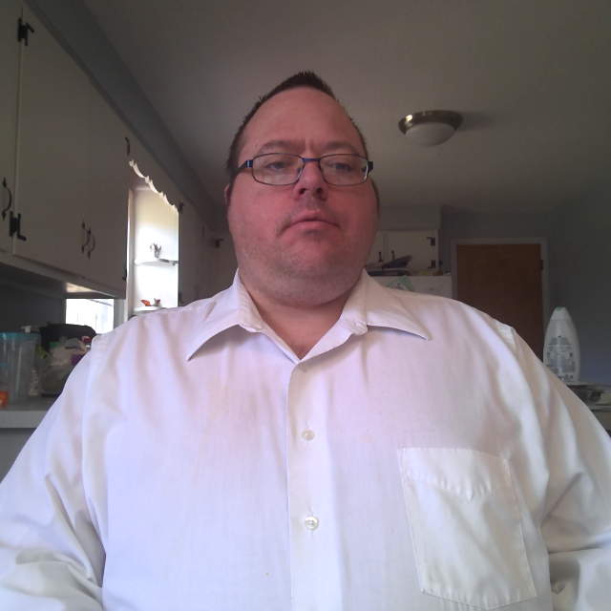
Get a gift for someone!
Checking in with others.
Taking out the trash.
Sending flowers.
Connecting through ZOOM or TEAMS
Helping others connect on social media.
Being calm and patient.
Sending a card in the mail
Calling elderly relatives
Give compliments
Doing your share around the house

Slide 11
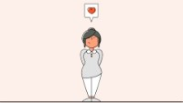
How do I show kindness?

Slide 12
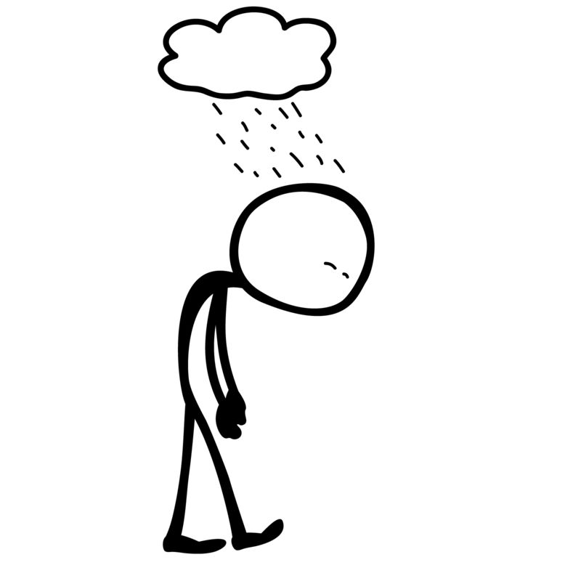
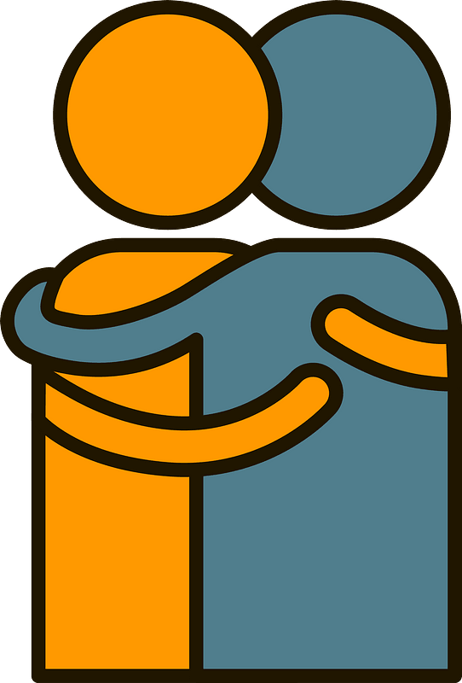
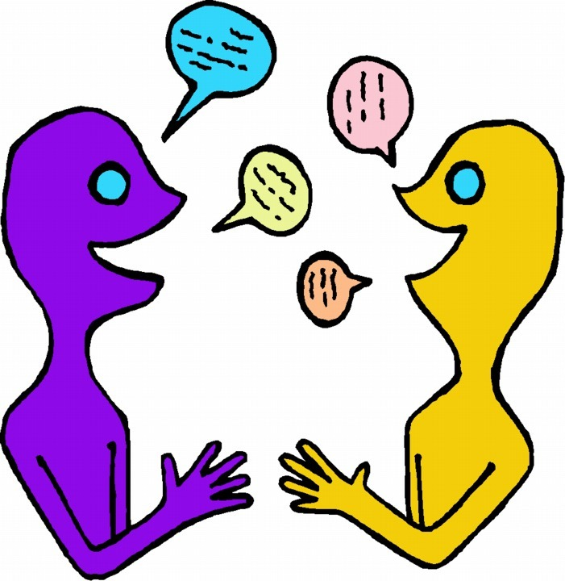
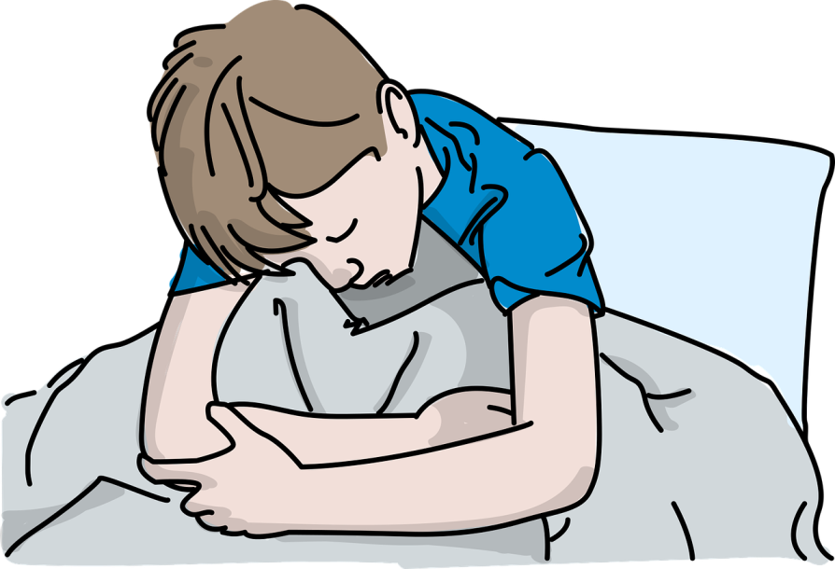
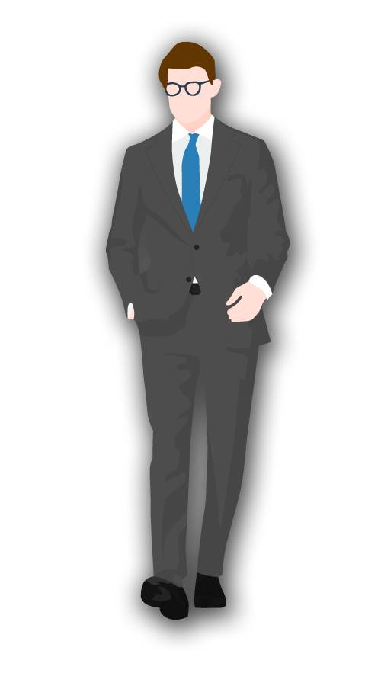
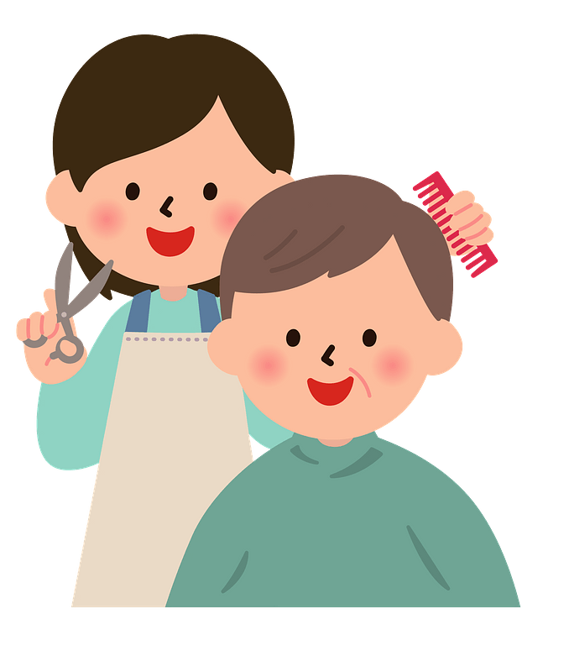
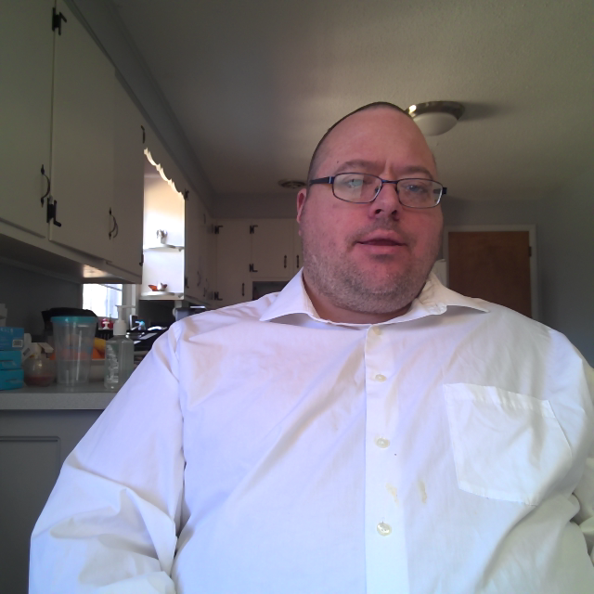
How do I show kindness?
Down!
Giving!
Feeling!
Nice!

Slide 13
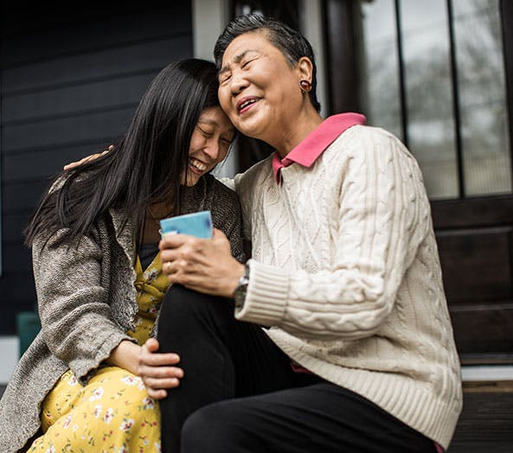
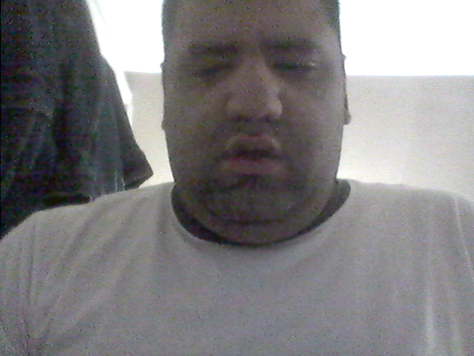
25 Easy ays to Be Kinder to Others (and Yourself) - PureWow
Be kind to yourself,
2. Pay someone a compliment,
3. Give money to a cause that you care about,
4. Give time to a cause that you care about,
5. Pick up garbage off the street when you see it,
6. Make ‘em laugh,
7. Give an extra-large tip,
8. Kill the road rage,
9. Send someone a big surprise bouquet of flowers,
10. Call or visit an older family member,
11. Walk away from negative thoughts and negative people,
12. Bake a treat for a neighbor,
13. Be good to the environment,
14. Support local businesses,
15. Buy coffee for the person behind you,
16. Donate blood,
17. Listen carefully,
18. Forgive others,
19. Plant something green in a neglected neighborhood area ,
20. Buy or make a sandwich for a homeless person,
21. Appreciate other perspectives,
22. Read books that teach kindness,
23. Leave a glowing review,
24. Be a source of positivity on social media,
25. Pay it forward
Notes:
Be kind to yourself, 2. Pay someone a compliment, 3. Give money to a cause that you care about, 4. Give time to a cause that you care about, 5. Pick up garbage off the street when you see it, 6. Make ‘em laugh, 7. Give an extra-large tip, 8. Kill the road rage, 9. Send someone a big surprise bouquet of flowers, 10. Call or visit an older family member,
11. Walk away from negative thoughts and negative people, 12. Bake a treat for a neighbor, 13. Be good to the environment, 14. Support local businesses, 15. Buy coffee for the person behind you, 16. Donate blood, 17. Listen carefully, 18. Forgive others, 19. Plant something green in the neglected areas of your neighborhood, 20. Buy or make a sandwich for a homeless person, 21. Appreciate other perspectives, 22. Read books that teach kindness, 23. Leave a glowing review, 24. Be a source of positivity on social media, 25. Pay it forward

Slide 14
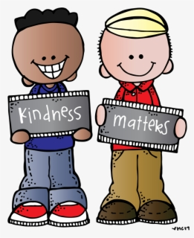
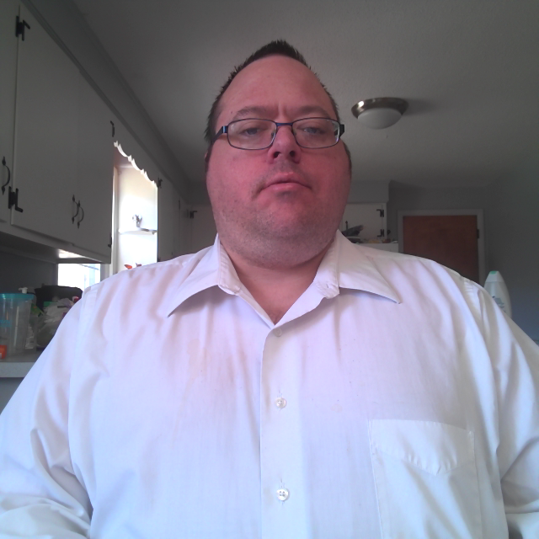
Question? What does it mean when someone is kind to you?

Slide 15

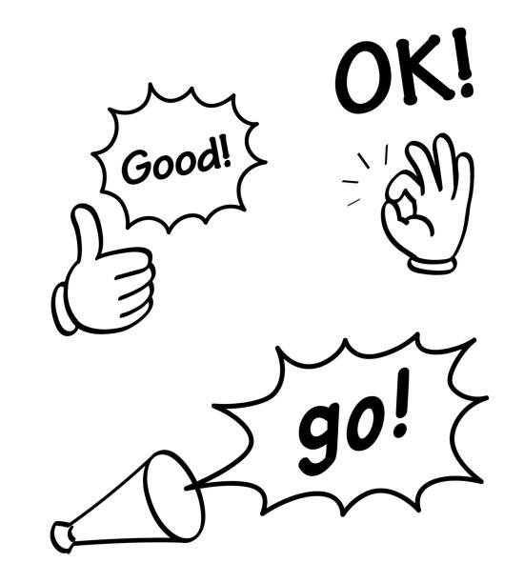
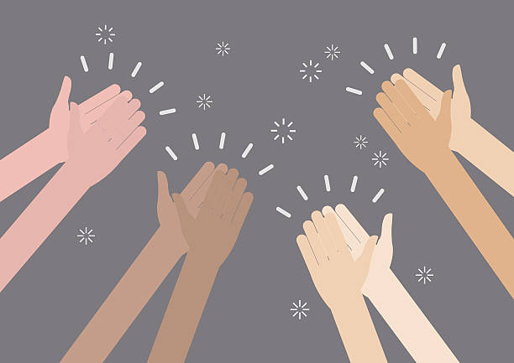
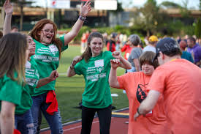
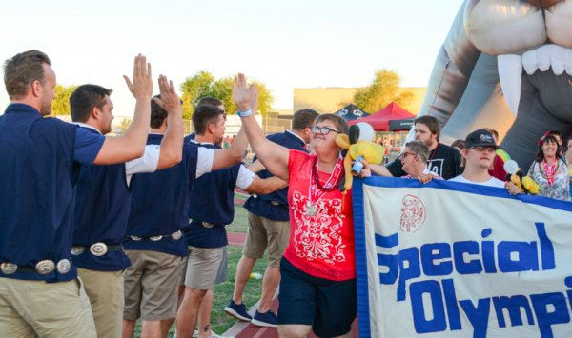
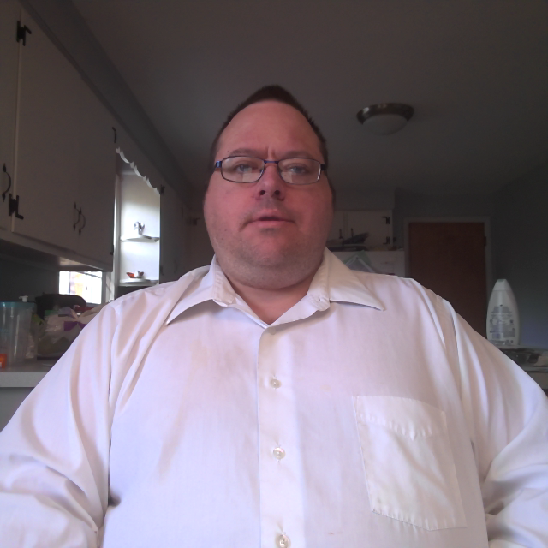
How do people notice kindness?
Great Job!
Encouragement!
Special Olympics!
Feeling!
Down!
Nice!

Slide 16
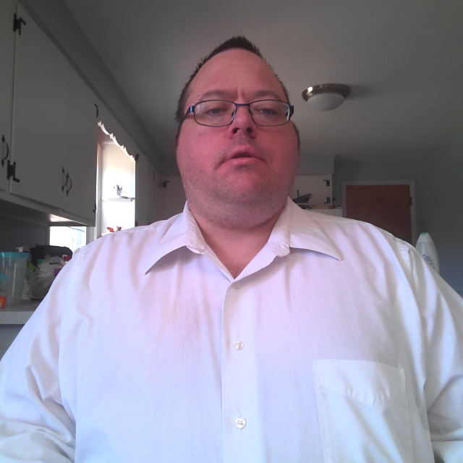
What does it mean to always do right? Give an example.

Slide 17
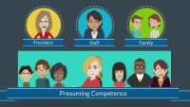
Presuming Competence!

Slide 18
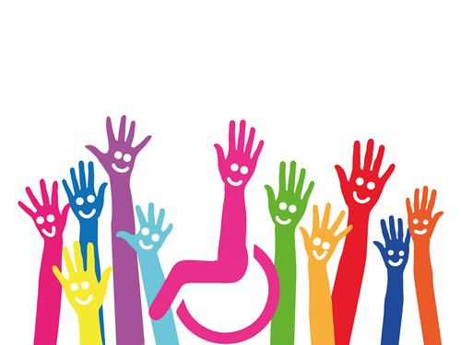
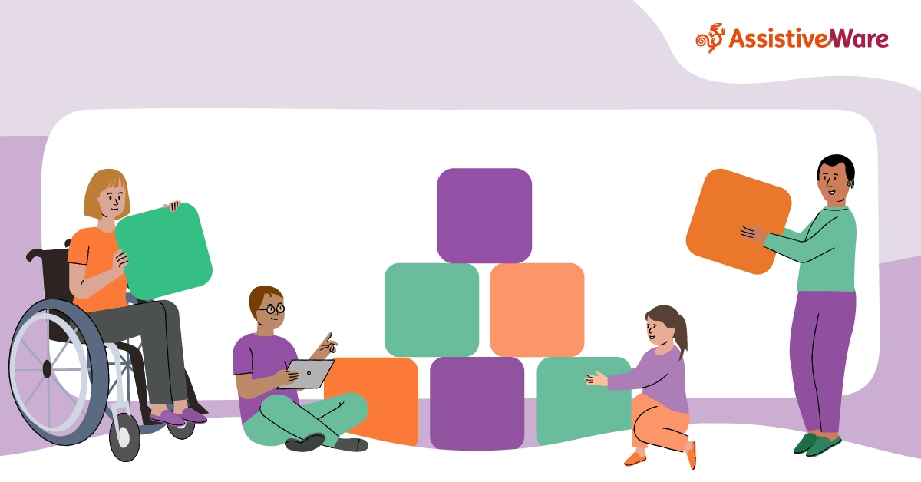
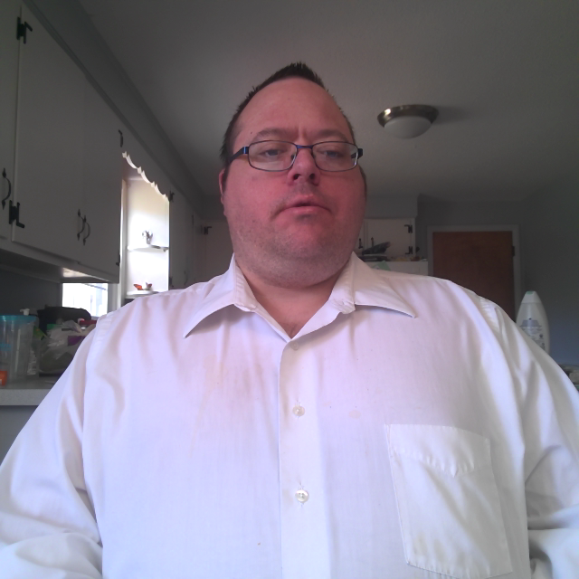
What does Presuming Competence mean?
Presumed competence means having respect for the individual & their Capabilities
Assuming the person understands & is able to accomplish the given task, until the individual tells you differently.

Slide 19
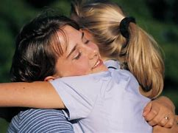

The potential of change through kindness can change the world for the better.
Being Nice Matters | Psychology Today
Nice, as defined by Dictonary.com, means “pleasing, agreeable, delightful, amiably pleasant, (and) kind.”
Nice matters, and perhaps now more than ever.
First try and accommodate others by putting yourself in their skin to better understand, appreciate, and connect with their experience of the world.
Second, approaching conversations with humility acknowledging that you may not have all the answers or the corner on the truth. And finally, expect goodness in others,
If we try to embrace accommodation, humility, and goodness in our interactions with others, being nice will likely quickly follow.
Notes:
. Nice, as defined by Dictonary.com, means “pleasing, agreeable, delightful, amiably pleasant, (and) kind.” Nice matters, and perhaps now more than ever. first try and accommodate others by putting yourself in their skin to better understand, appreciate, and connect with their experience of the world. Second, approaching conversations with humility acknowledging that you may not have all the answers or the corner on the truth. And finally, expect goodness in others,
If we try to embrace accommodation, humility, and goodness in our interactions with others, being nice will likely quickly follow.

Slide 20


Inspirational Video - Be Kind To Others - YouTube

Slide 21

How do you show Kindness?

Slide 22


Kindness Helps the world

Slide 23

How do I show kindness?

Slide 24


In conclusion

Slide 25

Connecting with Kindness!
THANK YOU

Slide 26

Connecting with Kindness!
Any questions?

