Slide 1

How to Play this Presentation
Open the presentation in the desktop version of PowerPoint
Wait for slide show to load up ( it may take a minute or two)​
Go to Slide Show in the toolbar ​
Click on the option that says From Beginning​
To watch videos, double click on video picture​
Click on arrows at the bottom of screen to go to the next slide or back a slide

Slide 2



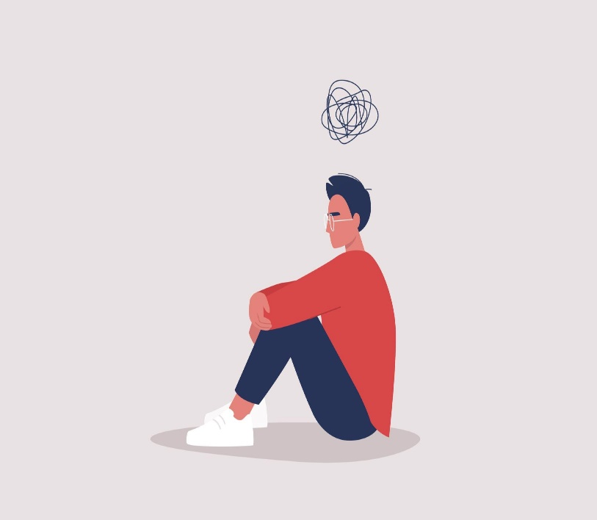
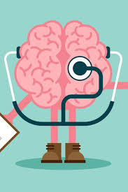

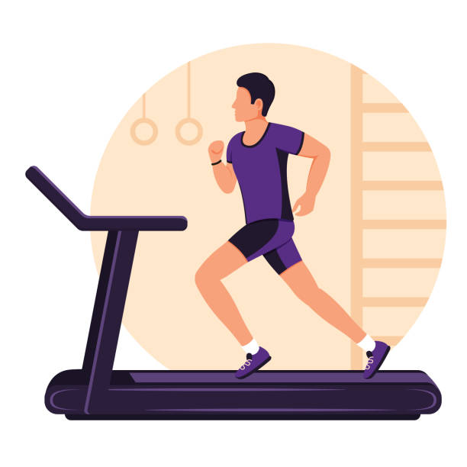
Men's Health & Men's Issues!
Living a Happy & Healthy Life!
Physically Mentally & Emotionally!
Notes:
We need to take care of ourselves in order to take care of others.

Slide 3

Men's Health & Men's Issues!
Do a mental check on yourself!

Slide 4


Men's Health & Men's Issues!
Supporting others/ without judgment!
Open the space to listen. Just listen.
Practice empathy and name the feeling.
Reassure them how important and meaningful they are to you.
Touch base with them often.
Be a safe space for someone else.
Notes:
Be a safe space for them and listen · Let the other person vent ·
Practice empathy · Help them name their feelings ·
Let them know they're important to you.
To listen without bias or judgment, with compassion and empathy, is how we can help one another, and no gift is greater than helping another

Slide 5



Men's Health & Men's Issues!
Supporting others/ without judgment!

Slide 6

Safe people to talk to

Slide 7
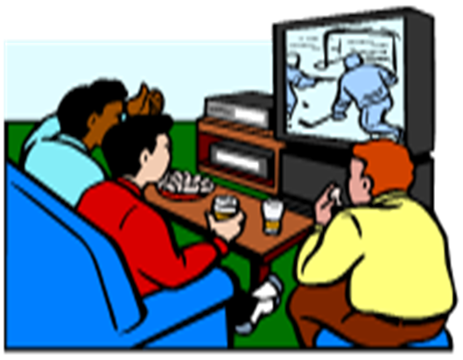

Men's Health & Men's Issues!
Personal Connections!
Social connection can help boosting mood, reducing stress, and improving self-esteem, lower anxiety and depression, help us regulate our emotions, lead to higher self-esteem and empathy, and actually improve our immune systems. By neglecting our need to connect, we put our health at risk.

Slide 8
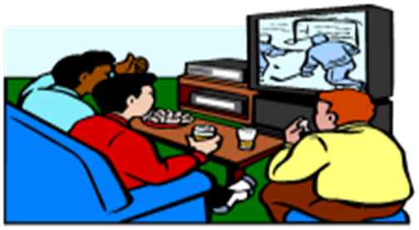

Men's Health & Men's Issues!
Personal Connections!

Slide 9



Men's Health & Men's Issues!
A lot of men with intellectual disabilities have a hard time finding love!
It may be due to due to low self-esteem, lower anxiety, depression & rejection!
You aren’t alone
As of 2022, Pew Research Center found More than 60 percent of young men are single!

Slide 10

Men's Health & Men's Issues!
Personal Connections!

Slide 11





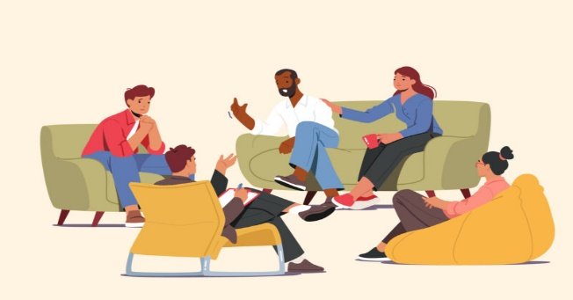
Men's Health & Men's Issues!
Dating!
Talking to a lot of women!
Talk to Women just as friends!
You can talk to women even if they don't want to be a girlfriend just talk to them as friends there is nothing wrong with having many girls as friends it's good to have the social connections!
Try New things!

Slide 12


Men's Health & Men's Issues!
Personal Connections!
Notes:
Maybe share about CT 211 Infoline as a place to seek resources when in crisis

Slide 13
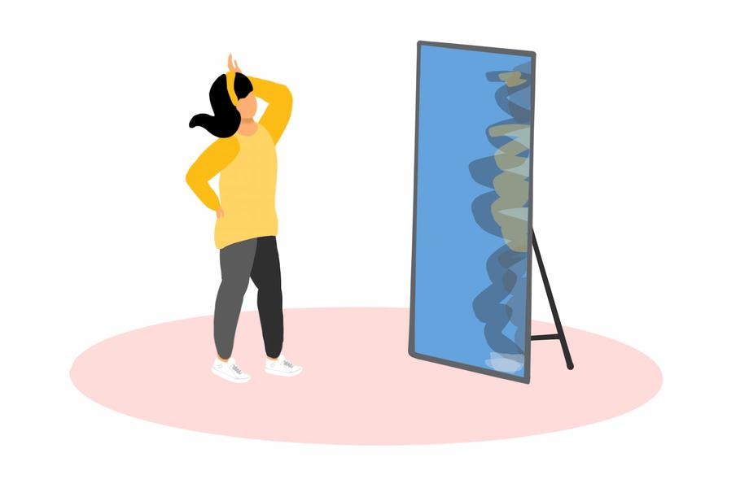

Men's Health & Men's Issues!
Self-Reflection/Regulation!
Self-Reflection is Being ok with your self knowing it’s ok to be you & the way you are

Slide 14


Slide 15
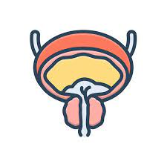

Men's Health & Men's Issues!
Prostate Cancer!
The American Cancer Society (ACS) recommends that men have a chance to make an informed decision with their health care provider about whether to be screened for prostate cancer. The decision should be made after getting information about the uncertainties, risks, and potential benefits of prostate cancer screening. The discussion about screening should take place at: Age 50 for men who are at average risk of prostate cancer and are expected to live at least 10 more years. Age 45 for men at high risk of developing prostate cancer. This includes African Americans and men who have a first-degree relative (father or brother) diagnosed with prostate cancer at an early age (younger than age 65). Age 40 for men at even higher risk (those with more than one first-degree relative who had prostate cancer at an early age).
Notes:
After this discussion, men who want to be screened should get the prostate-specific antigen (PSA) blood test. The digital rectal exam (DRE) may also be done as a part of screening. A Digital Rectal Exam (DRE) is a physical exam that is done when a doctor or nurse inserts a gloved, lubricated finger into the rectum to estimate the size of the prostate and feel for lumps or other abnormalities. Talk to your doctor about your risk for prostate cancer and when to begin screening.

Slide 16


Slide 17

Men's Health & Men's Issues!
Prostate Cancer!

Slide 18
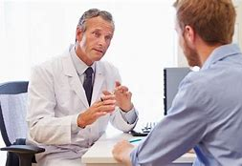
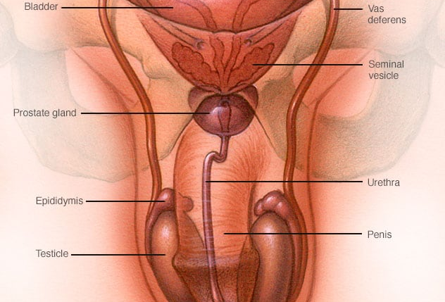
Testicular Cancer
Testicular cancer is a growth of cells that starts in the testicles. The testicles, which are also called testes, are in the scrotum. The scrotum is a loose bag of skin underneath the penis. The testicles make sperm and the hormone testosterone.
Notes:
Testicular cancer isn't a common type of cancer. It can happen at any age, but it happens most often between the ages of 15 and 45.

Slide 19
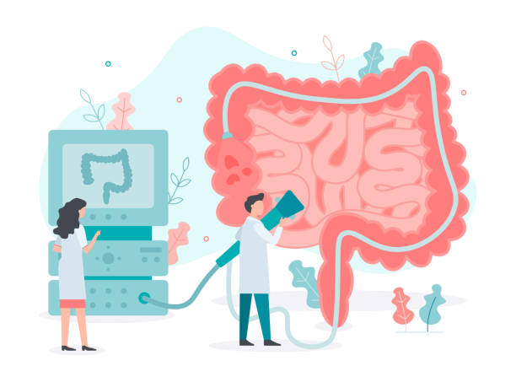

Men's Health & Men's Issues!
Colonoscopy!

Slide 20
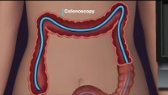
Men's Health & Men's Issues!
Colonoscopy!

Slide 21
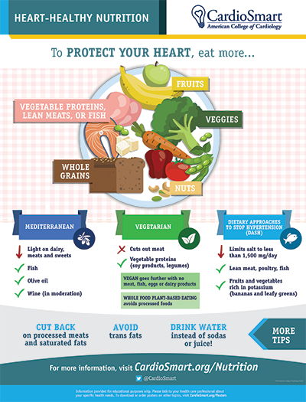

Men's Health & Men's Issues!
Heart Healthy diet!
Notes:
“Cardiac diet” is an unofficial term for a heart-healthy diet. It's an eating plan that emphasizes foods that promote heart health, such as vegetables and fruits, whole grains, lean poultry and oily fish like salmon and tuna that are high in omega-3 fatty acids.

Slide 22

A Healthy diet
Healthy Eating for a Healthy Weight | Healthy Weight, Nutrition, and Physical Activity | CDC
An eating plan that helps promote health and manage your weight includes a variety of healthy foods. Add an array of colors to your plate and think of it as eating the rainbow. Dark, leafy greens, oranges, and tomatoes—even fresh herbs—are loaded with vitamins, fiber, and minerals. Adding frozen peppers, broccoli, or onions to stews and omelets gives them a quick and convenient boost of color and nutrients.

Slide 23
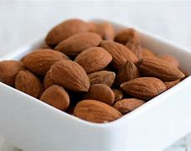
Almonds
Fun Fact: almonds are actually seeds rather than a nut. They are a good source of protein, and can help with:
Reduced risks of cancer
Better heart stability
Improvement in blood sugar levels

Slide 24

Men's Health & Men's Issues!
Heart Healthy diet!
Notes:
“Cardiac diet” is an unofficial term for a heart-healthy diet. It's an eating plan that emphasizes foods that promote heart health, such as vegetables and fruits, whole grains, lean poultry and oily fish like salmon and tuna that are high in omega-3 fatty acids.

Slide 25

What is Diabetes?
Diabetes Mellitus; Definition, Quick Facts, Symptoms & Types - A2Z Healthy
Diabetes mellitus refers to a group of diseases that affect how the body uses blood sugar (glucose). Glucose is an important source of energy for the cells that make up the muscles and tissues. It's also the brain's main source of fuel.
Notes:
The main cause of diabetes varies by type. But no matter what type of diabetes you have, it can lead to excess sugar in the blood. Too much sugar in the blood can lead to serious health problems.

Slide 26
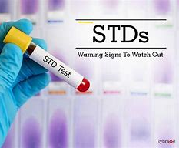
STD
Sexually Transmitted diseases can be very dangerous. Some STDs include:
AIDS
Hepatitis
Syphilis
Herpes
Notes:
Many STDs are treatable, but many of them are not curable. Many STDs such as AIDS, remain with you for the rest of your life.

Slide 27
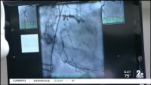
Men's Health & Men's Issues!
Heart Healthy diet!
Notes:
“Cardiac diet” is an unofficial term for a heart-healthy diet. It's an eating plan that emphasizes foods that promote heart health, such as vegetables and fruits, whole grains, lean poultry and oily fish like salmon and tuna that are high in omega-3 fatty acids.

Slide 28
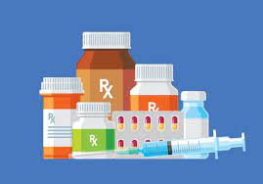
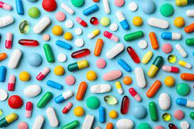
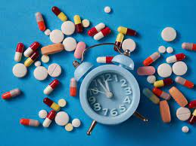


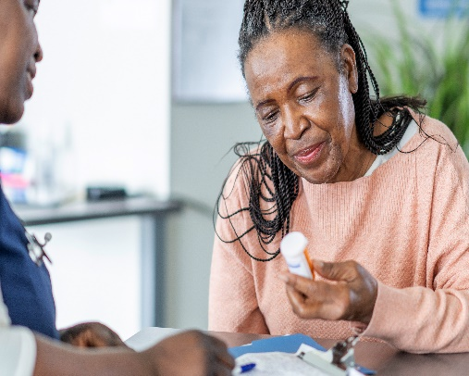
Men's Health & Men's Issues!
Medications!
Make sure to take medication correctly.
Be sure you understand what they are, and why you're taking them.
Talk to your doctor on a regular basis so they can be adjusted if needed.

Slide 29


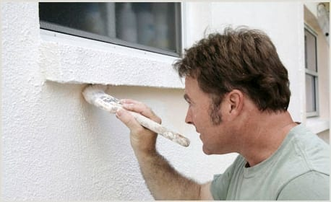

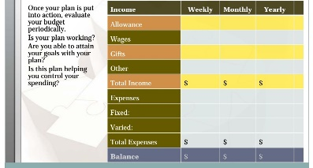

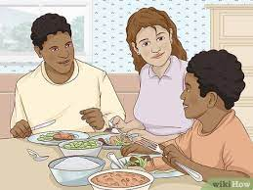


Men's Health & Men's Issues!
Family Responsibilities!
Maintaining the house & Creating a home.
Budgeting & making sure bills are paid.
Maintaining Relationships with Family members.
Sharing these responsibilities with other family members.

Slide 30

Men's Health & Men's Issues!
Family Responsibilities Maintaining the house & Creating a home.

Slide 31

Men's Health & Men's Issues!
Paying Bills!

Slide 32



Men's Health & Men's Issues!
Kevin Arce
Varian Salters
THANK YOU

Slide 33


Men's Health & Men's Issues!
Any questions?

