Slide 1
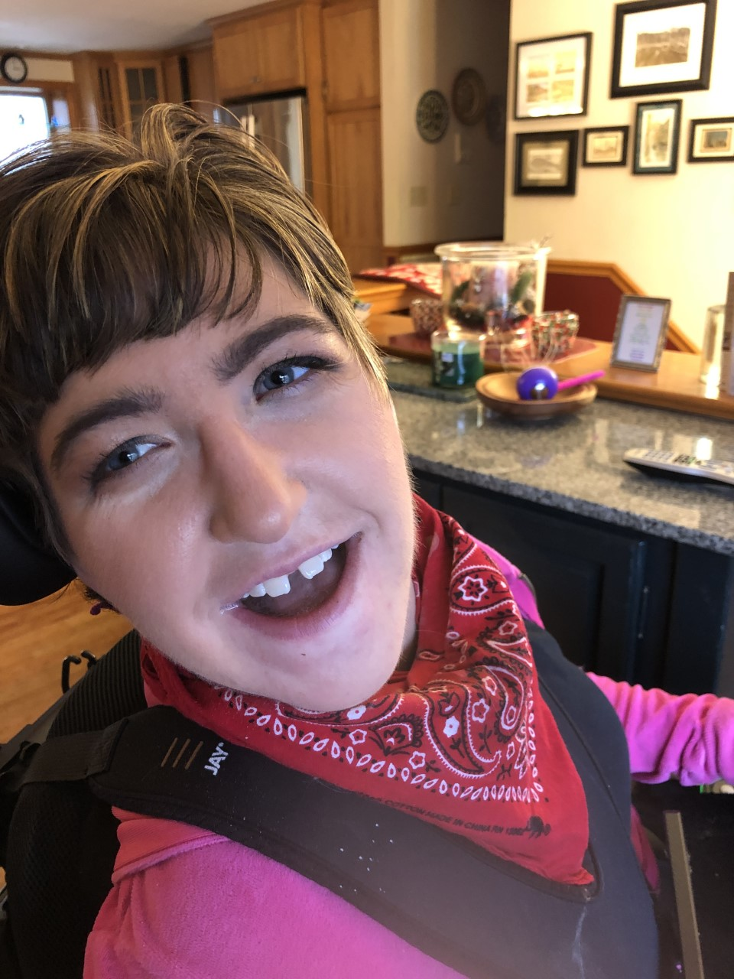

May Virtual Board
Challenges in Aging
By SACs Kevin Arce
Paige Librandi

Slide 2

How To Play This Presentation
Open the presentation in the desktop version of PowerPoint.
Wait for slide show to load up ( it may take a minute or two)
Go to Slide Show in the toolbar
Click on the option that says From Beginning
Viola!
To watch videos, double click on video picture
Click on arrows at the bottom of screen to go to the next slide or back a slide.

Slide 3
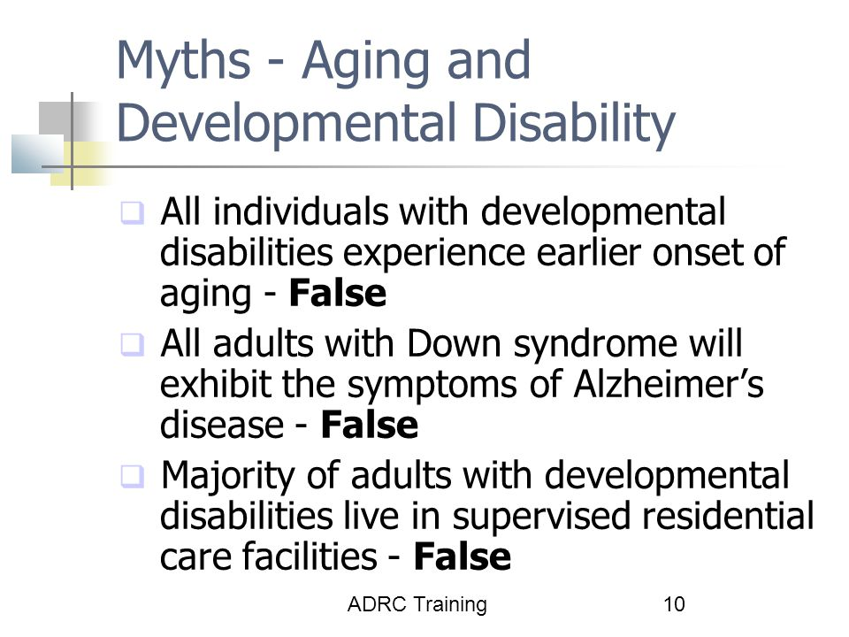

Notes:
Myths about aging and developmental disability. All individuals with developmental disabilities experience earlier onset of aging. False. All adults with down syndrome will exhibiting symptoms of Alzheimer’s disease. False. Majority of adults with developmental disabilities live in supervise residential care facilities. False.

Slide 4

Click to play video

Slide 5
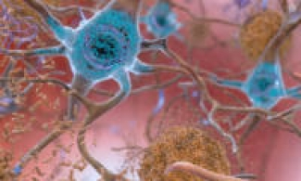

Early Onset Alzheimer's Disease in People with Down Syndrome​
Many, but not all, people with Down syndrome develop Alzheimer’s disease when they get older.
People with Down syndrome are born with an extra copy of chromosome 21, which carries the APP gene. This gene
produces a specific protein called amyloid precursor protein (APP).
Too much APP protein leads to a buildup of protein clumps called beta-amyloid plaques in the brain.
By age 40, almost all people with Down syndrome have these plaques, along with other protein deposits, called tau tangles, which cause problems with how brain cells function and increase the risk of developing Alzheimer’s dementia.
However, not all people with these brain plaques will develop the symptoms of Alzheimer’s. Estimates suggest that 50 percent or more of people with Down syndrome will develop dementia due to Alzheimer’s disease as they age.

Slide 6

Early Onset Alzheimer's Disease in People with Down Syndrome
According to the National Down Syndrome Society, about 30% of people with Down syndrome who are in their 50s have Alzheimer’s dementia. About 50% of people with Down syndrome in their 60s have Alzheimer’s dementia..​
Document baseline adult function by age 35. Ongoing evaluation of intellectual, behavioral and social function is important​ for everyone with Down syndrome. By age 35, everyone's medical record should ideally include detailed information ​ on his or her adult abilities. The person with Down syndrome, family members, and other reliable individuals are helpful​ sources for this information.​
Rule out other causes of symptoms. It’s important to rule out other medical conditions commonly associated with Down syndrome as the cause of changes in thinking and function, including thyroid problems, depression, chronic ear and sinus infections, vision loss, and sleep apnea.
As with other adults, people with Down Syndrome can benefit from a healthy lifestyle; diet, exercise and meaningful active social engagement can help stave off if not prevent the effects of the disease.
https://www.nia.nih.gov/health/alzheimers-disease-people-down-syndrome​
Aging and Down Syndrome: A Health & Well-Being Guidebook
This content is provided by the National Institute on Aging (NIA),
part of the National Institutes of Health​

Slide 7


Aging with IDD continues to present considerable challenges, as there is good evidence that while older persons with IDD experience the same age-related chronic diseases seen in the older general population, many of their health care needs go unidentified and unmet when compared with the general population.
Persons aging with IDD experience unrecognized or poorly managed health conditions (eg, visual and hearing impairments, mental health problems) and higher rates of morbidity and mortality than the general population.
When decline occurs for any reason health care professionals underscore the need to utilize therapeutic interventions aggressively to regain optimum health and maintain it.
Review medication lists frequently- take note of adverse reactions and long-term side effects.

Slide 8
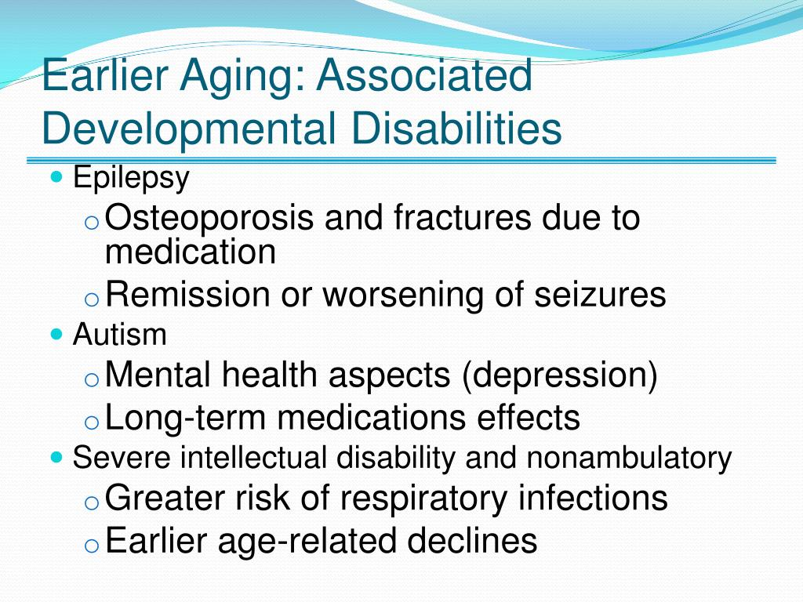


Slide 9
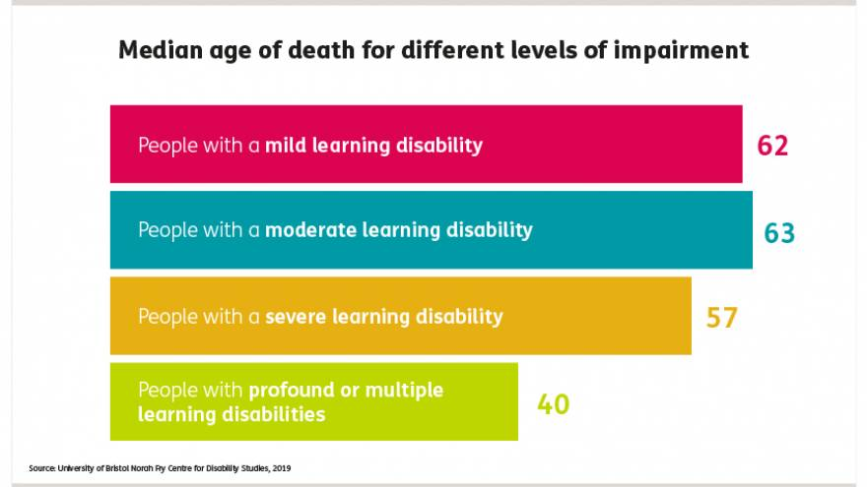

Life Expectancy for ID/DD
People with a learning disability have worse physical and mental health than people without a learning disability.
On average, the life expectancy of women with a learning disability is 18 years shorter than for women in the general population.
The life expectancy of men with a learning disability is 14 years shorter than for men in the general population

Slide 10

Tips for staving off dementia and keeping life interesting:
The more you use it the less apt you are to lose it-
Offer a choice of activities tht are stimulating & multi-sensory, this will assist the individual in grounding themselves to the present..
Make it meaningful.
Maintain Purpose- Keep individuals connected to family friends and the community.
Phone calls and cards at the very least.
Utilize Assistive tech for communication face time through Duo, Skype.
Assist individuals to connect through TEAMS or Zoom for social activities such as community and Advocacy Groups when physical participation is limited.
Utilize Volunteerism as a way for individuals to maintain Community engagement and give back.
Create a flexible Daily Schedule
Adds rhythm to the day and helps to develop routine.
Produces a sense of connection with time and place.
When possible allow individuals to age in place.
Make needed adaptations to existing residences.
The familiar is comfortable, processing new information and developing new routines can be challenging and upsetting for those experiencing dementia.

Slide 11

If our senior years are to be "Golden" we need more than crayons and TV now!

Slide 12
Thank you, Kevin Arce and Paige Librandi

