Slide 1
Test Administrator/
Teacher Training
Spring 2025
Notes:
Welcome to the 2024-25 Test Administrator/Teacher Training for Connecticut’s Statewide Assessment Program.
This training is optional and covers a variety of topics related to state assessments, test administration, and test policies and procedures.

Slide 2

Presentation Overview
Welcome from the Staff
Connecticut’s Sensible Assessment System
Student Participation
Assessment Calendar
Overview of the Connecticut Statewide Assessments
Getting to Know the Online Test Systems
Starting a Test Session
Test Monitoring and Security
Accessibility
Practice and Training
Resources
Notes:
Today’s agenda includes an overview of summative assessments for spring 2025. We will also provide updates on the Cambium System and accessibility and accommodations for eligible students.

Slide 3


Get to Know Staff from the Performance Office
Bureau Chief
Abe Krisst
Abe.Krisst@ct.gov; 860-713-6894
​
Education Support Technician
Kimberly Johnson
Kimberly.Johnson@ct.gov; 860-713-6885
Notes:
Before we get started, we’d like to take the opportunity to introduce you to the small but mighty assessment team at the CSDE.
Abe Krisst is the Bureau Chief in the Performance Office.
Kim Johnson supports the Performance Office and school administrators across a multitude of data collections and assessment related activities.

Slide 4


Meet the Assessment Team
Smarter Balanced/Interims
State Policy Test Administration Questions
Appeals/Reporting of Security Breaches
Cristi Alberino, Ph. D.
Cristi.Alberino@ct.gov ; (860) 713-6862​
NGSS​
State Policy Test Administration Questions​
Jeff Greig​
Jeff.greig@ct.gov; (860) 713-6748
NGSS​
State Policy Test Administration Questions​
Jeff Greig​
Jeff.greig@ct.gov; (860) 713-6748
Notes:
Cristi Alberino, ELA Consultant, oversees the Smarter Balanced and NGSS Interim Assessments and English Language Proficiency Assessment (LAS Links), testing appeals/security breaches, student alerts, and other state policy test administrations processes.
Jeff Greig, Science Consultant, oversees all aspects of the Next Generation Science Standards and the Connecticut Alternate Science Assessments (CTAS). He also oversees state policy test administration processes.

Slide 5



Meet the Assessment Team
Connecticut SAT School Day, PSAT, AP​
ED159 Collection
Michelle Rosado​​
Michelle.Rosado@ct.gov; 860-713-6748
​
Psychometrics​
Pei-Hsuan Chiu​
pei-hsuan.chiu@ct.gov; 860-713-6869​
English Learners Testing Supports; Assessment
Data/Accountability​
Michael Sabados​
Michael.Sabados@ct.gov; (860) 713-6856​
Notes:
Michelle Rosado oversees the Connecticut SAT School Day and PSAT/AP Assessments among other projects.
Pei-Hsuan Chiu is our psychometrician that oversees all things related to data analysis and reporting.
Michael Sabados also supports the analysis and reporting of student and accountability data and advises on English learners testing supports. He also works closely on Connecticut’s English Language Proficiency Assessment (LAS Links) for English learners/multilingual learners in Grades K-12.

Slide 6


Meet the Assessment Team
Smarter Balanced/NGSS/Accessibility Supports and Accommodations and the
Connecticut Alternate Assessment System (CTAA, CTAS, & CAAELP)​​
Deirdre Ducharme​
Deirdre.Ducharme@ct.gov; 860-713-6859​
​
Katherine Seifert​​
Katherine.Seifert@ct.gov; (860) 713-6722​
Katie Seifert​​
Katherine.Seifert@ct.gov; (860) 713-6722
​
Notes:
Deirdre Ducharme and Katie Seifert are available to answer questions related to test administration processes in addition to questions about accessibility supports for all students, including language supports for multilingual learners and accommodations for students with disabilities.
They also oversee the Connecticut Alternate Assessment System for math, ELA, science, and the CAAELP, Connecticut’s alternate language proficiency assessment, and support the accommodations process for the Connecticut SAT School Day.

Slide 7
Know Your Contacts
Contact​ | Name ​ | Phone/Email​
District Test Coordinator​ | ​ | ​
School Test Coordinator​ | ​ | ​
Special Education Contact
English Language Assessment Coordinator
Technology Coordinator​ | ​ | ​
CSDE Assessment Office​ | ​ | 860-713-6860; ctstudentassessment@ct.gov​
Connecticut Help Desk (Cambium Assessment )​ | ​ | 844-202-7583; ​ cthelpdesk@cambiumassessment.com​ ​ The Help Desk is open Monday – Friday 7:00 a.m. to 7:00 p.m. during testing.​
State policy test administration questions
Reporting of security breaches
CT-SEDS/TIDE syncing issues
Contact the Performance Office at 860-713-6860; ctstudentassessment@ct.gov
Notes:
Prior to testing, make sure you know who your school test coordinator is as well as your primary District Administrator for Testing (there is one DA per district). These individuals will provide training and guidance along the way and will answer questions related to your individual school’s testing schedule. Your District Administrator for Testing and School Coordinator should be the first line of contact when questions arise.
Use this worksheet to identify the key people in your school and district assigned to these roles. Also included are the phone numbers and emails for the CSDE Assessment Office and the Connecticut Help Desk. Keep this contact information on hand during testing.

Slide 8
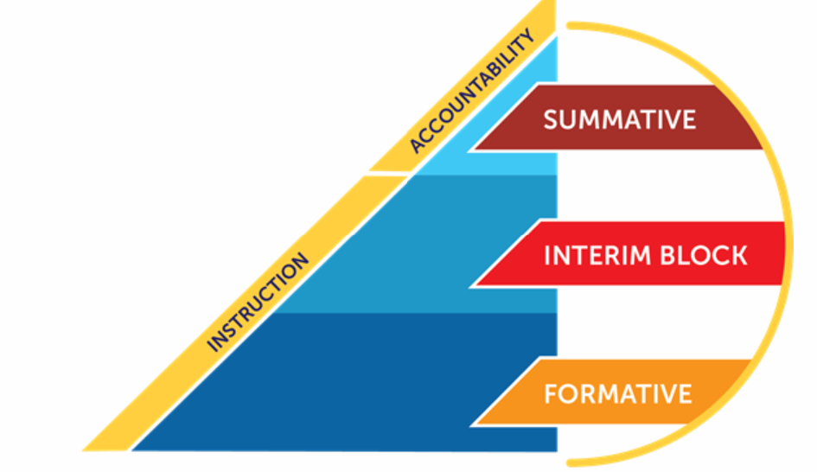
Overview of Connecticut’s Assessment Program
Connecticut’s assessment system is designed to support student learning of the Connecticut Core Standards and the Next Generation Science Standards.
The system is balanced and comprehensive. It offers different tools for various purposes.
Notes:
Before we provide an overview of assessments, let’s start with why assessments are important.
Connecticut’s assessment system is designed to support student learning of the Connecticut Core Standards and the Next Generation Science Standards. These standards set learning expectations for what students should learn and be able to do at each grade level so that by the time they graduate from high school, they are ready to succeed in college and the workplace. These standards help set clear and consistent expectations for rigorous, high-quality instruction and learning for all students.
As shown on this slide, Connecticut’s Sensible Assessment System is balanced and comprehensive. It offers different tools for various purposes. We offer resources and training that go beyond the summative assessments and have a variety of formative and interim resources to help support our teachers and students!
Let’s take a deeper dive and review each type of assessment.

Slide 9

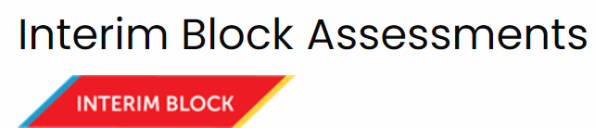
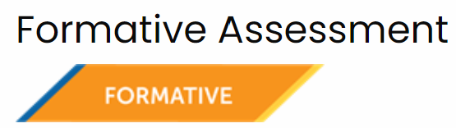
The Connecticut Sensible Assessment System
Summative assessments are administered in Grades 3-8 and 11, measure academic standards, performance, and growth in math, ELA, and science.
Interim assessments are optional, short, fixed-form assessments that are aligned to the standards and allow teachers to check student progress throughout the year, providing actionable results to inform instruction in ELA, math, and science.
Formative assessment is a process used by teachers and students during instruction throughout the year. It is aligned to the standards and provides feedback to teachers so they can adjust ongoing teaching and learning. It also provides feedback to students to help them know where they are, where they need to be, and what they need to do to reach mastery.
Notes:
As we noted on the previous slide, there are three components to a balanced and sensible assessment system. Let’s review each aspect. First, what are summative assessments?
Summative assessments are the culminating evaluation of student performance against a set of grade-appropriate standards. The primary purpose of the state’s summative assessments is to provide an efficient and reliable estimate of a student’s overall performance in a subject area relative to grade-appropriate standards that enable valid interpretations of student achievement (in all tested grades and subjects) and progress.
Then we have the Smarter Balanced Interim Assessments, which are optional assessments in mathematics and ELA and are available to students in Grades 3-8 and high school. The interim assessments are aligned to the CCS in both content areas, and they use the same testing platform as the summative assessments. Interims are one of the three components of the Smarter Balanced Assessment System—along with the end-of-year summative assessments in ELA/literacy and mathematics, and a library of formative assessment tools and practices that support classroom instruction. More information can be found on the Interim Assessment Page: https://portal.ct.gov/SDE/StudentAssessment/Smarter-Balanced/Smarter-Balanced-Interim-Assessments.
The NGSS Interim assessments are also an optional resource available to Connecticut school districts. These Interim assessments consist of item clusters and shorter stand-alone items that are each aligned to an NGSS performance expectation. Each item includes a stimulus based on real-world science phenomena and includes one or more item interactions to elicit student understanding. There are a variety of NGSS interim items available for Elementary School (Grades 3-5), Middle School (Grades 6-8), and High School (Grades 9-11), all of which can be taken on the same platform used in the summative NGSS Assessments.
And lastly, the formative assessment process.
Unlike a summative assessment, which is an “event” that measures a student’s overall performance, formative assessment is a process used by teachers and students during instruction throughout the year. It is aligned to the standards and provides feedback to teachers so that they may adjust ongoing teaching and learning to improve students’ achievement of intended instructional outcomes. It also provides feedback to students to help them know where they are, where they need to be, and what they need to do to reach mastery.

Slide 10
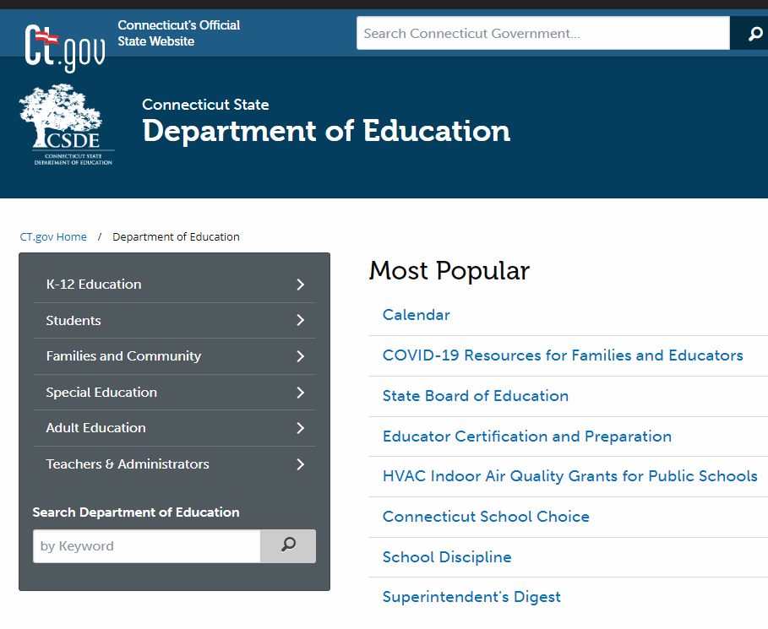
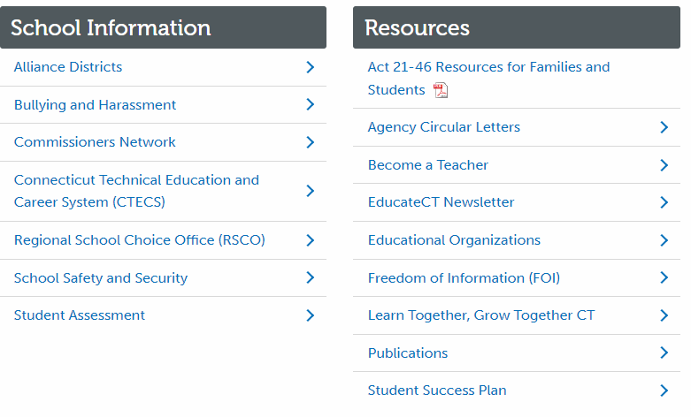
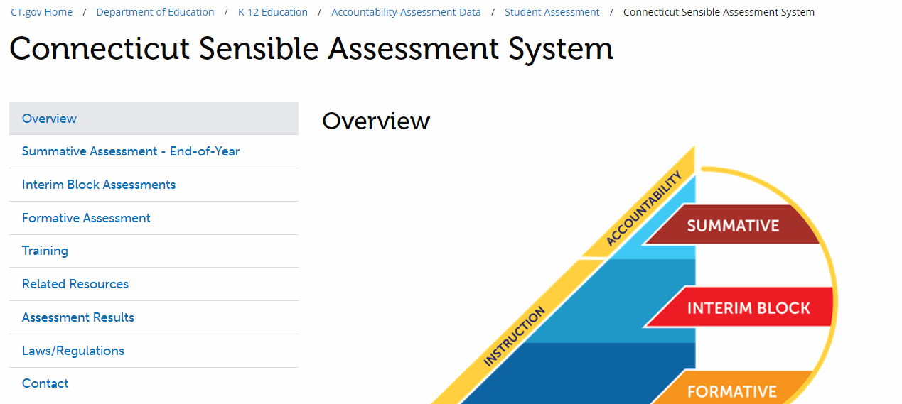
Visit the CSDE’s Sensible Assessment Webpage
1
CSDE Website Homepage.
2
Scroll to the bottom of the homepage and select Student Assessment.
3
Use one of the two Overview menus to select various Assessment topics.
Notes:
More information about Connecticut’s assessments are available on the CSDE’s Sensible Assessment webpage (Connecticut Student Assessment Main Page; https://portal.ct.gov/sde/student-assessment/main-assessment/student-assessment).
First, the Connecticut State Department of Education website (https://portal.ct.gov/SDE) includes the Student Assessment webpage, which is fully dedicated to information and resources related to each statewide assessment. To access information on the CSDE website, navigate to the CSDE Website, by entering the URL https://portal.ct.gov/SDE in your web browser.
On the home page of the CSDE Website scroll to the bottom of the page and select/locate the School Information section. (Refer to #2 on your slide.)
Select the Student Assessment option.
On the Student Assessment webpage, you may select the any of the options under the Overview section, view the current year’s Assessment Calendar, or scroll down to access webinars, assessment policy overviews, and resources that support special populations.
You can also select topics using the menu on the left-side of the webpage (as indicated by the red box on the slide). (Refer to #3 above.)

Slide 11
Who Participates in Testing?

Slide 12
Who Participates in Smarter Balanced, NGSS, and Connecticut SAT School Day
All students enrolled in the Public School Information System (PSIS) in Grades 3-8 and 11 (these students include those identified as English learners/multilingual learners and/or students with disabilities who have an active IEP or Section 504 Plan)
Students enrolled in PSIS attending Approved Private Special Education Programs (APSEPs)
Students enrolled in PSIS who are being educated in out-of-state facilities, in-state facilities, and non–approved facilities
  Refer to the Students in PSIS Who Attend Out-of-State and In-State Non-Approved Facilities brochure.
Notes:
The participation Expectations for Smarter Balanced, NGSS, and Connecticut SAT School Day include:
All students enrolled in the Public School Information System (PSIS) in Grades 3-8 and 11 (these students include those identified as English learners/multilingual learners and/or students with disabilities who have an IEP or Section 504 Plan)
Students enrolled in PSIS attending Approved Private Special Education Programs (APSEPs)
Students enrolled in PSIS who are being educated in out-of-state facilities, in-state facilities, and non–approved facilities
Refer to Students in PSIS Who Attend Out-of-State and In-State Non-Approved Facilities (https://ct.portal.cambiumast.com/resource-item/en/testing-students-in-psis-who-attend-out-of-state-and-non-approved-facilities) brochure.

Slide 13
Student Participation - Connecticut General Statutes 10-14n
    (b) (1) For the school year commencing July 1, 2015, and each school year thereafter, each student enrolled in grades three to eight, inclusive, and grade eleven in any public school shall, annually, take a mastery examination in reading, writing and mathematics during the regular school day.
    (3) For the school year commencing July 1, 2018, and each school year thereafter, each student enrolled in grades five, eight, and eleven in any public school shall annually take a state-wide mastery examination in science during the regular school day.
Notes:
Federal legislation, the Every Student Succeeds Act signed in 2015 reauthorized the Elementary and Secondary Education Act (ESEA). This act reaffirms and requires that each state institute challenging content and performance standards for its public school students. These performance standards establish the level at which students are expected to master the material included in the state’s content standards. The ESEA requires that all states have quality assessments established in reading, mathematics, and science to determine the extent to which students have mastered the material outlined in the state’s content standards. This requirement addresses a key element of the Title I program, i.e., a high-quality assessment system that is aligned with a state’s content and performance standards to ensure that all students are held to the same high academic standards.
This slide identifies the legislation that mandates state summative assessments. This legislation requires that students be assessed in Grades 3-8, and 11 in mathematics, reading, and writing, as well as science in Grades 5, 8, and 11.
Federal law requires full participation of all students on the state summative assessments. The minimum standard for the participation rate is at least 95 percent of all students and all student groups for each subject. For accountability purposes at the district and school level, the CSDE evaluates the participation rate for all students, as well as students in the "High Needs” group, for all content areas.
What are the legislatively mandated state summative assessments?
The Smarter Balanced Assessments are aligned to the Connecticut Core Standards (CCS) in English language arts (ELA) and mathematics and measure student progress toward college and career readiness. These assessments are administered to students in Grades 3-8. The ELA assessment consists of a Computer Adaptive Test (CAT) while the mathematics assessment consists of a CAT and a performance task (PT).
The Next Generation Science Standards (NGSS) Assessments are aligned to the NGSS. These standards were adopted by the Connecticut State Board of Education in November 2015. The first operational year of the NGSS Assessments was the 2018-19 school year. The assessments are also computer adaptive and are administered in Grades 5, 8, and 11.
The Connecticut SAT School Day is administered to all students in Grade 11 in Connecticut public schools. The Connecticut SAT School Day is aligned to the CCS in ELA and mathematics. Scores for the Connecticut SAT School Day can also be used for the college admissions process. The Connecticut SAT School Day is multi-stage adaptive and has two sections: reading/writing and mathematics.
The Connecticut Alternate Assessments (CTAA) support student independence to the greatest extent possible by making academic content accessible and the expected achievement levels appropriate. The CTAA for math and English language arts was developed to ensure that all students with significant cognitive disabilities that meet eligibility requirements for alternate assessments are able to participate in an assessment that measures what they know and can do in relation to grade-level standards. The CTAA is only administered to eligible students in Grades 3-8 and 11. It is a secure test, accessed online (or paper-pencil) with the support of a trained teacher.
The Connecticut Alternate Science (CTAS) Assessments was developed to ensure that all eligible students with significant cognitive disabilities are able to participate in an assessment that is a measure of what they know and can do in relation to the NGSS. The CTAS includes six Performance Tasks that are intended to be administered throughout the year as teachers work with eligible students to rate student performance on the CTAS Core Extensions. This alternate science assessment is only administered to eligible students in Grades 5, 8, and 11.
English Language Proficiency (ELP) Assessment is required to be administered to eligible students under the Connecticut Consolidated State Plan for the ESSA. Results of this assessment are included in Indicator 11 of the Next Generation Accountability System reports. Both Titles I and III of the ESEA require States and LEAs to annually assess the English proficiency of all ELs/MLs in the State enrolled in public schools in grades kindergarten through twelve in the domains of speaking, listening, reading, and writing (sections 1111(b)(7) and 1123(b)(3)(D) of the ESEA). Accordingly, as part of a general state assessment program, all Els/MLs with disabilities must participate in the annual State ELP assessment with or without appropriate accommodations or by taking an alternate assessment, if necessary, consistent with their IEPs. The IDEA, Titles I and III of the ESEA, and Federal civil rights laws require that all children, including children with disabilities, take statewide assessments that are valid and reliable for the purpose for which they are being used, and this includes the annual ELP assessment.
The Connecticut Alternate Assessment of English Language Proficiency (CAAELP) The CAAELP is designed for students with the most significant cognitive disabilities in Grades K-12 who are dually identified as EL/ML and receive services under the IDEA. Eligible students, determined at each annual Planning and Placement Team (PPT) meeting, may be considered for participation in the appropriate assessments associated with their grade and EL/ML identification.
Connecticut Physical Fitness Assessment
The Connecticut Physical Fitness Assessment (CPFA) is Connecticut’s annual assessment of public school students’ physical well-being. Students in Grades 4, 6, and 8 are assessed annually. At the high school level, schools have the flexibility to assess students at any grade, but must assess each student at some point between Grades 9 and 12.
The goals of the assessment program are to:
inform schools, districts and the public about programs focusing on fitness and physical activity in our schools and evaluate their success
Is there an Opt-Out Policy for academic statewide assessments?
There is no opt out for CT students taking the Smarter Balanced, NGSS, Connecticut's Alternate Assessment System, or Connecticut SAT School Day Assessments. If students do not test, they will be considered a non-participant and will impact school accountability.

Slide 14
2025 Assessment Calendar
State Assessment | Grade(s) | Testing Window | Delivery Method
Connecticut Alternate Assessment of English Language Proficiency (CAAELP) | K - 12 | January 13 - March 7, 2025 | Online
Smarter Balanced ELA & Math | 3 – 8 | March 24 - May 30, 2025 | Online
Connecticut Alternate Assessments (CTAA) | 3 – 8 and 11 | March 24 - May 30, 2025 | Online
NGSS Assessments | 11 | February 3 - May 30, 2025 | Online
 | 5 and 8 | March 24 - May 30, 2025 | Online
Connecticut Alternate Science Assessment (CTAS) | 5, 8, and 11 | Test administered throughout the school year. Student ratings entered in the DEI: March 24 - May 30, 2025 | Online Upload March 24 - May 30, 2025
Notes:
To assist districts with planning their calendars, the CSDE is providing the State Summative Assessment Calendar for Connecticut public schools for the 2024-25 school year.
Connecticut Sensible Assessment System--Summative Assessment - End-of-Year; https://portal.ct.gov/sde/student-assessment/main-assessment/student-assessment

Slide 15
Overview of Statewide Assessments

Slide 16

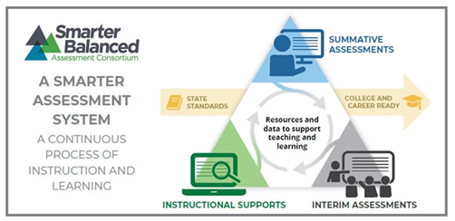


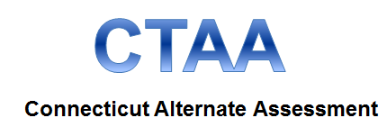


Overview of Connecticut Statewide Assessments
Notes:
We will now take a moment to identify Connecticut’s statewide assessments and answer general questions related to how they are administered.
Note that each of the assessments indicated on this slide are hyperlinked for easy access.
Links to each assessment webpage:
Smarter Balanced Finding Information about Smarter Balanced; https://portal.ct.gov/sde/student-assessment/smarter-balanced/find-information-about-smarter-balanced
CT SAT School Day Connecticut SAT School Day; https://portal.ct.gov/sde/student-assessment/sat/connecticut-sat-school-day
Next Generation Science Standards (NGSS) Assessment NGSS Science; Connecticut Alternate Assessment (CTAA) for Math and ELA The Connecticut Alternate Assessment System (CTAA, CTAS, and CAAELP) --CTAA Resources; https://portal.ct.gov/sde/student-assessment/ctaa-skills-checklist/connecticut-alternate-assessments/ctaa-resources
Connecticut Alternate Assessment (CTAS) for Science The Connecticut Alternate Assessment System (CTAA, CTAS, and CAAELP) --CTAS Resources; https://portal.ct.gov/sde/student-assessment/ctaa-skills-checklist/connecticut-alternate-assessments/ctas-resources
Connecticut Alternate Assessment of English Language Proficiency (CAAELP) The Connecticut Alternate Assessment System (CTAA, CTAS, and CAAELP) --CAAELP Resources; https://portal.ct.gov/sde/student-assessment/ctaa-skills-checklist/connecticut-alternate-assessments/caaelp-resources

Slide 17
How are students tested?
Online using a computer/tablet
Built-in tools (highlighter, mark for review, digital notepad)
Varied question types (multiple choice, constructed response, grid-in)
Adjusts item difficulty (computer adaptive) (Smarter Balanced/NGSS); CT SAT School Day is multi-stage adaptive)
Notes:
The Smarter Balanced summative assessment for English language arts and mathematics requires students to
Participate in an online assessment comprised of two components: a computer adaptive test (CAT) for both ELA and math; and a performance task (PT) for math. The tests are not timed, however, recommended test session lengths of 40 to 120 minutes, depending on content area and grade level, are provided in the Smarter Balanced Test Administration Manual;
Demonstrate critical-thinking and problem-solving skills; and
Accurately respond to various item response types using a keyboard and mouse or touchpad.
The Next Generation Science Standards (NGSS) Assessments consists of a variety of item types and interactions, many of which students will have experienced before on the NGSS Assessment and Smarter Balanced Assessments. Some items will be organized in item clusters that are designed to engage the student in a grade appropriate, meaningful scientific activity aligned to a specific NGSS performance expectation. Each item cluster begins with a real-world phenomenon and includes two or more item interactions that require students to demonstrate the ability to use the science and engineering practices, disciplinary core ideas, and cross-cutting concepts described by the performance expectation. In addition to item clusters, there are stand-alone items that most often contain a single interaction framed around a single task demand. Each student will receive six item clusters and 12 stand-alone items that will be scored. The suggested testing time of at least 90 minutes is a recommendation of how much time students will need to complete the NGSS Assessments. Students should be given additional time if needed. For details, refer to the NGSS Test Administration Manual.
The online Connecticut SAT School Day is shorter and multistage adaptive. This assessment is produced and delivered by the College Board using their own online platform. Teachers/test administrators use Test Day Toolkit to administer the tests, while students use the Bluebook App to take the tests. More information is available at Home – SAT Suite of Assessments | College Board (https://satsuite.collegeboard.org/).
Reading and Writing tests have an allotted time of 64 minutes for 54 questions. The math session has 44 questions with access to embedded Demos Calculator and students have 70 minutes to complete the session.
Most students will test in one day, even with 50% or 100% extended time per documented need in IEP or Section 504 Plan.

Slide 18
Getting to Know the Online Test Systems
Notes:
Cambium Assessments has a variety of systems that are linked to the test interface that ensure efficiency during test administration.

Slide 19
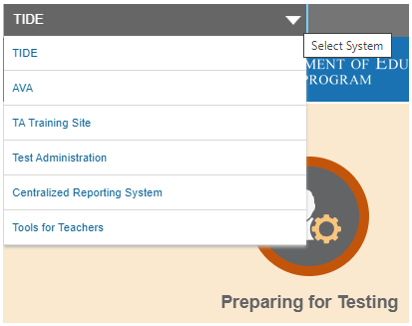
Accessing Systems
Existing user accounts were rolled over and passwords reset in August 2024.
If you log in on a new device or browser (or clear the cache) you must enter an emailed code after passing the login screen. This step does not occur when you activate your account.
See your District or School Test Administrator if you are a new user and don’t have a TIDE user account, or if your contact information needs to be updated (e.g., name, phone number).

Slide 20
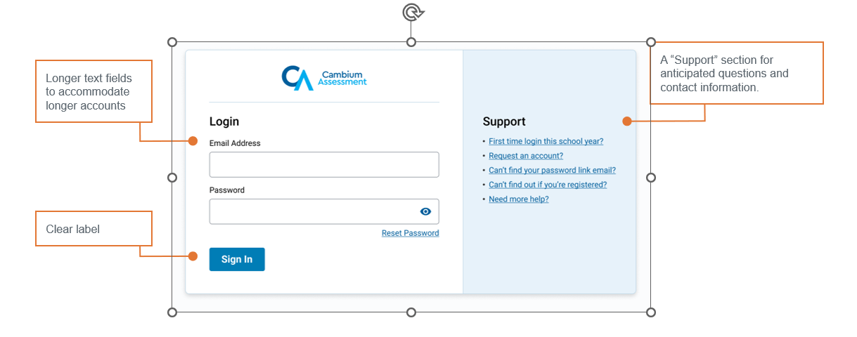
Single Sign-On
Notes:
A single sign-on password gives users access to all applicable testing systems, including Tools for Teachers). Keep the following criteria in mind when setting up your password for SY 2024-25.
One (1) uppercase letter
One (1) lowercase letter
One (1) number
One (1) special character
Min 12 characters (increase from min 8 characters)
Different from last 24 passwords (increase from last 2 passwords)
If you see a lock in the upper corner of the assessment cards, you will be required to sign-in using your TIDE password.

Slide 21
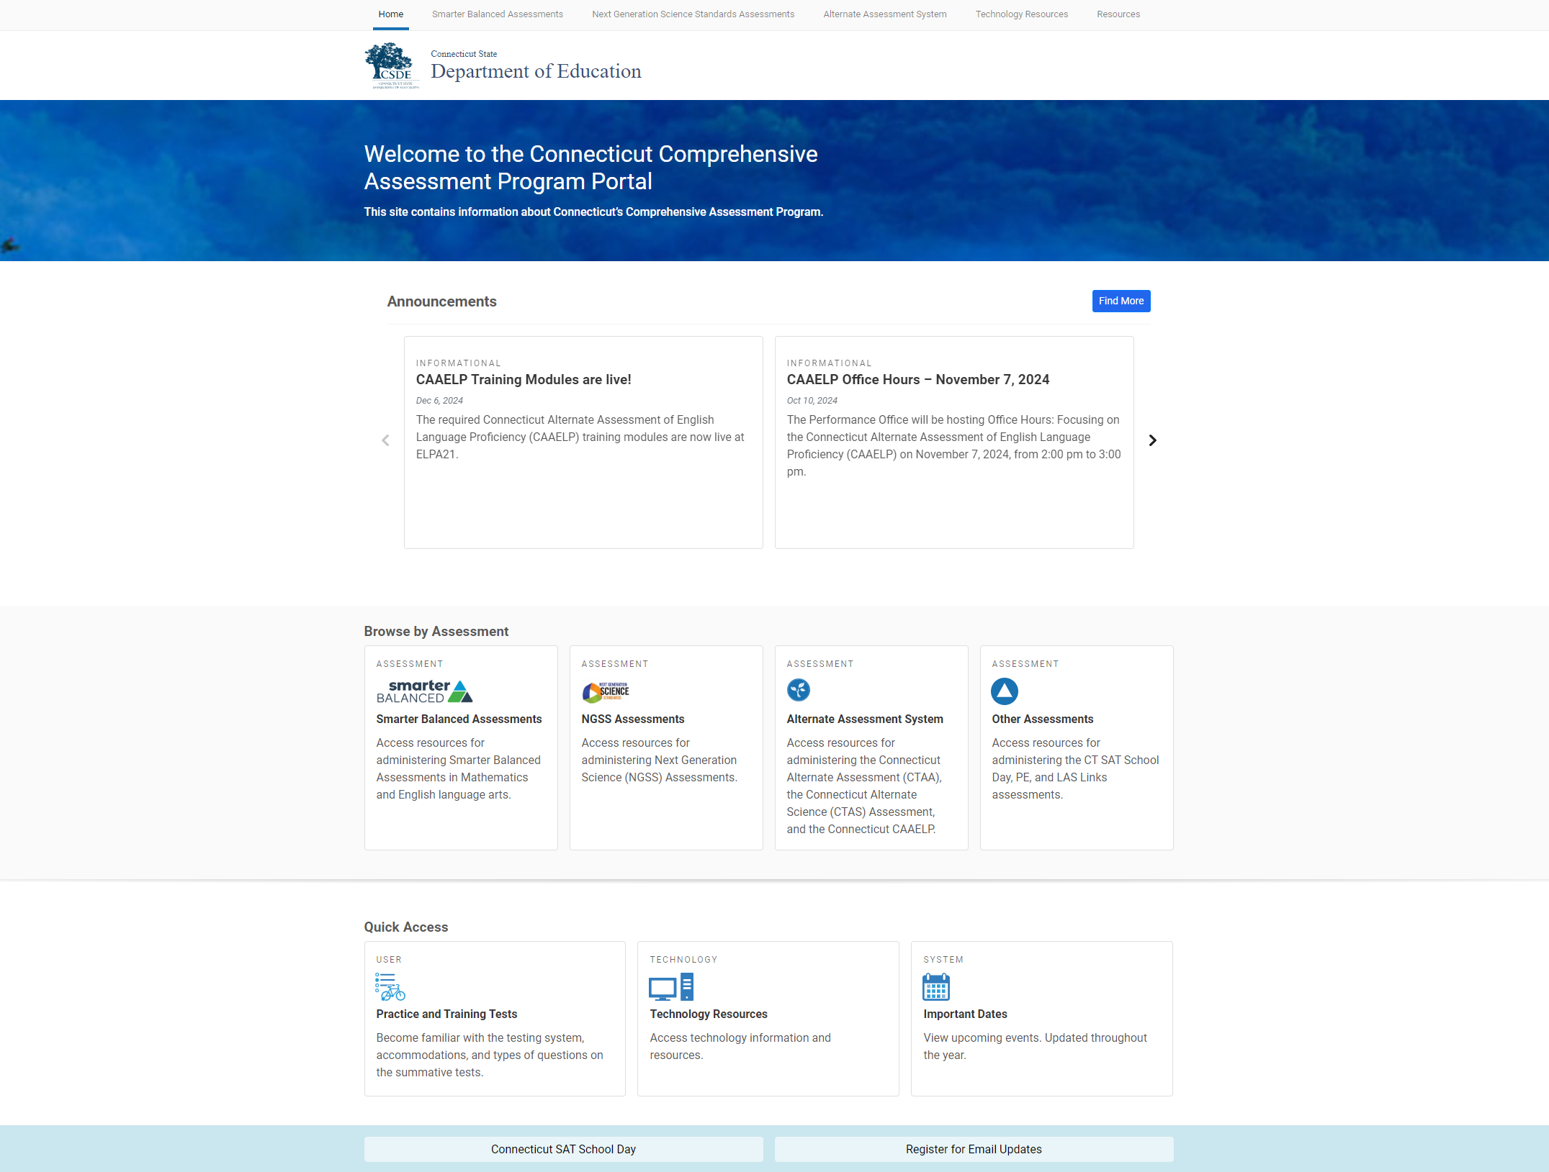

Connecticut Comprehensive Assessment Program Portal
Everything you for need concerning state assessments can be found on the Portal.
Notes:
Everything you need for test administration, such as accessing test manuals/user guides and the test administration interface, is located on the Connecticut Portal . As shown on this slide, you can browse by assessments as indicated by the red box on the lower section of the slide. Each assessment has its own page (Smarter Balanced, NGSS, or other assessments such as the Connecticut Alternate Assessment System) that can be accessed when you select the assessment card. By selecting the test of your choice, you can drill down based on the phase of testing. Systems are grouped by the following categories: Preparing for Testing, Administering Tests, and After Testing.
As mentioned earlier in the presentation, you can also use the Resource look-up, as referenced by the red box in the upper right corner of the portal.
To learn more about the assessment systems, let’s visit the CT Portal Smarter Balanced Assessments page.

Slide 22
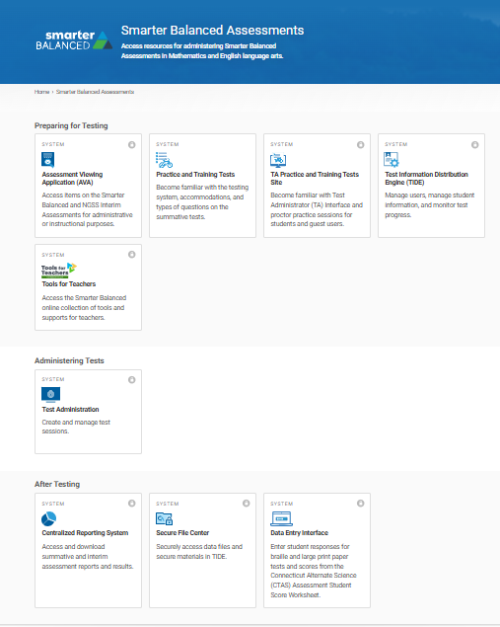



Connecticut Comprehensive Assessment Program Portal: Smarter Balanced
1. Practice tests; TIDE
2. Test Interface
3. Student Results
Notes:
This is what you will see when you select the Smarter Balanced Assessment card. The organization and access to these systems are the same when NGSS and the Alternate Assessment System cards are selected.
As shown on this slide, the red rectangular boxes indicate the phases of testing. Below each category are systems that support certain functions within the phase of testing.
First, look for Number 1 labeled on the slide. It calls out the Preparing for Testing section. In this section, you will find the Practice and Training Tests card. This will give you (and your students) access to grade-level practice tests for Smarter Balanced and NGSS. Practice tests are also available for other assessments, such as the Connecticut Alternate Assessment System which include CTAA and CAAELP.
TIDE, also located under the Preparing for Testing section, is populated with all students registered in PSIS. TIDE also includes all the school and district users and is populated by the District Administrator for Testing and/or the School Test Coordinator. TIDE syncs nightly with PSIS. That way, as student demographics change, they will be automatically reflected in TIDE in real time. TIDE also syncs nightly with CT-SEDS (Connecticut’s Special Education Data System). Students with designated supports and accommodations for state-wide testing documented in a finalized and implemented IEP or Section 504 Plan will sync nightly to TIDE.
There are other systems in the Preparing for Testing section such as the TA Practice and Training Site. Test examiners can use this resource to simulate a test administration without using the live Test Administration site.
Next, look for Number 2. When administering tests, you will select the Test Administration card to set up a live test session for summative testing.
Finally, Number 3 references “After Testing” activities and identifies the various systems that are applicable once testing is completed. For example, to view test results (e.g., interims or summative assessments), select the Centralized Reporting System card. This system will allow you to view results for students rostered to you.
There are other systems indicated on this slide that we have not highlighted. To learn more about what they are, refer to your TIDE User Guide. Test Information Distribution Engine (TIDE) User Guide; https://ct.portal.cambiumast.com/resource-item/en/test-information-distribution-engine-tide-user-guide
Also note the “lock” icon in the upper right corner of the card. This indicates that the site is secure and requires the user to sign-in with their TIDE username and password.

Slide 23
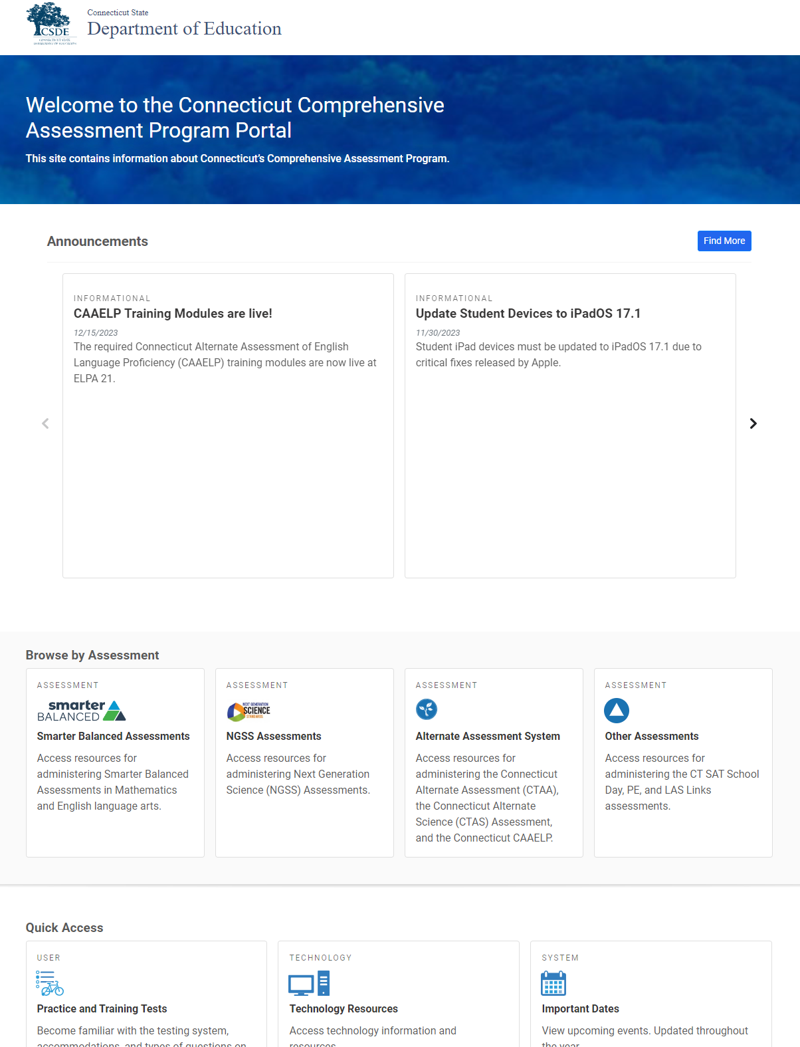
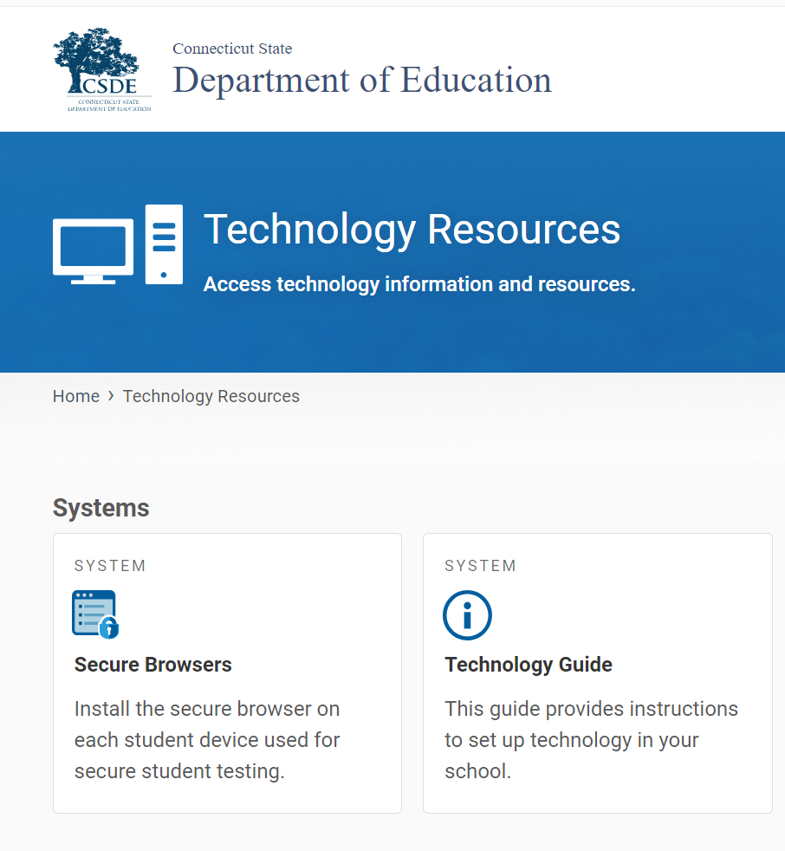
The Secure Browser
Notes:
Where is the secure browser located?
Technology Resources; https://ct.portal.cambiumast.com/technology-resources.html
The red box on your slide indicates where to access information on the secure browser. From the main page of the portal, select Technology Resources. Your school or district technology department may already have a process in place to download the secure browser on to each of the testing devices used by students. Without a secure browser, students will not have access to statewide assessments.
Resource:
Recommended for Technology Coordinators, the Technology Guide provides information about setting up test stations for staff and students, configuring networks for online testing, and managing test sessions from any secure browser: https://ct.portal.cambiumast.com/tech-guide.html.

Slide 24
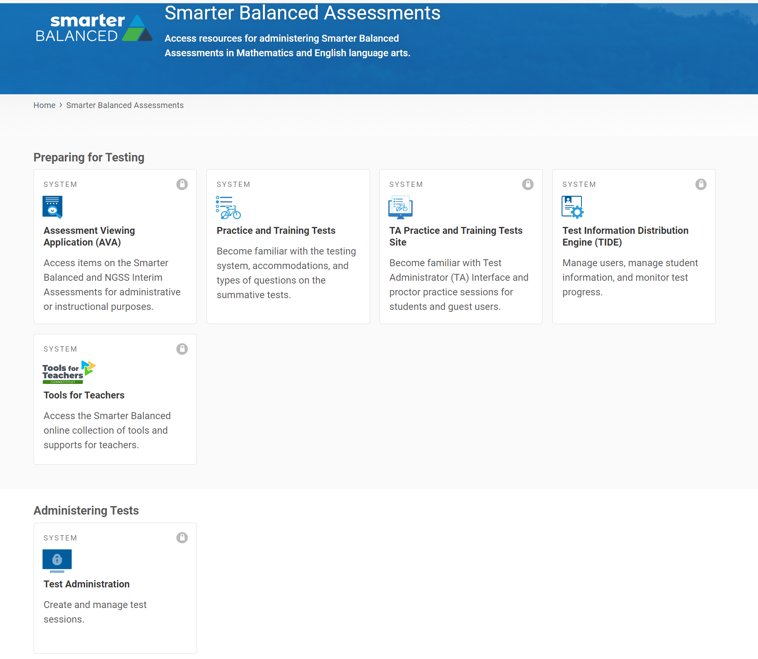
The Test Administration Interface
Notes:
The red box indicates where teachers access the Test Administration Interface.

Slide 25
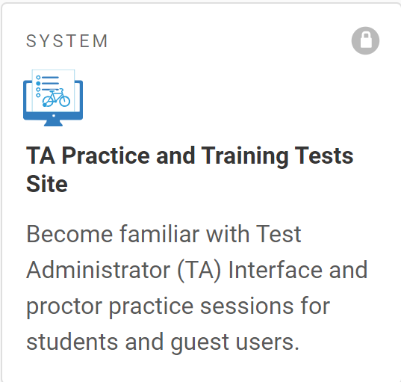
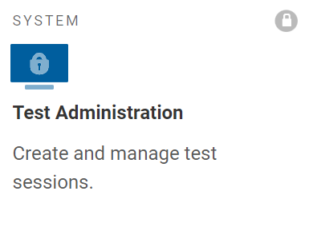
The Test Administration Interface
The Test Administration Interface consists of:
Practice Sites
  TA Practice & Training Site: Allows TAs to practice administering tests.
  Practice & Training Tests: Allows students to practice taking tests online and using test tools. Students can log in to the testing site with their name and ID or as guests. They can either take proctored tests in sessions created by TAs in the TA Practice & Training Site or they can take non-proctored tests.
Operational Testing Sites
  Test Administrator Interface: Allows TAs to administer interim and summative operational tests (Smarter Balanced, NGSS, Alternate Assessments).
  Student Interface (Secure Browser): Allows students to take operational test.
Notes:
The Test Delivery System delivers Connecticut’s online tests and consists of practice sites and operational testing sites (Interim and Summative Assessments). The practice sites function identically to the operational testing sites. However, the tests that are available in the practice and operational sites are different. Tests administered in the TA Practice & Training Site are for practice (and do not yield scores), whereas the tests provided in the Test Administrator Interface are operational and students’ scores will be official.
TA Practice & Training Site: https://ctpt.cambiumtds.com/testadmin
Test Administrator (TA) User Guide: Test Administrator (TA) User Guide; https://ct.portal.cambiumast.com/resource-item/en/test-administrator-ta-user-guide

Slide 26
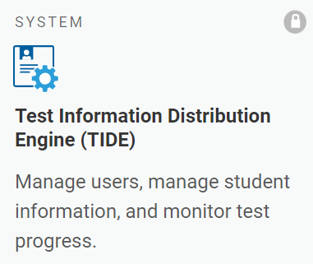
TIDE
School administrators use TIDE to
manage user accounts, manage rosters, file and/or view appeals, monitor testing progress, and manage test settings for students who participate in online assessments.
School personnel use TIDE account credentials to
access TIDE, the Assessment Viewing Application (AVA), Test Administration (TA) Interface, TA Practice & Training Site, the Centralized Reporting System (CRS), and the Data Entry Interface (DEI).
view students rostered to them and review test settings for students with designated supports and accommodations.
For information about using TIDE, refer to the TIDE User Guide, the User Role Permissions for Online Testing brochure for details about user access, and the Documenting Designated Supports and Accommodations brochure for details about test settings.
Notes:
TIDE includes all the school and district users and is populated by the District Administrator for Testing and/or the School Test Coordinator. Depending on your user role in TIDE, you will have access to the test delivery system for test administration and the Centralized Reporting System, where you can find student test results from interim and summative assessments. While there are a variety of user roles available to teachers, most test administrators only need a TE or TA user role. If you have teacher access, you will use TIDE to create student rosters, view student test settings, such as designated supports and accommodations, and you can print test tickets.
If you are a new administrator, you will need TIDE user access from your school or district test coordinator. Refer to the TIDE User Guide for information on user roles and permissions, along with more information about this important data repository.
For information about using TIDE, refer to the Test Information Distribution Engine (TIDE) User Guide (https://ct.portal.cambiumast.com/resource-item/en/test-information-distribution-engine-tide-user-guide).
The User Role Permissions for Secure Online Systems; (https://ct.portal.cambiumast.com/resource-item/en/user-role-permissions-for-secure-online-systems) provides details about the various user roles and associated permissions within the system.
Refer to Accessing TIDE brochure (https://ct.portal.cambiumast.com/resource-item/en/accessing-tide) for information about resetting accounts and managing user accounts.

Slide 27
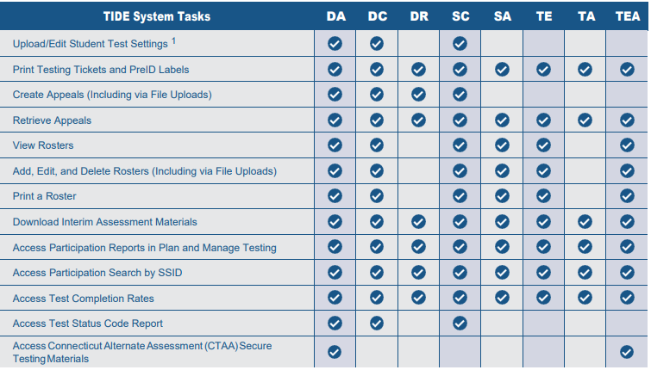
TIDE Access
To use TIDE, you need a recent version of a web browser, such as Firefox or Chrome.
Each user in TIDE has a role, such as a district-level user or a test administrator-level user. Each role has an associated list of permissions to access certain features within TIDE.
Notes:
User Role Permissions for Secure Online Systems; https://ct.portal.cambiumast.com/resource-item/en/user-role-permissions-for-secure-online-systems

Slide 28
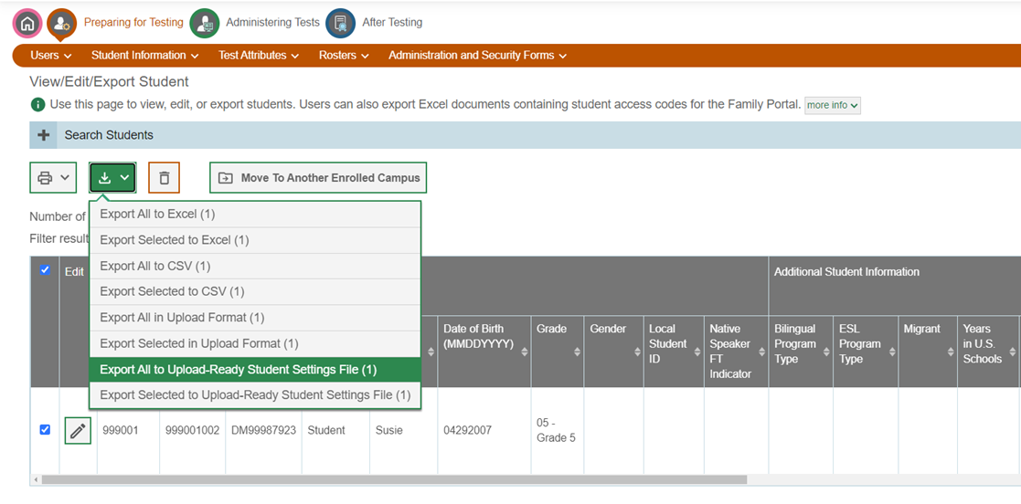
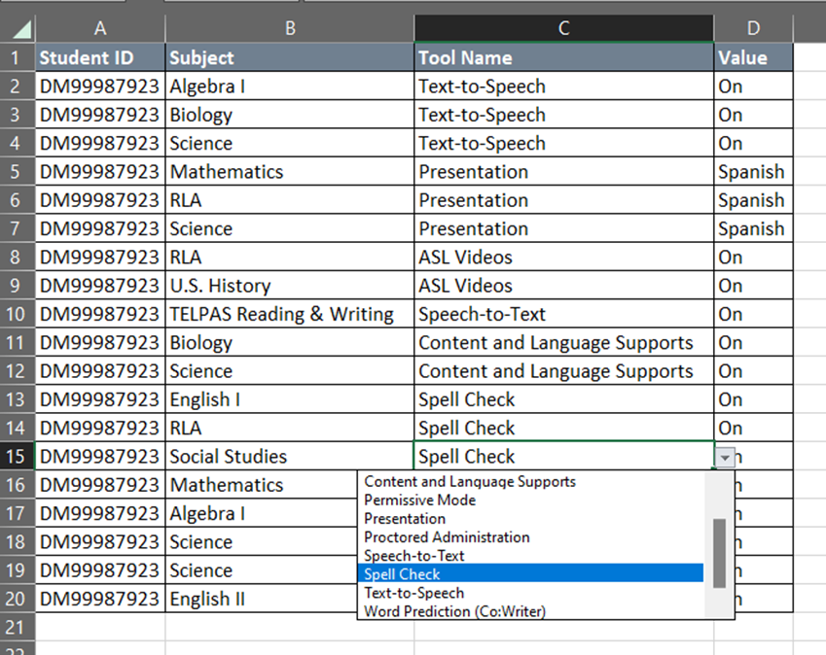
TIDE Upload-ready Student Settings Report
Student settings can be exported from TIDE in the same format as the upload file.
Notes:
Test administrators can export student settings from TIDE prior to testing to identify the designated supports and accommodations available to students. To this, students must be rostered to the teacher. Then, the teacher can follow these steps in TIDE:
Under the Preparing for Testing, choose from the Test Settings and Tools drop-down menu and select Settings and Tools.
From your student dashboard, select the download icon as shown on the slide.
Select the Export All to Upload Ready Student Settings File (as shown on the slide) and open the Excel file. This can be downloaded and or printed. Be sure to securely store confidential student information.

Slide 29
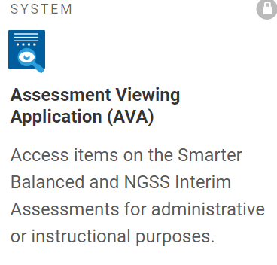
The Assessment Viewing Application
The Assessment Viewing Application (AVA) is a secure online system is used to view the optional interim assessments for math, ELA, and science.
Interim items presented in AVA can be used by teachers as an instructional tool aligned to instruction.
For more information, refer to the Assessment Viewing Application User Guide and the Interim Assessments: Smarter Balanced and Next Generation Science Standards guide.
Notes:
The Assessment Viewing Application (AVA) is a secure online system used to view the optional interim assessments for math, ELA, and science. This system is only for viewing interim assessments. While AVA does not score or provide answer keys for the Smarter Balanced ELA and Mathematics Interim Assessments, all item responses are provided for NGSS Interims in AVA. Answer keys for all interim assessments are provided in the Centralized Reporting System.
Since this application does not pertain to the administration of summative assessments, it will not be discussed in any greater detail within this presentation. However, you are welcome to use AVA if you are interested in learning more about interim assessments in the year ahead.
Assessment Viewing Application (AVA) User Guide; https://ct.portal.cambiumast.com/resource-item/en/assessment-viewing-application-ava-user-guide
Interim Assessments: Smarter Balanced and Next Generation Science Standards; https://portal.ct.gov/-/media/sde/student-assessment/smarter-interim-assessments/interimassessments-final.pdf?rev=4a1cdf0d973e4742a6d3a841c15d0554&hash=D85ED05C616E7E03D4E44798BE8B138F

Slide 30
Starting a Test Session
Notes:
Cambium Assessments has a variety of systems that are linked to the test interface that ensure efficiency during test administration.
Two computer devices are used to administer the online Smarter Balanced, NGSS, and Alternate Assessments:
One computer device is used by the student to access the secure browser, which gives students access to their tests (populated based on the grade in which the student is enrolled in PSIS).
The second device is used by the test examiner to access the Test Administration Interface, which is located on the Connecticut Comprehensive Assessment Program Portal and used to set up a test administration and monitor testing from start to finish.
Moving forward in this presentation, we will only focus on test administration for Smarter Balanced and NGSS.

Slide 31
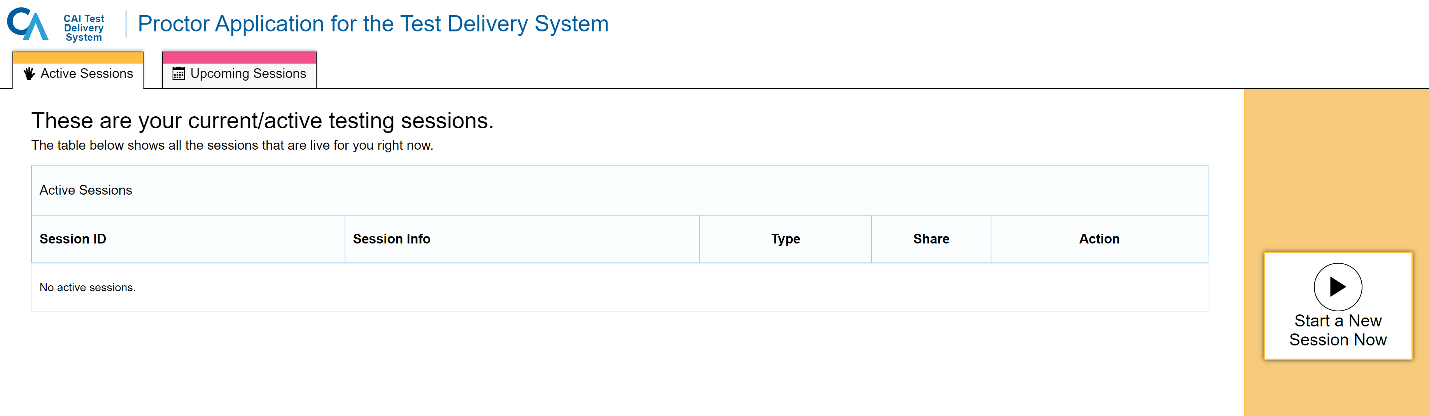
Starting a Test Session
Test administrators will log onto the Test Administration interface using their secure TIDE username and password.
Notes:
The test examiner must create a test session before students can log in to the Test Delivery System (but no more than 30 minutes prior or the system will time out unless the test session was scheduled in advance). When a test examiner creates a test session, a unique Session ID is randomly generated. This Session ID must be provided to the students before they log in and should be written down.
To set up a test session in real time, select the Active Sessions tab (as shown on slide) and follow the prompts. To set up a test session in advance, choose the Upcoming Sessions tab and follow the prompts.
Key Resource: All test administrators should use the Test Administration Manuals for Summative Testing specific to the assessment (e.g., Smarter Balanced, NGSS, CTAA, CTAS, CAAELP). Manuals should be reviewed prior to, during, and after testing to ensure that all steps are followed. The manuals include standardized scripts read to students at the time of testing. All TAMs are available for viewing, downloading/printing on the Connecticut Comprehensive Assessment Program Portal. Home Page; https://ct.portal.cambiumast.com/index.html

Slide 32
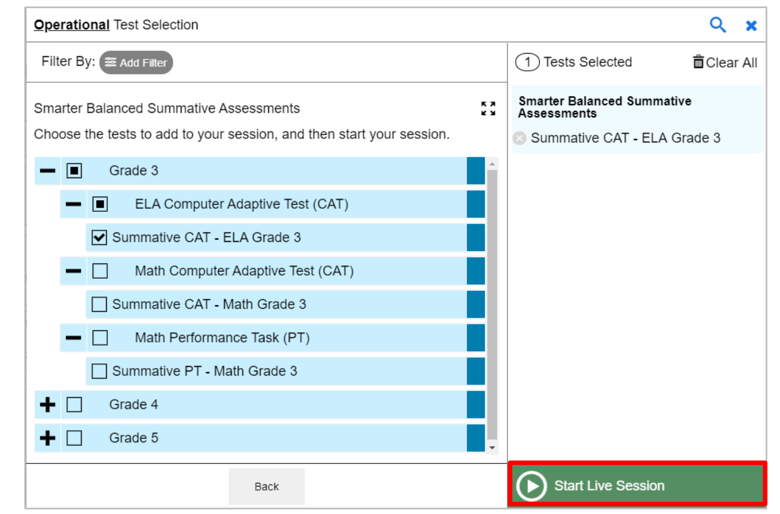
Starting a Test Session
Choose the grade and assessment(s) from the drop-down menu and select “Start Live Session.”
Notes:
When a test examiner logs in to the Test Administration Interface and chooses Active Sessions, the Test Selection window opens automatically. To create a test session, select the test(s), grade(s), content area(s), and CAT(s) or PT(s) to be administered in the test session.
The Test Selection window color codes tests (summative assessments are blue). Assessments are also categorized by test, grade, content area, and type (CAT or PT). All tests appear collapsed by default. To expand a category, click (+). To collapse an expanded a category, click (−).
After selecting the assessment(s) to be administered during the test session, the test examiner clicks the [Start Live Session] button to begin the test session and generate the Session ID that students use to join that test session. The example on this slide displays all Grade 3 summative tests and shows that the test examiner has selected the Grade 3 ELA CAT to include in the test session.

Slide 33

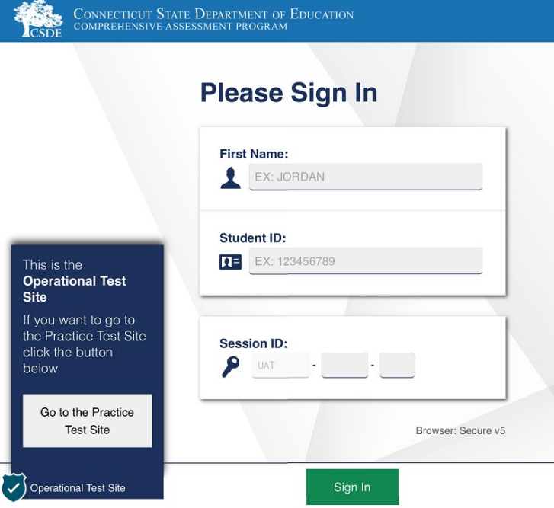
Starting a Test Session
Inform the student of the session ID.
Using the Secure Browser, the student will enter the Session ID, their full first name, and SASID.
Notes:
Provide the students with the Session ID. This ID should also be written on the chalk board for easy reference.
Students will enter this information into the Secure Browser, along with their fully first name (as indicated in the PSIS registration system) and their SASID.
Ensure that all students have successfully entered their information before they sign-in.

Slide 34
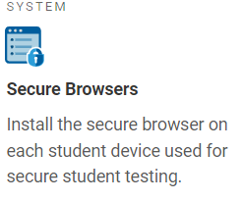
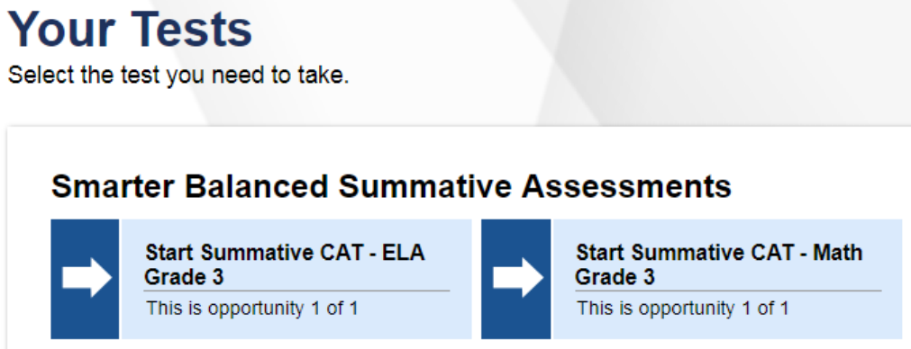
Student Test Menu
Inform students of the test session in which they will be taking.
Notes:
Once students sign into the Secure Browser, all assessments associated with their grade of enrollment will appear. Therefore, be sure to clearly communicate which assessment the student should choose. Tests are generated based on the student's grade in TIDE.
If you find an error with the student’s grade listed in TIDE or if the test form is not for the correct grade, do not test the student. Contact your DA immediately so that the student’s grade can be updated in PSIS.
Test administrators should look closely to the test name listed on the Test Administrator Interface prior to approving to be sure it is the correct summative test to be administered at that time.

Slide 35


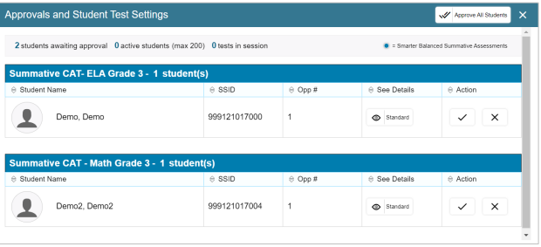

Reviewing, Approving, and Denying Tests
View students and their test settings (designated supports and accommodations) by selecting the “eye” icon.
If everything is accurate, select the green check mark, OR
choose the Approve All Students option located on the top menu bar.
If there is an error with the test selected, or with the student’s demographics/test settings, choose the red x.
Notes:
If a student selects a test other than the one the test examiner plans to administer to that student that day (for example, a student selected a PT instead of a CAT or selected mathematics instead of ELA), the test examiner must deny the test session by selecting the red x. The student may then log in again and select the correct test.
On the Test Administration Interface, the test examiner will select the [Approvals (#)] button as indicated by #1 on your slide. The Test Administrator can approve students individually by selecting the green check-mark associated with their student name/record (see #2 on your slide).
Then, a new window opens that shows a list of students. The test examiner should review the list to ensure that students are taking the correct content area (mathematics or ELA) and type of test (CAT or PT). All tests should say “Summative” in the title. See #2 on your slide.
Check the “eye” icon to see if the student has any embedded or non-embedded designated supports or accommodations. (See #2 on your slide). If non-embedded supports are listed, make sure that the student has the appropriate material prior to test administration (e.g., Bilingual Word-to-Word Glossary for NGSS).
If you notice that a student’s settings are incorrect, do not approve that student to begin testing. The test examiner will need to work directly with a School or District Coordinator to correct the test settings in TIDE for students without IEP/504 Plans. If the student has an implemented IEP/Section 504 Plan, reach out to the student’s Case Manager to conduct an amendment or review/revise of the plan to ensure appropriate accommodations. Please note: designated supports and accommodations should never be manually entered for students with an IEP or Section 504 plan.
Again, please do not approve a student’s test or have the student participate in testing until all test supports and/or accommodations are accurately reflected in TIDE. Ensuring the test settings are correct before the student begins testing is critical to avoid the need for a test reset that may result in additional testing for the student later.

Slide 36
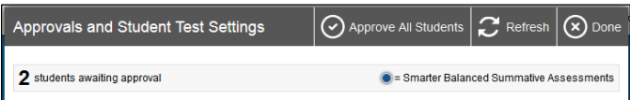
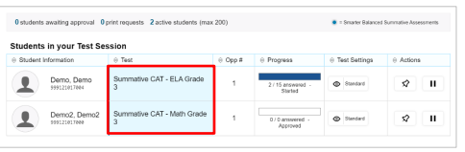
Monitoring Test Progress
Once students have started their tests, circulate through the room to ensure that all conditions of test security are maintained.
If you witness or suspect the possibility of a test security incident, contact the District Administrator for Testing immediately.
Refer to the Test Administration (TA) Interface to view the testing progress of any student. This site will not show test items or scores, but it will show how many items have been delivered to each student (e.g., question 24/40).
The TA Interface is designed to automatically refresh every 20 seconds, but you can refresh it manually by clicking the button at the top right of the screen.
Notes:
Once students have started their tests, circulate through the room to ensure that all conditions of test security are maintained.
If you witness or suspect the possibility of a test security incident, pause the student’s test and contact the District Administrator for Testing immediately in accordance with the security guidance provided in this manual.
Refer to the Test Administration Interface to view the testing progress of any student. This site will not show test items or scores, but it will show how many items have been delivered to each student (e.g., question 24/40). The Test Administration Interface is designed to automatically refresh every 20 seconds, but you can refresh it manually at any time by clicking the [refresh] button at the top right of the screen (as indicated by red text box on your screen).
As a security measure, test examiners are automatically logged out of the Test Administration Interface after 30 minutes of test examiner inactivity and student inactivity in the test session, which will result in closing the test session. If this occurs, create a new session, and the students will have to log in to the new session to resume testing. When starting a new session, give the students the new Session ID so that they can log in and resume testing.

Slide 37
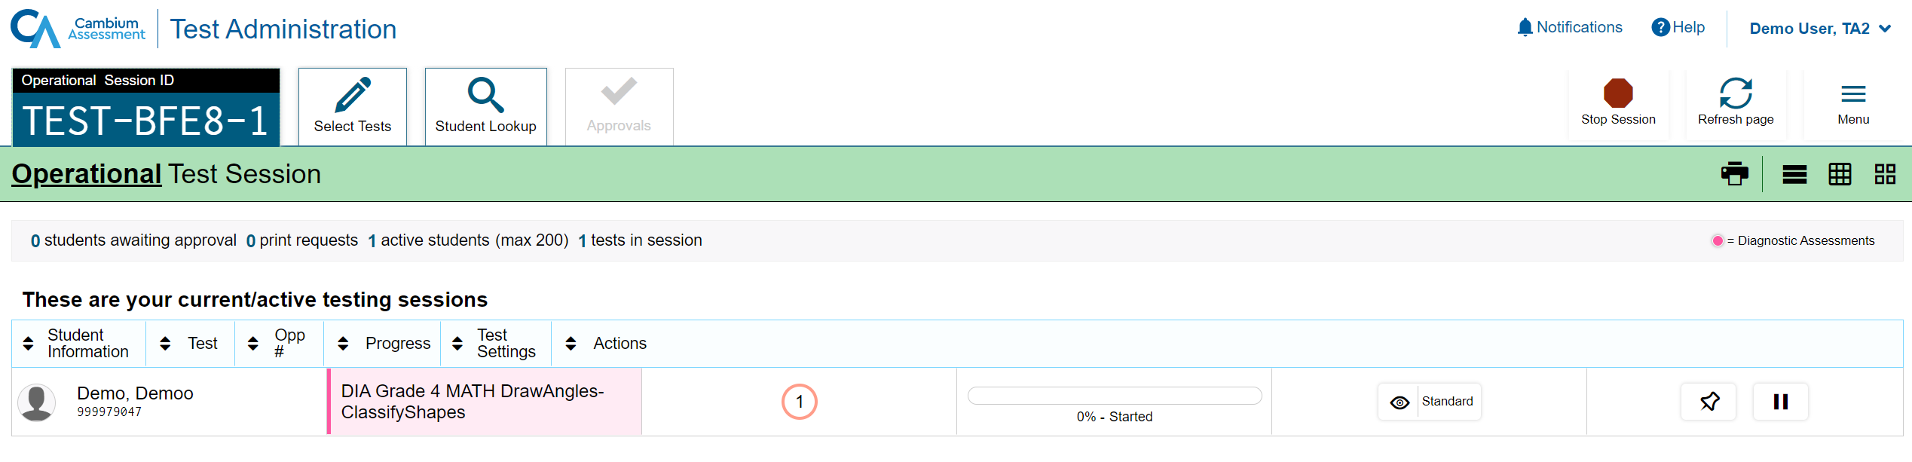
Things to Know
  Proctors have the ability to pin select students of interest to the top, so they are easy to monitor.
Notes:
Proctors have the ability to pin select students of interest to the top, so they are easy to monitor.

Slide 38
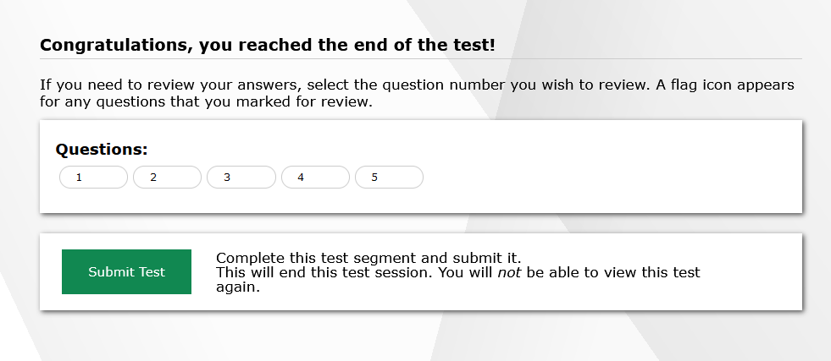
Ending Test
Notes:
After answering the last item in the test session, each student is presented with a screen prompting the student to review answers (marked and unmarked) for all items available to the student or prior to submitting the test.
After answering the last question, students must submit their tests. If students would like to review their answers before submitting their test, they should click the number of the question they wish to review and, only after they finish reviewing, should they click [SUBMIT TEST].
Once a student clicks [SUBMIT TEST], the student will not be able to review answers.

Slide 39
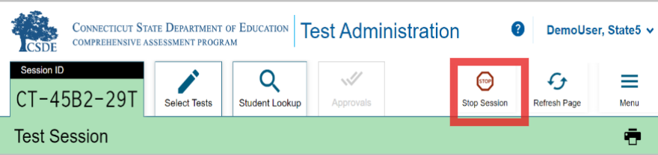
How does a test administrator end a test session?
Test administrators will click [STOP] in the Test Administration Interface to end the test session and pause any student test in the session that is still in progress.
Log out of the Test Administration Interface by clicking the [Logout] button at the top right.
Notes:
The test administrator will click [STOP] in the Test Administration Interface to end the test session and pause any student test in the session that is still in progress. Log out of the Test Administration Interface by clicking the [Logout] button at the top right.

Slide 40
Test Monitoring and Security

Slide 41
Test Security and Proctoring
Violation of test security is a serious matter with far-reaching consequences. Breaches of test security include, but are not limited to, copying or photographing of test materials, failing to return test materials, coaching students, giving students answers, and/or changing students’ answers. Such acts may lead to the invalidation of an entire school district’s student test scores, disruption of the test system statewide, and legal action against the individual(s) committing the breach. A breach of test security may be dealt with as a violation of the Code of Professional Responsibility for Teachers, as well as a violation of other pertinent state and federal law and regulation. The Connecticut State Department of Education will investigate all such matters and pursue appropriate follow-up action. Any person found to have intentionally breached the security of the test system may be subject to sanctions including, but not limited to, disciplinary action by a local board of education, the revocation of Connecticut teaching certification by the State Board of Education,* and civil liability pursuant to federal copyright law.
*See Section 10-145b(i) (2) (E) of the Connecticut General Statutes, which reads in relevant part as follows: The State Board of Education may revoke any certificate, permit, or authorization issued pursuant to said sections if the holder is found to have intentionally disclosed specific questions or answers to students, or otherwise improperly breached the security of any administration of a mastery examination, pursuant to section 10-14n.
Notes:
Take a moment to read and review the Test Security and Proctoring slide.
We include this language that is in the TAM, and it outlines the seriousness of testing and test security.
This is a reminder of the importance of test security and proctoring.
Please pass this important message on to your colleagues in district.

Slide 42
Test Security
Breaches of test security include, but are not limited to:
  Analyzing/copying test items
  Coaching students
  Giving students answers and/or changing students’ answers
  Allowing students access to digital, electronic, or manual devices (except approved accommodations)
  Unauthorized log in to the Test Delivery System
  Cell phone (including Smart Watches) use by students is prohibited!
Notes:
Breaches of test security include, but are not limited to:
analyzing/copying test items
coaching students
giving students answers, and/or changing students’ answers
allowing students access to digital, electronic, or manual devices (except approved accommodations)
unauthorized log-in to the Test Delivery System
This list is not comprehensive, but this represents most issues when it comes to issues in test security.
Please note that cell phone (including Smart Watches) use by students is prohibited!

Slide 43
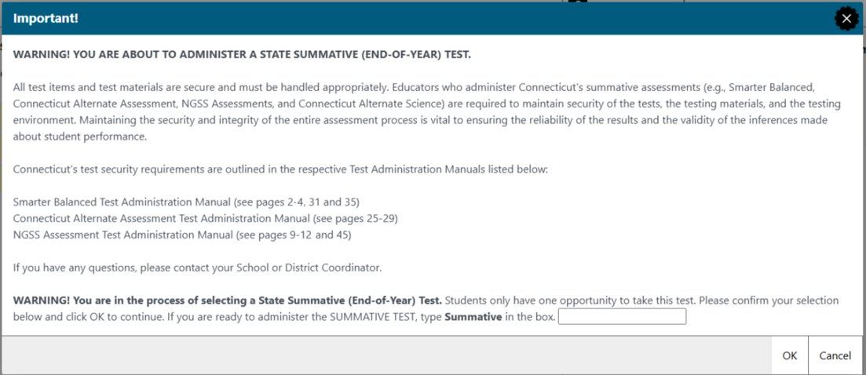
TA Security Confirmation/Attestation Page
Notes:
Each time a teacher proceeds to the Test Administration Site to administer a summative assessment; they will be asked to type in the word summative to attest that they have participated in local school/district assessment training and that they are aware of test security policies and procedures.

Slide 44
Test Security Definitions
Type | Definition
Impropriety | An incident that has a low impact on the individual or group of students testing and has a low risk of affecting student performance on the test, test security, or test validity. It can be corrected and contained at the local level.
Irregularity | An incident that impacts an individual or group of students and may potentially affect student performance on the test, test security, or test validity.
Breach | An incident that poses a threat to the validity of the test. Examples include the release of secure materials or a security/system risk. These circumstances have external implications and may result in a decision to remove the test item(s) from the available, secure item bank.
Notes:
Take a moment to look at the description for improprieties, irregularities, and breaches.

Slide 45
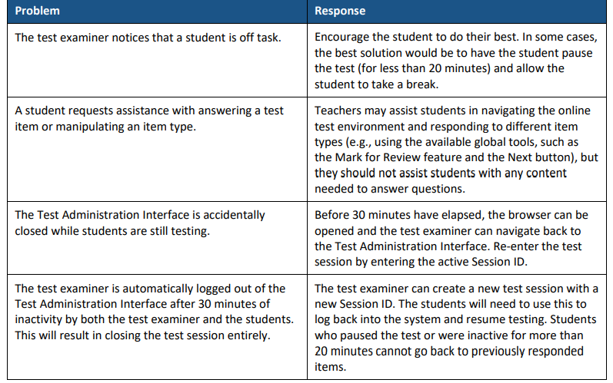
Issues that Might Arise During Testing
Notes:
The table on this slide shows appropriate responses to specific problems that may come up during testing.

Slide 46
Reminders!
Remove or cover instructional materials.
Ensure sufficient spacing between student seating.
Place a “TESTING—DO NOT DISTURB” sign on the door, or in halls.
Prepare the test setting (e.g., small group, lighting, testing devices, assistive technology etc.).
Set up a practice test experience for all students and model how to use universal tools, designated supports, and accommodations (e.g., text-to-speech, speech-to-text) with those students using them.
Ensure student’s have scrap paper and any non-embedded designated support/accommodation identified in TIDE. Headsets are also required on the Smarter Balanced ELA Listening Assessments.
Notes:
To ensure that all students are tested under the same conditions, the test examiner should adhere strictly to the script for administering the test as published in the Test Administration Manual. These instructions are provided in the boxes on the following pages. When asked, the test examiner should answer questions raised by students but should never help the class or individual students with specific test items. No test items or passages can be read to any student for any content area, unless the student requires a designated support or accommodation as described in the Assessment Guidelines.
Test Administrators should distribute
scratch paper to students for all test sessions (scratch paper can include plain paper, lined paper, paddy paper, or graph paper) for ELA, math, or science.
graph paper to students in Grades 6, 7, and 8 for the mathematics assessments; and
headphones to students for the listening portion of the English language arts assessments, to students who require Audio Glossaries on the mathematics assessments, and students who require text-to-speech on either assessment.
Be sure to provide students with any non-embedded designated supports or accommodations that they are approved for.
Other reminders:
Instructional materials must be removed or covered, including but not limited to, information that might assist students in answering questions. This includes materials that may be displayed on bulletin boards, chalkboards or dry-erase boards, or on charts (e.g., wall charts that contain literary definitions, maps, mathematics formulas, etc.).
Students must be seated so there is enough space between them to minimize opportunities to look at each other’s work, or they should be provided with tabletop partitions. Students may also be tested on an individual basis as appropriate
If helpful, place a “TESTING—DO NOT DISTURB” sign on the door or post signs in halls and entrances rerouting hallway traffic in order to promote optimum testing conditions.

Slide 47
Appeals
Tips
Actively monitor. Provide technical assistance when necessary.
If a test irregularity occurs, contact your School Coordinator or District Administrator as soon as possible.
When unsure of what to do, reach out for help by contacting your school or district test administrator.
Notes:
Test administrators should actively monitor and proctor the testing sessions. If a test irregularity occurs, contact your School Coordinator or District Administrator as soon as possible.
And remember, when unsure of what to do, reach out for help by contacting your school or district test administrator.

Slide 48
Who is Eligible for Designated Supports and Accommodations?

Slide 49

Universal Design
Smarter Balanced and NGSS Assessments offers three tiers of embedded and non-embedded accessibility resources on its interim and summative assessments to meet the varied needs of learners:
universal tools,
designed supports, and
accommodations.
Refer to the Accessibility Chart and Assessment Guidelines for a complete listing.
Visit the Tools for Teachers webpage for educator-created lessons, activities, strategies, and professional development.
Notes:
Connecticut’s statewide assessments incorporate the principles of Universal Design for Learning (UDL). Universal Design for Learning is a scientifically valid framework for guiding educational and assessment practices that provides flexibility in the ways information is presented, in the ways students respond or demonstrate knowledge and skills, and in the ways in which students are engaged. Incorporating the principles of UDL reduces barriers, provides appropriate accessibility supports, and challenges, and maintains high achievement expectations for all students, including students with disabilities and students who are English learners. Teams should consider each student’s unique learning profile when considering supports. Accessibility supports should be individual and not a one size fit all.
For more information, refer to the:
2024-25 Accessibility Chart: Accessibility Chart; https://ct.portal.cambiumast.com/resource-item/en/accessibility-chart
Connecticut State Department of Education Assessment Guidelines: CSDE Assessment Guidelines; https://ct.portal.cambiumast.com/resource-item/en/csde-assessment-guidelines
Smarter Balanced Accessibility Strategies: New Tools for Teachers Quick Guides: How to Use Resources and Strategies; https://smarterbalanced.org/new-quick-guides/

Slide 50
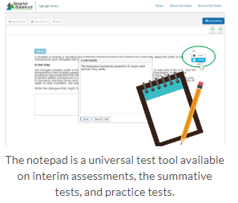
Who is eligible for universal tools?
Universal Tools
Embedded and non-embedded: Available to all students based on student preference and selection (e.g., highlighter, notepad).
Making Decisions about Universal Tools:
Universal tools are automatically available to all students through the test delivery system.
Educators may need to determine if certain universal features are distracting for certain students.
Universal tools can be turned off by the test administrator/proctor prior to testing.
Educators also need to ensure that appropriate, non-embedded universal features are available to meet individual students’ needs.
Resource: Five Built-in Test Tools Students Should Know (and Use!)
Notes:
Universal tools are accessibility features of the assessment that are either provided as digitally delivered components of the Test Delivery System or provided separately from the digital platform as a non-embedded tool. Universal tools are available to all students based on student preference and selection. Use of the universal tools yield valid scores that meet the requirements for participation and assessment identified in the ESSA when used in a manner consistent with the guidelines.
Familiarizing Students with Universal Test Tools Can Yield Confidence Boost
Smarter Balanced digitally-delivered assessments (interims, the summative test, and practice tests) include a wide array of embedded universal test tools. These are available to students as part of the technology platform. Students gain confidence with the testing software when they understand how to use these test tools and when they can be most useful. Using practice tests and/or administering interims, and coaching students on the built-in test tools are a great way to help them gain familiarity. Here’s the link to tips on using five of these universal test tools: https://smarterbalanced.org/five-built-in-test-tools-students-should-know-and-use/.
Access Practice and Training Tests on the Connecticut Comprehensive Assessment Program Portal: https://ctpt.tds.cambiumast.com/student.
For more information, refer to the:
2024-25 Accessibility Chart: Accessibility Chart; https://ct.portal.cambiumast.com/resource-item/en/accessibility-chart
Connecticut State Department of Education Assessment Guidelines: CSDE Assessment Guidelines; https://ct.portal.cambiumast.com/resource-item/en/csde-assessment-guidelines

Slide 51
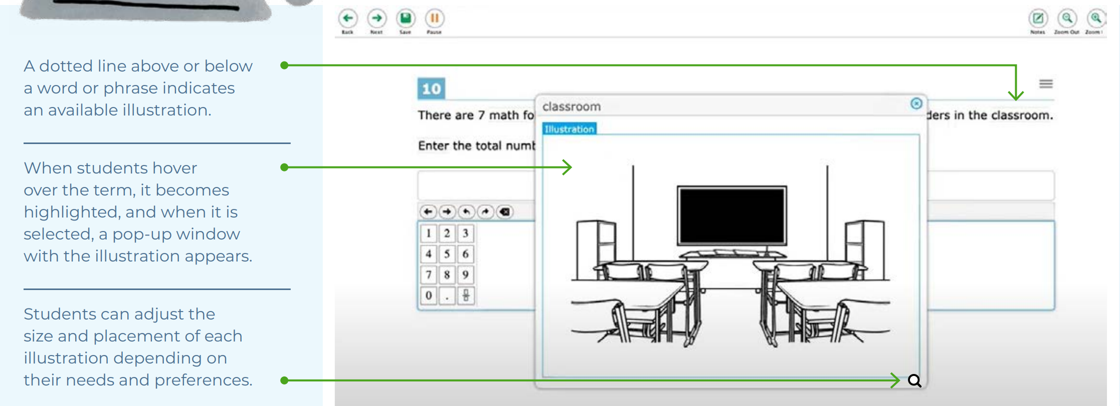
Who is eligible for designated supports?
Designated Supports
Embedded and non-embedded:
Accessibility features available for use by any student for whom the need has been indicated by an educator team with input from the parent/guardian and student. If these supports are selected for use on statewide assessments, they should also be consistently embedded and accessed in the student’s instructional setting.
Examples: color contrast, text-to-speech of items, illustration glossary (math) as shown to the right.
Making Decisions about Designated Supports:
Educator teams making these decisions should be familiar with the child’s characteristics and needs.
Notes:
What are designated supports?
Designated supports are those accessibility features available for use by any student for whom the need has been indicated by a team of educators with parent/guardian and student input. If these supports are selected for use on statewide assessments, they should also be consistently embedded and accessed in the student’s instructional setting. It is recommended that a consistent process in each district be used to determine and communicate decisions regarding these supports for individual students. All educators making these decisions should be trained by their School or District Administrator in this determination process and should be made aware of the range and types of designated supports available. Two general types of designated supports are identified: digitally-embedded and non-embedded. Designated supports need to be identified prior to assessment administration. Embedded and nonembedded supports must be entered into TIDE, unless the student has an IEP or Section 504 Plan. In these cases, designated supports will import from CT-SEDS to TIDE from finalized and implemented plans that have documented designated supports determined for the current grade of enrollment.
Any non-embedded designated supports must be acquired prior to testing with the assumption the student is using it during instruction.
For more information, refer to the:
2024-25 Accessibility Chart: Accessibility Chart; https://ct.portal.cambiumast.com/resource-item/en/accessibility-chart
Connecticut State Department of Education Assessment Guidelines: CSDE Assessment Guidelines; https://ct.portal.cambiumast.com/resource-item/en/csde-assessment-guidelines

Slide 52
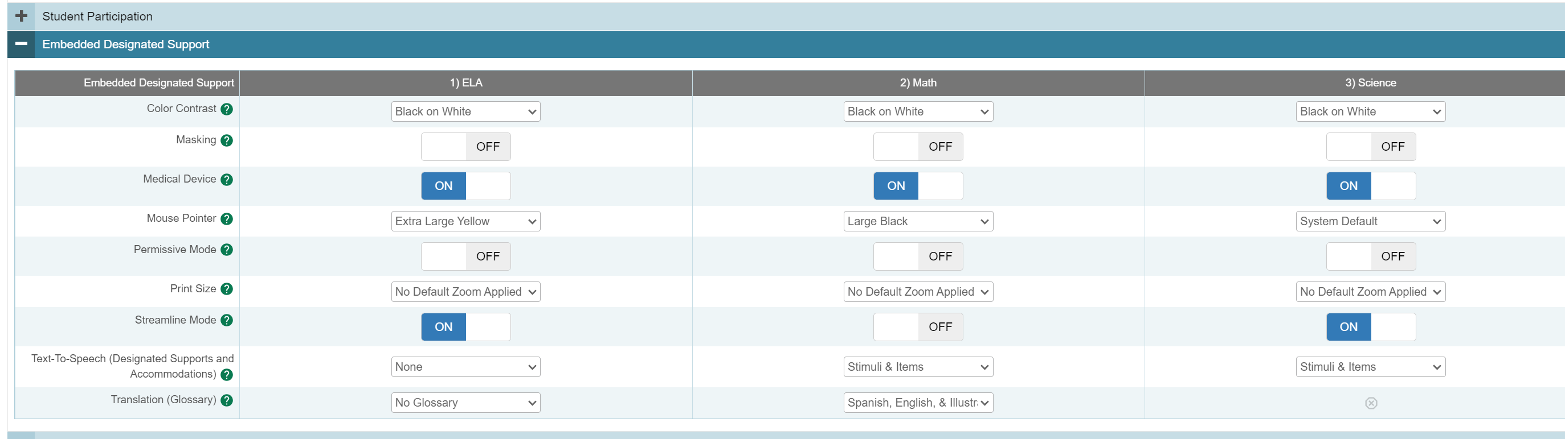
Review Test Settings in TIDE Prior to Testing
Teachers will not be making edits or adjustments to TIDE and the Student Dashboard. Teachers will want to review this information to ensure any designated supports and accommodations that are populated in the system are accurate prior to testing. If an error is noted, please contact your District Administrator and do not administer the test until corrected.
Per the example above, the student is eligible to have a medical device, a mouse pointer, streamline mode, text-to-speech of math and science stimuli and items, and the Translation Glossary for Math.
Notes:
It is important that teachers review and ensure students have the applicable accessibility supports documented in TIDE prior to testing. Teachers can review these through going to the TIDE Student Dashboard. If an error is noted, please contact your District Administrator in TIDE. Please note, accessibility supports for students with an IEP or Section 504 sync between CT-SEDS and TIDE. If an error is noted for these students, please reach out the either the 504 Coordinator or Special Education Case Manager and the DA in TIDE prior to testing.

Slide 53
Understanding Accessibility Supports
Accommodations (embedded and non-embedded): are changes in procedures or materials that increase equitable access during assessment. They:
generate valid assessment results for students who need them;
allow students to show what they know and can do.
Examples: Assistive technology, American Sign Language, braille, closed captioning
What to Know
Accommodations:
must be documented for the student’s current grade in a finalized and implemented plan in CT-SEDS.
sync directly from CT-SEDS to TIDE.
should be integrated into all district, school, and/or classroom processes which prioritize student access needs.
Notes:
Accommodations are for students with an IEP or 504 plan. These are changes in materials or procedures that increase equitable access during assessments. They allow students to show what they know and can do. Like designated supports they should be consistently accessed and incorporated into the students instructional setting. Students should have familiarity and independence with both accommodations and designated supports that are assigned. It is critical to note that although some accommodations may be appropriate for instructional use, they may not be appropriate for use on a standardized assessment. There may be consequences (e.g., invalidating a student’s test score) for the use of some accommodations during state assessments. It is very important for educators to become familiar with state policies regarding accommodations during statewide assessments.
For statewide testing, as well as for instructional access, accommodations are determined by the PPT or Section 504 Team and are selected in the student’s plan within CT-SEDS. Like designated supports, when the plan is finalized and implemented, accommodations in CT-SEDS will sync to TIDE nightly. Teachers should review the student’s test settings in TIDE prior to testing to understand what the student needs at the time of testing. If there are non-embedded designated supports or accommodations selected, these materials must be provided to the student by the teacher at the time of testing.
As mentioned before accommodations and designated supports that are in finalized and implemented plans in CT-SEDS will sync to TIDE. They should never be manually entered into the TIDE system.
If the teacher or test administrator has any questions about the accommodations listed in TIDE or if there is a possible error to the selection type, please contact your district administrator for testing. Do not start a test for a student if there is either a missing accommodation or question about appropriateness (e.g., TIDE indicates that the student will use both text-to-speech of stimuli and items AND a read aloud of stimuli and items). In this example, the selection of accommodations conflict and this error must be resolved by the team through an amendment or review/revise PPT or 504 meeting. The team will have to remove the incorrect accommodation/revise in CT-SEDS first. Once the amendment/IEP/504 is finalized and implemented, allow for up to 48 hours for the accommodations to reflect in TIDE before scheduling a test for the student.
If you have any concerns, see your District Administrator for Testing.
Additional Information and Resources:
Some examples of accommodations include Assistive Technology, American Sign Language, braille, and closed captioning.
Refer to the CSDE Assessment Guidelines for details about accommodations available for each assessment: (https://ct.portal.cambiumast.com/resource-item/en/csde-assessment-guidelines)
Documenting Designated Supports and Accommodations in TIDE; https://ct.portal.cambiumast.com/resource-item/en/documenting-designated-supports-and-accommodations-in-tide
CT-SEDS to TIDE Designated Supports/Accommodations Sync Frequently Asked Questions; https://ct.portal.cambiumast.com/resource-item/en/ct-seds-to-tide-designated-supports-and-accommodations-sync-faq
Cross-Checking Student TIDE Test Settings and CT-SEDS; https://ct.portal.cambiumast.com/resource-item/en/cross-checking-student-tide-test-settings-and-ct-seds

Slide 54
Special Documented Accommodations
Special Documented Accommodations
Non-embedded: Non-standard accommodations (e.g., human reader or signer, or a scribe to support written communication when the embedded accommodation, or standard accommodations, are not appropriate given the complexity of student need.) These accommodations require testing in an individual test setting and may require additional training for the test administrator. Refer to the Special Documented Accommodations resource available on the portal.
Making Decisions about Special Documented Accommodations
Must be determined at the PPT/Section 504 Convening.
The educator team rules out that the standard embedded and non-embedded accommodations and accessibility features do not provide adequate access given the students documented disability.
These accommodations require the greatest extent of adult-dependence/support.
Notes:
In exceptional circumstances, there may be a student whose disabilities are such that the allowable embedded and non-embedded accommodations described in the CSDE Assessment Guidelines (https://ct.portal.cambiumast.com/resource-item/en/csde-assessment-guidelines) provide insufficient access to the Smarter Balanced and/or NGSS Assessments. ​
These Special Documents Accommodations are non-standard accommodations (available to students with an IEP or Section 504 Plan)for those who are unable to access standard designated supports and accommodations. Special Documented Accommodations require the greatest extent of adult-dependence and support. The student’s PPT or Section 504 Team should refer to the Special Documented Accommodations; https://ct.portal.cambiumast.com/resource-item/en/process-for-requesting-special-documented-accommodations available on the portal to determine the eligibility criteria and description of these accommodations as part of the screening process.
If you are administering a special documented accommodation to a student, please follow the appropriate test procedures and test security protocols identified in the Special Documented Accommodations resource (referenced above). Students approved for these special accommodations will test in a 1:1 test setting.

Slide 55
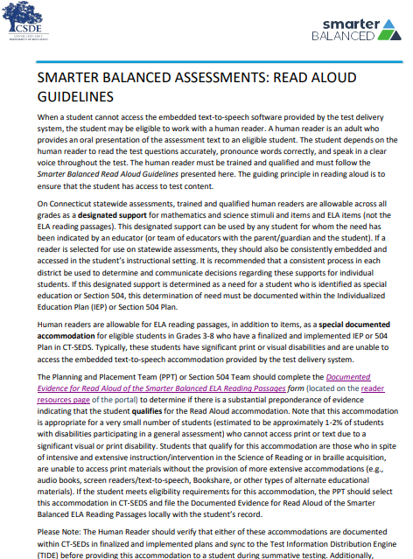
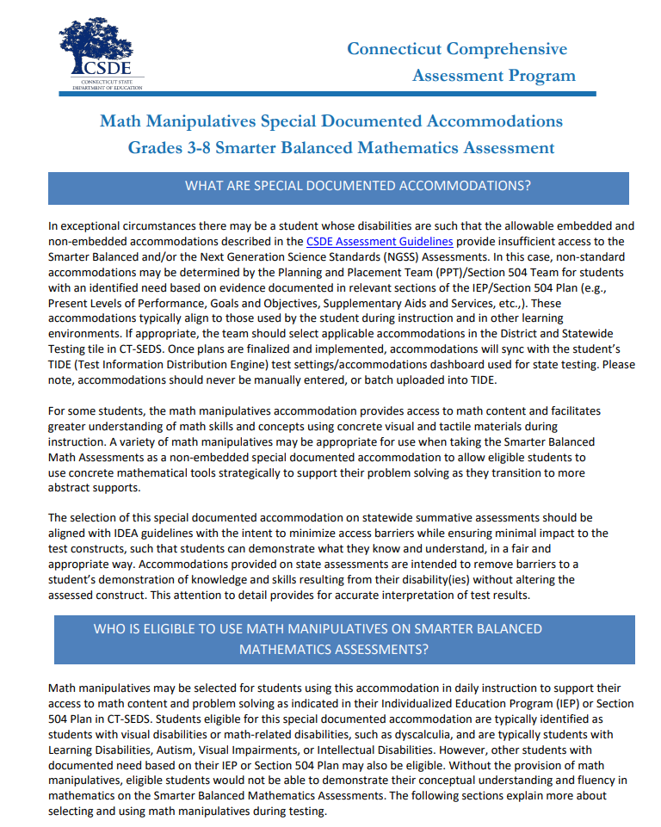
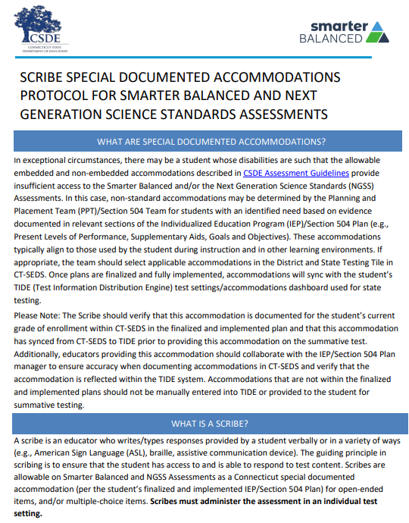
Special Documented Accommodations
Protocols and Procedures for Providing Special Documented Accommodations
The student must test in a 1:1 test setting.
The teacher must review and follow specific guidelines and sign a test security/confidentiality form and maintain locally (refer to your DA for more information on local policies).
Refer to the Special Documented Accommodations guidelines for more information.
Special Documented Accommodations Include:
Scribe
Read Aloud of ELA Reading Passages
Human Signer/Visual Support for Smarter Balanced ELA or Math and/or NGSS (includes directions, math and science items and stimuli, and ELA items [Not Reading Passages])
Human Signer/Visual Support for ELA Reading Passages • Math Manipulatives (Grades 3-8)
Non-Embedded Calculator (Math Grades 6-8, calculator-allowed items only)
Print on Demand (must contact the CSDE)
Customized Accommodation (must contact the CSDE)
Notes:
Educators need to follow guidance for special documented accommodations. Also customized accommodations need to be cleared through CSDE prior to testing. ​​
Critical information about Special Documented Accommodations are located on the portal: Special Documented Accommodations; https://ct.portal.cambiumast.com/resource-item/en/process-for-requesting-special-documented-accommodations
Read Aloud Guidelines; https://ct.portal.cambiumast.com/content/contentresources/en/Smarter-Balanced-Read-Aloud-Guidelines.pdf
Math-Manipulatives-Brochure.pdf; https://ct.portal.cambiumast.com/content/contentresources/en/Math-Manipulatives-Brochure.pdf
Scribe Special Documented Accommodations Protocol for Smarter Balanced and Next Generation Science Standards Assessments; https://ct.portal.cambiumast.com/resource-item/en/scribe-special-documented-accommodations-protocol-for-sb-and-ngss-assessments

Slide 56


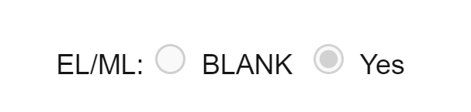
Accommodation Eligibility
Eligibility for any embedded or non-embedded accommodation requires the IDEA or Section 504 indicator (based on the PSIS registration fields) set to Yes. Without this indication, accommodations cannot sync to TIDE from CT-SEDS.
The student’s EL/ML designation must be set to Yes in PSIS if the student is identified as EL/ML.
Accommodations should NEVER be manually entered in TIDE. The IEP/Section 504 is the source of truth! If corrections are necessary, contact the Case Manager and an amendment of edit/revise can be conducted.
Notes:
When reviewing accommodations on the student dashboard in TIDE you will want to be aware of the following indicators and how they are set.
Eligibility for any embedded or non-embedded accommodation requires the IDEA or Section 504 indicator (based on the PSIS registration fields) set to Yes. Without this indication, accommodations cannot sync to TIDE from CT-SEDS.
The student’s EL/ML designation must be set to Yes in PSIS if the student is identified as EL/ML.
Accommodations should NEVER be manually entered in TIDE. The IEP/Section 504 is the source of truth! If corrections are necessary, contact the Case Manager or 504 coordinator to make corrections through the PPT or 504 process by either an amendment of edit/revise PPT or 504 meeting. All corrections must be done through CT-SEDS.

Slide 57
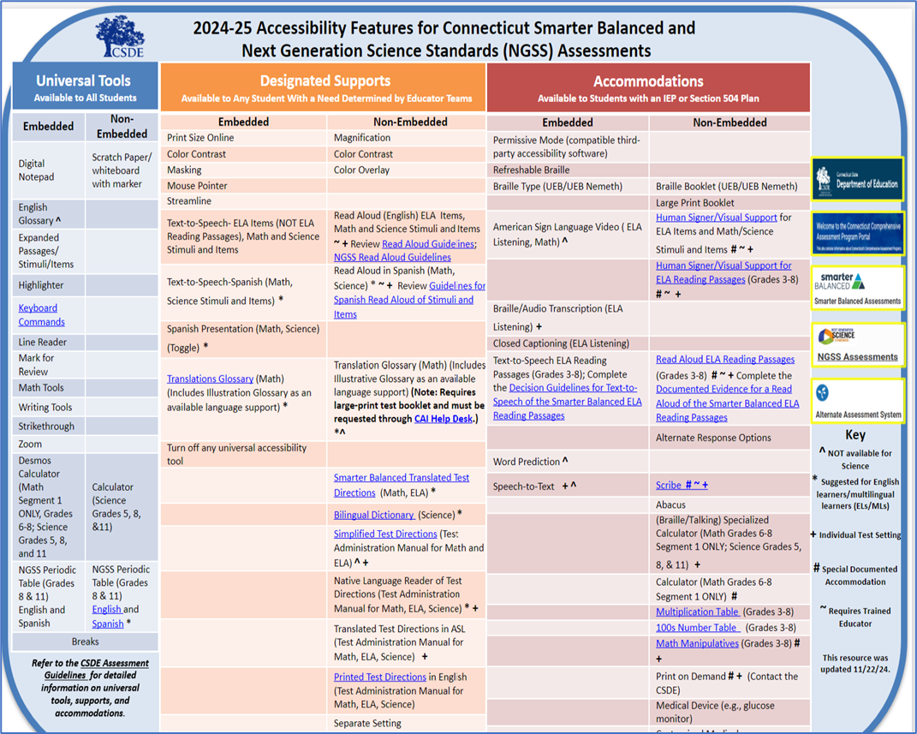
The Accessibility Chart
Notes:
The Accessibility Chart; (https://ct.portal.cambiumast.com/resource-item/en/accessibility-chart), shown here, was developed specifically for the Smarter Balanced and the Next Generation Science Standards Assessments. It provides 3 tiers of support ranging from Universal Tools (shown to the far left in blue), designated supports (shown in orange and located in the center of the chart), and accommodations shown in red to the far right. You will notice that within each section, embedded and non embedded tools are listed along with hyperlinks to additional information if applicable. Please note the user Key, located on the far right, that includes symbols noting tools that are not available on science versions, those accommodations that are non-standard and require additional teacher training, along with other tools that might be appropriate for ELs/MLs. ​Teams should understand the purpose and functionality of these tools and accommodations before selecting them.
Extra care should be used to ensure that selected supports do not conflict, such as the selection of the embedded text-to-speech of items AND the non-embedded Read Aloud of items.
​
While the Accessibility Chart is a great reference, details about each of these accessibility features are documented in the CSDE Assessment Guidelines. ​
​
Other Accessibility Charts are available for LAS Links (las-links-accessibility-chart-final.pdf) and the Connecticut SAT School Day (PowerPoint Presentation) located on the Connecticut Sensible Assessment System webpage: Connecticut Sensible Assessment System--Summative Assessment - End-of-Year; https://portal.ct.gov/sde/student-assessment/main-assessment/student-assessment/summative-assessment---end-of-year.

Slide 58


CSDE Assessment Guidelines
The CSDE Assessment Guidelines include detailed information related to accessibility supports and accommodations on statewide assessments.
They provide guidance related to special circumstances such as medical exemptions and requests for non-standard special documented accommodations.
Notes:
CSDE Assessment Guidelines; https://ct.portal.cambiumast.com/content/contentresources/en/CSDE-Assessment-Guidelines.pdf
The CSDE Assessment Guidelines provides administrators and educators with detailed information related to accessibility supports and accommodations on statewide assessments. Additionally, this documents provides information and guidance on medical exemptions and requests for non-standard special documented accommodations.

Slide 59
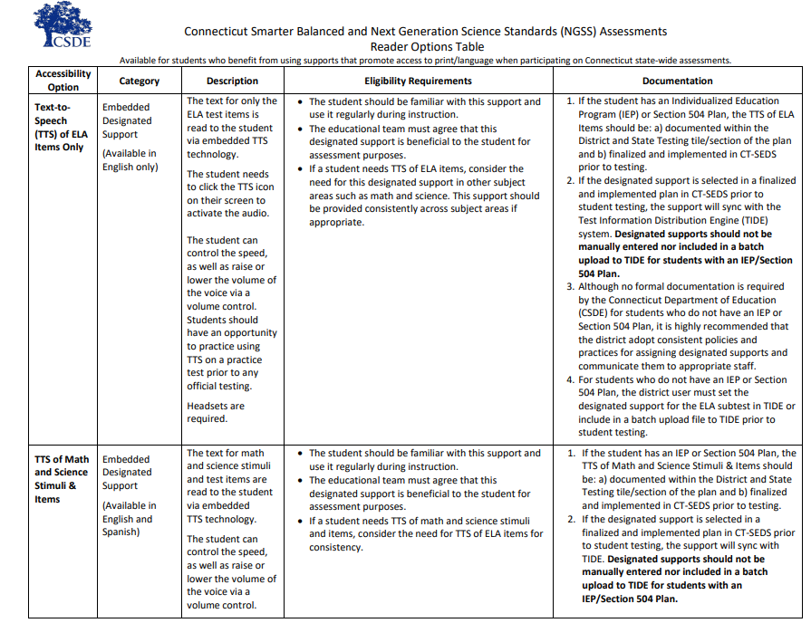
Reader Options Resource for Smarter Balanced/NGSS
Connecticut Smarter Balanced and NGSS Assessments Reader Options Table
This resource provides information on various embedded and non-embedded Smarter Balanced and NGSS reader supports and accommodations for students with reading, print, and visual disabilities. This document:
defines the purpose,
outlines accessibility options ranging from designated supports to accommodations
test requirement (i.e., test setting, teacher materials), and;
necessary documentation (if applicable)
Notes:
Connecticut Smarter Balanced and NGSS Assessments Reader Options Table Connecticut Smarter Balanced and NGSS Assessments Reader Options Table; https://ct.portal.cambiumast.com/resource-item/en/connecticut-smarter-balanced-and-ngss-assessments-reader-options-table
The Connecticut Smarter Balanced and NGSS Assessments Reader Options Table​ provides an in-depth look at the different reader options available for SB/NGSS. It defines the purpose, test requirements, and necessary documentation (if applicable) for various embedded and non-embedded Smarter Balanced and NGSS reader supports and accommodations. This tool can help educators determine the most appropriate accessibility features that support access to print/text. ​

Slide 60
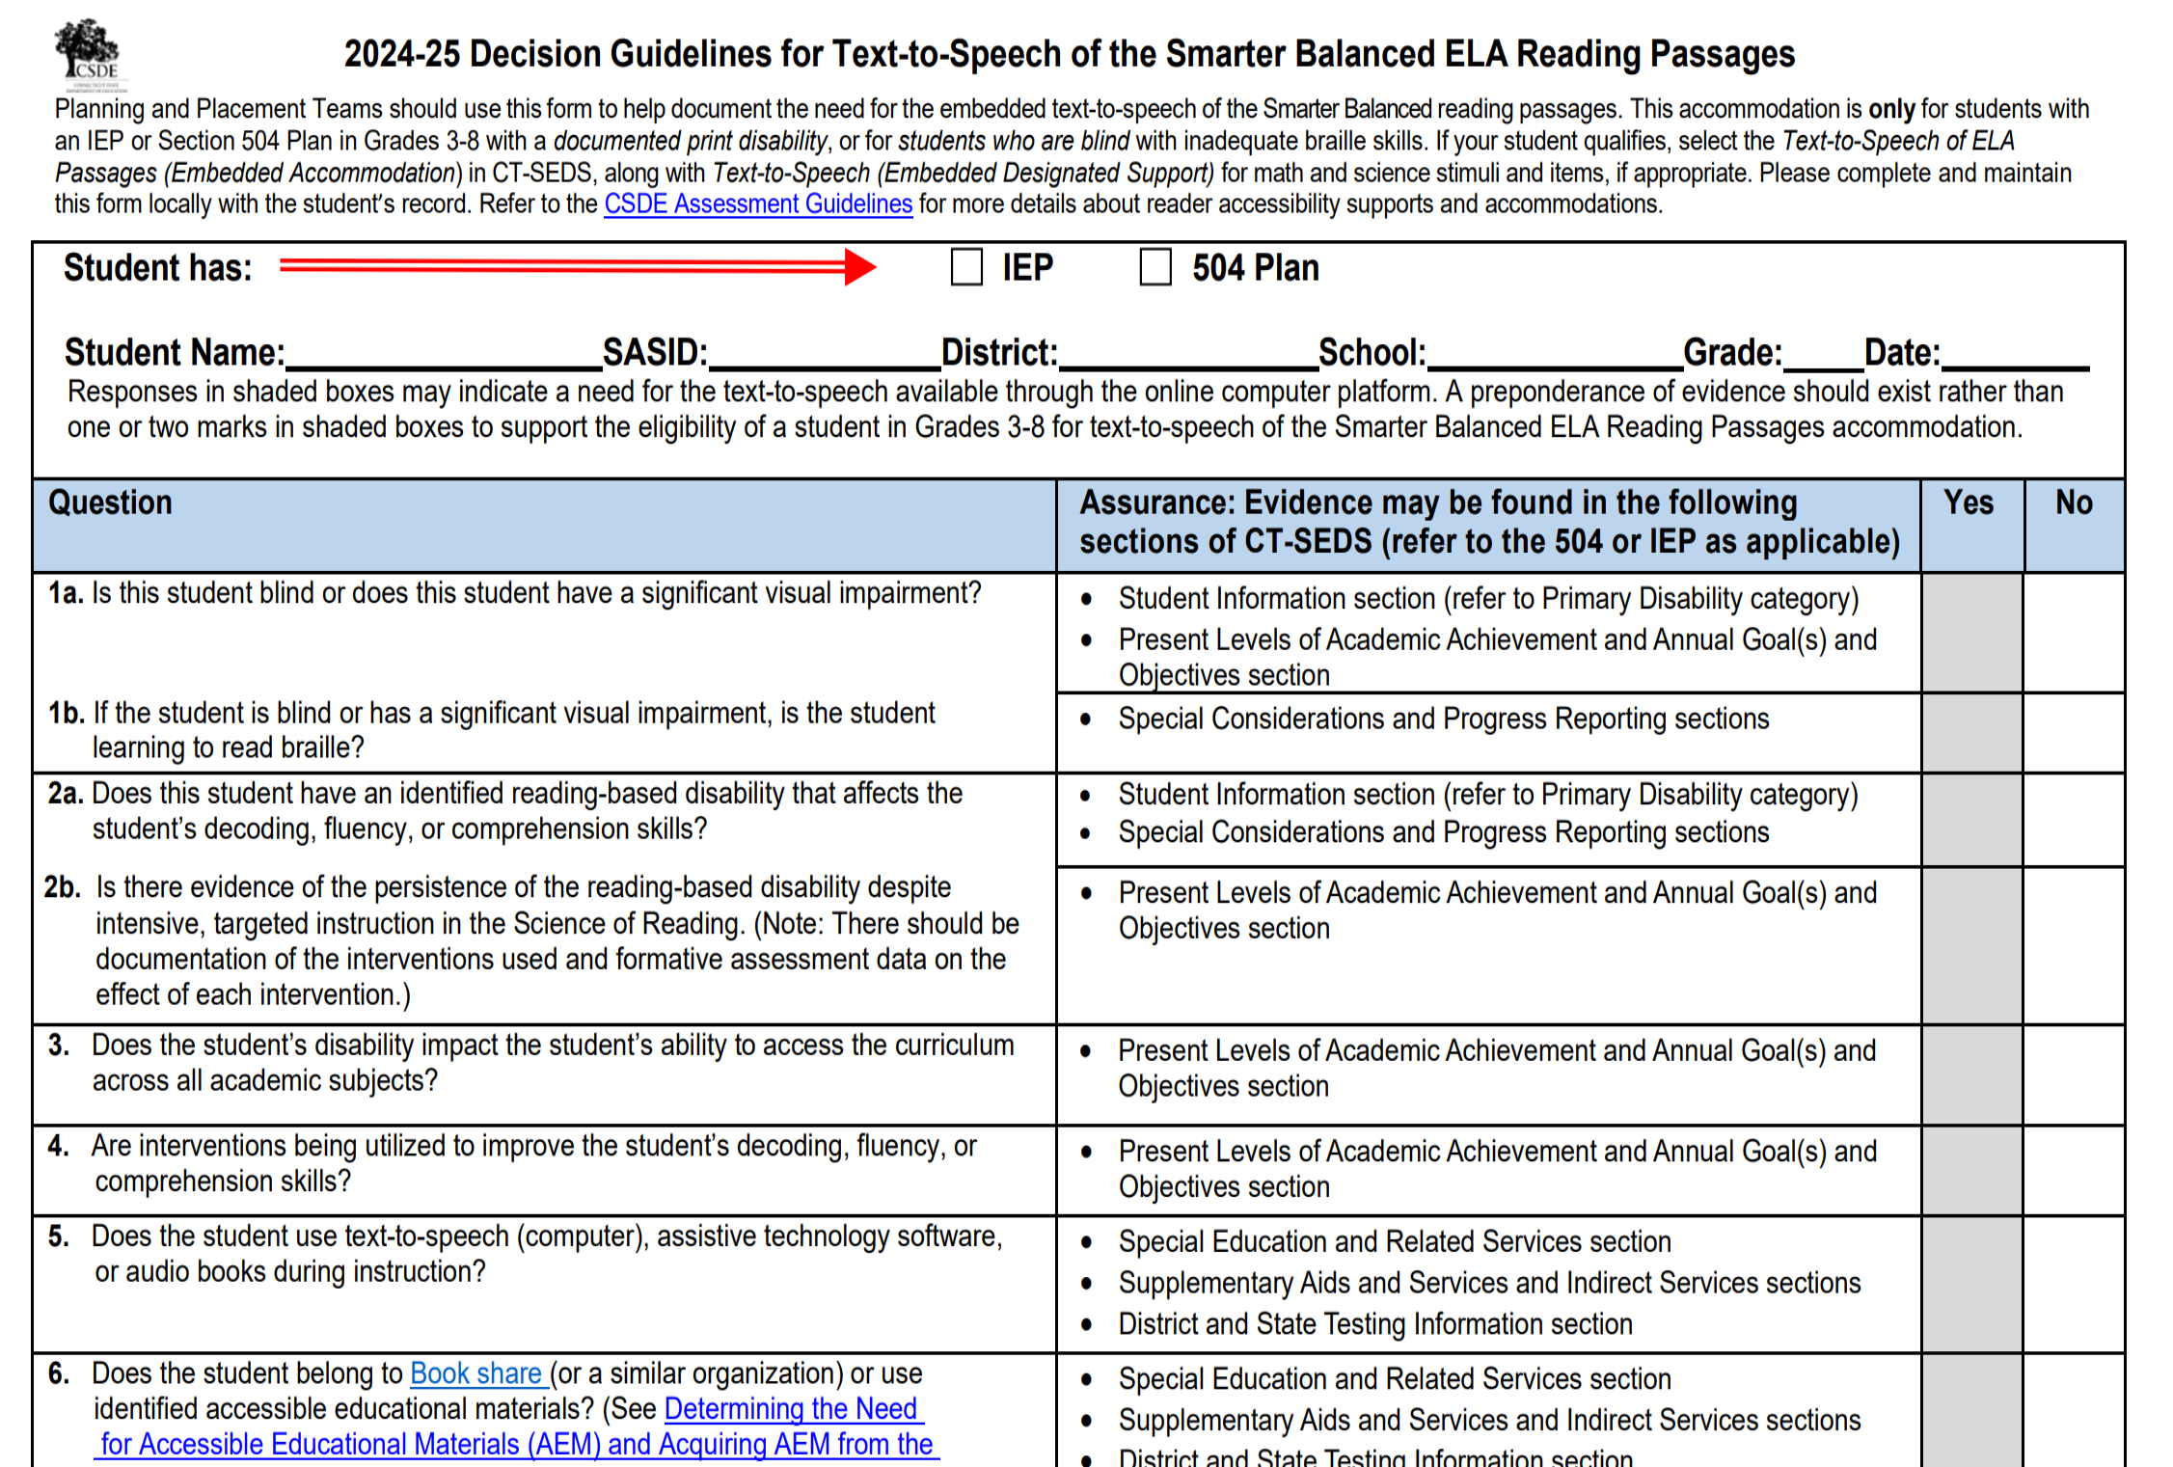
Decision Guidelines for Reader Supports
Some reader supports require documented evidence for a reader, either embedded TTS of ELA Reading Passages or non-embedded Read Aloud of ELA Reading Passages.
Embedded - TTS of ELA Reading Passages
The PPT/Section 504 Team complete the Decision Guidelines for Text-to-Speech of the Smarter Balanced ELA Reading Passages and maintain with the student’s record.
The team must document this accommodation in CT-SEDS for ELA and other subtests as applicable (i.e., math, science).
Notes:
Some reader supports require documented evidence. These supports are for the reading, either embedded or non-embedded of reading passages.
Students that qualify for this TTS of Reading Passages (Embedded) or Read Aloud of Reading Passages (Non-Embedded) are those students who in spite of intensive and extensive instruction/intervention in the Science of Reading or in braille acquisition, are unable to access print materials without the provision of more extensive accommodations (e.g., audio books, screen readers/text-to-speech, Bookshare, or other types of alternate educational materials).
Regardless of a student’s primary disability category, if there is evidence of a specific word reading disability that impacts their ability to decode/encode words and phonological processing, text-to-speech (or as a Read Aloud) might be an appropriate accessibility support used during instruction and on assessments. However, attributes of a specific word disability or dyslexia should be evidenced in the student’s current evaluation results and programming. In the context of assessing reading comprehension on a statewide assessment, TTS or Read Aloud of passages should only be provided as an access point/tool to the text
The Planning and Placement Team (PPT) or Section 504 Team should complete either the Decision Guidelines for Text-to-Speech of the Smarter Balance ELA Reading Passages or the Documented Evidence for Read Aloud of the Smarter Balanced ELA Reading Passages form (located on the reader resources page of the portal) to determine if there is a substantial preponderance of evidence indicating that the student qualifies for either the TTS or the Read Aloud accommodation.
Note that this accommodation is appropriate for a very small number of students (estimated to be approximately 1-2% of students with disabilities participating in a general assessment).
If the student meets eligibility requirements for this accommodation, the PPT or 504 Team should select this accommodation in CT-SEDS and file either Decision Guidelines for Text-to-Speech of the Smarter Balance ELA Reading Passages or the Documented Evidence for Read Aloud of the Smarter Balanced ELA Reading Passages locally with the student’s record.
For information on available designated supports and accommodations, please refer to the CSDE Assessment Guidelines.
Embedded - TTS of ELA Reading Passages: The ELA reading passages are read to the student via embedded TTS technology. The student can control the speed, as well as raise or lower the volume of the voice via a volume control. Headsets are required unless the student is testing in an individual test setting.
Decision Guidelines for Text-to-Speech of the Smarter Balanced ELA Reading Passages; https://ct.portal.cambiumast.com/resource-item/en/decision-guidelines-for-text-to-speech-of-the-smarter-balanced-ela-reading-passages

Slide 61
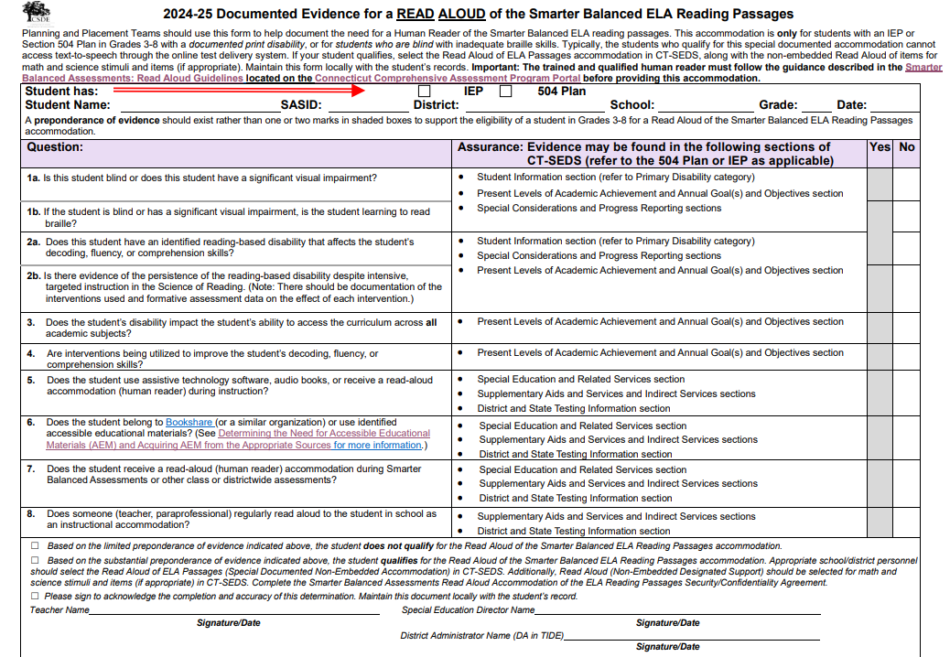
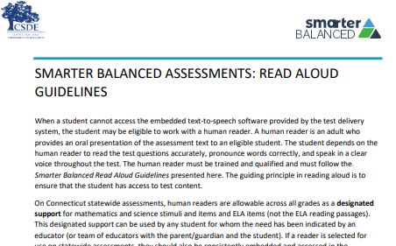
Documented Evidence for Reader Supports - Continued
Non-Embedded –Read Aloud of ELA Reading Passages
Special Documented Accommodation must be indicated with attestation in CT-SEDS.
(1) The PPT/Section 504 Team must complete the Documented Evidence for a Read Aloud of the Smarter Balanced ELA Reading Passages and maintain in the student’s record.
(2) The qualified individual acting as the reader should review the Smarter Balanced Assessments: Read Aloud Guidelines and sign the Test Security/Confidentiality Agreement Form (Appendix B of document).
Notes:
Non-Embedded –Special Documented Read Aloud of ELA Reading Passages (Human Reader):
When a student cannot access the embedded text-to-speech software provided by the test delivery system, the student may be eligible to work with a human reader. Note: this special documented accommodation is only available to eligible students with significant visual or print disabilities.
Guidance for Read Aloud Accommodation:
Human readers are allowable for ELA reading passages, in addition to items, as a special documented accommodation for eligible students in Grades 3-8 who have a finalized and implemented IEP or 504 Plan in CT-SEDS. A human reader is an adult who provides an oral presentation of the assessment text to an eligible student. The student depends on the human reader to read the test questions accurately, pronounce words correctly, and speak in a clear voice throughout the test. The human reader must be trained and qualified and must follow the Smarter Balanced Read Aloud Guidelines presented here. The guiding principle in reading aloud is to ensure that the student has access to test content.
If a reader is selected for use on statewide assessments, they should also be consistently embedded and accessed in the student’s instructional setting. It is recommended that a consistent process in each district be used to determine and communicate decisions regarding these supports for individual students.
If the accommodation or special documented accommodation is selected in an implemented IEP or Section 504 Plan in CT-SEDS prior to student testing, the accommodation will import to the TIDE system. Please note students should not have both as they are conflicting accommodations.
Before serving as a human reader, the teacher/proctor must review the Read Aloud Guidelines and sign the Test Security/Confidentiality Agreement Form (Appendix B of the Read Aloud Guidelines). Once signed, the form should be returned to the District Administrator for signature and filing with student record.
Documented Evidence for a Read Aloud of the Smarter Balanced ELA Reading Passages; https://ct.portal.cambiumast.com/resource-item/en/documented-evidence-for-a-read-aloud-of-the-smarter-balanced-ela-reading-passages
Smarter Balanced Assessments: Read Aloud Guidelines; https://ct.portal.cambiumast.com/resource-item/en/smarter-balanced-assessments-read-aloud-guidelines

Slide 62
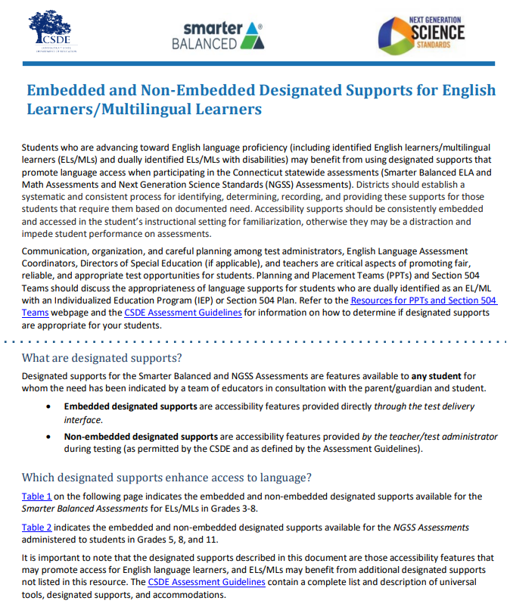
EL/ML Language Supports Smarter Balanced/NGSS
Examples of English Language Supports
Simplified Test Directions (Math and ELA)
Smarter Balanced Translated Test Directions (Math and ELA)
Bilingual Word-to-Word Dictionary (NGSS only)
Translation Glossary (Math)
Read Aloud (Spanish) for Math and Science
For more information, refer to the Assessment Guidelines and the Embedded and Non-Embedded Designated Supports for English Learners/Multilingual Learners (shown here).
Notes:
Students who are advancing toward English language proficiency (including identified ELs/MLs and dually identified ELs/MLs with disabilities) may benefit from using designated supports that promote language access when participating in the Connecticut state-wide assessments.
Districts should establish a systemic and consistent process for identifying, determining, recording, and providing these supports for those students that require them based on documented needs. Accessibility supports should be consistently embedded and accessed in the student’s instructional setting for familiarization, otherwise they may be a distraction and impede student performance on assessments. Communication, organization, and careful planning among test administrators, English Language Assessment Coordinators, Directors of Special Education (if applicable), and teachers are critical aspects of promoting fair, reliable, and appropriate test opportunities for students. Please note, for students who are dually identified as EL/ML and either IDEA or Section 504, language supports should be documented within their IEP or Section 504 Plan in CT-SEDS and should not be manually entered into TIDE.
Refer to the CSDE Assessment Guidelines for information on how to determine if these supports are appropriate for your students.
https://ct.portal.cambiumast.com/resource-item/en/guidelines-for-simplified-test-directions-in-the-test-administration-manual
Guidelines for Simplified Test Directions in the Test Administration Manual;
Translated Test Directions; https://ct.portal.cambiumast.com/resource-list/en/translated-test-directions
Bilingual Dictionaries and Glossaries Authorized for Use by English Language Learners; https://ct.portal.cambiumast.com/resource-item/en/bilingual-dictionaries-and-glossaries-authorized-for-use-by-english-language-learners
Translation (Glossary) – Embedded Designated Support; https://ct.portal.cambiumast.com/resource-item/en/translation-glossary-embedded-designated-support
Smarter Balanced Mathematics and Next Generation Science Standards (NGSS) Assessments: Guidelines for Spanish Read Aloud of Stimuli and Items; https://ct.portal.cambiumast.com/resource-item/en/sb-mathematics-and-ngss-assessments-guidelines-for-spanish-read-aloud-of-stimuli-and-items
CSDE Assessment Guidelines; https://ct.portal.cambiumast.com/resource-item/en/csde-assessment-guidelines
Embedded and Non-Embedded Designated Supports for English Learners/Multilingual Learners; https://ct.portal.cambiumast.com/resource-item/en/embedded-and-non-embedded-designated-supports-for-english-learners

Slide 63
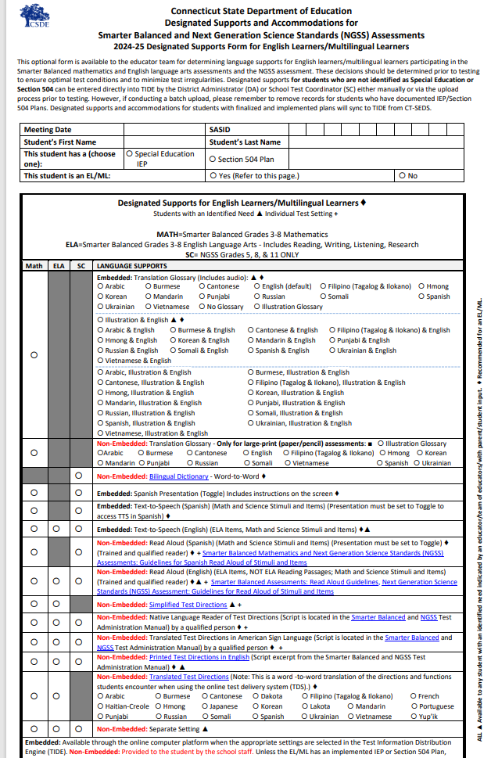
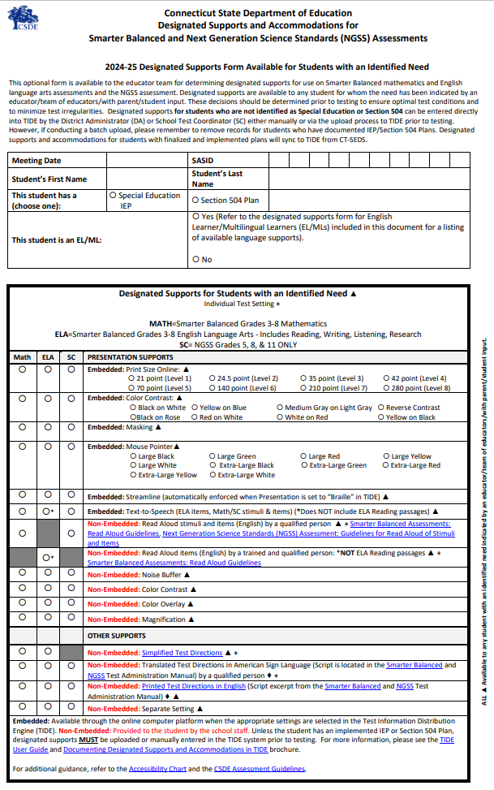
EL/ML Language Supports Smarter Balanced/NGSS
Designated Supports/Accommodations Form:
This resource includes three optional forms that can be used by educator teams to determine accessibility supports and accommodations for students when taking the Smarter Balanced and Next Generation Science Standards Assessments.
The Designated Supports/Accommodations Form (shown above) provides a listing of available embedded and non-embedded designated supports. The form shown on the left is specific for English Learners/Multilingual Learners, while the form shown to the right is available for any student based on educator team determination of a documented need. Another form, not shown here, is specific for students with an IEP/Section 504 Plan.
Notes:
Designated Supports/Accommodations Form; https://ct.portal.cambiumast.com/resource-item/en/designated-supports-accommodations-form
This optional form consists of three separate forms that educators and educator teams can use to review and determine accessibility supports for students on Smarter Balanced and NGSS.

Slide 64



Provide Students with Opportunities to Practice
Administer Practice Tests to allow students to become familiar with the online test platform, item format, universal tools, and practice with designated supports and accommodations (if applicable).
For optimal practice with certain accommodation that support language access and written communication, administer a Math Performance Task Practice Test.
Notes:
Practice Tests are available for Smarter Balanced Math and ELA in Grades 3-8 and high school. They are similar in format and structure to the actual test and include about 30 questions. Practice Tests area also available for NGSS and the Connecticut Alternate Assessment System.
https://ctpt.tds.cambiumast.com/student
Use the Practice Tests to model how to use specific features such as the Desmos Calculator (available for certain math items in Grades 6-8), text-to-speech, math translation glossary, and speech-to-text. Students need to know in advance how to activate these features if applicable.

Slide 65

Review Test Settings and Item Types with Students Using Practice Tests
Teachers can use the Practice Test to explicitly demonstrate to students how to navigate the test interface, use tools, and practice using them.
1. Tool Strip
2. Tool Strip is embedded within the passage/stimuli
3. Tool Strips is embedded within the item
Notes:
It is important that teachers review and ensure students have the applicable accessibility supports documented in TIDE prior to testing. During the Practice Test, show students how to use the tool strip (indicated by #1 on the slide) to access applicable tools available to students based on the test, grade, and supports available in TIDE. For illustration purposes, the tool strip on the slide includes icons for masking, line reader, print page and zoom.
Note: Tool strips will include universal tools available to ALL students as well as designated supports that are documented for a student in TIDE. For example, if a student is taking the grade 8 NGSS, the embedded Periodic Table icon will appear in the tool strip. Another example might include the “toggle” icon available to an EL/ML that has Spanish toggle (math) documented in TIDE. Finally, another example might include a student in grades 6-8 taking the math calculator section of Smarter Balanced. For these items, the Demos calculator would be included in the tool strip. Accommodation tools (such as text-to-speech and American Sign Language) can be activated by students using the tool strip, while other accessibility features can be turned on using the context menu (hamburger menu). It is important that teachers explicitly show and model these features to their students using a Practice Test.
Item #2 on the slide shows that the tool strips are included in the passage/stimuli section of the test screen (if applicable to the student). This will only appear for students who have specific designated supports and accommodations documented in TIDE. Per the illustration, the tools are greyed-out, which means that the student is not eligible for the tools (such as text-to-speech or American Sign Language). If the tools are not greyed out, they can be accessed by the student.
Item #3 on the slide shows tool strips available for the test item. As shown on the slide, text-to-speech, American Sign Language, and the context menu can be selected for the student per their TIDE test settings. This would be an important feature to show applicable students so that they can practice using their designated support/accommodation.

Slide 66


Practice with Item Type Tutorials
Teachers can review the Item Type Tutorials with students.
Notes:
Teachers can also review item types with students using the Item Type Tutorial: Item Type Tutorials; https://ct.portal.cambiumast.com/resource-item/en/item-type-tutorials.
Item type tutorials show users how to navigate the items and tools available while taking an online assessment. Descriptions of the item types are provided. Click an item type to view its tutorial. Please note these tutorials have closed captioning and no audio.
While testing, item type tutorials are accessible to students throughout the assessment. Students can review the tutorials here to become familiar with the different item types that may appear on an assessment.

Slide 67
CSDE Performance Office Contacts
Abe Krisst Bureau Chief Connecticut Education – Performance Office Phone: 860-713-6894; Mobile Phone: 860-690-0650 Email: Abe.Krisst@ct.gov
Deirdre Ducharme Education Consultant Performance Office- Special Populations Direct line: 860-713-6859 Email: Deirdre.Ducharme@ct.gov
Katie Seifert Associate Education Consultant Performance Office- Special Populations Direct line: 860-713-6722 Email: Katherine.Seifert@ct.gov
Kimberly Johnson Education Support Technician Performance Office Phone: 860-713-6885 Email: Kimberly.Johnson@ct.gov
Cristi Alberino Education Consultant Performance Office –Interim & Summative Assessments Email: Cristi.Alberino@ct.gov
Jeff Greig Education Consultant Performance Office – NGSS Interim & Summative Assessments Email: Jeff.Greig@ct.gov
Notes:
Here are CSDE contacts from the Performance Office and Bureau of Special Education. Please reach out with any questions.
We are here to support you and your teams.

Slide 68
Thank you!!!!
Thank you for attending and for all you do for your students.
Connecticut State Department of Education

