Slide 1
CT-SEDS Office Hours
January 21, 2025

Slide 2
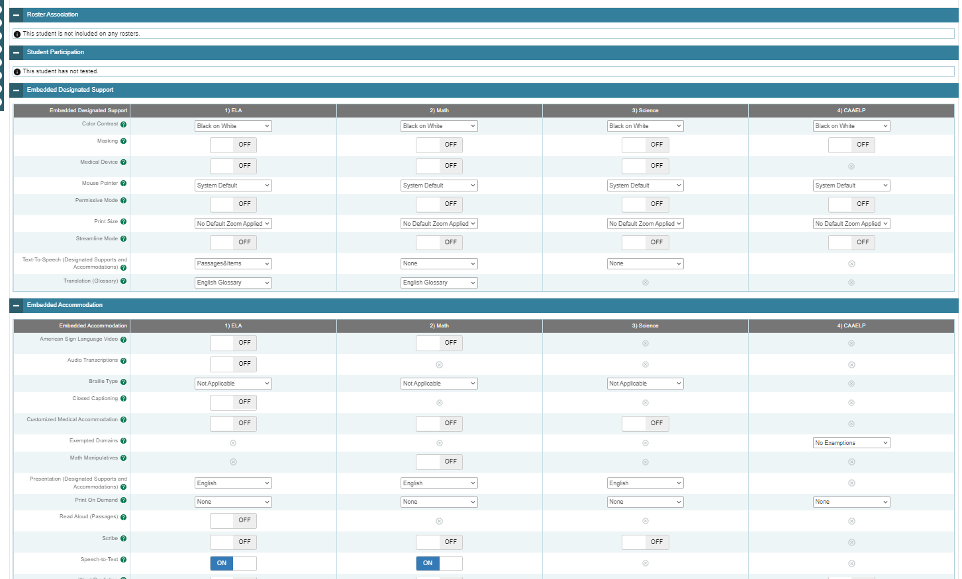
CT-SEDS/TIDE Data Sync
Designated supports and accommodations must be identified for the student’s current grade in finalized and implemented plans in CT-SEDS.
These must be implemented prior to your school/district's testing schedule. Delay testing student if plan is not finalized/implemented and accommodations are needed.
Designated supports and accommodations are updated daily in TIDE to reflect changes made to students’ plans in CT-SEDS within 48 hours of finalization and the implementation date. (Image shown on upper right.)
Notes:
Designated supports and accommodations must be identified for the student’s current grade in CT-SEDS and plans must be finalized and implemented.
Designated supports and accommodations are updated daily in TIDE to reflect changes made to students plans in CT-SEDS within 48 hours of finalization and the implementation date.
Look for the following:
Eligibility for any embedded or non-embedded accommodation requires the IDEA or Section 504 indicator (based on the PSIS registration fields) set to Yes. Without this indication, accommodations cannot sync to TIDE from CT-SEDS. Contact your PSIS Coordinator if this field is not set in TIDE.
The student’s EL/ML designation must be set to Yes in PSIS if the student is identified as EL/ML. Contact your PSIS Coordinator if this field is not set in TIDE.
Accommodations should NEVER be manually entered or batch uploaded in TIDE. The IEP/Section 504 is the source of truth! If corrections are necessary, contact the Case Manager and an amendment of edit/revise can be conducted.
Refer to the CT-SEDS to TIDE Designated Supports and Accommodations FAQ for more information.
CT-SEDS to TIDE Designated Supports/Accommodations Sync Frequently Asked Questions; https://ct.portal.cambiumast.com/resource-item/en/ct-seds-to-tide-designated-supports-and-accommodations-sync-faq
Cross-Checking Student TIDE Test Settings and CT-SEDS; https://ct.portal.cambiumast.com/resource-item/en/cross-checking-student-tide-test-settings-and-ct-seds

Slide 3


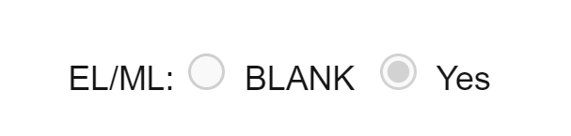

CT-SEDS/TIDE Data Sync
PSIS must accurately reflect the student's status to sync with TIDE. Without these indicators set in PSIS, accommodations will not sync between CT-SEDS and TIDE. (Images shown on upper right.)
  Contact your PSIS Coordinator if a student is newly identified in CT-SEDS under IDEA or Section 504 status, or if the student is dually identified with either categories and EL/ML.
The Alternate Assessment indicator in TIDE will activate for students who qualify for the Alternate Assessment per the completion of the Connecticut Alternate Assessment System Eligibility Form for the student's current grade in CT-SEDS. (Image shown on right.)
Do not schedule testing for a student that qualifies for an alternate assessment until their plan is finalized, implemented, and the Alternate Assessment indicator is set in TIDE. (The same applies to students whose plan is changing from alternate to standard.)
CT-SEDS/TIDE Resources
CT-SEDS to TIDE Designated Supports and Accommodations FAQ
Cross-Checking Student TIDE Test Settings and CT-SEDS
Notes:
Designated supports and accommodations must be identified for the student’s current grade in CT-SEDS and plans must be finalized and implemented.
The Alternate Assessment Indicator in TIDE will activate for students who qualify for the Connecticut Alternate Assessment System per the completion of the Connecticut Alternate Assessment System Eligibility Form (embedded within CT-SEDS). This form must be completed annually and align to the student’s current grade of enrollment. The plan must be finalized and implemented for the alternate assessment data to sync to TIDE.
Designated supports and accommodations are updated daily in TIDE to reflect changes made to students plans in CT-SEDS within 48 hours of finalization and the implementation date.
Refer to the CT-SEDS to TIDE Designated Supports/Accommodations Sync Frequently Asked Questions; https://ct.portal.cambiumast.com/resource-item/en/ct-seds-to-tide-designated-supports-and-accommodations-sync-faq for more information.
Cross-Checking Student TIDE Test Settings and CT-SEDS; https://ct.portal.cambiumast.com/resource-item/en/cross-checking-student-tide-test-settings-and-ct-seds

Slide 4
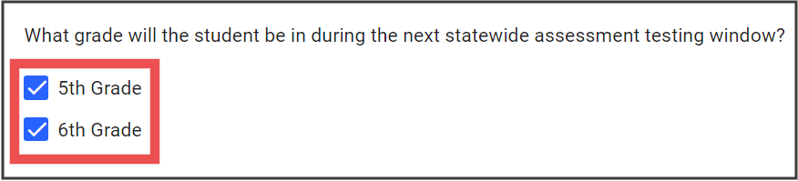
Reminders
Plan for all grades covered by the duration of the IEP/Section 504 Plan.
Complete the Connecticut Alternate Assessment System Eligibility Form to determine eligibility of the CAAELP in Grades K-12.
Notes:
When convening at the PPT or Section 504 meeting, be sure to select the student’s current grade of enrollment and any other grade covered by the duration of the plan.
Also, on the statewide accommodation page in CT-SEDS, indicate if the student is being considered for the Connecticut Alternate Assessment System (CTAA, CTAS, and/or CAAELP). If the student is not being considered for this assessment system, choose not and proceed with the selection of accommodations for applicable testing areas (Smarter Balanced Math, ELA, and NGSS- if applicable). If the team is considering the student for the Alternate Assessment System, select yes and complete the embedded eligibility form.

Slide 5
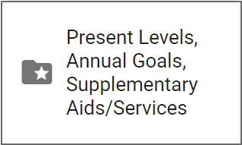
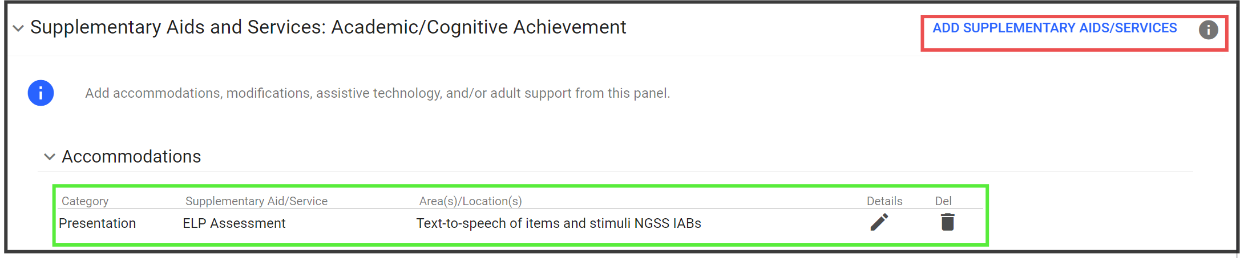
Off-Grade Level NGSS Interim Assessments and College Board
Document language supports (if applicable) and accommodations in the Supplemental Aids and Services Section for students in Grades K-2 and 9-10 and 12. This ensures that the correct accommodations are selected for LAS Links, PSAT/SAT, and the optional interim assessments.
Refer to the CT-SEDS to TIDE Designated Supports and Accommodations FAQ for more information.
Notes:
The NGSS summative assessments (grades 5, 8, and 11)
Use drop-down menu on the statewide testing tile in CT-SEDS to document designated supports/accommodations
NGSS interims are available in grade bands (Grades 3-4, 6-7, 9-10)
Teams should document designated supports/accommodations for off-grade interims in the districtwide testing portion of the District/Statewide Assessment tile and in the Supplemental Aids and Services portion of CT-SEDS.
These designated supports and accommodations should mirror those selected for Smarter Balanced ELA and math in the finalized and implemented plan for that current grade level.
Accommodations for PSAT/SAT (in off-grades 9-10, 12) should be documented in the Supplemental Aids and Services section.
Accommodations for CT SAT School Day (Grade 11) should be documented in CT SAT School Day accommodation menu. Please note that accommodation names will be updated soon to reflect the new embedded text-to-speech and flexibility in extended time.
The NGSS summative assessments, administered in Grades 5, 8, and 11, includes an accommodations drop-down menu on the statewide testing tile in CT-SEDS. If students are going to participate on NGSS interim assessments in off grades (Grades 3-4, 6-7, 9-10), teams should document accommodations in the districtwide testing portion of the District/Statewide Assessment tile and in the Supplemental Aids and Services portion of CT-SEDS. These designated supports and accommodations should mirror those selected for Smarter Balanced ELA and math in the finalized and implemented plan for that current grade level.
Although NGSS accommodations in off-grades will not sync to TIDE, teachers can refer to the documentation within the finalized and implemented plan to know which supports and accommodations certain students are eligible for when taking NGSS interims. Following the directions in the Entering Designated Supports and Accommodations Using the Test Administration Interface section, teachers can add applicable test supports using the Test Administration Interface prior to approving the interim assessment. Note: The Planning and Placement Team (PPT) or Section 504 Team will need to convene or amend plans if designated supports and accommodations were not planned for the current grade of enrollment. Refer to the Documenting Designated Supports and Accommodations in TIDE brochure for more information on students taking NGSS interims in off-grades.
Similarly, teams should select accommodations for the College Board Assessments in the Supplemental Aids and Services and district wide assessments page for students taking the PSAT/SAT in grades 8/9, 9-10, and 12. Accommodations for the CT SAT School Day (Grade 11) should be documented in the CT SAT School Day accommodation menu for statewide testing. As a reminder, accommodations from CT-SEDS do not sync to the College Board’s SSD System. Requests must be requested separately by the SSD Coordinator. Be sure to work with this point-person to ensure that the student is eligible for accommodations for the College Board and that the student account accurately represent those accommodations selected in the IEP.

Slide 6
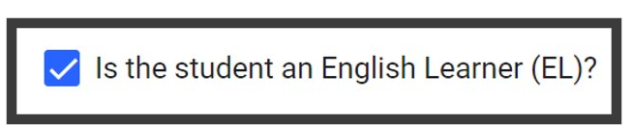
English Language Proficiency Assessments and CT-SEDS
Important items to check and verify:
Consult with English Language Assessment Coordinator for EL/ML Status.
Check CT-SEDS Student Information and Personal Information tiles to verify if CT-SEDS has the accurate EL/ML status. If student is EL/ML, refer to the blue check box in PSIS to confirm that the "Is the student an English Learner (EL)?“ is selected.
If this is not accurate reach out to your PSIS Coordinator.
Notes:
When planning for students who are dually identified teams need to be aware of and verify the following:
Consult with English Language Assessment Coordinator for EL/ML Status.
Check CT-SEDS Student Information and Personal Information tiles to verify if CT-SEDS has the accurate EL/ML status. If student is EL/ML, refer to the blue check box in PSIS to confirm that the "Is the student an English Learner (EL)?“ is selected.
If this is not accurate reach out to your PSIS Coordinator.

Slide 7
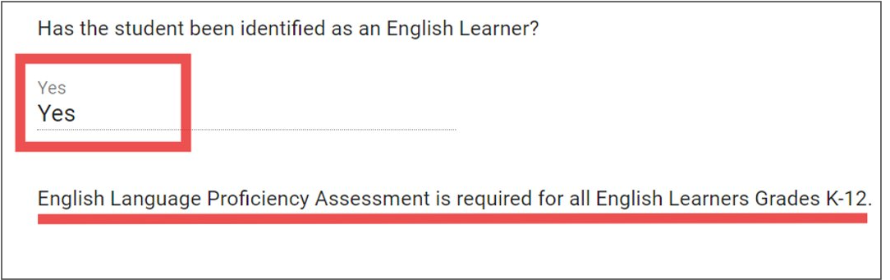
English Language Proficiency Assessments and CT-SEDS
Important items to check and verify:
That the student has been identified as an English Learner (refer to the District and State Testing tile under the Statewide Assessment Information tile).
Notes:
Additionally, on the District and State Testing tile under the Statewide Assessment Information tile, teams will want to ensure for student who are dually identified that "yes" is indicated for English Learner. If this is not indicated as "yes" then the ELP assessments will not populate for the grade levels selected.

Slide 8
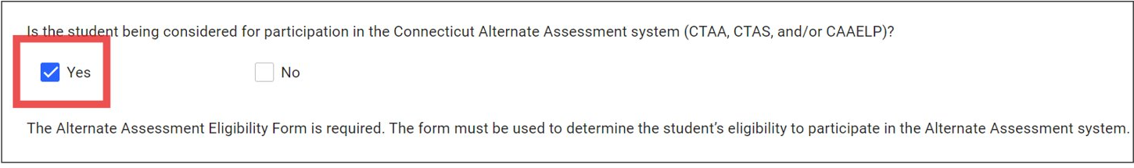
CAAELP (ALT-ELP)
If the PPT is considering any of the Connecticut Alternate Assessments, including CAAELP, they must indicate that the team is considering the Connecticut Alternate Assessments by clicking "Yes".
Once "Yes" is selected, the PPT will then complete the Connecticut Alternate Assessment System Eligibility Form that will populate in CT-SEDS.
Notes:
If the PPT is considering any of the Connecticut Alternate Assessments, including CAAELP, they must indicate that the team is considering the Connecticut Alternate Assessments by clicking "Yes". Teams can now complete the Connecticut Alternate Assessment System Eligibility Form that will populate in CT-SEDS to determine if the student is eligible for the Alternate Assessment System.

Slide 9
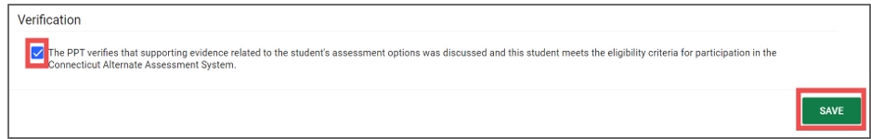
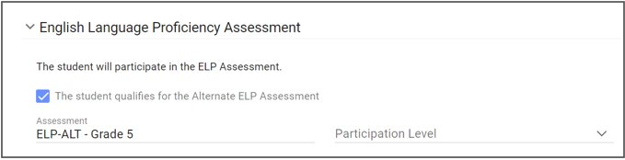
CAAELP (ALT-ELP)
After the Alternate Assessment System Eligibility Form is completed in its entirety with current numerical data, the team will verify this information and click "Save".
Next, the PPT will go to the grades that were selected for summative testing and verify that ELP-ALT is prepopulated for the student based on the completion of the Alternate Assessment System Eligibility Form.
Notes:
Once the Connecticut Alternate Assessment System Eligibility Form populates, the PPT will complete with current evaluation results and numerical scores the Connecticut Alternate Assessment System Eligibility Form that will populate in CT-SEDS. The PPT will then verify the student is eligible and will participate in the Connecticut Alternate Assessment System. Once this is verified and saved the PPT will then be able to select ELP-ALT. Only when both the Connecticut Alternate Assessment System Eligibility Form and the correct grade of enrollment of ELP-ALT are completed will the student be rostered for the CAAELP. Once the IEP is finalized and implemented CT-SEDS will sync with TIDE to turn the Alternate Assessment Indicator on in TIDE.
Please note, in Grades K-2, 9, 10, and 12 the CT-SEDS systems provides the option to select ELP-ALT. PPTs should not select this unless they have completed and verified eligibility through the Connecticut Alternate Assessment System Eligibility Form. If the Connecticut Alternate Assessment System Eligibility Form is not completed and only ELP-ALT is selected the will not roster for the CAAELP assessment in TIDE. For students in Grades 5-8 and 11, ELP-ALT will only populate if the Connecticut Alternate Assessment System Eligibility Form is completed and verified.

Slide 10
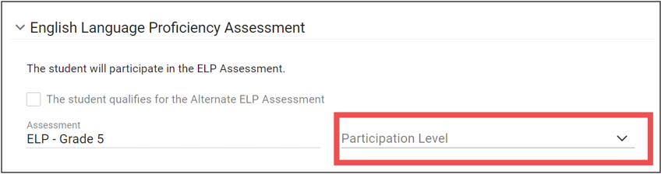
LAS Links (ELP)
For ELs/MLs who are not being considered for the Connecticut Alternate Assessment System, PPTs or Section 504 teams will complete the following for the English Language Proficiency Assessment:
Verify the assessment listed is accurate.
Select with or without accommodations in the "Participation Level".
Notes:
For ELs/MLs who are not being considered for the Connecticut Alternate Assessment System, PPTs or Section 504 teams will complete the following for the English Language Proficiency Assessment:
Verify the assessment listed is accurate.
Select with or without accommodations in the "Participation Level".

Slide 11
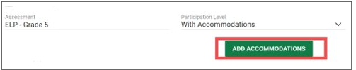
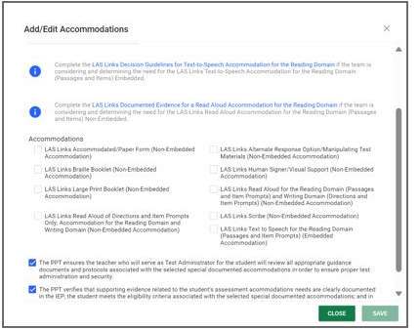
LAS Links (ELP)
If selecting with accommodations, ensure the accommodations selected align with accessibility supports used throughout instruction and on other assessments.
Add accommodations by clicking the "Add Accommodations" button.
Please note, if selecting LAS Links TTS or LAS Links Read Aloud of Passages, the corresponding hyperlinked decision guides should be completed for screening purposes. File and maintain locally.
Notes:
If selecting with accommodations, ensure the accommodations selected align with accessibility supports used throughout instruction and on other assessments.
Teams will add accommodations by clicking the "Add Accommodations" button.
Please note, if selecting LAS Links TTS or LAS Links Read Aloud of Passages, the corresponding hyperlinked decision guides should be completed for screening purposes. File and maintain locally.

Slide 12
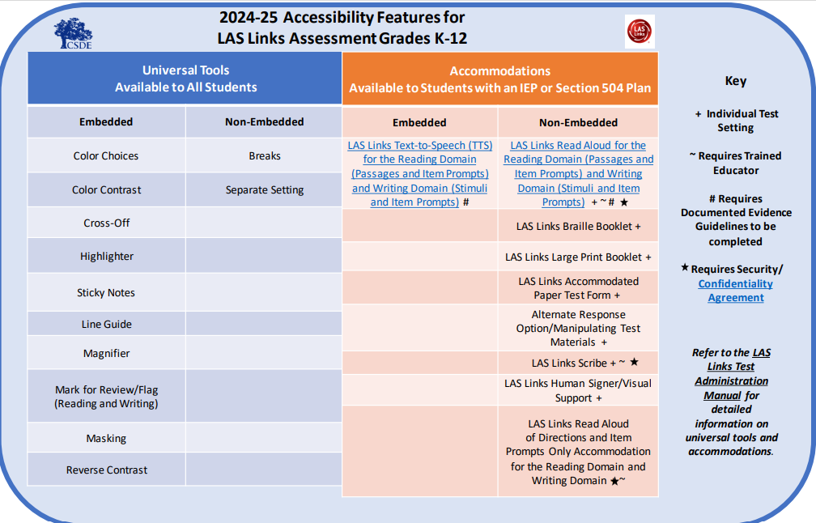
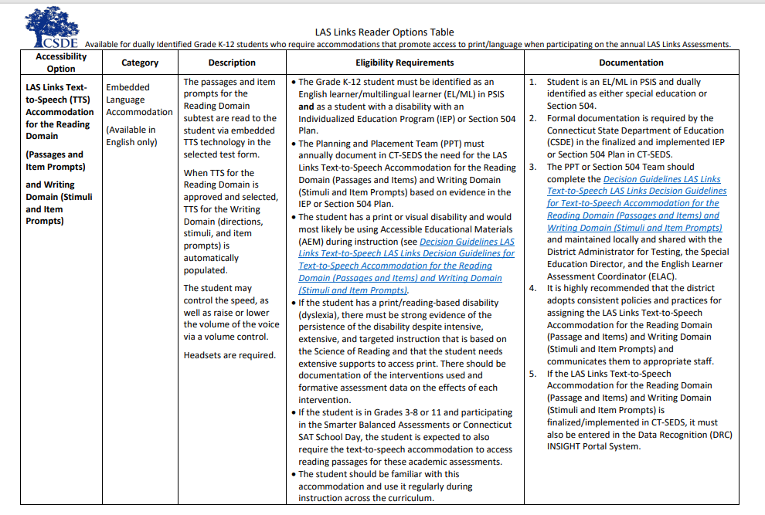
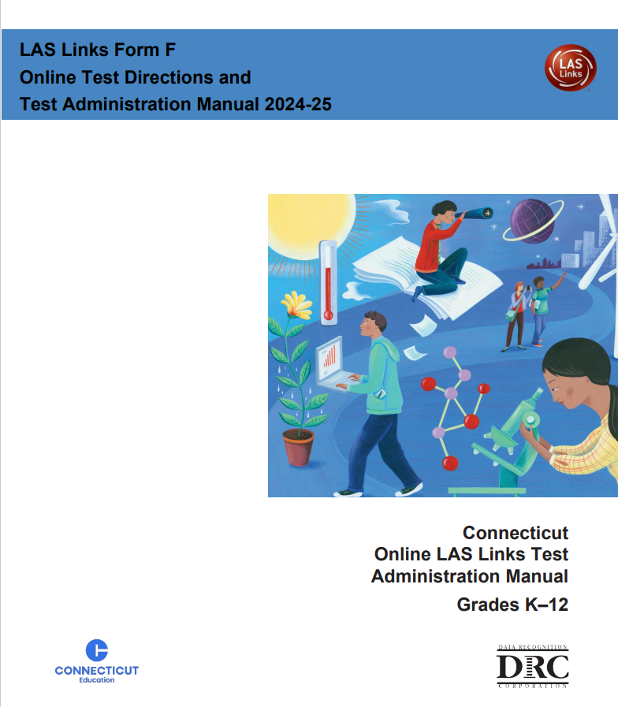
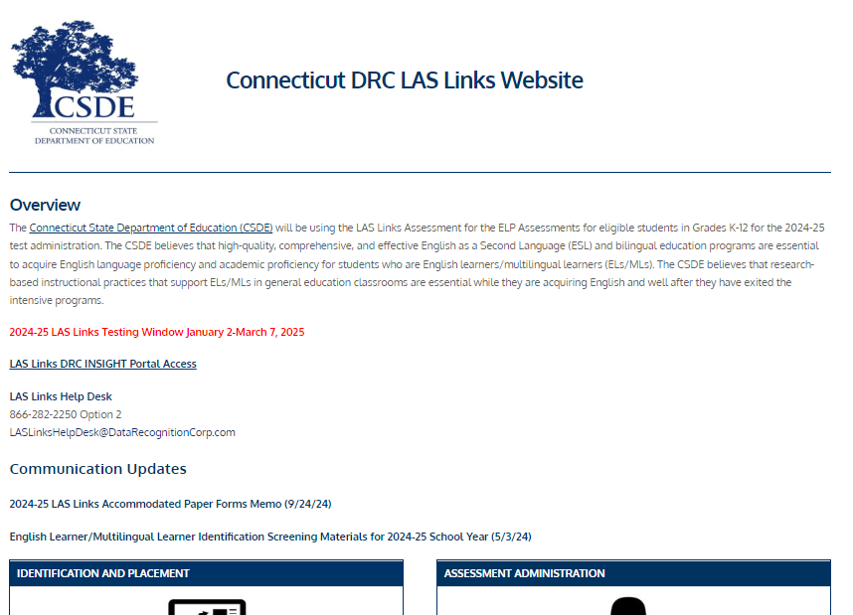
LAS Links (ELP) Accommodation Resources for PPT/Section 504 Teams
2024-25 Accessibility Features for LAS Links Assessment Grades K-12
LAS Links Reader Options Table
LAS Links Form F Online Test Directions and Test Administration Manual 2024-25 Appendix C
Connecticut DRC LAS Links Website
Notes:
Here are some resources to support teams with determining LAS Links Accommodations.

Slide 13
CT SAT School Day
PPT/Section 504 teams should communicate regularly with high school SSD Coordinators to ensure student eligibility and approval of accommodations in SSD (remember CT-SEDS and SSD do not sync).
  Only active/implemented IEP/Section 504 Plans = Eligibility for CT SAT School Day Accommodations in SSD.
  Accommodations in CT-SEDS should be requested in SSD; the nomenclature may vary but there should be a match between the two systems. Keep in mind that the CT SAT School Day is online, therefore accommodations requests should be relevant for online testing.
  Accommodations in SSD should be reviewed to ensure alignment with CT-SEDs. Refer to the CSDE Assessment Guidelines for more details.
Updated accommodations for spring 2025!
  Embedded text-to-speech (SY 2025) vs. text-to-speech (via operating system –in SY 2024)
  Students newly identified with embedded text-to-speech in SSD will not automatically be approved for time and one-half; this extended time will need to be requested separately in SSD.
  Flexibility with extended time (Up to time and one-half; up to double time)
SAT School Day Resources
CT SAT School Day webpage
CT SAT School Day Accessibility Chart
Supports for ELs/MLs
College Board brief on Text-to-Speech
Question and Answers for Parents & Guardians Regarding Extended-Time Accommodations provides information to parents about extended time and the new flexibility to end the test after standard time has elapsed.
Accommodations and Assistive Technology
Bluebook Practice Tests
Recorded webinars and trainings
Notes:
Connecticut SAT School Day--Related Resources; https://portal.ct.gov/sde/student-assessment/sat/connecticut-sat-school-day/related-resources
Questions and Answers for Parents & Guardians Regarding Extended-Time Accommodation: https://portal.ct.gov/-/media/sde/student-assessment/sat/parent_guardian-q-and-a-flexibility-for-extended-time.pdf?rev=2f6728bcabca469faeb7a1f71975bf00&hash=F41B5FB9EECE20C615AE2B0D84B7AE63
CT SAT School Day Accessibility Chart: https://portal.ct.gov/-/media/sde/student-assessment/sat/2024_25-ct-sat-school-day-accessibility-chart-fall-version.pdf?rev=61abb70fb53f435bbfad65eea3d32460&hash=CBDFA77A9EA595794CEB46B27F8BEA52
Supports for ELs/MLs: Supports for English Learners | In-School Testing - SAT Suite of Assessments; https://support.satsuite.collegeboard.org/in-school-testing/accommodations/supports-english-learners
Additional Information
For more information about screen readers (non-embedded), see Accommodations and Assistive Technology. For general information about accommodations, see Accommodations on College Board Exams or speak with your school's SSD coordinator, or contact College Board Services for Students with Disabilities at 844-255-7728 (international: +1-212-713-8333) or complete the College Board Accommodations Inquiry Form.
Accommodations and Assistive Technology - Bluebook | College Board; https://bluebook.collegeboard.org/students/accommodations-assistive-technology
Practice – Bluebook for Students | College Board; https://bluebook.collegeboard.org/students/practice

Slide 14
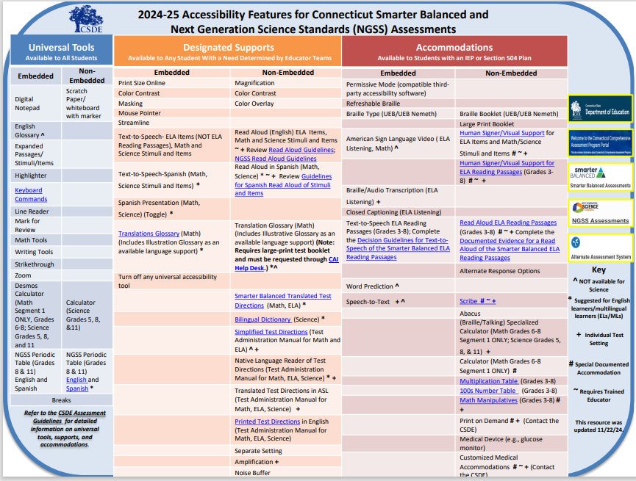

Accessibility Features for Smarter Balanced and Next Generation Science Standards
Accessibility Resources
CSDE Assessment Guidelines
Accessibility Considerations
CCSSO Questions to Ask When Selecting Accessibility Supports (various tools that elicit discussion with educator teams, student, parent/guardian, and classroom teacher)
EL/ML Designated Supports brochure
Resources for PPT/Section 504 Teams webpage
Notes:
The best resource to begin with is the Assessment Guidelines (CSDE Assessment Guidelines; https://ct.portal.cambiumast.com/resource-item/en/csde-assessment-guidelines) and Accessibility Chart (shown on the next slide).
The Accessibility Chart, shown here, was developed specifically for the Smarter Balanced and the Next Generation Science Standards Assessments. It provides 3 tiers of support ranging from Universal Tools (shown to the far left in blue), designated supports (shown in orange and located in the center of the chart), and accommodations shown in red to the far right. You'll notice that within each section, embedded and non embedded tools are listed along with hyperlinks to additional information if applicable. Please note the user Key, located on the far right, that includes symbols noting tools that are not available on science versions, those accommodations that are non-standard and require additional teacher training, along with other tools that might be appropriate for ELs/MLs.
While the Accessibility Chart is a great reference, details about each of these accessibility features are documented in the CSDE Assessment Guidelines.
Accessibility Charts, also available for the LAS Links Assessment and the Connecticut SAT School Day, are posted to the CSDE web page.
Additional Information:
Accessibility Chart for Smarter Balanced/NGSS: Accessibility Chart; https://ct.portal.cambiumast.com/resource-item/en/accessibility-chart
Other Accessibility Charts are available for the CT SAT School Day and LAS Links –available on the CSDE webpage. Connecticut Sensible Assessment System--Summative Assessment - End-of-Year; https://portal.ct.gov/sde/student-assessment/main-assessment/student-assessment/summative-assessment---end-of-year
CT SAT School Day: PowerPoint Presentation; https://portal.ct.gov/-/media/sde/student-assessment/sat/2024_25-ct-sat-school-day-accessibility-chart-fall-version.pdf?rev=61abb70fb53f435bbfad65eea3d32460&hash=CBDFA77A9EA595794CEB46B27F8BEA52
LAS Links: las-links-accessibility-chart-final.pdf; https://portal.ct.gov/-/media/sde/student-assessment/special-populations/las-links-accessibility-chart-final.pdf?rev=a9cb927b69fd4717911a7271fd568dc3&hash=A16B453E1EA2739002CCAD62A422E6E1

Slide 15
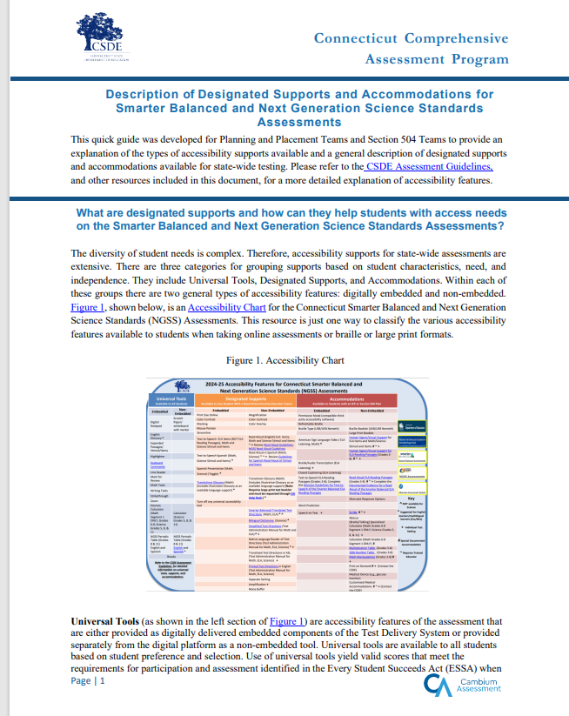
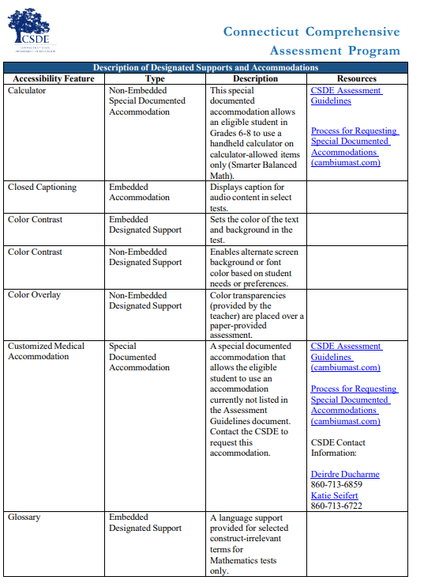
2024-25 Accessibility Features for Connecticut Smarter Balanced and
Next Generation Science Standards (NGSS) Assessments
Key
^ NOT available for Science
* Suggested for English learners/multilingual learners (ELs/MLs)
+ Individual Test Setting
# Special Documented Accommodation
~ Requires Trained Educator
This resource was updated 11/22/24.
Refer to the CSDE Assessment Guidelines for detailed information on universal tools, supports, and accommodations.
Notes:
Description of Designated Supports and Accommodations for Smarter Balanced and Next Generation Science Standards Assessments; https://ct.portal.cambiumast.com/resource-item/en/description-of-designated-supports-and-accommodations-for-smarter-balanced-and-ngss-assessments

Slide 16
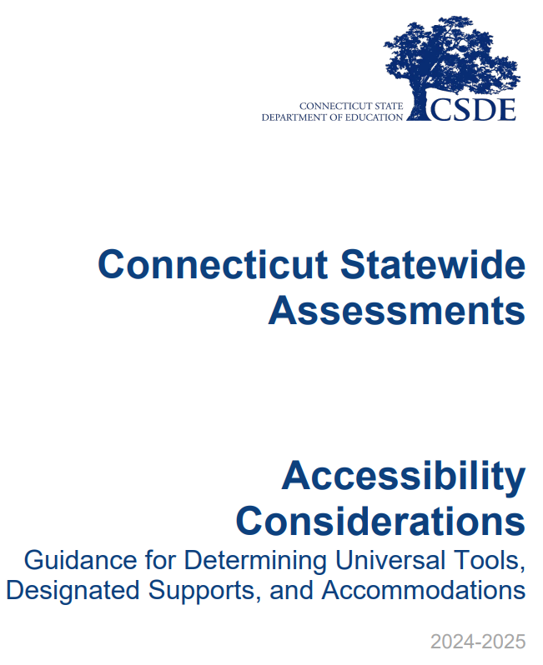
Considerations for Educator Teams Including PPT and Section 504 Teams
What are the specific barriers that the individual has that require universal tools, designated supports, language supports, or accommodations within the learning environment?
What considerations have been reviewed for student accessibility and independence along the continuum of services for access?
What are the specific universal tools, designated supports, language supports, or accommodations being used within the learning environment with success that are providing the student with access?
Has the student utilized the universal tools, designated supports, language supports, or accommodations within the educational setting? If yes:
  What was the level of student usage?
  Has it shown that it increases accessibility?
  Has it shown that it increases independence?
CT-Assessments-Accessibility-Considerations.pdf
Notes:
When considering accessibility supports, educators, including those on the PPT and Section 504 Teams should consider the following:
What are the student’s strengths that can be built upon to increase access?
What are the barriers the student is currently facing in accessing the learning environment?
What tools are they currently using with success (automaticity, accuracy, independence, positive reporting by student)?
Has the team reviewed accessibility through the continuum of supports? (Low to High)?
The CT-Assessments-Accessibility-Considerations.pdf resource provides more information about implementing a clear and consistent process for determining accessibility features. https://ct.portal.cambiumast.com/content/contentresources/en/CT-Assessments-Accessibility-Considerations.pdf.

Slide 17
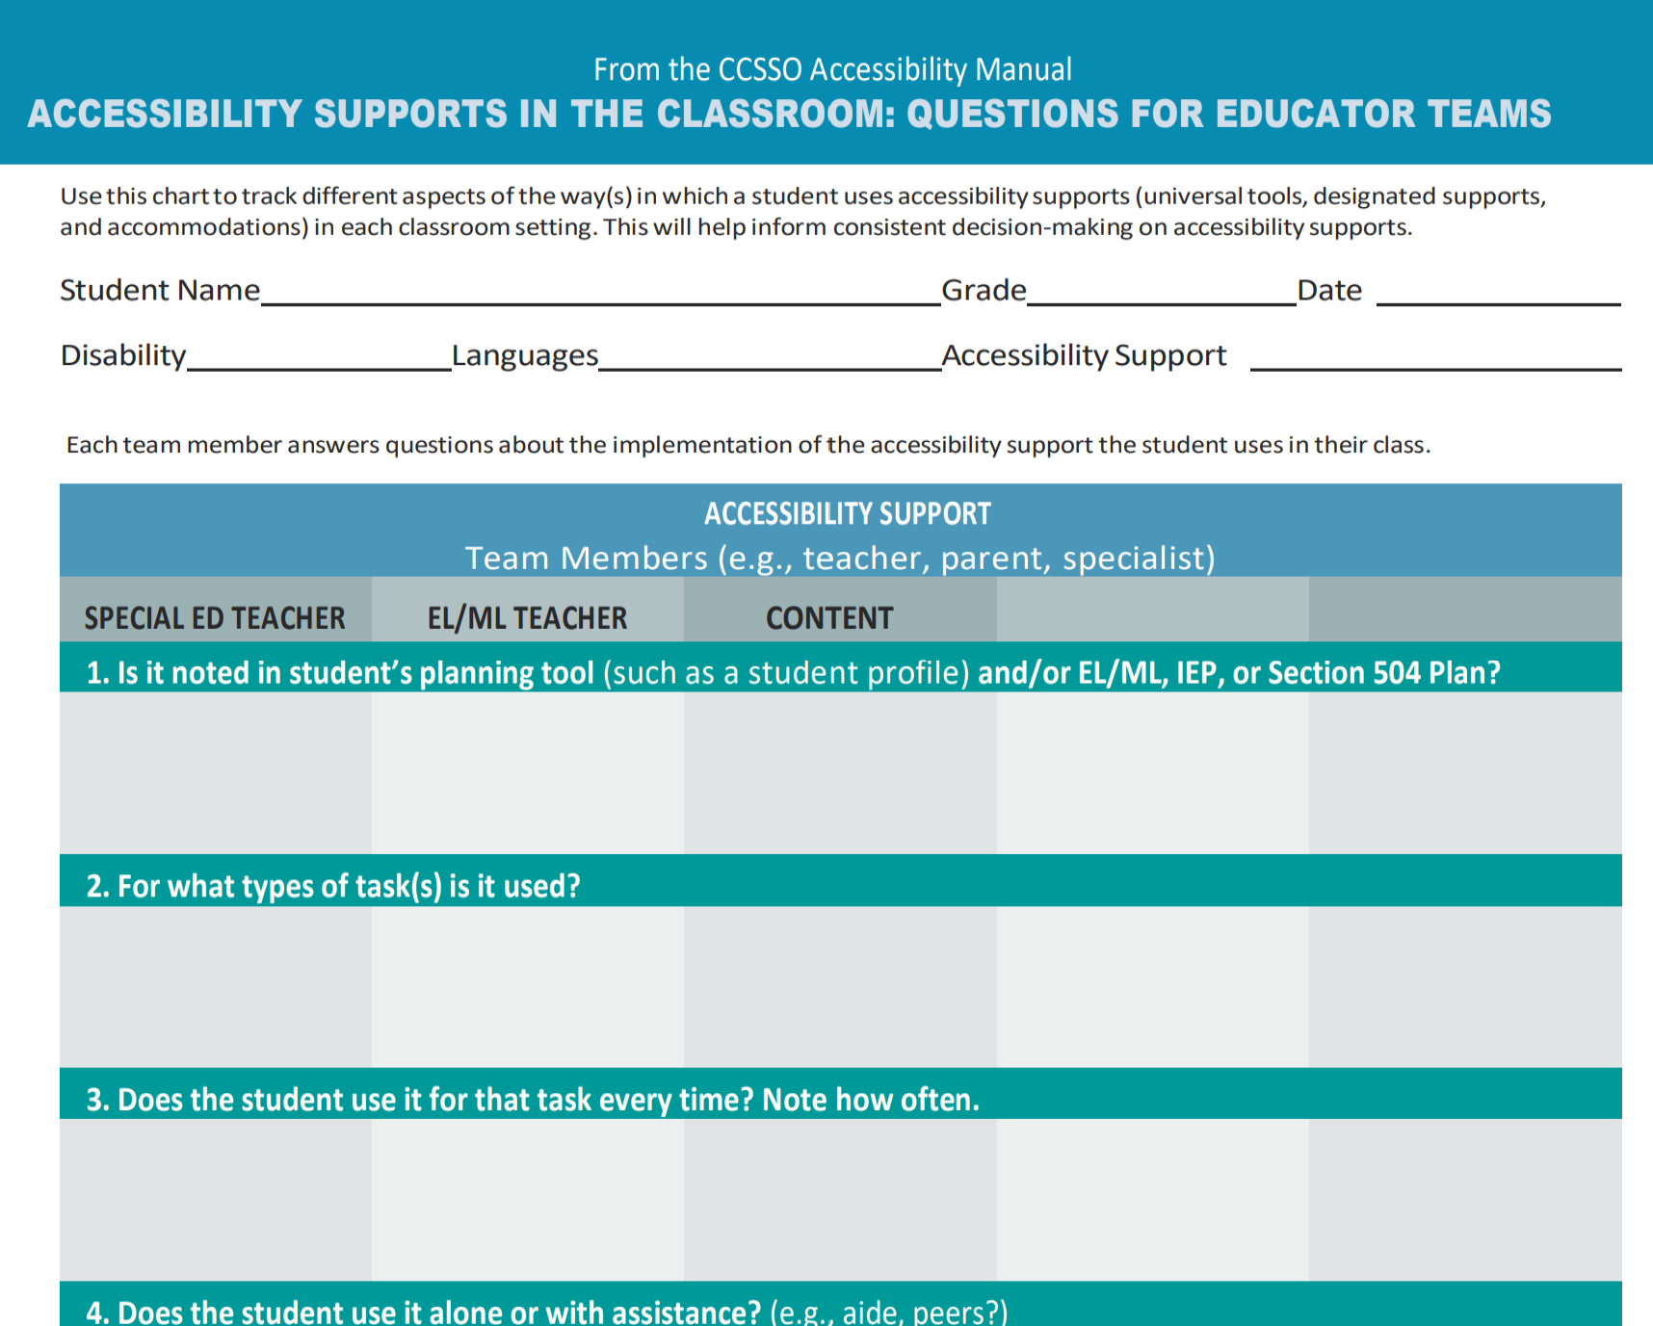
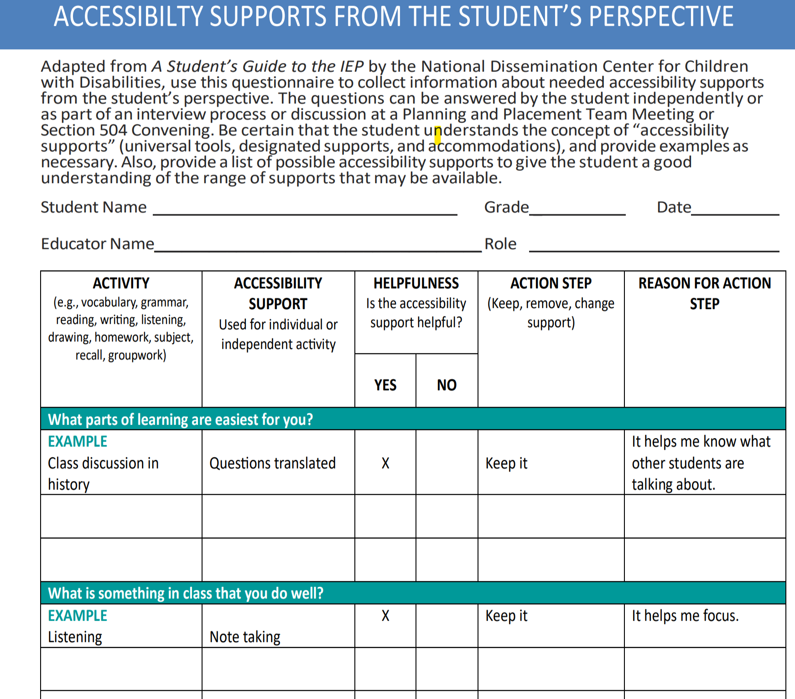
Considerations for Educator Teams Including PPT and Section 504 Teams
Trial the designated support, language supports (for EL/ML), and/or accommodations within the practice test in TIDE. What was the student’s level of:
  Automaticity
  Independence
  Usage
  Talk to the student about their perception of how well the universal tools, designated supports, language supports, or accommodations worked.
  CCSSO Questions to Ask When Selecting Accessibility Supports (various tools that elicit discussion with educator teams, student, parent/guardian, and classroom teacher)
Notes:
Trialing supports is key in determining if the accessibility tool is the right fit for the student in effort to reduce barriers. Educators can use practice tests and interim assessments to ensure the student is able to and wants to use the support. Take time to talk with the student to discuss if the student sees benefit to the tool, and uses it with accuracy, automaticity, and with independence. By doing this you will gain information to ensure appropriate accessibility supports.
Has the student practiced with these tools before?
Has the student used these tools within the instructional setting?
How does the student report they feel about the tool, does it help or is it confusing to use?
Is there evidence to support that this tool reduces the barrier?
How well do students who receive universal tools, designated supports, language supports, and accommodations perform on assessments (e.g., Smarter Balanced, NGSS, summative and interim)? If students are not meeting the expected level of performance, is it due to:
Students not having access to the necessary instruction?
Students not receiving the appropriate universal tools, designated supports, language supports or accommodations?
Students using universal tools, designated supports, or accommodations that were not effective?
Students unfamiliar with how to use and/or access the universal tools, designated supports, or accommodations?
What combinations of universal tools, designated supports, language supports, and accommodations seem to be effective? What data do you have to support this?
Created by the Counsel of Chief State School Officers, these resources can be used by educators to help guide their identification and provision of accessibility supports to meet the individual needs of learners.
The first tool (shown to the left), the Accessibility Supports in the Classroom: Questions for Educator Teams, helps educator teams collaborate and collect feedback from all vested parties, including the student if applicable. Use this chart to track different aspects of the way(s) in which a student uses accessibility supports (universal tools, designated supports, and accommodations) in each classroom setting. This will help inform consistent decision-making on accessibility supports.
Each team member answers questions about the implementation of the accessibility support the student uses in their class.
Is it noted in student’s planning tool (such as a student profile) and/or EL/ML, IEP, or Section 504 Plan?
For what types of task(s) is it used?
Does the student use it for that task every time? Note how often.
Does the student use it alone or with assistance? (e.g., aide, peers?)
If more than one support is available, how do these supports interact? (e.g., does one accessibility support seem more effective when used with another on a task?)
If the accessibility support is presented differently on the test (e.g., DESMOS calculator), how can you give the student opportunities to practice using it?
The second tool displayed on the right is the Accessibility Supports From the Student’s Perspective. This tools is so important to gain a student’s perspective on which tools and accessibility features they feel are helpful to them. This not only creates voice and choice for the student but empowers them in their learning. The questions can be answered by the student independently or as part of an interview process. Be certain that the student understands the concept of “accessibility supports” (universal tools, designated supports, and accommodations), and provide examples as necessary. Teams may want to do this as part of a trial or after accessing tools on the practice test. Educators may also want to provide a list of possible accessibility supports to provide the student with an understanding of the range of supports that may be available. If trialing the support, keep in mind that the teacher may need to explicitly show the student how and when to use it. After use and practice, determine if this is the best fit for this student.
This resource is located on the CSDE webpage: https://portal.ct.gov/-/media/sde/student-assessment/special-populations/ccsso_educator-team-accessibility-supports-implementation-and-followup-questionnaires_master.pdf?rev=9c69a7534709410c9b40ed411e8090c4&hash=84026AD06AF4C13E5994BDA2984940A3.

Slide 18
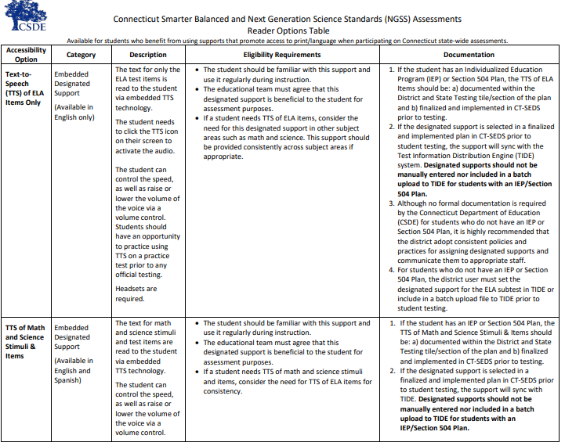
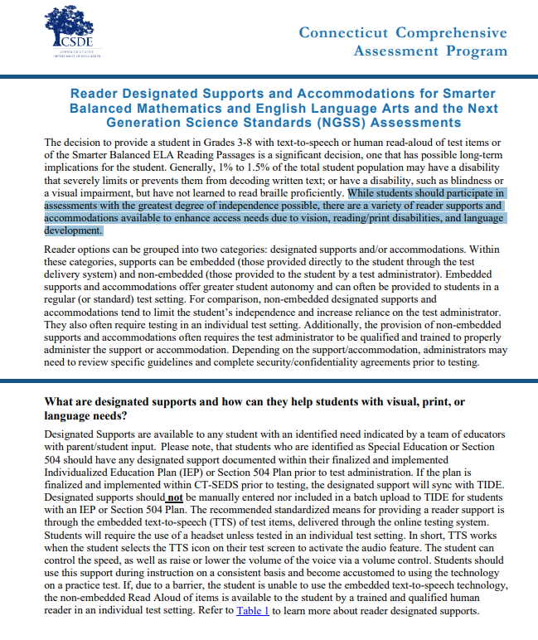
Reader Options for
Smarter Balanced & NGSS
Connecticut Smarter Balanced and NGSS Assessments Reader Options Table
This resource provides a quick glance at reader supports by accessibility type and assessment. PPTs and Section 504 Teams should review this resource to determine if and which designated supports and accommodations are most appropriate for the student.
Reader Designated Supports and Accommodations for Smarter Balanced and NGSS
This resource provides an explanation of reader designated supports and accommodations with corresponding screeners and guidelines to support eligibility and use on statewide assessments.
Notes:
Planning and Placement Teams and Section 504 Teams should be familiar with these resources to understand which supports are available to certain students based on identified need. There are specific policies ad procedures that must be followed to ensure accurate measurement of student learning and accurate reporting of student performance.
The Connecticut Smarter Balanced and NGSS Assessments Reader Options Table​ provides an in-depth look at the different reader options available for SB/NGSS. It defines the purpose, test requirements, and necessary documentation (if applicable) for various embedded and non-embedded Smarter Balanced and NGSS reader supports and accommodations. This tool can help educators determine the most appropriate accessibility features that support access to print/text.
Connecticut Smarter Balanced and NGSS Assessments Reader Options Table; https://ct.portal.cambiumast.com/resource-item/en/connecticut-smarter-balanced-and-ngss-assessments-reader-options-table
Reader Designated Supports and Accommodations for Smarter Balanced Mathematics and English Language Arts and the Next Generation Science Standards (NGSS) Assessments; https://ct.portal.cambiumast.com/resource-item/en/reader-designated-supports-and-accommodations-for-sb-and-the-ngss

Slide 19
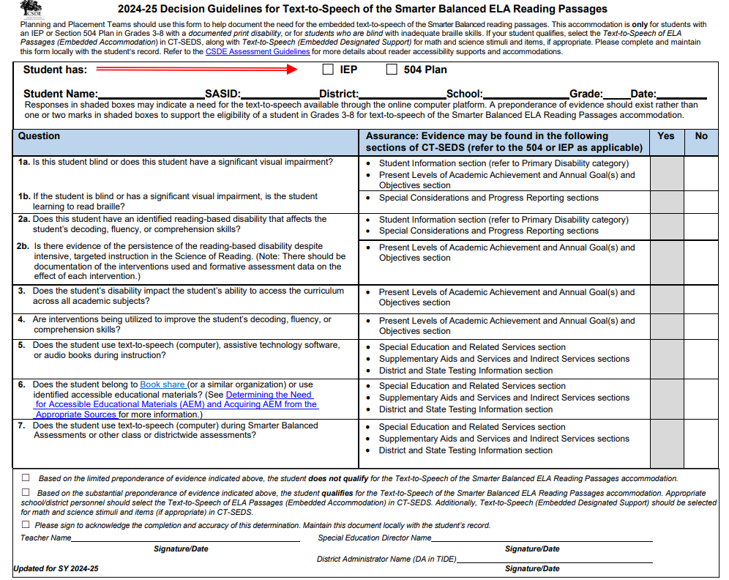
Decision Guidelines for Text-to-Speech of the Smarter Balanced ELA Reading Passages
Decision Guidelines for Text-to-Speech of the Smarter Balanced ELA Reading Passages
Used by PPTs/Section 504 Teams to establish the extent of need of this reader accommodation for the text-to-speech (TTS) of ELA Reading Passages.
This accommodation is intended for students:
  with a documented print disability
  with significant visual disabilities
  who are blind with inadequate braille skills
Complete this and maintain this form locally with the student’s record.
Notes:
The questions provided in this document can assist IEP/Section 504 decision-making teams in determining whether it is appropriate to indicate that the student should be provided the reading passages for an ELA reading assessment via a text-to-speech accommodation.
PPTs should use this form to help document the need for the embedded text-to-speech of the Smarter Balanced reading passages. This accommodation is only for students with an IEP or Section 504 Plan in Grades 3-8 with a documented print disability, or for students who are blind with inadequate braille skills. Additionally, if the student has a print/reading-based disability (dyslexia), there must be strong evidence of the persistence of the disability despite intensive, extensive, and targeted instruction that is based on the Science of Reading and that the student needs extensive supports to access print. There should be documentation of the interventions used and formative assessment data on the effects of each intervention. The student should be familiar with this accommodation and use it regularly during instruction, and typically, the student would most likely be using alternate educational materials (AEM) during instruction.
If your student qualifies, select the Text-to-Speech of ELA Passages (Embedded Accommodation) in CT-SEDS, along with Text-to-Speech (Embedded Designated Support) for math and science stimuli and items, if appropriate. Please complete and maintain this form locally with the student’s record.
This accommodation is intended to be used for students with a documented print disability, or for students who are blind with inadequate braille skills. Please complete and maintain this form locally with the student’s record.
Decision Guidelines for Text-to-Speech of the Smarter Balanced ELA Reading Passages; https://ct.portal.cambiumast.com/resource-item/en/decision-guidelines-for-text-to-speech-of-the-smarter-balanced-ela-reading-passages

Slide 20
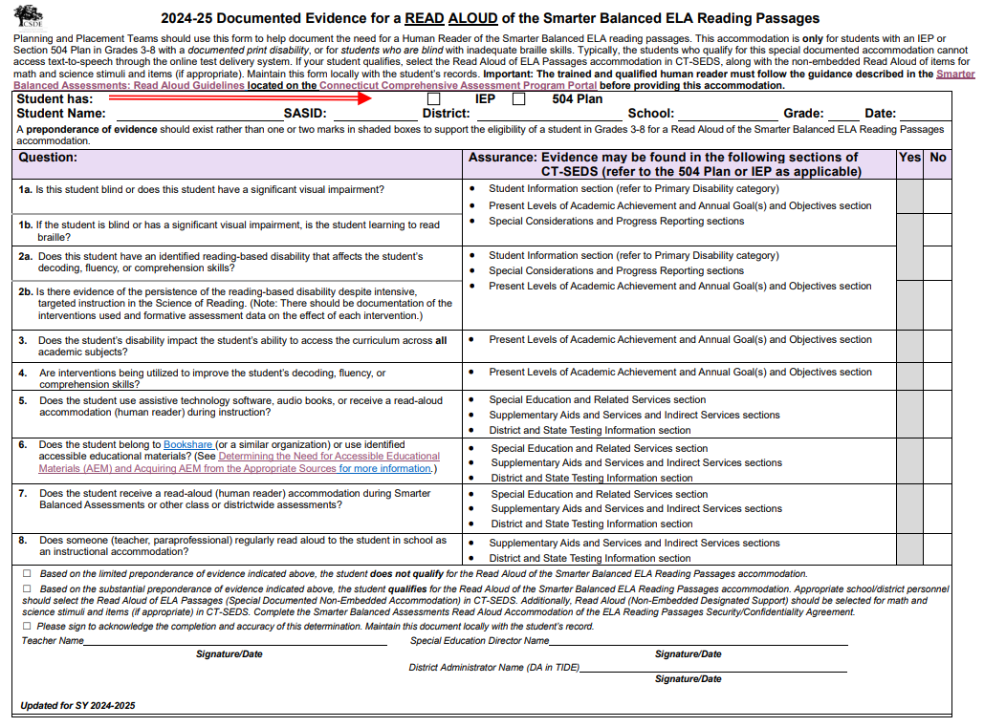
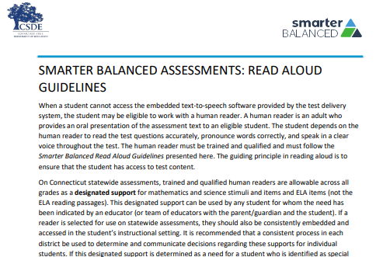
Documented Evidence for Read Aloud of the Smarter Balanced ELA Reading Passages
Non-Embedded Read Aloud of ELA Reading Passages
Teams should complete the Documented Evidence for a Read Aloud of the Smarter Balanced ELA Reading Passages as a screener for eligibility and maintain locally with the student’s record.
The qualified individual acting as the reader should review the Smarter Balanced Assessments Read Aloud Guidelines and sign the Test Security/Confidentiality Agreement Form (Appendix B of document). The signed security/attestation form should be maintained locally.
Notes:
The Non-Embedded Special Documented Read Aloud of ELA Reading Passages (Human Reader) screener should be used when a student cannot access the embedded text-to-speech software provided by the test delivery system, the student may be eligible to work with a human reader. ​
​
Guidance for Read Aloud Accommodation: ​
Human readers are allowable for ELA reading passages, in addition to items, as a special documented accommodation for eligible students in Grades 3-8 who have an implemented IEP or 504 Plan in CT-SEDS. A human reader is an adult who provides an oral presentation of the assessment text to an eligible student. The student depends on the human reader to read the test questions accurately, pronounce words correctly, and speak in a clear voice throughout the test. The human reader must be trained and qualified and must follow the Smarter Balanced Read Aloud Guidelines presented here. The guiding principle in reading aloud is to ensure that the student has access to test content. ​
​
If a reader is selected for use on statewide assessments, they should also be consistently embedded and accessed in the student’s instructional setting. It is recommended that a consistent process in each district be used to determine and communicate decisions regarding these supports for individual students.​
​
If the accommodation or special documented accommodation is selected in an implemented IEP or Section 504 Plan in CT-SEDS prior to student testing, the accommodation will import to the TIDE system. Please note students should not have both as they are conflicting accommodations. ​
​
Before serving as a human reader, the teacher/proctor must review the Read Aloud Guidelines and sign the Test Security/Confidentiality Agreement Form (Appendix B of the Read Aloud Guidelines). Once signed, the form should be returned to the District Administrator for signature and filed with the student record.
Documented Evidence for a Read Aloud of the Smarter Balanced ELA Reading Passages; https://ct.portal.cambiumast.com/resource-item/en/documented-evidence-for-a-read-aloud-of-the-smarter-balanced-ela-reading-passages
Smarter Balanced Assessments: Read Aloud Guidelines; https://ct.portal.cambiumast.com/resource-item/en/smarter-balanced-assessments-read-aloud-guidelines

Slide 21
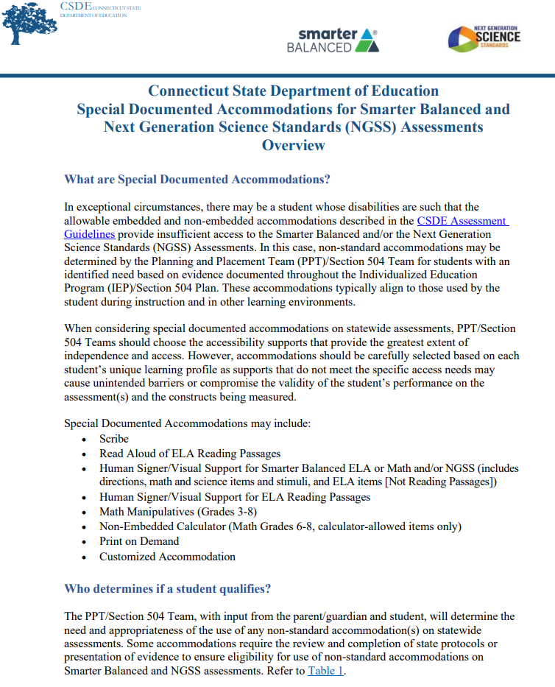
What are Special Documented Accommodations?
Special Documented Accommodations are:
non-standard accommodations (e.g., scribe, read aloud of ELA Reading Passages, Human Signer, Math Manipulatives).
align to those used by the student during instruction and in other learning environments.
must be administered in an individual test setting.
Teams should review the Special Documented Accommodations for Smarter Balanced and Next Generation Science Standards (NGSS) Assessments Overview (shown on the right) for a listing of corresponding guidelines and protocols.
Notes:
In exceptional circumstances, there may be a student whose disabilities are such that the allowable embedded and non-embedded accommodations described in the CSDE Assessment Guidelines (https://ct.portal.cambiumast.com/resource-item/en/csde-assessment-guidelines) provide insufficient access to the Smarter Balanced and/or NGSS Assessments.
In this case, non-standard accommodations may be determined by the Planning and Placement Team (PPT)/Section 504 Team for students with an identified need based on evidence documented throughout the IEP/Section 504 Plan. These accommodations typically align to those used by the student during instruction and in other learning environments.
Special Documented Accommodations; https://ct.portal.cambiumast.com/resource-item/en/process-for-requesting-special-documented-accommodations
CSDE Assessment Guidelines; https://ct.portal.cambiumast.com/resource-item/en/csde-assessment-guidelines

Slide 22

The Connecticut Alternate Assessment System (CTAA, CTAS, & CAAELP)
Notes:
We are now going to briefly discuss the purpose for alternate assessments.

Slide 23
What are the characteristics of a student with the most significant cognitive disabilities?
Resources
Frequently Asked Questions and Answers about the Connecticut Alternate Assessment System
Annotated Connecticut Alternate Assessment System Eligibility Form
Frequently asked Questions and Answers About the Connecticut Alternate Assessment System Eligibility Form
Connecticut Alternate Assessment System Participation Guidance for Planning and Placement Teams Flowchart
Comparison of Connecticut Alternate Assessments
Ensuring Appropriate Student Identification and Eligibility Criteria for Alternate Assessments [PDF]
PDFs of Connecticut Alternate Assessment Training
For more information, visit the CSDE Website and the Connecticut Comprehensive Assessment Program Portal
The Connecticut Alternate Assessment System is designed for a very small number of children with the most significant cognitive disabilities. Characteristics include:
The identification of one or more of the existing categories of disability under the IDEA
Significant Intellectual Impairment
Functional adaptive skills are well below age level expectations
Need for intensive instruction and significant supports
Notes:
The following characteristics describe a student with the most significant cognitive disabilities. The Planning and Placement Team will need to review and document certain criteria using the Connecticut Alternate Assessment Eligibility Form, which is embedded within CT-SEDS. To qualify the student must:
be identified with one or more of the existing categories of disability under the IDEA
have a significant Intellectual Impairment
have functional adaptive skills that are well below age level expectations
require intensive instruction and significant supports
Additional Resources:
Frequently Asked Questions and Answers about the Connecticut Alternate Assessment System; https://ct.portal.cambiumast.com/resource-item/en/frequently-asked-questions-and-answers-about-the-connecticut-alternate-assessment-system
FAQ About the Connecticut Alternate Assessment System Eligibility Form; https://ct.portal.cambiumast.com/resource-item/en/faq-about-the-connecticut-alternate-assessment-system-eligibility-form
Connecticut Alternate Assessment Eligibility Form; https://ct.portal.cambiumast.com/resource-item/en/connecticut-alternate-assessment-eligibility-form
Included on this slide are resources to help support your understanding of the purpose and eligibility for the Connecticut Alternate Assessment System.
Links to Resources:
Frequently Asked Questions and Answers about the Connecticut Alternate Assessment System; https://ct.portal.cambiumast.com/resource-item/en/frequently-asked-questions-and-answers-about-the-connecticut-alternate-assessment-system
Annotated Connecticut Alternate Assessment Eligibility Form; https://ct.portal.cambiumast.com/resource-item/en/annotated-connecticut-alternate-assessment-eligibility-form
FAQ About the Connecticut Alternate Assessment System Eligibility Form; https://ct.portal.cambiumast.com/resource-item/en/faq-about-the-connecticut-alternate-assessment-system-eligibility-form
Connecticut Alternate Assessment System Participation Guidance for Planning and Placement Teams; https://ct.portal.cambiumast.com/resource-item/en/connecticut-alternate-assessment-system-participation-guidance-for-planning-and-placement-teams
Comparison of Connecticut Alternate Assessments; https://ct.portal.cambiumast.com/resource-item/en/comparison-of-connecticut-alternate-assessments
Connecticut State Department of Education homepage: Connecticut State Department of Education; https://portal.ct.gov/sde
Cambium Home Page; https://ct.portal.cambiumast.com/

Slide 24
Disability Categories
Students with an intellectual disability, multiple disabilities, autism, or traumatic brain injury are more likely to be eligible for an alternate assessment.
Students with a primary disability category of SLD, SLD/Dyslexia, and Emotional Disability may not have evidence supporting a significant cognitive disability that is pervasive in nature. ​
  Sections 34 CFR 300.309 (3)(a)(1) and (2) and 300.8(c)(4)(i) of the IDEA requires that intellectual factors/impairments be ruled out in order to qualify for special education services under the categories of a specific learning disability or emotional disability. ​
  These students should participate on standard assessments with the provision of designated supports, accommodations, and assistive technology (if applicable).
Notes:
While a student may not be determined to have a significant cognitive disability based solely on an IDEA classification, individuals with an intellectual disability, multiple disabilities, autism, or traumatic brain injury are more likely to be eligible for an alternate assessment. Students with a primary disability category of SLD, SLD/Dyslexia, and Emotional Disability may not have evidence supporting a significant cognitive disability that is pervasive in nature. ​
Sections 34 CFR 300.309 (3)(a)(1) and (2) and 300.8(c)(4)(i) of the IDEA requires that intellectual factors/impairments be ruled out in order to qualify for special education services under the categories of a specific learning disability or emotional disability. ​
These students should participate on standard assessments with the provision of designated supports, accommodations, and assistive technology (if applicable).

Slide 25
CSDE Performance Office Contacts
Abe Krisst Bureau Chief Connecticut Education – Performance Office Phone: 860-713-6894; Mobile Phone: 860-690-0650 Email: Abe.Krisst@ct.gov
Deirdre Ducharme Education Consultant Performance Office- Special Populations Direct line: 860-713-6859 Email: Deirdre.Ducharme@ct.gov
Katie Seifert Associate Education Consultant Performance Office- Special Populations Direct line: 860-713-6722 Email: Katherine.Seifert@ct.gov
Kimberly Johnson Education Support Technician Performance Office Phone: 860-713-6885 Email: Kimberly.Johnson@ct.gov
Cristi Alberino Education Consultant Performance Office –Interim & Summative Assessments Email: Cristi.Alberino@ct.gov
Jeff Greig Education Consultant Performance Office – NGSS Interim & Summative Assessments Email: Jeff.Greig@ct.gov
Notes:
Here are CSDE contacts from the Performance Office and Bureau of Special Education. Please reach out with any questions.
We are here to support you and your teams.

Slide 26
Thank you!!!!
Thank you for attending and for all you do for your students.
Connecticut State Department of Education

