Slide 1
CT-SEDS Office Hours
Ten “Do Now's” for Accommodation Planning on Statewide Assessments
Spring 2025

Slide 2
Do Now #1. Know Your Contacts
Contact​ | Name ​ | Phone/Email​
District Test Coordinator​ | ​ | ​
School Test Coordinator​ | ​ | ​
Special Education Contact
English Language Assessment Coordinator
Technology Coordinator​ | ​ | ​
CSDE Assessment Office​ | ​ | 860-713-6860; ctstudentassessment@ct.gov​
Connecticut Help Desk (Cambium Assessment )​ | ​ | 844-202-7583; ​ cthelpdesk@cambiumassessment.com​ ​ The Help Desk is open Monday – Friday 7:00 a.m. to 7:00 p.m. during testing.​
State policy test administration questions
Reporting of security breaches
CT-SEDS/TIDE syncing issues
Contact the Performance Office at 860-713-6860; ctstudentassessment@ct.gov
Notes:
Do Now #1. Know Your Contacts
Prior to testing, make sure you know who your School Test Coordinator is as well as your primary District Administrator for Testing. There is one DA per district. These individuals will provide training and guidance along the way and will answer questions related to your individual school/district testing schedule. Your District Administrator for Testing and School Coordinator should be the first line of contact when questions arise. Other critical contacts include the Director for Special Education/Pupil Services, the English Language Assessment Coordinator, and Technology Coordinators. Each point person should be included when decisions are made during the IEP/Section 504 Plan to ensure that language supports, accommodations, and assistive technology are in place if needed by the student. These individuals can support the trialing of certain supports to ensure the functionality and appropriateness based on the student’s specific barriers.
Teams can use this optional worksheet to identify the key people in their school and district assigned to these roles. Also included are the phone numbers and emails for the CSDE Assessment Office and the Connecticut Help Desk. Keep this contact information on hand throughout the school year. Please reach out to Deirdre and Katie with any questions related to state assessments, accommodations, and policy/procedural issues.

Slide 3
Do Now #2. Know Your Districtwide Testing Schedule within the State- Testing Window
2025 State Assessment Calendar
Smarter Balanced Assessments (Math & ELA) in Grades 3-8: March 24-May 30, 2025
Next Generation Science Standards (NGSS) Grade 11: February 3-May 30, 2025
NGSS Grades 3 & 5: March 24-May 30, 2025
CT SAT School Day (Grade 11): March 3-April 23, 2025
Connecticut Alternate Assessment System (CTAA Math and ELA) in Grades 3-8 and 11: March 24-May 30, 2025
Connecticut Alternate Science (CTAS) Assessment in Grades 5, 8, and 11: Performance Tasks can be administered throughout the year, but student responses must be entered by the trained TEA in the Data Entry Interface between March 24-May 30, 2025.
Connecticut Summative Assessment Calendar 2025-26
District/School Testing Schedule:
Smarter Balanced:
NGSS:
CTAA for Math & ELA:
CTAS:
CT SAT School Day:
Notes:
Do Now #2. Know your Districtwide Testing Schedule within the State-Testing Window
The CSDE provides districts with ample flexibility to assess students within the allocated state-testing window. Teams should be aware of these dates along with those specific testing dates determined locally. All assessments must be administered by the last day of testing. Extensions are not permitted. These dates are important for teams as they plan for their student’s accessibility needs. If teams are convening during this window, please communicate to appropriate staff to delay testing the student until plans are updated (and implemented) if there are pending changes to a students test eligibility (alternate vs. standard assessment) or if there are changes to student accommodations (e.g., adding or removing accommodations). Ideally, these decisions should be made in advance of testing. Teams should plan for all grades covered by the duration of the plan. This ensures consistency across years, while also allowing for the continuation of information to flow between CT-SEDS and TIDE throughout the school year.

Slide 4
Do Now #3. Communicate Regularly with Educator Teams, ELACs, Test Coordinators, & Teachers
Regular communication with District Administrator (DA for Testing) and English Learner Assessment Coordinator (ELAC) is critical. Notify your team:
  If you have students with convenings scheduled during the testing window.
  If there is an amendment or review/revise that impacts:
    testing eligibility (e.g., new eligibility for the alternate vs. standard)
    test accessibility supports (if there are changes to designated supports or accommodations).
  With the finalization/implementation date of the plan. (Allow 48 hours for the student data to sync between CT-SEDS and TIDE following date of implementation.) Testing should be delayed until TIDE correctly reflects the student’s accommodations and test eligibility status (alternate vs. standard).
  Important!
  Designated supports, accommodations and Alternate Assessment System Eligibility Forms must be planned for all grades covered by the duration of the plan.
  If accommodations are missing in TIDE, check CT-SEDS to confirm that they were planned for the student’s current grade of enrollment.
Notes:
Do Now #3. Communicate Regularly with Educator Teams, ELACS, Test Coordinators, and Teachers
Communication with DAs and ELACs is key for a successful planning and test administration.
If updating and changing accessibility supports or eligibility during the testing window, be sure to remember the following:
Communication is critical! Please inform your school/district testing coordinator if there is a PPT/504 meeting occurring in the testing window that might impact test eligibility or updates to accommodations (adding or removing). Provide the test coordinators with the anticipated finalization and implementation dates so that they can verify data in TIDE and schedule testing for the student once everything in in place.
Changes in designated supports and accommodations, as well as Alternate Assessment Eligibility Status, are updated daily in TIDE to reflect changes made to students plans in CT-SEDS within 48 hours of finalization and the implementation date. This must be communicated to any/all test administrators. Please note: if PPTs or 504 meetings occurs closer to the end of the testing window and the student has not tested, teams will want to ensure that IEPs or Section 504 plans are both finalized and implemented at least 5 days prior to the close of the test window to ensure that accessibility supports and the correct assessment syncs and are available for that student before the close of the test window. Additionally, students should not participate in state testing until the accommodations are correctly reflected in TIDE. Please allow between 24-48 hours for updated accommodations to sync between CT-SEDS and TIDE.
Teams need to communicate to PPT chairs/Case Managers/ and 504 Coordinators that plans should reflect the current grade of enrollment and the upcoming grade to ensure eligibility and accessibility support persist for the 24-25 school year.
Communicate any missing supports to the Case Manager or Section 504 Coordinator as these will need to be corrected in CT-SEDS. NO accessibility supports should be manually entered for student’s who have an IEP or Section 504 program.
Refer to the CT-SEDS to TIDE Designated Supports and Accommodations FAQ for more information.
CT-SEDS to TIDE Designated Supports/Accommodations Sync Frequently Asked Questions; https://ct.portal.cambiumast.com/resource-item/en/ct-seds-to-tide-designated-supports-and-accommodations-sync-faq
Cross-Checking Student TIDE Test Settings and CT-SEDS; https://ct.portal.cambiumast.com/resource-item/en/cross-checking-student-tide-test-settings-and-ct-seds

Slide 5
Do Now #3. Communicate Regularly with Educator Teams, ELACs, Test Coordinators, & Teachers
Inform your student’s primary teacher of the designated supports and accommodations the student is approved for.
Note that:
  These designated supports and accommodations should be the same as those the student uses during instruction (and on districtwide assessments, if applicable).
  Teachers should provide students with a Practice Test to trial the accessibility supports per their IEP/Section 504 Plan.
  Teachers may need to explicitly model how to use the accessibility features in advance of state testing.
  Teachers may need to review special guidelines and protocols if serving as a human reader, signer, scribe, or in other special capacities based on state testing policies and procedures.
Important! Designated supports and accommodations should never be manually adjusted or entered in TIDE for students with an IEP/Section 504 Plan! Students should not test until information is accurately reported in TIDE.
Notes:
Do Now #3. Communicate Regularly with Educator Teams, ELACS, Test Coordinators and Teachers, Continued
Communication with your student’s primary teacher (including the special education teacher and EL/ML teacher if applicable) is critical.
Inform your student’s primary teacher of the designated supports and/or accommodations the student is approved for based on the IEP or Section 504 plan. Note that:
These designated supports and accommodations should be the same as those the student uses during instruction (and on districtwide assessments, if applicable).
The selection of accessibility supports should also be consistent across subject areas, with the exception of a few that are Math and/or ELA specific (e.g., 100 Numbers Table, Multiplication Table, Translation Glossary (Math).
Teachers should provide students with a Practice Test to trial the designated supports and accommodations per their IEP/Section 504 Plan in advance of testing. If the supports don’t meet the student’s need, contact the Case Manager so that the team can reconvene and update the designated supports and accommodations as appropriate. Again, these things should be done in advance of testing.
Teachers may need to explicitly model how to use the accessibility features, including designated supports and/or accommodations in advance of state testing, especially if the student uses assistive technology. Teachers may also need to model certain supports that may be new to the student (e.g., the Desmos calculator to students in Grades 6-8). Also, third-graders may need extra support on the practice test since this may be their first experience with statewide testing.
Teachers may need to review special guidelines and protocols if serving as a human reader, signer, scribe, or in other special capacities based on state test policies and procedures. This is especially true for teachers that provide special documented accommodations or certain non-embedded designated supports (i.e., reader of test items for ELA (no passages) and math and science items and stimuli).
Designated supports and accommodations should NEVER be manually entered or batch uploaded in TIDE. The IEP/Section 504 is the source of truth! If corrections are necessary, contact the Case Manager and an amendment or edit/revise can be conducted.
Refer to the CT-SEDS to TIDE Designated Supports and Accommodations FAQ for more information.
CT-SEDS to TIDE Designated Supports/Accommodations Sync Frequently Asked Questions; https://ct.portal.cambiumast.com/resource-item/en/ct-seds-to-tide-designated-supports-and-accommodations-sync-faq
Cross-Checking Student TIDE Test Settings and CT-SEDS; https://ct.portal.cambiumast.com/resource-item/en/cross-checking-student-tide-test-settings-and-ct-seds

Slide 6
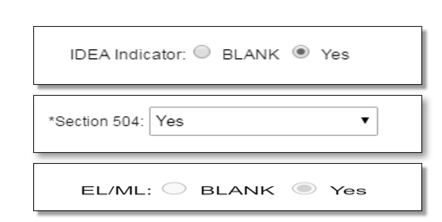
Do Now #4. Ensure Accuracy of Student Demographics between CT-SEDS and PSIS
PSIS must accurately reflect the student's status to sync with TIDE. Without these indicators set in PSIS, accommodations will not sync between CT-SEDS and TIDE.
Contact your PSIS Coordinator if a student is newly identified in CT-SEDS under IDEA or Section 504 status, or if the student is dually identified with either of these categories and is an EL/ML. These fields must reflect student eligibility in PSIS at the time of testing.
CT-SEDS/TIDE Resources
CT-SEDS to TIDE Designated Supports and Accommodations FAQ
Cross-Checking Student TIDE Test Settings and CT-SEDS
Notes:
Do Now #4. Ensure Accuracy of Student Demographics between CT-SEDS and PSIS
Teams should inform their PSIS Coordinator if they have students who newly qualify for services under IDEA or Section 504.
TEAMS should check PSIS/TIDE to ensure the following:
The IDEA or 504 indicators are on for their students that qualify.
Check EL/ML status (especially important for CAAELP and LAS Links) if the student is identified as an English learner/multilingual learner.
The grades listed in the statewide testing section of the plan match the grade of enrollment listed in PSIS/TIDE.
If any changes occur to a student’s eligibility under IDEA or Section 504 over the course of the school year, please notify your PSIS coordinator so that updates can be made in PSIS.
Remember!!! Accommodations from CT-SEDS will not sync to TIDE if the IDEA or Section 504 Indicator is not activated in PSIS.
Refer to the CT-SEDS to TIDE Designated Supports/Accommodations Sync Frequently Asked Questions; https://ct.portal.cambiumast.com/resource-item/en/ct-seds-to-tide-designated-supports-and-accommodations-sync-faq for more information.
Cross-Checking Student TIDE Test Settings and CT-SEDS; https://ct.portal.cambiumast.com/resource-item/en/cross-checking-student-tide-test-settings-and-ct-seds

Slide 7

Do Now #4. Ensure Accuracy of Student Demographics between CT-SEDS and PSIS
The Alternate Assessment Indicator in TIDE will activate for students who qualify for the Alternate Assessment per the completion of the Connecticut Alternate Assessment System Eligibility Form for the student's current grade in CT-SEDS.
Do not schedule testing if the Alternate Assessment Indicator does not accurately reflect student eligibility. Contact the Case Manager to review any discrepancies or missing documentation.
CT-SEDS/TIDE Resources
CT-SEDS to TIDE Designated Supports and Accommodations FAQ
Cross-Checking Student TIDE Test Settings and CT-SEDS
Notes:
Do Now #4. Ensure Accuracy of Student Demographics between CT-SEDS and PSIS- Continued
The Alternate Assessment Indicator in TIDE will activate for students who qualify for the Connecticut Alternate Assessment System per the completion of the Connecticut Alternate Assessment System Eligibility Form within CT-SEDS. Reminder: This form is embedded within CT-SEDS within the District and State Testing Tile. Teams do not upload a paper version of this form to CT-SEDS. The Connecticut Alternate Assessment System Eligibility Form must be completed annually and should algin to the grades that span the duration of the IEP. If your student is dually identified as an EL/ML, the form should be completed annually across Grades K-12.
The plan must be finalized and implemented for the alternate assessment data to sync to TIDE. Please note, this form will need to be completed again if conducting a review/revise or an amendment unless the PPT has determined the student is no longer eligible as part of the review/revise PPT or amendment. The eligibility form MUST be considered and updated at each annual review to determine if the student’s current performance meets eligibility for the Alternate Assessment System (CTAA, CTAS, CAAELP).
Please note: Do not schedule testing if the Alternate Assessment Indicator does not accurately reflect student eligibility in TIDE. Test Coordinators and teachers are advised to contact the Case Manager to review any discrepancies or missing documentation in CT-SEDS.
Refer to the CT-SEDS to TIDE Designated Supports/Accommodations Sync Frequently Asked Questions; https://ct.portal.cambiumast.com/resource-item/en/ct-seds-to-tide-designated-supports-and-accommodations-sync-faq for more information.
Cross-Checking Student TIDE Test Settings and CT-SEDS; https://ct.portal.cambiumast.com/resource-item/en/cross-checking-student-tide-test-settings-and-ct-seds

Slide 8
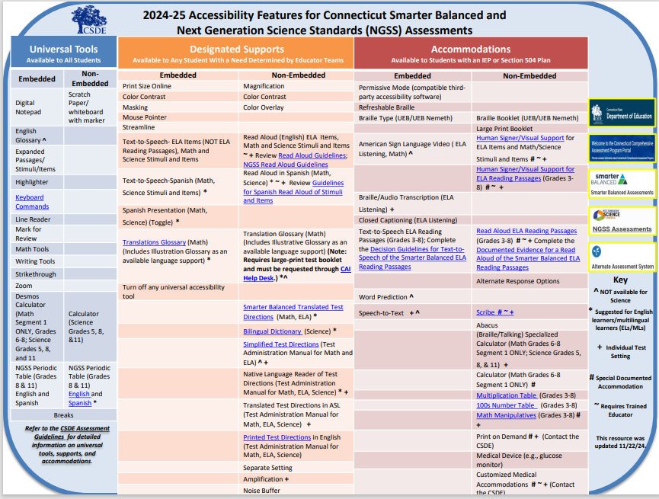
Do Now #5. Understand the Purpose and Types of Designated Supports/Accommodations Available for State Testing
Accessibility Resources
CSDE Assessment Guidelines
Description of Designated Supports and Accommodations
Accessibility Considerations
EL/ML Designated Supports brochure
Resources for PPT/Section 504 Teams webpage
CCSSO Questions to Ask When Selecting Accessibility Supports (various tools that elicit discussion with educator teams, student, parent/guardian, and classroom teacher)
Notes:
Do Now #5. Understand the Purpose and Types of Designated Supports/Accommodations Available for State Testing
It’s important to know and understand the accessibility supports for each assessment and how they function within the assessment platforms. Here are some tools to help you with Smarter Balanced and NGSS. Please visit the Connecticut DRC LAS Links Website | LAS Links for accessibility tools for the LAS Links.
Teachers can use the practice tests to see the functionality of tools. It is also important that the student’s have familiarity with these tools and can use them with automaticity and fluency. These tools (or tools with similar functionality) should also be utilized during students' instruction as well as on local assessments, if applicable. They should not be a stand-alone accessibility support only provided during summative assessments.
The CSDE created a webpage specifically for PPTs and Section 504 Teams to support decision making for state assessments: Resources for PPTs and 504 Teams Related to CT SEDS and Statewide Assessments
Refer to the following resources:
CSDE Assessment Guidelines
Description of Designated Supports and Accommodations
Accessibility Considerations
EL/ML Designated Supports brochure
CCSSO Questions to Ask When Selecting Accessibility Supports (various tools that elicit discussion with educator teams, student, parent/guardian, and classroom teacher)

Slide 9
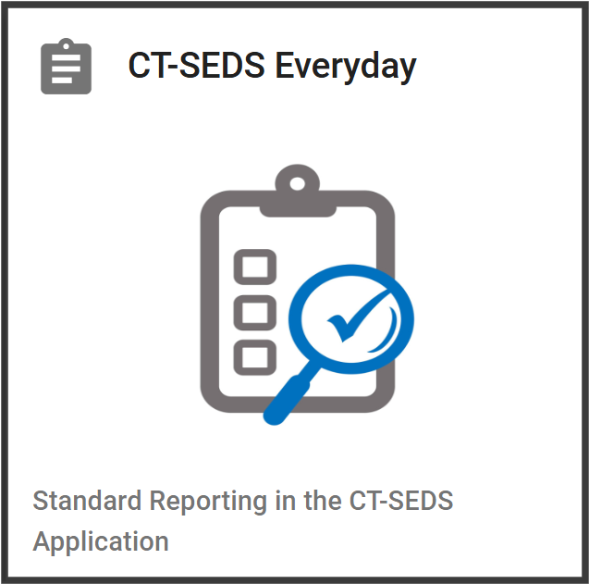
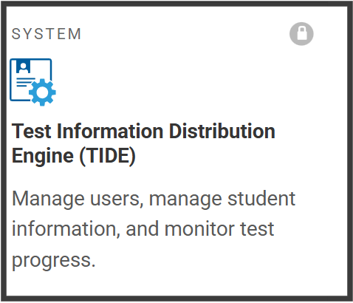
Do Now #6. Review CT-SEDS Everyday Accommodation Reports for Accuracy
Review the IEP and 504 Accommodations Report in CT-SEDS Everyday and check for accuracy.
If designated supports or accommodations are missing in TIDE, check CT-SEDS to confirm that they were planned for the student’s current grade of enrollment.
Identify conflicting accommodations (e.g., text-to-speech & read aloud, scribe & speech-to-text, or large print & print size).
  Look for designated supports and accommodations that were selected for one testing area, but not another (e.g., text-to-speech for math, but not ELA or science (or any combination).
  If a student has both an IEP and Section 504 Plan, designated supports and accommodations planned for summative assessments should match from plan to plan. If there is a mismatch of accommodations between plan, conduct an amendment or review/revise to ensure agreed upon accessibility supports from plan-to-plan.
Notes:
Do Now #6. Review CT-SEDS Everyday Accommodation Reports for Accuracy
Ensuring that supports are accurately reflected in student plans prior to testing is essential for students to receive the correct supports during testing.
Not providing (or providing inaccurate) supports will result in an irregularity, appeal, and potential retesting of that student. Testing should be delayed for students whose accommodations are not accurately reported in TIDE so that an amendment can be made to the plan.
Besides checking for accuracy of supports, educators will want to look for the following:
Identify any conflicting accommodations (e.g., text-to-speech & read aloud, scribe & speech-to-text, or large print & print size). These are just a few examples, but teams should take time to carefully review the supports needed by the student and select them for each test subject as applicable to the student.
Look for accommodations that were selected for one testing area, but not another (e.g., text-to-speech for math, but not ELA or science (or any combination). Supports should be consistently given, as much as feasible, between not only content areas but assessments, as applicable. Note: Some designated supports/accommodations may be subject specific (e.g., translation glossary for math, 100 Number Table). Moreover, text-to-speech is considered a designated support for test items for math, ELA , and science, but it is considered an accommodation for ELA Reading Passages.
If a student has both an IEP and Section 504 Plan, designated supports and accommodations planned for summative assessments should match from plan to plan. The plan that is the most recent plan is the one that pulls from TIDE. If there is a mismatch of accommodations between plan, conduct an amendment or review/revise to ensure agreed upon accessibility supports from plan-to-plan.
Refer to the following resources:
Special Documented Accommodations for Smarter Balanced and Next Generation Science Standards (NGSS) Assessments Overview
CT-SEDS to TIDE Designated Supports and Accommodations FAQ for more information.
CT-SEDS to TIDE Designated Supports/Accommodations Sync Frequently Asked Questions; https://ct.portal.cambiumast.com/resource-item/en/ct-seds-to-tide-designated-supports-and-accommodations-sync-faq
Cross-Checking Student TIDE Test Settings and CT-SEDS; https://ct.portal.cambiumast.com/resource-item/en/cross-checking-student-tide-test-settings-and-ct-seds

Slide 10
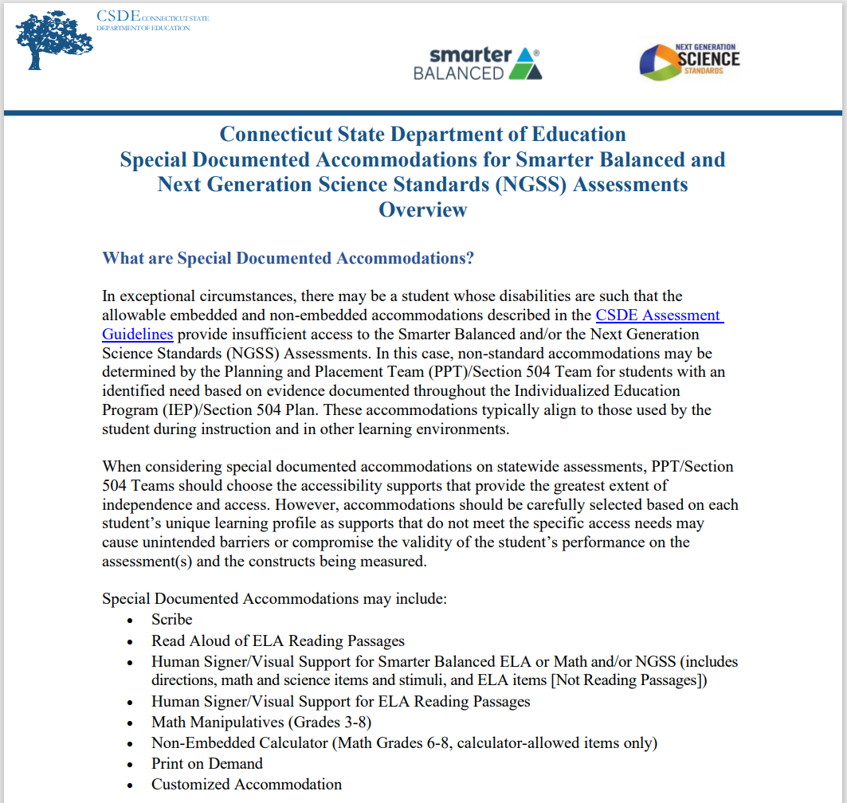
Do Now #6. Review CT-SEDS Everyday Accommodation Reports for Accuracy
Identify students approved for a Special Documented Accommodation and provide SASIDs to the DA for Testing.
The DA and assigned teacher/proctor should review the Special Documented Accommodations for Smarter Balanced and Next Generation Science Standards (NGSS) Assessments Overview for the applicable guidelines and protocols associated with the student’s approved accommodation.
Remind teacher (or educator teams) to cross-check student settings in TIDE and CT-SEDS to prevent test irregularities with special documented accommodations. Testing should be delayed for students whose accommodations are not accurately reported in TIDE.
Notes:
Do Now #6. Review CT-SEDS Everyday Accommodation Reports for Accuracy, Continued
While reviewing the CT-SEDS Everyday Accommodation Report, specifically highlight those students selected to use Special Documented Accommodations (e.g., human reader/human signer, scribe, math manipulatives, or other customized accommodations) and communicate those accommodations with the DA, school coordinator, and teacher. Refer to the Overview for Special Documented Accommodations for more information about the purpose and testing policies regarding non-standard accommodations: Process-for-Requesting-Special-Documented-Accommodations.pdf.
The provision of Special Documented Accommodations requires additional planning by the DA/SC as students will need to test in an individualized test setting. The teacher/test administrator will also be required to review important test procedures and protocols about providing the accommodation appropriately in a secure test environment. Many of these protocols also require signed attestations by the teacher, Special Education Director, and District Administrator (DA for testing). The provision of math manipulatives also requires important pre-planning and organization as numbers, formulas, or other identifying features must be removed from the manipulatives prior to testing.
Finally, remind teacher (or educator teams) to cross-check student settings in TIDE and CT-SEDS to prevent test irregularities. Testing should be delayed for students whose accommodations are not accurately reported in TIDE to allow time for the team to reconvene and amend the plan. Testing can be planned once the amendment is fully implemented.

Slide 11
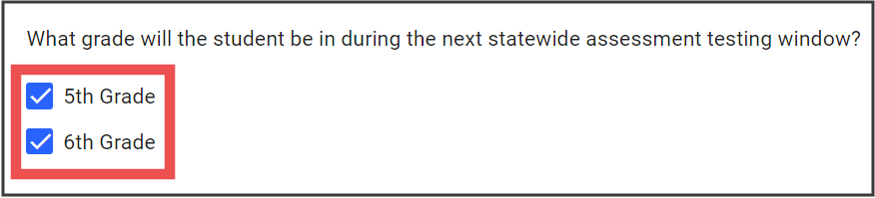
Do Now #7. Always Plan for all Grades Covered by the Duration of the Plan
Plan for all grades covered by the duration of the IEP/Section 504 Plan.
Notes:
Do Now #7. Always Plan for all Grades Covered by the Duration of the Plan
When convening at the PPT or Section 504 meeting, be sure to select the student’s current grade of enrollment (throughout this school year) and any other grade covered by the duration of the plan.
The student’s current grade of enrollment should align with the grade indicated in PSIS. If there is an error in PSIS, be sure to contact your PSIS Coordinator so that the correct grade is documented.
TIDE will only reflect the current grade of enrollment for supports and each assessment. This data is populated to TIDE from PSIS.
It is important that teams remember to continue the current grade of enrollment until the last day of school for the current calendar year.

Slide 12
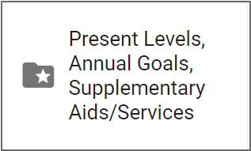
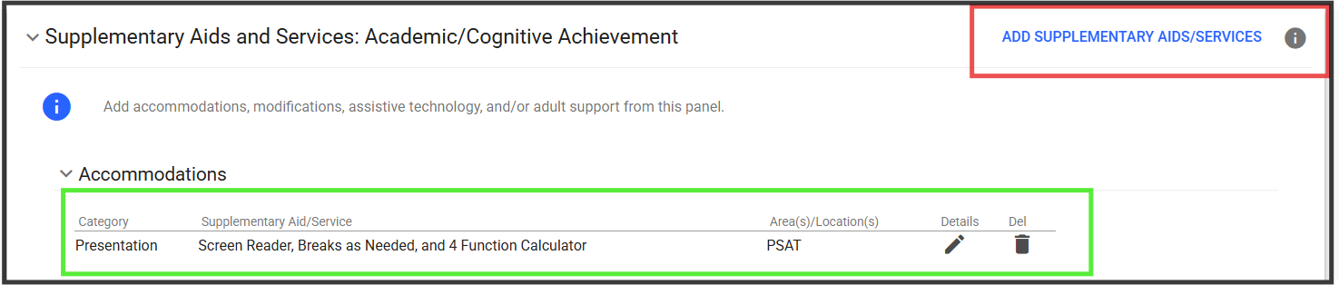
Do Now #8. Continue to Plan for Designated Supports and Accommodations for Off-Grade Level NGSS Interim and College Board Assessments
Document designated supports (if applicable) and accommodations in the Supplemental Aids and Services Section for students in Grades K-2 and 9-10 and 12. This ensures that the correct accommodations are selected for PSAT/SAT, and the optional interim assessments.
Refer to the CT-SEDS to TIDE Designated Supports and Accommodations FAQ for more information.
Notes:
Do Now #8. Continue to Plan for Accommodations for Off-Grade Level NGSS Interim and College Board Assessments
Please note off-grade level supports will not sync to TIDE and educators should adhere to the guidance in CT-SEDS-to-TIDE-Designated-Supports-Accommodations-FAQ.pdf. Refer to the Documenting Designated Supports and Accommodations in TIDE brochure for more information.
Teams must document designated supports and accommodations in the Supplemental Aids and Services Section for students in Grades K-2 and 9-10 and 12. This ensures that the correct accommodations are selected for PSAT/SAT, and the optional interim assessments.
The following describes where to document designated supports and accommodations for students participating on the NGSS summative and interim assessments:
The NGSS summative assessments (Grades 5, 8, and 11)
Use drop-down menu on the statewide testing tile in CT-SEDS to document designated supports/accommodations
NGSS Interims are available in grade bands (Grades 3-4, 6-7, 9-10)
Teams should document designated supports/accommodations for off-grade interims in the districtwide testing portion of the District/Statewide Assessment tile and in the Supplemental Aids and Services portion of CT-SEDS.
These designated supports and accommodations should mirror those selected for Smarter Balanced ELA and math in the finalized and implemented plan for that current grade level.
The NGSS summative assessments, administered in Grades 5, 8, and 11, includes an accommodations drop-down menu on the statewide testing tile in CT-SEDS. If students are going to participate on NGSS Interim Assessments in off grades (Grades 3-4, 6-7, 9-10), teams should document accommodations in the districtwide testing portion of the District/Statewide Assessment tile and in the Supplemental Aids and Services portion of CT-SEDS. These designated supports and accommodations should mirror those selected for Smarter Balanced ELA and math in the finalized and implemented plan for that current grade level.
Although NGSS accommodations in off-grades will not sync to TIDE, teachers can refer to the documentation within the finalized and implemented plan to know which supports and accommodations certain students are eligible for when taking NGSS interims. Following the directions in the Entering Designated Supports and Accommodations Using the Test Administration Interface section, teachers can add applicable test supports using the Test Administration Interface prior to approving the interim assessment. Note: The Planning and Placement Team (PPT) or Section 504 Team will need to convene or amend plans if designated supports and accommodations were not planned for the current grade of enrollment. Refer to the Documenting Designated Supports and Accommodations in TIDE brochure for more information on students taking NGSS interims in off-grades.
College Board Assessments:
Accommodations for PSAT/SAT (in off-grades 9-10, 12) should be documented in the Supplemental Aids and Services section.
Accommodations for CT SAT School Day (Grade 11) should be documented in CT SAT School Day accommodation menu. Please note that accommodation names will be updated soon to reflect the new embedded text-to-speech and flexibility in extended time.
Similarly, teams should select accommodations for the College Board Assessments in the Supplemental Aids and Services and district wide assessments page for students taking the PSAT/SAT in Grades 8/9, 9-10, and 12. Accommodations for the CT SAT School Day (Grade 11) should be documented in the CT SAT School Day accommodation menu for statewide testing. As a reminder, accommodations from CT-SEDS do not sync to the College Board’s SSD System. Requests must be requested separately by the SSD Coordinator. Be sure to work with this point-person to ensure that the student is eligible for accommodations for the College Board and that the student account accurately represent those accommodations selected in the IEP.
IMPORTANT! While accommodations for College Board Assessments should be documented in CT-SEDS, they must also be formally requested and documented directly through the College Board using their SSD Online System. The submission and review of accommodations in SSD Online is managed by the high school SSD Coordinator.

Slide 13
Do Now #9. Ensure that Eligibility for the Connecticut Alternate Assessment System is Accurate
Complete the Connecticut Alternate Assessment System Eligibility Form to determine eligibility for alternate assessments. These include the CAAELP in grades K-12 for dually identified ELs/MLs, the CTAA (for students in grades 3-8 & 11) and CTAS (for students in grades 5, 8, & 11).
Notes:
Do Now #9. Ensure that Eligibility for the Connecticut Alternate Assessment System is Accurate
On the statewide accommodation page in CT-SEDS, indicate if the student is being considered for the Connecticut Alternate Assessment System (CTAA, CTAS, and/or CAAELP). If the student is not being considered for this assessment system, choose “No” and proceed with the selection of accommodations for applicable testing areas (Smarter Balanced Math, ELA, and NGSS- if applicable). If the team is considering the student for the Alternate Assessment System, select “Yes” and complete the embedded eligibility form.
IMPORTANT! This must be selected for all students in Grades K-12. Students enrolled in Grades K-12 that are dually identified under IDEA with a significant cognitive disability and EL/ML. Teams should select YES if they are planning for the Connecticut Alternate Assessment for English Language Proficiency. If this option is not selected, and the Connecticut Alternate Assessment System Eligibility Form is not completed and verified, the student will NOT be eligible to participate on CAAELP.

Slide 14
Do Now #10. Review Critical Resources if Considering Participation on the Connecticut Alternate Assessment System
Resources
Frequently Asked Questions and Answers about the Connecticut Alternate Assessment System
Annotated Connecticut Alternate Assessment System Eligibility Form
Frequently asked Questions and Answers About the Connecticut Alternate Assessment System Eligibility Form
Connecticut Alternate Assessment System Participation Guidance for Planning and Placement Teams Flowchart
Comparison of Connecticut Alternate Assessments
Ensuring Appropriate Student Identification and Eligibility Criteria for Alternate Assessments [PDF]
PDFs of Connecticut Alternate Assessment Training
For more information, visit the CSDE Website and the Connecticut Comprehensive Assessment Program Portal
The Connecticut Alternate Assessment System is designed for a very small number of children with the most significant cognitive disabilities. Characteristics include:
The identification of one or more of the existing categories of disability under the IDEA
Significant Intellectual Impairment
Functional adaptive skills that are well below age level expectations
Need for intensive instruction and significant supports
Notes:
Do Now #10. Review Critical Resources if Considering Participation on the Connecticut Alternate Assessment System
The following characteristics describe a student with the most significant cognitive disabilities. The Planning and Placement Team will need to review and document certain criteria using the Connecticut Alternate Assessment Eligibility Form, which is embedded within CT-SEDS. To qualify the student must:
be identified with one or more of the existing categories of disability under the IDEA
have a significant Intellectual Impairment
have functional adaptive skills that are well below age level expectations
require intensive instruction and significant supports
Included on this slide are resources to help support your understanding of the purpose and eligibility for the Connecticut Alternate Assessment System.
Links to Resources:
Frequently Asked Questions and Answers about the Connecticut Alternate Assessment System; https://ct.portal.cambiumast.com/resource-item/en/frequently-asked-questions-and-answers-about-the-connecticut-alternate-assessment-system
Annotated Connecticut Alternate Assessment Eligibility Form; https://ct.portal.cambiumast.com/resource-item/en/annotated-connecticut-alternate-assessment-eligibility-form
FAQ About the Connecticut Alternate Assessment System Eligibility Form; https://ct.portal.cambiumast.com/resource-item/en/faq-about-the-connecticut-alternate-assessment-system-eligibility-form
Connecticut Alternate Assessment System Participation Guidance for Planning and Placement Teams; https://ct.portal.cambiumast.com/resource-item/en/connecticut-alternate-assessment-system-participation-guidance-for-planning-and-placement-teams
Comparison of Connecticut Alternate Assessments; https://ct.portal.cambiumast.com/resource-item/en/comparison-of-connecticut-alternate-assessments
Connecticut State Department of Education homepage: Connecticut State Department of Education; https://portal.ct.gov/sde
Cambium Home Page; https://ct.portal.cambiumast.com/

Slide 15
CSDE Performance Office Contacts
Abe Krisst Bureau Chief Connecticut Education – Performance Office Phone: 860-713-6894; Mobile Phone: 860-690-0650 Email: Abe.Krisst@ct.gov
Deirdre Ducharme Education Consultant Performance Office- Special Populations Direct line: 860-713-6859 Email: Deirdre.Ducharme@ct.gov
Katie Seifert Associate Education Consultant Performance Office- Special Populations Direct line: 860-713-6722 Email: Katherine.Seifert@ct.gov
Kimberly Johnson Education Support Technician Performance Office Phone: 860-713-6885 Email: Kimberly.Johnson@ct.gov
Cristi Alberino Education Consultant Performance Office –Interim & Summative Assessments Email: Cristi.Alberino@ct.gov
Jeff Greig Education Consultant Performance Office – NGSS Interim & Summative Assessments Email: Jeff.Greig@ct.gov
Notes:
Here are CSDE contacts from the Performance Office and Bureau of Special Education. Please reach out with any questions.
We are here to support you and your teams.

Slide 16

Thank you!!!!
Thank you for attending and for all you do for your students.
Connecticut State Department of Education

