Slide 1
District Administrator Training for Statewide Assessments
January 2025

Slide 2
Tips to make this Webinar a Success
The slide deck is linked in the chat.
This webinar will be recorded and posted.
There will be several points during the webinar to answer audio questions via the “raise hand” feature. This will be the only time to ask audio questions.
Chat questions will be answered, time permitting, via the chat. If your question is not addressed, please email ctstudentassessment@ct.gov for an answer.
No breaks will be taken.
Thank you for attending and enjoy the webinar!

Slide 3
The Performance Office
Data Collection, Assessment, Information Technology, Reporting, Research, and Accountability
Mission: Improve student outcomes through the use of data and technology.
  Goal #1: Data Collection
  Goal #2: Student Assessments
  Goal #3: Data Integration/Reporting
  Goal #4: Research and Analyses
  Goal #5: Accountability

Slide 4
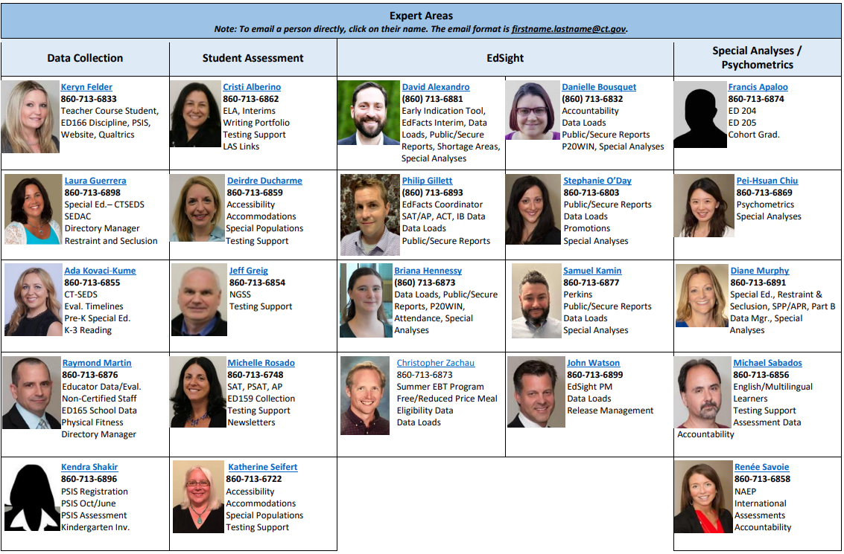





Performance Office Team
Ajit Gopalakrishnan
Chief Performance Officer
860-713-6888
Abe Krisst
Bureau Chief
860-713-6894
Renee Brousseau
Support Staff
860-713-6865
Shondel Edwards
Administrative Assistant
860-713-6887
Kimberly Johnson
Education Support Technician
860-713-6885

Slide 5
Cambium Project Team
  Jen Chou, Program Director
  jennifer.chou@cambiumassessment.com
Marie Musumeci, Senior Program Coordinator
marie.musumeci@cambiumassessment.com
Christine Jung, Program Coordinator
christine.jung@cambiumassessment.com

Slide 6
Who and When Do I Contact?
Performance Office
860-713-6860
ctstudentassessment@ct.gov
If you have questions pertaining to:
State policy test administration questions
Accommodations, designated supports, customized accommodations, special circumstances
Reporting of security breaches
CT-SEDS/TIDE syncing issues

Slide 7
Who and When Do I Contact?
Connecticut Help Desk-Cambium Assessment
844-202-7583
cthelpdesk@cambiumassessment.com
If you have questions pertaining to:
Test administration procedure questions
Secure browser
Technology questions

Slide 8

Presentation Overview
Overview of Summative Assessments
Cambium System Overview
Special Populations Update
Connecticut Alternate Assessments

Slide 9
2025 Assessment Calendar
State Assessment | Grade(s) | Testing Window | Delivery Method
Connecticut Alternate Assessment of English Language Proficiency (CAAELP) | K - 12 | January 13 - March 7, 2025 | Online
Smarter Balanced ELA & Math | 3 – 8 | March 24 - May 30, 2025 | Online
Connecticut Alternate Assessments (CTAA) | 3 – 8 and 11 | March 24 - May 30, 2025 | Online
NGSS Assessments | 11 | February 3 - May 30, 2025 | Online
 | 5 and 8 | March 24 - May 30, 2025 | Online
Connecticut Alternate Science Assessment (CTAS) | 5, 8, and 11 | Test administered throughout the school year. Student ratings entered in the DEI: March 24 - May 30, 2025 | Online Upload March 24 - May 30, 2025
Notes:
To assist districts with planning their calendars, the CSDE is providing the State Summative Assessment Calendar for Connecticut public schools for the 2024-25 school year.

Slide 10
SAT Bonus Info
Students in grade 11 are required to take the CT SAT.​
  The testing window is March 3- April 23, 2025.​
  Schools can choose whichever dates to test students. All students do NOT need to be tested on the same day. ​
  CT SAT training is February 10 and 11. Registration is available through Connecticut State Department of Education (SDE) Events Calendar​
  Resources and recorded webinars are posted to the CT SAT School Day webpage.
  Contact: michelle.rosado@ct.gov

Slide 11
What’s new? What’s the same?
New
Updated Secure Browser
New CAAELP webpage
Timing and distribution of Individual Student Reports (ISR’s) changing
Affirmation/attestation page
2025 - 26 calendar
CT-SEDS to TIDE sync improvements
Change in Alert Notification on February 3
Same
Designated supports and accommodations
Data is still coming from PSIS and CTSEDS
Cambium Systems
Office Hours
Processes for CAAELP Domain Exemptions and the Early Stopping Rule (ESR) for the Alternate Assessment System
Teacher Training Slide Deck
Testing students out-of-state and in non-approved facilities
Rolling release of results
Shipping paper manuals to districts
Notes:
To ease any worries, let start with what remains the same this year?
There are no changes for Designated Supports and Accommodations.
Data is still coming from PSIS and CTSEDS. This information is being feed into TIDE.
Cambium Systems are still the same such as TIDE, Test Administration Interface, and the Centralized Reporting System
We are still doing Office Hours from April to May.
The processes for CAAELP Domain Exemptions and the Early Stopping Rule (ESR) for the Alternate Assessment System remain the same.
We will be producing a Teacher Training Slide Deck and releasing it soon.
The procedures for Testing students out-of-state and in non-approved facilities remain the same.
The rolling release of results will still occur in May for NGSS, Smarter and Alts.
We will be shipping paper manuals to districts in late January.
What’s New?
Each school year, a new and updated Secure Browser is available and must be downloaded to student testing devices prior to testing. This is a new browser but this process of updating the browser is the same as in past years.
The webpage for the Connecticut Alternate Assessment of English Language Proficiency (CAAELP) is updated with a new look and easy access to resources for English Language Assessment Coordinators (ELACs), District Test Administrators (DAs), and teachers.
PDF and paper reports will still be arriving in early August for parent/guardian distribution. Districts will receive two copies this summer. What is new is that we will be trying to get them to you again earlier than last year. Also, since we have heard that many districts do not use the paper reports anymore due to local electronic distribution and the next school year we will likely only distribute the PDF and one hard copy. Then in 2027, we will likely only distribute PDFs. I know this is far in advance, but we wanted to give you extra notice.
Since this was last minute last year, we included it as new here again. We are asking that TAa do that attestation again which will include typing the wording summative for summative assessments when administering them.
We have a new 25/26 calendar for planning purposes.
CT SEDS to TIDE is now much improved. Last year we were still learning so there were some gaps in the upload. This year, we should be close to perfection. Of course, if you do not see that., let us know.
How many of you have received students alerts from us? Currently, you likely would have received them from Cristi Alberino or myself if we find any concerning content written in tests (summative or interim). We will continue doing that. However, for the remainder of the year, you will also be receiving a communication from CAI too from their system. This will be a duplicative effort. Next year, we will likely stop sending them from our office and you will only hear from CAI about them.

Slide 12
State Policy Regarding Assessment Participation

Slide 13
Participation - Connecticut General Statutes 10-14n
    (b) (1) For the school year commencing July 1, 2015, and each school year thereafter, each student enrolled in grades three to eight, inclusive, and grade eleven in any public school shall, annually, take a mastery examination in reading, writing and mathematics during the regular school day.
    (3) For the school year commencing July 1, 2018, and each school year thereafter, each student enrolled in grades five, eight, and eleven in any public school shall annually take a state-wide mastery examination in science during the regular school day.
Notes:
This is the language that drives our summative testing for reading, writing, mathematics, and science.
These are the statutes if needed when communicating with parents/guardians or other educators; this may be helpful to use in the district.

Slide 14
ESSA Requirements for Alternate Assessments
ESSA placed a 1.0% cap on the state participation rate for each subject, based on the total number of all students in the state assessed in the subject (34 CFR 200.6(c)(2)). This is to ensure that students with the most significant cognitive disabilities have access to the grade level, general education standards.
The CSDE has provided guidance and support to districts in making appropriate alternate eligibility determinations.
Notes:
The Every Student Succeeds Act (ESSA) ensures that vital information is provided to educators, families, students, and communities through annual statewide assessments.
One of the requirements included in ESSA is the state-level cap of 1.0% on the percentage of tested students in a subject area who participate in the Connecticut Alternate Assessment System. This is calculated by dividing the number of students participating in the Connecticut Alternate Assessments in a subject area by the number of all students tested in that subject area.
While it is important for Connecticut to monitor and adhere to guidance from the US Department of Education, the CSDE is committed to serving as a key resource to districts to provide guidance on essential areas, including making appropriate eligibility determinations on alternate assessments. Off this link is a great resource to support this.

Slide 15
PSIS/TIDE/CT-SEDS
Data Sync

Slide 16
TIDE/PSIS Data Sync
District Administrators must work with District PSIS Coordinators to ensure accurate student information is reported in the PSIS Registration Module and TIDE.
During the summative test window, changes made in PSIS Registration will automatically be updated in TIDE by the following day.
Students identified eligible for services under EL/ML, IDEA, or Section 504 must have the applicable demographic fields indicated in PSIS.
Notes:
DA’s should work with their PSIS Coordinators to be sure that the information in PSIS is accurate.
During the summative test window, any changes in the PSIS Registration Module will be updated in TIDE the next day.
Remember that all students who are identified as English learners/multilingual learners (ELs/MLs) or who have and IEP or 504 Plan must have the applicable field indicated in PSIS.

Slide 17
TIDE/PSIS Data Sync Facts
Testing Demographics SPED, FRL, EL/ML, Military Family, and Homeless values were loaded in November 2024.
The values for Recently Arrived EL/ML and Section 504 were not pulled from Freeze Zero. These must be set in the PSIS Registration Module.
Student demographic values will be saved, and the fields locked in PSIS on May 30, 2025*. All changes to a student’s status at the time of testing must be made by May 30, 2025.
Students who are repeaters should be tested.
Student’s grade in PSIS is that grade in which the test is given.
Grade 11 "skippers" are not tested.
* Student demographic values will be locked in PSIS for the following assessments: March 7, 2025, for LAS Links and CAAELP; April 23, 2025, for the Connecticut SAT School Day; and May 30, 2025, for Smarter Balanced Assessments, NGSS, CTAS, and CTAA.
Notes:
Here are some critical facts for the TIDE/PSIS Sync.

Slide 18
TIDE/PSIS Data Sync
Student Status Change
Status | If student has already taken any state assessment | If student has not already taken any state assessment
If SPED/EL/FRL was YES originally and then changed | Leave status as YES for all tests | Change status to NO for all tests
If SPED/EL/FRL was NO originally and then changed | Change to YES for all subsequent tests and the CSDE will apply this status for all tests | Change status to YES
*Making these changes may impact the student eligibility for designated supports and accommodations.
Refer to the December 2024 edition of the Student Assessment Newsletter for details on PSIS and state assessments.
Notes:
This addresses the way students need to be changed in PSIS if there are status changes during the test window.
We are not going to review every case, but this can be used as a resource locally.

Slide 19
CT-SEDS/TIDE Data Sync
Designated supports and accommodations must be identified for the student’s current grade in finalized and implemented plans in CT-SEDS.
The Alternate Assessment Indicator in TIDE will activate for students who qualify for the Alternate Assessment per the completion of the Connecticut Alternate Assessment System Eligibility Form for the student's current grade.
Designated supports and accommodations are updated daily in TIDE to reflect changes made to students’ plans in CT-SEDS within 48 hours of finalization and the implementation date.
Refer to the CT-SEDS to TIDE Designated Supports and Accommodations FAQ for more information.
Notes:
Designated supports and accommodations must be identified for the student’s current grade in CT-SEDS and plans must be finalized and implemented.
The Alternate Assessment Indicator in TIDE will activate for students who qualify for the Connecticut Alternate Assessment System per the completion of the Connecticut Alternate Assessment System Eligibility Form embedded within CT-SEDS. This form must be completed annually and align to the student’s current grade of enrollment. The plan must be finalized and implemented for the alternate assessment data to sync to TIDE.
Designated supports and accommodations are updated daily in TIDE to reflect changes made to students plans in CT-SEDS within 48 hours of finalization and the implementation date.

Slide 20
Test Security

Slide 21
Test Security
Breaches of test security include, but are not limited to:
  Analyzing/copying test items
  Coaching students
  Giving students answers and/or changing students’ answers
  Allowing students access to digital, electronic, or manual devices (except approved accommodations)
  Unauthorized log-in to the Test Delivery System
  Cell phone (including Smart Watches) use by students is prohibited!
Notes:
Breaches of test security include analyzing or copying test items, coaching students or giving students answers and changing students’ answers. We do not allow students to access to digital, electronic, or manual devices (except for approved accommodations). Any unauthorized log-in to the Test Delivery System may also be a breach of test security. This list is not comprehensive, but this represents most issues we see when it comes to issues in test security.
Please note that the use of cell phones (including Smart Watches) by students is strictly prohibited!

Slide 22
Test Security and Proctoring
Violation of test security is a serious matter with far-reaching consequences. Breaches of test security include, but are not limited to, copying or photographing of test materials, failing to return test materials, coaching students, giving students answers, and/or changing students’ answers. Such acts may lead to the invalidation of an entire school district’s student test scores, disruption of the test system statewide, and legal action against the individual(s) committing the breach. A breach of test security may be dealt with as a violation of the Code of Professional Responsibility for Teachers, as well as a violation of other pertinent state and federal law and regulation. The Connecticut State Department of Education will investigate all such matters and pursue appropriate follow-up action. Any person found to have intentionally breached the security of the test system may be subject to sanctions including, but not limited to, disciplinary action by a local board of education, the revocation of Connecticut teaching certification by the State Board of Education,* and civil liability pursuant to federal copyright law.
*See Section 10-145b(i) (2) (E) of the Connecticut General Statutes, which reads in relevant part as follows: The State Board of Education may revoke any certificate, permit, or authorization issued pursuant to said sections if the holder is found to have intentionally disclosed specific questions or answers to students, or otherwise improperly breached the security of any administration of a mastery examination, pursuant to section 10-14n.
Notes:
This long and brutal slide is our test security and proctoring policy. Please review this with your staff to be aware of the state statutes concerning test security.

Slide 23
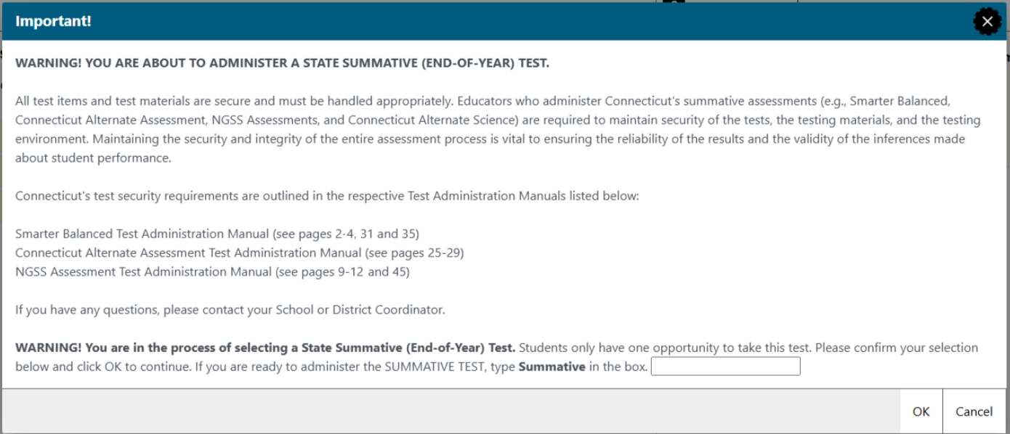
Test Administrator Security Confirmation/Attestation Page
Notes:
This is the TA confirmation screen. This will appear again this year and TAs will have to select OK to advance and begin creating test sessions.
This protocol is not new as we have been doing it for several years. It is critical that all school proctors/test administrators are trained locally and use the Test Administration Manuals carefully when planning and administering tests.
Once again, when selecting a summative assessment, users will be asked to type in the word summative.

Slide 24
Improprieties, Irregularities, and Breaches

Slide 25
Test Security Actions
Impropriety (low-level incident)
Keep records locally.
Breach (high-level incident)
Irregularity (medium-level incident)
File an appeal in the system by day’s end.
Follow instructions in Appeals system.
Keep records locally.
Corrected at the local level and/or entered in Appeals system if appropriate.
Contact CSDE at 860-713-6860 or ctstudentassessment@ct.gov immediately.
Note: The Test Security Levels are described in Appendix G of the Test Coordinator’s Manual.

Slide 26
Appeal Types
Re-open a Test | Allows for a test that has already been submitted in error or has expired to be re-opened.
Re-open a Test Segment | Re-opening a test segment allows a student to access the first segment of a test that was submitted in error.
Grace Period Extension | Granted if a test session is unexpectedly interrupted. Allows access to all previous responses.
Reset a Test | Removes the test and scores from the system. Enables student to start a new test.
Invalidate a Test | Rarely used. Eliminates the test. Student does not receive a score.

Slide 27
Entering Appeals
Enter Appeals Judiciously | Staff entering appeals should be trained. CSDE is reviewing every appeal closely. Provide necessary information in the entry box.
Re-open or Grace Period Extension should only be used when needed | Students should not be allowed back into the test just to double check work if they already submitted their test. Students are encouraged to review items prior to ending their test.
Unsure of what to do, reach out for help | Contact the CSDE with any questions. ctstudentassessment@ct.gov; 860-713-6860; 860-713-6862 or email Cristi.Alberino@ct.gov

Slide 28
Appeals Process for an Accommodation Issue
The DA must send a signed letter to the CSDE on letterhead that must include:
  The student’s grade, SASID, and the name of the test on which the irregularity occurred;
  The date and a detailed explanation of the irregularity;
  The name of the proctor;
  A description of the discussion with parents/guardians explaining the irregularity, and options offered; and
  Procedures to ensure the irregularity is not repeated.
  Can be emailed with SASID only (no student name), posted to TIDE Secure File Center, or faxed to 860-713-7033.

Slide 29
Testing Time Reminders

Slide 30
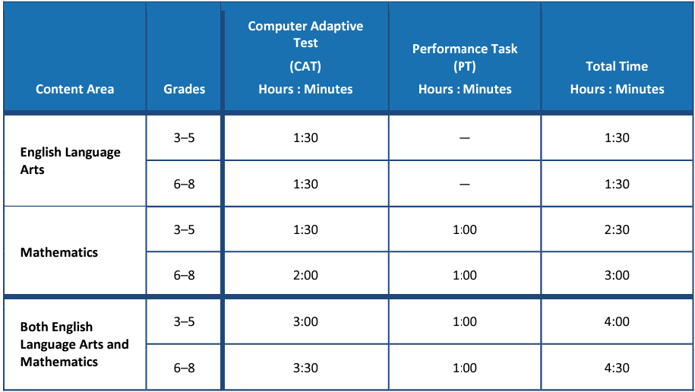
Testing Time Reminder
Some districts are testing much more than the suggested time.
Please monitor this closely. Extra time does not necessarily correlate with achievement and very low/high times may represent lack of effort/motivation/proctoring.
Notes:
These are the suggested times for ELA and Math.
Some districts are testing much more than the suggested time for each test. While this is not a timed test, and students may need more than the suggested time, please monitor this closely. Extra time does not necessarily correlate with achievement and very low/high times may represent lack of effort, motivation, or active proctoring.

Slide 31
Testing Time Reminder
NGSS can be administered in one day or two consecutive days.
The recommended testing time is at least 90 minutes for testing with an additional 10 minutes for directions.
Pause rules: If a student pauses a test, a 20-minute pause timer starts running.
  If a student resumes the test within 20 minutes, they can review previously answered questions.
  If a student resumes the test after 20 minutes, they cannot access previously answered questions, only unanswered questions.
Notes:
The NGSS can be administered in one day or over two consecutive days.
The recommended testing time is at least 90 minutes for testing with an additional 10 minutes provided to read the directions to the students.
Remember the pause rules: If a student pauses a test, a 20-minute pause timer starts running.
If a student resumes the test within 20 minutes, they can review previously answered questions.
If a student resumes the test after 20 minutes, they cannot review previously answered questions. They can only work on unanswered questions.

Slide 32

Questions
Use “Raise Hand” Tool

Slide 33
CAI System

Slide 34
CT Comprehensive Assessment Program Portal
All CAI systems and resource materials can be accessed on the Connecticut Comprehensive Assessment Program Portal
(https://ct.portal.cambiumast.com/).
Notes:
This is the link to the CT Comprehensive Assessment Portal. All systems and resources for the summative tests are available on this site.

Slide 35
Secure Browser Updates
The Secure Browser prohibits access to other programs or websites during testing.
The 2024-25 Secure Browser was released in August 2024. Download the latest secure browser from the portal. The secure browser from 2023-24 no longer works.
Students are required to use the Secure Browser to take the summative Smarter Balanced, NGSS, the CTAA math and ELA assessments, and the CAAELP.
Notes:
The Secure Browser is designed to ensure test security by prohibiting students from accessing any other programs or websites during testing.
The 2024-25 Secure Browser was released in August 2025. Download the latest secure browser from the portal. The secure browser from 2023-24 will no longer work.
Students will be required to use the Secure Browser on their device to take the summative Smarter Balanced, NGSS, the CTAA math and ELA assessments, and the CAAELP.

Slide 36
Chrome Update
With the upcoming release of ChromeOS version 133 on the Stable channel, a required setting for the secure browser will no longer be enabled by default. District technology staff must utilize one of the options below to continue using the secure browser for student testing on ChromeOS devices.
1. Ensure all devices are on the Long-Term Support (LTS) channel or the Long-Term Support Candidate (LTC) channel. For more information on these channels, visit Long-term Support (LTS) on ChromeOS.
2. Enable the NativeClientForceAllowed (NaCl) setting in the ChromeOS Management Console. For more information on enabling NaCl, visit Chrome Enterprise Policy List & Management | Documentation
Taking these actions now ensures that the ChromeOS Secure Browser will be usable for the remainder of the 2024-2025 school year.

Slide 37
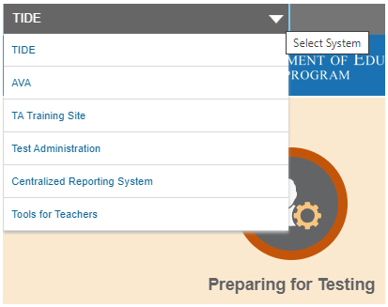
Accessing Systems
All user accounts were rolled over and passwords reset in August 2024.
If you log in on a new device or browser (or clear the cache) you must enter an emailed code after passing the login screen. This step does not occur when you activate your account.

Slide 38
Single Sign-On – Password Policy
New password policy
Password policy effective Fall 2024:
One (1) uppercase letter
One (1) lowercase letter
One (1) number
One (1) special character
Min 12 characters (increase from min 8 characters)
Different from last 24 passwords (increase from last 2 passwords)
Notes:
All user accounts were rolled over and passwords reset in August 2024.
If you log in on a new device or browser (or clear the cache on a previously-used browser) you must enter an emailed code after passing the initial login screen. This step does not occur when you activate your account for the first time.

Slide 39
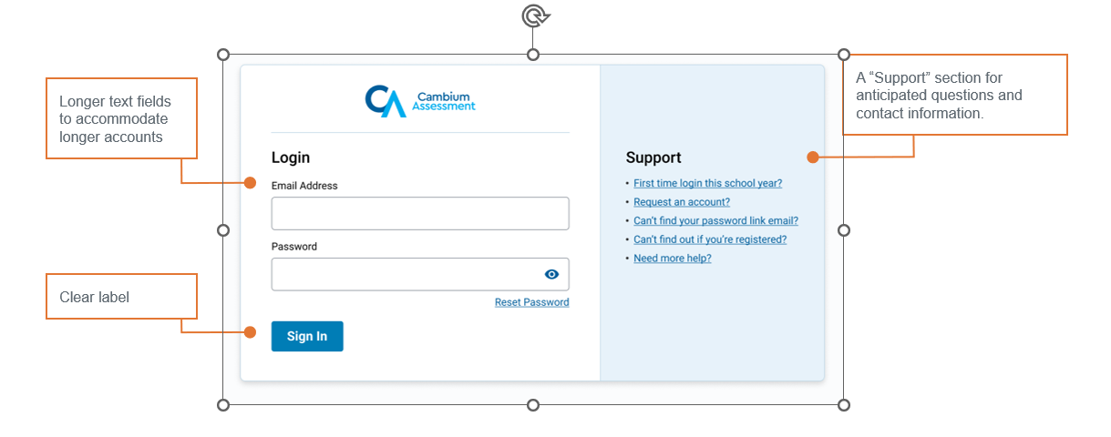
Single Sign-On – User Interface Improvements

Slide 40
Test Information Distribution Engine (TIDE)
Refer to the TIDE User Guide for details.
Features include the following:
  Add/Manage User Accounts
  Review Student Demographic Information
  Review/Edit Student Settings (Note: Accommodations should not be changed directly in TIDE. All accommodations are imported from CT-SEDS.)
  Create/Submit Appeals
  Create Rosters (Understanding and Creating Rosters)
  Order Paper Materials (i.e., large print and braille test booklets)
  Run Participation Reports (Accessing Participation Reports)
Notes:
TIDE supports state, district, and school test coordinators throughout the testing process, from test preparation, to test administration, to post-administration. Refer to the TIDE User Guide for details.
Features include the following:
Add/Manage User Accounts
Review Student Demographic Information
Review/Edit Student Settings (Note: Accommodations should not be changed directly in TIDE. All accommodations are imported from CT-SEDS.)
Create/Submit Appeals
Create Rosters (Understanding and Creating Rosters)
Order Paper Materials (i.e., large print and braille test booklets)
Run Participation Reports (Accessing Participation Reports)
Test Information Distribution Engine (TIDE) User Guide; https://ct.portal.cambiumast.com/resource-item/en/test-information-distribution-engine-tide-user-guide
Understanding and Creating Rosters; https://ct.portal.cambiumast.com/resource-item/en/understanding-and-creating-rosters
Accessing Participation Reports; https://ct.portal.cambiumast.com/resource-item/en/accessing-participation-reports

Slide 41
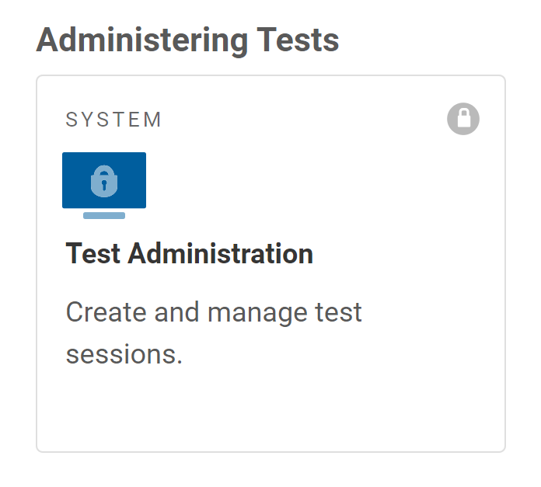
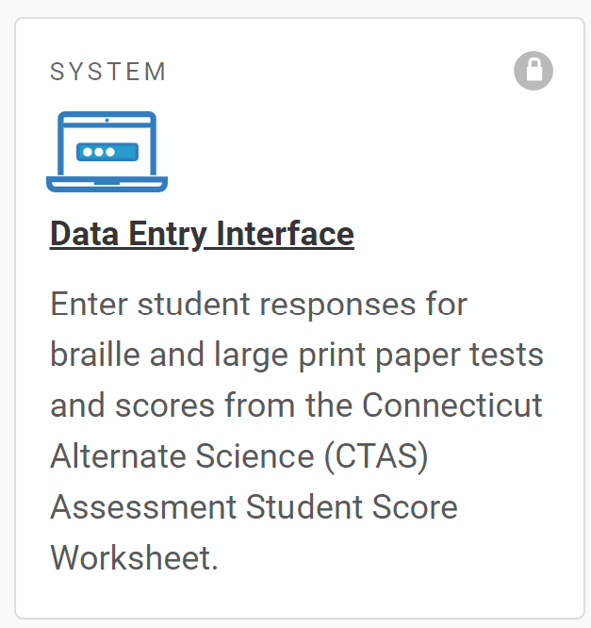
TIDE Reminders
All students taking a summative assessment need to be in TIDE. Work with your PSIS Coordinator if there are concerns about missing students or incorrect student demographics.
All users who are proctoring a summative assessment or need access to the Data Entry Interface (DEI) need to have an account in TIDE.
Notes:
All students taking a summative assessment need to be in TIDE. Work with your PSIS Coordinator if there are concerns about missing students or incorrect student demographics.
All users who are proctoring a summative assessment or need access to the Data Entry Interface (DEI) need to have an account in TIDE. Refer to the User Role Permissions brochure for details about various user roles and corresponding access to different systems for secure online testing: User Role Permissions for Secure Online Systems; https://ct.portal.cambiumast.com/resource-item/en/user-role-permissions-for-secure-online-systems.

Slide 42
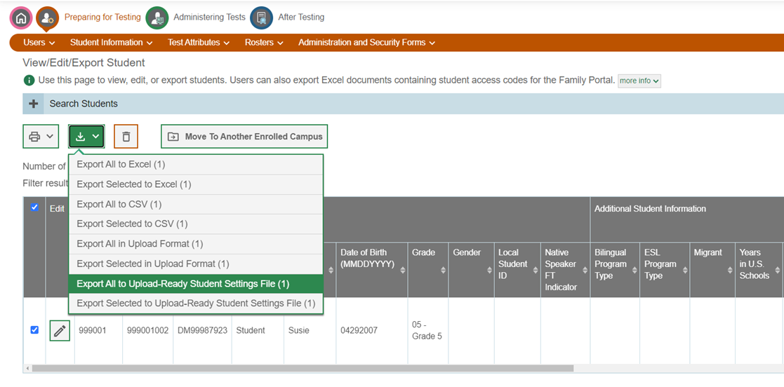
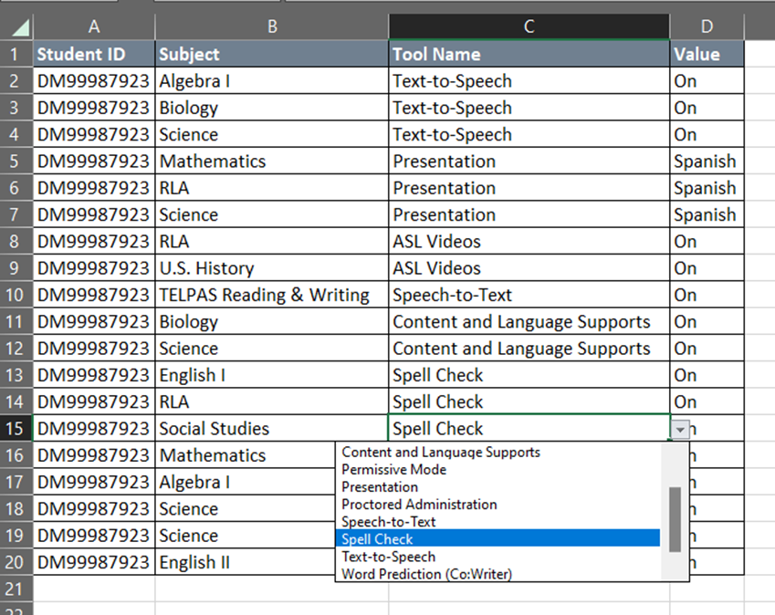
TIDE Upload-ready Student Settings Report
Student settings can be exported from TIDE in the same format as the upload file.

Slide 43
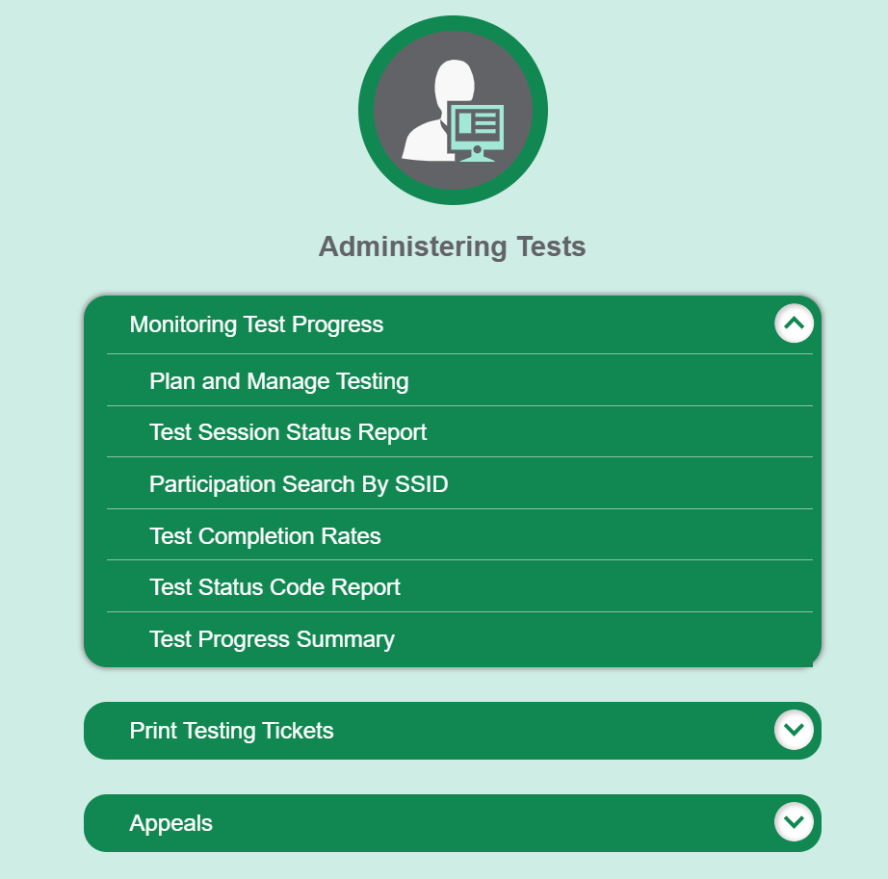
TIDE Participation Reports
Plan and Manage Testing
Test Status Code Report
Test Completion Rates
Test Session Status Report
Test Progress Summary
Notes:
It is very important that districts and schools track test completion for students taking summative assessments. A variety of reports are available in TIDE and can be used as tools to track test completion.
Refer to the Monitoring Test Progress brochure for information on generating Test Status Code Reports and Test Completion Rates in TIDE.
Monitoring Test Progress: Test Status Code Report and Test Completion Rates; https://ct.portal.cambiumast.com/resource-item/en/monitoring-test-progress-test-status-code-report-and-test-completion-rates

Slide 44
TIDE Participation Reports
(Test Completion Rates)
Used to summarize the number and percentage of students who have started or completed a test.
Generated at the district or school level, depending on your user role.
Includes all students in the specified school or district.
Generated for each test to obtain an accurate picture that reflects the testing status of all students for all tests in the school or district.
Notes:
The test completion rate report is a high-level report used to summarize the number and percentage of students who have started or completed a test.
May be generated at the district or school level, depending on your user role.
All students in the specified school or district will be included in this report.
Report should be generated for each test to obtain an accurate picture that reflects the testing status of all students for all tests in the school or district.
Users will be able to view test completion data by combo tests (e.g., completion of both the Math CAT and Math PT).

Slide 45
TIDE Participation Reports
(Test Status Report)
Used to view each student’s test status and all special codes to explain a student’s non-participation in a test.
Displays all test statuses for each test for which each student in a district/school is eligible.
Generated at the district level or at the school level, depending on your user role.
Generated for each test to obtain an accurate picture reflecting the testing status of all students for all tests by school or district.
Useful for summative assessments.
Notes:
This is a specific report used to view each student’s test status and all special codes to explain a student’s non-participation in a test.
It displays all test statuses for each test for which each student in a district/school is eligible.
The participation report may be generated at the district level or at the school level, depending on your user role.
The report should be generated for each test to obtain an accurate picture reflecting the testing status of all students for all tests in the school or district.
This report is particularly useful for summative assessments.

Slide 46
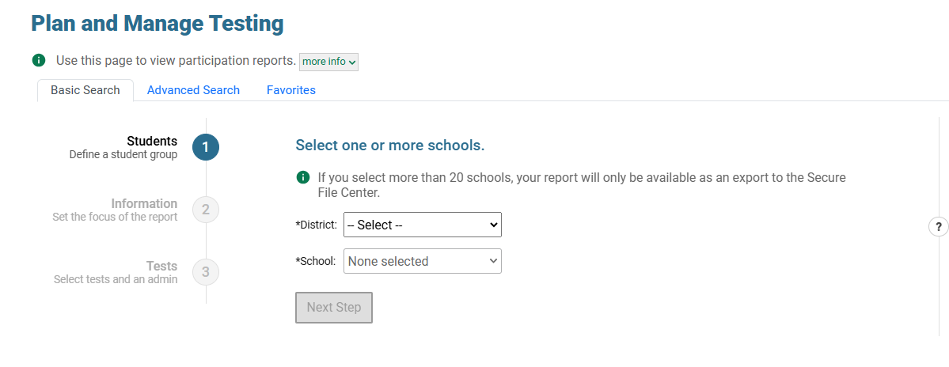
TIDE Participation Reports
(Plan and Manage Testing)
The Plan and Manage Testing Report in TIDE has undergone a complete redesign.
The new design:
Provides a more intuitive, unified interface
Supports users at all levels in quickly finding the information they need to monitor and manage testing
Minimizes mouse clicks and decision points
Notes:
This is a specific report used to view each student’s test status and all special codes to explain a student’s non-participation in a test.
It displays all test statuses for each test for which each student in a district/school is eligible.
The participation report may be generated at the district level or at the school level, depending on your user role.
The report should be generated for each test to obtain an accurate picture reflecting the testing status of all students for all tests in the school or district.
This report is particularly useful for summative assessments.

Slide 47
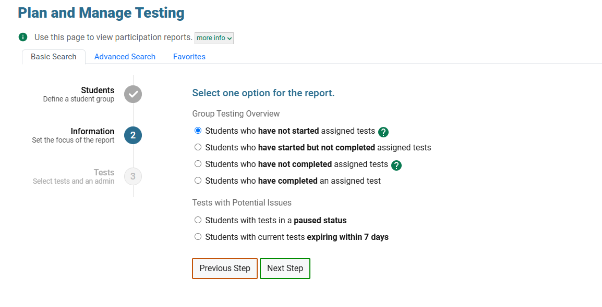

TIDE Participation Reports
(Plan and Manage Testing)
The Plan and Manage Testing Report includes quick-access reports and smart defaults.
This means fewer mouse clicks and fewer decisions required of users to answer questions such as, “Who still needs to test?”
“Smart defaults” means TIDE will preselect as many options as possible based on a user’s role, the most important test window to monitor right now, and so on.

Slide 48
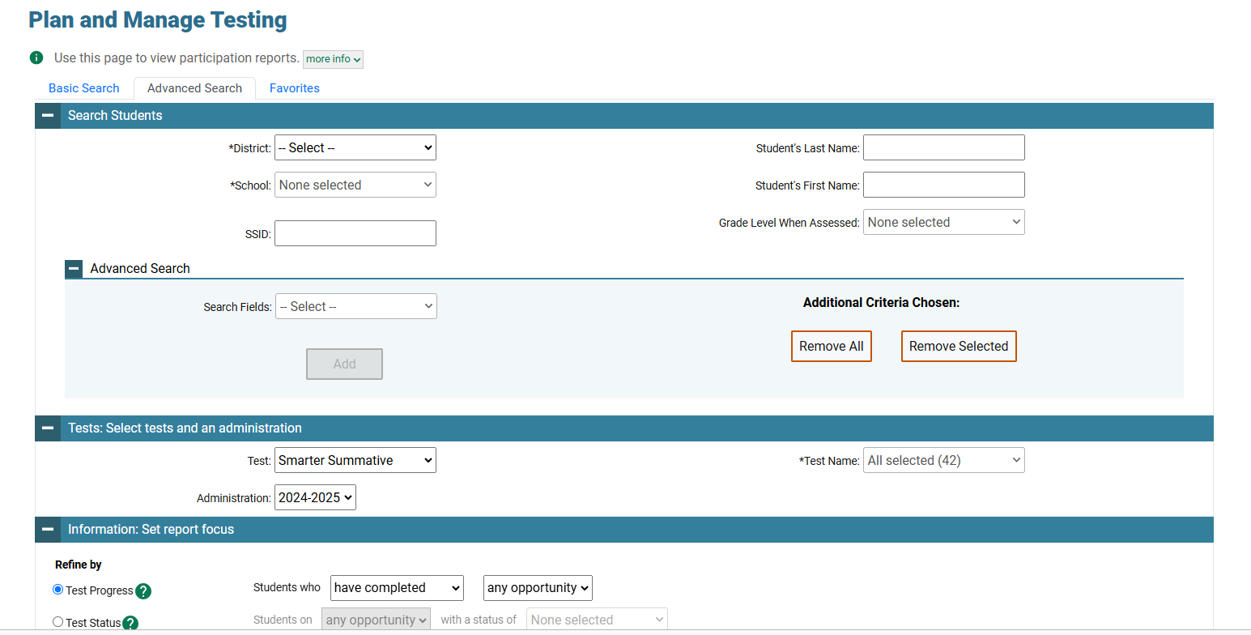
TIDE Participation Reports
(Plan and Manage Testing)
If you need something more than the quick-access report, the original Plan and Manage Testing report can be found under advanced search. This will allow you to create more detailed participation searches.

Slide 49
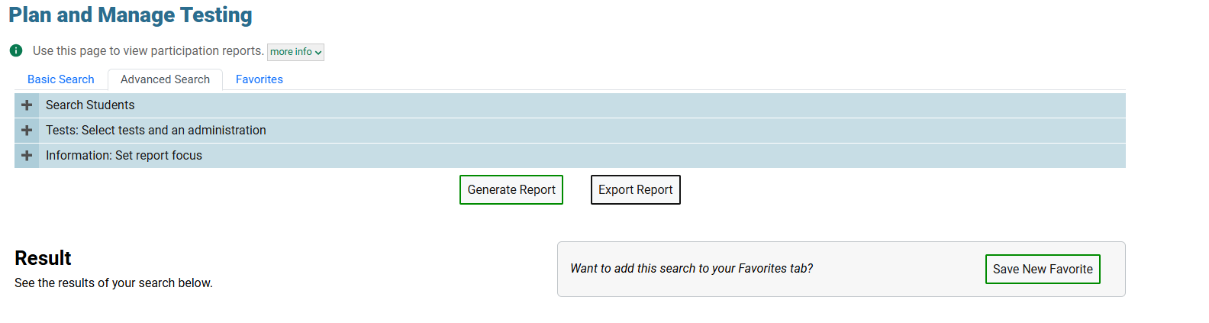

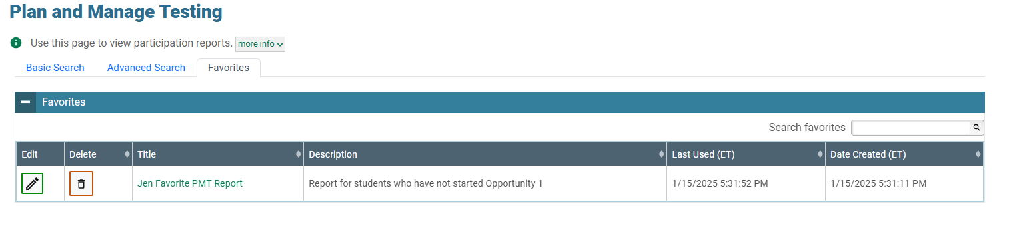

TIDE Participation Reports
(Plan and Manage Testing)
You can also create your own personal report and save it which will allow you to return to and rerun the report.

Slide 50
TIDE Participation Reports
(Test Progress Summary)
The Test Progress Summary provides charts of the information available in Test Completion Report to provide a quick visual reference. You can also view the data on the screen, as well as export it.

Slide 51
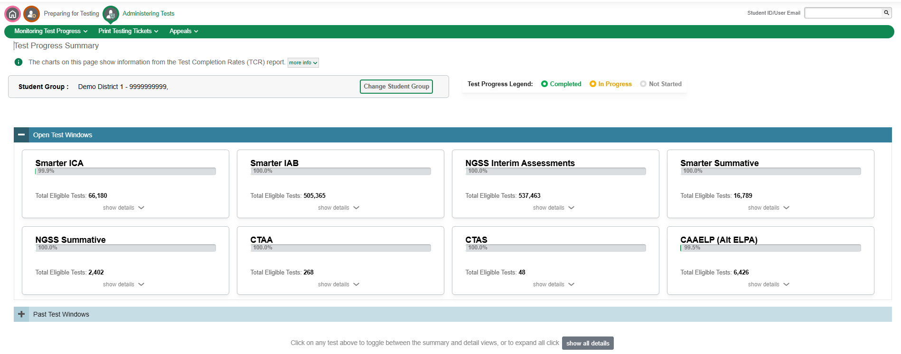
TIDE Participation Reports
(Test Progress Summary)

Slide 52
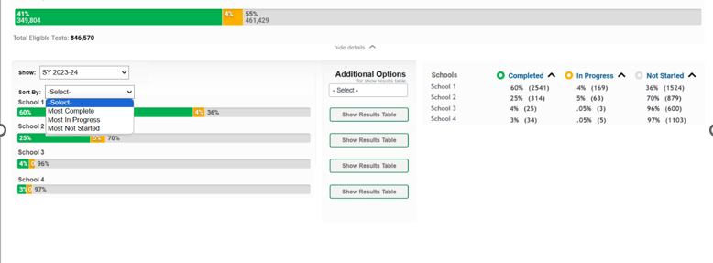
TIDE Participation Reports
(Test Progress Summary)

Slide 53
TDS: Tool Strips
Tools that students use on the tests are typically added inside the context menu. These tools include; TTS, ASL, strikethrough etc. This potentially creates a problem where students don’t know they have access to an important feature like Text-to-Speech or American Sign Language until they “discover” it through opening the context menu.
This has been done for years now to avoid too much clutter on the screen, which might distract students while they are testing.”
Our new feature, called Toolstrips, will elevate really important features like TTS and ASL outside that menu and give them their own dedicated button.

Slide 54
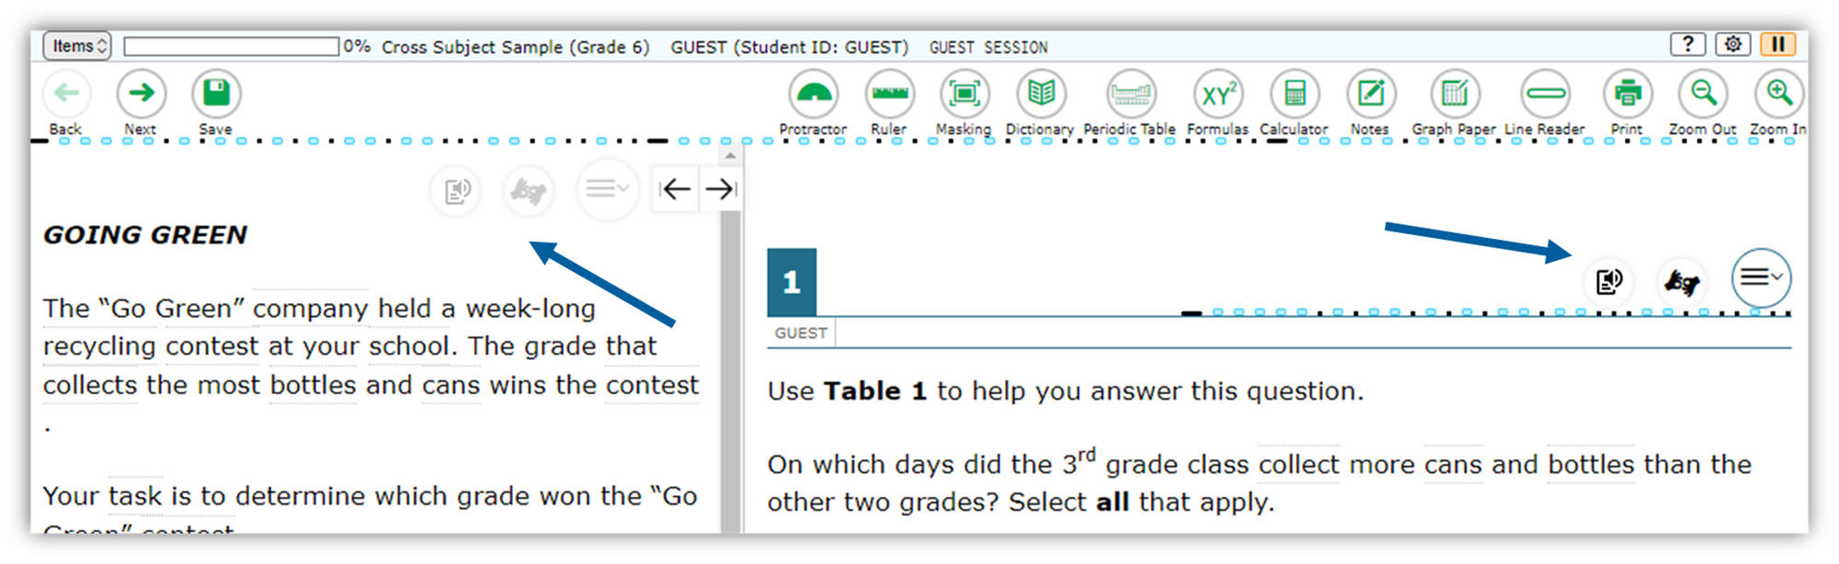
TDS: Tool Strips
New, dedicated buttons for frequently accessed, very important accommodations like TTS and ASL.

Slide 55
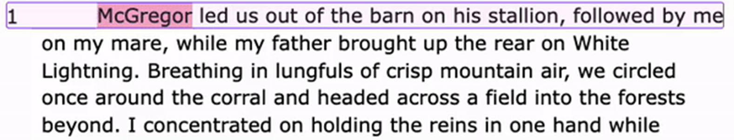
TDS: Text-to-Speech Tracking by Line
TDS highlights words as they are spoken aloud with text-to-speech. CAI has now added the ability to sentence tracking as well.
The new TTS Tracking functionality will now highlight the word that is spoken aloud and the line that the word is on.

Slide 56
Questions
Use “Raise Hand” Tool

Slide 57
Accessibility and Special Populations
Notes:
Now we will discuss a variety of accessibility features that are available on statewide assessments, including language supports for ELs/MLs, and accommodations for eligible students with IEPs and Section 504 Plans.

Slide 58
Special Populations Calendar 2024-25
Connecticut Alternate Assessment Eligibility Form | CAAELP (Grades K-12 EL/ML students) and CTAA and CTAS (Grade 11)- Due December 20, 2024 CTAA (Grades 3-8, and newly identified students in Grade 11) and CTAS (Grades 5, 8, and newly identified students in Grade 11) – Due February 1, 2025
Emergency Medical Exemptions | Smarter Balanced, NGSS, and CTAA/CTAS - due by June 6, 2025
Customized or Temporary Accommodations | DAs must request well in advance of testing.
Early Stopping Rule CTAA/CTAS | Student Response Check (SRC) completed by TEA no later than February 1, 2025. The DA in TIDE submits Connecticut Alternate Assessment System Early Stopping Rule Request and Attestation Form via TIDE Forms by March 1, 2025.
Notes:
When planning for the upcoming assessment window, keep in mind these deadlines related to students that qualify for alternate assessments, or those that may need an emergency medical exemption or temporary accommodation due to an injury.
For specifics, refer to the CSDE Assessment Guidelines; https://ct.portal.cambiumast.com/resource-item/en/csde-assessment-guidelines or contact Deirdre Ducharme- Deirdre.Ducharme@ct.gov or Katie Seifert- Katherine.Seifert@ct.gov.
Additional Details:
The Connecticut Alternate Assessment Eligibility Form, embedded within CT-SEDS, must be approved, verified, finalized, and implemented prior to testing. Teams should make every effort to finalize student eligibility by the dates shown here to ensure the correct rostering of students into the specific assessments designated per their IEPs. Refer to this resource, Connecticut Alternate Assessment Eligibility Form, (https://ct.portal.cambiumast.com/resource-item/en/connecticut-alternate-assessment-eligibility-form) located on the portal.
If you have questions about the LAS Links or CAAELP Domain Exemptions, refer to: CAAELP-Domain-Exemptions.pdf; https://ct.portal.cambiumast.com/resource-item/en/caaelp-domain-exemptions and LAS Links Domain Exemption Students - 2024-2025 https://laslinks.com/connecticut-information/.
Details about Medical Exemptions, customized accommodations, and temporary accommodations are located in the CSDE Assessment Guidelines.
ESRs: TEAs should be completing the ESR Student Response Checks for applicable students and submit the ESR Request and Attestation Form, to their DAs if they meet eligibility criteria. DAs should have this information by February 1st and the submission of the ESR needs to be done no later than March 1st. For more information, refer to the Connecticut Alternate Assessment System Early Stopping Rule and Student Response Check; https://ct.portal.cambiumast.com/resource-item/en/connecticut-alternate-assessment-system-early-stopping-rule-and-student-response-check.
How to Submit the Early Stopping Rule (ESR) Request and Attestation Form in TIDE for District Administrators; https://ct.portal.cambiumast.com/resource-item/en/how-to-submit-the-early-stopping-rule-esr-request-and-attestation-form-in-tide

Slide 59

Who is Eligible for Supports and Accommodations?
Notes:
We are now going to take a few moments to review who is eligible for the different accessibility supports.

Slide 60

Who is Eligible for Supports and Accommodations?
Designated supports and accommodations are determined based on student need.
IEP determined per the PPT
Section 504 Plan determined by the Section 504 Team
EL/ML Language Plan determined by an educator team
Educator(s) recommendation determined by an educator team
Notes:
There are a variety of features that are built into the test delivery interface as supports to assist students in navigating and completing their assessments. For example, students can use annotation features such as note taking, highlighting, and marking items for review. These are examples of universal tools that can be accessed by any student as needed.
Other accessibility supports are available to students with a higher need but should be determined by an educator team, including but not limited to Planning and Placement Teams and Section 504 Teams. When considering eligibility for accessibility supports, determine if the student:
Is in the general education curriculum, and based on their current learning profile, they need and utilize a designated support for access.
Is an EL/ML and, based on their current learning profile, they need and utilize a designated support for access to language.
Has a Section 504 Plan or an IEP that has determined they require either a designated support or an accommodation for access.
Note: Only students with an IEP/Section 504 Plan are eligible to participate on statewide assessments with accommodations.

Slide 61
Who Determines the Need and Provision of Accessibility Supports?
Educator Teams include but are not limited to the:
Classroom teacher
Special Education Teacher
English learner/multilingual learner instructor
Special service providers (e.g., speech/language specialist, reading/math coach)
Student
Parent/Guardian
Planning and Placement Team
Section 504 Team
Notes:
Who determines the need and provision of accessibility supports?
When considering the provision of accessibility supports for a student, the educator team should include but not be limited to the following staff members listed on this slide as applicable:
Classroom teacher
Special Education Teacher
English learner/multilingual learner instructor
Special service providers (e.g., speech/language specialist, reading/math coach)
Student
Parent/Guardian
Planning and Placement Team
Section 504 Team
These teams of educators should review the student’s current learning profile including their strengths to aid in determining which accessibility support best meets their current access needs. Educators should be aware of the following:
The types of supports available for each assessment and their functionality.
What supports the student currently uses with automaticity and accuracy that decrease barriers.
If the student has an IEP or Section 504 plan, that these supports are global and imbedded across the student’s plan as much as applicable.

Slide 62
Pre-planning Consideration for District Administrators
How many students receive designated supports, language supports (for EL/ML), and accommodations?
What types of designated supports, language supports, and accommodations are provided, and are some used more than others?
Does the student have an IEP or Section 504 Plan? If so, accessibility needs should be considered across instructional and assessment areas.
What is our district plan for identification of accessibility features, implementation, evaluation of usage, and determination of need based on student barriers and increased access?
Notes:
District Administrators should develop a plan for the accurate usage and identification of accessibility supports to reduce barriers and the potential for inadvertently causing barriers due to the misalignment of supports. This will aid in the student having the appropriate accessibility supports not only on summative testing but during instruction.

Slide 63
Considerations for Educator Teams Including PPT and Section 504 Teams
What are the specific barriers that the individual has that require universal tools, designated supports, language supports, or accommodations within the learning environment?
What considerations have been reviewed for student accessibility and independence along the continuum of services for access?
What are the specific universal tools, designated supports, language supports, or accommodations being used within the learning environment with success that are providing the student with access?
Has the student utilized the universal tools, designated supports, language supports, or accommodations within the educational setting? If yes:
  What was the level of student usage?
  Has it shown that it increases accessibility?
  Has it shown that it increases independence?
Notes:
When considering accessibility supports, educators, including those on the PPT and Section 504 Teams should consider the following:
What are the student’s strengths that can be built upon to increase access?
What are the barriers the student is currently facing in accessing the learning environment?
What tools are they currently using with success (automaticity, accuracy, independence, positive reporting by student)?
Has the team reviewed accessibility through the continuum of supports? (Low to High)?

Slide 64
Considerations for Educator Teams Including PPT and Section 504 Teams
Trial the designated support, language supports (for EL/ML), and/or accommodations within the practice test in TIDE. What was the student’s level of:
  Automaticity
  Independence
  Usage
  Talk to the student about their perception of how well the universal tools, designated supports, language supports, or accommodations worked.
  CCSSO Questions to Ask When Selecting Accessibility Supports (various tools that elicit discussion with educator teams, student, parent/guardian, and classroom teacher)
Notes:
Trialing supports is key in determining if the accessibility tool is the right fit for the student in effort to reduce barriers. Educators can use practice tests and interim assessments to ensure the student is able to and wants to use the support. Take time to talk with the student to discuss if the student sees benefit to the tool, and uses it with accuracy, automaticity, and with independence. By doing this you will gain information to ensure appropriate accessibility supports.
Has the student practiced with these tools before?
Has the student used these tools within the instructional setting?
How does the student report they feel about the tool, does it help or is it confusing to use?
Is there evidence to support that this tool reduces the barrier?
How well do students who receive universal tools, designated supports, language supports, and accommodations perform on assessments (e.g., Smarter Balanced, NGSS, summative and interim)? If students are not meeting the expected level of performance, is it due to:
Students not having access to the necessary instruction?
Students not receiving the appropriate universal tools, designated supports, language supports or accommodations?
Students using universal tools, designated supports, or accommodations that were not effective?
Students unfamiliar with how to use and/or access the universal tools, designated supports, or accommodations?
What combinations of universal tools, designated supports, language supports, and accommodations seem to be effective? What data do you have to support this?

Slide 65
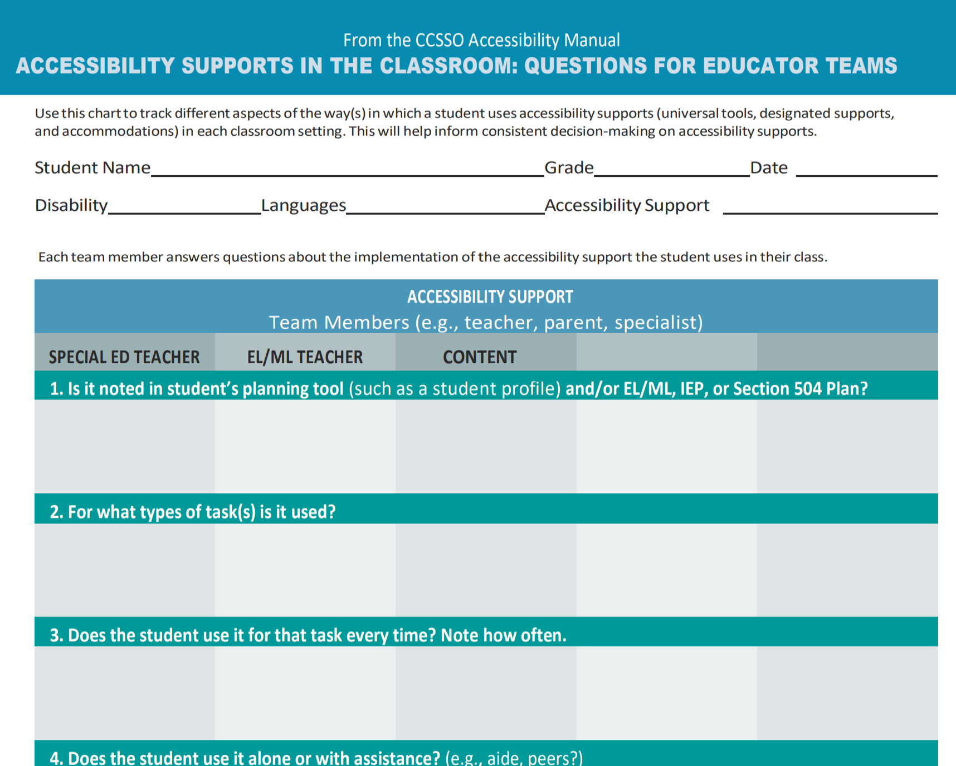
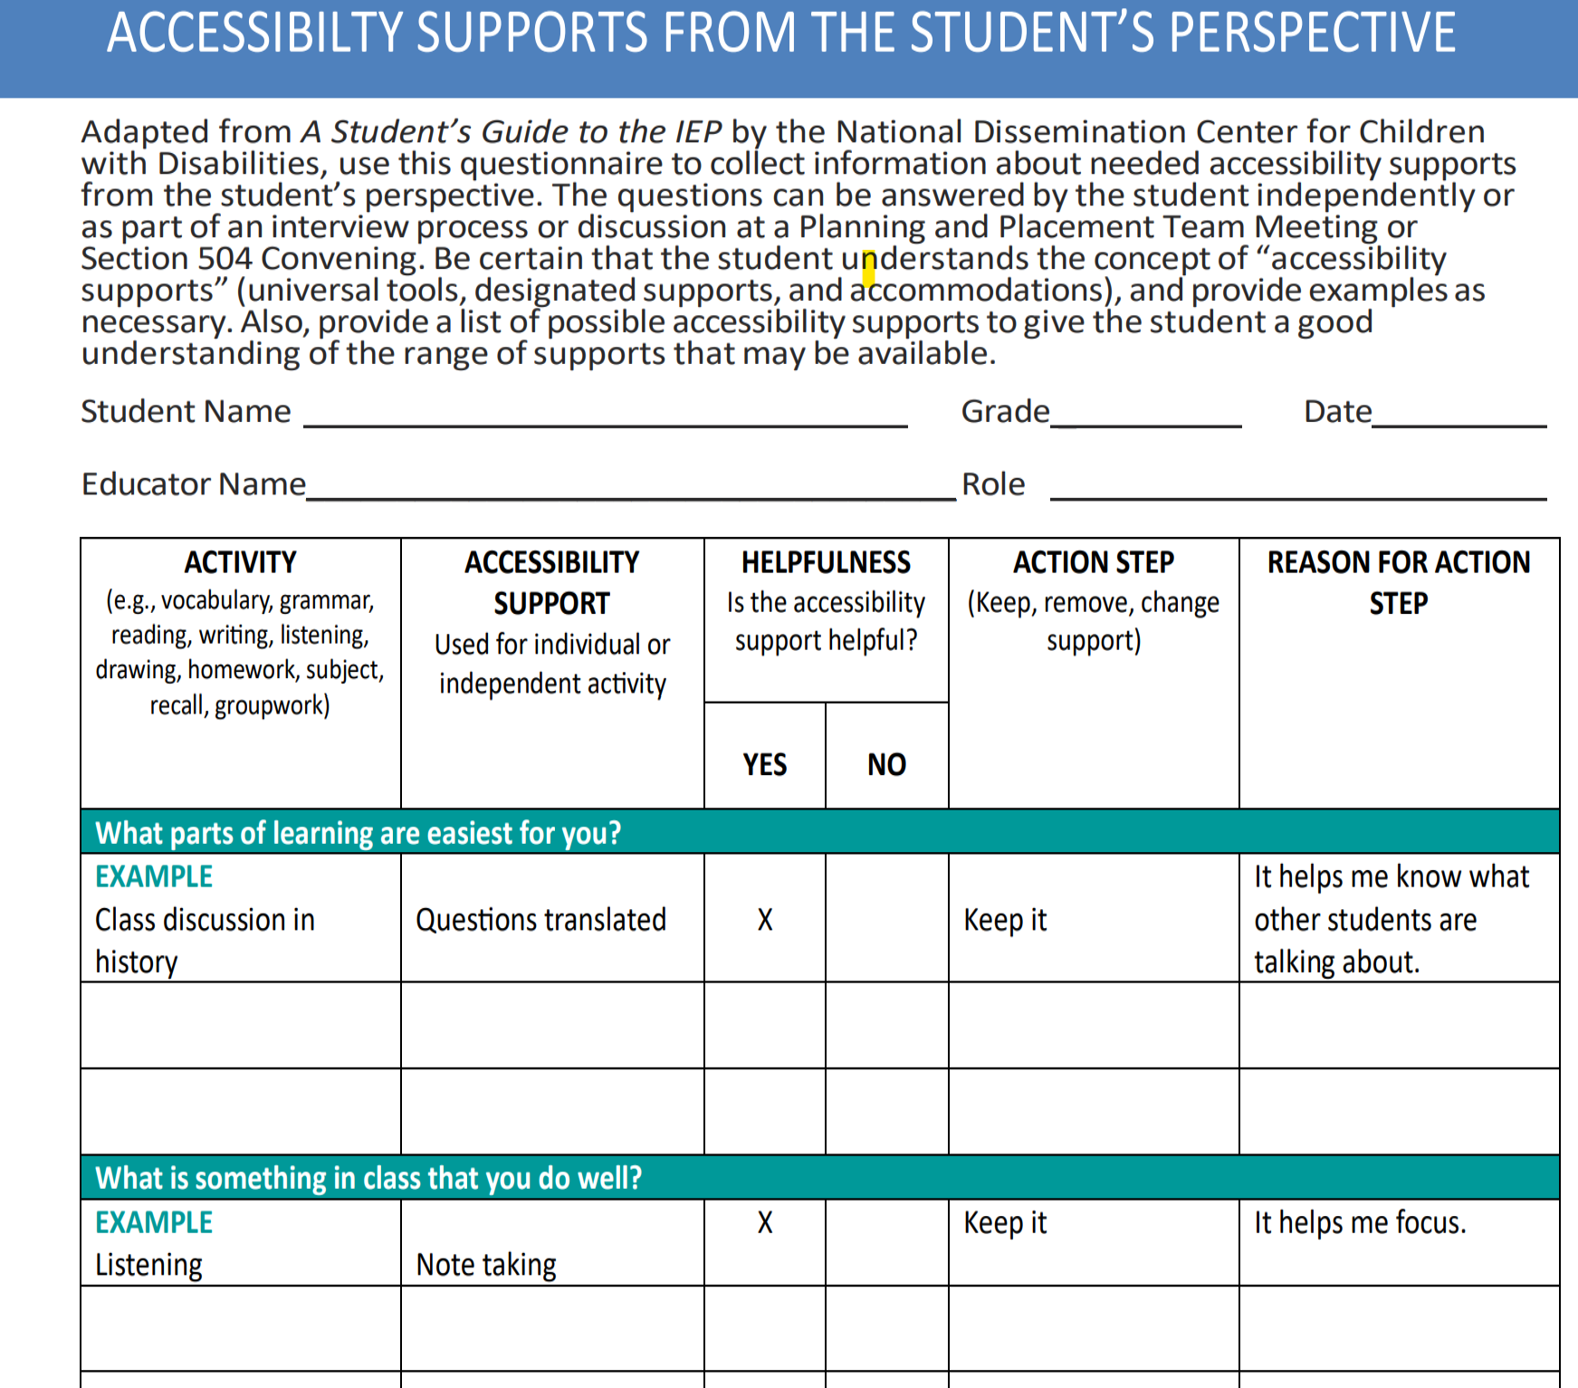
Resources for Accessibility Planning
Excerpts from the CCSSO Questions to Ask When Selecting Accessibility Supports
Notes:
Created by the Counsel of Chief State School Officers, these resources can be used by educators to help guide their identification and provision of accessibility supports to meet the individual needs of learners.
The first tool (shown to the left), the Accessibility Supports in the Classroom: Questions for Educator Teams, helps educator teams collaborate and collect feedback from all vested parties, including the student if applicable. Use this chart to track different aspects of the way(s) in which a student uses accessibility supports (universal tools, designated supports, and accommodations) in each classroom setting. This will help inform consistent decision-making on accessibility supports.​
​
Each team member answers questions about the implementation of the accessibility support the student uses in their class.​
​
Is it noted in student’s planning tool (such as a student profile) and/or EL/ML, IEP, or Section 504 Plan?​
For what types of task(s) is it used?​
Does the student use it for that task every time? Note how often.​
Does the student use it alone or with assistance? (e.g., aide, peers?)​
If more than one support is available, how do these supports interact? (e.g., does one accessibility support seem more effective when used with another on a task?)​
If the accessibility support is presented differently on the test (e.g., DESMOS calculator), how can you give the student opportunities to practice using it?
The second tool displayed on the right is the Accessibility Supports From the Student’s Perspective. This tools is so important to gain a student’s perspective on which tools and accessibility features they feel are helpful to them. This not only creates voice and choice for the student but empowers them in their learning. ​The questions can be answered by the student independently or as part of an interview process. Be certain that the student understands the concept of “accessibility supports” (universal tools, designated supports, and accommodations), and provide examples, as necessary. Teams may want to do this as part of a trial or after accessing tools on the practice test. Educators may also want to provide a list of possible accessibility supports to provide the student with an understanding of the range of supports that may be available.​ If trialing the support, keep in mind that the teacher may need to explicitly show the student how and when to use it. After use and practice, determine if this is the best fit for this student.
This resource is located on the CSDE webpage: https://portal.ct.gov/-/media/sde/student-assessment/special-populations/ccsso_educator-team-accessibility-supports-implementation-and-followup-questionnaires_master.pdf?rev=9c69a7534709410c9b40ed411e8090c4&hash=84026AD06AF4C13E5994BDA2984940A3.

Slide 66
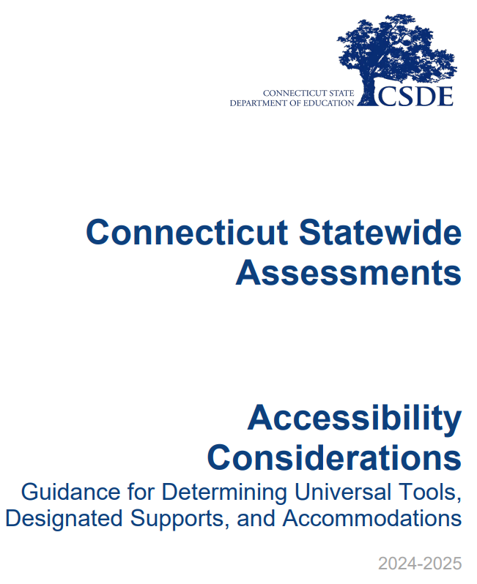
How are Accessibility Needs Determined?
Develop a systematic process across the district.
Provide training to educators on available accessibility tools and supports.
Communicate expectations and responsibilities to ensure effective implementation and fair/valid test experience for all students.
CT-Assessments-Accessibility-Considerations.pdf
Notes:
The CSDE recommends a consistent and systematic process be communicated and implemented by districts to determine the need and appropriateness for accommodations and supports provided to individual students with accessibility considerations. The selection of supports is not a one size fits all. Educators making these determinations should be aware of and familiar with the functionality of supports prior to determining them for the individualized and unique needs of students.
Additionally, educators should ensure that students are familiar with, and demonstrate accuracy, automaticity, and independence in usage of supports prior to determining them as a tool for summative testing. Training on accessibility supports should be at the district level for teachers and then if determined as a need for a student the student should have the opportunity for training and practice on the application of the tool within the testing platform.
The CT-Assessments-Accessibility-Considerations.pdf resource provides more information about implementing a clear and consistent process for determining accessibility features. https://ct.portal.cambiumast.com/content/contentresources/en/CT-Assessments-Accessibility-Considerations.pdf

Slide 67

Which Types of Accessibility Supports are Available?
Notes:
We are now going to take a few moments to review who is eligible for the different accessibility supports available.
The best resource to begin with is the Assessment Guidelines (CSDE Assessment Guidelines; https://ct.portal.cambiumast.com/resource-item/en/csde-assessment-guidelines) and Accessibility Chart (shown on the next slide).

Slide 68


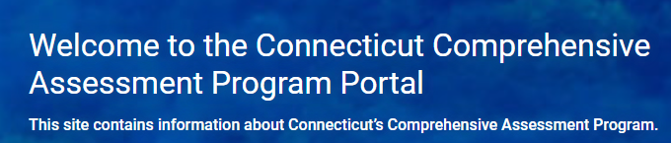



2024-25 Accessibility Features for Connecticut Smarter Balanced and
Next Generation Science Standards (NGSS) Assessments
Universal Tools Available to All Students
Embedded | Non-Embedded
Digital Notepad | Scratch Paper/ whiteboard with marker
English Glossary ^
Expanded Passages/ Stimuli/Items
Highlighter
Keyboard Commands
Line Reader
Mark for Review
Math Tools
Writing Tools
Strikethrough
Zoom
Desmos Calculator (Math Segment 1 ONLY, Grades 6-8; Science Grades 5, 8, and 11 | Calculator (Science Grades 5, 8, &11)
NGSS Periodic Table (Grades 8 & 11) English and Spanish | NGSS Periodic Table (Grades 8 & 11) English and Spanish *
Breaks
Designated Supports Available to Any Student With a Need Determined by Educator Teams
Embedded | Non-Embedded
Print Size Online | Magnification
Color Contrast | Color Contrast
Masking | Color Overlay
Mouse Pointer
Streamline
Text-to-Speech- ELA Items (NOT ELA Reading Passages), Math and Science Stimuli and Items | Read Aloud (English) ELA Items, Math and Science Stimuli and Items ~ + Review Read Aloud Guidelines; NGSS Read Aloud Guidelines
Text-to-Speech-Spanish (Math, Science Stimuli and Items) * | Read Aloud in Spanish (Math, Science) * ~ + Review Guidelines for Spanish Read Aloud of Stimuli and Items
Spanish Presentation (Math, Science) (Toggle) *
Translations Glossary (Math) (Includes Illustration Glossary as an available language support) * | Translation Glossary (Math) (Includes Illustrative Glossary as an available language support) (Note: Requires large-print test booklet and must be requested through CAI Help Desk.) *^
Turn off any universal accessibility tool
 | Smarter Balanced Translated Test Directions (Math, ELA) *
 | Bilingual Dictionary (Science) *
 | Simplified Test Directions (Test Administration Manual for Math and ELA) ^ +
 | Native Language Reader of Test Directions (Test Administration Manual for Math, ELA, Science) * +
 | Translated Test Directions in ASL (Test Administration Manual for Math, ELA, Science) +
 | Printed Test Directions in English (Test Administration Manual for Math, ELA, Science)
 | Separate Setting
 | Amplification +
 | Noise Buffer
Accommodations Available to Students with an IEP or Section 504 Plan
Embedded | Non-Embedded
Permissive Mode (compatible third-party accessibility software)
Refreshable Braille
Braille Type (UEB/UEB Nemeth) | Braille Booklet (UEB/UEB Nemeth)
 | Large Print Booklet
American Sign Language Video ( ELA Listening, Math) ^ | Human Signer/Visual Support for ELA Items and Math/Science Stimuli and Items # ~ +
 | Human Signer/Visual Support for ELA Reading Passages (Grades 3-8) # ~ +
Braille/Audio Transcription (ELA Listening) +
Closed Captioning (ELA Listening)
Text-to-Speech ELA Reading Passages (Grades 3-8); Complete the Decision Guidelines for Text-to-Speech of the Smarter Balanced ELA Reading Passages | Read Aloud ELA Reading Passages (Grades 3-8) # ~ + Complete the Documented Evidence for a Read Aloud of the Smarter Balanced ELA Reading Passages
 | Alternate Response Options
Word Prediction ^
Speech-to-Text + ^ | Scribe # ~ +
 | Abacus
 | (Braille/Talking) Specialized Calculator (Math Grades 6-8 Segment 1 ONLY; Science Grades 5, 8, & 11) +
 | Calculator (Math Grades 6-8 Segment 1 ONLY) #
 | Multiplication Table (Grades 3-8)
 | 100s Number Table (Grades 3-8)
 | Math Manipulatives (Grades 3-8) # +
 | Print on Demand # + (Contact the CSDE)
 | Medical Device (e.g., glucose monitor)
 | Customized Medical Accommodations # ~ + (Contact the CSDE)
Key
^ NOT available for Science
* Suggested for English learners/multilingual learners (ELs/MLs)
+ Individual Test Setting
# Special Documented Accommodation
~ Requires Trained Educator
This resource was updated 11/22/24.
Refer to the CSDE Assessment Guidelines for detailed information on universal tools, supports, and accommodations.
Notes:
The Accessibility Chart, shown here, was developed specifically for the Smarter Balanced and the Next Generation Science Standards Assessments. It provides 3 tiers of support ranging from Universal Tools (shown to the far left in blue), designated supports (shown in orange and located in the center of the chart), and accommodations shown in red to the far right. You will notice that within each section, embedded and non embedded tools are listed along with hyperlinks to additional information if applicable. Please note the user Key, located on the far right, that includes symbols noting tools that are not available on science versions, those accommodations that are non-standard and require additional teacher training, along with other tools that might be appropriate for ELs/MLs.
While the Accessibility Chart is a great reference, details about each of these accessibility features are documented in the CSDE Assessment Guidelines.
Accessibility Charts, also available for the LAS Links Assessment and the Connecticut SAT School Day, are posted to the CSDE web page.
Additional Information:
Accessibility Chart for Smarter Balanced/NGSS: Accessibility Chart; https://ct.portal.cambiumast.com/resource-item/en/accessibility-chart
Other Accessibility Charts are available for the CT SAT School Day and LAS Links –available on the CSDE webpage. Connecticut Sensible Assessment System--Summative Assessment - End-of-Year; https://portal.ct.gov/sde/student-assessment/main-assessment/student-assessment/summative-assessment---end-of-year
CT SAT School Day: PowerPoint Presentation; https://portal.ct.gov/-/media/sde/student-assessment/sat/2024_25-ct-sat-school-day-accessibility-chart-fall-version.pdf?rev=61abb70fb53f435bbfad65eea3d32460&hash=CBDFA77A9EA595794CEB46B27F8BEA52
LAS Links: las-links-accessibility-chart-final.pdf; https://portal.ct.gov/-/media/sde/student-assessment/special-populations/las-links-accessibility-chart-final.pdf?rev=a9cb927b69fd4717911a7271fd568dc3&hash=A16B453E1EA2739002CCAD62A422E6E1

Slide 69
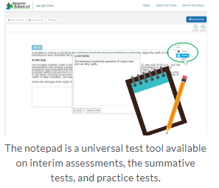
Understanding Universal Tools
Universal Tools (embedded and non-embedded): available to all students based on student preference and selection (e.g., highlighter, notepad).
What to Know
Universal Tools
are automatically available to all students through the test delivery system.
can be turned off by the test administrator/proctor prior to testing.
include non-embedded tools if needed by the student (Refer to Accessibility Chart).
Resource: Five Built-in Test Tools Students Should Know (and Use!)
Notes:
Here we provide the definition of universal tools and considerations the team can use. Remember universal tools are available to ALL students. However, just because they are available doesn’t mean that they are appropriate for all students.
Therefore, universal tools can be turned off by the test administrator/proctor prior to testing. Also remember, that in the context of statewide assessments, different assessments use different platforms and offer different tools. Take time to learn about the unique accessibility features provided for each assessment.
Resource: Familiarize Students with Smarter Balanced Universal Test Tools; https://smarterbalanced.org/five-built-in-test-tools-students-should-know-and-use/
Accessibility Chart; https://ct.portal.cambiumast.com/resource-item/en/accessibility-chart

Slide 70
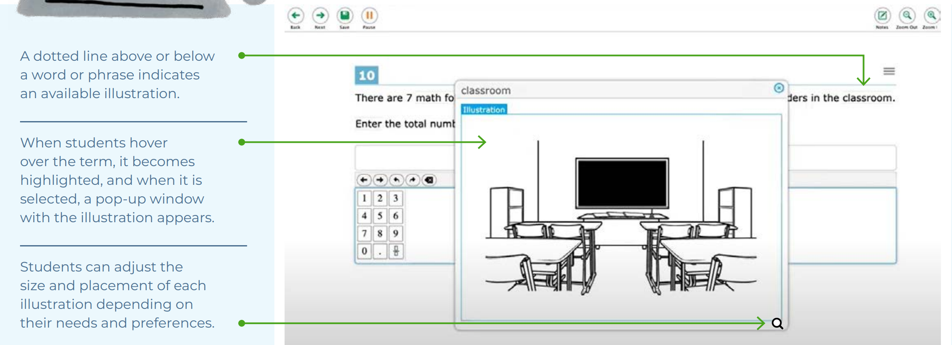
Understanding Designated Supports
Designated Supports (embedded and non-embedded): accessibility features available for use by any student (determined by educator team with input from the parent/guardian and student).
Examples: color contrast, text-to-speech of items, illustration glossary (math) as shown to the right.
Notes:
Here we provide the definition of designated supports and considerations the team can use. Designated supports are accessibility features available for any student whom the need has been indicated by an educator team with input from the parent/guardian and student. This should be based off the students specific and unique learning profile.
When teams make this recommendation, it should also be consistently utilized across educational settings as applicable.

Slide 71
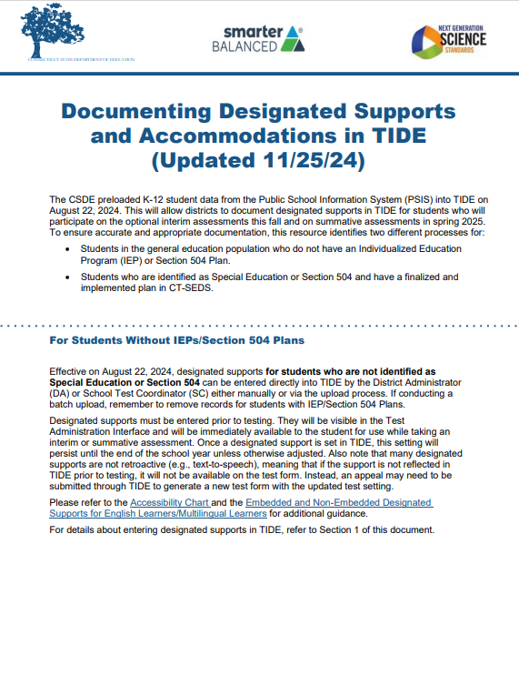
Determining Designated Supports for Students Without IEPs/Section 504 Plans
Establish a process for setting designated supports in TIDE for eligible students who do not have an IEP or Section 504 Plan.
Test supports must be set prior to the start of the student’s test session.
If using a batch file to upload accessibility supports to TIDE, be sure to remove any records of students that have IEP/Section 504 Plans.
Refer to the Documenting Designated Supports and Accommodations in TIDE and the TIDE User Guide for more information.
Notes:
When entering designated supports for students who do not have an IEP or Section 504 plan the DA should establish a process for setting designated supports in TIDE. Any test support needs to be assigned in advance of testing. Students with a finalized and implemented plan will have designated supports and accommodations sync from CT-SEDS to TIDE. Designated supports and accommodations should not be manually entered or batch uploaded for students with an IEP or Section 504 Plan.
Refer to Documenting Designated Supports and Accommodations in TIDE for more information about this process. https://ct.portal.cambiumast.com/resource-item/en/documenting-designated-supports-and-accommodations-in-tide
Additional Resources:
TIDE User Guide: Test Information Distribution Engine (TIDE) User Guide; https://ct.portal.cambiumast.com/resource-item/en/test-information-distribution-engine-tide-user-guide
Accessing TIDE: Accessing-TIDE-Brochure.pdf; https://ct.portal.cambiumast.com/content/contentresources/en/Accessing-TIDE-Brochure.pdf
User Role Permissions for Secure Online Systems: User Role Permissions for Secure Online Systems; https://ct.portal.cambiumast.com/resource-item/en/user-role-permissions-for-secure-online-systems
CT-SEDS to TIDE Designated Supports/Accommodations Sync Frequently Asked Questions; https://ct.portal.cambiumast.com/resource-item/en/ct-seds-to-tide-designated-supports-and-accommodations-sync-faq
Cross-Checking Student TIDE Test Settings and CT-SEDS; https://ct.portal.cambiumast.com/resource-item/en/cross-checking-student-tide-test-settings-and-ct-seds

Slide 72
Understanding Accessibility Supports
Accommodations (embedded and non-embedded): are changes in procedures or materials that increase equitable access during assessment. They:
generate valid assessment results for students who need them;
allow students to show what they know and can do.
Examples: Assistive technology, American Sign Language, braille, closed captioning
What to Know
Accommodations:
must be documented for the student’s current grade in a finalized and implemented plan in CT-SEDS.
sync directly from CT-SEDS to TIDE.
should be integrated into all district, school, and/or classroom processes which prioritize student access needs.
Notes:
Accommodations are for students with an IEP or 504 plan. These are changes in materials or procedures that increase equitable access during assessments. They allow students to show what they know and can do. Like designated supports they should be consistently accessed and incorporated into the students instructional setting. Students should have familiarity and independence with both accommodations and designated supports that are assigned.
As mentioned before accommodations that are in finalized and implemented plans in CT-SEDS will sync to TIDE.
Additional Resources:
Refer to the CSDE Assessment Guidelines for details about accommodations available for each assessment: CSDE Assessment Guidelines (cambiumast.com)
Documenting Designated Supports and Accommodations in TIDE; https://ct.portal.cambiumast.com/resource-item/en/documenting-designated-supports-and-accommodations-in-tide
CT-SEDS to TIDE Designated Supports/Accommodations Sync Frequently Asked Questions; https://ct.portal.cambiumast.com/resource-item/en/ct-seds-to-tide-designated-supports-and-accommodations-sync-faq
Cross-Checking Student TIDE Test Settings and CT-SEDS; https://ct.portal.cambiumast.com/resource-item/en/cross-checking-student-tide-test-settings-and-ct-seds

Slide 73


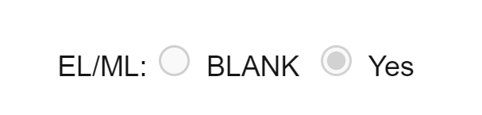
Designated Support/Accommodation Eligibility
The IDEA or Section 504 indicator (based on the PSIS registration fields) must be set to Yes for accommodations to sync from CT-SEDS.
The EL/ML designation must be set to Yes in PSIS if the student is identified as EL/ML.
Accommodations should NEVER be manually entered in TIDE unless authorized by the CSDE.
Notes:
When reviewing accommodations in the student dashboard in TIDE you will want to be aware of the following indicators and how they are set. ​These demographic fields must be updated in PSIS as applicable to students.
Eligibility for any embedded or non-embedded accommodation requires the IDEA or Section 504 indicator (based on the PSIS registration fields) set to Yes. Without this indication, accommodations cannot sync to TIDE from CT-SEDS.​
The student’s EL/ML designation must be set to Yes in PSIS if the student is identified as EL/ML.​
Accommodations should NEVER be manually entered or batch uploaded in TIDE. The IEP/Section 504 is the source of truth! If corrections are necessary, contact the Case Manager and an amendment of edit/revise can be conducted.

Slide 74
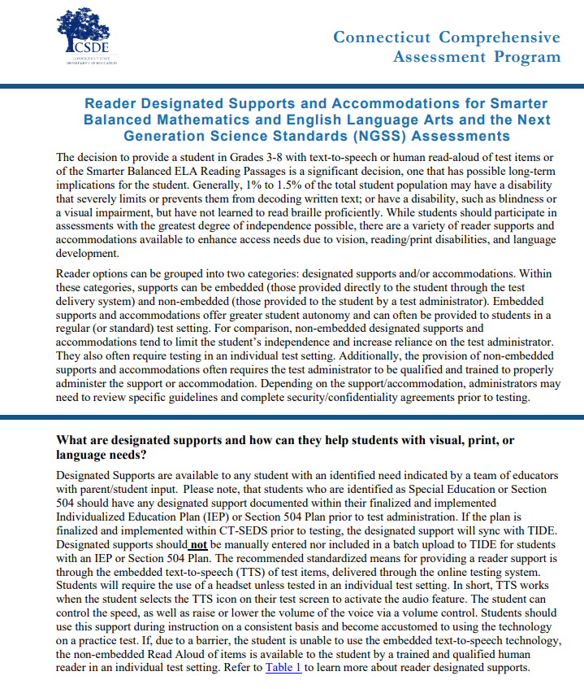
Reader Options Resources for Smarter Balanced/NGSS
Reader Designated Supports and Accommodations for Smarter Balanced Mathematics and English Language Arts and the Next Generation Science Standards (NGSS) Assessments
This resource provides information about designated supports and accommodations that provide access to print/text.
Notes:
Many students benefit from reader supports especially those students who have a reading or print disability, such as dyslexia. Other students with visual disabilities may need accessibility to information on the computer because they can’t see the text. The resource shown on this slide provides a range of reader supports available based on documented need. This guide provides educators with a review of reader options and the required documentation needed to administer a human reader. Reader supports are available on Smarter Balanced and NGSS assessments and the corresponding documents and resources associates with each accessibility feature. These reader options can be grouped into two categories: designated supports and/or accommodations. Within these categories, supports can be embedded (those provided directly to the student through the test delivery system) and non-embedded (those provided to the student by a test administrator).
Reader Designated Supports and Accommodations for Smarter Balanced Mathematics and English Language Arts and the Next Generation Science Standards (NGSS) Assessments; https://ct.portal.cambiumast.com/resource-item/en/reader-designated-supports-and-accommodations-for-sb-and-the-ngss

Slide 75
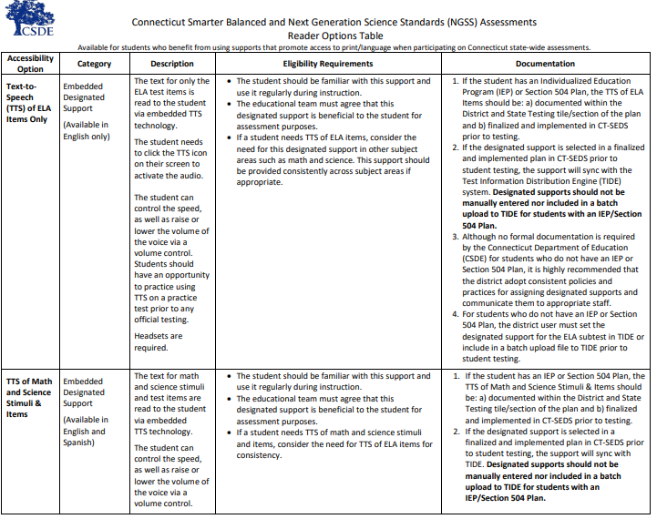
Reader Options Table for Smarter Balanced & NGSS
Connecticut Smarter Balanced and NGSS Assessments Reader Options Table
This resource provides a quick glance at reader supports by accessibility type and assessment.
Notes:
The Connecticut Smarter Balanced and NGSS Assessments Reader Options Table​ provides an in-depth look at the different reader options available for SB/NGSS. It defines the purpose, test requirements, and necessary documentation (if applicable) for various embedded and non-embedded Smarter Balanced and NGSS reader supports and accommodations. This tool can help educators determine the most appropriate accessibility features that support access to print/text.
Connecticut Smarter Balanced and NGSS Assessments Reader Options Table; https://ct.portal.cambiumast.com/resource-item/en/connecticut-smarter-balanced-and-ngss-assessments-reader-options-table

Slide 76
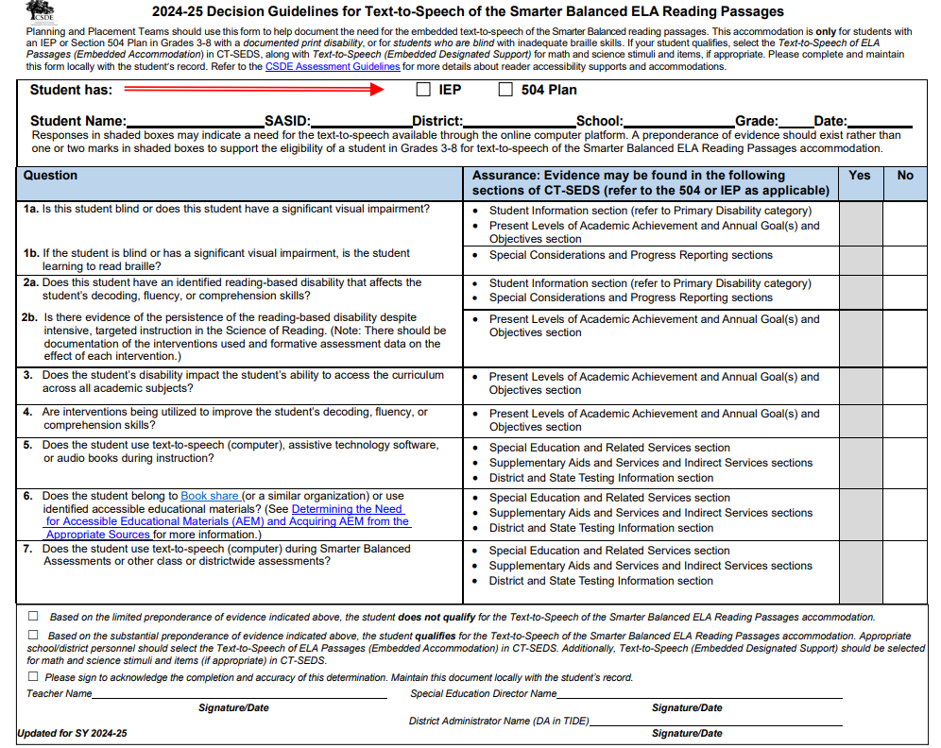
Decision Guidelines for Text-to-Speech of the Smarter Balanced ELA Reading Passages
Decision Guidelines for Text-to-Speech of the Smarter Balanced ELA Reading Passages
Used by educators (including PPTs/Section 504 Teams) to establish the extent of need of this reader accommodation for the text-to-speech (TTS) of ELA Reading Passages.
This accommodation is intended for students:
  with a documented print disability
  with significant visual disabilities
  who are blind with inadequate braille skills
Complete and maintain this form locally with the student’s record.
Notes:
The questions provided in this document can assist IEP/Section 504 decision-making teams in determining whether it is appropriate to indicate that the student should be provided the reading passages for an ELA reading assessment via a text-to-speech accommodation.
PPTs should use this form to help document the need for the embedded text-to-speech of the Smarter Balanced reading passages. This accommodation is only for students with an IEP or Section 504 Plan in Grades 3-8 with a documented print disability, or for students who are blind with inadequate braille skills. Additionally, if the student has a print/reading-based disability (dyslexia), there must be strong evidence of the persistence of the disability despite intensive, extensive, and targeted instruction that is based on the Science of Reading and that the student needs extensive supports to access print. There should be documentation of the interventions used and formative assessment data on the effects of each intervention. The student should be familiar with this accommodation and use it regularly during instruction, and typically, the student would most likely be using alternate educational materials (AEM) during instruction.
If your student qualifies, select the Text-to-Speech of ELA Passages (Embedded Accommodation) in CT-SEDS, along with Text-to-Speech (Embedded Designated Support) for math and science stimuli and items, if appropriate. Please complete and maintain this form locally with the student’s record.
This accommodation is intended to be used for students with a documented print disability, or for students who are blind with inadequate braille skills. Please complete and maintain this form locally with the student’s record.
Decision Guidelines for Text-to-Speech of the Smarter Balanced ELA Reading Passages; https://ct.portal.cambiumast.com/resource-item/en/decision-guidelines-for-text-to-speech-of-the-smarter-balanced-ela-reading-passages

Slide 77
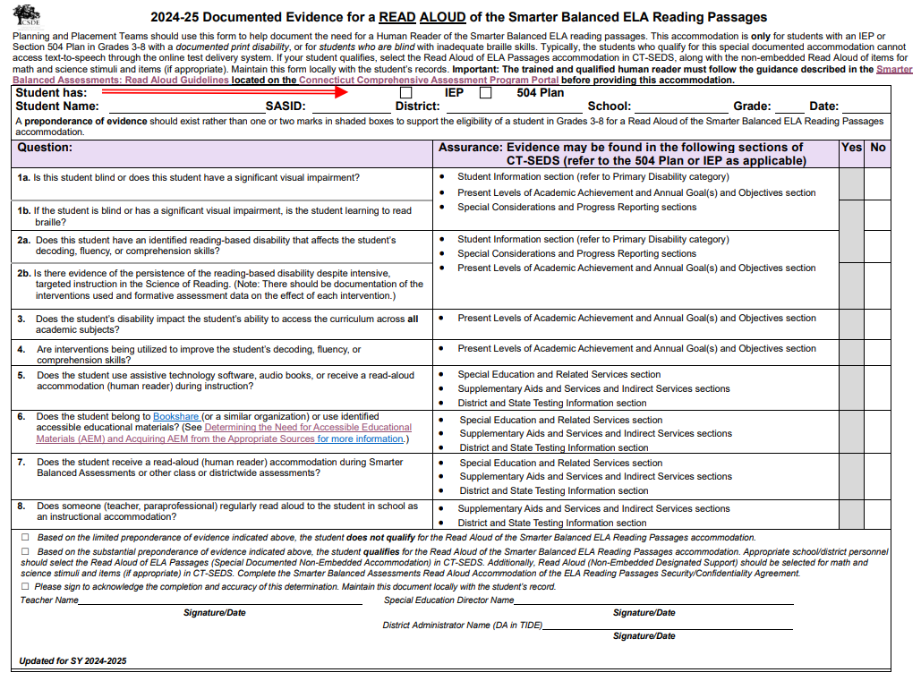
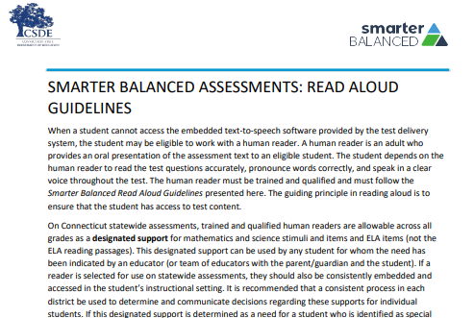
Documented Evidence for Read Aloud of the Smarter Balanced ELA Reading Passages
Non-Embedded Read Aloud of ELA Reading Passages
Teams should complete the Documented Evidence for a Read Aloud of the Smarter Balanced ELA Reading Passages and maintain with the student’s record.
The qualified individual acting as the reader should review the Smarter Balanced Assessments Read Aloud Guidelines and sign the Test Security/Confidentiality Agreement Form (Appendix B of document).
Notes:
The Non-Embedded Special Documented Read Aloud of ELA Reading Passages (Human Reader) screener should be used when a student cannot access the embedded text-to-speech software provided by the test delivery system, the student may be eligible to work with a human reader. ​
​
Guidance for Read Aloud Accommodation: ​
Human readers are allowable for ELA reading passages, in addition to items, as a special documented accommodation for eligible students in Grades 3-8 who have an implemented IEP or 504 Plan in CT-SEDS. A human reader is an adult who provides an oral presentation of the assessment text to an eligible student. The student depends on the human reader to read the test questions accurately, pronounce words correctly, and speak in a clear voice throughout the test. The human reader must be trained and qualified and must follow the Smarter Balanced Read Aloud Guidelines presented here. The guiding principle in reading aloud is to ensure that the student has access to test content. ​
​
If a reader is selected for use on statewide assessments, they should also be consistently embedded and accessed in the student’s instructional setting. It is recommended that a consistent process in each district be used to determine and communicate decisions regarding these supports for individual students.​
​
If the accommodation or special documented accommodation is selected in an implemented IEP or Section 504 Plan in CT-SEDS prior to student testing, the accommodation will import to the TIDE system. Please note students should not have both as they are conflicting accommodations. ​
​
Before serving as a human reader, the teacher/proctor must review the Read Aloud Guidelines and sign the Test Security/Confidentiality Agreement Form (Appendix B of the Read Aloud Guidelines). Once signed, the form should be returned to the District Administrator for signature and filed with the student record.
Documented Evidence for a Read Aloud of the Smarter Balanced ELA Reading Passages; https://ct.portal.cambiumast.com/resource-item/en/documented-evidence-for-a-read-aloud-of-the-smarter-balanced-ela-reading-passages
Smarter Balanced Assessments: Read Aloud Guidelines; https://ct.portal.cambiumast.com/resource-item/en/smarter-balanced-assessments-read-aloud-guidelines

Slide 78
What are Special Documented Accommodations?
Special Documented Accommodations are:
non-standard accommodations.
align to those used by the student during instruction and in other learning environments.
must be administered in an individual test setting.
Special Documented Accommodations may include:
• Scribe
• Read Aloud of ELA Reading Passages
• Human Signer/Visual Support for Smarter Balanced ELA or Math and/or NGSS (includes directions, math and science items and stimuli, and ELA items [Not Reading Passages])
• Human Signer/Visual Support for ELA Reading Passages
• Math Manipulatives (Grades 3-8)
• Non-Embedded Calculator (Math Grades 6-8, calculator-allowed items only)
• Print on Demand
• Customized Accommodation
Notes:
In exceptional circumstances, there may be a student whose disabilities are such that the allowable embedded and non-embedded accommodations described in the CSDE Assessment Guidelines (https://ct.portal.cambiumast.com/resource-item/en/csde-assessment-guidelines) provide insufficient access to the Smarter Balanced and/or NGSS Assessments.
In this case, non-standard accommodations may be determined by the Planning and Placement Team (PPT)/Section 504 Team for students with an identified need based on evidence documented throughout the IEP/Section 504 Plan. These accommodations typically align to those used by the student during instruction and in other learning environments.
Special Documented Accommodations; https://ct.portal.cambiumast.com/resource-item/en/process-for-requesting-special-documented-accommodations

Slide 79
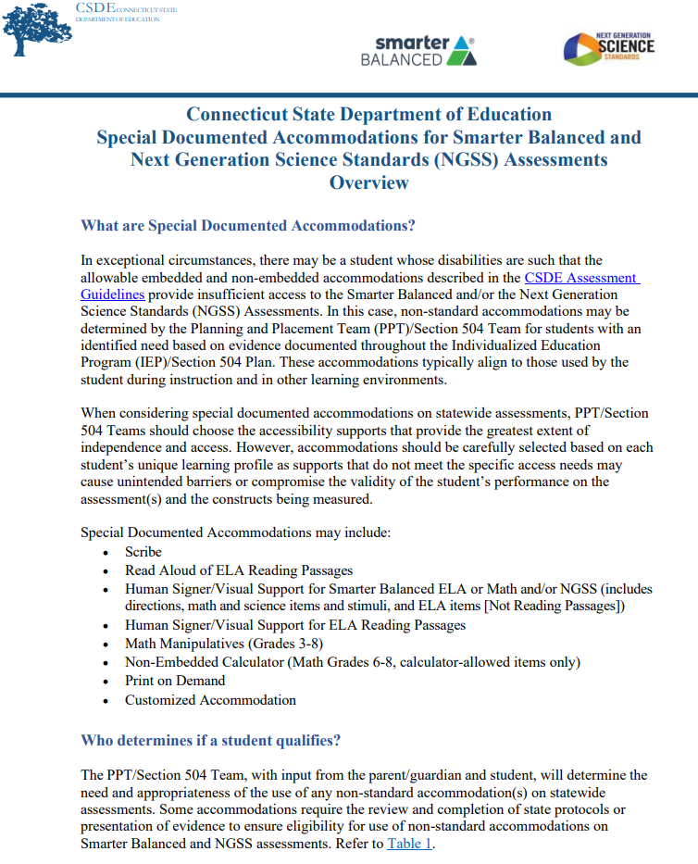
Special Documented Accommodations
Teams and DAs should:
review the Special Documented Accommodations for Smarter Balanced and Next Generation Science Standards (NGSS) Assessments Overview for a listing of corresponding guidelines and protocols.
work with teachers/test administrators to access and review applicable guidelines for those that qualify well in advance of testing.
ensure completion/signoff of a security/confidentiality form (collect and maintain locally).
Notes:
DA's need to follow guidance for special documented accommodations. Also customized accommodations need to be cleared through CSDE. ​
​
DA's need to develop a plan for reviewing:
Accommodations and Special Documented Accommodations (DA's need to work with their Data Manager in CT-SEDS and TIDE to verify the accommodation reports for student's who have accommodations assigned either through a 504 plan or IEP.)​
TTS of ELA Passages guidelines and Read Aloud of Passages guidelines (DAs should develop a plan for reviewing and maintaining these documents within their district)​
Training ​
Prepare for accommodations implementation for summative assessment​
Scheduling of assessment both practice and summative and room assignments for separate setting​
Staff assignment​
Materials needed for example math manipulative if selected, headphones, ​etc.
Special Documented Accommodations; https://ct.portal.cambiumast.com/resource-item/en/process-for-requesting-special-documented-accommodations
CSDE Assessment Guidelines; https://ct.portal.cambiumast.com/resource-item/en/csde-assessment-guidelines

Slide 80
Large Print and Braille Test Booklets

Slide 81
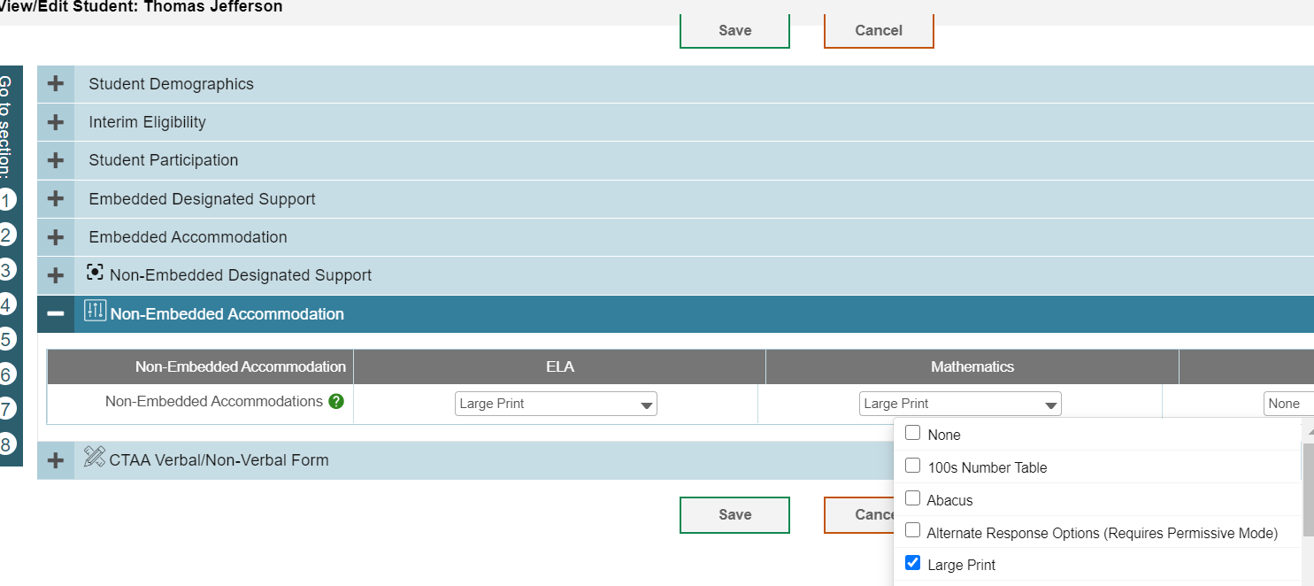
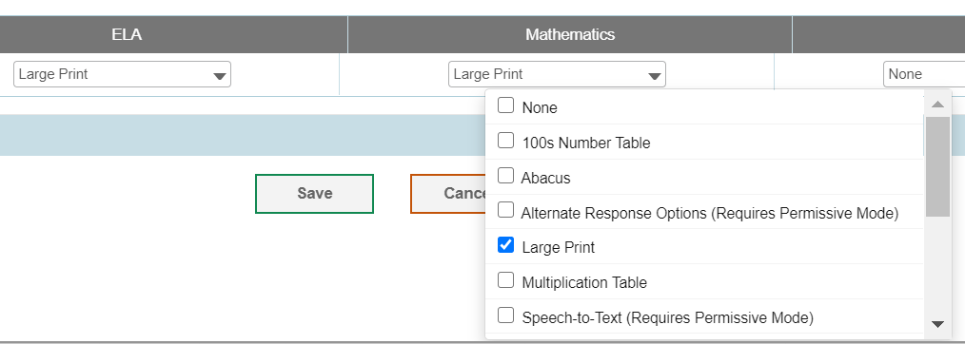
Large Print and Braille Test Booklets
District Administrators can order large-print and braille kits for Smarter Balanced and NGSS in TIDE any time after January 27, 2025.
Confirm that the student has the non-embedded accommodation set properly in TIDE. If the accommodation is missing or is incorrectly reported, contact the student’s Case Manager in CT-SEDS.
Notes:
Students that are unable to access the online assessment with embedded and non-embedded accommodations may be eligible to take the test using a large print or braille test booklet.
Even if this accommodation is selected in CT-SEDS, the DA still needs to place this order within TIDE.
These test materials must be ordered by the DA for Testing in TIDE on or after January 27, 2025.
The PPT or Section 504 Team must select these accommodations in CT-SEDS. Once the plan is implemented, the accommodations will sync to TIDE. Look for the Large Print selection in TIDE (refer to image on slide).
The DA will want to review the student dashboard and for this year collaborate with the special education teacher to ensure the correct Braille presentation is ordered in TIDE.
The following braille presentations are available. Refer to your student’s IEP for details on braille type:
UEB Contracted + Nemeth Math
UEB Contracted (No Math Content)
UEB Contracted + Nemeth
UEB Uncontracted + Nemeth Math
UEB Uncontracted (No Math Content)
UEB Contracted + UEB Math
UEB Uncontracted + UEB Math

Slide 82
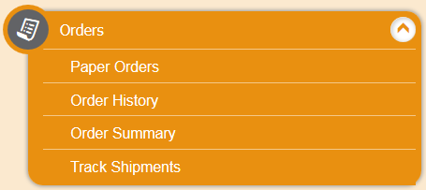
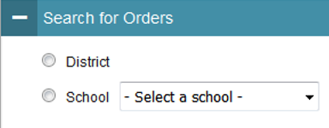
How to Order Large Print and Braille Test Booklets
Step 1: From the Orders task menu on the TIDE dashboard, the DA selects Paper Orders.
Step 2: Search for orders by District or School.
Step 3: Enter the quantity needed for each of the materials needed.
Districts can track shipments in TIDE.
Notes:
The DA will receive instructions with the test materials. As a reminder, tests are secure and should be securely maintained before, during, and after testing.
Once the student has completed testing, the teacher will use the Data Entry Interface to transcribe student responses to all subtests. This is how the tests are scored, and scores are reported. All transcriptions must be made by May 30, 2025. All test systems will close at the end of business on the last day of testing.

Slide 83
The Connecticut Alternate Assessment System (CTAA, CTAS, & CAAELP)
Notes:
We are now going to briefly discuss the purpose for alternate assessments.

Slide 84
What are the characteristics of a student with the most significant cognitive disabilities?
The Connecticut Alternate Assessment System is designed for a very small number of children with the most significant cognitive disabilities. Characteristics include:
The identification of one or more of the existing categories of disability under the IDEA
Significant Intellectual Impairment
Functional adaptive skills are well below age level expectations
Need for intensive instruction and significant supports
Notes:
The following characteristics describe a student with the most significant cognitive disabilities. The Planning and Placement Team will need to review and document certain criteria using the Connecticut Alternate Assessment Eligibility Form, which is embedded within CT-SEDS. To qualify the student must:
be identified with one or more of the existing categories of disability under the IDEA;
have a significant Intellectual Impairment;
have functional adaptive skills that are well below age level expectations; and
require intensive instruction and significant supports.
Additional Resources:
Frequently Asked Questions and Answers about the Connecticut Alternate Assessment System; https://ct.portal.cambiumast.com/resource-item/en/frequently-asked-questions-and-answers-about-the-connecticut-alternate-assessment-system
FAQ About the Connecticut Alternate Assessment System Eligibility Form; https://ct.portal.cambiumast.com/resource-item/en/faq-about-the-connecticut-alternate-assessment-system-eligibility-form
Connecticut Alternate Assessment Eligibility Form; https://ct.portal.cambiumast.com/resource-item/en/connecticut-alternate-assessment-eligibility-form

Slide 85
What are the characteristics of alternate assessments?
Based on grade-level learning standards developed for students with the most significant cognitive disabilities, the Connecticut Alternate Assessment System adjusts for:
  Depth (the level of cognitive complexity of the knowledge, skills, and abilities within the standard),
  Breadth (how many standards are measured), and
  Complexity (describes the difficulty of content with built-in scaffolding to support accessibility needs).
Notes:
The Connecticut Alternate Assessment System is designed to measure the knowledge and skills of students with the most significant cognitive disabilities as required by the IDEA and ESSA. They support student independence to the greatest extent possible by making academic and language content accessible and the expected achievement levels appropriate. These assessments adjust for the depth, or cognitive complexity of skills and abilities, within the grade level standards. The assessments measure fewer standards, and the content adjusts for difficulty and is scaffolded to support the diverse range of accessibility needs within this student population.
Additional Information:
Depth- refers to how much of a single skill is measured by an item; for example, a deeper level item may address both description and dialogue narrative techniques whereas an item of less depth may only address description.
Breadth- refers to the scope or range of the content standards covered by the items in the AA-AAAS. In some cases, the AA-AAAS may cover the same content standards as the general assessment (perhaps, the essence of those standards).
Complexity-refers specifically to the format of the passages, items, and tasks with built in scaffolding (documented in the secure Directions for Test Administration- applicable to the CTAA Math and ELA; and the CTAS Performance Task script read by the teacher).

Slide 86
What are the characteristics of alternate assessments?
Alternate Assessments incorporate:
Optimal testing conditions that must be provided to all students who take the test
Accessibility features that must be provided to students as needed
Accommodations and assistive technology that students should receive per their IEP (if applicable) in conjunction with CSDE testing policies and procedures
Notes:
The combination of accessibility features, optimal testing conditions, and accommodations are incorporated within the alternate assessment design and are intended to maximize students’ test access and performance.
​

Slide 87
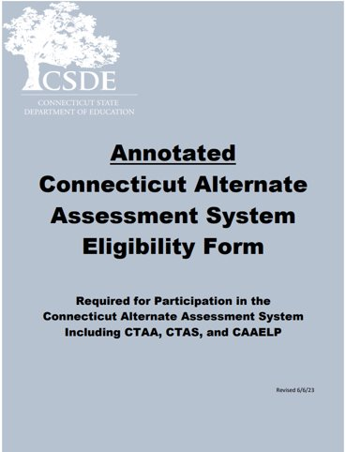
Connecticut Alternate Assessment System for Eligible Students
PPTs determine eligibility by completing the Connecticut Alternate Assessment System Eligibility Form in CT-SEDS.
If the student doesn’t meet eligibility, plan for standard testing with accommodations and assistive technology (if applicable).
Once IEP is finalized and implemented, CT-SEDS will sync with TIDE to turn on the Alternate Assessment Indicator.
Refer to the Annotated Connecticut Alternate Assessment System Eligibility Form for additional considerations and guidance.
Notes:
The Connecticut Alternate Assessment System Eligibility Form is used to determine eligibility for the Alternate Assessment System through discussion at the Planning and Placement Team (PPT) meeting. This document is required to register students for the CTAA, the CTAS and the CAAELP. PPT teams complete this form via the PPT process within CT-SEDS using the embedded form in the District and State Testing Tile. Once the form is completed and verified within the tile, and the IEP is finalized and implemented within CT-SEDS, there will be a sync with TIDE to turn the Alt Indicator on.
An important reminder: This assessment is designed for a small, specialized subgroup of students (approximately one-percent) with the most complex and significant needs. Districts should review local eligibility processes and screenings to ensure that there is not an overrepresentation of students selected for the alternate assessments.
The Annotated document may be accessed on the CSDE Comprehensive Assessment Program Portal. This tools helps guide IEP teams in the correct determination and evidence for documenting within the IEP a significant cognitive disability.
Annotated Connecticut Alternate Assessment Eligibility Form; https://ct.portal.cambiumast.com/resource-item/en/annotated-connecticut-alternate-assessment-eligibility-form

Slide 88



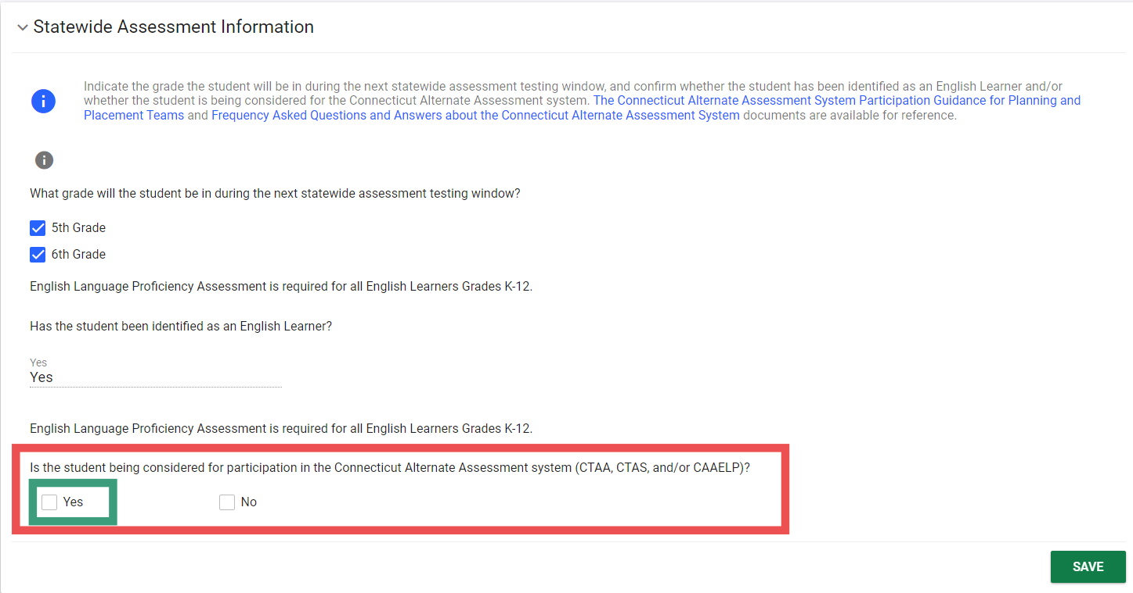
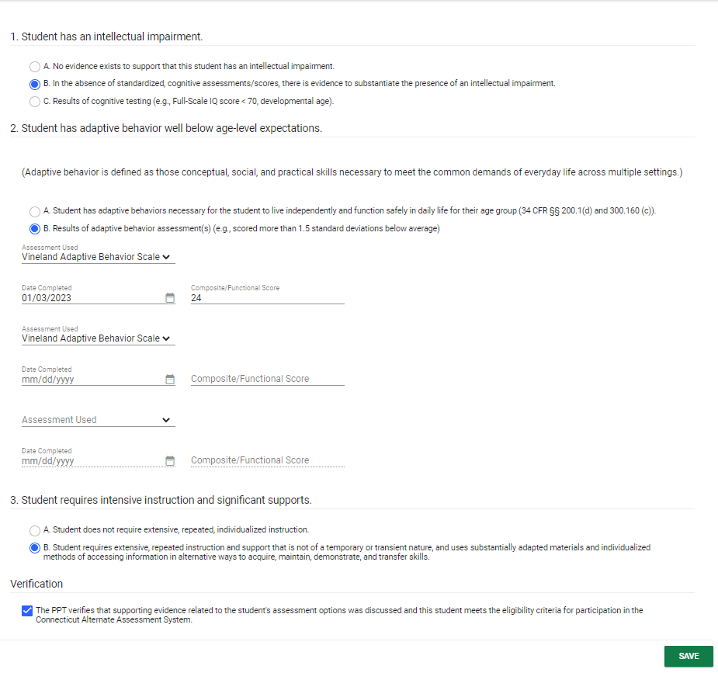
CT-SEDS: Alternate Assessment Eligibility
PPTs can indicate that a student is being considered for the Connecticut Alternate Assessment System.
The Connecticut Alternate Assessment System Eligibility Form is built into CT-SEDS.
Notes:
This is an example of what PPTs complete in CT-SEDS. The PPTs can select the Connecticut Alternate Assessment System from the CT-SEDS State-wide Testing Module. (See #1)
If “YES” is selected for the item “Is the student being considered to participate in the Connecticut Alternate Assessment System (CTAA, CTAS, CAAELP)?,” the Connecticut Alternate Assessment System Eligibility Form will populate on the screen for completion. (See #2) The PPT will complete and provide evidence of an intellectual impairment, adaptive functional skills well below age/grade level expectations, and confirmation that the student requires intensive and extensive instruction. Finally, they will verify this information and click save. Please note, teams should be completing this form with current evaluation information and information should include numerical composite score and not ranges or descriptors.
For students that have a completed Alternate Assessment System Eligibility Form, for their grade of enrollment, in a finalized and implemented plan, their alternate data will sync from CT-SEDS to TIDE and populate the Alternate Assessment Indicator to “YES”. This activation registers the student for the alternate assessments that they are eligible for (CTAA, CTAS, and/or CAAELP). As a reminder, the Connecticut Alternate Assessment System Eligibility Form is also used to determine CAAELP eligibility for dually identified ELs/MLs with cognitive disabilities in Grades K-12. Therefore, PPTs will need to consider this for EL/ML students dually identified whose IEP covers Grades K-12.

Slide 89
Connecticut Alternate Assessment System
 | CTAA for Math and ELA (Grades 3-8, 11) | CTAS (Grades 5, 8, 11) | CTAS (Grades 5, 8, 11) | CAAELP (Grades K-12)
Required Administration Materials | Administered online with secure Directions for Test Administration (DTAs) and Test Administration Manual. | Administered throughout the school year using CTAS Required Materials and CTAS Test Administration Manual. Student ratings recorded on the CTAS Student Score Worksheet and entered in the DEI. | Administered throughout the school year using CTAS Required Materials and CTAS Test Administration Manual. Student ratings recorded on the CTAS Student Score Worksheet and entered in the DEI. | Administered online using grade- and domain-specific Test Administrator Directions and Scoring Rubrics Booklets and CAAELP Test Administration Manual.
Security | Secure | Non-Secure | Non-Secure | Secure
Training | Connecticut Alternate Assessment System Training Course (cambiumast.com) |  |  | CAAELP Test Administration Training
Certificate | "Trained status" indicated in TIDE profile. TEA can print/download certificate after passing the required quiz. |  |  | Trained status certificate is not linked to TIDE and should be maintained locally.
Submissions into DEI | None |  | CTAS Score Worksheet for scoring between March 24 and May 30, 2025. | None
Notes:
We have included some training information here on this slide and crosswalk.
The CAAELP and CTAA are secure assessments. These secure testing materials are accessed through TIDE in the Secure Testing Materials. Please refer to each tests specific Test administration Manuals (TAMs).
The CTAS is a non secure assessment. Each Storyline includes a Performance Task at each assessed grade level with a series of assessment activities. Each activity provides a coherent sequence of instruction for the TEA on how to assess student performance associated with each Core Extension. The TEA assesses the eligible students on provided Performance Tasks using provided Resource Packet materials and rates the student’s performance on each activity using a 0–2 scale and provided scoring guidance. Supports include the use of communication devices and assistive technology or accommodations as described in the student’s Individualized Education Program (IEP). After the CTAS is fully administered, TEAs will enter the ratings recorded on the Student Score Worksheet in the Data Entry Interface (DEI) during the testing window of March 24-May 30, 2025.
Additional Information:
Connecticut Alternate Assessment System Training Course; https://ct.portal.cambiumast.com/resource-item/en/connecticut-alternate-assessment-system-training-course
ELPA21 Online; https://training.elpa21.org/index_login.php

Slide 90
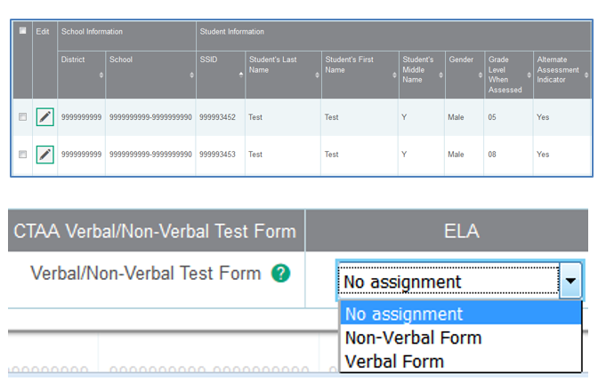
CTAA Verbal and Non-Verbal ELA Test Forms Grades 3 and 4 Only
The Non-Verbal Form presents the Open Response items in a Selected-Response format for students who do not respond:
  with oral speech;
  are blind, deaf, or deaf-blind; or
  use augmentative and alternative communication (AAC).
The forms differ in the presentation of the foundational word identification items or Open-Response (OR) items.
The form assignment must be made in TIDE prior to test administration.
The default setting is the Verbal form. Procedures for selecting the form are located in the CTAA Test Administration Manual.
Notes:
For students in Grades 3 and 4 taking the CTAA ELA reading assessment, select either a Verbal or Non-Verbal test form in the TIDE test settings. The forms differ in the presentation of the foundational word identification items or Open-Response (OR) items. Based on the student’s mode of communication, the Verbal or Non-Verbal form should be selected in TIDE prior to test administration.
As you can see in this image, the appropriate test form must be selected in the student’s test settings in TIDE for the CTAA ELA reading assessment, which includes the open-response items for students in Grades 3 or 4.
The Verbal Form is the default form presented to the student if no form is assigned in TIDE.
CTAA Test Administration Manual (TAM); https://ct.portal.cambiumast.com/resource-item/en/ctaa-test-administration-manual-tam

Slide 91
Training Requirements for the CTAA/CTAS
Resources
Overview for District Administrators
Overview for Teachers Administering the Alternate
CTAA Test Administration Manual
CTAS Test Administration Manual
Connecticut Alternate Assessment System Training Course
Connecticut Alternate Assessment System Training Resources
Connecticut Alternate Assessment System Training must be completed annually by certified educators administering the alternate (TEAs).
Training is online and available on the Alternate Assessment web page on the portal.
TEAs must complete and pass the end-of-training quiz with a score of at least 80 percent or better.
Notes:
Teachers Administering the Alternate (TEAs) are intricately involved in all aspects of the selection and supervision of the Connecticut Alternate Assessment and the Alternate Science. The Connecticut Alternate Assessment System Training requirements provide for high-quality standardized administration ensuring appropriate interpretations for results about what students with significant cognitive disabilities know and can do.
All teachers who will be administering the alternate assessments (CTAA and CTAS) must be trained annually via the online course regardless of previous training status. This training is required each school year. Once training and the embedded quiz is passed the TEA will have permission to:
Submit the CTAS Student Score Worksheet for students in Grades 5, 8, or 11;
Access the required secure test materials for the CTAA using TIDE; and
Administer the CTAA and CTAS assessments.
District Administrators are responsible for the following tasks:
Determine who will be administering an Alternate Assessment during the 2024-25 school year.
Verify that the teacher has a TEA User Role in TIDE. Update, add, and delete accounts as appropriate.
Communicate details regarding the required online training with your TEAs. Share the Overview for Teachers Administering the Alternate resource referenced on this slide.
Verify that all TEAs complete and pass the quiz. Those with passing scores will have their Trained Proctor Status as ALT in TIDE. Note: the CAAELP training is separate and does not sync with TIDE.
These are the links to the Resources:
Connecticut Alternate Assessment System Training – Overview for District Administrators; https://ct.portal.cambiumast.com/resource-item/en/connecticut-alternate-assessment-system-training-overview-for-district-administrators
Connecticut Alternate Assessment System Training – Overview for Teachers Administering the Alternate; https://ct.portal.cambiumast.com/resource-item/en/connecticut-alternate-assessment-system-training-overview-for-teachers-administering-the-alternate
CTAA Test Administration Manual (TAM); https://ct.portal.cambiumast.com/resource-item/en/ctaa-test-administration-manual-tam
Connecticut Alternate Science (CTAS) Assessment: Test Administration Manual; https://ct.portal.cambiumast.com/resource-item/en/connecticut-alternate-science-ctas-assessment-test-administration-manual
Connecticut Alternate Assessment System Training Course; https://ct.portal.cambiumast.com/resource-item/en/connecticut-alternate-assessment-system-training-course
Connecticut Alternate Assessment System Training Resources; https://ct.portal.cambiumast.com/resource-list/en/connecticut-alternate-assessment-system-training-resources

Slide 92
Resources to Support Alternate Assessment Eligibility
Frequently Asked Questions and Answers about the Connecticut Alternate Assessment System
Annotated Connecticut Alternate Assessment System Eligibility Form
Frequently asked Questions and Answers About the Connecticut Alternate Assessment System Eligibility Form
Connecticut Alternate Assessment System Participation Guidance for Planning and Placement Teams Flowchart
Comparison of Connecticut Alternate Assessments
For more information, visit the CSDE Website and the Connecticut Comprehensive Assessment Program Portal.
Notes:
Included on this slide are resources to help support your understanding of the purpose and eligibility for the Connecticut Alternate Assessment System.
Links to Resources:
Frequently Asked Questions and Answers about the Connecticut Alternate Assessment System; https://ct.portal.cambiumast.com/resource-item/en/frequently-asked-questions-and-answers-about-the-connecticut-alternate-assessment-system
Annotated Connecticut Alternate Assessment Eligibility Form; https://ct.portal.cambiumast.com/resource-item/en/annotated-connecticut-alternate-assessment-eligibility-form
FAQ About the Connecticut Alternate Assessment System Eligibility Form; https://ct.portal.cambiumast.com/resource-item/en/faq-about-the-connecticut-alternate-assessment-system-eligibility-form
Connecticut Alternate Assessment System Participation Guidance for Planning and Placement Teams; https://ct.portal.cambiumast.com/resource-item/en/connecticut-alternate-assessment-system-participation-guidance-for-planning-and-placement-teams
Comparison of Connecticut Alternate Assessments; https://ct.portal.cambiumast.com/resource-item/en/comparison-of-connecticut-alternate-assessments
Connecticut State Department of Education homepage: Connecticut State Department of Education; https://portal.ct.gov/sde
Cambium Home Page; https://ct.portal.cambiumast.com/

Slide 93
Training Requirements for the CAAELP (Grades K-12)
Resources
CAAELP Training Announcement
Directions for Accessing CAAELP Online Training for New Users
Directions for Accessing CAAELP Online Training for Returning Users
CAAELP Accessibility and Accommodations Manual
Connecticut Alternate Assessment of English Language Proficiency (CAAELP)Test Administration Manual
2024-25 Connecticut Alternate Assessment System Early Stopping Rule
CAAELP/Alt ELPA Training must be completed annually by certified educators administering the CAAELP (TEAs).
Training is online at ELPA 21.
District Verification code is elpa21.
Certificate is maintained locally through a process determined by the district.
Additional training available:
  CAAELP Office Hours
Notes:
The CAAELP/Alt ELPA Training is accessed through ELPA21. This training is required for any educator who is designated as a TEA in TIDE and will be administering the CAAELP Assessment this year. This training must be completed annually (each testing school year), and the certificate of training completion should be saved and shared with administrators as needed. There are separate training modules available for ELACs and TEAs. Please be aware that first time users will need to enter a district verification code, which is elpa21 (all lowercase).
Training guides:
•Directions for Accessing CAAELP Online Training for New Users
•Directions for Accessing CAAELP Online Training for Returning Users
•CAAELP Accessibility and Accommodations Manual
•2024-25 Connecticut Alternate Assessment System Early Stopping Rule
TEAs and ELACs taking this training need to be aware that this training has been developed by ELPA 21, and that some policies and procedures may not mirror those of Connecticut. Teams should participate in a thorough review of the Connecticut specific CAAELP resources available to them as part of this training process. These resources are located on the CAAELP Resource page on the Connecticut Comprehensive Program Portal.
Additional training available: CAAELP Office Hours
Links to Resources:
ELPA21: ELPA21 Online; https://training.elpa21.org/index_login.php
CAAELP Office Hours: Connecticut Sensible Assessment System—Training; https://portal.ct.gov/sde/student-assessment/main-assessment/student-assessment/training
CAAELP Training Modules are live!; https://ct.portal.cambiumast.com/announcement/en/announcement-detail-page
Directions for Accessing Training For New Users; https://ct.portal.cambiumast.com/resource-item/en/directions-for-accessing-training-for-new-users
Directions for Accessing Training For Returning Users; https://ct.portal.cambiumast.com/resource-item/en/directions-for-accessing-training-for-returning-users
CAAELP Accessibility and Accommodations Manual; https://ct.portal.cambiumast.com/resource-item/en/caaelp-accessibility-and-accommodations-manual
CAAELP Test Administration Manual; https://ct.portal.cambiumast.com/resource-item/en/connecticut-alternate-assessment-of-english-language-proficiency-caaelp-test
Connecticut Alternate Assessment System Early Stopping Rule and Student Response Check; https://ct.portal.cambiumast.com/resource-item/en/connecticut-alternate-assessment-system-early-stopping-rule-and-student-response-check

Slide 94
CSDE Performance Office Contacts
Abe Krisst Bureau Chief Connecticut Education – Performance Office Phone: 860-713-6894; Mobile Phone: 860-690-0650 Email: Abe.Krisst@ct.gov
Deirdre Ducharme Education Consultant Performance Office- Special Populations Direct line: 860-713-6859 Email: Deirdre.Ducharme@ct.gov
Katie Seifert Associate Education Consultant Performance Office- Special Populations Direct line: 860-713-6722 Email: Katherine.Seifert@ct.gov
Kimberly Johnson Education Support Technician Performance Office Phone: 860-713-6885 Email: Kimberly.Johnson@ct.gov
Cristi Alberino Education Consultant Performance Office –Interim & Summative Assessments Email: Cristi.Alberino@ct.gov
Jeff Greig Education Consultant Performance Office – NGSS Interim & Summative Assessments Email: Jeff.Greig@ct.gov
Notes:
Here are CSDE contacts from the Performance Office and Bureau of Special Education. Please reach out with any questions.
We are here to support you and your teams.

Slide 95
Questions
Use “Raise Hand” Tool

Slide 96
Thank you!!!!
Thank you for attending and for all you do for your students.
Connecticut State Department of Education

