Slide 1
2022 election outlook
2022 Continuing Education
2022 Series #1

Slide 2
Redistricting Timeline
February 15, 2021 - Legislative leaders appoint an eight-member Reapportionment Committee
September 15, 2021 - General Assembly adopts a plan of districting
Forthwith after September 15, 2021 - Governor appoints a Reapportionment Commission based on legislative leaders’ designations (if General Assembly fails to adopt a districting plan by September 15)
Within 30 days after appointment of Reapportionment Commission - Members select a state elector as the ninth member
November 30, 2021 - Reapportionment Commission submits a certified plan of districting to the secretary of the state
Forthwith after November 30, 2021 - Secretary of the state notifies the Chief Justice of the state Supreme Court (if Reapportionment Commission fails to submit a plan by November 30)
February 15, 2022 - State Supreme Court files its plan of districting with the secretary of the state
*The secretary of the state must forthwith publish the plan at which point it has the full force of law.

Slide 3
Redistricting Process
Following the publication of the Plan of Districting, our office transmits copies of the plan to the town clerk and registrars of voters of each town in the state. The plan is to be used by the clerks and the registrars for the development of voting districts in each town. In addition to the plan, our office also transmits maps reflecting the various district boundary lines to each town. Separate maps for the congressional, state senate, and state assembly districts are provided.
Once the plans are transmitted to the local officials, it is their responsibility to create, eliminate or re-align their local voting districts consistent with the Plan of Districting.

Slide 4
Redistricting Process
The legislative body of any town may divide such municipality into voting districts. (9-169)
The responsibility for assigning polling places to each of those districts in a municipality lies with the local registrars of voters or legislative body. (9-168)
Whenever a Congressional, Senatorial or Assembly district line splits a voting district in a town, by operation of law, each portion of the whole voting district becomes a new separate voting district. (Conn. Gen. Stat. §9-169a). If a town is located entirely within a Congressional, Senatorial or Assembly district separate voting districts are not established.

Slide 5
Redistricting Process
Election results must be reported and broken out by voting district and in some cases by congressional, senatorial and assembly district.
Delegates to the national conventions are determined by congressional district and delegates to the state conventions are determined by senatorial district. (May change subject to party rules).

Slide 6
Important Calendar Events
MARCH 22, 2022 to MARCH 29, 2022 (Tuesday – Tuesday) POLITICAL PARTIES | PARTY SELECTION OF DELEGATES. Selection for delegates to state and district conventions by town committee or caucus between these days. (§§ 9-390 and 9-391)
MARCH 30, 2022 (Wednesday) 4:00 p.m. POLITICAL PARTIES / TOWN CLERK | PARTY DELEGATE SELECTION -- CERTIFICATION. Last day for chairman or presiding officer OR the secretary of the caucus or the town committee, as the case may be, to certify to the town clerk the names and street addresses of party-selected delegates. Certification must also be accompanied by (1) The name and street address of each person selected, and (2) The name and number of the political subdivision or district for which each such person is selected. Clerk must forthwith publish notice of certification and that list of candidates is on file. (§§ 9-391 and 9-395)

Slide 7
Important Calendar Events
APRIL 26, 2022 (Tuesday) SEC’Y OF THE STATE | PRIMARY PETITIONS AVAILABLE. Petition forms for person desiring to oppose party endorsed candidates for state office or the district office of Representative in Congress available from the Secretary of the State beginning on this day. (§9-404a)

Slide 8
Important Calendar Events
MAY 3, 2022 to MAY 24, 2022 (Tuesday - Tuesday) POLITICAL PARTIES | CONVENTIONS. Period of time when major party conventions to endorse candidates for state and district office must be held. Party-endorsed candidates must file with the Secretary of the State a certificate of endorsement signed by candidates and attested by either (1) the chairman or presiding officer of the convention or (2) the secretary of the convention not later than 4:00 p.m. of the fourteenth day following close of convention. In order to primary, a 15% candidate must file with the Secretary of the State a certificate signed by him, stating that he received 15% of the convention vote on any roll call, and attested by either (1) the chairman or presiding officer of the convention or (2) the secretary of the convention plus statement of consent not later than 4:00 p.m. of the fourteenth day following close of convention. (§§ 9-383, 9-388 and 9-400) If a state convention voted that roll call be taken by town delegation, chairmen of town delegations to State Convention file list of names and votes of each delegate with Secretary of the State within 48 hours after the close of State Convention. (§ 9-385a)
MAY 9, 2022 (Monday) REGISTRARS | PARTY TRANSFER -- STATE, DISTRICT AND MUNICIPAL OFFICE PRIMARY. Last day that an enrolled elector can transfer from one party to another and be eligible to vote in state, district or municipal office primary of new party. (§ 9-59)

Slide 9
Important Calendar Events
MAY 17, 2022 to MAY 24, 2022 (Tuesday - Tuesday) POLITICAL PARTIES | PARTY ENDORSEMENT – MUNICIPAL OFFICE. Endorsement by major party for municipal office by town committee, caucus or convention between these days. (§§ 9-390 and 9-391) No party may endorse more candidates for municipal office than number for which an elector may vote. (§ 9-414)
MAY 17, 2022 to JUNE 7, 2022 (Tuesday – Tuesday) POLITICAL PARTIES | PARTY ENDORSEMENT – CERTIFICATION – STATE AND DISTRICT OFFICES. Certificates of party endorsement for state and district offices must be filed with the Secretary of the State signed by candidate and attested by either (1) the chairman or presiding officer of the convention or (2) the secretary of the convention not later than 4:00 p.m. of the fourteenth day following close of convention. In order to primary, a 15% candidate must file with the Secretary of the State a certificate signed by him, stating that he received 15% of the convention vote on any roll call, and attested by either (1) the chairman or presiding officer of the convention or (2) the secretary of the convention plus statement of consent not later than 4:00 p.m. of the fourteenth day following close of convention. (§§ 9-383, 9-388 and 9-400)
MAY 18, 2022 to MAY 25, 2022 (Wednesday – Wednesday) REGISTRARS | PRIMARY PETITIONS – AVAILABLE – MUNICIPAL OFFICE. Primary petitions for persons desiring to oppose candidates of major party for municipal offices shall be available from the registrars of voters on the day following the making of the party’s endorsement. (§9-409)

Slide 10
Important Calendar Events
MAY 24, 2022 (Tuesday) SEC’Y OF THE STATE | PRIMARY PETITIONS AVAILABLE – DISTRICT OFFICE. Petitions forms for persons desiring to oppose candidates for the district offices of state senator, state representative or judge of probate shall be available from the Secretary of the State. (§9-404a)

Slide 11
Important Calendar Events
JUNE 7, 2022 (Tuesday) REGISTRARS | PRIMARY PETITIONS – FILING – STATE OR DISTRICT OFFICE. Primary petitions for opposing candidates of major party for state office or district office including Representative in Congress must be submitted to the respective registrars of voters by 4:00 p.m. Registrars must be in their offices between 1:00 p.m. and 4:00 p.m. to accept petitions. (§ 9-400)
JUNE 7, 2022 (Tuesday) 4:00 p.m. REGISTRARS | PRIMARY PETITIONS – FILING – MUNICIPAL OFFICE. Primary petitions for opposition candidates of a major party for municipal offices must be submitted to respective registrars by 4:00 p.m. Registrars of voters must be in their offices between 1:00 p.m. and 4:00 p.m. to accept petitions. (§§ 9-405 and 9-406)

Slide 12
Important Calendar Events
JUNE 14, 2022 (Tuesday) REGISTRARS | PRIMARY PETITIONS FILED WITH SEC’Y OF THE STATE – STATE AND DISTRICT OFFICE. For State and District primary petitions, the Registrars of voters shall forthwith certify on each such page the number of signers of the page who were enrolled party members and forthwith file such certified page in person or by mail with the Secretary of the State within seven days after receipt of the page. (§9-404c)
JUNE 24, 2022 (Friday) TOWN CLERK | OVERSEAS BALLOT. Beginning this date, the primary overseas ballot is available from town clerk upon application properly made if Congressional primary is being held. (§§ 9-158c)
REGISTRARS | Registrars may direct the clerk to mail such overseas ballot set to an eligible U.S. citizen, and the town clerk may also so act on his own motion, but such ballot shall not be counted unless a prescribed application is received by the town clerk prior to primary day. (§ 9-153d)

Slide 13
Important Calendar Events
JULY 19, 2022 (Tuesday) TOWN CLERK REGISTRARS | ABSENTEE BALLOTS – STATE, DISTRICT AND MUNICIPAL PRIMARY. Absentee ballots for state, district or municipal primary become available on this day. (§§ 9-135 and 9-140(f)) Registrars of voters may direct town clerk to mail absentee ballot forms to a qualified elector or applicant for admission as an elector who (1) is living outside the U.S. or (2) is a member of the armed forces or the spouse or dependent of a member of the armed forces living where such member is stationed. Town clerk also may so act on his own motion. (§§ 9-133f, 9-140(f) and 9-153d)

Slide 14
Important Calendar Events
SEPTEMBER 7, 2022 (Wednesday) MINOR PARTIES | MINOR PARTY NOMINATIONS AND CERTIFICATION - ELECTION. All minor party nominations and certification for state, district and municipal office must be made and certified by this date and certified to Secretary of the State. Such certification must include each candidate’s name as authorized by each candidate, the signature of each candidate, the full street address of each candidate and the title and district of the office for which each candidate was nominated.(§ 9-452) Written notice of date, time, location and purpose of nominating meeting for state and district office must be filed with Secretary of the State, and for municipal office with town clerk, not later than five days before meeting. In addition, written notice shall also be published in a newspaper with a general circulation in the applicable town for such office. (§9-452a)
SEPTEMBER 7, 2022 (Wednesday) 4:00 p.m. NOMINATING PETITION PARTY DESIGNATIONS | STATEMENT OF ENDORSEMENT -- NOMINATING PETITION CANDIDATES - ELECTION. Last day that party designation committee or chairman or secretary of a minor party may file statement of endorsement of nominating petition candidate with a party designation with Secretary of the State. (§ 9-453o)

Slide 15
Important Calendar Events
AUGUST 10, 2022 (Wednesday) 4:00 p.m. CANDIDATES / TOWN CLERK | NOMINATING PETITIONS. Last day for filing with town clerk or the Secretary of the State nominating petitions for state, district or municipal office. Deadline 4:00 p.m. Town clerk or assistant town clerk must be in his office between 1:00 p.m. and 4:00 p.m. to accept petitions. (§ 9-453i) Clerk must file each petition page with Secretary of the State within 2 weeks after receiving it. (§ 9-453n)

Slide 16
Important Calendar Events
AUGUST 24, 2022 (Wednesday) TOWN CLERK | NOMINATING PETITIONS - ELECTION. Last day for town clerk to file nominating petition pages, received by clerk on August 10th, with Secretary of the State. (§§ 9-453i and 9-453n)

Slide 17
Important Calendar Events
SEPTEMBER 8, 2022 (Thursday) TOWN CLERK | QUESTIONS ON BALLOT. Last day for municipality to approve question to appear on ballot at state election, unless otherwise specifically provided by the general statutes. (§ 9-370) Town clerk must keep full text of question on file in his office open to public inspection from time question is approved for submission through election. (§ 9-369a)

Slide 18
Important Calendar Events
SEPTEMBER 15, 2022 (Thursday) SECRETARY OF THE STATE; TOWN CLERK TOWN CLERK TOWN CLERK | LIST OF CANDIDATES - ELECTION. List of candidates for state and district offices is sent to town clerk by Secretary of the State on this date. (§ 9-462) PRINTING ABSENTEE BALLOTS - ELECTION. Immediately after the deadline for the certification of all candidates whose names are to appear on the ballot, the town clerk must begin making arrangements to have the absentee ballots for the election printed. (§ 9-135b(a)) SAMPLE ABSENTEE BALLOT AVAILABLE - ELECTION. A layout model of each different absentee ballot shall be available for public inspection at town clerk's office prior to printing. (§ 9-135b(b)) ABSENTEE BALLOTS – FILING - ELECTION. Immediately upon receiving the printed absentee ballots, municipal clerk must file a printed absentee ballot for the town or for each different political subdivision, as the case may be, with Secretary of the State, and file an affidavit as to number of such ballots printed. (§ 135b(c))

Slide 19
Important Calendar Events
SEPTEMBER 23, 2022 (Friday) TOWN CLERK | QUESTIONS ON BALLOT. Last day for town clerk to file with Secretary of the State a statement setting forth the designation of each question to be voted on as it will appear on the voting machine, the date upon which the submitting action was taken, and a reference to the law under which such action was taken. (§ 9-369a) If questions are submitted within the period of forty-five days before election under specific authority of general statutes, such statement must be filed forthwith upon taking of such action. (§ 9-369a)
SEPTEMBER 23, 2022 (Friday) TOWN CLERK | OVERSEAS BALLOT - ELECTION. Beginning this date, the election overseas ballot for the office of Representative in Congress and US Senator only is available from town clerk upon application properly made. (§ 9-158c)
OCTOBER 7, 2022 (Friday) TOWN CLERK | ABSENTEE BALLOTS. Printed absentee ballots for the election become available to electors on this day. (§§ 9-135 and 9-140(f)). Constitutional Pamphlet. (§§ 2-30a, 9-140(d)). Explanatory text and/or arguments regarding local questions (optional). (§§ 9-140(d) and 9-369b.)

Slide 20
Important Calendar Events
OCTOBER 24, 2022 to NOVEMBER 2, 2022 (Monday - Wednesday) TOWN CLERK | WARNING OF ELECTION. Town clerk or assistant town clerk must publish, once, in a newspaper and on the town’s website, on or between any of these dates, notice of election, which notice shall include the time and location of the polling places, and record each such warning. (§ 9-225)
 | If central counting of absentee ballots is timely designated by registrars of voters, the warning for the election shall include such central location. (§ 9-147a) The warning must also include a statement concerning any question to be included on the ballot. (§§ 9-369 and 9-369a)
NOVEMBER 7, 2022 (Monday) TOWN CLERK | ABSENTEE BALLOTS. DEADLINE TO ISSUE - ELECTION. Absentee ballots may not be issued on election day, except overseas ballots and except electors who suddenly become ill within six days immediately preceding the close of the polls at the election or who are patients in a hospital within such six-day period, may apply for and be issued an absentee ballot up to the close of the polls. (§§ 9-140(h) and 9-150c)

Slide 21
Important Calendar Events
NOVEMBER 10, 2022 thru NOVEMBER 14, 2022 (Thursday - Monday) MODERATOR, TOWN CLERK & REGISTRAR | HEAD MODERATOR’S RETURN – REVIEW. Not later than forty-eight hours following each regular state election, the registrars of voters shall provide the results of the votes cast to the town clerk. Not later than 9 a.m. on the third day following the election the head moderator, registrars of voters and town clerk for each town divided into voting districts shall meet to identify any error in the returns filed with the Secretary of the State. Once identified, the error must be corrected and an amended head moderator’s return shall be filed with the Secretary of the State no later than 1:00 p.m. on November 14, 2022. (§9-322a)
NOVEMBER 18, 2022 (Friday) TOWN CLERK | ABSENTEE BALLOTS REPORT - ELECTION. Last day for town clerk to file with Secretary of the State statement accounting for number of absentee ballot forms received from said Secretary for the election. (§§ 9-139c and 9-232e)
NOVEMBER 23, 2022 (Wednesday) TOWN CLERK | REPORT OF REFERENDUM. Town clerk to file with Secretary of the State result of a referendum (a) on charter or charter amendment, or (b) on the question of the acceptance of a special act, or (c) conducted in accordance with the provisions of a special act. (§ 9-371)
NOVEMBER 29, 2022 (Tuesday) TOWN CLERK | VOTING DISTRICT RETURNS - ELECTION. Last day that town clerk of towns divided into voting districts may file voting district returns in tabular or summary form with the Secretary of the State. (§ 9-322a)

Slide 22
Important Calendar Events
DECEMBER 8, 2022 (Thursday) TOWN CLERK | COPIES OF CHARTERS. Last day for clerk to file with Secretary of the State three certified copies of any charter, charter amendments or home rule ordinance amendments approved at the election, with the effective date indicated and in the case of the approval of charter or home rule ordinance amendments, three certified copies of the complete charter or ordinance incorporating such amendments. (§ 7-191)

Slide 23
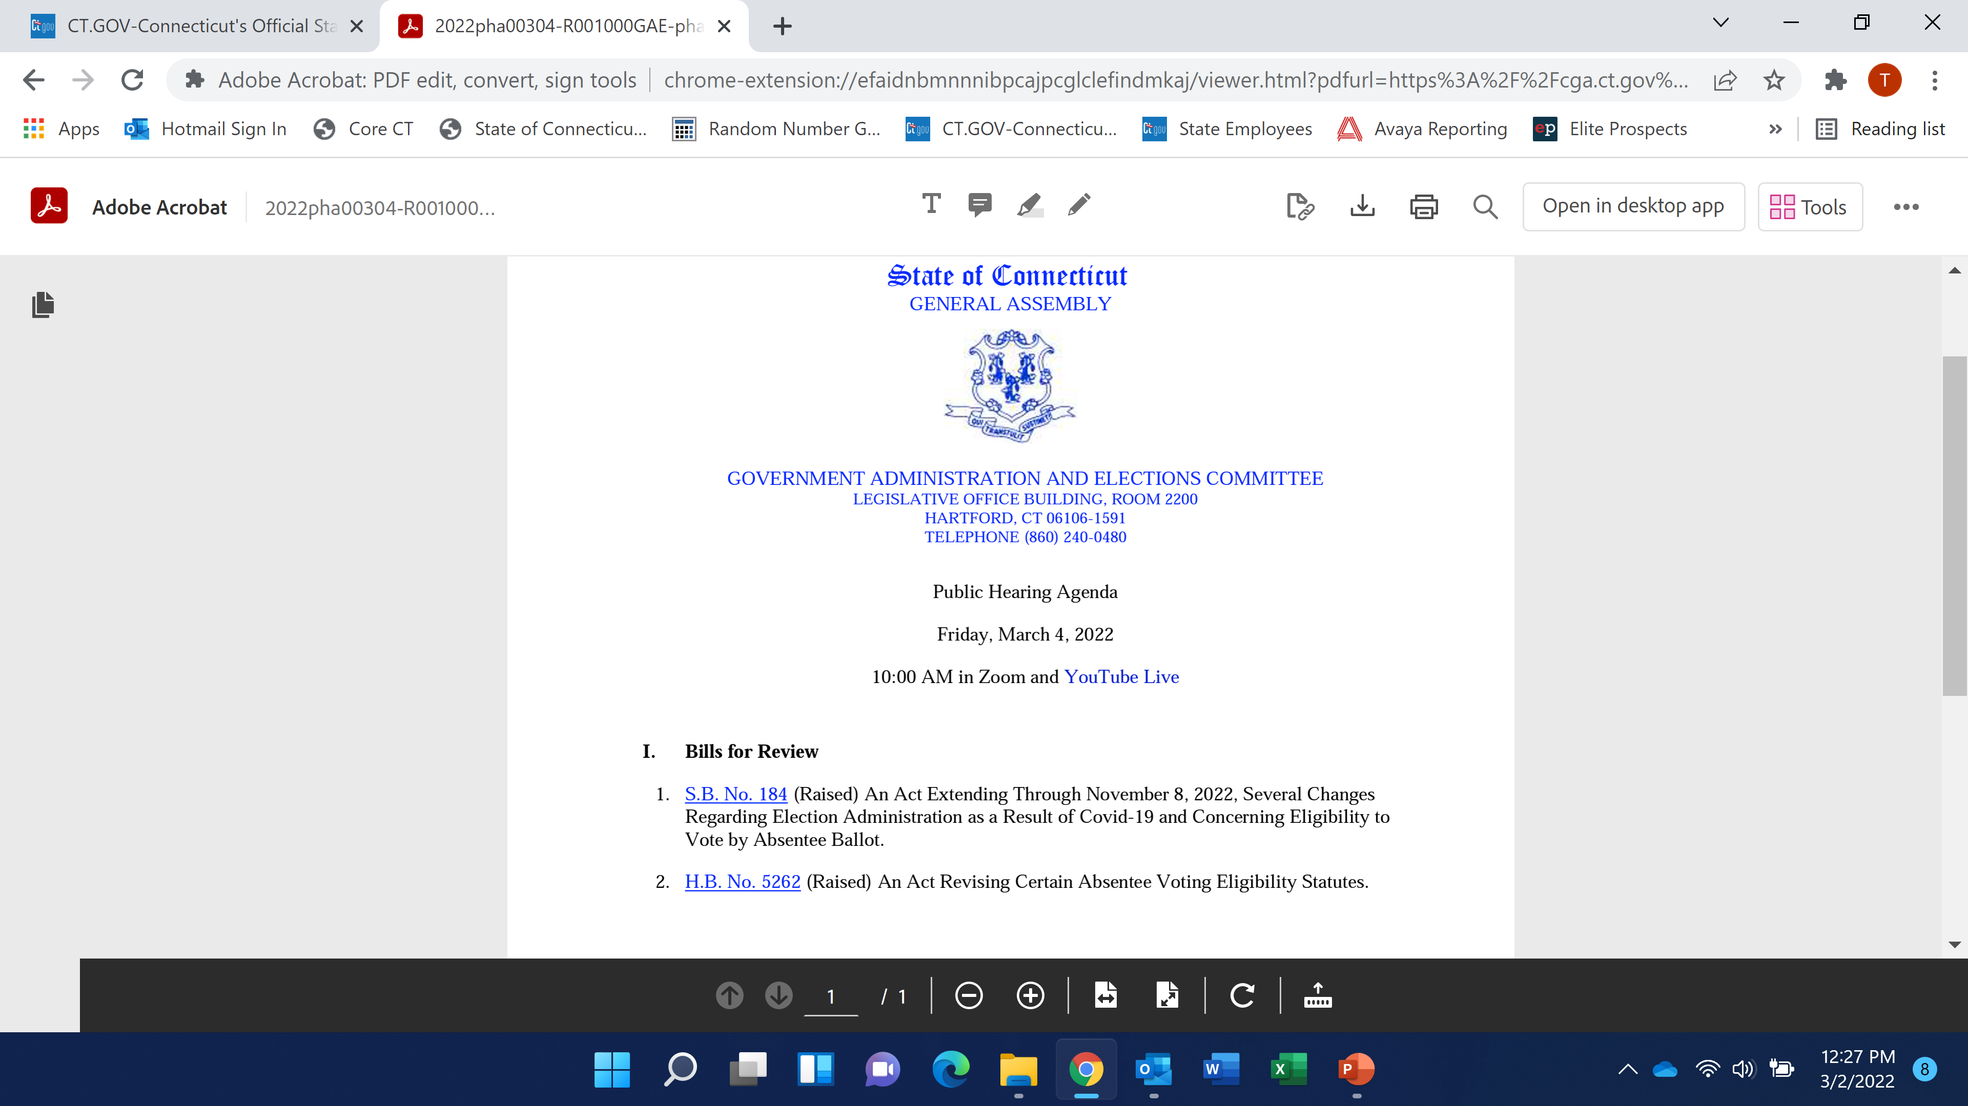
COVID v. Non-COVID

