Slide 1
CSC Staff Training
LUNCH and LEARN
May 1, 2024

Slide 2
AGENDA
Eversource Electric Bill
Suppliers Obligation
Solar – Duck Curve
ISO-NE
Open Access Transmission Tariff (OATT)
CEII

Slide 3
DEFINITIONS
  Energy – kWh or MWH
  Capacity – kW of MW
  Renewable Energy Credits (RECs) - kWh
  Load Obligation
  Capacity Obligation
  Net Energy Billing
  BTM – Behind the Meter
  FTM - Front of the Meter

Slide 4
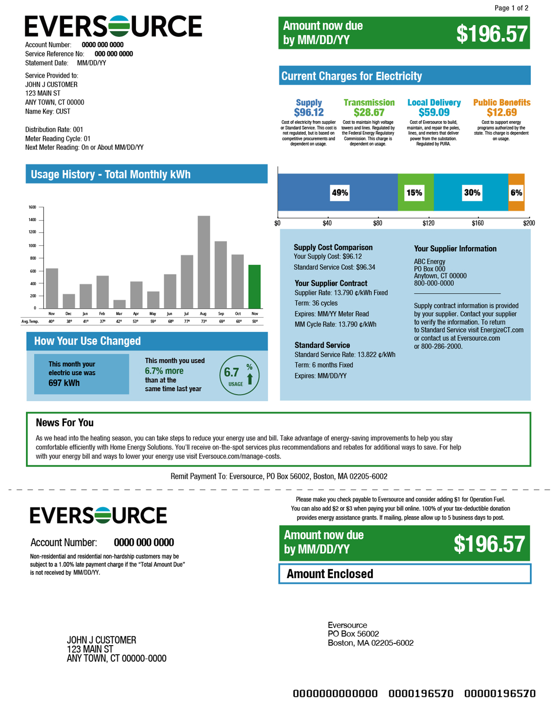
Connecticut Sample Electric Bill

Slide 5
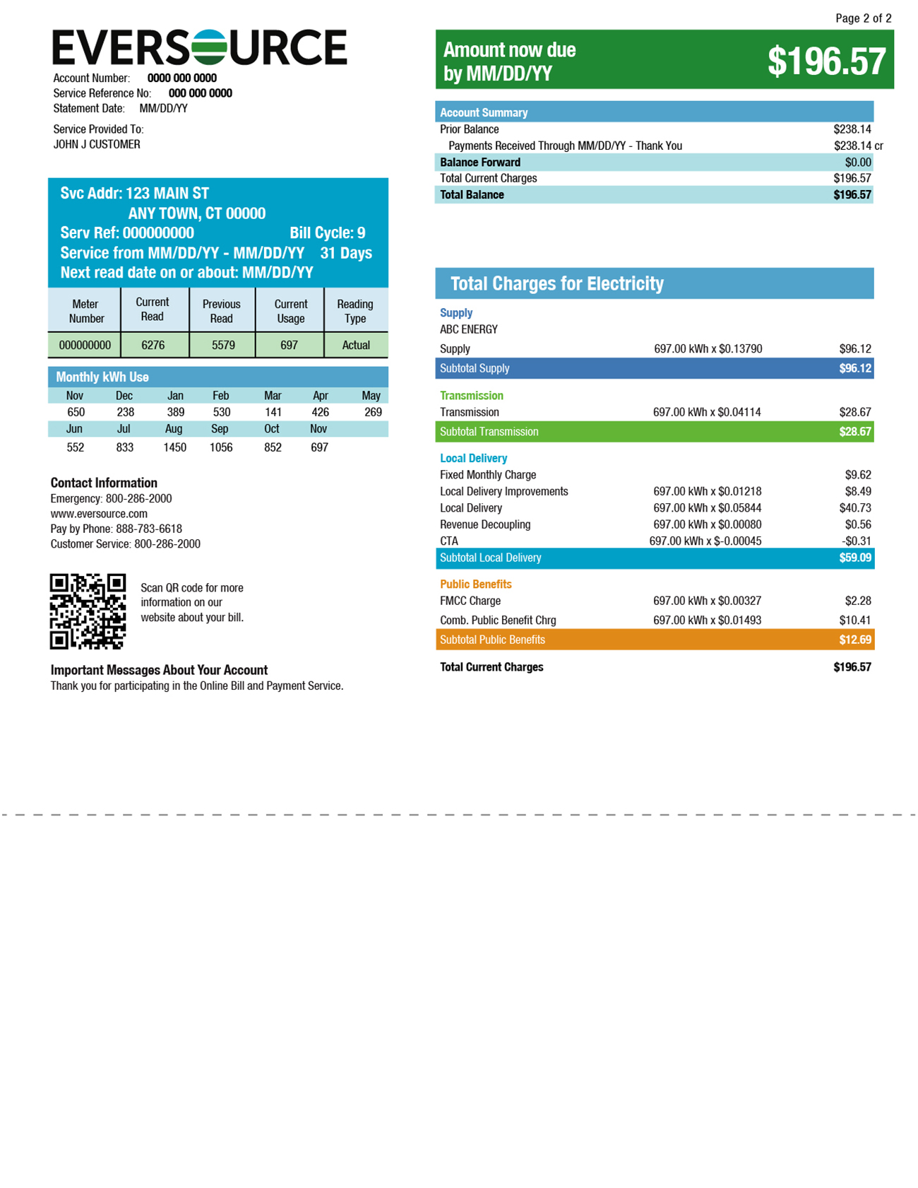
Connecticut Sample Electric Bill

Slide 6
Supplier Costs to Supply Energy (kWh)
Locational Marginal Pricing (LMP)
  Day Ahead
  Real Time
Capacity
Reserve and Ancillary Services – In Real Time
Financial Transmission Rights (FTR) – Hedging Locational Price
Risks
  Weather
  Load following
  Loss of supply
  Loss of Fuel
  Congestion
  Improper hedging
  Counterparty Financial Stability

Slide 7
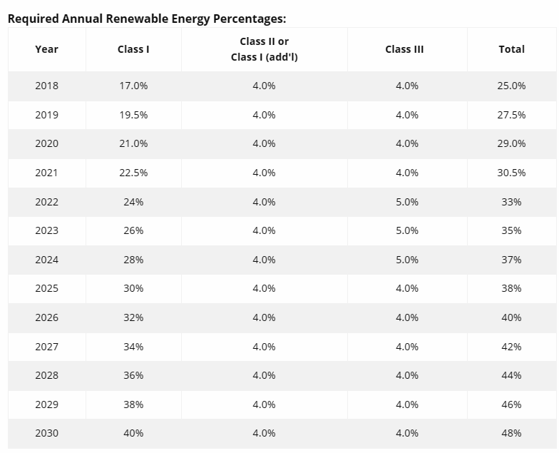
Renewable Portfolio Standards

Slide 8
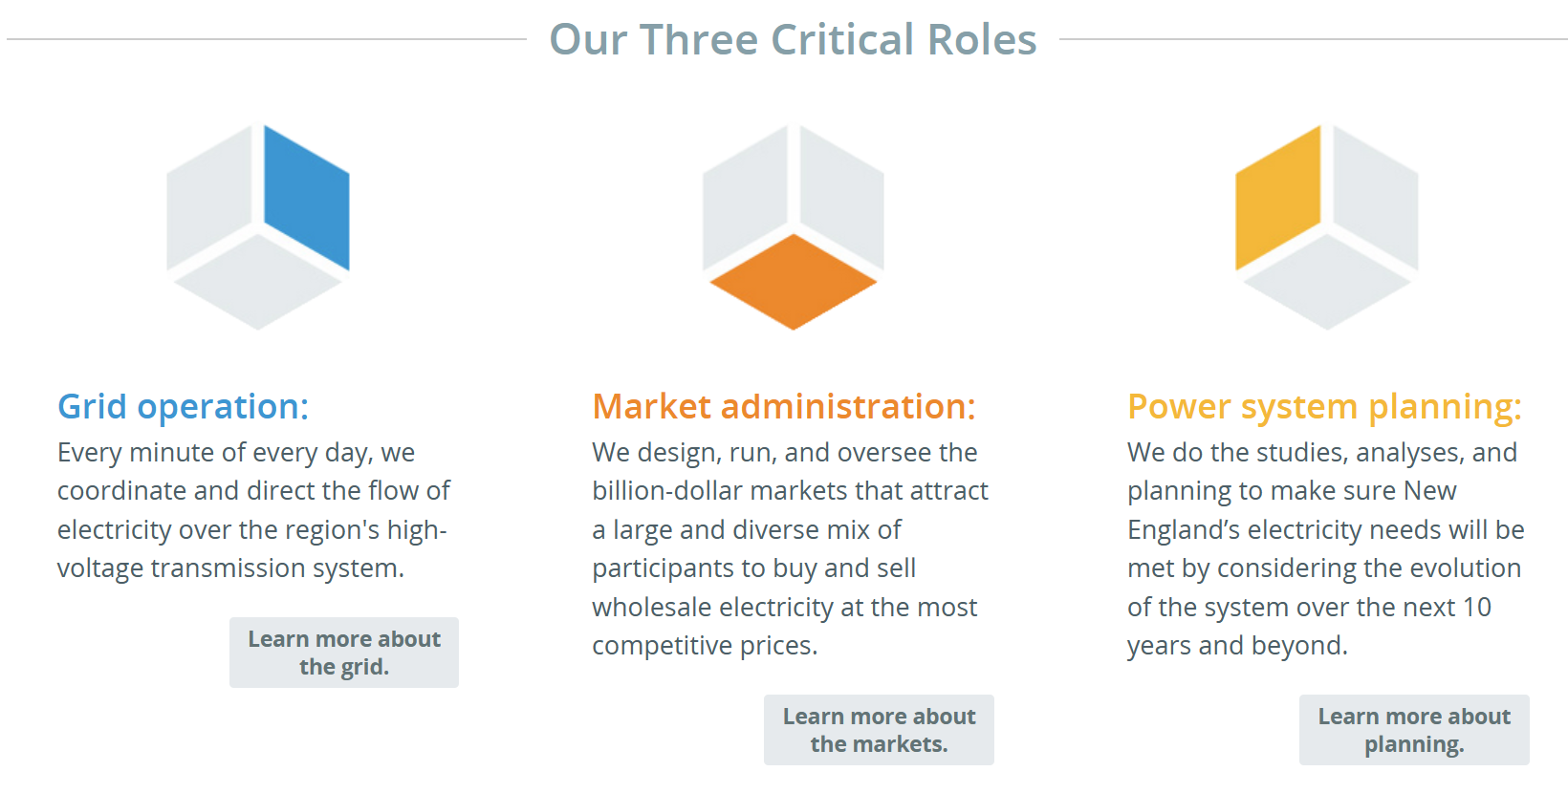
ISO-NE Critical Roles

Slide 9
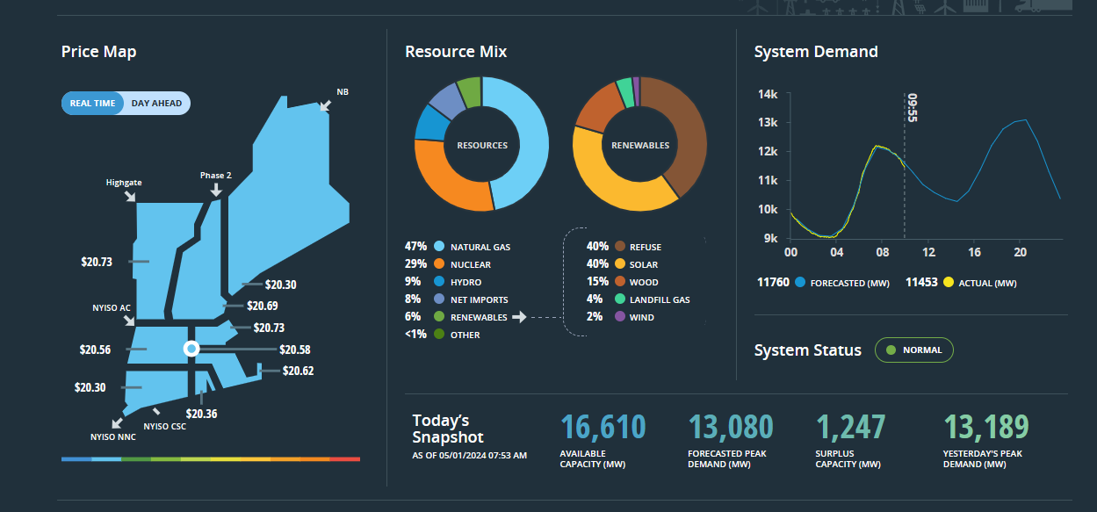
ISO-NE Home Page

Slide 10
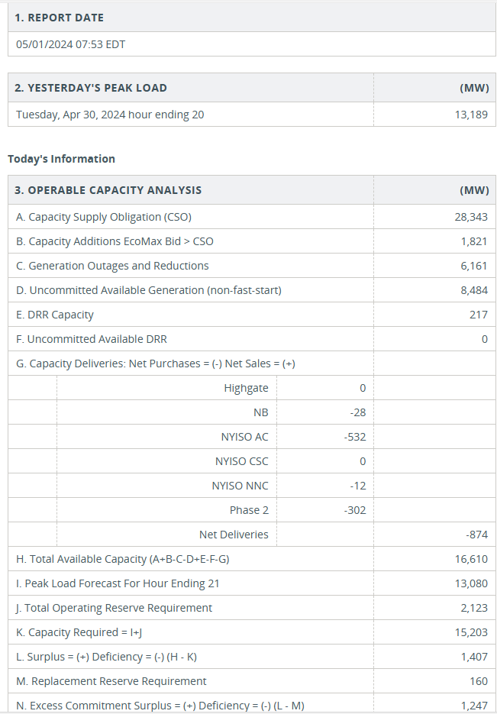
ISO-NE Morning Report

Slide 11
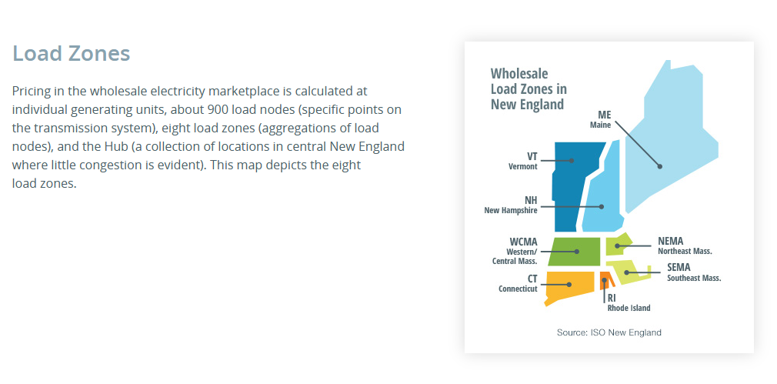

Slide 12
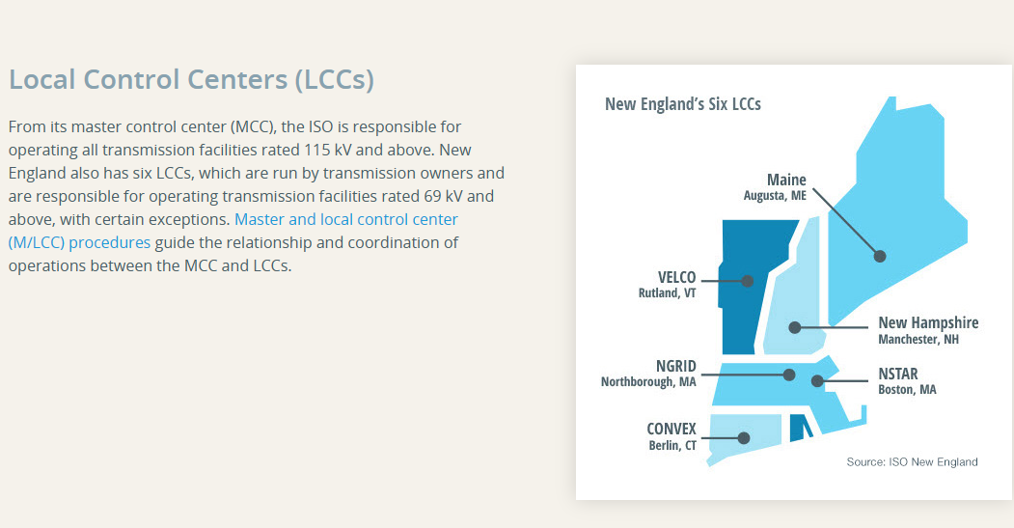

Slide 13
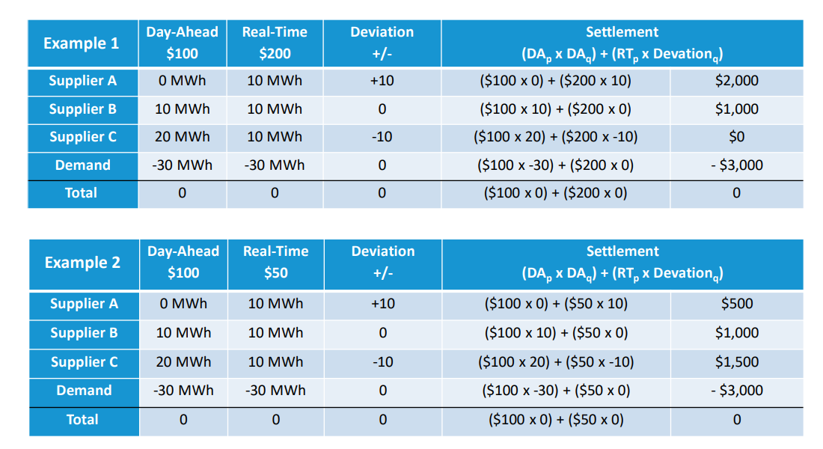
DAY AHEAD vs REAL TIME

Slide 14
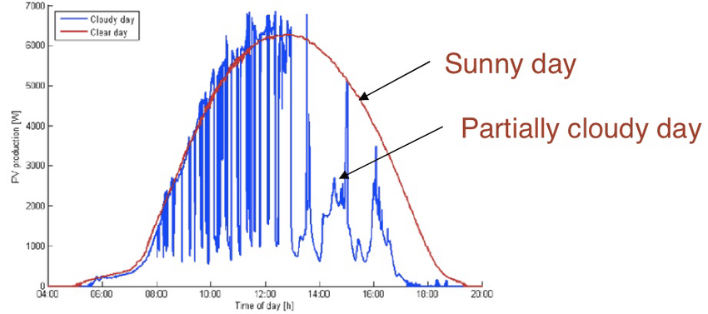
Solar Power Curve

Slide 15
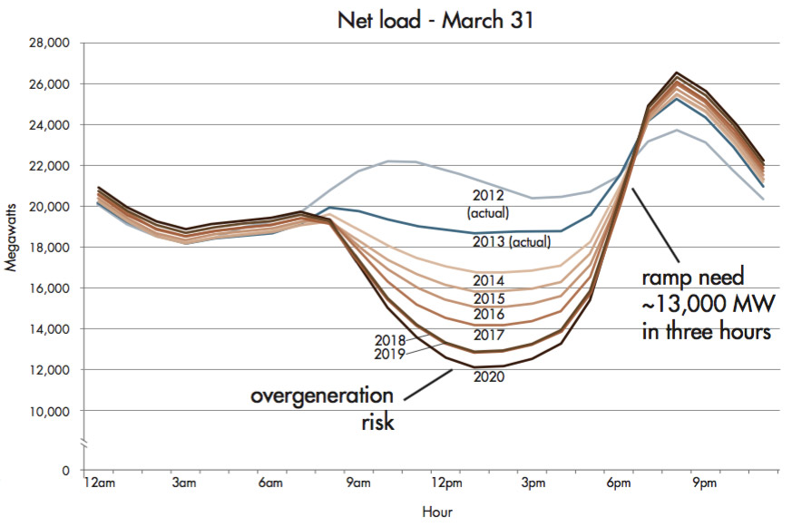
DUCK Curve

Slide 16
Open Access Transmission Tariff - OATT
Under ISO-NE Control
  PTF – Pool Transmission Facilities
  Non-PTF – Non- Pool Transmission Facilities
  MTF – Merchant Transmission Facilities
  OTF – Other Transmission Facilities
External Interconnections
  CSC Interconnection
  Northport Norwalk Cable (“NNC”) Interconnection
  New York/New England (“NY/NE”) Northern AC Interconnection
  Highgate Interconnection
  Phase I/II Interconnection
  New England/New Brunswick Power - System Operator (“NBP-SO”) Interconnection

Slide 17
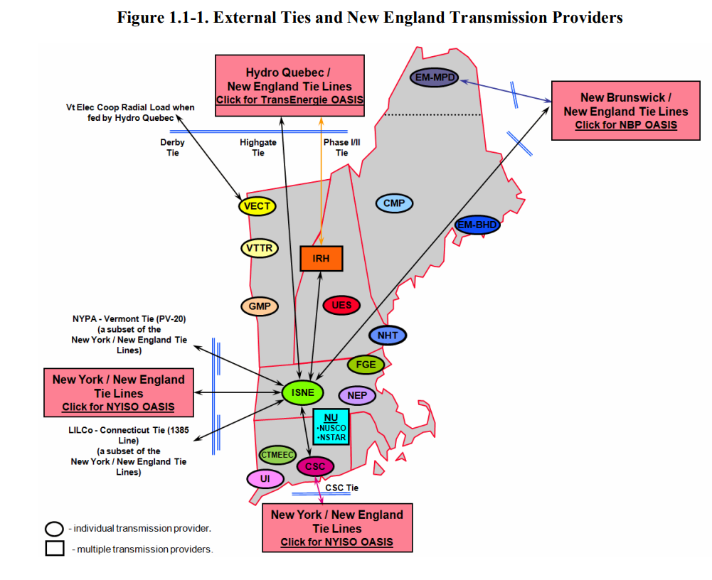

Slide 18
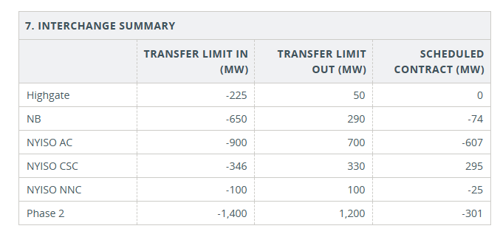

Slide 19
CEII
ISO defines CEII materials consistent with the Federal Energy Regulatory Commission (“FERC”) definition, which is “specific engineering, vulnerability, or detailed design information about proposed or existing critical infrastructure that:
(1) relates details about the production, generation, transportation, transmission, or distribution of energy;
(2) could be useful to a person in planning an attack on critical infrastructure;
(3) is exempt from mandatory disclosure under the Freedom of Information Act, 5 U.S.C. 552 (2000); and
(4) does not simply give the general location of the critical infrastructure.”

Slide 20
THANK YOU

