Slide 1
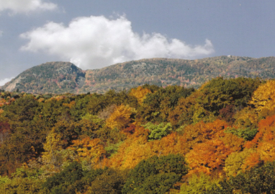
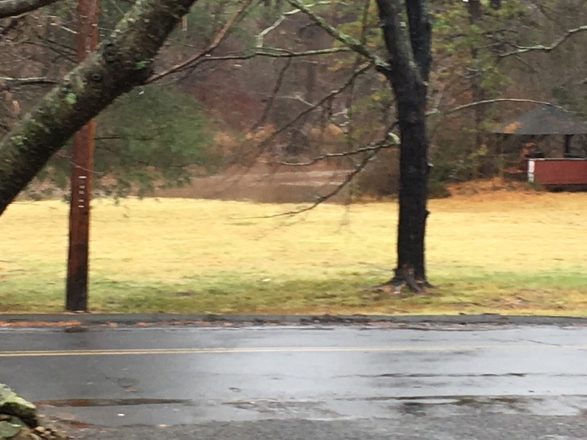

Let’s Get Started
Location – Sleeping Giant State Park and Pine Brook
Birds – 55
4-Legged Creatures
Insects
Reptiles – 3
Frogs, Toads, and COVID

Slide 2
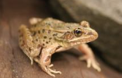
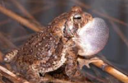
Frogs and Toads in Connecticut:
There are 11 species of frogs and toads native to Connecticut:
  True Toads: American Toad and Fowler’s Toad
  Tree Frogs: Gray Treefrog and Spring Peeper
  True Frogs: American Bullfrog, Green Frog, Atlantic Coast Leopard Frog, Northern Leopard Frog, Pickerel Frog, and Wood Frog
  Spadefoots: Eastern Spadefoot Toad
Both frogs and toads are amphibians.
What are the differences between frogs and toads?

Slide 3
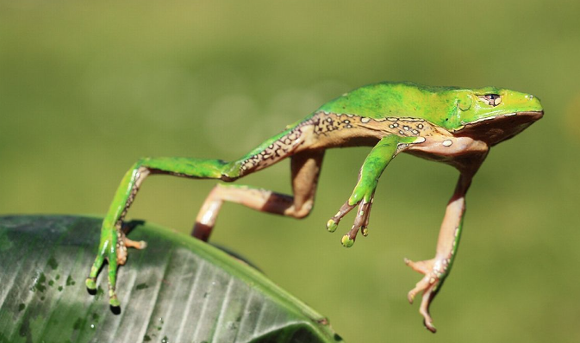
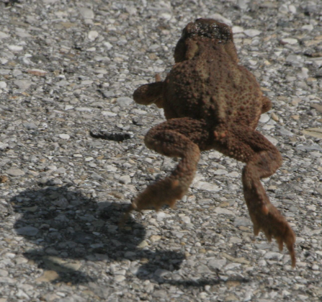
General Differences:
Frogs Toads
Smooth or Slimy Skin Warty, Dry Skin
Lay Eggs in Clusters Lay Eggs in Long Strands
Usually Live Near Water Usually Live on Dry Land
Skinny Bodies with Long Legs Fat Bodies with Short Legs
Move in Leaps and Jumps Move in Short Hops
Upper Jaw with Teeth No Teeth

Slide 4
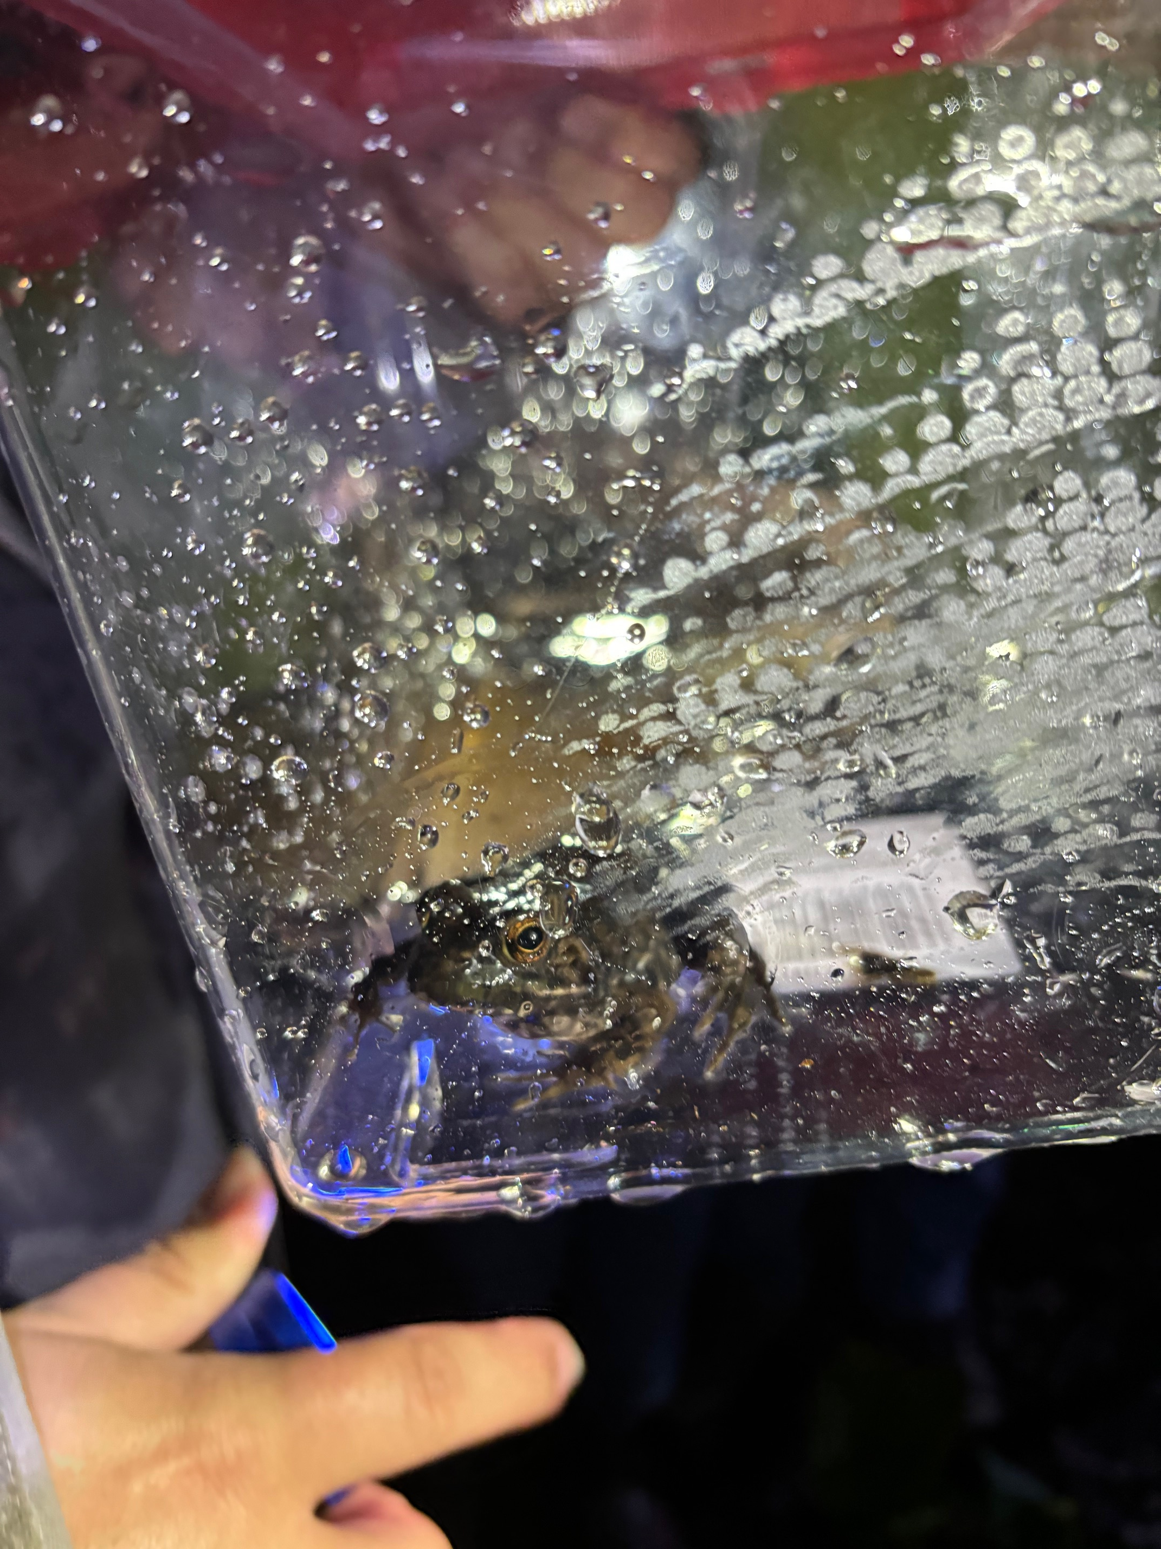
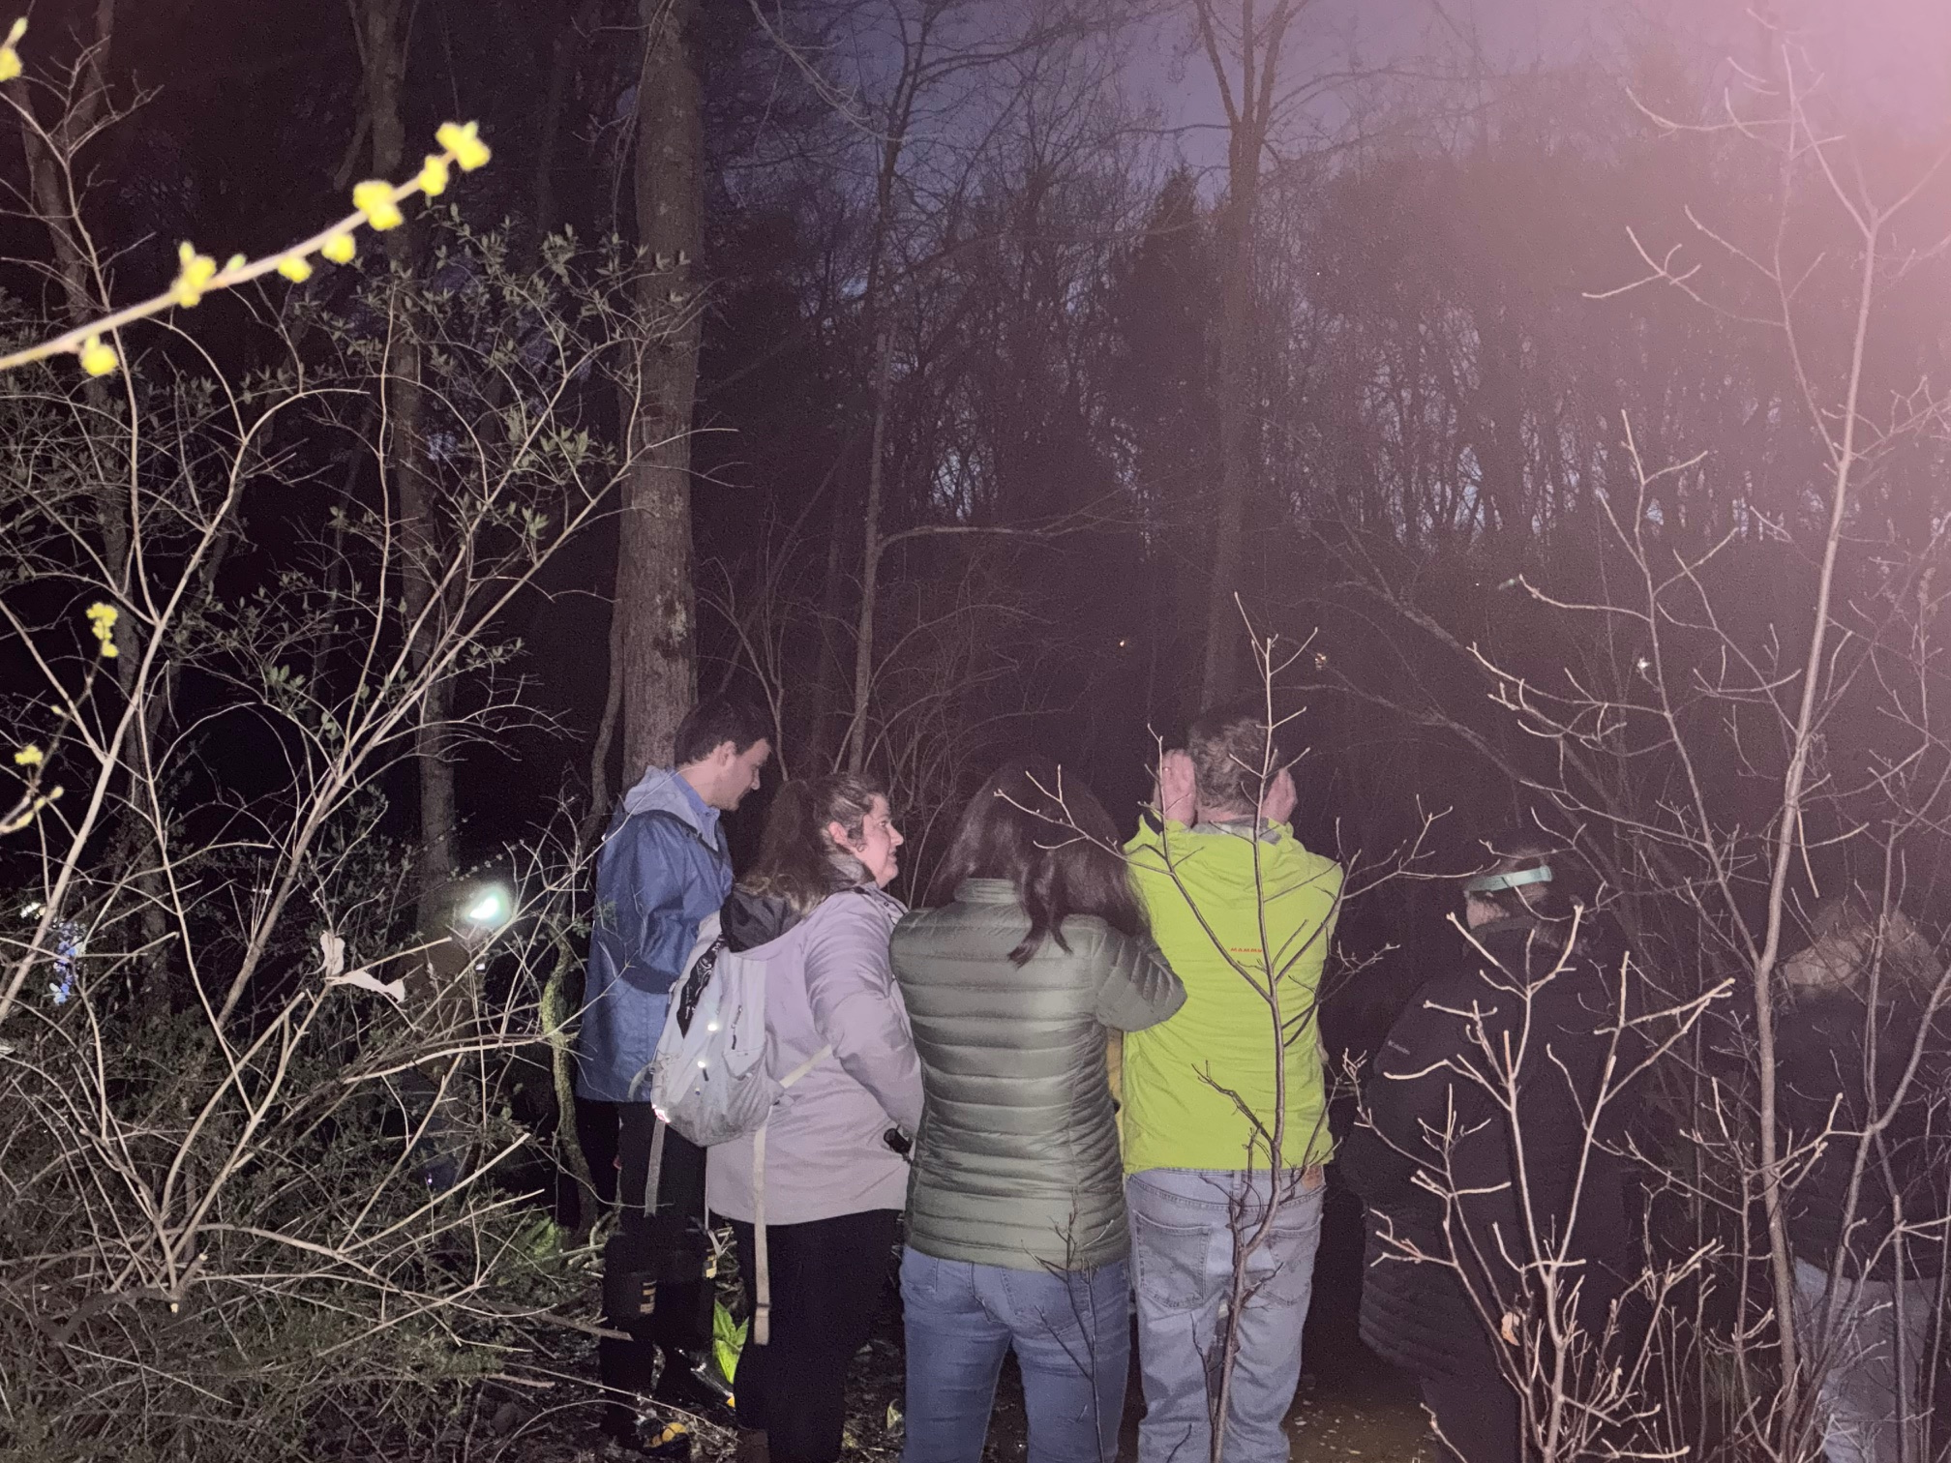
FrogWatch
A community science program established in 1998 to provide individuals, groups and families with opportunities to learn about wetlands in their communities by reporting calls of local frogs and toads.

Slide 5
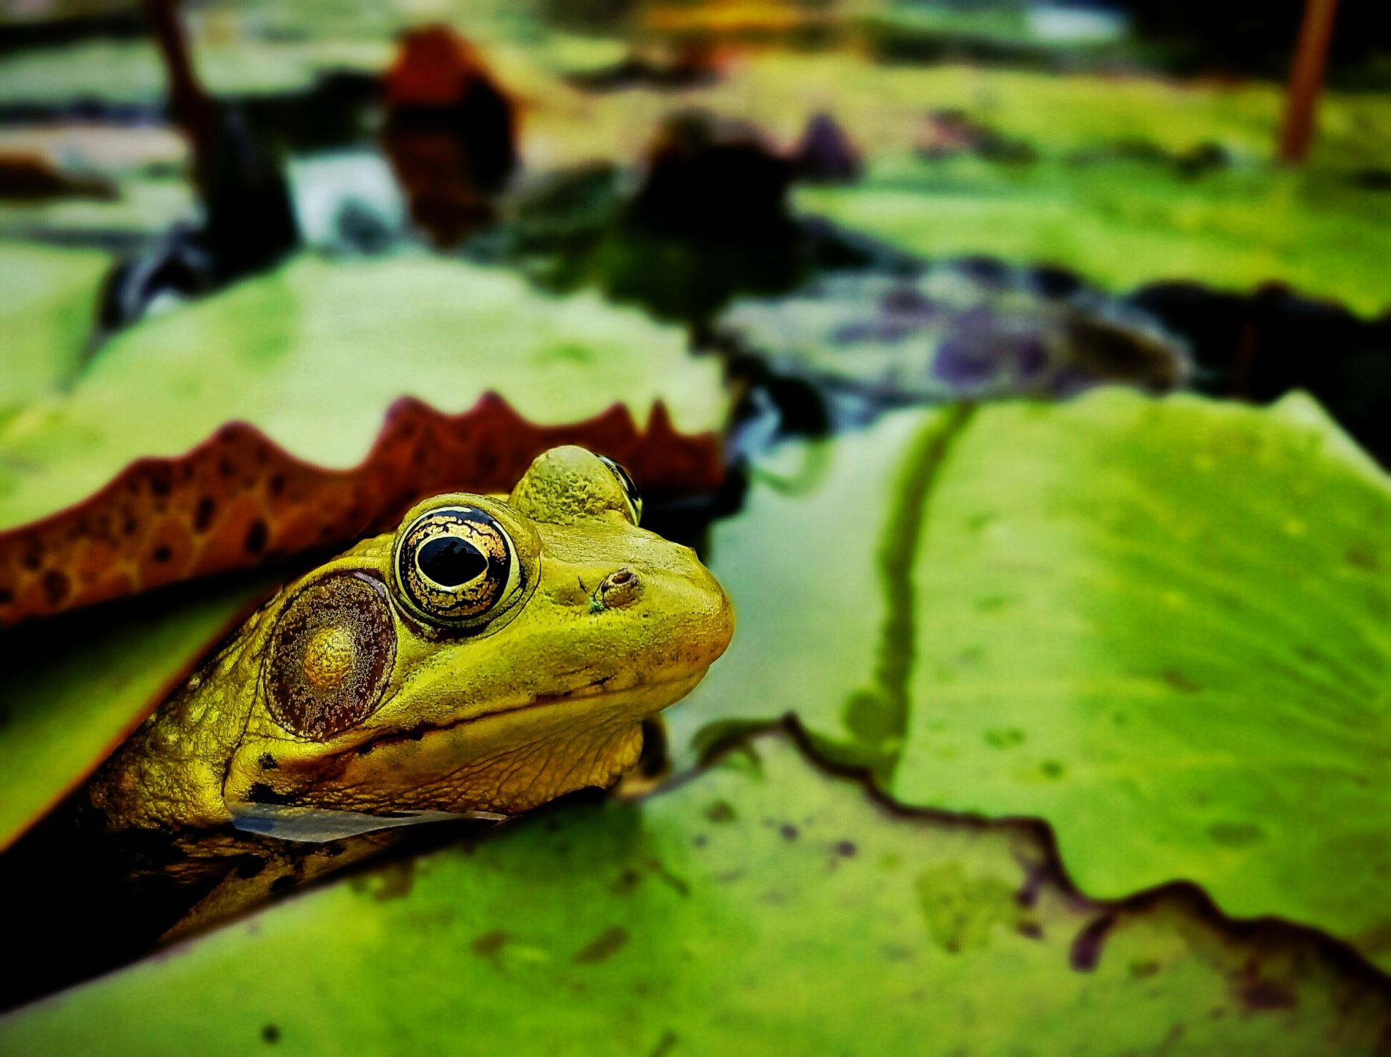
FrogWatch- How it works:
Attend a training to learn to identify frogs by their unique calls
Find a local wetland to monitor
To monitor- listen for 3 minutes, and record species heard and call intensity
From early March – August, monitor your wetland once a week

Slide 6

Monitoring Protocol:
At least 30 minutes after sunset
Air temperature
Relative Wind Speed:
  0 - Calm
  1 – Light Air; Rising Smoke Drifts
  2 – Light Breeze; Leaves Rustle; Can Feel Wind on Face
  3 – Gentle Breeze; Leaves and Twigs in Constant Motion
Current Precipitation
48-Hour Weather History
Quiet for 2 Minutes Before and Listen for 3 Minutes
Record Data on FrogWatchUSA Website

Slide 7
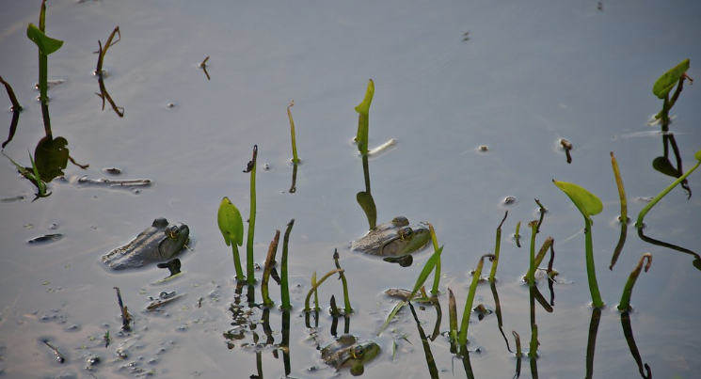
Calls and Intensity:
Which Species?
Intensity of the Calls:
  0 – No Species Heard
  1 – Individuals Can Be Counted. There is Space Between Calls
  2 – Calls of Individuals Can Be Counted But There is Some Overlap of Calls
  3 – Full Chorus, Calls Are Constant, Continuous, and Overlapping

Slide 8

Benefits of volunteering with Frog Watch
Increase understanding of nature and science
Collect scientific data on frogs and toads
Better understand the importance of wetlands
Closer relationship with nature
Develop an appreciation for frogs and toads in your community

Slide 9
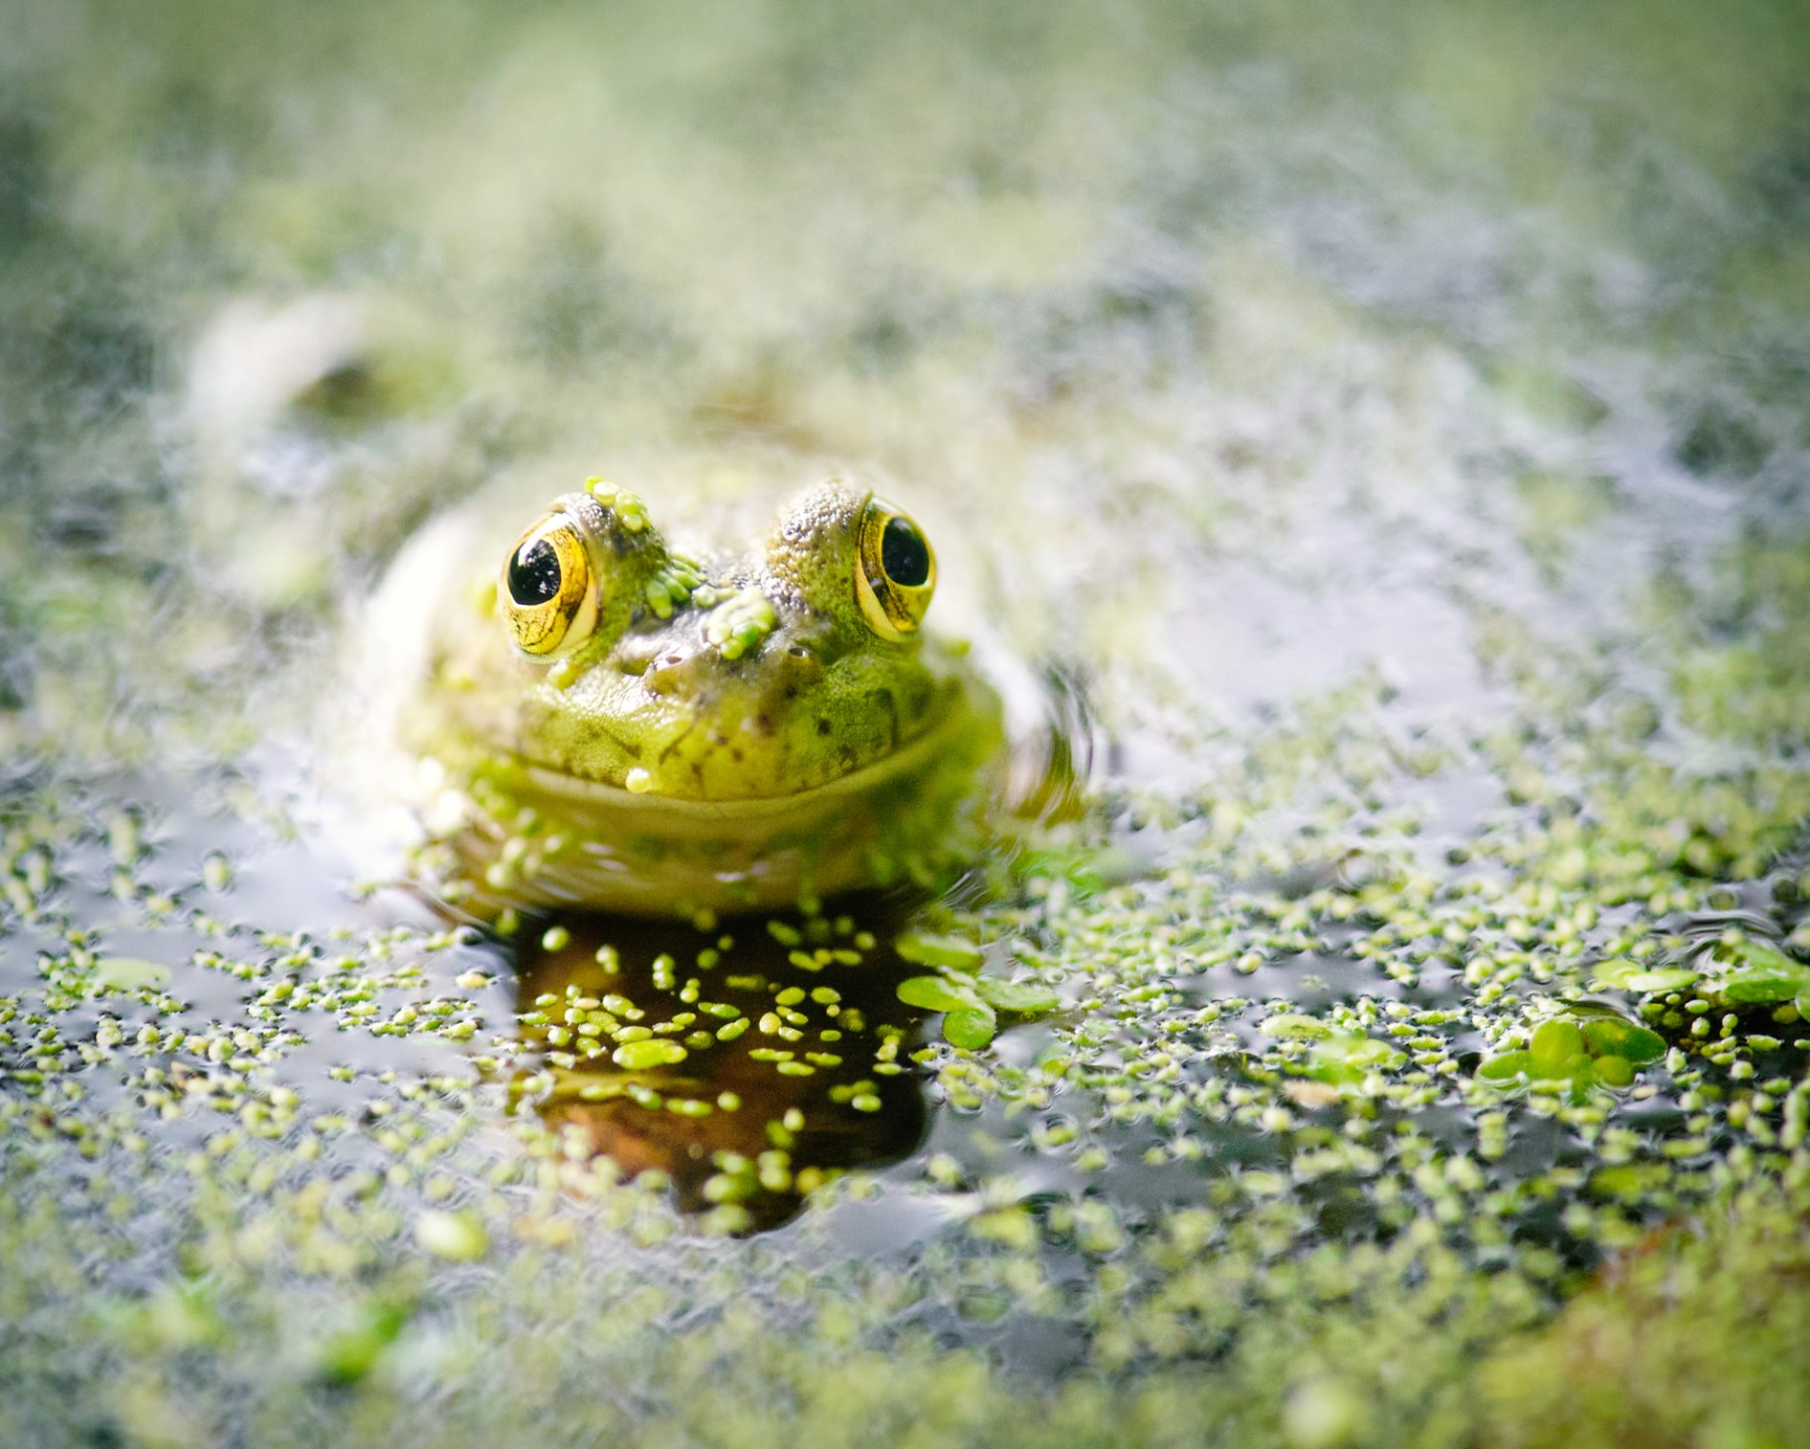
Why do we care about the frogs?​
Predators and prey within ecosystems​
Pest control​
Food ​
Medicine​
Education and research​
Indicator of wetland health​

Slide 10
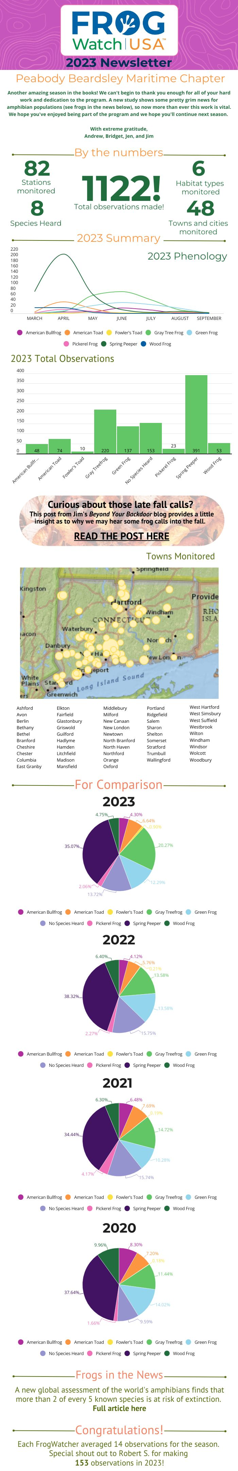
What we've learned
Relative Abundance
Phenology- the study of the timing and cyclical patterns of events in the natural world

Slide 11
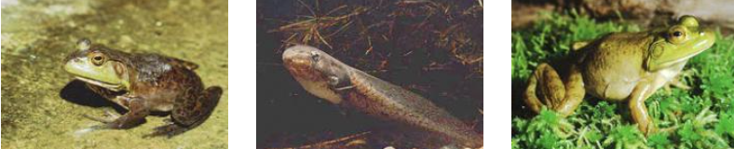
Let’s Start With (Hopefully) An Easy One.
Can you identify this Amphibian?
https://peabody.yale.edu/sites/default/files/audio/2022-02/american-bullfrog.mp3
Frog or Toad?

Slide 12
AMERICAN BULLFROG - RANA CATESBEIANA
Vocalization: A deep, often booming, call in middle to late summer. Commonly described as “chug-a-rum.”
A large, bulky frog measuring up to 8 inches (20 cm) snout to vent. Its color is primarily green to dark green, generally with a white belly. The feet are large and strongly webbed.
Its habitat is Fresh water ponds, streams and rivers.

Slide 13
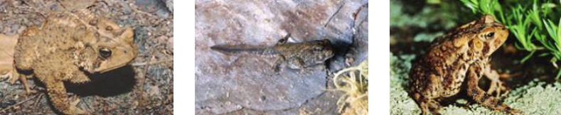
How about Amphibian #2?
https://peabody.yale.edu/sites/default/files/audio/2022-02/american-toad.mp3
Frog or Toad?

Slide 14
AMERICAN TOAD - BUFO AMERICANUS
A brown or brownish gray toad of 3 to 4 inches (7.6 to 10 cm) in length. The brown spots on the back generally contain 1 or 2 wart-like protuberances. The belly is creamy white with a peppering of dark spots.
Its habitat is highly variable. The species can be found in mixed hardwood forests, or suburban backyards. Typical requirements include sandy soil with leaf litter or other substrate to hide under, and some source of moisture.

Slide 15
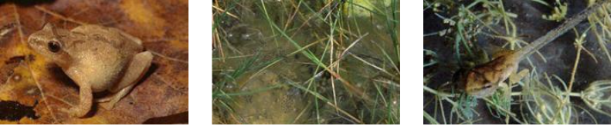
Amphibian #3 is my favorite
https://peabody.yale.edu/sites/default/files/audio/2022-02/spring-peeper.mp3
Frog or Toad?

Slide 16
SPRING PEEPER - PSEUDACRIS CRUCIFER
The smallest species of frog in Connecticut. It reaches a maximum body length of 1.5 inches (3.7 cm) as an adult. The toes have adhesive disks similar to those of tree frogs. The dorsal coloration is brown or brownish red, nearly always with a dark “X” pattern in the middle.
Its is reclusive outside the breeding season, but is found in woodland areas with marshy, vernal ponds or bogs. Breeds very early in the spring, often when snow is still on the ground.

Slide 17
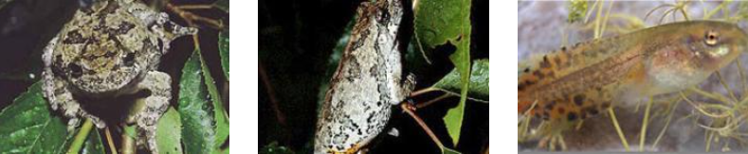
Let’s Try One More - Amphibian #4
https://peabody.yale.edu/sites/default/files/audio/2022-02/gray-treefrog.mp3
Frog or Toad?

Slide 18
GRAY TREEFROG - HYLA VERSICOLOR
A granular-skinned tree frog reaching 2 inches (5.0 cm). The coloration is highly variable, though most specimens are grayish with black markings on the back. Some specimens are green, occasionally completely lacking dorsal patterning. Individuals change color readily, though some seem to do so more readily than others.
Uses many habitats, but especially moist deciduous forests. It can also be found in upland habitats, even resting on rocky cliff faces by day. Its coloration camouflages it well against either tree bark or lichen-covered rock.
Though not listed as a threatened species, its dependency on vernal pools and shrubby wetlands has resulted in apparent decline in populations.

Slide 19
Others:
Common:
https://peabody.yale.edu/sites/default/files/audio/2022-02/wood-frog.mp3
Common:
https://peabody.yale.edu/sites/default/files/audio/2022-02/pickerel-frog.mp3
Common:
https://peabody.yale.edu/sites/default/files/audio/2022-02/fowlers-toad.mp3
Common:
https://peabody.yale.edu/sites/default/files/audio/2022-02/green-frog.mp3
Critically rare with only two known populations statewide:
https://peabody.yale.edu/sites/default/files/audio/2022-02/atlantic-coast-leopard-frog-small-chorus.mp3
Species of Concern:
https://peabody.yale.edu/sites/default/files/audio/2022-02/northern-leopard-frog.mp3

Slide 20
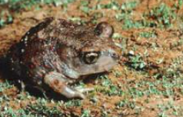
Others, Cont:
Endangered:
https://peabody.yale.edu/sites/default/files/audio/2022-02/eastern-spadefoot-toad.mp3
An unusual frog with vertical pupils. Spadefoots reach an adult size of 2 to 2.5 inches and are brownish gray, or blackish with yellow, gold or whitish stripes or mottling. The hind foot has a keratinized “spade” used for digging into the sand.
Very few populations are known in Connecticut. Current populations are scattered in eastern Connecticut. They are declining throughout its range from habitat loss. In Connecticut it is listed as an endangered species with most of the historical populations now extinct.

Slide 21
What we've learned

Slide 22
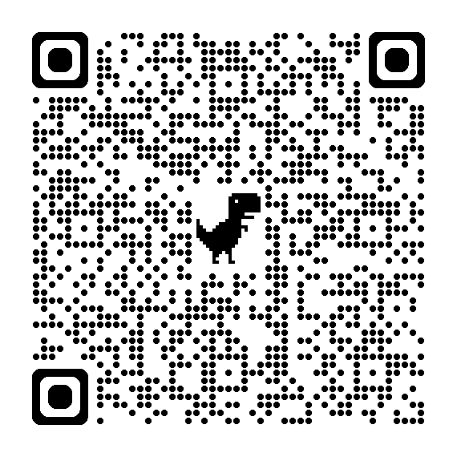
Trainings
Trainings are held in February/March
Offer both in-person and virtual trainings
To be notified of upcoming trainings, scan the QR code and complete the community science application
Chapter coordinators:
  Jen Farrell- jfarrell@beardsleyzoo.org
  Andrew Connoly- aconnoly@beardsleyzoo.org
  Jim Sirch- jimsirch95@gmail.com
  Bridget Cervero- bcervero@maritimeaquarium.org

