Slide 1
Loadshedding in South Africa
A presentation to the CT Siting Council
by: Chance Carter
Tuesday, March 5, 2024

Slide 2
What is loadshedding?
Loadshedding is an ongoing period of nationwide rolling blackouts that have affected South Africa since late 2007. (Rathi, 2022)
Energy in South Africa is provided through a national utility, Eskom.
Eskom started in 1923 to provide power to white areas and bypassed Black areas during the Apartheid era
This problem has been exacerbated since the end of Apartheid as the Black population has gained more economic power.

Slide 3
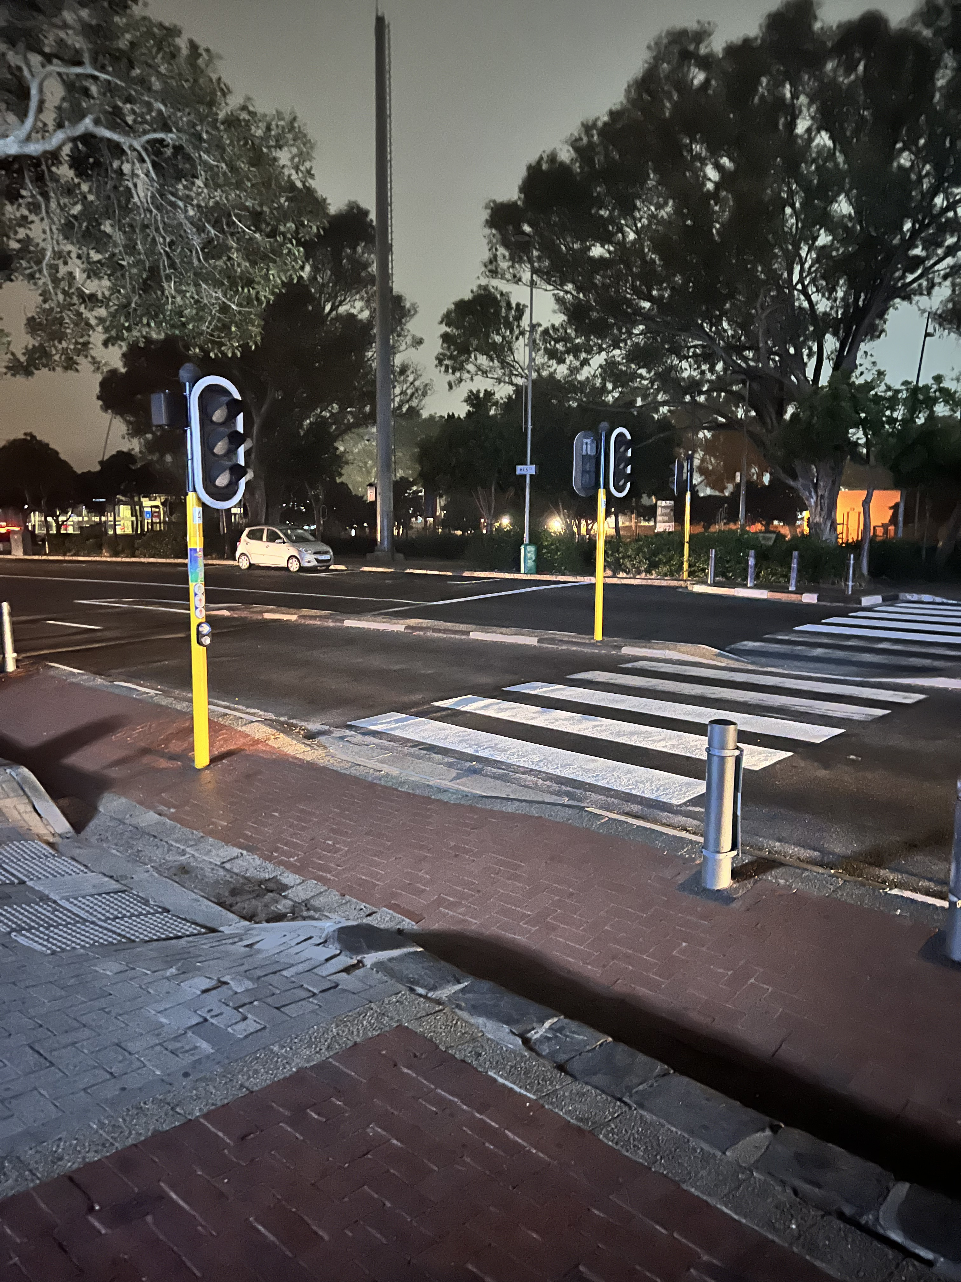
Was loadshedding avoidable?
In short, Yes!
A white paper was published in December 1998 outlining the future problems that would arise with South Africa’s electric grid as the country experienced large economic growth as the Apartheid era ended.
An example of loadshedding, this is at 12:30am.

Slide 4
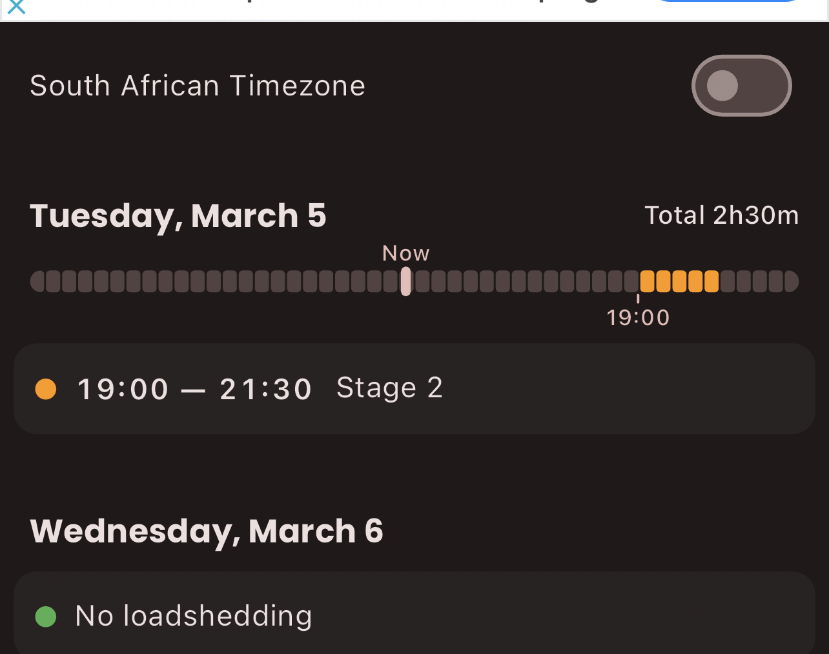
How often does loadshedding occur?
It depends on how much demand is on the system. During periods of low demand, like the Summertime festive season (around the time of the US Winter Holidays) demand is lower and therefore loadshedding occurs less.
Luckily, there is an app that can help you predict when loadshedding will occur!

Slide 5
Energy Generation in South Africa
South Africa has an abundance of natural resources, but primarily relies on coal for power generation.
South Africa does have one nuclear power plant.
Source: CIA World Factbook

Slide 6
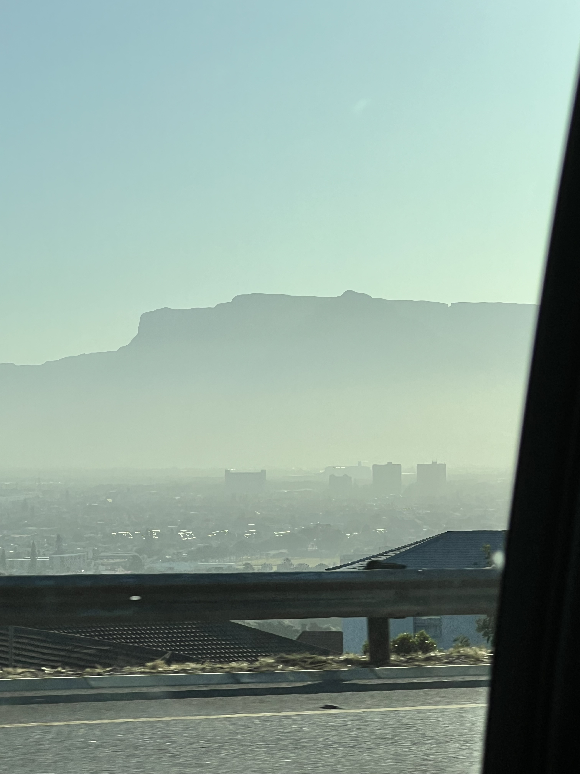
Ramifications of loadshedding
Security
  More private security than police and armed forces
Economic
  Losses estimated at $40m/day due to loadshedding
Environmental
  Poor air quality

Slide 7

Thank you!
Questions/Thoughts?

Slide 8
Works Cited
CIA. CIA World Factbook - South Africa. 27 February 2024. 5 March 2024.
Department of Minerals and Energy. White Paper on the Energy Policy of the Republic of South Africa. White Paper. Pretoria: Government of South Africa, 1998.
Rathi, Anusha. "Why South Africa Is in the Dark, Again." Foreign Policy 8 July 2022.

