Slide 2
Air Quality Awareness Week
Communicating Air Quality Alerts to the Public
April 2016
Michael Geigert
Air Planning and Standards

Slide 3

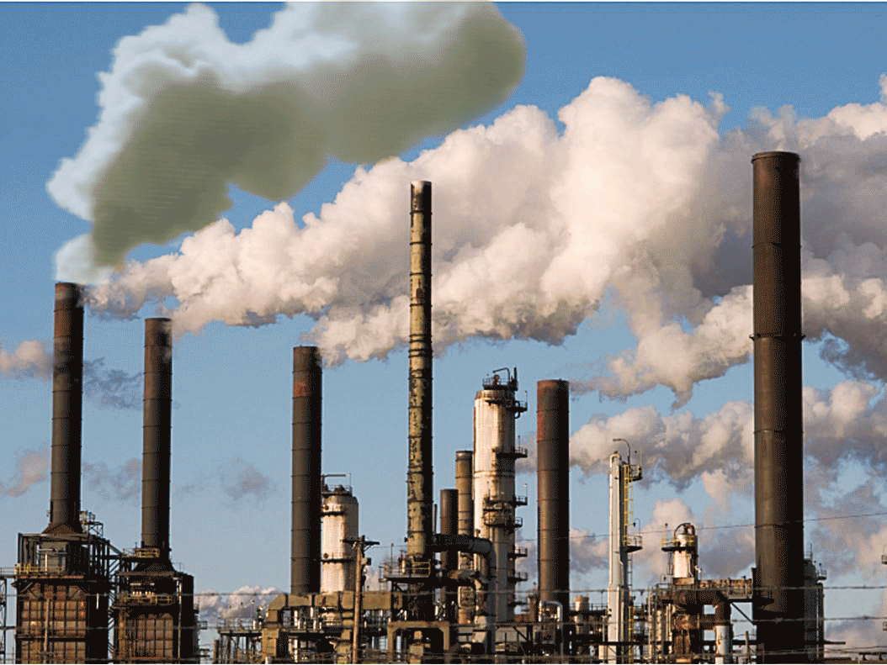
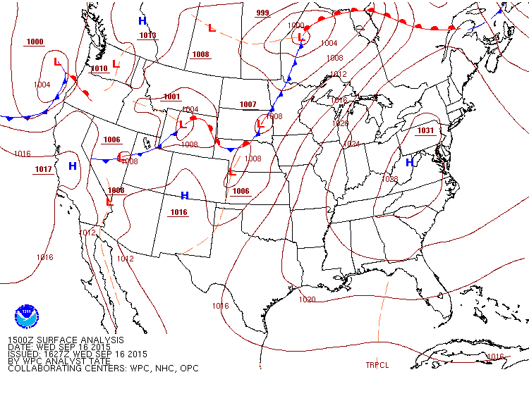
Air Quality and Meteorology
Emissions and meteorology are the two most important factors determining the air quality

Slide 4
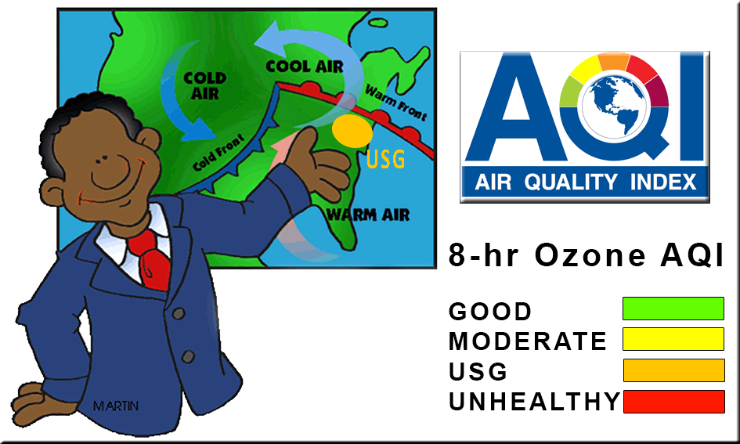

Why Include the Air Quality?
You are the messenger to the people!

Slide 5

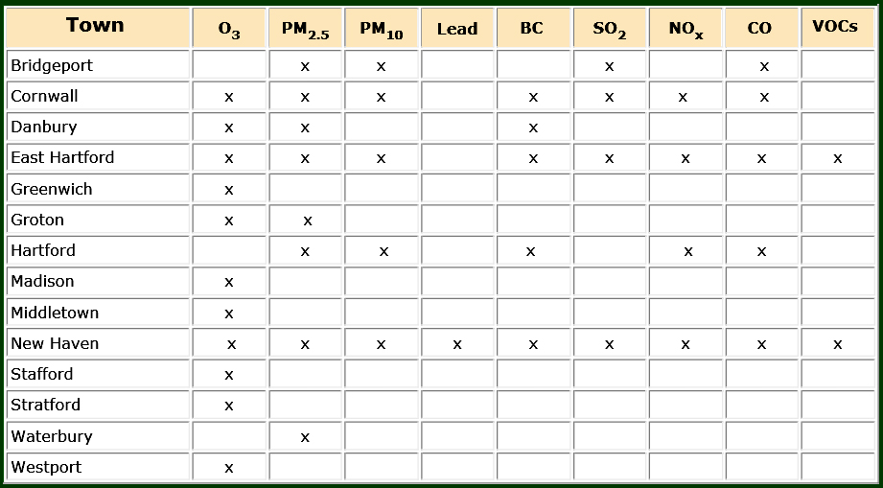
Ambient Air Monitoring in Connecticut
Lead Monitoring ceases on 6/30/2016
Criteria Pollutants
Forecast Pollutants

Slide 6
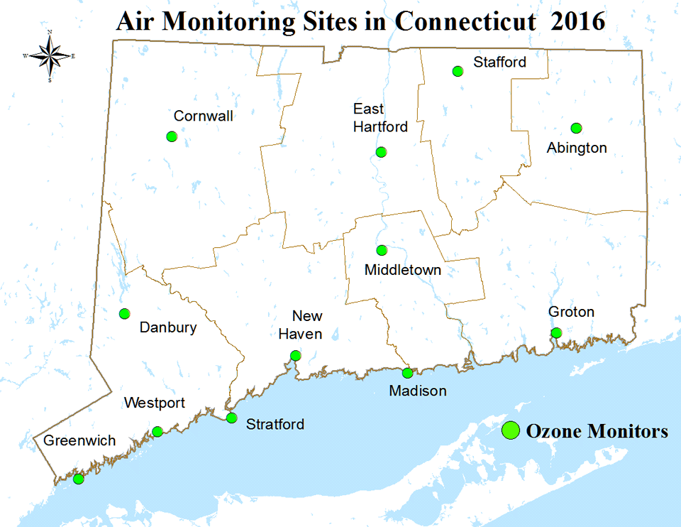
Extra Slides

Slide 7
Ozone and Particulate Matter (PM2.5)
With the new ozone 8-hr NAAQS of 70 ppb, expect more alerts this summer;
Ozone monitoring season runs from March- September; daily forecasting usually begins in May;
PM2.5 monitoring runs year-round;
Expect only a few 24-hr PM2.5 exceedance days per year, generally in the winter.
PM2.5 24-hr NAAQS = 35 µg/m³; Annual = 12 µg/m³
CTDEEP issues air quality forecasts everyday of the year.

Slide 8
The CT DEEP AQI Web Page

Slide 9
Sign up for AQI updates on Twitter
Air Quality Updates on Twitter
Follow us on Twitter for Connecticut air quality forecasts and alerts. Tweets are generated by EPA's EnviroFlash system and provide the date and air quality forecast for the selected area.
Twitter updates are available for the following towns in Connecticut:
Bridgeport
Danbury
Greenwich
Groton
Hartford
Madison
Middletown
New Haven
Stafford
Stratford
Torrington
Westport

Slide 10
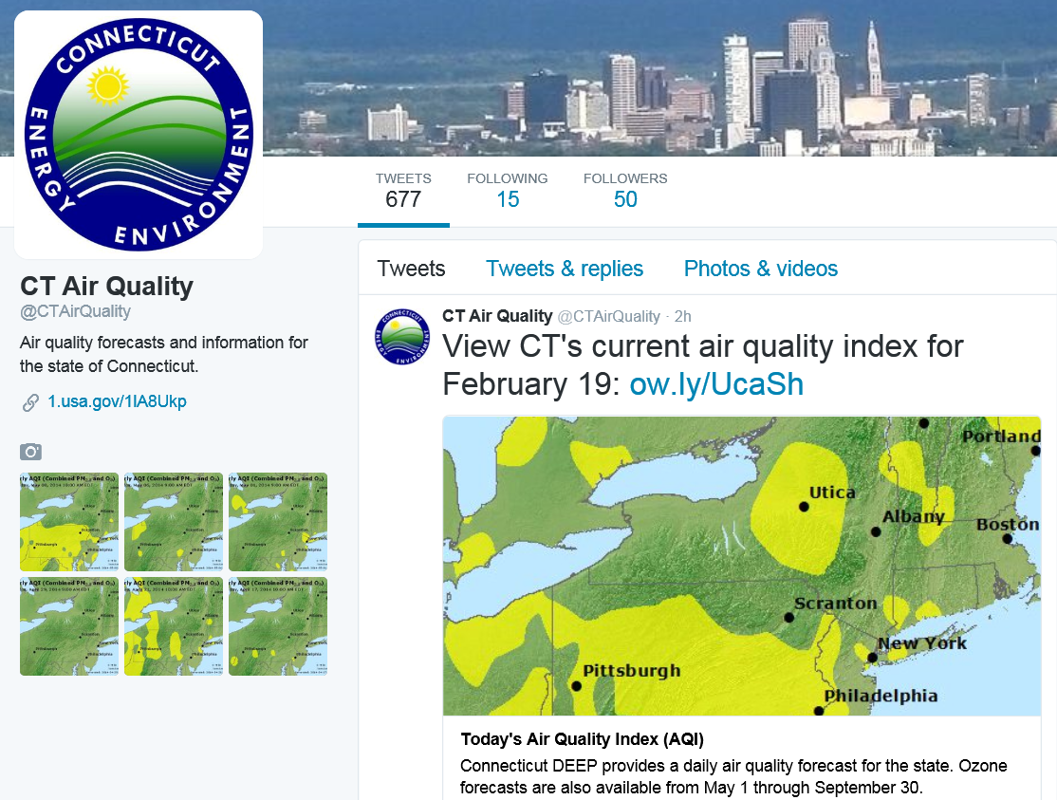
Extra Slides

Slide 11
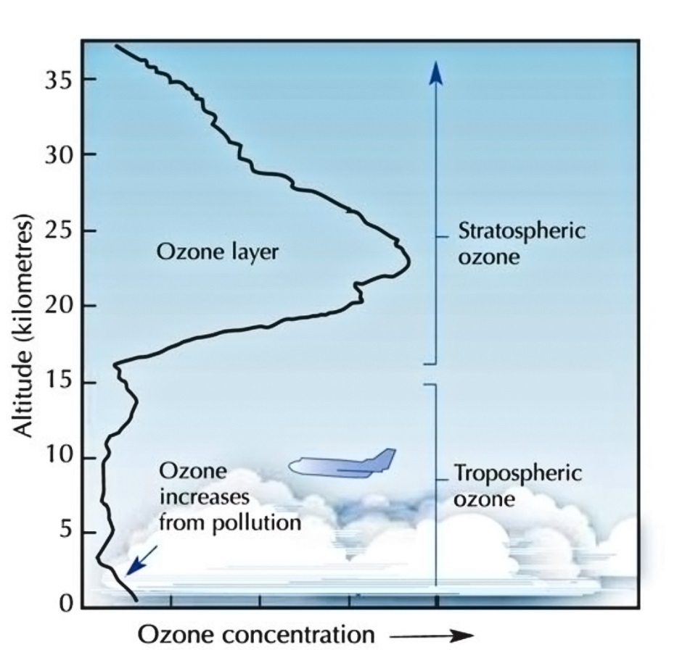
Where is the Ozone?
GOOD!
Tropopause
Bad!

Slide 12

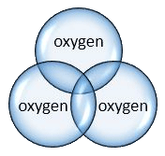


What is ground-level ozone?
Ozone is a colorless gas formed when nitrogen oxides (NOx) and volatile organic compounds (VOCs) chemically react in the sun.
Ozone is a major component of smog — especially during the summer, when weather conditions are ripe for ground-level ozone to form.
VOC + NOx + sunlight = OZONE

Slide 13
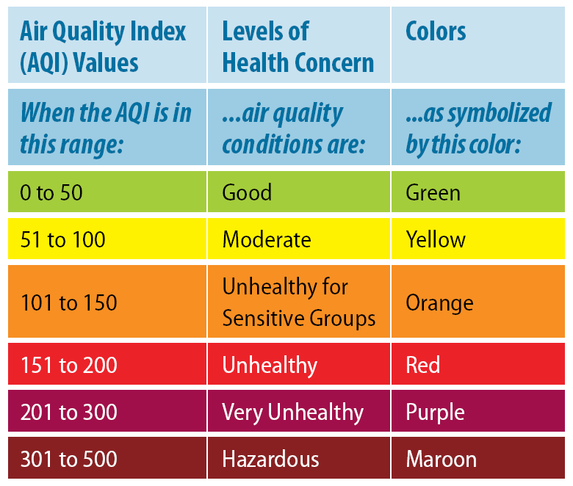
What do the AQI values mean?

Slide 14
Ozone: USG Levels
Ozone Orange: The air quality forecast for tomorrow is unhealthy for sensitive groups (code orange).
Key On-Air Message
Air quality is unhealthy for people in sensitive groups.
Supporting Message/ What Action Should People Take?
Sensitive groups, including people with lung disease (such as asthma), active adults and children should take precautions, such as limiting prolonged outdoor exertion.

Slide 15
Ozone: Unhealthy Levels
Ozone Red: The air quality forecast for tomorrow is unhealthy for Everyone (code red).
Key On-Air Message:
The air quality forecast for tomorrow is unhealthy for everyone.
Supporting Message/ What Action Should People Take?
Everyone needs to limit prolonged outdoor exertion!

Slide 16
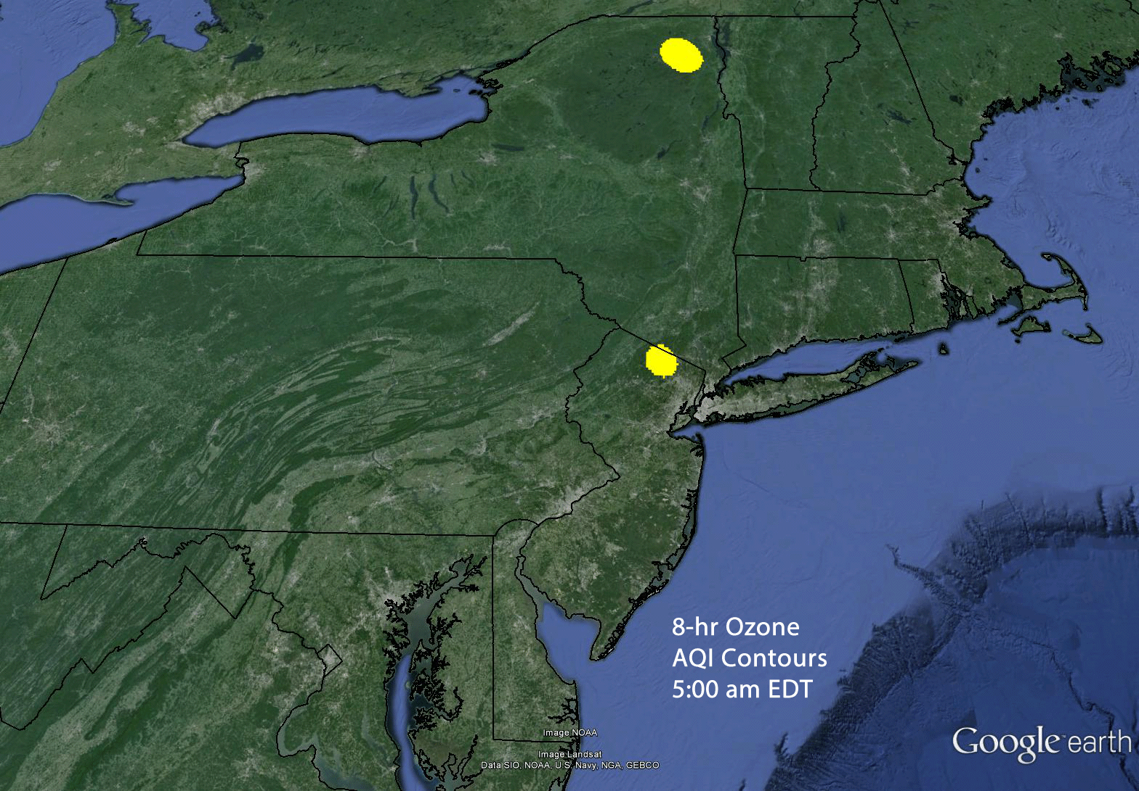
September 17, 2015- 8-hour Ozone AQI

Slide 17
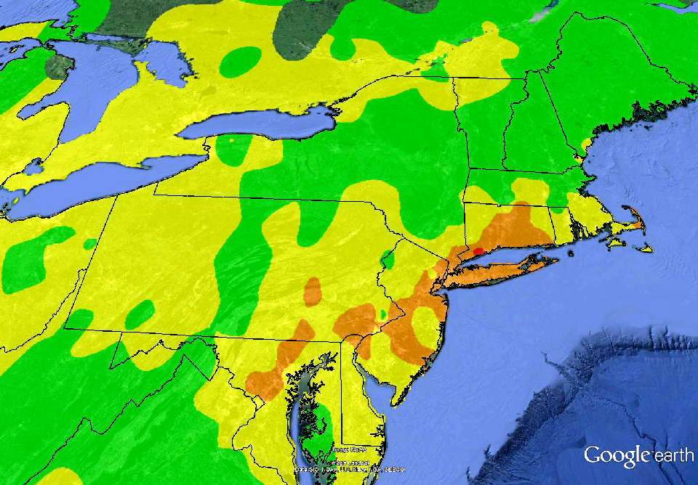
Peak Ozone AQI- September 17, 2015

Slide 18
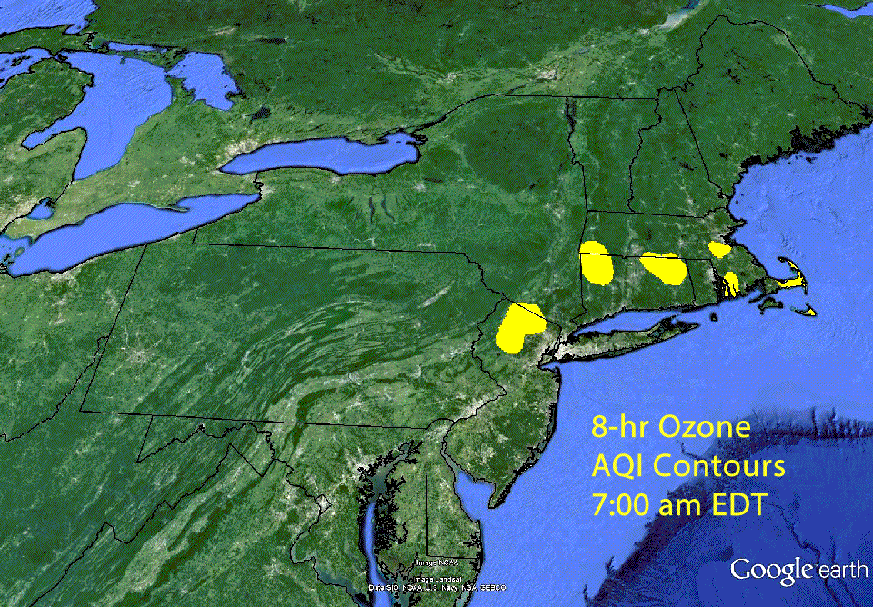
September 18, 2015- 8-hour Ozone AQI

Slide 19
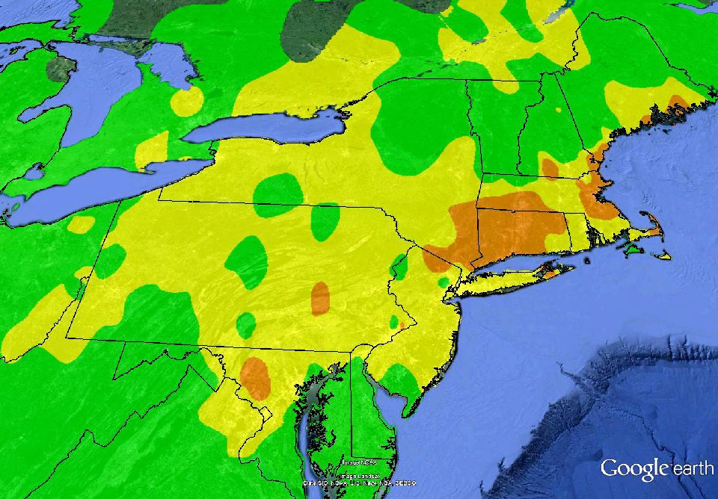
Peak Ozone AQI- September 18, 2015

Slide 20
Surface Analysis Animation
September 16, 11:00 am- September 19, 2:00 am
Note the nearly stationary high pressure center over the mid-Atlantic region.
This resulted in light winds and stagnant conditions that tended to trap pollutants in the boundary layer.

Slide 21
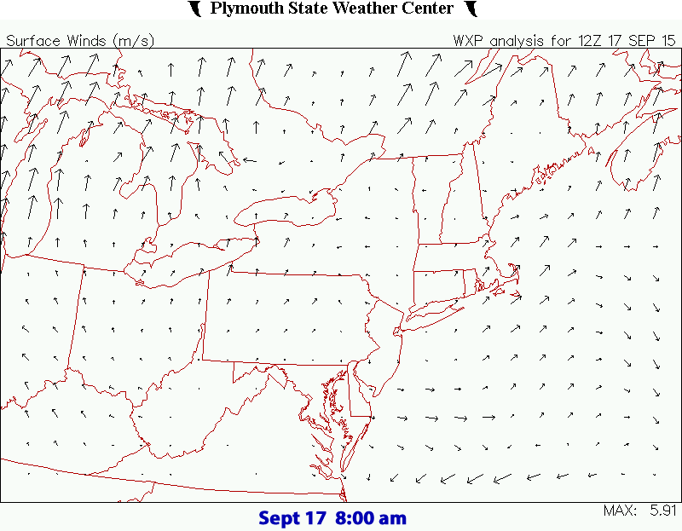
Surface Wind Vector Animation
September 17-18, 2015

Slide 22
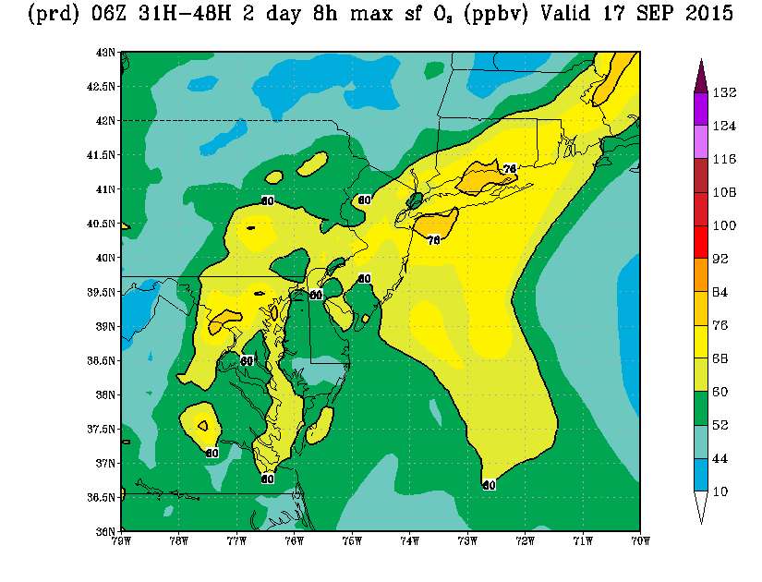
September 17th NOAA Model
The publicly available NOAA ozone forecast model is of great value to our forecasters!

Slide 23
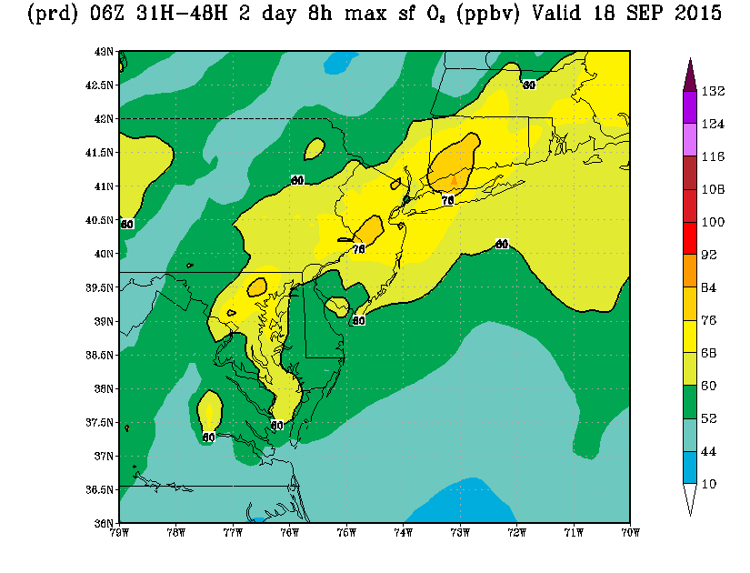
September 18th NOAA Model

Slide 24
Westport CT Modeled Ozone

Slide 25
Particle Pollution: USG
Key On-Air Message
The air quality forecast for tomorrow is unhealthy for sensitive groups (code orange) for fine particles.
Supporting Message/ What Action Should People Take?
If you are in a sensitive group, including people with heart or lung disease (such as asthma), older adults and children:
You might want to go for a walk instead of a jog.
Try to cut back your strenuous activities or reschedule them when air quality is better.
Take precautions if you experience any unusual coughing or chest discomfort.

Slide 26
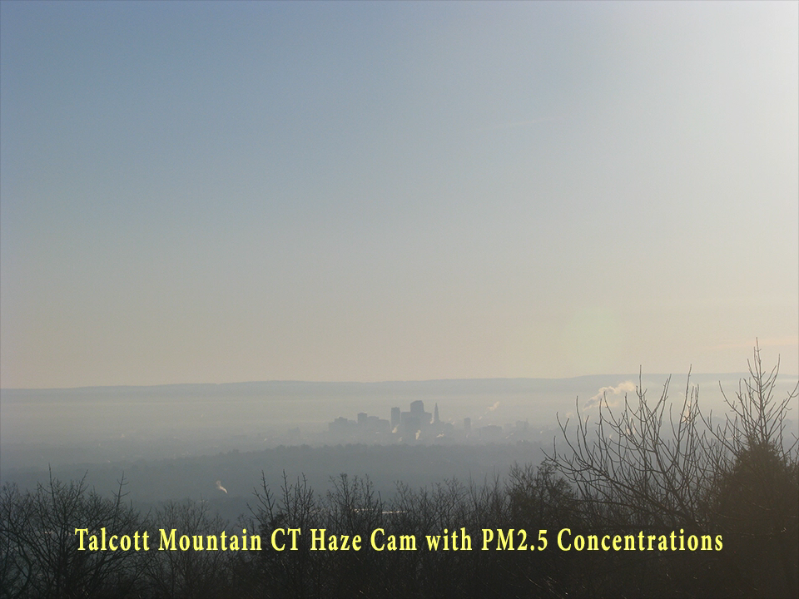
PM2.5 decreases as the atmosphere becomes well-mixed

Slide 27
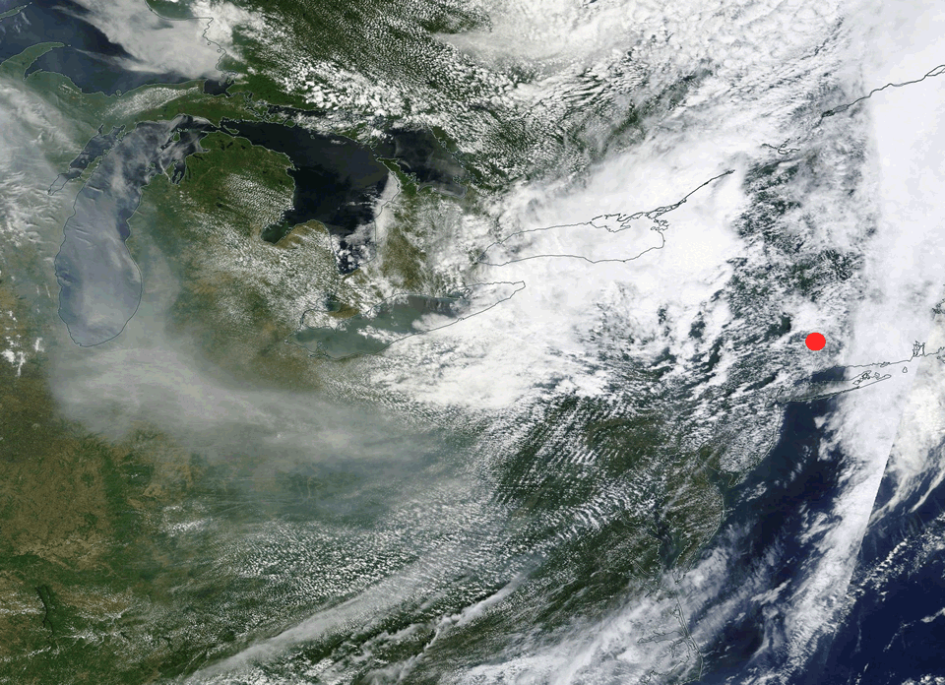
PM2.5 Generally Higher in the Winter, unless…
June 10-11, 2015 Smoke Plume from Canadian Wildfires

Slide 28
Myths and Facts
MYTH | FACT
Asthma is only a concern during the summer and/or when playing sports. | Asthma is a lung disease, and people with asthma are susceptible to air pollution year-round.
Air quality only affects us when we are outside. | That's right for ozone. But when particle levels are high outdoors, they can also be high indoors.
Air pollution is only a concern in the summer. | Particle pollution, unlike ozone, occurs year-round.
There is nothing I can do about air pollution, so I should just ignore it. | People can reduce their exposure to air pollution by simply checking their daily air quality forecast and using it to adjust their strenuous outdoor activities.
Ozone and particle pollution affect the same groups of people. | People with heart or lung disease, older adults, and children are particularly sensitive to the harmful effects of particle pollution. The sensitive groups for ozone include people with lung disease (but not heart disease), and children and adults who are active outdoors.
The health effects of ozone and particle pollution are the same. | While both ozone and particles have been associated with effects on the lungs, particles have also been associated with effects on the heart and cardiovascular system.
Air pollution is a health concern only for people with lung disease (including asthma) and older adults. | Others can be affected by air pollution, including people with heart disease, active adults and children. And when the air quality forecast is code red - everyone can be affected.

Slide 29
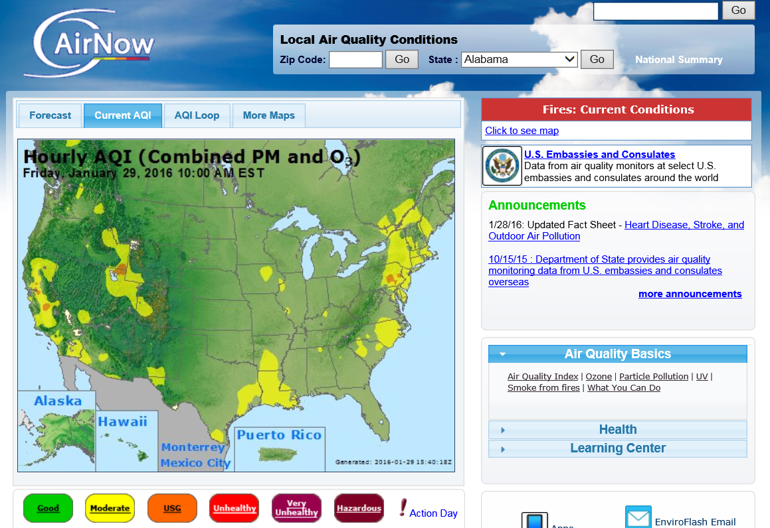
http://airnow.gov/ Web Page

Slide 30
http://www.enviroflash.info/

Slide 31
Typical EnviroFlash Message

Slide 32
2015 had 22 Ozone Exceedance Days in CT
The air quality continues to improve despite the expected increase in air quality alerts.

Slide 33
What to Expect for 2016
Previous large El Nino had increased ozone exceedance days

Slide 34
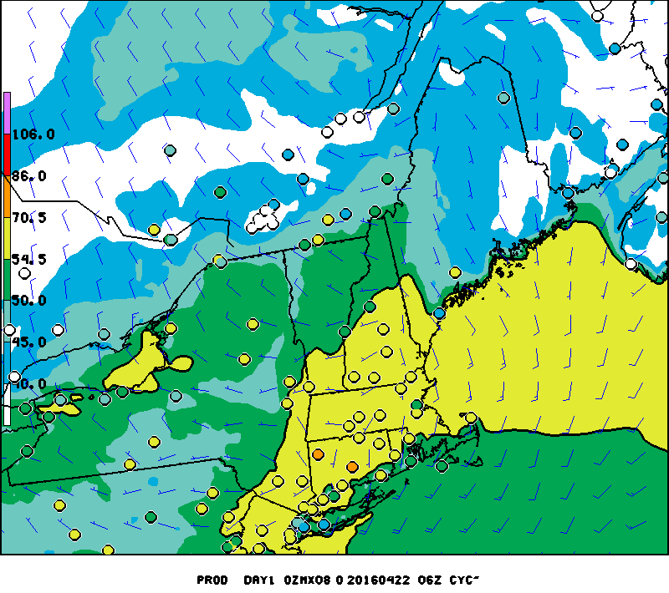
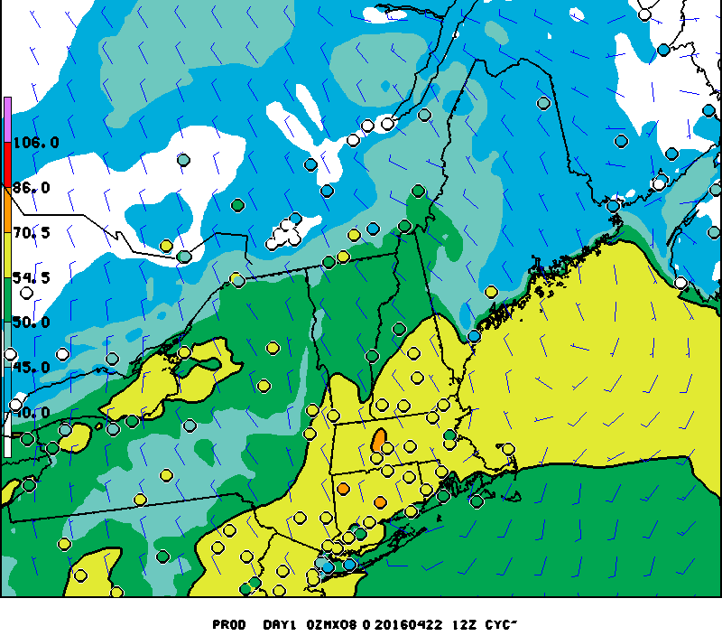
April 22nd: First Ozone Exceedance!
NOAA 06z Model
NOAA 12z Model
Cornwall
Middletown

Slide 35
Temperature vs. Ozone
High Temperature = 79° F
8-hour Ozone = 73 ppb
High Temperature = 76° F
8-hour Ozone = 72 ppb

Slide 36
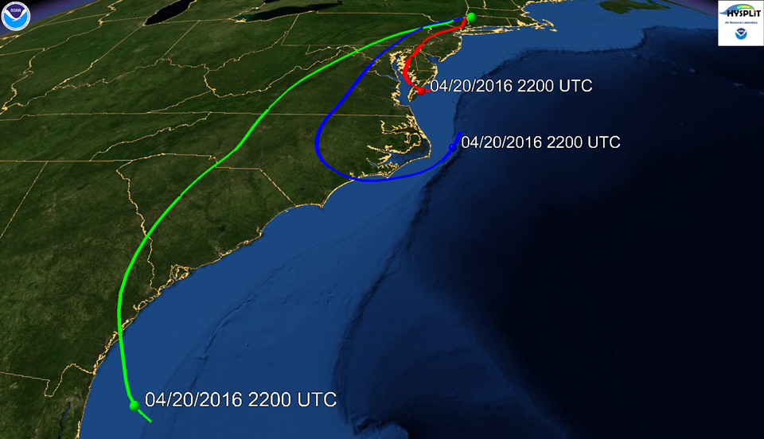
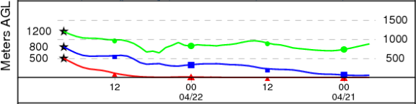
Cornwall 48-hr Back Trajectories 20z April 22, 2016
1200 Meters
800 Meters
500 Meters

Slide 37
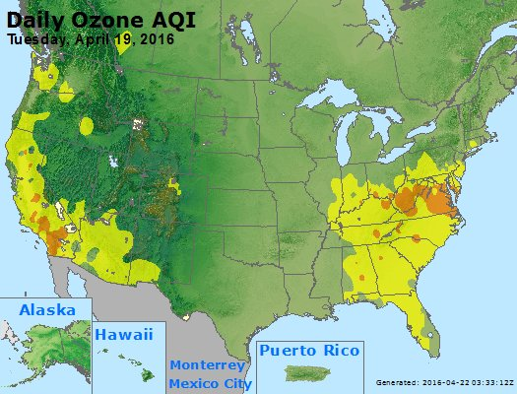
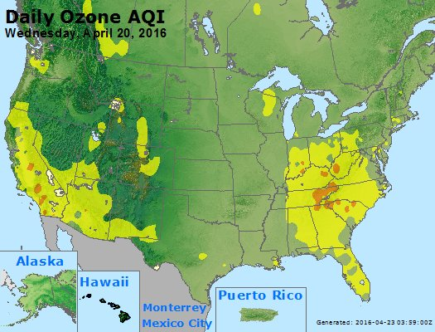
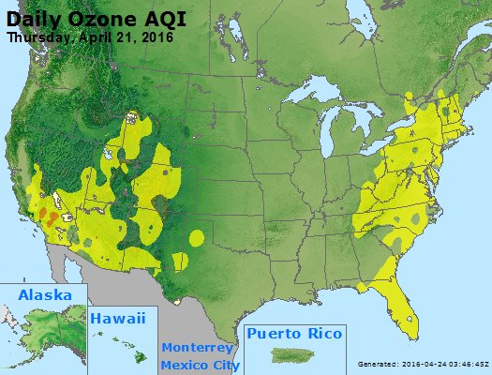
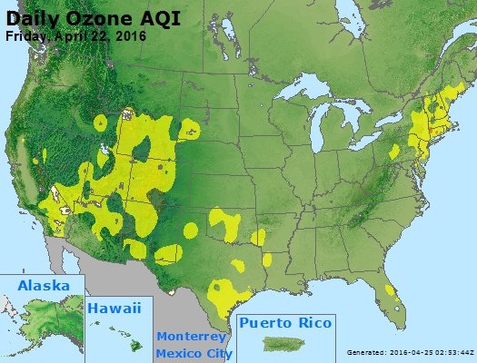
Persistent Elevated Ozone over the Southeast

Slide 38
Questions?

