Slide 2
May 25-29, 2016 Ozone Exceptional Event Analysis for Connecticut
Michael Geigert
SIPRAC November 2016

Slide 3

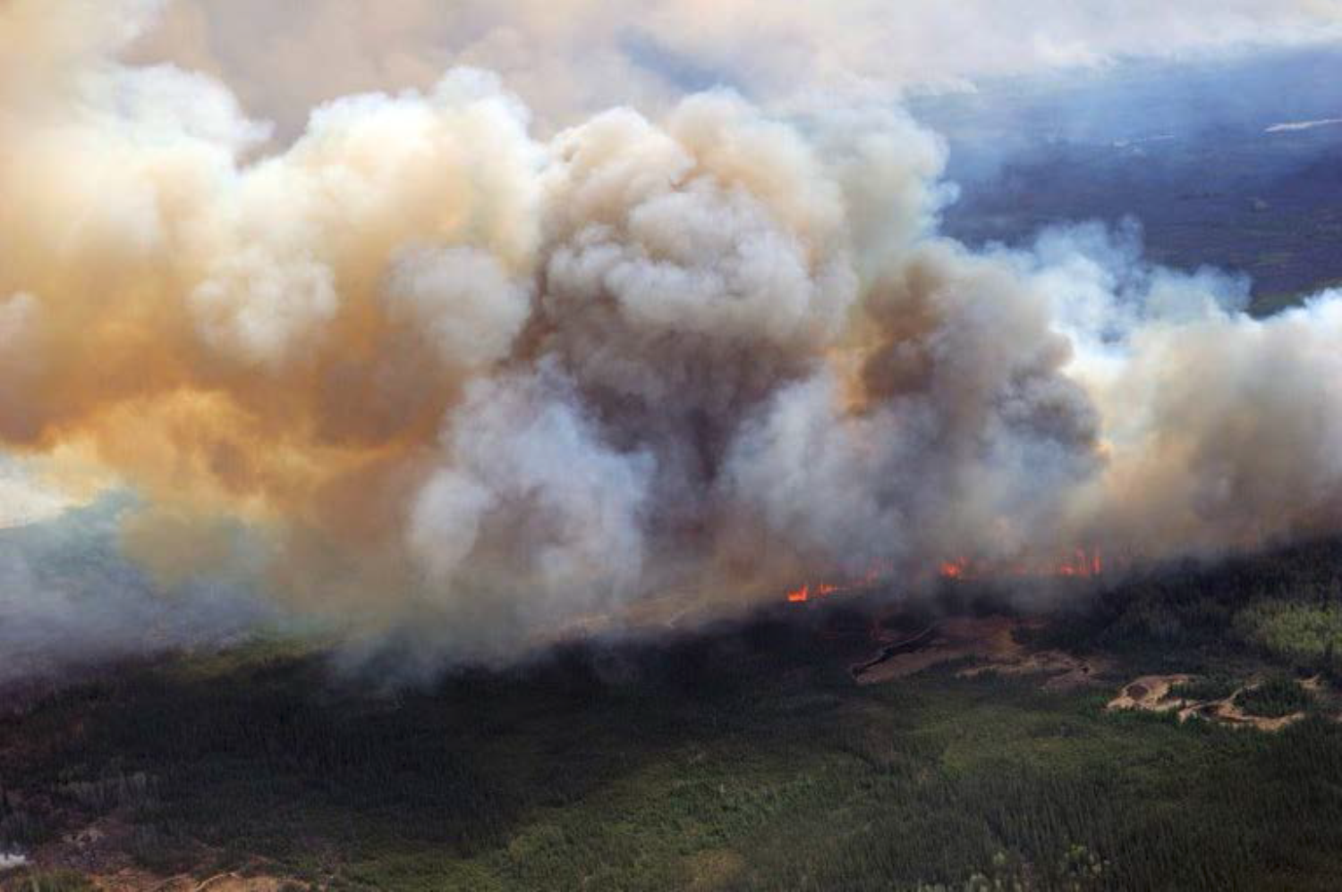
Fort McMurray Wildfire
On May 1, 2016, a wildfire began southwest of Fort McMurray, Alberta, Canada
On May 1, 2016, a wildfire began southwest of Fort McMurray, Alberta, Canada.
On May 3, it swept through the community, destroying approximately 2,400 homes
and buildings and forcing the largest wildfire evacuation in Albertan history.
The fire spread across approximately 590,000 hectares (1,500,000 acres) before
it was declared to be under control on July 5, 2016.

Slide 4
Available Tools for Analysis
Satellite animation with AOD estimations;
Analyzed plume coverage by NESDIS ;
Calipso satellite aerosol analysis;
Airnowtech Navigator trajectory analysis;
Hysplit trajectory analysis;
NOAA Model Forecasts;
NWS archive surface analysis;
Airnow AQI maps;
CTDEEP PM2.5, BC, and Ceilometer data.

Slide 5
2016 Exceptional Events Rule
On September 16, 2016, the U.S. Environmental Protection Agency (EPA) finalized revisions to the 2007 Exceptional Events Rule:
addressed issues raised by stakeholders (e.g.“but for” clause);
Released non-binding guidance document, “Guidance on the Preparation of Exceptional Events Demonstrations for Wildfire Events that May Influence Ozone Concentrations,” which explains how to apply the rule revisions to wildfire events that could influence monitored ozone concentrations.
“…applies to the treatment of data showing exceedances or violations for the following types of regulatory actions: An action to designate or redesignate an area as attainment, unclassifiable/ attainment, nonattainment or unclassifiable for a particular NAAQS…”etc.

Slide 6
Attainment Status Affected

Slide 7
Attainment Status Affected
May 25-26 had the most impact on current design values

Slide 8
Attainment Status Affected
Westport 2016 DV would drop to 83 ppb!

Slide 9
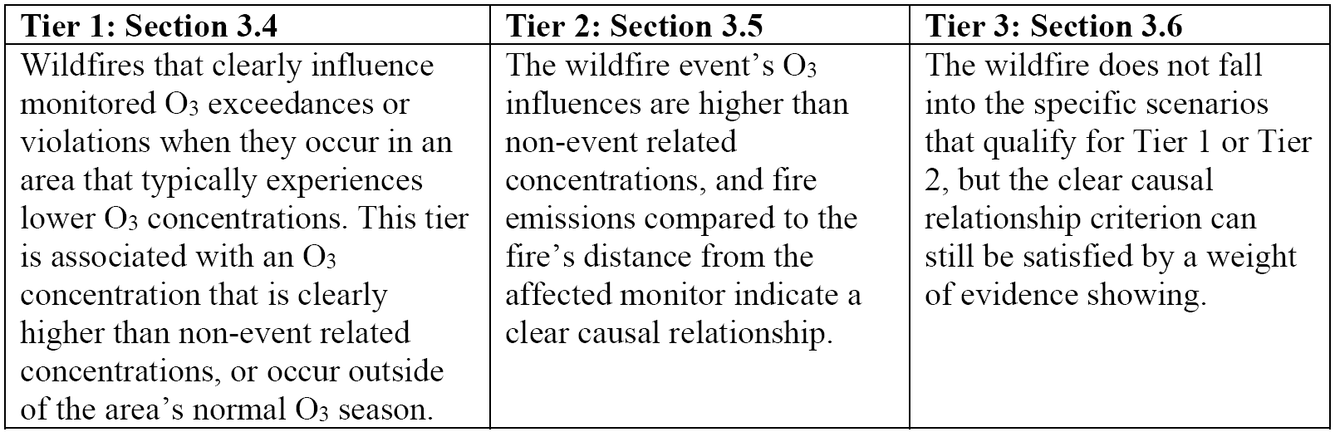
The Trail of Tiers…
Clear Causal Relationship between the Specific Event and the Monitored Concentration
“… demonstrating that the wildfire’s emissions were transported to the monitor, that the emissions from the wildfire influenced the monitored concentrations, and, in some cases, quantifying the contribution of the wildfire’s emissions to the monitored O3 exceedance or violation.”

Slide 10
Weight of Evidence
We intend to show :
Effects of the exceptional event on the regulatory determination on the Westport monitor;
The route of the wildfire emissions to the influenced monitors, including meteorological information regarding the transport of wildfire emissions to the monitor;
Satellite imagery and smoke plume analysis that shows the Fort McMurray plume settling over the Great Lakes area producing high concentrations of ozone that subsequently gets transported to Connecticut;
Why, at the onset of the event, meteorological conditions were not conducive for producing the high levels of ozone that were observed at our monitors;
That the NOAA operational ozone model, which did not incorporate real time wildfire emissions into the inventory, was under predicting ozone levels at the onset by at least 10 ppb;
Monitoring data at our sites was showing black carbon, PM2.5 and other parameters that concur with the presence of a smoke plume during the ozone event.

Slide 11
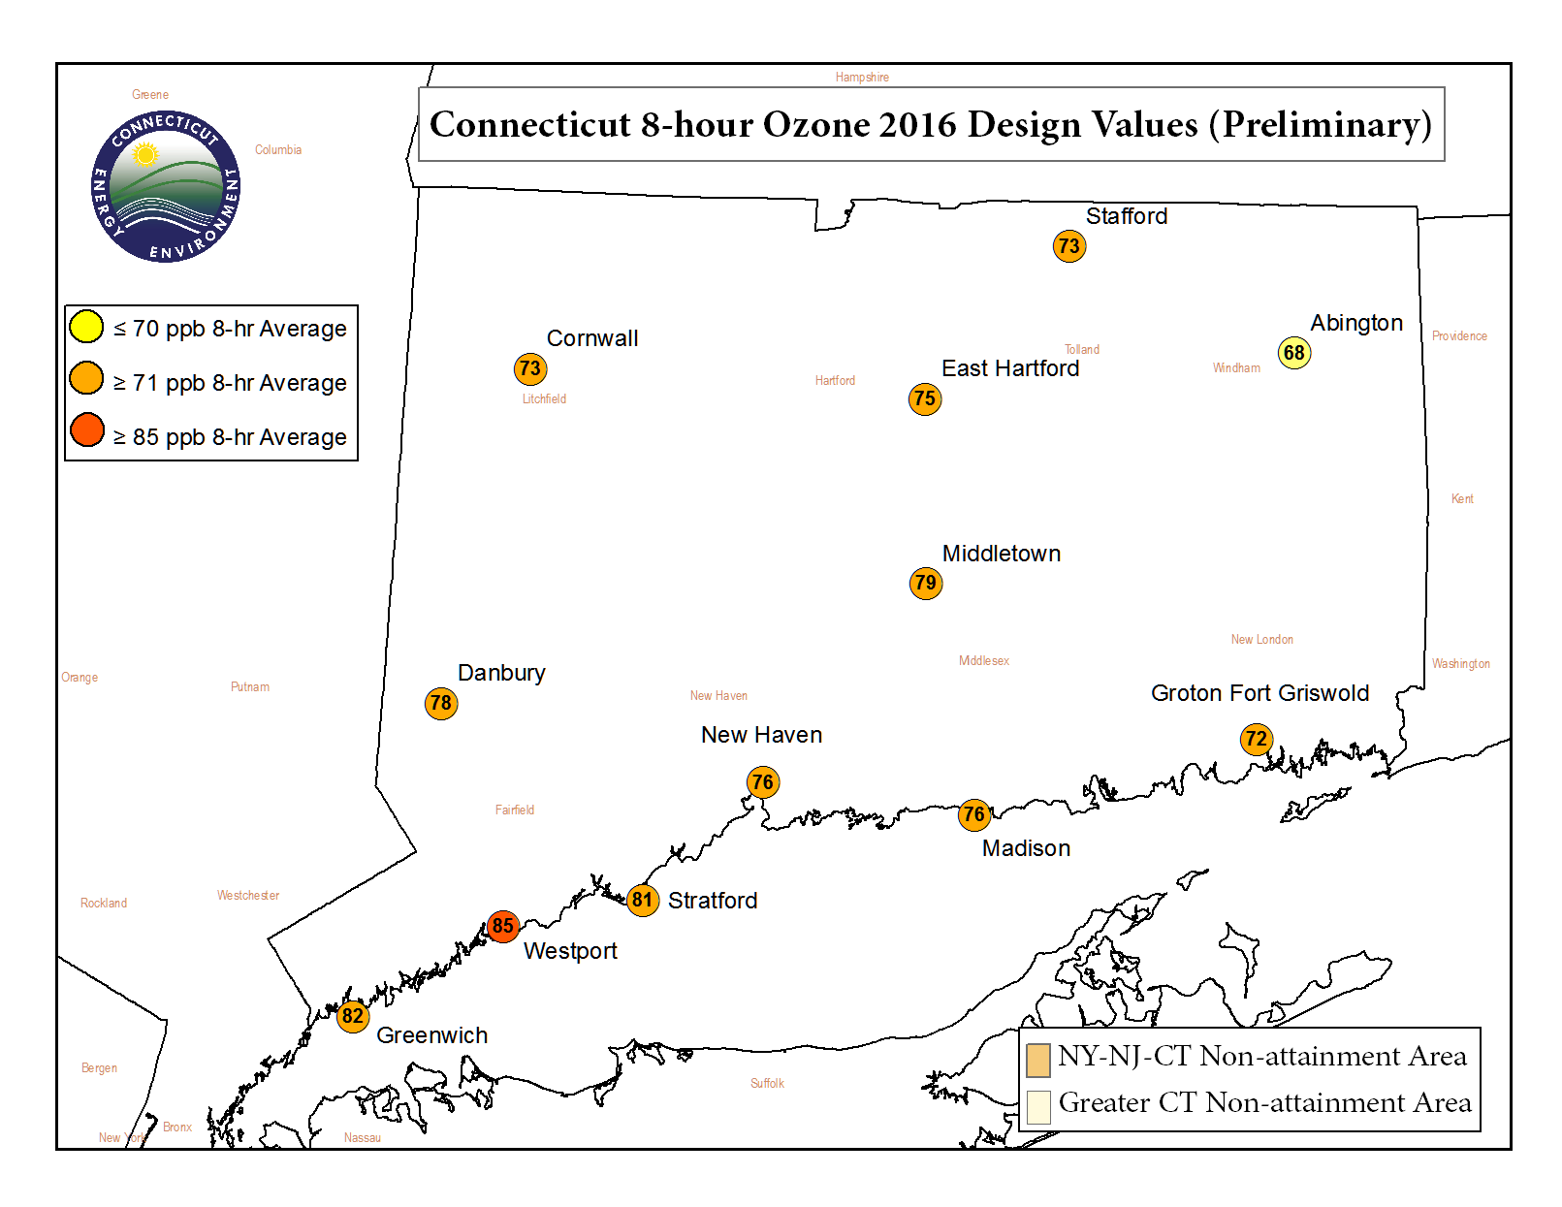
Elevation: 513 m (1683 ft)

Slide 12
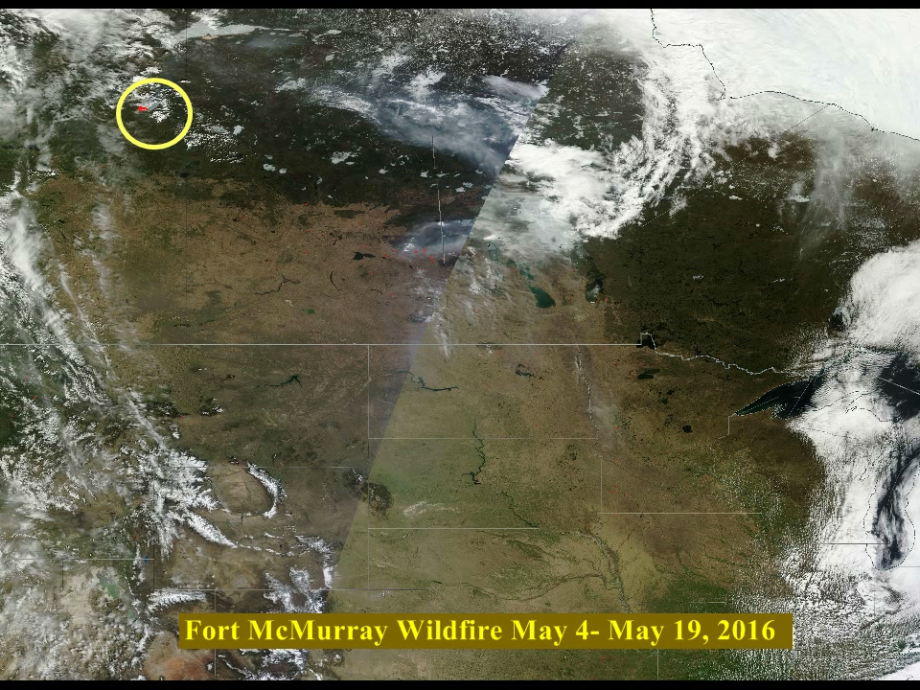
Video of Wildfire evolution since May 4th, 2016
Click to animate

Slide 13
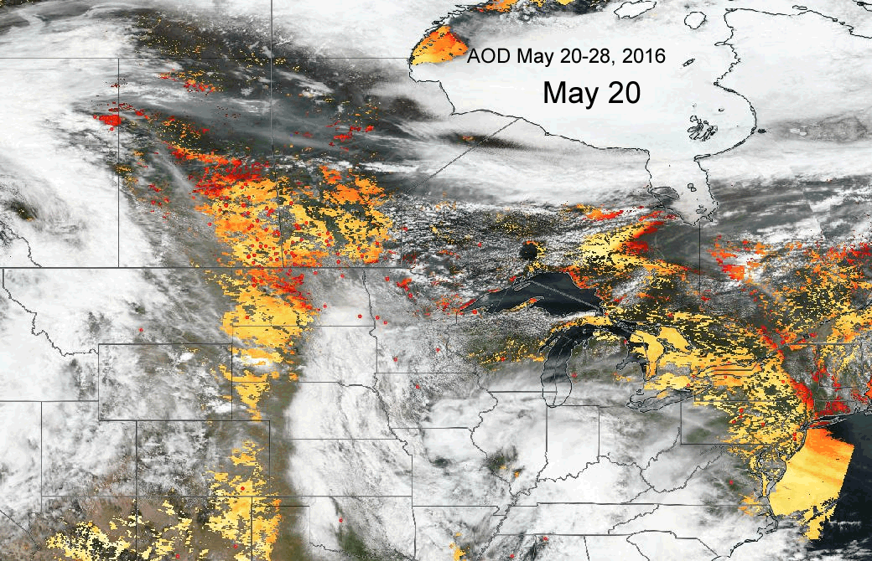
May 20-28 AOD Satellite Animation
Orange and red AOD signify
Higher aerosol concentrations in
Total vertical column (not surface)

Slide 14
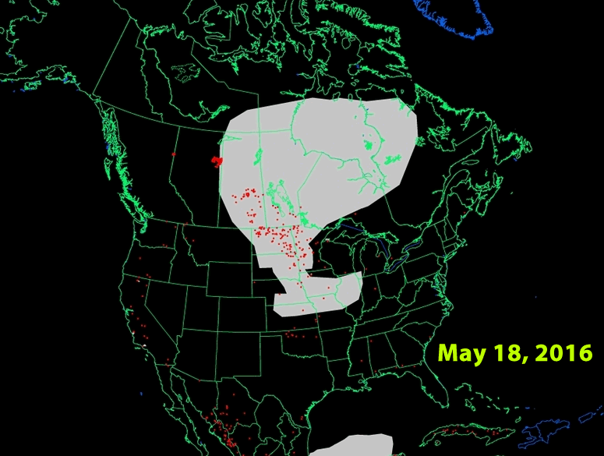
Smoke Plume Animation from May 18th- May 25th

Slide 15
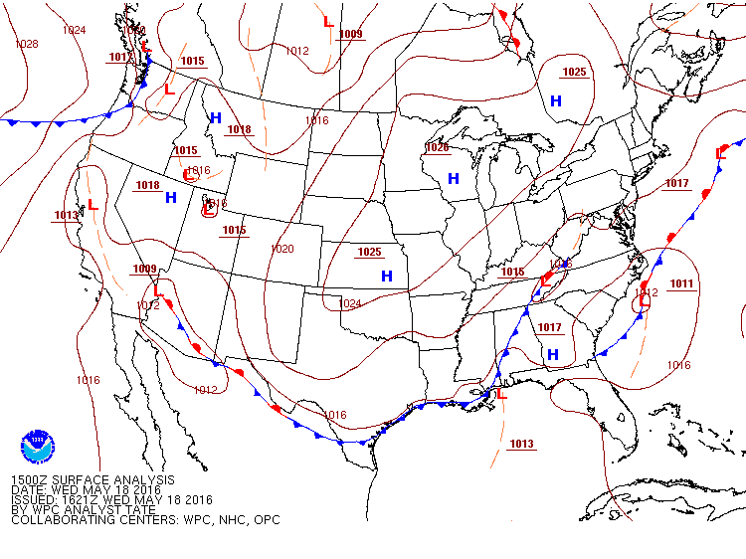
Surface Animation May 18-24, 2016
On May 18, 2016, the plume began dispersing towards the upper Midwest and Great Lakes, where it was trapped beneath a dome of high pressure

Slide 16
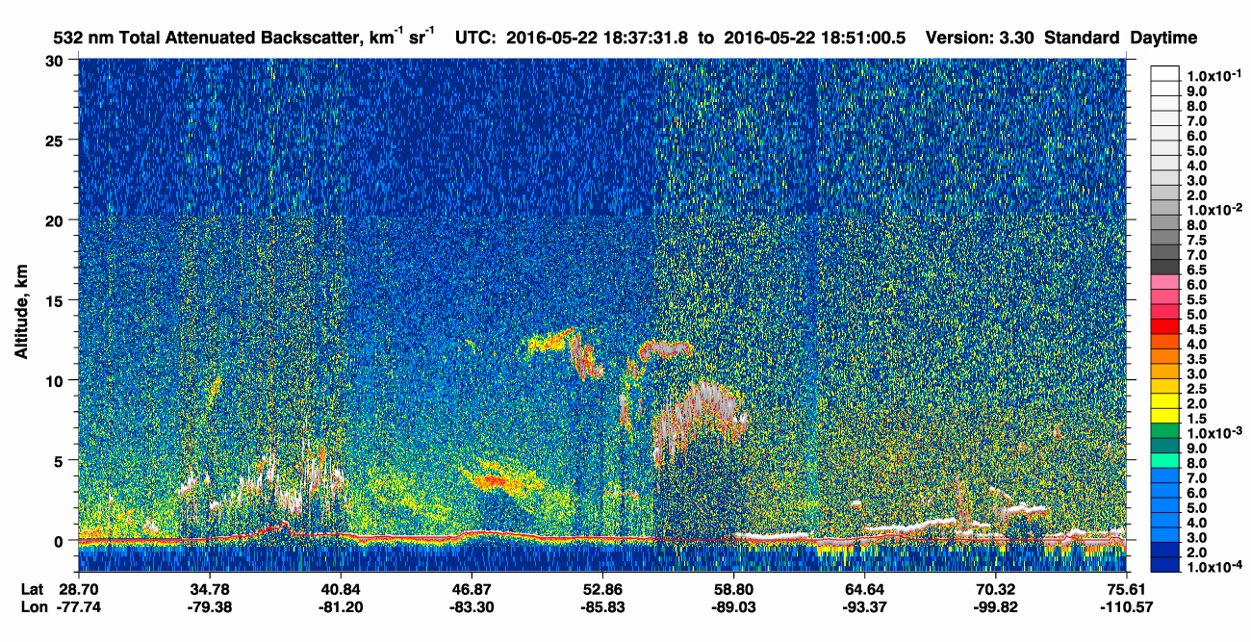
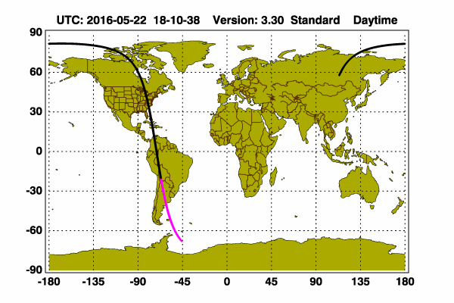
Calipso LIDAR 5/22/16
U.P. MI

Slide 17
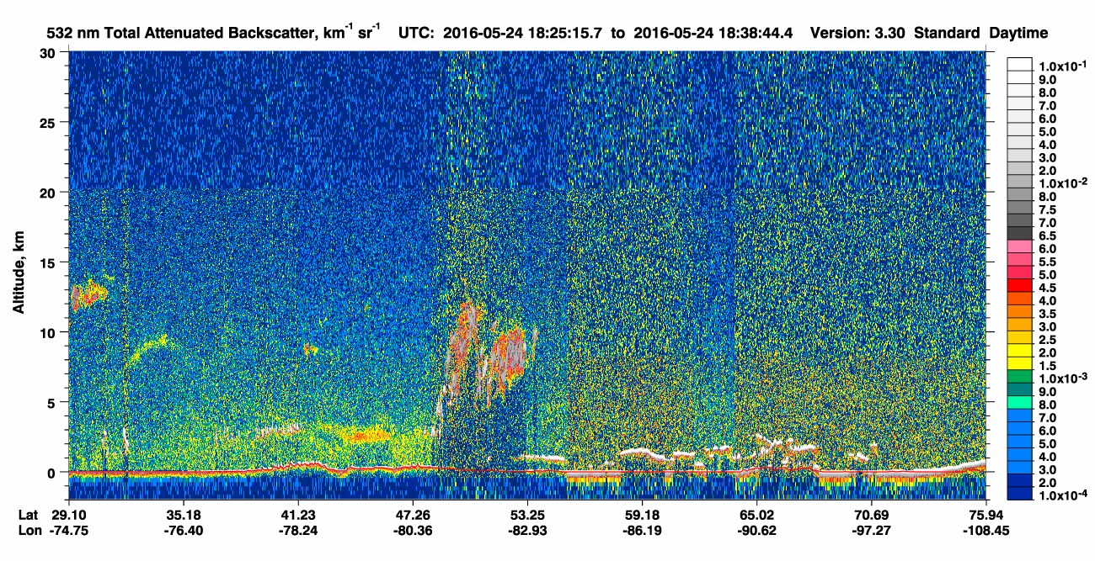

Calipso LIDAR 5/24/16
Ontario, Canada

Slide 18
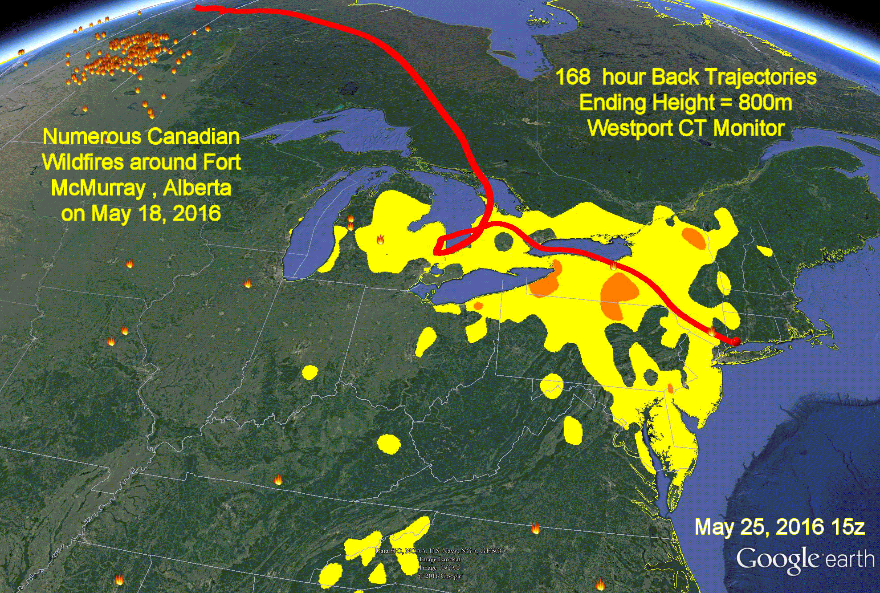
Back Trajectory Animation

Slide 19
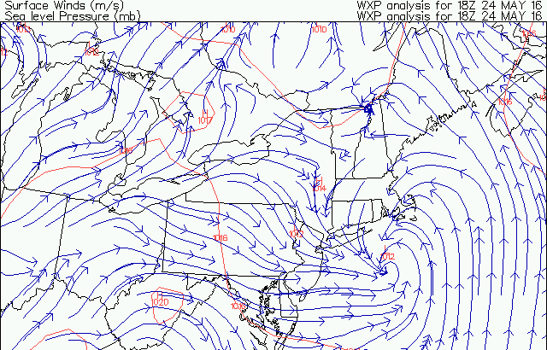
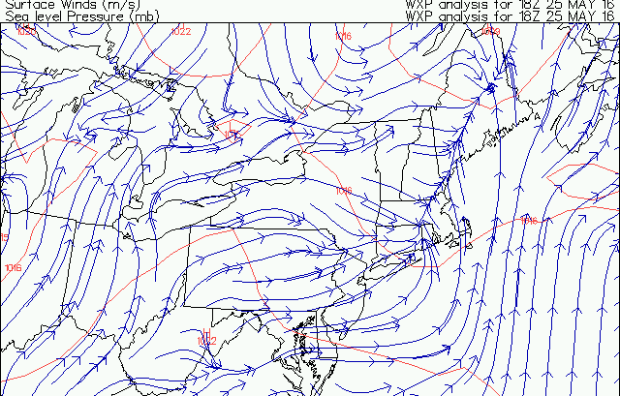
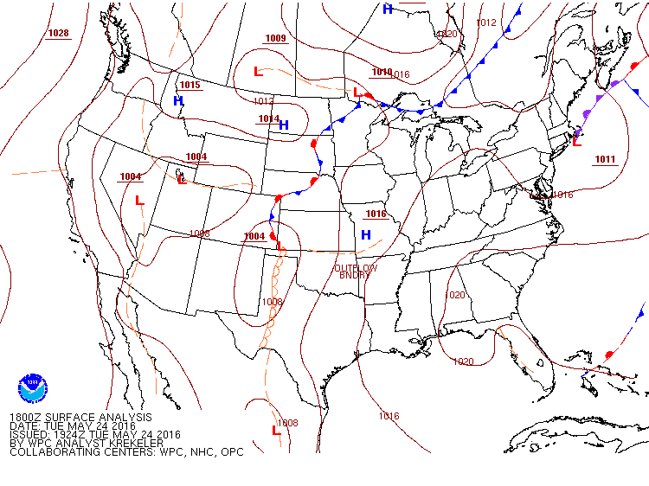
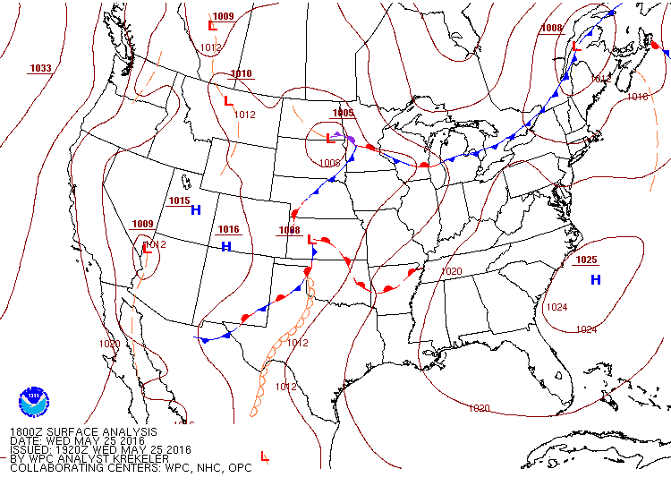
May 24-25, 2016 Surface Map and Winds

Slide 20
Hysplit Back Trajectories
Hysplit offers several meteorological models to use for trajectory analysis;
I have illustrated the 24-hour back trajectories using the NAM(12km) model;
Ending heights for the three trajectories are 10m, 100m and 1000m from our Westport monitor.

Slide 21
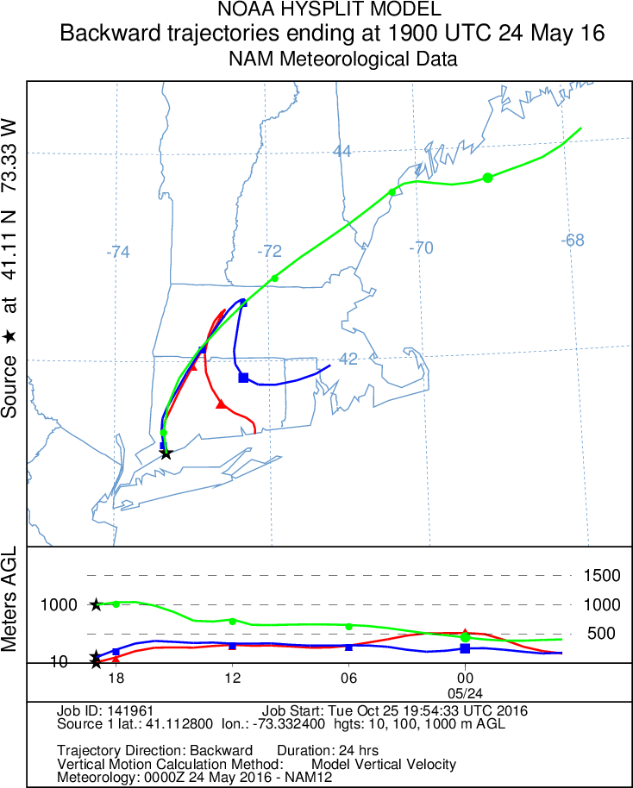
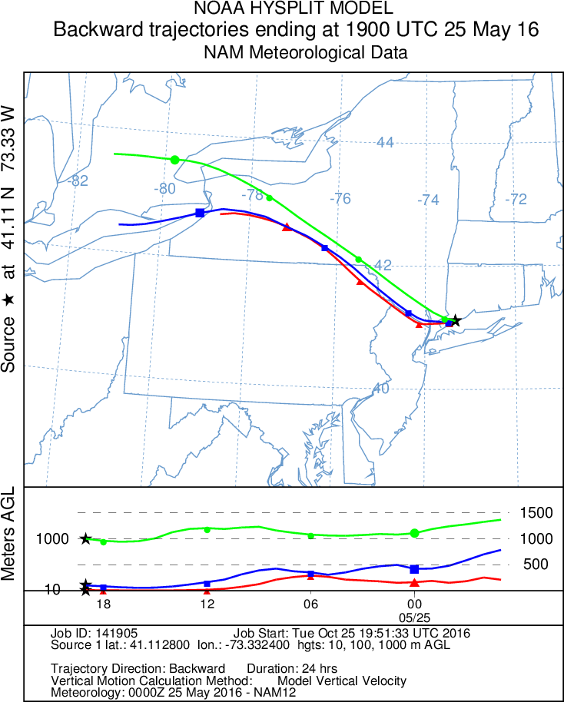
May 24 -25 Back Trajectories (NAM)

Slide 22
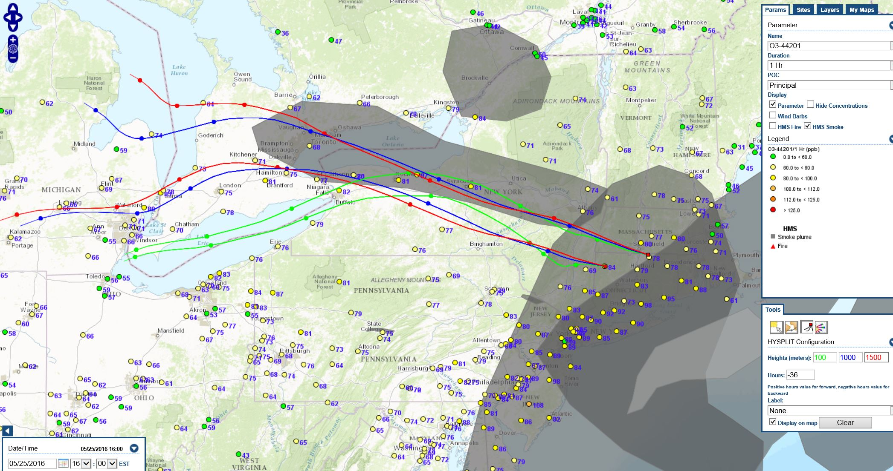
May 25th 36-hr Back Trajectories
This was the beginning of a ‘smoke enhanced’ multi-day ozone event for Connecticut, which lasted 5 days

Slide 23
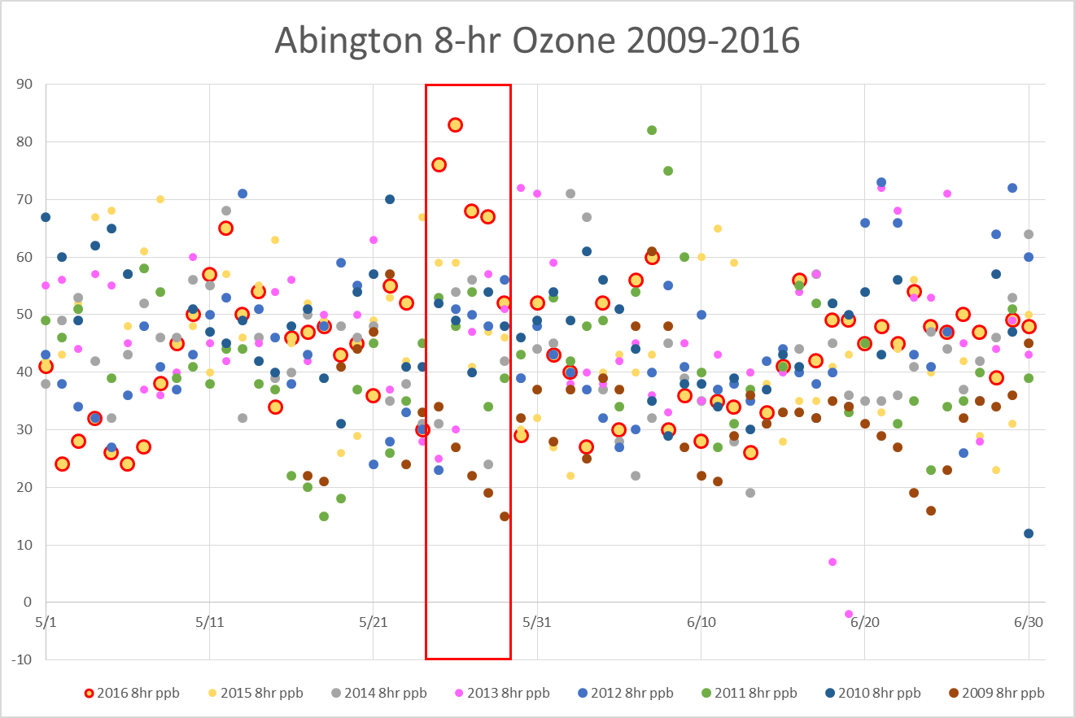
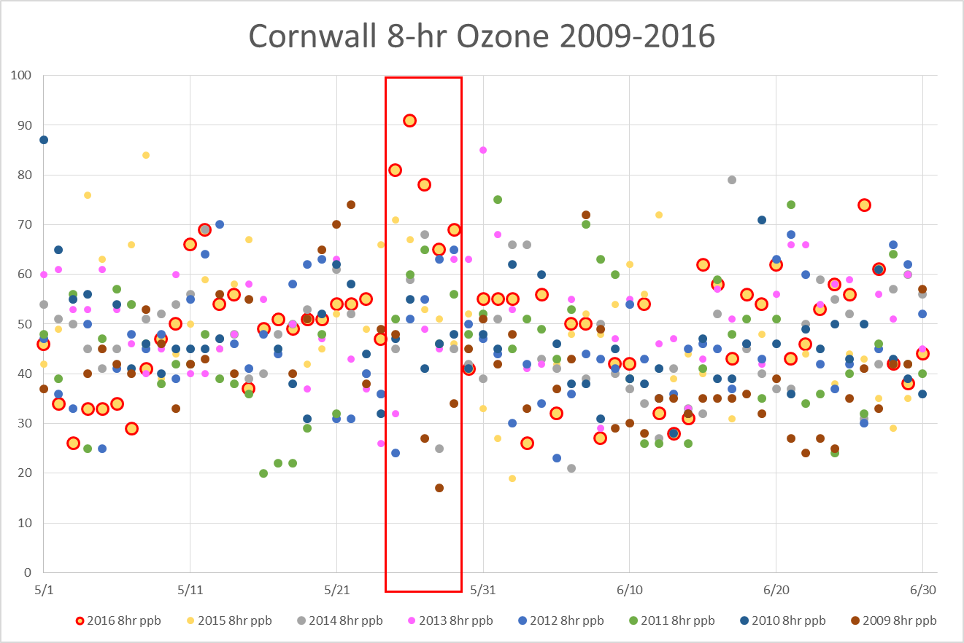
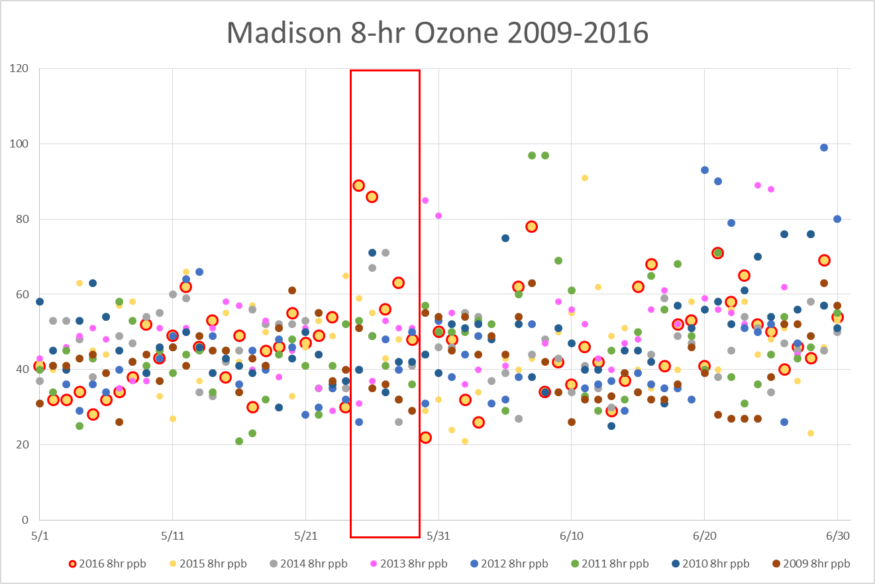
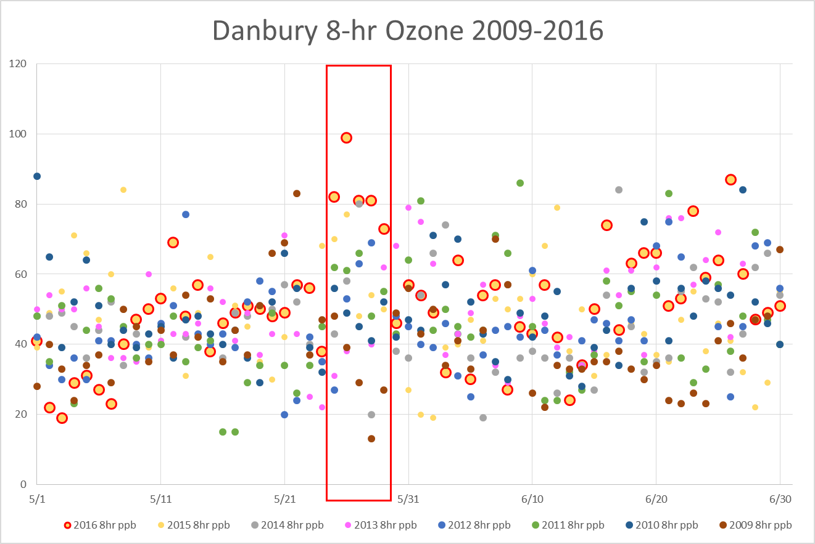
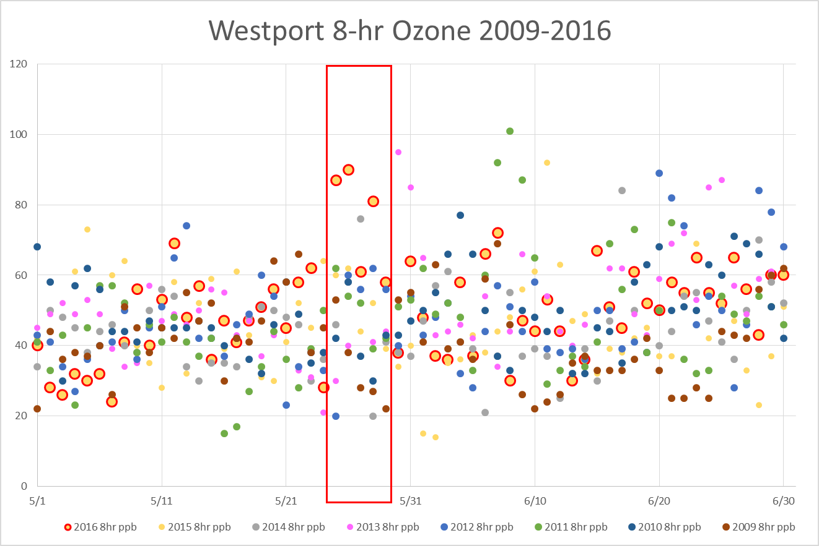
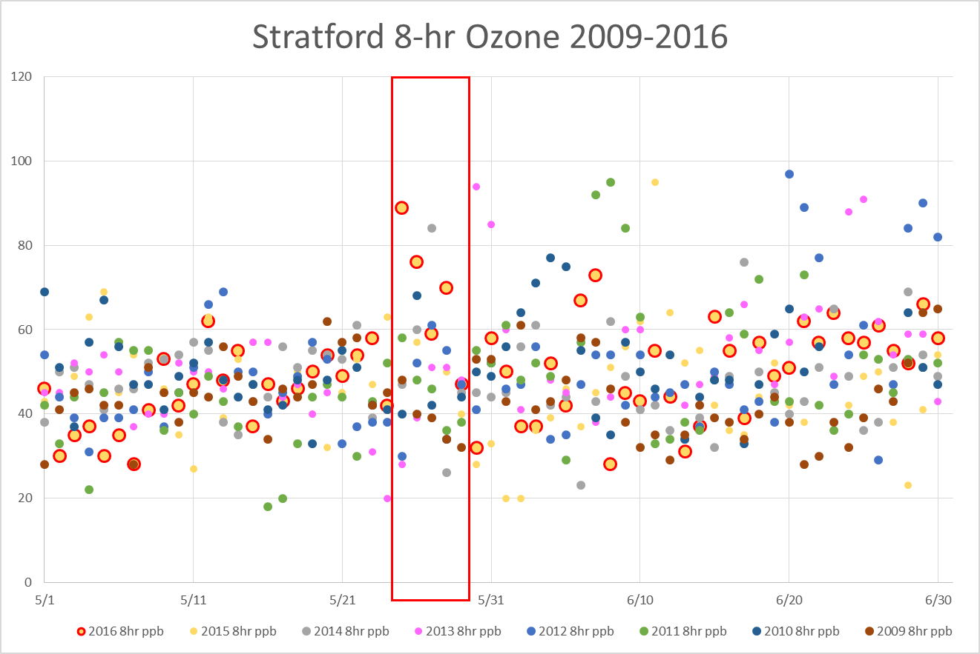
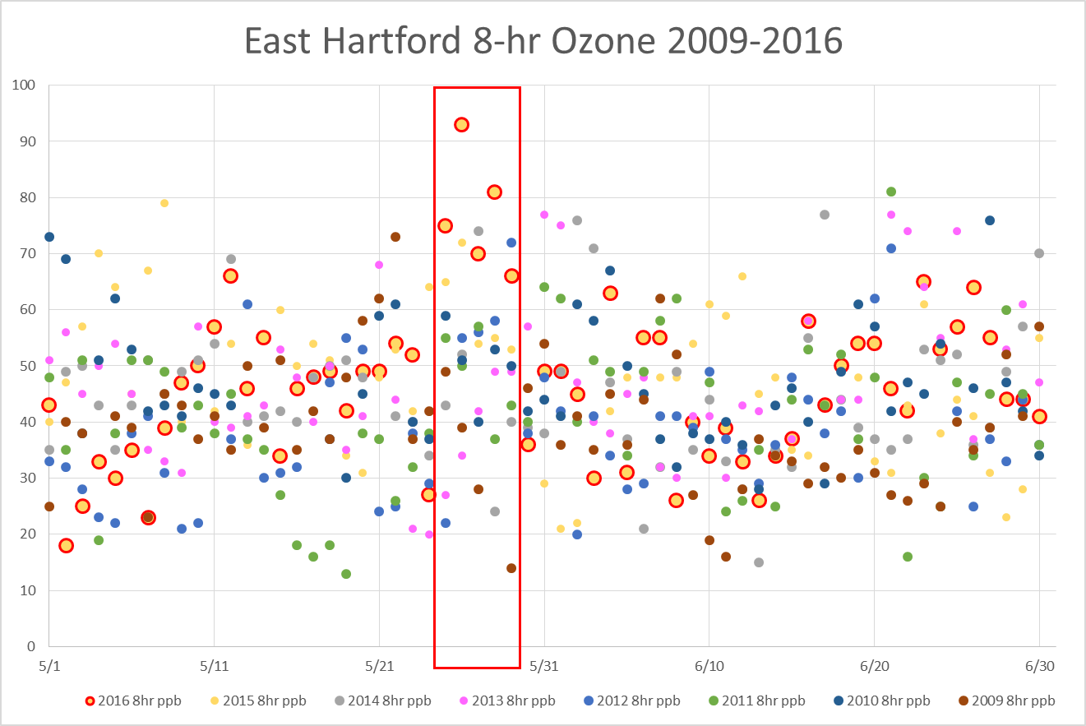
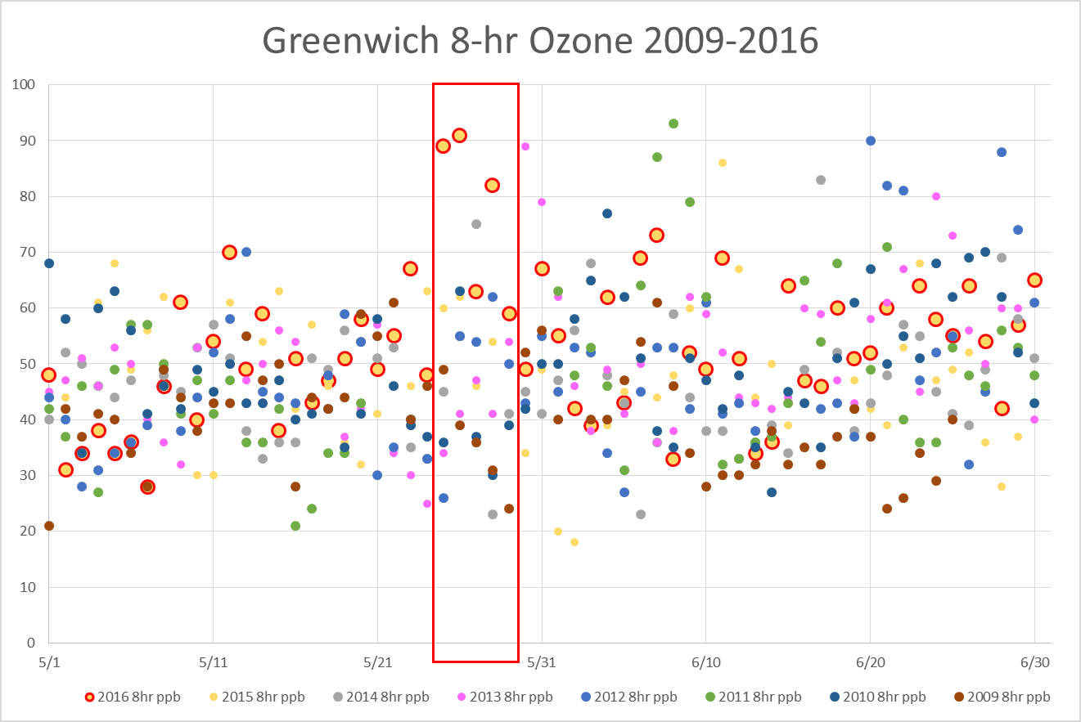
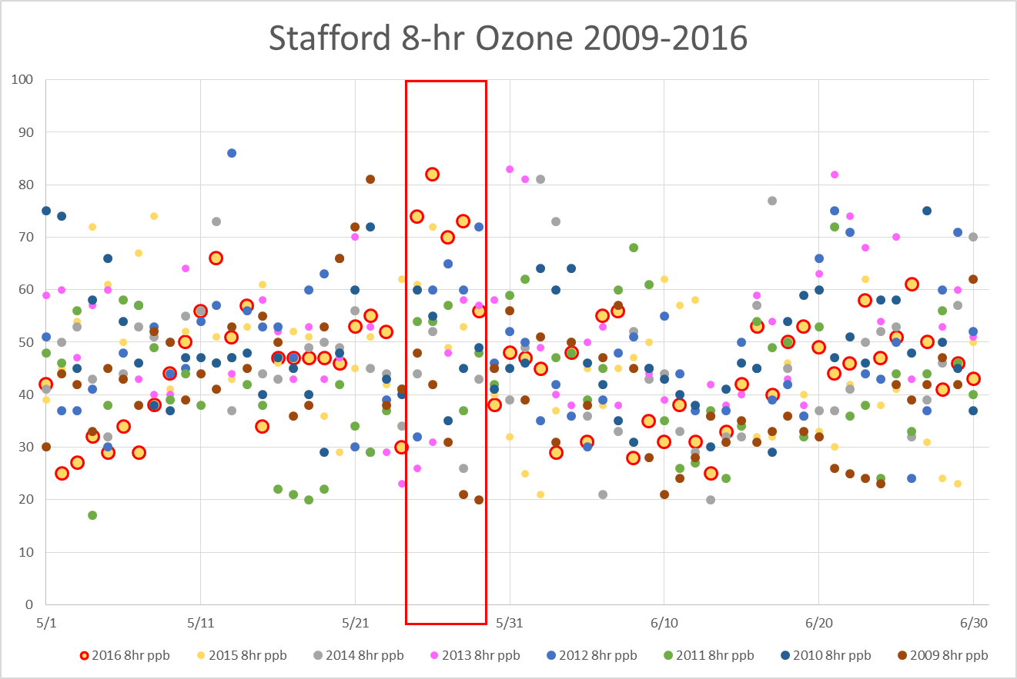
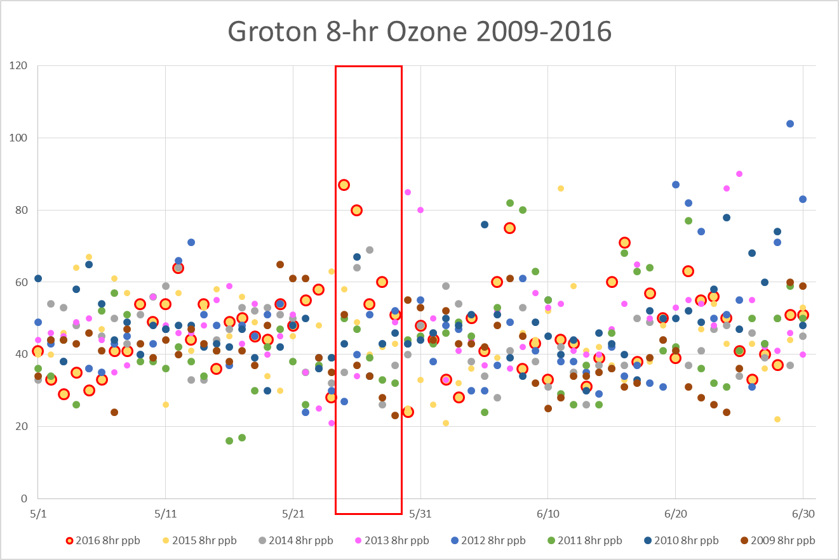
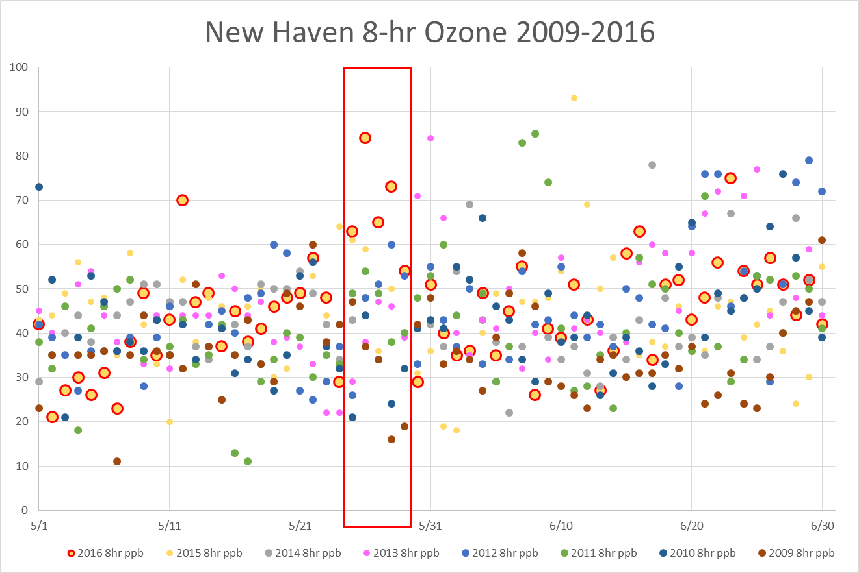
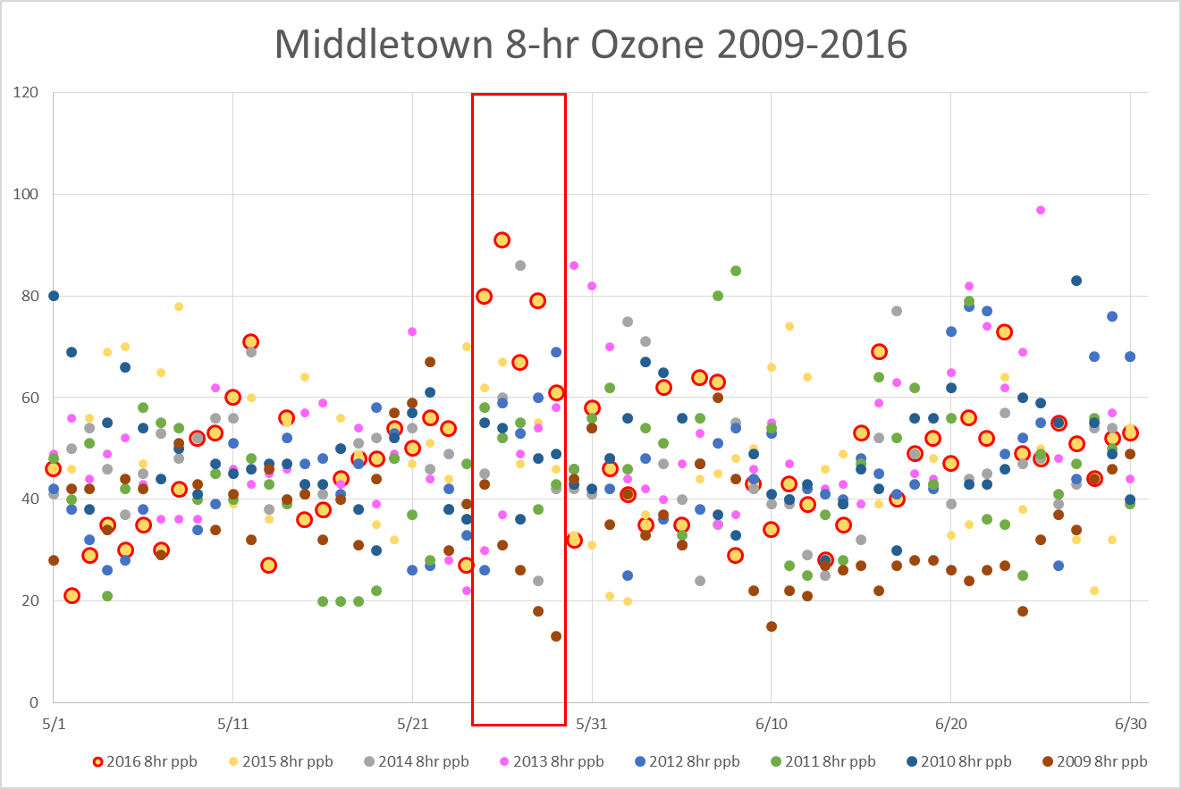
Max 8-hour Ozone May-June, 2009-2016 Animation
Event was an outlier under these meteorological conditions.

Slide 24
Surface Wind Rose Cornwall May-June 2015, 2016
Hourly wind directions vs. ozone concentrations were plotted for 2015 and 2016;
May-June hours were used to represent early season ozone patterns;
2016 exhibited elevated ozone from the northwest quadrant, whereas 2015 had no elevated ozone from the northwest;
49/56 of the 2016 exceedance hours occurred during the May 25-29 timeframe.

Slide 25
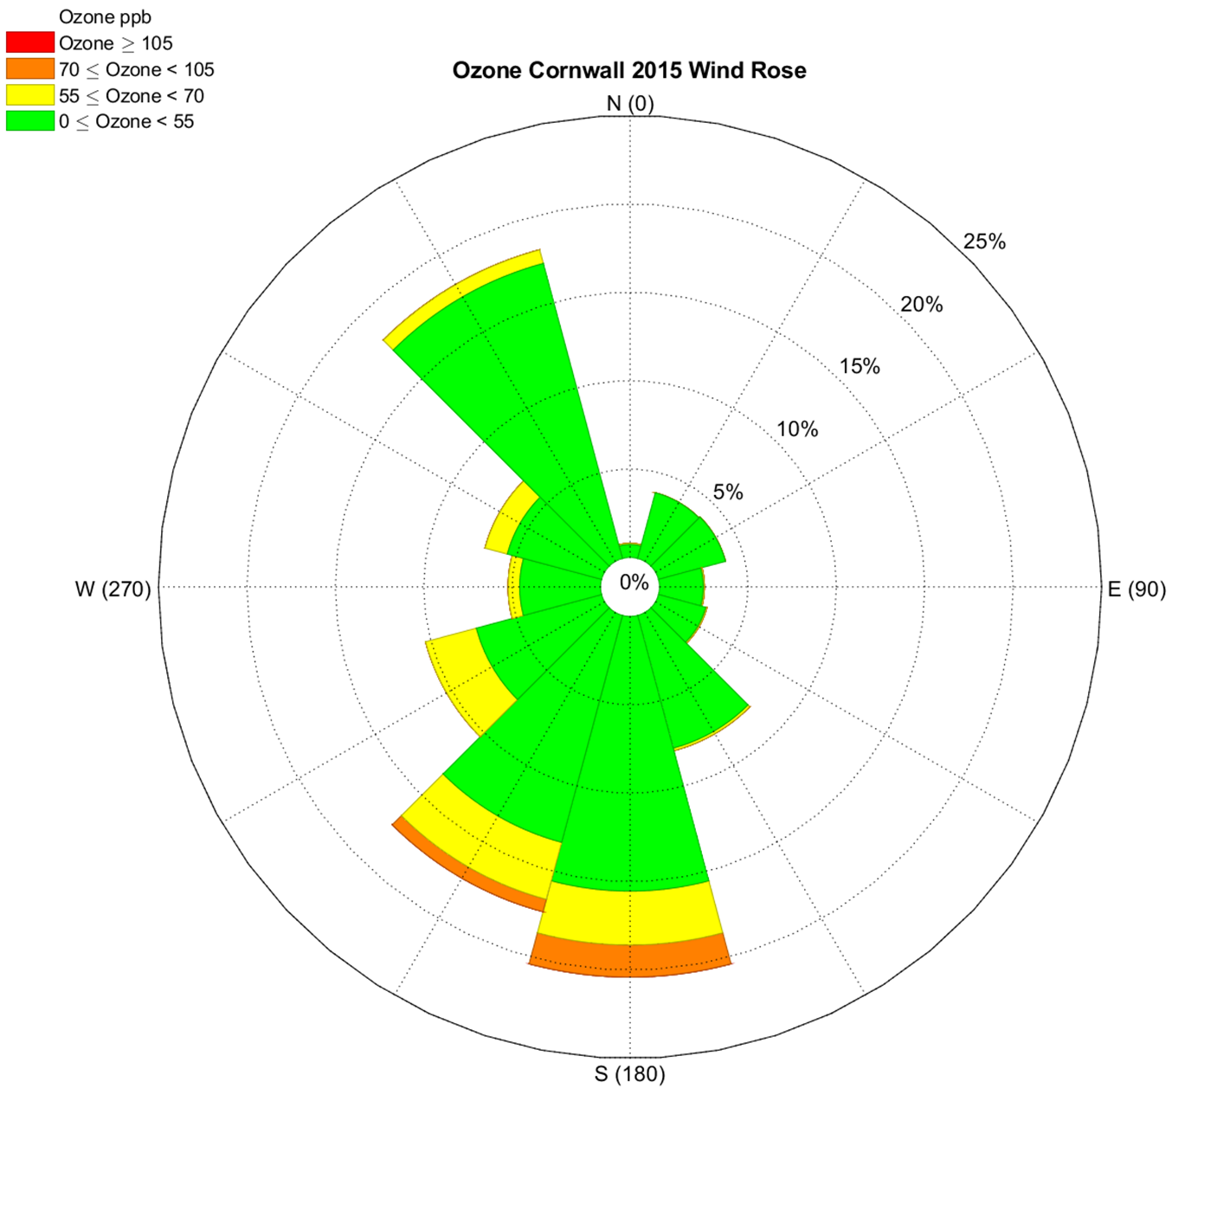
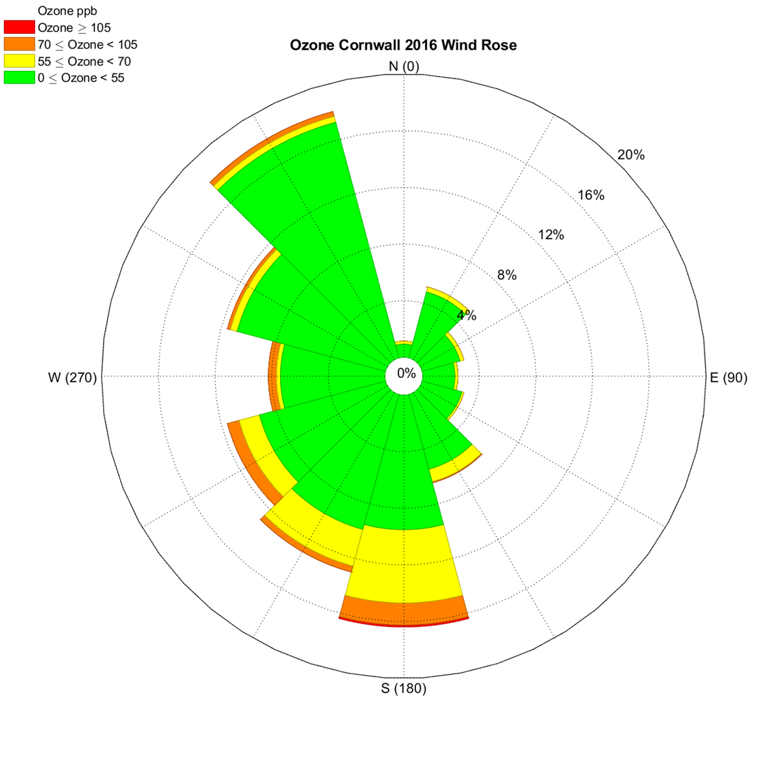
Surface Wind Rose Cornwall May-June 2015, 2016

Slide 26
Cornwall Pollutant Charts: May 20-30, 2016
Plots of Cornwall ozone data with Black carbon, PM2.5, ‘Delta C’ PM2.5 and CO show coincident increases in these species from May 25-May 29th;
The Cornwall monitor sits at an elevation of over 1600 feet (500+m), making it the best indicator for long range, out of State pollutant transport;
The pollutant data has been ‘normalized’ by multipliers for a direct comparison with the ozone concentrations.
It was after 6:00am on May 25th that the ‘event’ began at the Cornwall monitor, with PM2.5 levels on the rise.
When HYSPLIT modeled mixing height reached 600 meters at 7:00 am LST, PM2.5 levels began spiking.

Slide 27
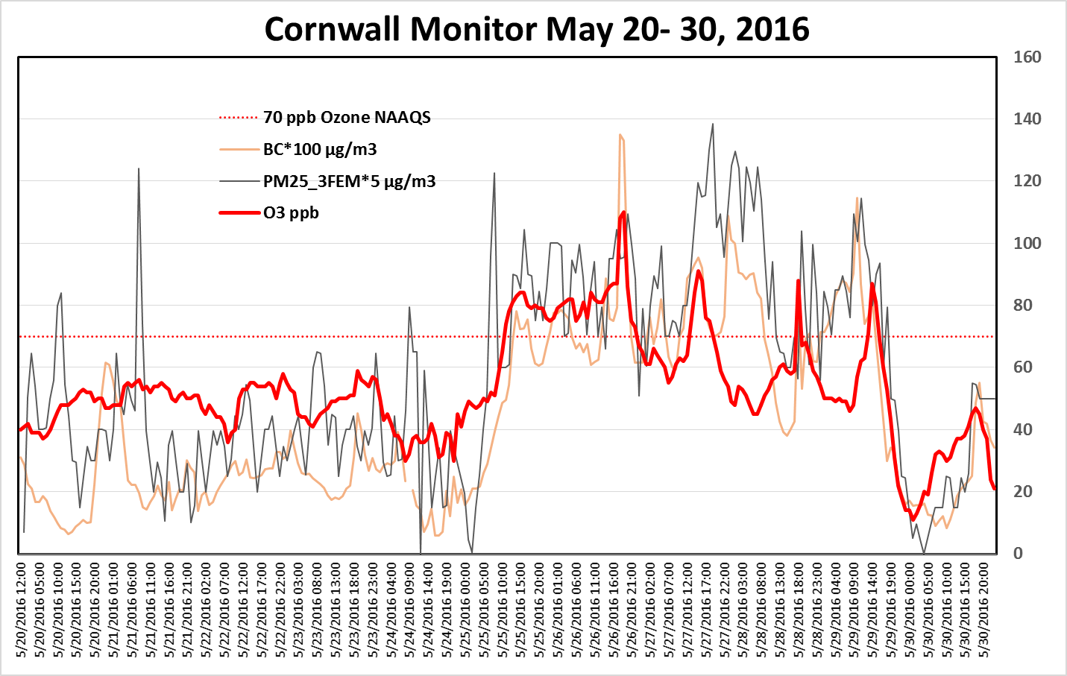
Cornwall Ozone, BC and PM2.5
Pollutants have been scaled to match range of ozone ppbs

Slide 28
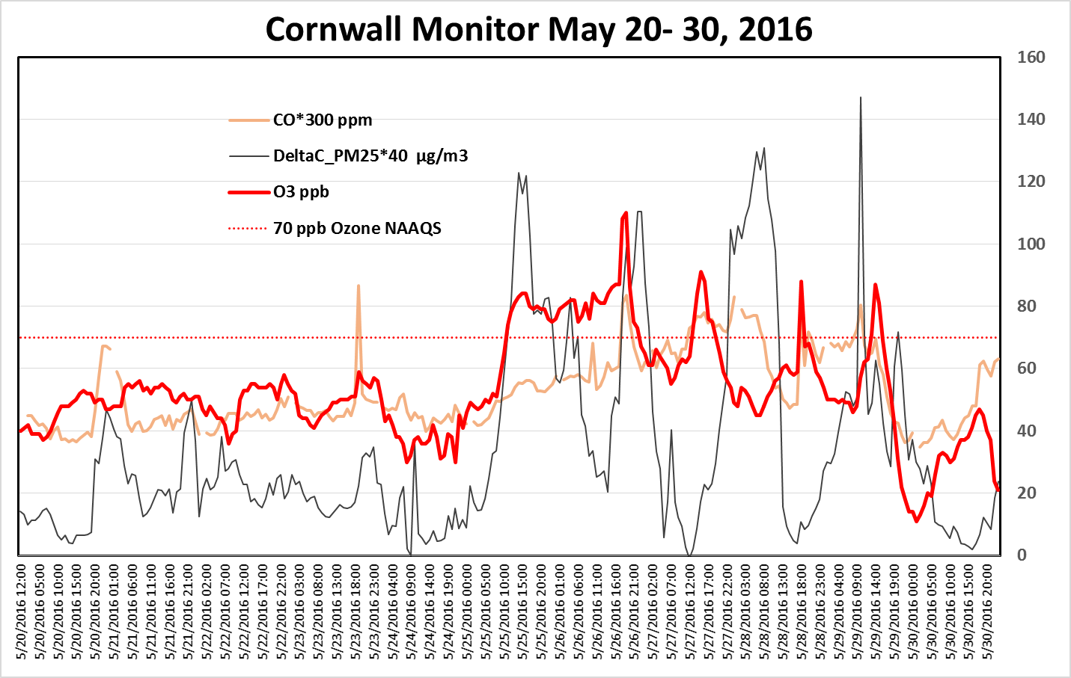
Cornwall Ozone, DeltaC and CO
Pollutants have been scaled to match range of ozone ppbs

Slide 29
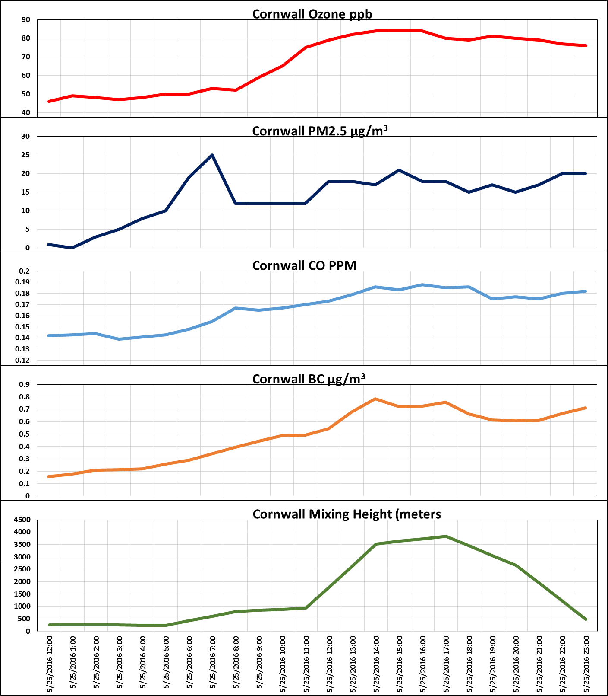
Stacked Charts with HYSPLIT Modeled Mixing Heights
Likely beginning of event
Note that as mixing height rises after 5:00am, so do the other parameters;
CO and particulate matter indicate an aerosol plume likely from a wildfire.

Slide 30
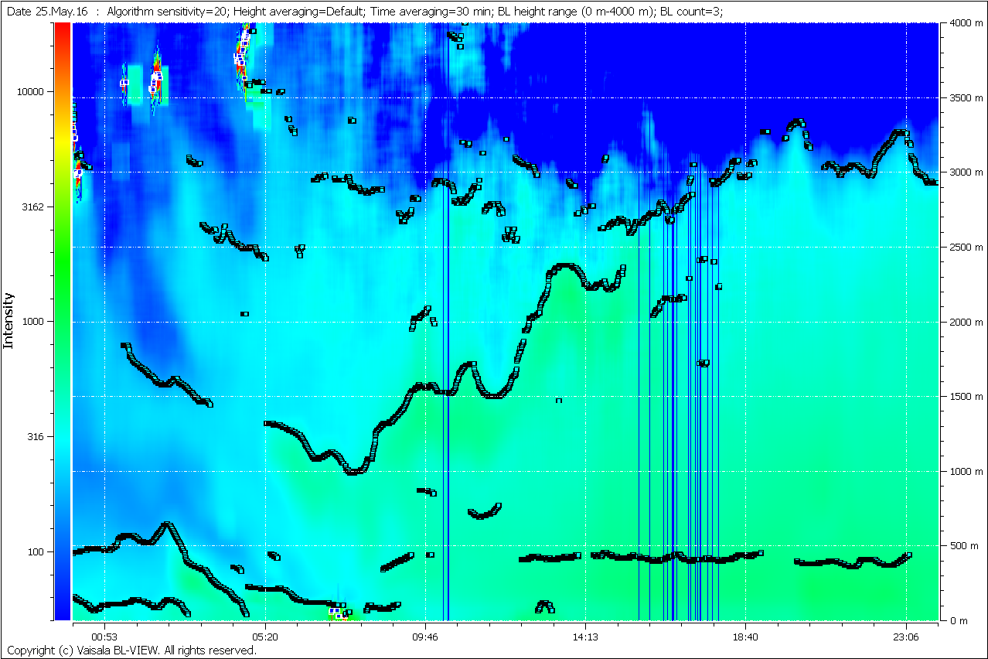
New Haven Ceilometer Back Scatter Aerosols
Thick aerosol layer moves over New Haven after 6:00 am LST with mixing layer exceeding 3000 meters during the afternoon. This agrees well with modeled mixing height over the Cornwall monitor.

Slide 31
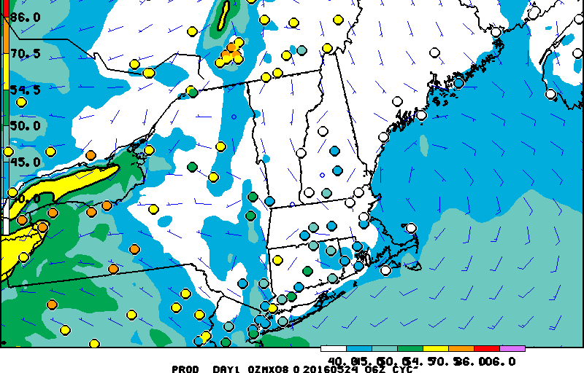
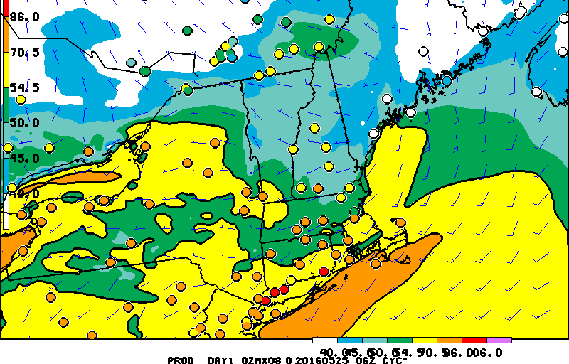
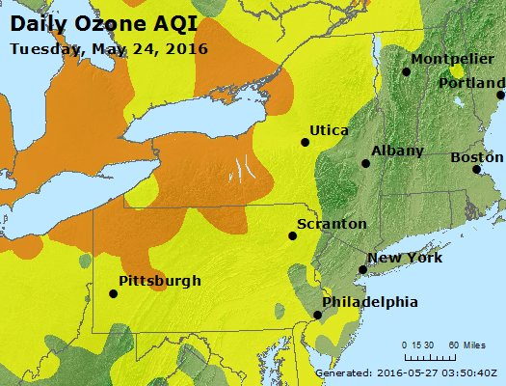
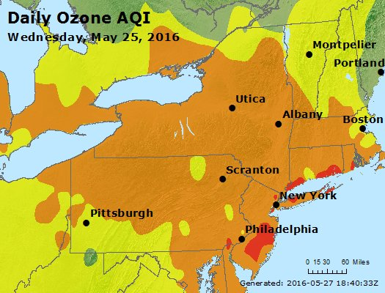
NE States NOAA Model/ AQI Observed

Slide 32
Conclusion
There is no doubt that the Fort McMurray wildfire plume directly affected ozone production in the States surrounding the Great Lakes and that ozone, as well as residual pollutants from the plume, was transported to the southeast to enhance ozone production in the northeast States beginning on May 25, 2016
All evidence points to flagging some or all of the May 25-29th period as an exceptional event.

