Slide 1


Nursing Home Financial Advisory Committee
January 8, 2025
Members:
Nicole Godburn, DSS, Director of Rate Setting; Lorraine Cullen, DPH, Branch Chief, Healthcare Quality and Safety; Barbara Cass, DPH, Senior Advisor to the Commissioner for LTC; Claudio Gualtieri, Senior Policy Advisor to the Secretary of OPM; Mairead Painter, State LTC Ombudsperson; Michael Morris, CHEFA; Margaret Morelli, Executive Director, Leading Age CT; Matthew Barrett, Executive Director CAHCF.

Slide 2
Welcome/Call to Order​
Approval of October 9, 2024 Meeting Minutes​
General Nursing Home Data for the Quarter and Year-To-Date​
  Licensed Beds and Census​
  Facilities by Size and Region​
Receiverships, Bankruptcies, Closures, Temporary Managers​
Request for Interim Rates​
Change in Ownerships (CHOW’s)​
Healthcare Quality and Safety Issues​
Back to Basics Training Update
CLA Presentation – Medicare Advantage
Discussion
Agenda
Connecticut Department of Social Services

Slide 3
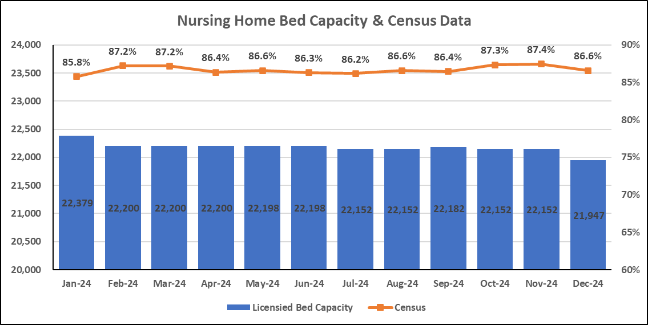
Bed Capacity-Census Data
Connecticut Department of Social Services

Slide 4
Number of Homes by Bed Count
N=196* Nursing Homes
There was one new closure in Q1 of 2025.
Abbott Terrace Health Center had 205 licensed beds and closed on 11/05/2024.
*updated 12/31/2024
Connecticut Department of Social Services

Slide 5
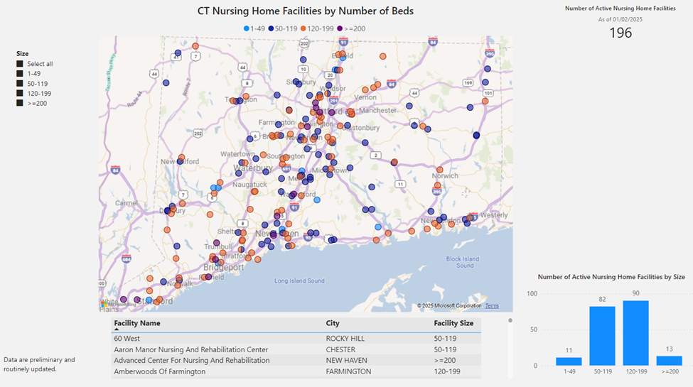

Slide 6
Nursing Home Receiverships, Bankruptcies, Temporary Managers and Closures
​Fiscal Year​ | Receivership​​ | Bankruptcy​ | Temporary Manager​​ | Closure​
SFY 25 7/1/24-6/30/25 | 0 | 0 | 0 | 1*
SFY24​ 7/1/23-6/30/24​ | Trinity Terraces ​ (Jan. 2024, 46 beds)​ ​ | 0​ | 0​ | 4*​
*2024: Chesterfields, Touchpoints of Farmington, Crestfield, Middlesex Health Care
*2025: Abbott Terrace
Connecticut Department of Social Services
Notes:
There were no additional receiverships, bankruptcies, temp. managers, or closures during the quarter ended 6/30/24.

Slide 7
Request for Interim Rates
Facility | Reason | Date | Determination
CY 2023 Summary – 7 Requests | Increased costs since last rate rebasing (labor, temp staffing, food, utility) | Q1 2023 –Q4 2023 | 1 Facility Closed 5 Not Granted 1 Approved
Bel-Air | Increased staffing costs for specialized cardiac unit (specialized staff) | Q1 2024 | Request Granted
Geer Nursing | Substantiated vendor cost increase due to geographic location of facility (Canaan, CT) | Q1 2024 | Request Granted
No Requests During Q2 2024
No Requests During Q3 2024
Apple Facilities – 6 Requests | Increased costs since last rate rebasing (temp staffing, direct care costs, financial losses) | Q4 2024 | Request Under Review
Connecticut Department of Social Services
Notes:
Updated! No interim rate requests during the quarter ended 6/30/24.

Slide 8
Change of Ownership (CHOW) SFY 2022-2025
Connecticut Department of Social Services

Slide 9
CHOW Activity: 10/01/24-12/31/24
There were 12 CHOWs in the past quarter.
Date | Prior Doing Business As (DBA) | Licensed Bed Count | Town | For Profit (FP) Not For Profit (NFP)
10/01/2024 | Civita Care Center at West River | 120 | Milford | FP
10/01/2024 | Civita Care Center at Milford | 120 | Milford | FP
10/01/2024 | Civita Care Center at Long Ridge | 120 | Stamford | FP
10/01/2024 | Civita Care Center at Newington | 180 | Newington | FP
10/01/2024 | Civita Care Center at Danbury | 120 | Danbury | FP
10/01/2024 | Civita Care Center at Cheshire | 85 | Cheshire | FP
10/10/2024 | Laurel Ridge Center for Health and Rehabilitation | 126 | Ridgefield | FP
10/10/2024 | Glastonbury Center for Health & Rehabilitation | 105 | Glastonbury | FP
10/10/2024 | Maefair Center for Health & Rehabilitation | 134 | Trumbull | FP
10/10/2024 | Shady Knoll Center for Health & Rehabilitation | 128 | Seymour | FP
10/10/2024 | Summit at Plantsville Center for Health & Rehabilitation | 150 | Plantsville | FP
12/31/2024 | Masonicare at Bishop Wicke Health Center | 120 | Shelton | NFP
Connecticut Department of Social Services

Slide 10
Nursing Home Quality and Safety Issues
Top Five Federal Tags for the period October 1, 2024, to December 31, 2024
Rank | Tag Number​ | Description​ | Examples
1 | F684 | Quality of Care | Failed to ensure resident known to wander had physician’s orders and care plan in place for wander guard, in accordance with facility’s policies.
2 | F689 | Free of Accident Hazards/Supervision/Devices | Failure to ensure appropriate interventions in place for resident at risk for falls.
3 | F600 | Free from Abuse and Neglect | Failure to provide care timely.
4 | F609 | Reporting of Alleged Violations | Failure to notify state agency according to established timeframes when resident complained of new, severe wrist pain of unknown origin.
5 | F880 | Infection Prevention and Control | Failure to ensure water management plan was followed.
Connecticut Department of Social Services

Slide 11
Top 5 Most Frequently Cited Deficiencies
Rank | Q2 Period 1/1/24-3/31/24 | Q3 Period 4/1/24-6/30/24 | Q4 Period 7/1/24-9/30/24 | Q1 Period 10/1/24-12/31/24
1 | F884 (NHSN Reporting)* | F684​ (Quality of Care​) | F684 (Quality of Care) | F684 (Quality of Care)
2 | F684 (Quality of Care) | F689​ (Free From Accidents/ Hazards/Supervision/Devices​) | F689 (Free From Accidents/ Hazards/Supervision/Devices​) | F689 (Free of Accident Hazards/Supervision/Devices)
3 | F600 (Abuse/Neglect) | F842​ (Resident Records​) | F550 (Resident Rights/Exercise of Rights) | F600 (Free from Abuse and Neglect)
4 | F656 (Comp. Care Plan) | F600​ (Free From Abuse/Neglect​) | F842 (Resident Records) | F609 (Reporting of Alleged Violations)
5 | F842 (Resident Records) | F656​ (Develop/Implement Comprehensive Care Plan​) | F657 (Care Plan Timing and Revision) | F880 (Infection Prevention and Control)
Connecticut Department of Social Services

Slide 12

Immediate Jeopardy FFY 2025
Q2 1/1/24-3/31/24 | Reason for Investigation | Reason for Investigation
6 IJs across 5 facilities
F684. Quality of Care |  | Reportable
F689. Free From Accidents/Hazard Supervision/Device |  | Reportable
F760. Significant Medication Errors |  | Reportable
F600. Free from Abuse/Neglect |  | Certification Survey
F678. CPR |  | Reportable
F805. Food in Form to Meet Individual Needs |  | Reportable
Q3 4/1/24-6/30/24 | Reason for Investigation
9 IJs across 8 facilities
F684. Quality of Care | Complaint & Reportable
F689. Free of Accident and Hazards | Complaint & Certification Survey
F760. Significant Medication Errors | Complaint & Reportable
Q4 7/1/24-9/30/24 | Reason for Investigation | Reason for Investigation
7 IJs across 5 facilities
F684. Quality of Care |  | Complaint & Reportable
F689. Free of Accident and Hazards at 2 facilities |  | Certification Survey & Reportable
Q1 10/1/24-12/31/24 | Reason for Investigation
5 IJs across 5 facilities
F689. Free of Accident and Hazards at 4 facilities | Reportable
F805 Food in Form to Meet Individual Needs | Reportable
F600. Free from Abuse/Neglect | Reportable
F658. Services Provided Meet Professional Standards | Complaint
K358. (Life Safety) Fire Alarm System | Certification Survey
F609. Reporting of Alleged Violations | Reportable
F610. Investigate/ Prevent/Correct Alleged Violation | Reportable
K341. Fire Alarm System - Installation | Certification Survey
K351. Sprinkler System - Installation | Certification Survey
A red arrow indicates IJ deficiencies that have been seen across quarters.
An exclamation point indicates an IJ that was not seen in the previous quarter.
Connecticut Department of Social Services

Slide 13
IJs over time, Facilities Impacted
Connecticut Department of Social Services

Slide 14
Back To Basics Training Update
DPH hosted a Back to Basics Training on Nov 13, 2024.
  Training lasted from 8:30am - 4:30pm.
  In collaboration with DSS and the Long-Term Care Ombudsman Program.
Target audience: nursing home administrators and directors of nursing.
Key points:
  200 attendees.
  Topics ranged from Medicaid in nursing homes, to resident rights, key legislation, survey process and preparedness, and the role of nursing home administrator and director of nursing.
  Training was paid for using CMP money available to DPH from CMS.
Notes:
Back to basics training on Nov 13, 8:30-4:30
Target audience – NH administrators and directors of nursing
200 attendees
Presentations from DPH, DSS, and LTC ombudsperson
Topics ranged from Medicaid in nursing homes, to resident rights, key legislation, survey process and preparedness, and the role of nursing home administrator and director of nursing
Training was paid for using CMP money available to DPH from CMS

Slide 15
CLA Presentation
Connecticut Department of Social Services

Slide 16
Understanding Medicare Advantage & Payor Mix Impacts on Connecticut Nursing Homes
January 8, 2025

Slide 18
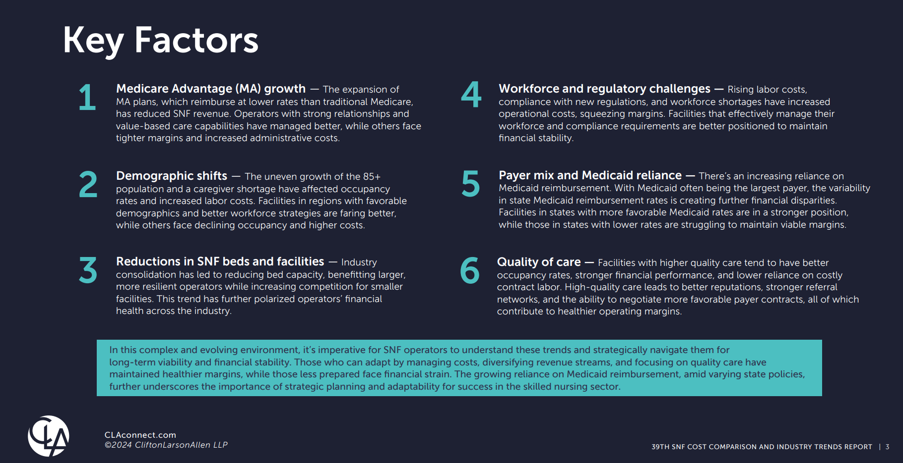
CLA 39th SNF Cost Comparison, Trends Report
Theme: The Great Divergence
https://www.claconnect.com/en/resources/white-papers/snf-cost-comparison-industry-trends-report

Slide 19
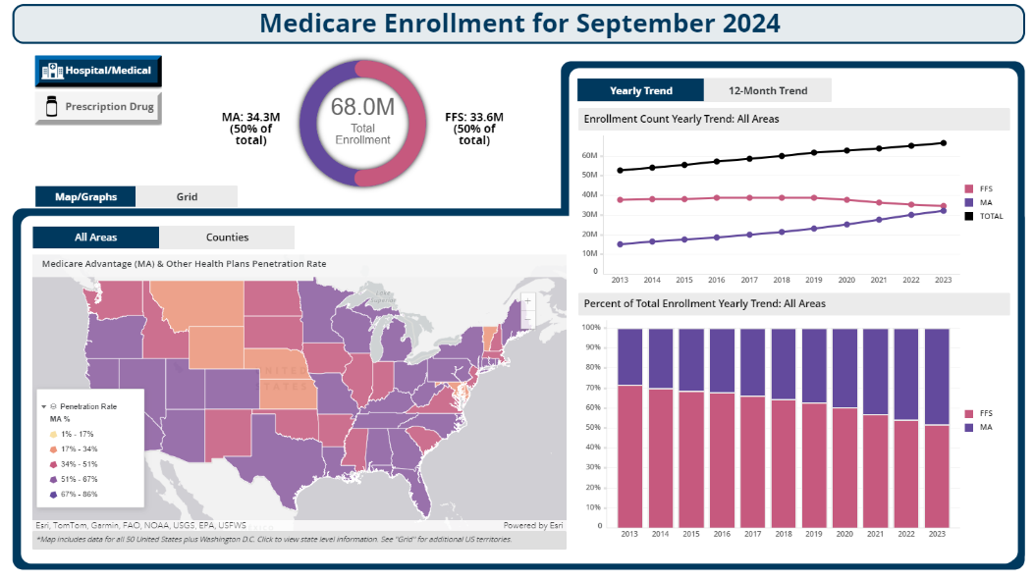
Why are we talking about Medicare Advantage?
Because…
Over 50% of all eligible beneficiaries select MA over for fee-for-service
It has been continuously growing
It has very real revenue impacts for providers compared to traditional Fee-For-Service (FFS) revenues
https://data.cms.gov/tools/medicare-enrollment-dashboard

Slide 20
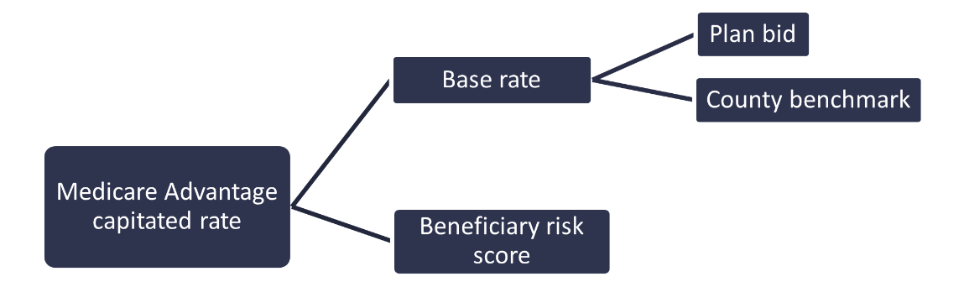
Medicare Advantage: Capitation payments
Medicare Advantage plans are paid a Per Member Per Month capitation rate regardless of amount of services
Rate is created from a county benchmark compared to the plan bid. This creates a base rate. The base rate is adjusted based on the beneficiary’s risk score (i.e.: comorbidities, age etc.) to reflect patient acuity/risk. This is the risk adjustment.

Slide 21
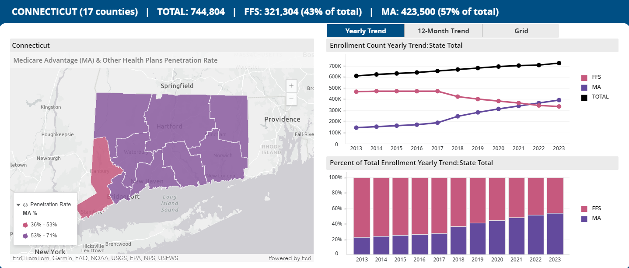
Connecticut
Medicare Enrollment Dashboard | CMS Data

Slide 22
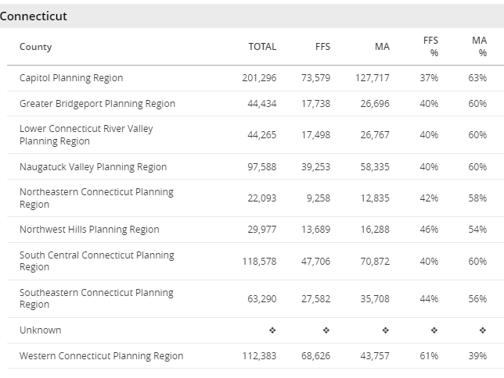
Connecticut: MA vs. FFS
Medicare Advantage in 2025
The average monthly Medicare Advantage plan premium changed from $19.77 in 2024 to $20.03 in 2025
61 Medicare Advantage plans are available in 2025, compared to 51 plans in 2024
100% of people with Medicare have access to a Medicare Advantage plan.
$0 is the lowest monthly premium for a Medicare Advantage plan.
100% of people with Medicare will have access to a Medicare Advantage plan with a $0 monthly premium.
Medicare Enrollment Dashboard | CMS Data
2025-ma-part-d-landscape-state-state-fact-sheet.pdf

Slide 23
Medicare Advantage vs FFS
Anecdotally and research shows MA plans pay less than FFS, oftentimes significantly less
How much less depends on different factors (market-specific factors, MA penetration, number of SNF beds, competition, strength of providers etc.)
National Investment Center
Zimmet - eCapintel Research
NIC data showed traditional Medicare rates nationally at nearly $600 per resident day, while managed Medicare paid $468 per day.
https://skillednursingnews.com/2023/05/big-trouble-medicare-advantage-rates-strain-snf-margins-deepen-sectors-pain/
Looked at 13 markets nationally with over 1,500 admissions (2021-2022)
All markets showed MA paid less (7-42% less per day; 45-66% less per admission)
https://ecap-directory-dev.s3.amazonaws.com/MA%20analysis%20ZHSG-CORE%2011-9-22.pdf

Slide 24
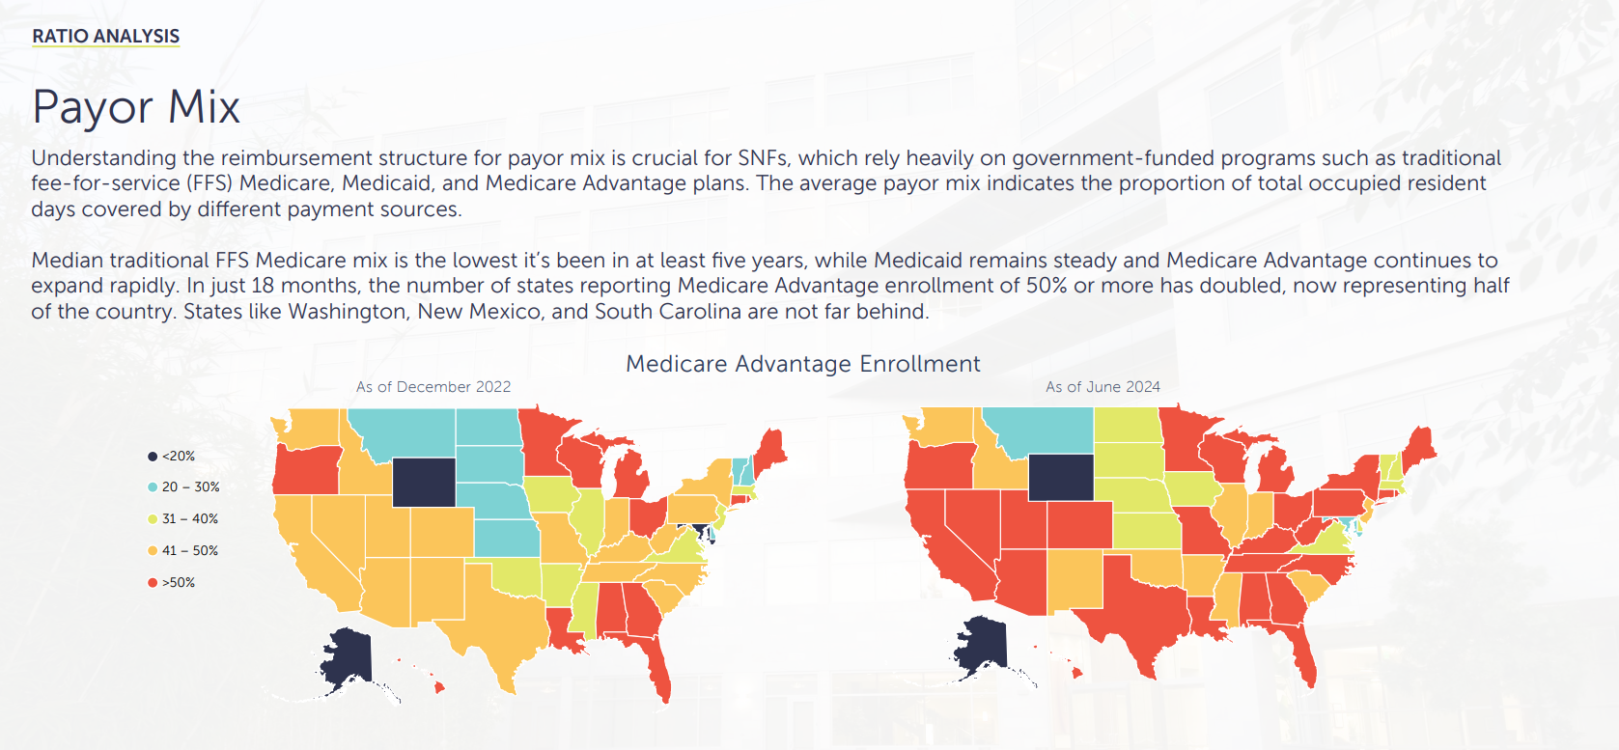
CLA’s 39th Trends Report: Payor Mix
https://www.claconnect.com/en/resources/white-papers/snf-cost-comparison-industry-trends-report

Slide 25
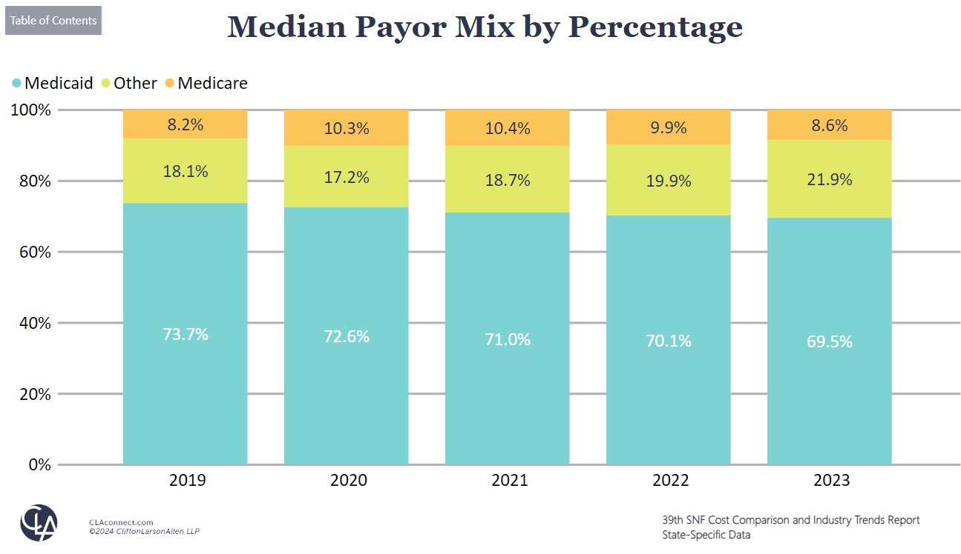
CLA 39th Report: CT Median Payor Mix
https://www.claconnect.com/en/resources/white-papers/snf-cost-comparison-industry-trends-report

Slide 26
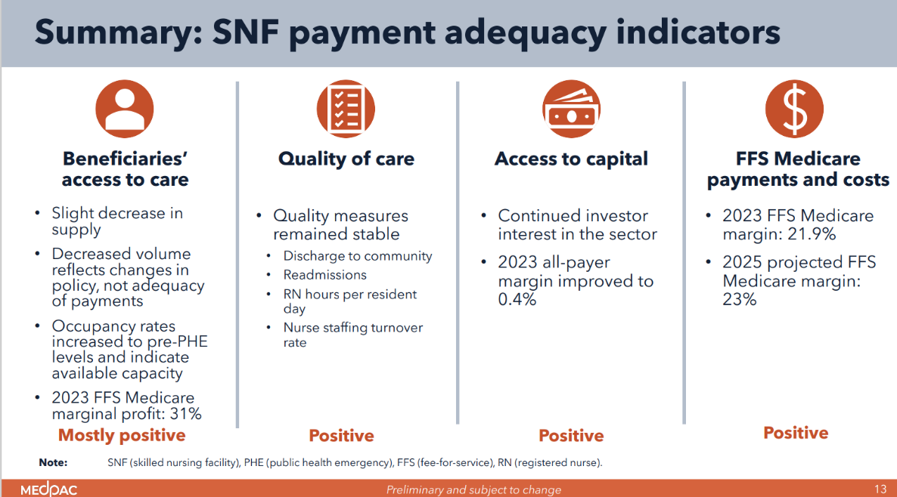
Nursing Home Outlook?
Medicare FFS rates are sufficient (see MedPAC graphic at right)
  Don’t expect any increases
MA growth will continue
  Congress may look at adm burden but not payment adequacy
Adequate Medicaid rates are essential
Tab-E-SNF-payment-adequacy-December-2024_SEC-1.pdf

Slide 27
Questions?
Jennifer Boese, MS
Director, Health Care Policy & Innovation
Jennifer.Boese@CLAConnect.com
Jonathan Fink, CPA
Principal
Jonathan.Fink@CLAConnect.com

Slide 28
Discussion
Connecticut Department of Social Services

