Slide 1


Voices United, Empowering Choices: Strength in Advocacy
2024

Slide 2

Pledge of Allegiance
I pledge allegiance to the flag of the United States of America and to the Republic for which it stands; one Nation under God, indivisible with Liberty and Justice for ALL.
Notes:
As many of you know, it is our tradition each year to begin by having a council president lead us in the Pledge of Allegiance. Today, we are honored to invite Professor Moore from the State of Connecticut Veterans Home to lead us in this special moment.
Professor Moore proudly served in the U.S. Army during the Vietnam War, and we are deeply grateful for his service to our country. His commitment to leadership continues today, not only as a veteran but also as an advocate, guiding us as a member of our statewide council.
Please join me in welcoming Professor Moore to lead us in the Pledge of Allegiance.

Slide 3

Welcome
Mairead Painter
State Long-Term Care Ombudsman

Slide 4
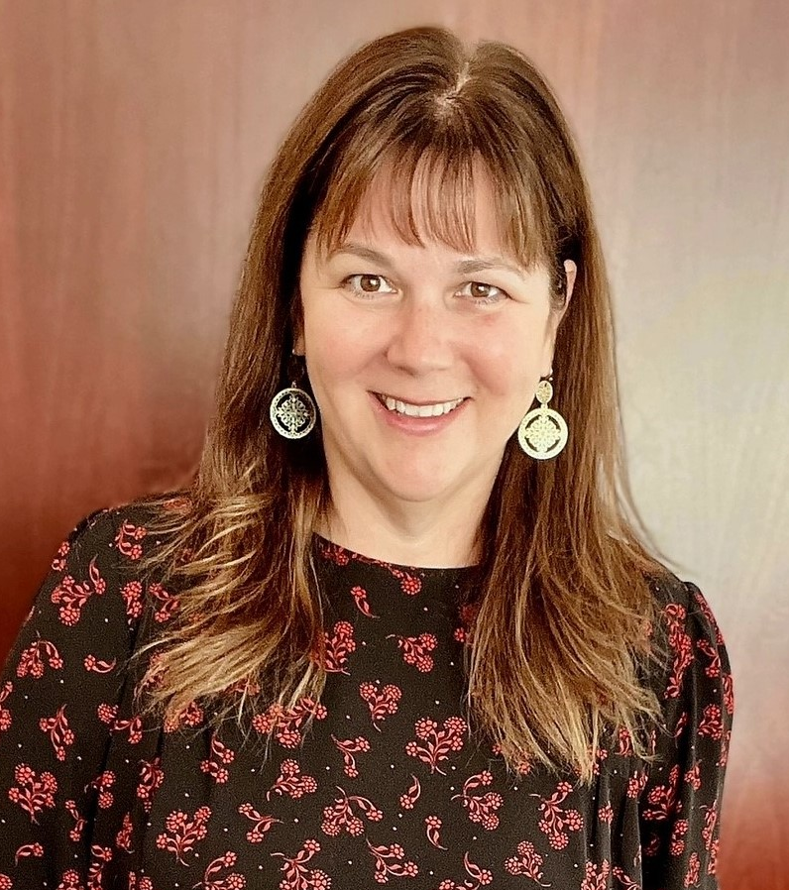
Opening Remarks
Commissioner Amy Porter
Department of Aging
and
Disability Services

Slide 5
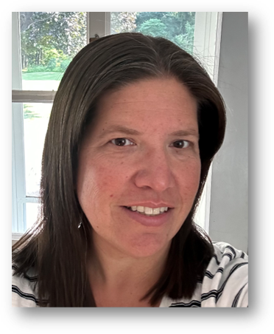
Money Follows the Person
Christine Weston
Director of Community Options at the Department of Social Services (DSS)

Slide 6
Money Follows the Person (MFP)
A Federally Funded Demonstration that helps people residing in qualified institutional settings, transition to the community with supports and services.
MFP provides individuals with choice about where they want to receive their care.

Slide 7
MFP Demonstration Transitions
MFP funds the first 365 days in the community.
After 365 days the individual is transferred to the waiver or regular state plan. Home and community-based services (HCBS) under which they are being served.
  To the individual – unless their needs have changes – they should see no change in supports or services – it is simply a change in funding source.

Slide 8
Eligibility for MFP Transition
Must be in a Qualified Institution
Nursing Facility
Hospital
Chronic Disease Hospital
Intermediate Care Facility for Persons with Intellectual Disabilities (ICF-ID)
At the time of Transition:
Must have been institutionalized for 60 days
Have a person-centered care plan targeted for the Medicaid Waiver under which they will be served after day 365 or under State Plan HCBS Services:
approved by MFP
at or below the individuals cost of care in the facility on the day they were referred
plan must be sustainable under regular Home and community-based services (HCBS) at end of MFP year
as long as it is continuous, hospital, rehab & nursing facility time can be counted

Slide 9
Eligibility for MFP Transition - Continued
Active Medicaid in the facility
Medicaid must pay at for at least the day before transition
Community Medicaid Eligible for Waiver or State Plan HCBS
Moving to Qualified Housing:
A home owned or leased by the individual or a family member
An apartment* with
an individual lease, and
with lockable access and egress, and
which includes living, sleeping, bathing, and cooking areas over which the individual or their family has domain and control
A residence in a community based residential setting, in which no more than 4 other unrelated individuals reside.
* In CT, Assisted Living qualifies as an apartment – there a number of affordable options for Assisted Living

Slide 10
Individuals Not Eligible for MFP Transition (Non-Demo)
If the eligibility for MFP Transition is not-met, the individual may still be transitioned as a State Funded *(Non-Demo) Transition.
Some reasons include:
  Going to a residential care home (more than 4 unrelated individuals).
  Less than a 60-day institutional stay
  Medicaid not paying the facility.
  * Transition services are funded under State Funds, not the demonstration.

Slide 11
Non-Demo Transitions
Non-demo Transitions can receive:
  Transition Assistance
  Transition Coordinator – Coordinates Transition and follows for six months in community.
  Transitional Budget – to assist with purchasing basic furnishings, start-up groceries, etc.

Slide 12
MFP Demo Transitions
MFP Transitions can receive:
  Transition Assistance
    Transition Coordinator – Coordinates Transition and follows for a year.
  Housing Assistance
    Housing Coordinator
    Rental Assistance
    Access to the State Security Deposit Guarantee Program
    Home Modifications for Accessibility
      Possible Funds available through CIL for higher cost mods.
      Transitional Budget – to assist with purchasing basic furnishings, start-up groceries, etc. (Max. $2,000 /2 years

Slide 13
What happens if the person is institutionalized during their MFP year?
The MFP clock stops while they are hospitalized or in a nursing facility. The clock restarts upon return to the community – claiming days.
If institutionalized 180 days – case closes, however, a new referral can be made.

Slide 14
Responsibilities of a Qualified Institution when coordinating an MFP Transition.
Coordinate a safe discharge with the individual, family, legal representative and MFP staff.
May need to complete a medical packet to for disability determination - eligibility for waiver services
Schedule PT/OT evaluation
Order Durable Medical Equipment (DME)
Facilitate discharge planning meeting
Schedule medical appointments prior to discharge
Adhere to DPH regulations for a safe discharge
Ensure teaching is completed and documented for a safe discharge

Slide 15
How to Apply?
How to apply: www.ctmfp.com
Contact with questions: 888-99CTMFP (888-992-8637)
How to Apply

Slide 16

Questions?

Slide 17

Raffle
Presented By:

Slide 18

Strengthening Resident Councils Pilot

Slide 19

Strengthening Resident Council Guide
Resident councils play a critical role in ensuring residents' voices are heard, but some homes may lack the standardized practices needed to fully support them.
The Moving Forward Coalition has developed a Strengthening Resident Council Guide to enhance the effectiveness of resident councils in all nursing homes.
The guide offers a structured approach to creating and sustaining inclusive, resident-directed councils in compliance with CMS Federal Regulations (CFR 483.10(f)(5)). It provides resident councils and those who support them with tools to foster engagement, address grievances, and maintain effective council activities.

Slide 20

Essential Caregivers Act 2024
Irma Rappaport
Essential Caregivers Movement

Slide 21
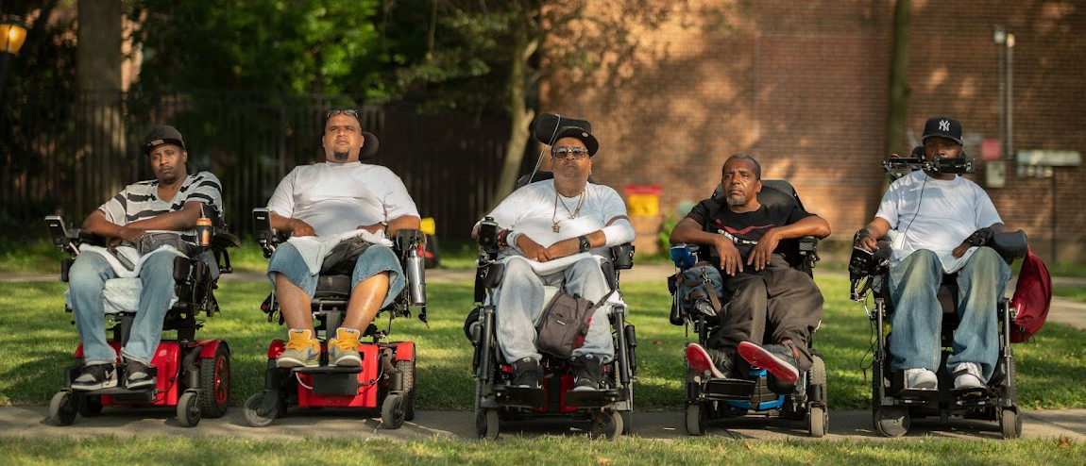
Fire Through Dry Grass
Alhassan “EL” Abdulfattaah
Shannon Nelson
Peter ”Pete” Yearwood
Vincent “V” Pierce
Notes:
What is Fire Through Dry Grass - "Fire Through Dry Grass" is a documentary film that uncovers the devastating impact of the COVID-19 pandemic on residents of a New York City nursing home. The film is notably brought to life by The Reality Poets, a group of young Black and brown disabled artists. These artists use their poetry and art to document their experiences during the lockdown, highlighting the dangers they faced and their feelings of imprisonment. The film sheds light on the neglect they endured and their refusal to be marginalized or erased. The Reality Poets, many of whom are survivors of gun violence, represent a unique and powerful voice, providing an intimate look at a community often overlooked during the pandemic.
"Fire Through Dry Grass" is a profound commentary on resilience, visibility, and advocacy for marginalized communities, particularly those with disabilities. It underscores the necessity of acknowledging and addressing the systemic neglect and marginalization faced by disabled individuals, particularly in crisis situations like the COVID-19 pandemic. The film, through the voices of The Reality Poets, highlights the importance of self-expression, community solidarity, and the power of art as a tool for advocacy and change. It serves as a call to action for greater inclusivity, respect, and care for all members of society, especially those who are often overlooked or forgotten.

Slide 22


Slide 23


Slide 24


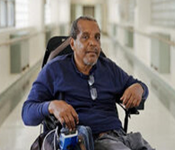
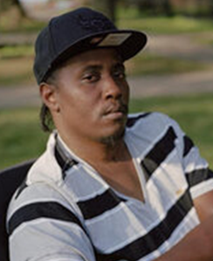
Fire Through Dry Grass
Alhassan “EL” Abdulfattaah
Shannon Nelson
Peter ”Pete” Yearwood
Vincent “V” Pierce
Notes:
Topic 1: Recognizing the Issues (2 minutes) Topic: The film underscores issues such as institutional neglect, lack of autonomy, and the dangers and isolation experienced during the COVID-19 lockdown. It highlights the need for recognizing the residents' skills and contributions, and the importance of having a seat at the decision-making table.
Question: “What are the most significant issues highlighted in ‘Fire Through Dry Grass’ that nursing home residents face?”
Topic 2: Importance of Resident Leadership (2 minutes) Topic: Residents live with the consequences of policy decisions daily. Their firsthand experiences and perspectives are crucial for creating effective and empathetic policies. Empowering residents ensures that their needs and rights are prioritized, leading to better care and quality of life.
Question: “Why is it important for nursing home residents to lead the decision-making process regarding their care and living conditions?”
Topic 3: Using Art for Activism (2 minutes) Topic: Art, such as poetry and filmmaking, can powerfully convey personal experiences and emotions, raising awareness and generating empathy. The Reality Poets in the film use their art to document their lives and advocate for change, demonstrating that creative expression can be a compelling vehicle for social justice.
Question: "How can art be used as a tool for activism in advocating for nursing home changes?"
Topic 4: Overcoming Ableism and Racism (2 minutes) Topic: Strategies include promoting diversity and inclusion training for staff, ensuring policies that protect against discrimination, and actively involving residents in creating a more equitable environment. Advocacy and education are vital in addressing and dismantling these systemic issues.
Question: "What strategies can be implemented to combat ableism and racism in nursing homes?"
Topic 5: Engaging the Community (2 minutes Topic: Community support can come through volunteering, participating in advocacy campaigns, and supporting legislation that protects nursing home residents’ rights. Raising awareness and educating others about the issues faced by residents can also drive collective action and change.
Question: “How can the broader community support efforts to improve conditions in nursing homes?”
Topic 6: Legislative Actions (2 minutes) Answer: Supporting bills that protect resident rights, fund improvements in care quality, and enforce accountability measures for nursing home management are essential. Engaging with policymakers and advocating for laws that prioritize resident well-being and autonomy can lead to systemic changes.
Question 5: "What legislative actions can be taken to ensure better care and conditions in nursing homes?"
Topic 7 Call to Action (2 minutes): Individuals can start by educating themselves and others about the issues, supporting relevant advocacy groups, and participating in local and national campaigns. Signing petitions, contacting legislators, and volunteering at nursing homes are practical steps to make a difference.
Question 7: "What steps can individuals take today to contribute to nursing home reform?"

Slide 25

View the Film In It’s Entirety
POV believes in the power of film to engage communities in dialogue around the most important social issues of our time. Join POV's Community Network to gain access to POV's award-winning films and digital projects. Discover discussion guides, standards-aligned lesson plans, reading lists and other resources to help shape the conversation and inspire action.
For Support Reach Out to the LTCOP at 1-866-388-1888
Notes:
To facilitate this, we encourage you to take advantage of the POV Community Network. This network is a complimentary digital film lending service designed for educators, nonprofits, librarians, media centers, and actively engaged community members. It allows for the hosting of free community screening events of POV films, either virtually via platforms like Zoom or in person. You can do this several ways.
By joining the lending library, you can register to host a screening event, providing a fantastic opportunity for our community to view "Fire Through Dry Grass" in advance of the Voices Event. The process is simple:
Visit communitynetwork.amdoc.org and sign up for a free account.
Once approved by the POV team, navigate to 'Events' on the left sidebar, and click 'Request New Event' to submit your Event Request Form.
Upon approval, the POV events team will provide a Dropbox streaming link for the film, alongside valuable resources including a Discussion Guide, a Virtual Screenings Training Manual, and an Audience Evaluation Form, 2-3 weeks before your event date.

Slide 26

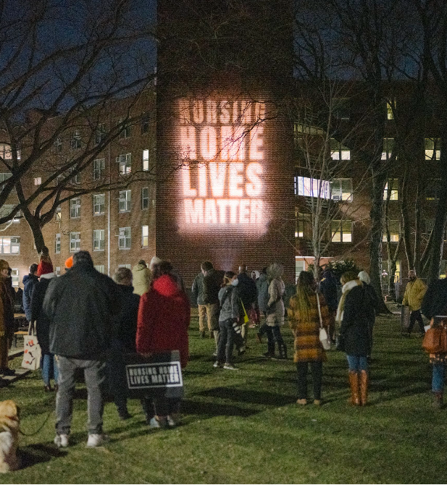
Open Doors / Reality Poets / Nursing Home Lives Matter
Nursing Home Lives matter - #NHLM fights for a healthcare system that protects, respects and cares for all those living and working in long-term care, especially Black and brown people.
  It is our goal to not just take policy, but eventually to make policy.
  Nursing Home Lives Matter Bill of Rights

Slide 27
Awards

Slide 28
Brian Capshaw Rockstar Award
Peter ”Pete” Yearwood
Shannon Nelson
Alhassan “EL” Abdulfattaah
Vincent “V” Pierce

Slide 29
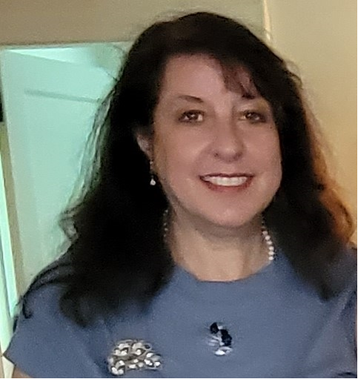
Carol Rosenwald Spirit of Advocacy
Irma Rappaport

Slide 30
UConn Center of Aging
Disparities Related to Dementia Research Studies
Christine Bailey, MA
and
Ellis Dillon, PhD

Slide 31

Legislative Session General Overview 2024
https://www.cga.ct.gov/2024/rpt/pdf/2024-R-0108.pdf
Notes:
Good morning, I’m Daniel Beem with the Long Term Care Ombudsman Program, and I’m delighted to present a brief overview of the Connecticut Legislative Update for the 2024 session. First, I’d like to extend my congratulations to the E-board members, resident council leaders, and all attendees for your dedicated advocacy in protecting resident rights and working to maximize the quality of life and care for nursing home and long-term care residents.
A Brief Overview: The 2024 Connecticut Legislative Session
The session, which ran from February 7 to May 8, marked a pivotal period for advancing significant policy changes.
On February 29 and March 5, 2024, the Long Term Care Ombudsman Program (LTCOP), E-Board, Statewide Family Council, and various advocacy groups convened at the Legislative Office Building to participate in public hearings on several critical nursing home reform bills, including comprehensive measures such as HB 5001 and 5046. The objective was to highlight the persistent challenges faced by long-term care residents in Connecticut and to advocate for greater transparency, accountability, and quality of care.
While not all proposed bills were passed, the session resulted in the enactment of several key reforms aimed at improving quality, choice, and transparency in care. These legislative successes exemplify strong bipartisan collaboration across multiple committees. The LTCOP and the Executive Board of the Statewide Coalition of Presidents of Resident Councils extend their sincere recognition and appreciation to the Speaker of the House and the Aging Committee. Their efforts this session have further demonstrated an unwavering commitment to meeting the needs of older adults and those in long-term care across the state.
The implementation of these measures is anticipated to not only generate cost savings but also significantly enhance the quality of life for seniors, promoting a more dignified and independent lifestyle within their chosen communities.
Notably, the session saw the implementation of enhanced privacy measures, including limiting room occupancy to no more than two beds, aimed at reducing overcrowding and increasing privacy for residents. The session also mandated the transition of nursing facility waiting lists to an electronic format, enhancing the accuracy and transparency of the admissions process.
In addition, the legislature focused on promoting best practices and improving public access to care comparisons by requiring the display of links to the Medicare Nursing Home Care Compare website on both the Department of Social Services and Department of Public Health’s website and the establishment of a Connecticut-specific nursing home dashboard; an initiative is designed to aid residents and their families in making informed choices about care facilities. It also saw for the development of a “Centers of Excellence program”, which would provide incentives for nursing homes that meet specific evidence-based standards for high-quality and person centered care.
The session also addressed issues of fairness and safety: it prohibited discrimination in admissions based on a history of mental health treatment and introduced enhanced workplace violence prevention standards to safeguard both residents and staff. It also now generally requires nursing homes, without regard for the waiting list, to admit transferring residents from a nursing home that is closing, in order to minimize the risk of transfer trauma and allow individuals to remain in their communities of origin.
Regulatory authorities were given enhanced powers to discipline facilities that fall short in care and practices according to state and federal law, ensuring accountability and maintaining high care standards.
Moreover, the recent legislative changes in Connecticut significantly enhance the flexibility and responsiveness of the ombudsman program, ensuring that individuals receiving care can access critical and appropriate services more rapidly and in their preferred settings.
Collectively, these measures significantly improve the operational transparency, safety, and care quality in Connecticut’s nursing, residential and community care settings, thereby enhancing the quality of life for older and vulnerable populations.

Slide 32
Legislative Session 2025
Looking Forward
Notes:
LOOKING FORWARD: CT LEGISLATION 2025
Looking forward In Connecticut for 2025, the legislative items may include
Increase to Nursing Home Personal Needs Allowance to Include Cost of living increases.
Continued expansion of the Ombudsman Program to address the continual increase in number and complexity of concerns raised to the program.
Increased transparency in nursing home ownership and financial accountability.
Incorporation of LGBTQ+ Specific Resident Rights into Connecticut State Statutes:
Strengthening Protections Against Involuntary Discharges in Residential Care Homes
Issues Related to Closures/Evacuations for RCH’s and SNF’s
Require further diversity of the DPH survey teams
Strengthening Accountability through Increased Civil Monetary Penalties for Facility Abandonment
Working to Prohibit the use of Pre-Dispute Arbitration Agreements in Nursing Homes and Residential Care Homes
Strengthen mandatory reporting requirements for suspected abuse, neglect, exploitation, or abandonment of elderly persons in long-term care facilities by eliminating subjective interpretation in reporting decisions.
Increase access for veterans to VA-contracted homes by allowing veterans who meet eligibility criteria and are appropriately qualified through the VA to receive priority status on nursing home waitlists
Federal Advocacy
As part of our ongoing commitment to advocating for the rights and well-being of all nursing home residents in the nation, we wanted to highlight two key issues: ensuring residents are protected from isolation and from unfair arbitration practices.
As reviewed earlier today, a top federal priority remains the passage of the Essential Caregivers Act of 2024 (H.R. 8331). This critical legislation would allow residents in long-term care facilities to designate an essential caregiver to maintain contact and support even during emergencies.
We also stand in full support of Senator Blumenthal’s Fairness in Nursing Home Arbitration Act 2024, which aims to prohibit the use of pre-dispute arbitration agreements in long-term care facilities at the national level. This important legislation would ensure that residents and their families are not forced into unfair arbitration processes before a dispute even arises, preserving their right to seek justice in court. By eliminating mandatory pre-dispute arbitration, the bill strengthens protections for residents, ensuring greater accountability and transparency in care.
Conclusion
We’ve provided a big picture overview, highlighted key state legislation passed this session impacting nursing homes and long-term care, and touched on federal initiatives aimed at improving care for our residents. Additionally, we’ve discussed potential 2025 legislative goals at the state level, celebrating the positive achievements of the 2024 session.
For more details on our legislative initiatives and successes, please visit the Advocacy Page on our website at ct.gov/LTCOP.
Wishing everyone continued success in advocacy efforts for 2025. Thank you.

Slide 33

Lunch and Raffle!

Slide 34

    Open Microphone
    &
    Panel Discussion

Slide 35
Closing
Mairead Painter
State Long-Term Care Ombudsman

Slide 36

Voices Forum 2024 Post Event Survey
Share your Feedback!
Anyone can respond, Anonymous
Scan the QR code to Vote or go to:
https://forms.office.com/g/Ftm7ne94UJ

Slide 37

IT’S YOUR CHOICE, LETS HEAR YOUR VOICE!
Submitted by Jeanette Martinez, E-Board Member
https://portal.ct.gov/LTCOP/Content/Executive-Board-RCP/Executive-Board-RCP
Resident council has been very rewarding for me. When I came to the home in which I live I was very sad for several days and then realized that what I was feeling wasn’t different from anyone else.
My hope was that I would be able to adjust and change things in the home to benefit me and the other residence. Resident council gave me that opportunity. I’ve been influential in many things in my building from a residential store to even changes on our food menu. This not only helps me, but it also aided others in my building.
If this is something that you would like to be a part of, contact the State Ombudsmen‘s office 1-866-388-1888 and ask to speak with the Regional Ombudsman that visits your building and let them know your interest.
The Statewide Coalition of Presidents of Resident Councils (SCPRC) is also looking for new members. While initially membership was just open to the resident council presidents only, we have opened it up to allow for other nursing home member to join and participate if they wish to advocate on their behalf and others to make changes in the lives of nursing home residents. If this is something you feel strongly about please let us know.
Feel free to hang or distribute the following flyer which is included in the VOICES Special Edition Silver Panther throughout your home to inform residents about this opportunity to make systemic change.

Slide 38


Slide 39

the Statewide Coalition of Presidents of Resident Councils
Jeanette Sullivan-Martinez President | Pendleton Healthcare
John Balisciano Jr. Vice President | Hewitt Health and Rehab
Susan Bilansky | Hebrew Home
Martha Leland | Touchpoints of Manchester
Ivette Alvarez | Stonebridge Health and Rehab
Cindy Michaud | Summit Of Plantsville
Richard Metayer | Pendleton Healthcare
Robert Willis | West Side Care Center
Carol Runlett | Branford Hills (ARK)

Slide 40
To our Resident Advocates who selflessly volunteer their time advocating on behalf of nursing home residents.
Thank You!
Volunteer | Facility
Javier Vargas | Trinity Hill
Carolina Diaz | Parkville Healthcare Center
Allan Johanson | Wadsworth Glen
Colleen Mcdermott | Touchpoints of Farmington
Deb Ciofi | Bayview Health Care Center
Doreen Near | Mystic Healthcare
Jennifer Glick | Chelsea Place
Joyce Werden | Norwich Sub-Acute (Norwichtown)
Susan Williams | Touchpoints at Chestnut
Kevin Place | Candlewood Valley Nursing Home
Linda Rosen | Governor’s House
Richard Steele | Beechwood
Joann Seraphin | Douglas Manor

Slide 41
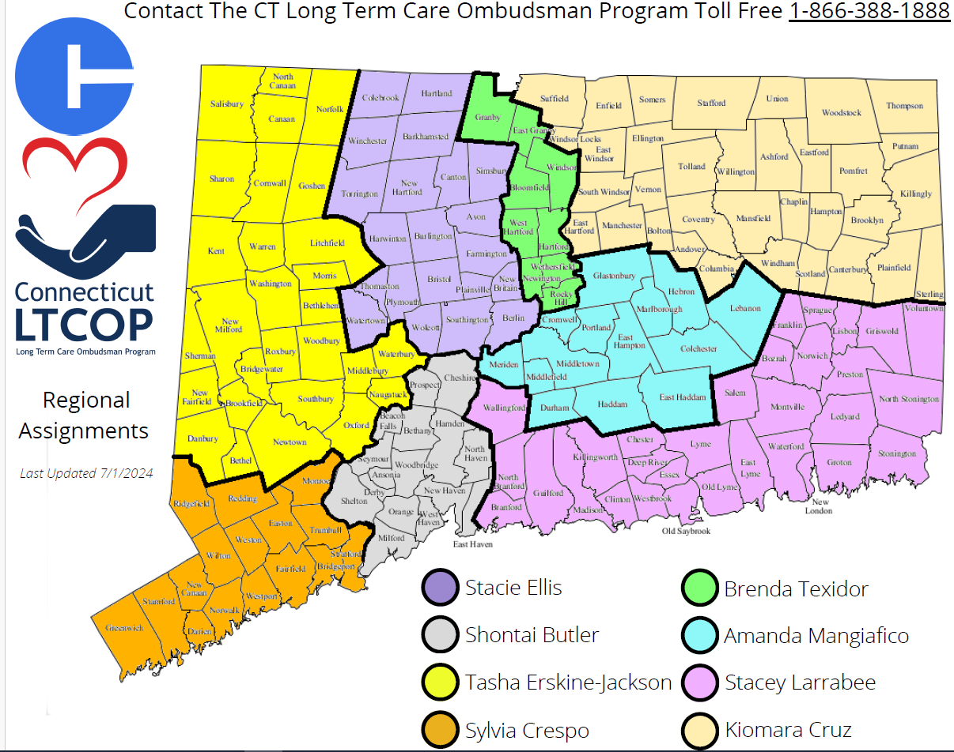

Slide 42
Contact the Ombudsman Program
Call: 1-866-388-1888
Email: LTCOP@CT.GOV

Slide 43


Thank You For Attending!

