Slide 1
Aquifer Protection Area Program Training
{Name of facility}
{Instructor, title}
{Date}

Slide 2
Why are you here today?
State of Connecticut Regulation 22a-354i, managed by the Connecticut Department of Energy and Environmental Protection
{Insert municipality} – Aquifer Protection Area Regulations
{Insert any other applicable training requirements}
{Insert image of Aquifer Protection Area boundary map as it relates to location of your facility}

Slide 3
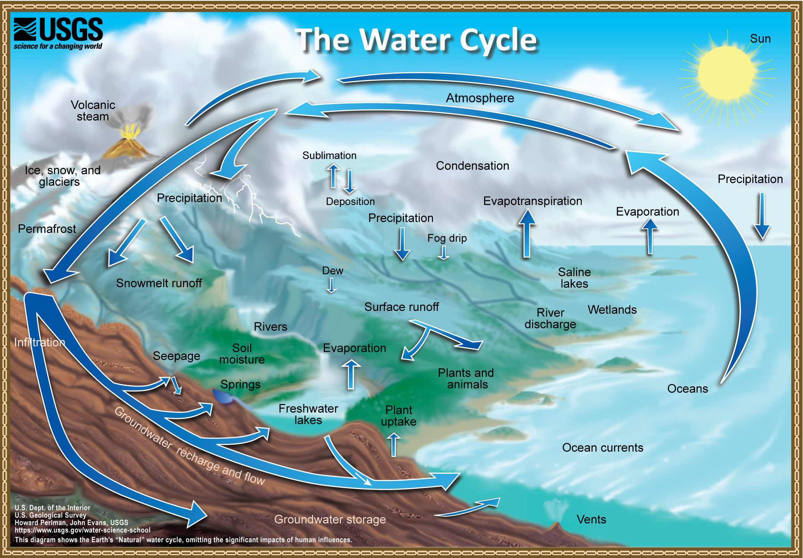
Groundwater Basics
{Provide a general review of groundwater and how it relates to the water cycle as a whole}

Slide 4
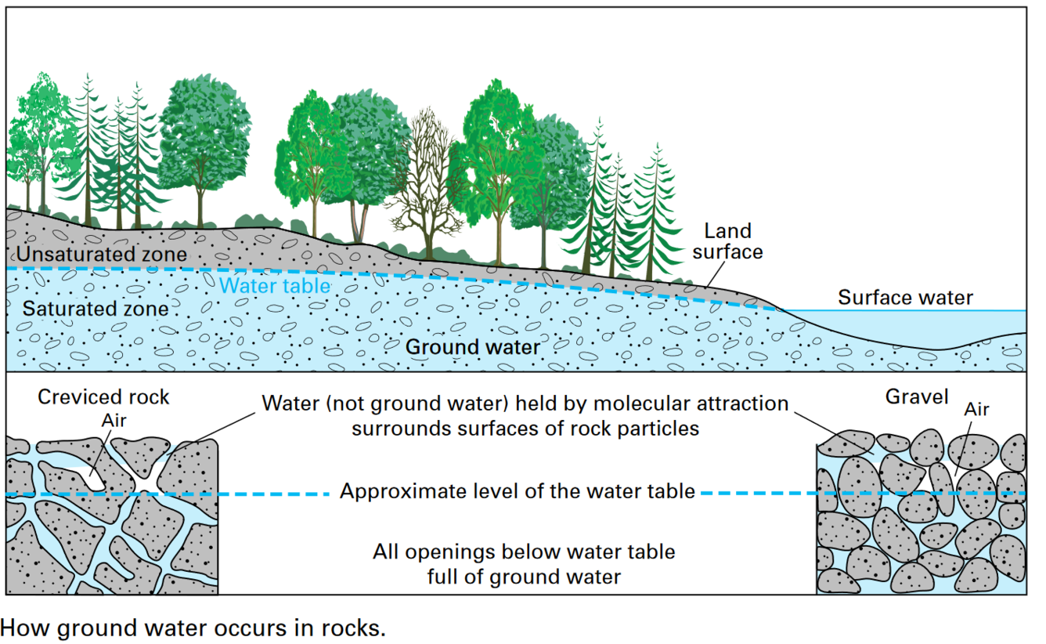
Groundwater Basics
{Provide more detail about groundwater concepts and how it can occur in different mediums}
Sources - https://www.usgs.gov/media/images/groundwater-saturated-zone-soilrock-below-land-surface

Slide 5
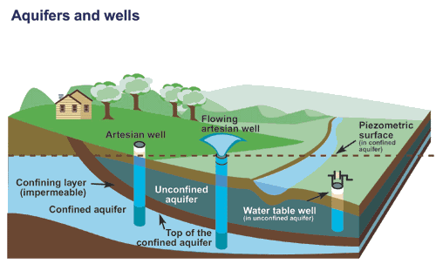
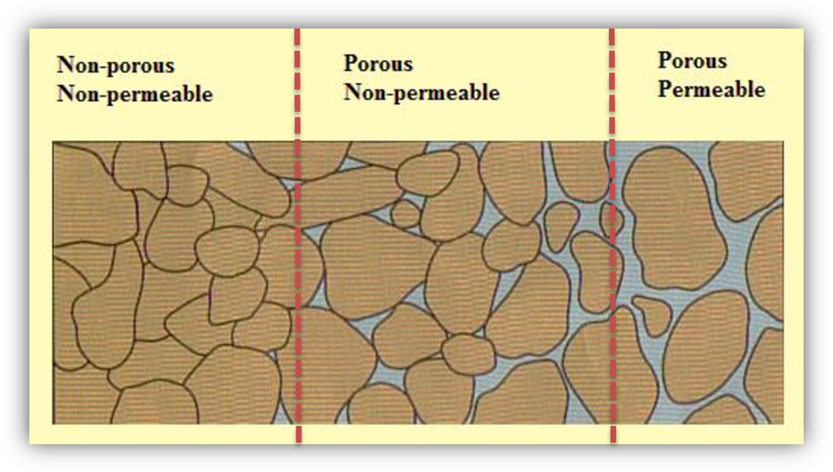
What is an Aquifer?
Aquifer - permeable material (rock or sediment) that can contain or transmit groundwater
Replenished by infiltration of water at the surface to the ground
{Briefly explain porosity and permeability}
{Don’t need to go into too much detail about the different types of aquifers. The image is just to show an example. The important point here is to mention that aquifers are a significant source of existing public drinking water}
Source - https://www.usgs.gov/special-topics/water-science-school/science/aquifers-and-groundwater, https://overallscience.com/groundwater-and-permeability/

Slide 6
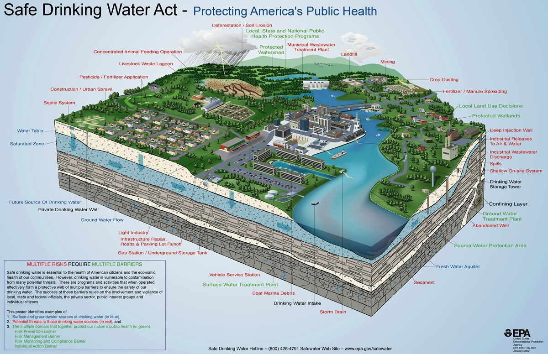
Aquifer Protection Area Program
The purpose of the program is to protect major public water supply wells through land use controls to ensure a plentiful supply for present and future generations
Threats to aquifers include:
  Any spills or releases that may contaminate ground water from oil, gasoline, diesel, solvents, and chemicals, and from leaking underground storage tanks
Businesses that pose a high-risk threat to the aquifer include:
  Gas stations
  Auto repair and maintenance facilities
  Underground storage tanks
  Industrial operations
  Bulk chemical storage facilities
  Storage of de-icing chemicals

Slide 7
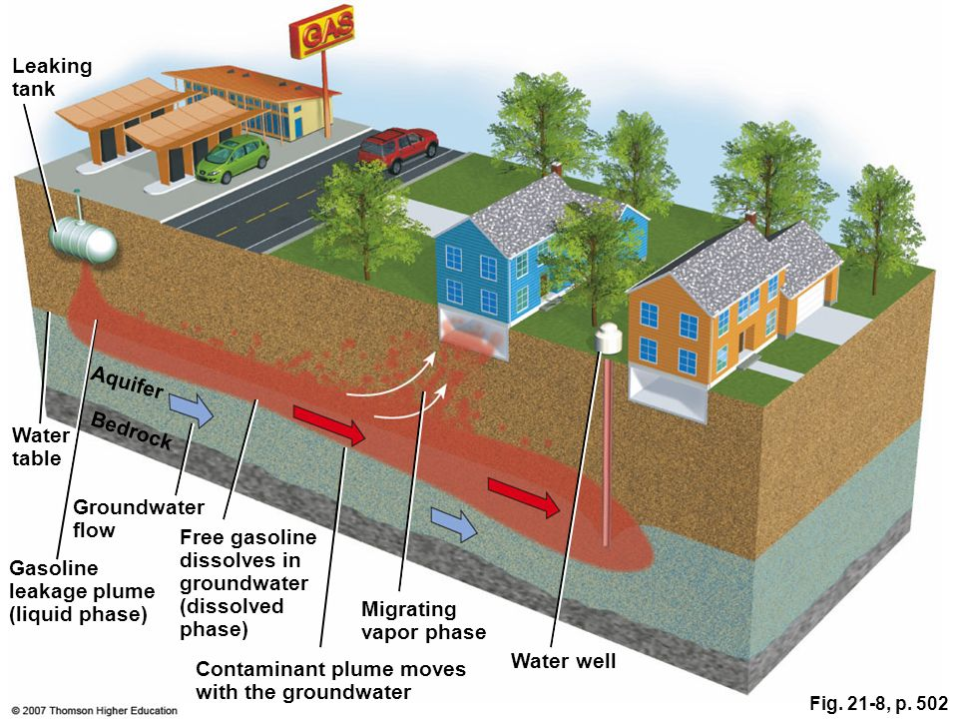
Aquifer Protection Area Program
The purpose of the program is to protect major public water supply wells through land use controls (e.g. local Aquifer Protection Area Regulations) to ensure a plentiful supply for present and future generations
{Explain the different threats observed in the image and state that the threats to groundwater can be minimized through land use controls}

Slide 8
Hot Spots
Areas or activities with greater potential for high pollutant loads that can pose a threat to the aquifer
  Vehicle or equipment maintenance and storage areas
  Fueling stations
  De-icing material storage areas
  Heating oil tanks
  Treatment areas
  Waste disposal areas
  {Add or delete any of the above as it applies to your facility}
{Insert images to show examples of “hot spots” at your facility}

Slide 9
Facility Site Plan – Regulated Activities
{Show images of facility site plan and highlight areas in which regulated activities occur}
{Also identify stormwater structures and potential drainage areas}

Slide 10
Best Management Practices (BMPs)
Conduct regular inspections at “hot spot” areas and maintain good housekeeping
  Make sure that spill kits are stocked and easily accessible, especially in fueling and transfer areas
  All drums (even empty) must be stored inside a building or under a covered structure
  All drums containing process-related material must be accounted for stored indoors (or under a covered structure) with an impermeable floor and placed on secondary containment
  All dumpsters must be covered and stored on an impermeable surface
  All vehicles must be stored on an impermeable surface

Slide 11
Best Management Practices (BMPs) Continued
Conduct regular inspections at “hot spot” areas and maintain good housekeeping
  Waste manifests are readily available and kept up to date
  All floor drains are accounted for connected to the municipal sewer system {or another structure that prevents it from discharging directly to the ground}
  Make sure that all labeled tanks containing any material are in good condition
  Make sure that there are no cracks or significant damage to the ground surface as this creates a pathway for contamination to enter the subsurface
  For specific list of BMPs, see Regulations of Connecticut State Agencies (RCSA) Sec 22a-354i-9
  {Modify to facility specifications}

Slide 12
Inspections
{Mention and discuss any other regularly-conducted inspections conducted at your facility}

Slide 13
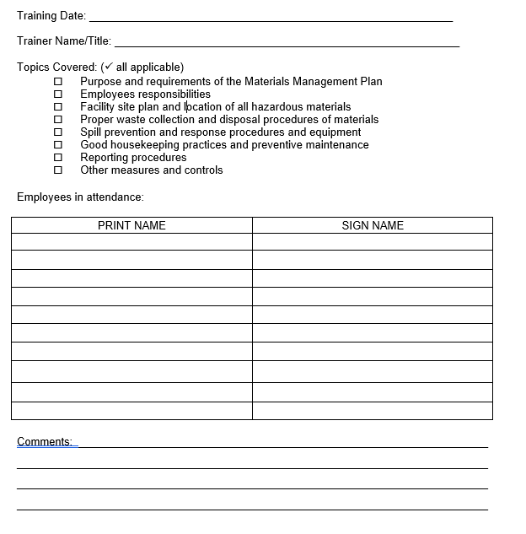
Training Logs
It is the responsibility of the facility operator to ensure that employees are trained in materials management
All employees are to be trained annually and new hires should be trained within 30 days of starting
Training logs are to be kept up to date and readily available on site

Slide 14
Emergency Response and Spill Prevention
Spill
  {Define spill and provide examples of material that could spill as it relates to your facility}
Temporary spill control
  {Insert information as it applies to your facility}
In the event of a spill
  Follow Stormwater Management Plan and Materials Management Plan procedures {remind employees where these documents are located and that these documents should always be located on site}
  Call 860-424-3338 or 1-866-DEP-SPIL

Slide 15
Contact Information
{Instructor contact information}
{Municipal APA agent contact information}
{DEEP APA contact information}

