Slide 1


Nursing Home Financial Advisory Committee
April 9, 2025
Members:
Nicole Godburn, DSS, Director of Rate Setting; Lorraine Cullen, DPH, Branch Chief, Healthcare Quality and Safety; Barbara Cass, DPH, Senior Advisor to the Commissioner for LTC; Claudio Gualtieri, Senior Policy Advisor to the Secretary of OPM; Mairead Painter, State LTC Ombudsperson; Michael Morris, CHEFA; Margaret Morelli, Executive Director, Leading Age CT; Matthew Barrett, Executive Director CAHCF/CCAL.

Slide 2
Welcome/Call to Order​
Approval of January 8, 2025 Meeting Minutes​
General Nursing Home Data for the Quarter and Year-To-Date​
  Licensed Beds and Census​
  Facilities by Size and Region​
Receiverships, Bankruptcies, Closures, Temporary Managers​
Request for Interim Rates​
Change in Ownerships (CHOW’s)​
Healthcare Quality and Safety Issues​
Discussion
Agenda
Connecticut Department of Social Services

Slide 3
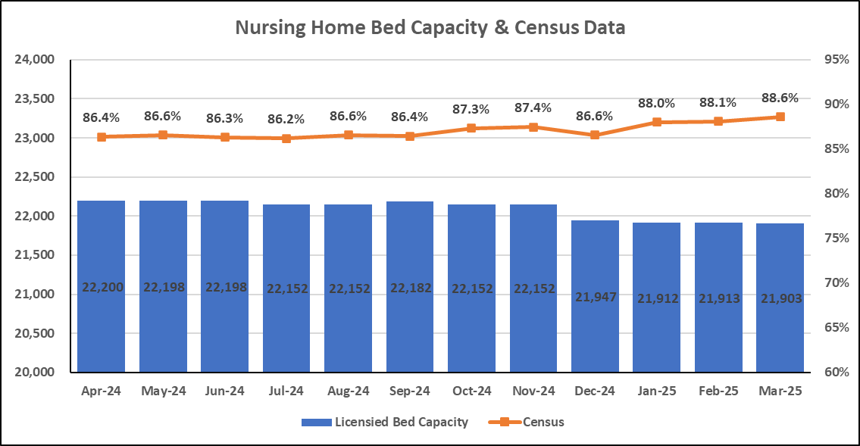
Bed Capacity-Census Data
Connecticut Department of Social Services

Slide 4
Number of Homes by Bed Count
N=193* Nursing Homes
*updated 4/02/2025
Connecticut Department of Social Services

Slide 5
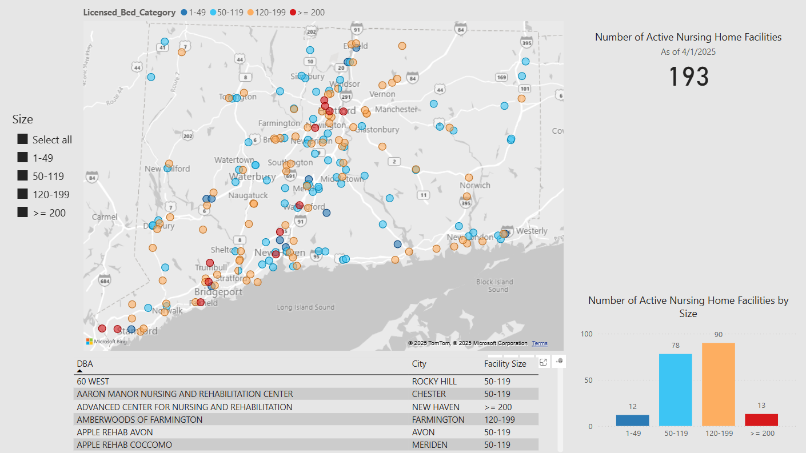

Slide 6
Nursing Home Receiverships, Bankruptcies, Temporary Managers and Closures
​Fiscal Year​ | Receivership​​ | Bankruptcy​ | Temporary Manager​​ | Closure​
SFY 25 7/1/24-6/30/25 | 0 | 0 | 0 | 3*
SFY24​ 7/1/23-6/30/24​ | Trinity Terraces ​ (Jan. 2024, 46 beds)​ ​ | 0​ | 0​ | 4*​
*2024: Chesterfields, Touchpoints of Farmington, Crestfield, Middlesex Health Care
*2025: Abbott Terrace, Countryside, Wolcott View Manor (building has been empty, license closed this quarter)
Connecticut Department of Social Services
Notes:
There were no additional receiverships, bankruptcies, temp. managers, or closures during the quarter ended 6/30/24.

Slide 7
Request for Interim Rates
Facility | Reason | Date | Determination
No Requests During Q1 2025
CY 2024 Summary – 8 Requests | Increased costs since last rate rebasing, increases in vendor costs due to geographic location | Q1 2024 – Q4 2024 | 8 Approved
CY 2023 Summary – 7 Requests | Increased costs since last rate rebasing (labor, temp staffing, food, utility) | Q1 2023 – Q4 2023 | 1 Facility Closed 5 Not Granted 1 Approved
Connecticut Department of Social Services
Notes:
Updated! No interim rate requests during the quarter ended 6/30/24.

Slide 8
Change of Ownership (CHOW) SFY 2022-2025
Connecticut Department of Social Services

Slide 9
CHOW Activity: 1/01/25-3/31/25
There were 3 CHOWs in the past quarter.
Date | Prior Doing Business As (DBA) | Licensed Bed Count | Town | For Profit (FP) Not For Profit (NFP)
2/27/2025 | Village Green of Bristol Rehabilitation and Health Center | 95 | Bristol | FP
2/27/2025 | Chestelm Health and Rehabilitation Center | 76 | Moodus | FP
3/01/2025 | Beechwood Health & Rehabilitation Center | 60 | New London | FP
Connecticut Department of Social Services

Slide 10
Nursing Home Quality and Safety Issues
Top Five Federal Tags for the period January 1, 2025, to March 31, 2025
Rank | Tag Number​ | Description​ | Examples
1 | F684 | Quality of Care | Facility failed to provide care in accordance with professional standards of practice. For residents who were at risk for the development of pressure ulcers, the facility failed to ensure the LAL (low air loss) mattress was set according to the manufacturer recommendations, and failed to ensure the Braden Scale and the weekly body audits were completed per facility policy.
2 | F689 | Free of Accident Hazards/Supervision/Devices | Facility failed to ensure staff supervision was conducted timely to identify a missing resident's whereabouts, failed to act timely when a resident was identified to be missing, and failed to follow their own policy.
3 | F580 | Notify of Changes | Facility failed to notify the physician regarding the resident not receiving his/her medication.
4 | F842 | Resident Records – Identifiable Information | Facility failed to ensure Nurse Aide (NA) documentation was complete in the clinical record and failed to retain medical records within the facility per policy.
5 | F600 | Free from Abuse and Neglect | Facility failed ensure the resident was free from verbal mistreatment.
Connecticut Department of Social Services

Slide 11
Top 5 Most Frequently Cited Deficiencies
Rank | Q3 Period 4/1/24-6/30/24 | Q4 Period 7/1/24-9/30/24 | Q1 Period 10/1/24-12/31/24 | Q2 Period 1/1/25-3/31/24
1 | F684​ (Quality of Care​) | F684 (Quality of Care) | F684 (Quality of Care) | F684 (Quality of Care)
2 | F689​ (Free From Accidents/ Hazards/Supervision/Devices​) | F689 (Free From Accidents/ Hazards/Supervision/Devices​) | F689 (Free of Accident Hazards/Supervision/Devices) | F689 (Free of Accident Hazards/Supervision/Devices)
3 | F842​ (Resident Records​) | F550 (Resident Rights/Exercise of Rights) | F600 (Free from Abuse and Neglect) | F580 (Notify of Changes)
4 | F600​ (Free From Abuse/Neglect​) | F842 (Resident Records) | F609 (Reporting of Alleged Violations) | F842 (Resident Records)
5 | F656​ (Develop/Implement Comprehensive Care Plan​) | F657 (Care Plan Timing and Revision) | F880 (Infection Prevention and Control) | F600 (Free from Abuse and Neglect)
Connecticut Department of Social Services

Slide 12

Immediate Jeopardy FFY 2025
A red arrow indicates IJ deficiencies that have been seen across quarters.
An exclamation point indicates an IJ that was not seen in the previous quarter.
Q3 4/1/24-6/30/24 | Reason for Investigation
9 IJs across 8 facilities
F684. Quality of Care | Complaint & Reportable
F689. Free of Accidents and Hazards | Complaint & Certification Survey
F760. Significant Medication Errors | Complaint & Reportable
F658. Services Provided Meet Professional Standards | Complaint
K358. (Life Safety) Fire Alarm System | Certification Survey
Q4 7/1/24-9/30/24 | Reason for Investigation | Reason for Investigation
7 IJs across 5 facilities
F684. Quality of Care |  | Complaint & Reportable
F689. Free of Accidents and Hazards at 2 facilities |  | Certification Survey & Reportable
Q1 10/1/24-12/31/24 | Reason for Investigation
5 IJs across 5 facilities
Q2 1/1/25-3/31/25 | Reason for Investigation
8 IJs across 8 facilities
F689. Free of Accidents and Hazards at 4 facilities | Reportable
F689. Free of Accidents and Hazards at 3 facilities | Complaint
F760. Significant Medication Errors | Complaint
F600. Free from Abuse/Neglect | Complaint
F698. Dialysis | Complaint
F610. Investigate/ Prevent/Correct Alleged Violation | Certification Survey & Complaint
F742. Treatment/Srvcs Mental/Psychosocial Concerns | Certification Survey & Complaint
F600. Free from Abuse/Neglect | Reportable
F609. Reporting of Alleged Violations | Reportable
F610. Investigate/ Prevent/Correct Alleged Violation | Reportable
K341. Fire Alarm System - Installation | Certification Survey
K351. Sprinkler System - Installation | Certification Survey
F805. Food in Form to Meet Individual Needs | Reportable
Connecticut Department of Social Services

Slide 13
IJs over time, Facilities Impacted
Connecticut Department of Social Services

Slide 14
Discussion
Connecticut Department of Social Services

