Slide 1


Nursing Home Financial Advisory Committee
October 9, 2024
Members:
Nicole Godburn, DSS, Director of Rate Setting; Lorraine Cullen, DPH, Branch Chief, Healthcare Quality and Safety; Barbara Cass, DPH, Senior Advisor to the Commissioner for LTC; Claudio Gualtieri, Senior Policy Advisor to the Secretary of OPM; Mairead Painter, State LTC Ombudsperson; Michael Morris, CHEFA; Margaret Morelli, Executive Director, Leading Age CT; Matthew Barrett, Executive Director CAHCF.

Slide 2
Welcome/Call to Order​
Approval of July 10, 2024 Meeting Minutes​
General Nursing Home Data for the Quarter and Year-To-Date​
  Licensed Beds and Census​
  Facilities by Size and Region​
Receiverships, Bankruptcies, Closures, Temporary Managers​
Request for Interim Rates​
Change in Ownerships (CHOW’s)​
Healthcare Quality and Safety Issues​
Discussion
Agenda
Connecticut Department of Social Services

Slide 3
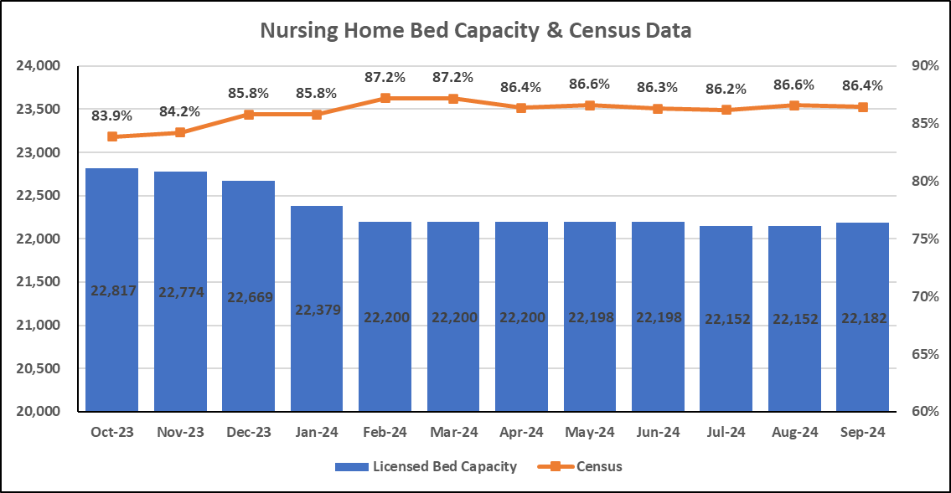
Bed Capacity-Census Data
Connecticut Department of Social Services

Slide 4
Number of Homes by Bed Count
N=197* Nursing Homes
No new closures in Q4 of 2024.
*updated 9/30/24
Connecticut Department of Social Services

Slide 5
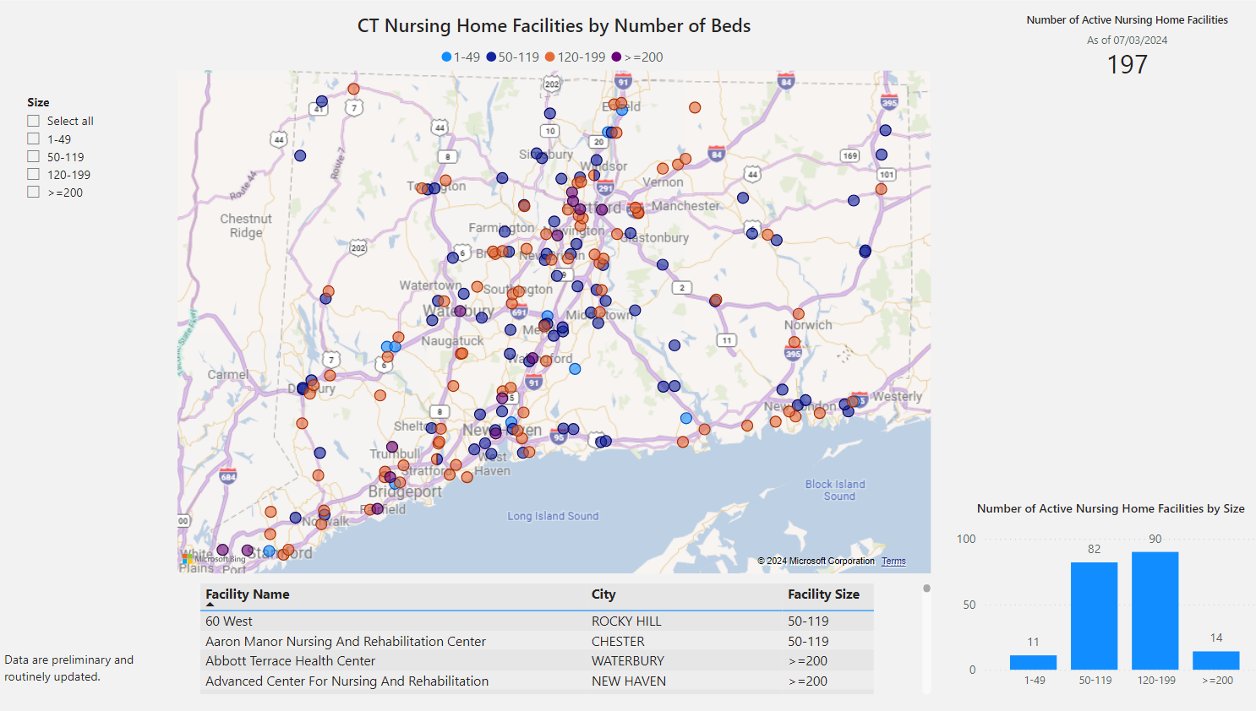

Slide 6
Nursing Home Receiverships, Bankruptcies, Temporary Managers and Closures
​Fiscal Year​ | Receivership​​ | Bankruptcy​ | Temporary Manager​​ | Closure​
SFY 25 7/1/24-6/30/25 | 0 | 0 | 0 | 1*
SFY24​ 7/1/23-6/30/24​ | Trinity Terraces ​ (Jan. 2024, 46 beds)​ ​ | 0​ | 0​ | 4*​
*2024: Chesterfields, Touchpoints of Farmington, Crestfield, Middlesex Health Care
*2025: Abbott Terrace (in process)
Connecticut Department of Social Services
Notes:
There were no additional receiverships, bankruptcies, temp. managers, or closures during the quarter ended 6/30/24.

Slide 7
Request for Interim Rates
Facility | Reason | Date | Determination
CY 2023 Summary – 7 Requests | Increased costs since last rate rebasing (labor, temp staffing, food, utility) | Q1 2023 –Q4 2023 | 1 Facility Closed 5 Not Granted 1 Approved
Bel-Air | Increased staffing costs for specialized cardiac unit (specialized staff) | Q1 2024 | Request Granted
Geer Nursing | Substantiated vendor cost increase due to geographic location of facility (Canaan, CT) | Q1 2024 | Request Granted
No Requests made in Q2 2024
No Requests made in Q3 2024
Connecticut Department of Social Services
Notes:
Updated! No interim rate requests during the quarter ended 6/30/24.

Slide 8
Change of Ownership (CHOW) SFY 2022-2024
Connecticut Department of Social Services

Slide 9
CHOW Activity: 7/1/24-9/30/24
Date | Prior Doing Business As (DBA) | Licensed Bed Count | Town | For Profit (FP) Not For Profit (NFP)
8/01/2024 | Mansfield Center for Nursing and Rehabilitation | 88 | Mansfield | FP
9/01/2024 | Autumn Lake Healthcare at Glen Hill | 100 | Danbury | FP
Connecticut Department of Social Services

Slide 10
Nursing Home Quality and Safety Issues
Top Five Federal Tags for the period July 1, 2024, to September 30, 2024
Rank | Tag Number​ | Description​ | Examples
1 | F684 | Quality of Care | Assessed needs are not met in accordance with the plan of care.
2 | F689 | Free of Accident Hazards/Supervision/Devices | Failure to properly position resident in bed; failure to ensure a resident’s wheelchair free from accident hazards.
3 | F550 | Resident Rights/Exercise of Rights | Failure to provide a dignified dining experience.
4 | F842 | Resident Records | Inaccurate/incomplete documentation in the medical record.
5 | F657 | Care Plan Timing and Revision | Failure to ensure Resident Care Conferences in accordance with facility policy.
Connecticut Department of Social Services

Slide 11
Top 5 Most Frequently Cited Deficiencies
Rank | Q1 Period 9/1/23-12/31/23 | Q2 Period 1/1/24-3/31/24 | Q3 Period 4/1/24-6/30/24 | Q4 Period 7/1/24-9/30/24
1 | F884 (NHSN Reporting)* | F884 (NHSN Reporting)* | F684​ (Quality of Care​) | F684 (Quality of Care)
2 | F689 (Accidents-Hazards) | F684 (Quality of Care) | F689​ (Free From Accidents/ Hazards/Supervision/Devices​) | F689 (Free From Accidents/ Hazards/Supervision/Devices​)
3 | F684 (Quality of Care) | F600 (Abuse/Neglect) | F842​ (Resident Records​) | F550 (Resident Rights/Exercise of Rights)
4 | F600 (Abuse/Neglect) | F656 (Comp. Care Plan) | F600​ (Free From Abuse/Neglect​) | F842 (Resident Records)
5 | F656 (Comp. Care Plan) | F842 (Resident Records) | F656​ (Develop/Implement Comprehensive Care Plan​) | F657 (Care Plan Timing and Revision)
Connecticut Department of Social Services

Slide 12

Immediate Jeopardy FFY 2024
Q1 10/1/23-12/31/23 | Reason for Investigation
7 IJs across 5 facilities
F684. Quality of Care | Reportable
F689. Free From Accidents/Hazards/Supervision/Device | Reportable
F760. Significant Medication Errors | Reportable
F600. Free from Abuse/Neglect | Reportable
F678. CPR | Reportable
Q2 1/1/24-3/31/24 | Reason for Investigation | Reason for Investigation
6 IJs across 5 facilities
F684. Quality of Care |  | Reportable
F689. Free From Accidents/Hazard Supervision/Device |  | Reportable
F760. Significant Medication Errors |  | Reportable
F600. Free from Abuse/Neglect |  | Certification Survey
F678. CPR |  | Reportable
F805. Food in Form to Meet Individual Needs |  | Reportable
Q3 4/1/24-6/30/24 | Reason for Investigation
9 IJs across 8 facilities
F684. Quality of Care | Complaint & Reportable
F689. Free of Accident and Hazards | Complaint & Certification Survey
F760. Significant Medication Errors | Complaint & Reportable
Q4 7/1/24-9/30/24 | Reason for Investigation | Reason for Investigation
7 IJs across 5 facilities
F684. Quality of Care |  | Complaint & Reportable
F689. Free of Accident and Hazards at 2 facilities |  | Certification Survey & Reportable
F600. Free from Abuse/Neglect | Reportable
F658. Services Provided Meet Professional Standards | Complaint
K358. (Life Safety) Fire Alarm System | Certification Survey
F609. Reporting of Alleged Violations | Reportable
F610. Investigate/ Prevent/Correct Alleged Violation | Reportable
K341. Fire Alarm System - Installation | Certification Survey
K351. Sprinkler System - Installation | Certification Survey
A red arrow indicates IJ deficiencies that have been seen across quarters.
An exclamation point indicates an IJ that was not seen in the previous quarter.
Connecticut Department of Social Services

Slide 13
IJs over time, Facilities Impacted
Connecticut Department of Social Services

Slide 14
Discussion
Connecticut Department of Social Services

