Slide 1


Nursing Home Financial Advisory Committee
April 10, 2024
Members:
Members: Nicole Godburn, DSS, Director of Rate Setting, Adelita Orefice, DPH, Chief of Staff, Barbara Cass, DPH, Senior Advisor to the Commissioner for LTC, Claudio Gualtieri, Senior Policy Advisor to the Secretary of OPM, Mairead Painter, State LTC Ombudsperson, Michael Morris, CHEFA, Margaret Morelli, Executive Director, Leading Age CT, Matthew Barrett, Executive Director CAHCF

Slide 2
Legislation
Sec. 17b-339. Nursing Home Financial Advisory Committee. Duties. Membership. Reports. Annual meeting. (a) There is established a Nursing Home Financial Advisory Committee to examine the financial solvency of nursing homes on an ongoing basis and to support the Departments of Social Services and Public Health in their mission to provide oversight to the nursing home industry on issues concerning the financial solvency of and quality of care provided by nursing homes. The committee shall convene not later than August 1, 2014, and consist of the following members: The Commissioner of Social Services, or the commissioner's designee; the Commissioner of Public Health, or the commissioner's designee; the Secretary of the Office of Policy and Management, or the secretary's designee; the executive director of the Connecticut Health and Education Facilities Authority, or the director's designee; the Long-Term Care Ombudsman and two members appointed by the Governor, one of whom shall be a representative of not-for-profit nursing homes and one of whom shall be a representative of for-profit nursing homes. In addition, the Labor Commissioner may appoint a nonvoting member to the committee. The Commissioner of Social Services and the Commissioner of Public Health, or their designees, shall be the chairpersons of the committee.
(b) The committee shall (1) evaluate any information and data available, including, but not limited to, (A) quality of care, (B) acuity, (C) census, and (D) staffing levels of nursing homes operating in the state to assess the overall infrastructure and projected needs of such homes, and (2) recommend appropriate action consistent with the goals, strategies and long-term care needs set forth in the strategic plan developed pursuant to subsection (c) of section 17b-369 to the Commissioner of Social Services and the Commissioner of Public Health. The Commissioner of Social Services shall submit quarterly reports to the committee concerning pending nursing home requests for interim rate increases. Such reports shall, without identifying any requesting facility by name, list the amount of each increase requested, the reason for the request and the rate that will result if the request is granted.
(c) Not later than January 1, 2015, and annually thereafter, the committee shall submit a report on its activities to the joint standing committees of the General Assembly having cognizance of matters relating to aging, appropriations and the budgets of state agencies, human services and public health, in accordance with the provisions of section 11-4a.
(d) Not later than October 1, 2014, and quarterly thereafter, the committee shall meet with the chairpersons and ranking members of the joint standing committees of the General Assembly having cognizance of matters relating to appropriations and the budgets of state agencies, human services and public health to discuss activities of the committee relating to the financial solvency of and quality of care provided by nursing homes.

Slide 3
Agenda
Welcome/Call to Order
Approval of January 10, 2024 meeting minutes
General Nursing Home Data for the Quarter and Year-To-Date
  Licensed Beds and Census
  Facilities by Size and Region
Receiverships, Bankruptcies, Closures, Temporary Managers
Request for interim rates
Change in Ownerships (CHOW’s)
Healthcare Quality and Safety Issues
July 10, 2024 meeting location: Hybrid?
Discussion

Slide 4
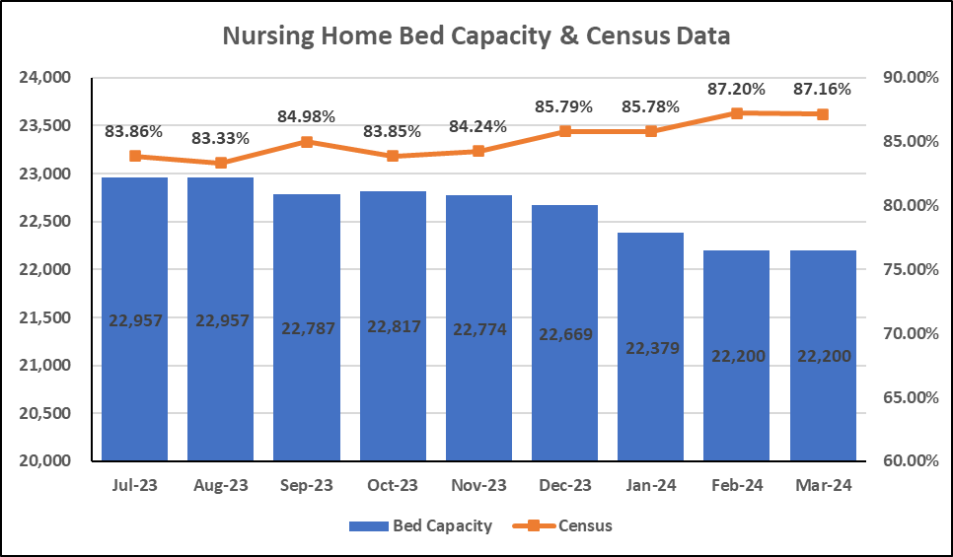
Bed Capacity-Census Data
Notes:
DSS slide

Slide 5
Number of Homes by Bed Count
N=198* Nursing Homes
*updated 4/1/24
Notes:
Updated for 4/10/24 presentation with loss of Middlesex and 150 beds

Slide 6
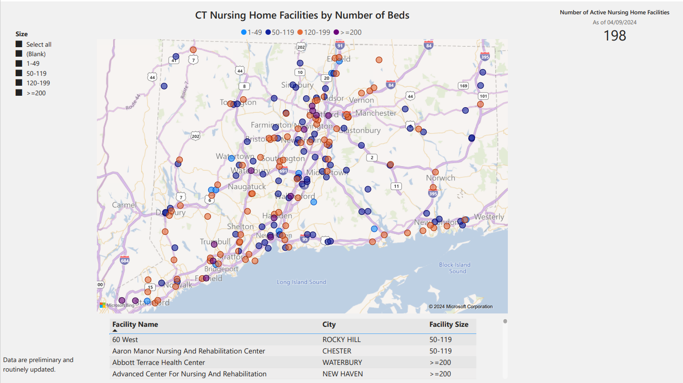
Bed Capacity Data
Notes:
Updated

Slide 7
Nursing Home Receiverships, Bankruptcies, Temporary Managers and Closures
​Fiscal Year | Receivership​ | Bankruptcy | Temporary Manager​ | Voluntary Closure
SFY24 7/1/23-3/31/24 | Trinity Terraces (Jan. 2024, 46 beds) | 0 | 0 | 4*
SFY23 7/1/22-6/30/23 | 1 (Waterbury Gardens)​ | 0 | 0 | 6*
*2023: Hughes, QVC, Grove Manor, Westport, Yale, Regal-Greenwich
*2024: FFY Q1 and 2, Chesterfields, Touchpoints of Farmington, Crestfield, Middlesex Health Care,
Notes:
DSS slide

Slide 8
Request For Interim Rates - 7/1/23 to Current
17b-340d (14) The Commissioner of Social Services may authorize an interim rate for a facility demonstrating circumstances particular to that individual facility impacting facility finances or costs not reflected in the underlying rates.
Facility | Reason | Determination
Farmington Care Center | Increased costs since last rate rebasing in 2020 (labor, food, utility) | Facility Closed
Parkville Care Center | Increased costs since last rate rebasing in 2020 (labor, food, utility) | Not granted - increases not particular to individual facility; industry wide cost changes are captured during a rebasing; rebasing is required every 2 to 4 years in accordance with statute
Touchpoints Bloomfield | Increased costs since last rate rebasing in 2020 (labor, food, utility) | Not granted - increases not particular to individual facility; industry wide cost changes are captured during a rebasing; rebasing is required every 2 to 4 years in accordance with statute
Touchpoints Chestnut | Increased costs since last rate rebasing in 2020 (labor, food, utility) | Not granted - increases not particular to individual facility; industry wide cost changes are captured during a rebasing; rebasing is required every 2 to 4 years in accordance with statute
Touchpoints Manchester | Increased costs since last rate rebasing in 2020 (labor, food, utility) | Not granted - increases not particular to individual facility; industry wide cost changes are captured during a rebasing; rebasing is required every 2 to 4 years in accordance with statute
Westside Care Center | Increased costs since last rate rebasing in 2020 (labor, food, utility) | Not granted - increases not particular to individual facility; industry wide cost changes are captured during a rebasing; rebasing is required every 2 to 4 years in accordance with statute
Aaron Manor | Temp staffing agency cost increases due to geographic location of facility (Chester, CT) | Request Granted
Bel-Air | Increased staffing costs for specialized cardiac unit (specialized staff) | Request Granted
Geer Nursing | Substantiated vendor cost increase due to geographic location of facility (Canaan, CT) | Request Granted
Notes:
DSS slide

Slide 9
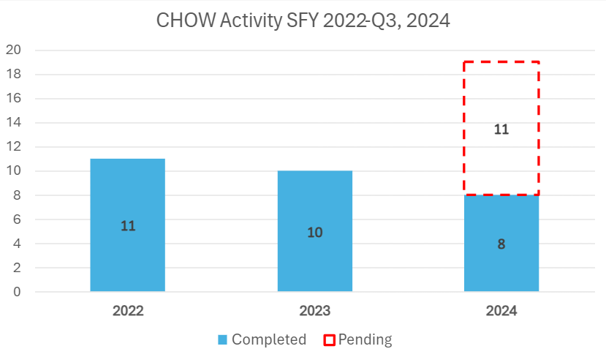
Change of Ownership (CHOW) SFY 2022-2024

Slide 10
CHOW Activity
July 1, 2023 to March 31, 2024*
Date | Previous Licensee | New Licensee | Licensed Bed Count | Town | For Profit (FP) Not For Profit (NFP)
8/4/23 | Amberwoods of Farmington | Amberwoods of Farmington | 130 | Farmington | FP
9/13/23 | Hancock Hall | Havencare at Hancock Hall | 96 | Danbury | FP
9/13/23 | Filosa | Havencare at Filosa | 46 | Danbury | FP
10/12/23 | Middlebury Convalescent | Complete Care at Middlebury | 58 | Middlebury | FP
11/29/23 | The Reservoir | Autumn Lake HC at West Hartford | 75 | West Hartford | FP
11/29/23 | Madison House | Autumn Lake HC at Madison | 89 | Madison | FP
11/29/23 | The Willows | Autumn Lake HC at the Willows | 90 | Woodbridge | FP
3/15/24 | Essex Meadows Health Center | Essex Meadows Health Center | 45 | Essex | FP
*Three Quarters of the State Fiscal Year
Notes:
Keep or delete. Slide that demonstrates SFY 2022, 2023 and 2024-total CHOWS, Add in text box 3 quarters of SFY 2024 Slide 9 will have aggregate for 2022, 2023 and 2024, slide 10 will be 3 quarters of data . Consider a bar graph with 2024 showing pending CHOWS

Slide 11
Nursing Home Quality and Safety Issues
Top Five Federal Tags for the period January 1, 2024 to March 31, 2024
Tag Number | Description | Examples
F-884* | Reporting: National Health Safety Network (NHSN) data | Facility did not report complete information to NHSN about COVID-19 in the standardized format and frequency as specified by CMS and the CDC
F684 | Quality of Care | Assessed needs are met in accordance with the plan of care
F600 | Free from Abuse and Neglect | Failure to provide care timely
F656 | Develop/Implement Comprehensive Care Plans | Care plans have not been developed/implemented that reflect resident assessed needs
F842 | Resident Records | Inaccurate-incomplete documentation in the medical record
*CMS issues the deficiency

Slide 12
Top 5 Most Frequently Cited Deficiencies
Period 9/1/23-12/31/23 | Period 1/1/24-3/31/24 | Period 4/1/24-6/30/24 | Period 7/1/24-9/30/24
Tag | Tag | Tag | Tag
F884 (NHSN Reporting)* | F884 (NHSN Reporting)*
F689 (Accidents-Hazards) | F684 (Quality of Care)
F684 (Quality of Care) | F600 (Abuse/Neglect)
F600 (Abuse/Neglect) | F656 (Comp. Care Plan)
F656 (Comp Care Plan) | F842 (Resident Records)
*CMS issues the deficiency
Notes:
In order of frequency of citing

Slide 13
IJ’s over time
Notes:
This is a new slide, if we keep I want to change the line colors

Slide 14
Immediate Jeopardy FFY 2024
10/1/23-12/31/23 7 deficiencies/5 facilities | Reason for Investigation | 1/1/24-3/31/24 6 deficiencies/5 facilities | Reason for Investigation | 4/1/24-6/30/24 | Reason for Investigation | 7/1/24-9/30/24 | Reason for Investigation
F684, Quality of Care | Reportable | F684, Quality of Care | Reportable
F689, Free From Accidents/Hazards/Supervision/Device | Reportable | F689, Free From Accidents/Hazard Supervision/Device | Reportable
F600. Free from Abuse/Neglect | Reportable | F600. Free from Abuse/Neglect | Certification Survey
F678, CPR | Reportable | F678, CPR | Reportable
F760. Significant Medication Errors | Reportable | F760. Significant Medication Errors | Reportable
 |  | F805, Food in Form to Meet Individual Needs | Reportable
Notes:
2 reporting periods, no themes other than all but one facility (Avery) FP (, e.g. geography, staffing links). Arden had IJ in Q 1 and Q 2

Slide 15
Discussion

