Slide 1


Nursing Home Financial Advisory Committee
July 10, 2024
Members:
Nicole Godburn, DSS, Director of Rate Setting; Adelita Orefice, DPH, Chief of Staff; Barbara Cass, DPH, Senior Advisor to the Commissioner for LTC; Lorraine Cullen, Branch Chief, Healthcare Quality and Safety Branch; Claudio Gualtieri, Senior Policy Advisor to the Secretary of OPM; Mairead Painter, State LTC Ombudsperson; Michael Morris, CHEFA; Margaret Morelli, Executive Director, Leading Age CT; Matthew Barrett, Executive Director CAHCF.

Slide 2
Welcome/Call to Order​
Approval of April 10, 2024 Meeting Minutes​
General Nursing Home Data for the Quarter and Year-To-Date​
  Licensed Beds and Census​
  Facilities by Size and Region​
Receiverships, Bankruptcies, Closures, Temporary Managers​
Request for Interim Rates​
Change in Ownerships (CHOW’s)​
Healthcare Quality and Safety Issues​
Presentation on Nursing Home Staffing Changes by CAHCF/CCAL and LeadingAge CT
Discussion
Agenda
Connecticut Department of Social Services

Slide 3
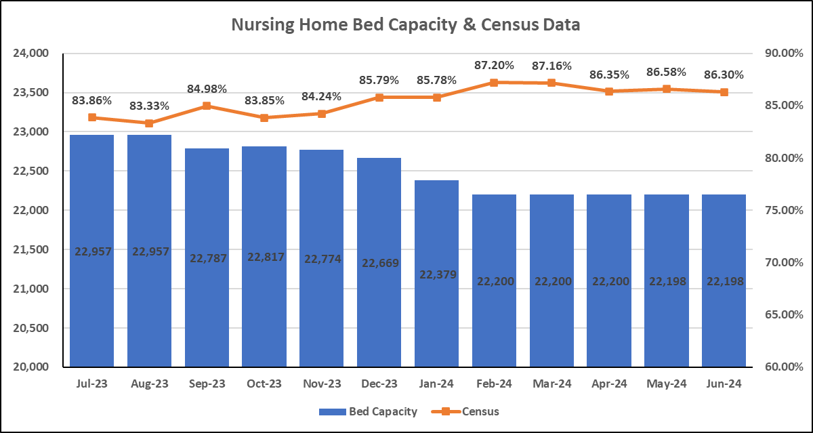
Bed Capacity-Census Data
Connecticut Department of Social Services

Slide 4
Number of Homes by Bed Count
N=197* Nursing Homes
*updated 7/1/24
Connecticut Department of Social Services

Slide 5
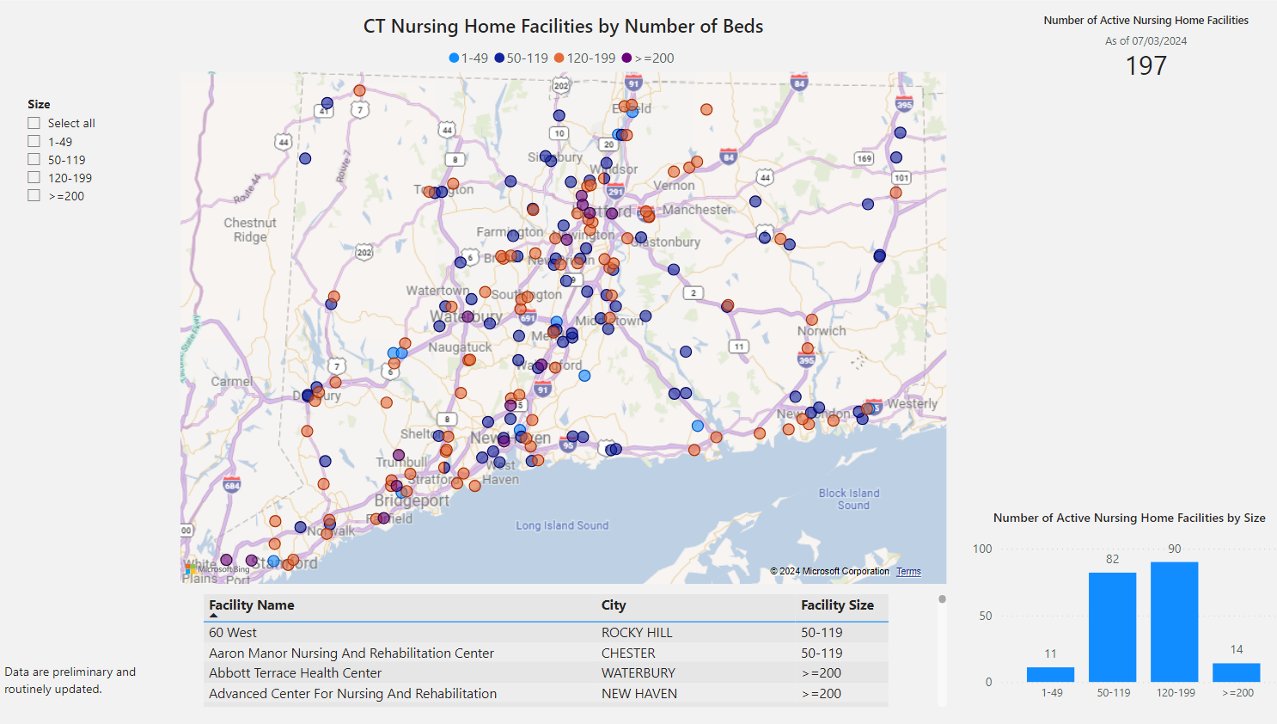

Slide 6
Nursing Home Receiverships, Bankruptcies, Temporary Managers and Closures
​Fiscal Year​ | Receivership​​ | Bankruptcy​ | Temporary Manager​​ | Voluntary Closure​
SFY24​ 7/1/23-3/31/24​ | Trinity Terraces ​ (Jan. 2024, 46 beds)​ ​ | 0​ | 0​ | 4*​
SFY23​ 7/1/22-6/30/23​ | ​ 1 (Waterbury Gardens)​​ | 0​ | 0​ | 6*​
*2023: Hughes, QVC, Grove Manor, Westport, Yale, Regal-Greenwich​
*2024: FFY Q1 and 2, Chesterfields, Touchpoints of Farmington, Crestfield, Middlesex Health Care, ​
Connecticut Department of Social Services
Notes:
There were no additional receiverships, bankruptcies, temp. managers, or closures during the quarter ended 6/30/24.

Slide 7
Request for Interim Rates
Facility | Reason | Date | Determination
Farmington Care Center | Increased costs since last rate rebasing in 2020 (labor, food, utility) | Q3 2023 | Facility Closed
Parkville Care Center | Increased costs since last rate rebasing in 2020 (labor, food, utility) | Q3 2023 | Not granted - increases not particular to individual facility; industry wide cost changes are captured during a rebasing; rebasing is required every 2 to 4 years in accordance with statute
Touchpoints Bloomfield | Increased costs since last rate rebasing in 2020 (labor, food, utility) | Q3 2023 | Not granted - increases not particular to individual facility; industry wide cost changes are captured during a rebasing; rebasing is required every 2 to 4 years in accordance with statute
Touchpoints Chestnut | Increased costs since last rate rebasing in 2020 (labor, food, utility) | Q3 2023 | Not granted - increases not particular to individual facility; industry wide cost changes are captured during a rebasing; rebasing is required every 2 to 4 years in accordance with statute
Touchpoints Manchester | Increased costs since last rate rebasing in 2020 (labor, food, utility) | Q3 2023 | Not granted - increases not particular to individual facility; industry wide cost changes are captured during a rebasing; rebasing is required every 2 to 4 years in accordance with statute
Westside Care Center | Increased costs since last rate rebasing in 2020 (labor, food, utility) | Q3 2023 | Not granted - increases not particular to individual facility; industry wide cost changes are captured during a rebasing; rebasing is required every 2 to 4 years in accordance with statute
Aaron Manor | Temp staffing agency cost increases due to geographic location of facility (Chester, CT) | Q4 2023 | Request Granted
Bel-Air | Increased staffing costs for specialized cardiac unit (specialized staff) | Q1 2024 | Request Granted
Geer Nursing | Substantiated vendor cost increase due to geographic location of facility (Canaan, CT) | Q1 2024 | Request Granted
No Requests made in Q2 2024
Connecticut Department of Social Services
Notes:
Updated! No interim rate requests during the quarter ended 6/30/24.

Slide 8
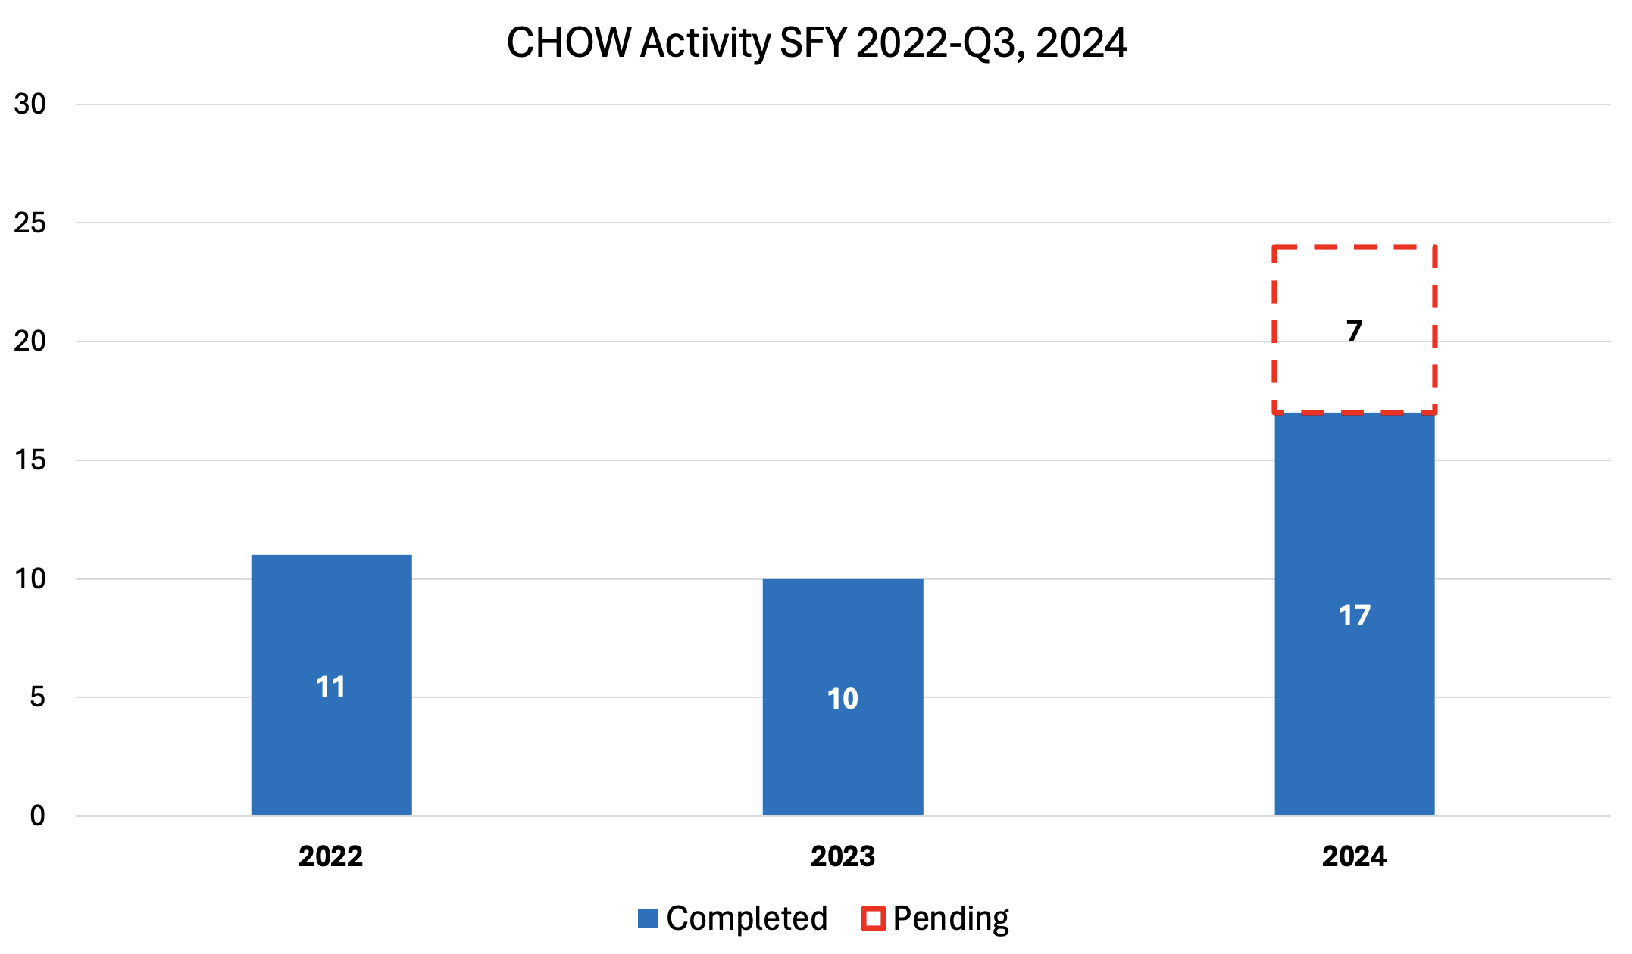
Change of Ownership (CHOW) SFY 2022-2024
Connecticut Department of Social Services

Slide 9
CHOW Activity: 4/1/24-6/30/24
Date | Prior Doing Business As (DBA) | Licensed Bed Count | Town | For Profit (FP) Not For Profit (NFP)
4/1/2024 | Miller Memorial Community, Inc. | 90 | Meriden | FP
5/1/2024 | The Suffield House | 128 | Suffield | FP
5/1/2024 | Saint John Paul II Center | 141 | Danbury | FP
6/3/2024 | Arden House | 271 | Hamden | FP
6/7/2024 | Montowese Health & Rehabilitation | 120 | North Haven | FP
6/7/2024 | Beacon Brook Health Center | 126 | Naugatuck | FP
6/7/2024 | Sharon Health Care Center | 88 | Sharon | FP
6/7/2024 | Newtown Rehabilitation & Health Care Center | 154 | Newtown | FP
6/7/2024 | Evergreen Health Care Center | 189 | Stafford Springs | FP
Connecticut Department of Social Services

Slide 10
Nursing Home Quality and Safety Issues
Top Five Federal Tags for the period April 1, 2024, to June 30, 2024
Tag Number​ | Description​ | Examples
F684​ | Quality of Care​ | Very broad category, failure to provide necessary services to promote quality care, e.g. medication errors, treatment to non-pressure skin areas
F689​ | Free From Accidents/Hazards/Supervision/Devices​ | Failure to provide the necessary supervision to prevent/mitigate accidents, e.g. elopement, inadequate assistance with transfers
F842​ | Resident Records​ | Incomplete or inaccurate medical records
F600​ | Free From Abuse/Neglect​ | Failure to provide care timely
F656​ | Develop/Implement Comprehensive Care Plan​ | Failure to develop or revise a care plan related to an assessed need
Connecticut Department of Social Services

Slide 11
Top 5 Most Frequently Cited Deficiencies
Rank | Period 9/1/23-12/31/23 | Period 1/1/24-3/31/24 | Period 4/1/24-6/30/24 | Period 7/1/24-9/30/24
 | Tag | Tag | Tag | Tag
1 | F884 (NHSN Reporting)* | F884 (NHSN Reporting)* | F684​ (Quality of Care​)
2 | F689 (Accidents-Hazards) | F684 (Quality of Care) | F689​ (Free From Accidents/Hazards/Supervision/Devices​)
3 | F684 (Quality of Care) | F600 (Abuse/Neglect) | F842​ (Resident Records​)
4 | F600 (Abuse/Neglect) | F656 (Comp. Care Plan) | F600​ (Free From Abuse/Neglect​)
5 | F656 (Comp Care Plan) | F842 (Resident Records) | F656​ (Develop/Implement Comprehensive Care Plan​)
Connecticut Department of Social Services

Slide 12
Immediate Jeopardy FFY 2024
10/1/23-12/31/23 | Reason for Investigation | 1/1/24-3/31/24 | Reason for Investigation | 4/1/24-6/30/24 | Reason for Investigation | 7/1/24-9/30/24 | Reason for Investigation
7 deficiencies 5 facilities |  | 6 deficiencies 5 facilities |  | 9 deficiencies 8 facilities
F684. Quality of Care | Reportable | F684. Quality of Care | Reportable | F684. Quality of Care | Complaint & Reportable
F689. Free From Accidents/Hazards/Supervision/Device | Reportable | F689. Free From Accidents/Hazard Supervision/Device | Reportable | F689. Free of Accident and Hazards | Complaint & Certification Survey
F760. Significant Medication Errors | Reportable | F760. Significant Medication Errors | Reportable | F760. Significant Medication Errors | Complaint & Reportable
F600. Free from Abuse/Neglect | Reportable | F600. Free from Abuse/Neglect | Certification Survey | F600. No IJ identified this quarter
F678. CPR | Reportable | F678. CPR | Reportable | F678. No IJ identified this quarter
 |  | F805. Food in Form to Meet Individual Needs | Reportable | F805. No IJ identified this quarter
 |  |  |  | F658. Services Provided Meet Professional Standards | Complaint
 |  |  |  | K358. (Life Safety) Fire Alarm System | Certification Survey
Connecticut Department of Social Services

Slide 13
IJs over time, Facilities Impacted
Connecticut Department of Social Services

Slide 14


Overview of the CMS Nursing Home Staffing Mandate
CT Nursing Home Financial Advisory Committee
July 10, 2024

Slide 15


CT’s Current Nursing Home Staffing Minimum
In no instance shall a chronic and convalescent nursing home have staff below the following standards based on 3.0 minimum staffing hours:
(A) Licensed nursing personnel:
7 a.m. to 9 p.m.: .57 hours per patient
9 p.m. to 7 a.m.: .27 hours per patient
(B) Total nursing and nurse's aide personnel:
7 a.m. to 9 p.m.: 2.17 hours per patient
9 p.m. to 7 a.m.: .83 hours per patient

Slide 16
CMS Staffing Mandate
3.48 total hours per resident day nurse staffing:
• 0.55 Registered Nurse
• 2.45 Nurse aide
Additional 0.48 HPRD can be any combination of nurse staffing

Slide 17
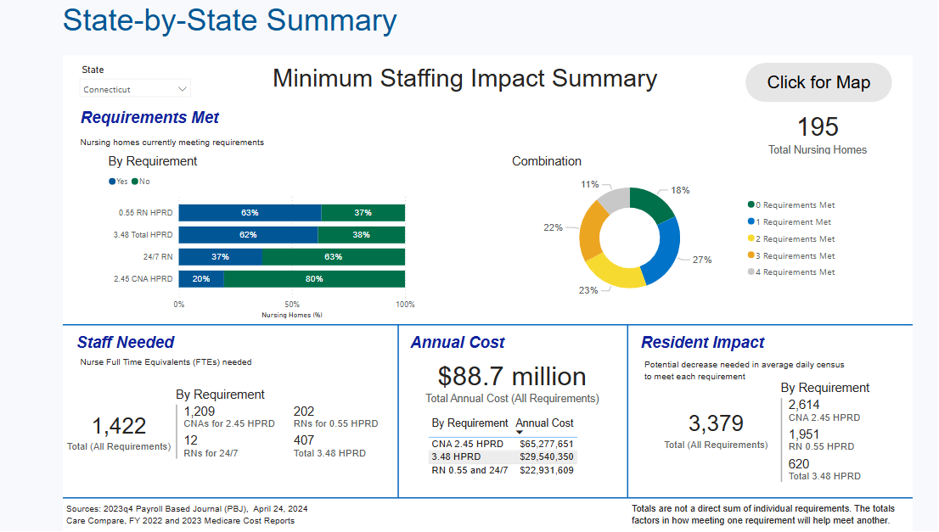


Potential Staffing Needs (AHCA Data Slide)
*
*data taken from the American Health Care Association (AHCA)

Slide 18
Implementation Timelines
Final Rule was published on May 10, 2024
Phased in over a period of years
Staggered: Rural vs. Non-rural
  “Rural” as defined by OMB
  “Metro”/urban: 50,000 or more population
  Non-metro = rural (only Litchfield County)

Slide 19
Implementation Timelines
Non-rural Areas
24/7 RN, 3.48 total nurse staffing
  2 years from published date
0.55 RN HPRD, 2.45 nurse aide
  3 years from published date
Rural Areas
24/7 RN, 3.48 total nurse staffing
  3 years from published date
0.55 RN HPRD, 2.45 nurse aide
  5 years from published date

Slide 20
Discussion
Connecticut Department of Social Services

