Slide 1

Incorporating Infectious Disease Planning into a School Emergency Operations Plan

Slide 2
Presentation Outline
Introduction to the topic: Incorporating Infectious Disease Planning into a School Emergency Operations Plan (EOP)
Connection to the six step planning process
Summary and next steps
Notes:
This training is an advanced topic intended to build upon skills and experiences that you already possess, including:
Knowledge of the six step process for developing school emergency operations plans (EOPs).
Your direct experience as a practitioner and your knowledge of your unique school district, school site, and community.
In this training, we will be working through some of the issues that we need to consider when incorporating the topic of infectious diseases in schools into an EOP. Our goal is for you to:
Receive background information on this topic; and
Learn how to incorporate planning for infectious diseases into the six step planning process for developing a high-quality EOP.

Slide 3
Infectious Diseases 101
Infectious diseases are illnesses that are transmitted from one person to another via various routes.
  Although not an infectious disease, lice occurrences are similar in their characteristics and risk factors.
 | Common Infectious Diseases that Affect Schools
Viral | Gastroenteritis (noroviruses) Influenza (seasonal, H1N1) | Varicella (chicken pox) Coxsackievirus (Hand, Food, and Mouth)
Bacterial | E. coli MRSA | Strep Throat
Fungal | Ringworm
Notes:
The next few slides provide an overview of the topic of infectious diseases in schools and include the following information:
Common routes of transmission;
Continuum of the spread of infectious diseases;
Key considerations related to infectious diseases and children; and
Consequences of infectious diseases for schools.
One note about lice before we move forward: Although lice outbreaks are not due to an infectious disease, these have similar characteristics and risk factors. Because of this, we will briefly cover a few points about lice and then transition back to focusing exclusively on infectious diseases.
Lice are human parasites and are easily transmitted from person-to-person.
Lice outbreaks are common in schools, particularly elementary schools.
Children don’t necessarily get lice from school. They get lice from infected public areas. Yet schools find themselves responsible for screening for lice and for educating others about lice.
While lice are not known to transmit disease, they are a nuisance condition and infestations cause emotional responses in the school community.
The same considerations should be taken into account with lice infestations as with infectious disease outbreaks, such as responding quickly to stop transmission and communicating effectively with parents, students, and staff.
Schools can help prevent the spread of lice by encouraging students not to share personal items (such as hairbrushes and hats), and by giving students individual places to hang their coats and other garments, instead of storing students’ personal effects together.
It would be extremely rare for a school to have to close because of a head lice infestation, but infestations are an issue that schools face almost annually.
Any questions about lice before we move on from this topic?

Slide 4


Transmission of Infectious Diseases
Common transmission routes
Person-to-Person
  Droplet transmission
  Airborne transmission
  Fecal—Oral
  Skin contact
  Blood/Body secretion
  Sexually Transmitted Diseases
Contaminated surfaces
Foodborne
Waterborne
Notes:
Some common routes of transmission for infectious diseases include the following:
Person-to-Person
Droplet transmission (e.g., influenza)
Airborne transmission (e.g., TB)
Fecal—Oral (e.g., E. coli and salmonella)
Skin contact/Direct contact (e.g., chicken pox and lice)
Blood/Body secretions (e.g., hepatitis)
Sexually transmitted diseases (e.g., chlamydia)
Contaminated surfaces (e.g., influenza)
Food-borne (e.g., salmonella and E. coli)
Waterborne (e.g., Cryptosporidium)

Slide 5
Spread of Infectious Diseases
Spread of infectious diseases—a continuum
Case
Outbreak
Epidemic
Pandemic
Notes:
Infectious diseases may be categorized according to the rate at which they infect the population. The terms used to describe this rate (i.e., case, outbreak, epidemic, and pandemic) are in a continuum, from smallest to largest.
The Centers for Disease Control and Prevention (CDC) defined these terms in a 2011 epidemiology glossary (available at http://www.cdc.gov/reproductivehealth/Data_Stats/Glossary.htm).
Case: An individual with the particular disease.
Outbreak: A localized as opposed to a generalized epidemic. Note that this term is used synonymously with “epidemic.” “Outbreak” is sometimes the preferred term because it deflects from the sensationalism often associated with “epidemic.”
Epidemic - The occurrence of more cases of disease than expected in a given area or among a specific group of people over a particular period of time.
Pandemic: An epidemic occurring over a very large geographic area (i.e., throughout several countries or continents) and usually affecting a large portion of the population.
Although these definitions represent general epidemiological concepts, the classification of infectious diseases according to these categories varies according to the disease and the time of year. For example, in Week 6 of 2014, the epidemic threshold for deaths due to influenza and pneumonia was 7.3 percent. In Week 24, however, the epidemic threshold was 6.5 percent.

Slide 6


Infectious Diseases in Schools (1 of 3)
Diseases transmit easily in a school environment.
Children may be susceptible to vaccine-preventable diseases.
There are variations in disease transmission between elementary and middle/high school students.
Many infectious diseases can be prevented.
Notes:
Diseases transmit easily in a school environment.
Children and youth are particularly efficient at transmitting diseases.
Schools tend to be densely packed environments.
Areas in a school environment (e.g., desks and playgrounds) may not be routinely cleaned and disinfected in a manner that reduces the potential for disease transmission.
Children may be susceptible to vaccine-preventable diseases.
Children may have less developed immune systems than adults.
Children may not be fully immunized against vaccine-preventable diseases (or require boosters).
Vaccinations are given in a medically approved timeframe. Younger children may have not yet been fully immunized.
Student immunization records should be routinely checked to be on the alert for vaccine omissions, including the need for boosters. The state department of health will have the required immunizations needed for schools, including boosters. This preventive measure is essential to assist in the prevention of outbreaks of vaccine-preventable diseases (e.g., measles, mumps, and chickenpox).
There are variations in disease transmission between elementary and middle/high school students.
Level of vaccine coverage:
Elementary school students may have less coverage; high school students may not get boosters.
Involvement in high school sports may increase the risk of some infection transmission:
Because students may be in situations where personal effects (e.g., towels and mouth guards) are shared, or contact is made with bodily secretions (e.g., via injuries or activities such as wrestling), there is an increased risk of exposure to infectious diseases, such as MRSA, measles, etc.
School policies should explicitly address additional precautions to be taken by students participating in sports.
Many infectious diseases can be prevented or transmission can be mitigated or stopped through
Vaccines;
Safe food-handling;
Adherence to disease prevention practices (e.g., regular hand washing, respiratory hygiene/cough etiquette, staying home when sick, routine cleaning); and
Education and outreach.

Slide 7

Infectious Diseases in Schools (2 of 3)
Infectious diseases account for millions of school days lost each year for K-12 public school students in the United States.
Forty percent of children ages 5-17 years missed 3 or more school days in the past year because of illness or injury.
Nearly 22 million school days are lost each year due to colds alone.
Thirty-eight million school days are missed each year due to the influenza virus.
Schools inherently foster the transmission of infections.
Schools are group setting in which people are in close contact.
People share supplies and equipment.
Notes:
Source: http://www.cdc.gov/healthyyouth/infectious/

Slide 8
Infectious Diseases in Schools (3 of 3)
According to the CDC, approximately 69 percent of districts required schools to include, and 77.3 percent of districts did include, procedures for responding to pandemic flu or other infectious disease outbreaks in school EOPs.
Advanced training is needed to help school and district emergency planners effectively incorporate planning for infectious disease outbreaks into a high-quality school EOP. Key considerations include:
  Activation of EOPs;
  Prolonged school closures due to student and staff absences;
  Potential for more severe consequences, including deaths; and
  How response could impact community trust in schools.
Notes:
If there is an infectious disease outbreak, school EOPs may have to be activated with community partners.
Extensive student and staff absences may cause schools to close for days or weeks, calling for the enactment of the Continuity of Operations (COOP) Annex as part of the school EOP. A COOP Annex:
Ensures continued performance of essential functions across a full range of potential emergencies, be they natural or man-made; and
Provides guidance and sets forth the duties and procedures that will ensure resilience is created and maintained.
Depending on the disease, there may be potential for some deaths in the school community.
If handled poorly, community trust in schools is likely to be shaken.
Source: The Center for Disease Control’s 2012 report, “Results from the School Health Policies and Practices Study.”
http://www.cdc.gov/healthyyouth/shpps/2012/pdf/shpps-results_2012.pdf

Slide 9
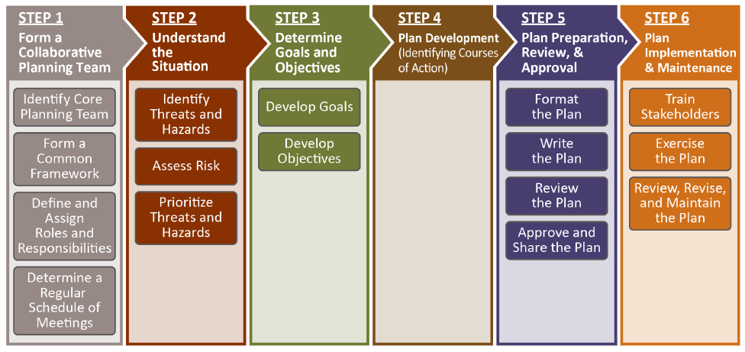
Connection to the Six Step Planning Process
Notes:
At this point in the presentation, we are transitioning into how infectious disease planning fits into the overall emergency operations planning process.
As a brief reminder, this six step process guides an emergency operations planning team through the development of a high-quality EOP.

Slide 10

Step 1: Form a Collaborative Planning Team
Members of the collaborative planning team should include:
  School nurse/state school nurse consultant
  State and local public health officials
  State education agency officials
  School administrators, board members, and faculty
  School custodians, food service, transportation officials, and human resources representative
  Student and family representatives
  Local health care practitioners
Notes:
Step 1 of the planning process is “Form a Collaborative Planning Team.” Lessons learned indicate that operational planning is best performed by a team. Close collaboration between schools and community partners ensures the coordination of efforts and the integration of EOPs. With respect to the effective emergency management of infectious diseases in schools, it is important that education and public health officials work together to create a high-quality school EOP.
Example demonstrating the importance of collaboration:
The 2009 H1N1 flu outbreak demonstrated the critical role of partnerships, surveillance, communication, and planning. In particular, school and public health officials worked together closely to respond to the outbreak and its many serious and difficult challenges. Through these partnerships, resources were disseminated (e.g., school response guidance, school-located vaccination sites); campaigns were launched (e.g., efforts to stop the spread of the flu); and efforts were made to continually monitor the impact of H1N1 on local communities nationwide.
10

Slide 11
Step 2: Understand the Situation
Identify threats and hazards.
  List should include: infectious diseases (e.g., pandemic influenza, drug-resistant tuberculosis, Staphylococcus aureus, and meningitis)
Assess the risk of identified threats and hazards.
  The capacity assessment will yield data on which of the school’s inventory of supplies can be used to help prevent the transmission of infectious diseases.
Notes:
Step 2 in the planning process prompts the planning team to identify the threats and hazards that are likely to affect the school and community. Although the threats and hazards identified by each school are different, all schools should consider including infectious diseases in their lists of hazards.
Schools should use a variety of assessments to determine the risk of their identified threats and hazards. For infectious diseases in particular, a capacity assessment may be useful for learning about what supplies the school currently possesses that could potentially limit the spread of infectious diseases, such as the following:
Personal hygiene supplies: soap, paper towels, tissues;
First aid supplies: bandages, antiseptics; and
Cleaning supplies: disinfectants.

Slide 12
Steps 3 & 4: Develop Goals and Objectives, Identify Courses of Action
Step 3: Determine Goals and Objectives and Step 4: Plan Development (Identify Courses of Action) will reveal a need for a multiple measures to maintain the health of students and staff.
Some of the courses of action may be grouped into functional annexes that address multiple types of emergencies, while other courses of actions (such as those for infectious diseases) may have an annex devoted exclusively to them.
Notes:
In Steps 3 and 4, the planning team will develop goals and objectives for each of the threats and hazards identified in Step 2, including infectious diseases, and then will develop courses of action for accomplishing each of the objectives.

Slide 13
Functional Annexes and Threat- and Hazard-Specific Annexes
FUNCTIONAL ANNEXES
BASIC PLAN
THREAT- AND HAZARD-SPECIFIC ANNEXES
SCHOOL EOP
Communications and Warning Annex
COOP Annex
Public Health, Medical, and Mental Health Annex
Infectious Disease Annex
Notes:
The work performed in Steps 3 and 4 will reveal the need to include infectious disease planning into both functional and hazard-specific annexes.
As a reminder, the traditional format of an EOP has three major sections: the Basic Plan, Functional Annexes, and Threat- and Hazard-Specific Annexes.
(1) The Basic Plan section of the school EOP provides an overview of the school’s approach to emergency operations.
(2) The Functional Annexes section details the goals, objectives, and courses of action of essential functions (e.g., evacuation, lockdown, communications, etc.) that apply across multiple threats or hazards.
(3) The Threat- and Hazard-Specific Annexes section specifies the goals, objectives, and courses of action that a school will follow before, during, and after a particular type of threat or hazard (e.g., hurricane, active shooter, fire).
The annexes related to infectious disease planning include the following:
Infectious Disease Annex – This hazard-specific annex describes the courses of action that are unique to infectious diseases in schools.
Communications and Warning Annex – This functional annex includes communication and coordination during emergencies and disasters (both internal communication and communication with external stakeholders) as well as the communication of emergency protocols before an emergency and communication after an emergency. The Communications and Warning Annex is particularly relevant to managing infectious disease outbreaks, since schools will need to have protocols in place to effectively communicate with internal and external stakeholders before, during, and after the outbreak.
Continuity of Operations (COOP) Annex – This functional annex describes how a school and district will help ensure that essential functions continue during an emergency and its immediate aftermath. Essential functions include: business services (payroll and purchasing), communication (internal and external), computer and systems support, facilities maintenance, safety and security, and continuity of teaching and learning. In considering how an infectious disease outbreak may lead to prolonged school closures, the COOP Annex is particularly useful for addressing continuity of teaching and learning.
Public Health, Medical, and Mental Health Annex – This functional annex describes the courses of action that the school will follow to address emergency medical (e.g., first aid), public health, and mental health counseling issues. Schools should coordinate these efforts with the appropriate emergency medical services, public health, mental health, law enforcement, fire department, and emergency management representatives.
The next several slides address key considerations for the content of each of these annexes.

Slide 14
Infectious Disease Annex (1 of 12)
A hazard-specific annex that describes the courses of action needed to address infectious diseases in schools — before, during, and after an outbreak.* This annex should:
Take into account multiple diseases;
Decrease exposure to the disease;
Limit the disruption of day-to-day learning activities;
Adapt to evolving knowledge and guidance;
Support individuals with disabilities, and others with access and functional needs; and
Include a continuum of response measures that address multiple scenarios—a single case, an outbreak, an epidemic, or a pandemic—and varying degrees of severity of symptoms.
Notes:
*The term “outbreak” is used loosely here. “Epidemic” or “pandemic” can be used instead if a given infectious disease was officially determined to have reached the levels ascribed to those terms.

Slide 15
Infectious Disease Annex (2 of 12)
  Before an outbreak occurs, schools and districts should create and enforce effective policies, such as the following:
  Ensure hand-washing policies and procedures are in place;
  Provide education regarding cough and sneeze etiquette;
  Review and update routine cleaning and sanitation policies;
  Review policies and practices related to handing animals in school or on field trips; and
  Ensure students are appropriately vaccinated.
Notes:
The next few slides address policies that should be put in place and enforced before an infectious disease outbreak occurs.
Infectious disease policies vary widely. They may focus on simple exclusion criteria, considerations about students with chronic infectious diseases, such as HIV/AIDS and hepatitis, or on staff with infectious diseases. A comprehensive policy should be documented and include a range of considerations.
Documented policies foster stability, inform the school community, and provide planned and consistent prevention and intervention.
School boards may need to review and approve policies, but if policies are pursued in collaboration with the public health department, these may be easier to pass.
Another important consideration is how widely-known the policies are. If they only exist in the central office, are they effective and useful policies?
Questions:
Does your district currently have infectious disease policies?
What are they?
What do they include?

Slide 16

Infectious Disease Annex (3 of 12)
Time to wash hands;
Hand washing supplies;
Hand washing techniques; and
Routine communications and awareness campaigns.
Hand washing policy and procedure considerations:
Notes:
Ensure hand washing policies and procedures are in place:
Time to wash hands.
Hand washing supplies are readily available.
Teach students and teachers how to wash hands properly.
Routinely communicate and launch awareness campaigns.
Hand washing technique (should take at least 20 seconds, while singing “Happy Birthday” twice, or while singing the Alphabet song once):
Use soap and running warm water.
Rub hand vigorously as you wash.
Wash all surfaces of hands, including front and back, wrists and fingernails.
Rinse hands well.
Dry hands well.
If using a paper towel, use the towel to turn off the faucet. (Don’t use clean hands when touching the faucet to turn it off).
Encourage hand washing:
After coughing, sneezing, wiping noses, cleaning up messes.
After using the toilet.
After diaper-changing.
Before eating and drinking.
After handling animals.
Whenever hands are dirty.
Hand sanitizers may be used if there is no visible dirt on hands, but it should not replace hand washing if facilities are available. Hand sanitizers must be used by keeping hands wet for 10-15 seconds while rubbing vigorously.
Although hand washing seems obvious, for some schools and districts, it can be a major challenge. Not only are supplies needed, but administrative issues can arise that may make hand washing policies difficult to put into effect. For example, having teachers available to monitor bathrooms if hand washing facilities are not available in the classroom. Also, making accommodations for students with special needs who may need assistance when washing hands or who may need special faucets if they have physical limitations. All of these may hinder hand washing efforts. We do know, however, that hand washing is one of the most effective means of mitigating the spread of disease.

Slide 17

Infectious Disease Annex (4 of 12)
  Cough and sneeze etiquette considerations:
Teach students and teachers to cough/sneeze into their elbow or to use a tissue;
Teach students and teachers how to properly dispose of tissues; and
Routinely communicate and launch awareness campaigns.
Notes:
Examples of healthy etiquette and hygiene include:
Covering your cough and sneeze;
Washing your hands frequently and thoroughly with soap and water or using hand sanitizer;
Avoiding touching your nose, mouth, and eyes; and
Maintaining a healthy lifestyle—eating well, staying active, and getting plenty of sleep.
The CDC offers schools numerous, free awareness resources (e.g., posters, signs, social media tools) promoting healthy hygiene and etiquette. The Cover Your Cough campaign is one example.
As a result of its response to the 2009 H1N1 flu outbreak, the CDC also makes available specific resources—including communication toolkits, posters, and social media tools—for schools to promote general habits for good health. The CDC also makes available critical infection control policies that can be put into effect during an outbreak or pandemic.
17

Slide 18


Infectious Disease Annex (5 of 12)
Routine cleaning and sanitizing policy considerations:
  Routinely clean and disinfect the following:
    Frequently touched surfaces; and
    Resources shared frequently (toys, musical instruments).
  Ensure appropriate practices by doing the following
    Using products properly (as directed on the label);
    Providing training; and
    Following safe chemical management policies.
Notes:
Schools should have clear policies for cleaning and disinfecting regularly touched surfaces and other areas in a school. These tasks should not be left to classroom teachers, nor should the collection of supplies be delegated to the Parent Teacher Association (PTA).
Products should be used as indicated on the label. Many times, products are not used correctly and their effectiveness is undermined.
Schools should work with local public health officials to determine which supplies they would need during an outbreak and how to design appropriate outbreak-specific cleaning routines.
The school plan should put in place a program to collect, evaluate, and continually maintain sufficient supplies.
Supplies programs should support:
Healthy hygiene and cleaning programs (soap, paper towels, sanitizing chemicals, etc.);
An increase in prevention measures; and
Possible vaccination clinics.

Slide 19


Infectious Disease Annex (6 of 12)
Animal-handling policy and practice considerations:
Review policies and practices related to handling animals in school or on field trips, as some animals carry bacteria, such as Salmonella*;
Students should always wash hands after handling animals; and
Routinely communicate and launch awareness campaigns.
Notes:
Because of the risk of Salmonella and other infectious diseases, some schools prohibit the presence of live animals on their premises.
Questions:
Does your district have education and outreach campaigns that support health policies such as good, healthy hygiene and etiquette? How about for the handling of animals?
Does your district use the free materials provided by the CDC? Customized materials?

Slide 20
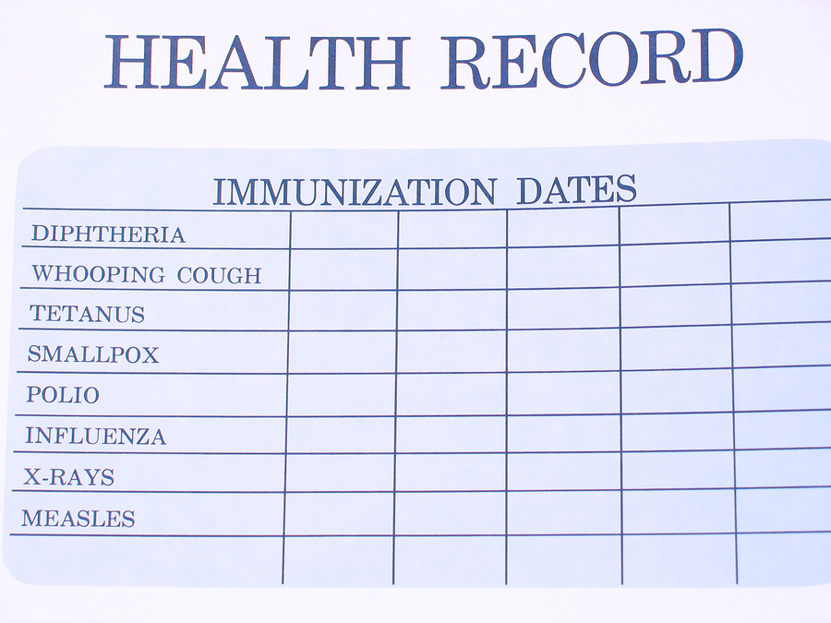
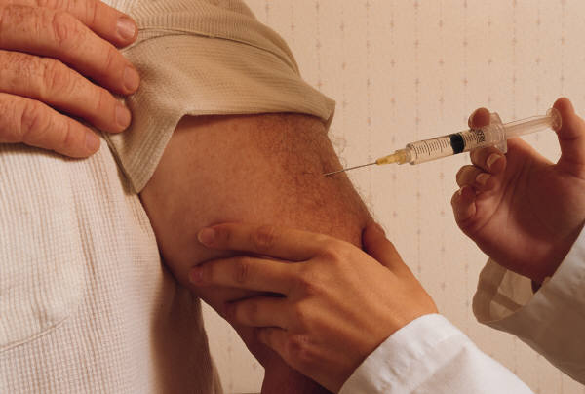
Infectious Disease Annex (7 of 12)
Ensure students are appropriately vaccinated by doing the following:
  Develop immunization policies and practices;
  Continually assess student vaccination records; and
  Provide school-located vaccination clinics (SLVs).
Notes:
Immunizations protect students against a set of infectious diseases, including measles, mumps, rubella, pertussis, and meningitis. If most of the students in the school are fully immunized, there is some degree of “herd immunity,” which is protective of the whole community. However, if there are large enough pockets of unimmunized or under-immunized students, it is possible for there to be an outbreak of these diseases. For example, in 2005, a large outbreak of measles sickened 34 people ranging in ages from 9 months to 49 years of age. The source of the transmission was an unvaccinated 17-year-old girl who had done some volunteer work in Romania. Only two of the 34 people infected were vaccinated.
Develop immunization policies and practices:
All states require that students be fully immunized (this typically includes immunization for measles, mumps, rubella, pertussis, Hib, diphtheria, and others) before attending school and that they provide proof of immunization.
Exemptions are sometimes available for medical, religious, personal, or philosophical reasons, but availability of and requirements for these waivers vary by state.
Laws for specific states can be found at: http://www.immunizationinfo.org/vaccineInfo/index.cfm#state.
Continually assess student vaccination records:
The monitoring of student immunization records is instrumental in reducing vaccine-preventable outbreaks.
Student immunization records should be checked, preferably by a school nurse. The records of children who have not received vaccinations because of medical, religious, or philosophical reasons should be flagged so that the school can contact the parent/guardian should an outbreak occur.
Provide SLVs:
Many schools serve as seasonal flu vaccination sites.
Many more schools became vaccination sites during the H1N1 pandemic.
Schools offer access to a large number of students in a single setting; vaccinations can be easily provided to students and staff if they so desire and it is deemed appropriate.
Feasibility varies from community to community and is dependent upon local capacity.
Schools should work with their community partners to determine the circumstances under which the school may serve as a vaccination site.
Question for Audience: Did your district host SLVs? What experiences did your district have with these?

Slide 21
Infectious Disease Annex (8 of 12)
During an outbreak, schools and districts should put into effect multiple response measures, including the following:
Promote early treatment for those who may be at higher risk;
Advise the sick to stay home from school and school events;
Conduct active screening for illness at school;
Separate sick students and staff at school;
Increase social distances within the school environment;
Adapt attendance policies; and
Consider school dismissals.
Notes:
At this point, we are going to transition to a discussion about how the Infectious Disease Annex should address infectious diseases during an outbreak. The next few slides outline a variety of protocols for responding to an infectious disease outbreak.

Slide 22
Infectious Disease Annex (9 of 12)
During an outbreak, schools and districts should work with public health officials to monitor the situation by doing the following:*
  Identify the source of outbreak, scale, and case definition to determine the required response and the level of infectiousness;
  Identify an unusual cluster of the disease (i.e., an unusually high number of absences); and
  Develop a case definition:
    Who is sick?
    When did they get sick?
    What are the symptoms?
    Are new people getting sick?
Notes:
*This activity overlaps with the courses of action described in the Public Health, Medical, and Mental Health Annex.

Slide 23
Infectious Disease Annex (10 of 12)
Enforce effective policies
Enforce exclusion guidelines consistently and adapt attendance policies as necessary: | Types of school dismissals include:
Permit students and staff at higher risk for flu complications to stay home; Advise students with sick household members to stay home; and Extend the time that sick people stay home. | Selective dismissals, which prevent the spread of disease to vulnerable communities; Reactive dismissals, which occur when schools are not able to maintain normal functioning; and Preemptive dismissals, a proactive strategy to decrease the spread of disease.
Notes:
Exclusion guidelines generally stipulate:
Conditions that would keep children home from school (e.g., vomiting, diarrhea, fever); and
How long students should remain home after feeling better or after symptoms end.
Exclusion guidelines may need to be altered during specific outbreaks (e.g., norovirus, H1N1). If the health department doesn‘t have such a chart of exclusion guidelines, work with them or local health practitioners to develop one.
Examples of exclusion guidelines are as follows:
Students who have a sick household member should stay home for 5 days from the day the first household member got sick. This is the time period they are most likely to get sick themselves.
If flu severity increases, people with flu-like illness should stay home for at least 7 days, even if they have no more symptoms. If people are still sick, they should stay home until 24 hours after they have no symptoms.
The team can work to balance the risks of disease in their community with the disruption that dismissals will cause in both education and the wider community. This should be based on the goal of reducing the number of people who become seriously ill or die from the disease, with the added goal of minimizing social disruption and safety risks to children.
However, the plan should be adaptable to any specific guidance that the CDC and the U.S. Department of Education (ED) set forth during a pandemic.
To close or not to close?
Review legal authorities for school closures during declared emergencies and non-emergencies.
Depending on the severity and transmissibility of the illness, and the number of affected students or staff, schools may decide to close down to mitigate disease transmission or until enough students or staff are healthy enough to return to school.
For some viruses, schools may need to close only for a few days, while in other cases, such as a severe influenza pandemic, schools may need to close for several weeks or even months.
Questions: What are the exclusion guidelines in your district? Are they known to all staff? Are they practiced by staff and parents?

Slide 24
Infectious Disease Annex (11 of 12)
Work with health officials to determine appropriate protocols for identifying and separating students and staff:
Actively screen for illness before and during the school day; and
Increase social distances within the school environment.
Notes:
Actively screen for illness:
Check students and staff for symptoms when they get to school in the morning. Then, separate those who are sick, and ask them to go home as soon as possible.
Throughout the day, staff should be vigilant in identifying students and other staff who appear to be sick.
Increase social distances within the school environment:
The CDC encourages schools to try innovative ways of separating students. These can be as simple as moving desks farther apart or cancelling classes that bring together children from different classrooms.
Students and staff who develop symptoms of infection at school will need care and attention. Furthermore, keep sick persons separated from others until they can go home or be transferred to an alternative setting for care or treatment.

Slide 25
Infectious Disease Annex (12 of 12)
After an outbreak, schools and districts should:
Determine if school facility needs remediation before it can reopen; and
Determine process for re-opening schools or reconvening students by
  Following policy regarding re-opening of school and be sure to follow medical/health department advice;
  Communicating with parents, students, staff, and media*; and
  Assessing achievement during dismissals and absences.
Notes:
At this point, we are going to transition to the final section of the Infectious Disease Annex—how schools should address infectious diseases after an outbreak.
One factor that may determine whether or not a school facility needs remediation before it can reopen is if the school was used for a vaccination clinic, or some other health-related purpose.
*Communicating with parents, students, staff and media will be tied to the Communications Annex.

Slide 26
Communications and Warning Annex (1 of 2)
Includes communication and coordination activity during emergencies and disasters
 | Key considerations related to infectious diseases
Before | Create templates Identify spokespersons Promote good hygiene practices
During | Continuously inform stakeholders on updates
After | Outcome of the emergency, changes for the future
Notes:
Communications Annex – This functional annex includes courses of action for: (1) communication and coordination during emergencies and disasters (both internal communication and external communication with stakeholders); (2) communication of emergency protocols before an emergency; and (3) communication of protocols after an emergency. The Communications Annex is particularly relevant to managing an infectious disease outbreak, since schools will need to have protocols in place to effectively communicate with internal and external stakeholders before, during, and after the outbreak.
Schools will be a key source of accurate and timely information about a variety of threats and hazards, including infectious diseases. As with all threats and hazards, a communications strategy may change and evolve on an ongoing basis. It is important to have a strong Communications Annex to adequately address the need for communication before, during, and after an emergency.
Before an outbreak:
Create templates for letters to send to the school community related to a variety of outbreaks.
Identify appropriate spokespersons (e.g., school superintendent, board of education members, school or district nurse, public information officer). These may not be the same spokespersons you use during other school emergencies. Ensure that spokespersons have opportunities to practice their roles in advance.
Promote awareness of healthy hygiene and respiratory etiquette.
During an outbreak, continually inform students, staff, and families about the following:
Characteristics of the disease;
Methods for detecting the disease;
Current and possible future response measures;
Any positive aspects related to the situation, even if to let them know there are no changes;
Healthy hygiene and etiquette, and include reminders.
After an outbreak:
Inform students, staff, and families of the outcome of the emergency, as well as practices that will be implemented to prevent such an outbreak in the future.

Slide 27
Communications and Warning Annex (2 of 2)
Key considerations for developing a Communications Annex to effectively addresses infectious disease outbreaks, as well as other threats and hazards, include the following:
Incorporate recommended practices for effective communication:
Ask for input from knowledgeable practitioners;
Be consistent with communication efforts;
Coordinate communication;
Consider the target audience; and
Consider multiple communication methods.
Use pre-determined spokesperson(s);
Notes:
Communications should come from the pre-determined spokesperson(s).
The emergency manager, key administrators, and school nurse should all provide input on communications.
Consistent information is vital.
It is important to make sure that information is coordinated between individual schools (if more than one school is involved), the central or district school office, and the local/state health department.
Consider the target audience when developing communications plans (i.e., the school emergency management team, the school community, community partners, and the media).
Consider multiple communication methods (e.g., email, letters, Website updates, and press releases).

Slide 28
Continuity of Operations (COOP) Annex
Describes how a school and district will help ensure that essential functions continue during an emergency and its immediate aftermath, including teaching and learning.
In the event of prolonged absences or school closures due to an infectious disease outbreak, schools can decide to provide continuity of learning services by doing the following:
Using a variety of instructional services (low-tech to high-tech);
Including formative and summative assessments; and
Providing instruction to individuals, small groups, or large groups.
Notes:
Continuity of Operations (COOP) Annex – This functional annex describes how a school and district will help ensure that essential functions continue during an emergency and its immediate aftermath. Essential functions include: business services (payroll and purchasing), communication (internal and external), computer and systems support, facilities maintenance, safety and security, and continuity of teaching and learning. In considering how an infectious disease outbreak may lead to prolonged school closures, the COOP Annex is particularly useful for addressing continuity of teaching and learning.
States, districts, schools, and additional partners should work together to create programs and resources to develop continuity of learning programs.
Schools and districts should reach out to families to let them know about the program, and inform them about student and family expectations.
It is important to keep issues of access in mind when developing your continuity of education plans. A broad array of both technological and non-technological opportunities may be used to provide for continuity of education during school closures. This may include the use of radio or public broadcast television stations, conducting class via telephone conference calls, phone tutoring, or sending “educational packets” to students’ homes. All of these materials can be developed ahead of an emergency and, in the event of an extended closure, can then be on hand for easy distribution. A combination of both may supplement traditional education, allowing students to maintain skills while they remain at home.
Questions for the audience:
Has your district begun continuity of learning programs?
What kind of instruction delivery and methods are being used? Packets? Email? Websites?
Does your program assess achievement? Does it include students with individualized education programs (IEPs)?

Slide 29
Public Health, Medical, and Mental Health Annex
Describes the courses of action that the school will implement to address emergency medical (e.g., first aid), public health, and mental health counseling issues.
Includes infectious diseases reporting and surveillance focused on the following:
Work with local health department to determine roles and responsibilities in disease reporting and surveillance: | Create and maintain surveillance systems:
Which communicable diseases must be reported in your state? Measles? TB? To whom does your school report a disease outbreak? | Determine roles and responsibilities of all surveillance partners Assess the current system and determine what it monitors
Notes:
Public Health, Medical, and Mental Health Annex – This functional annex describes the courses of action that the school will follow to address emergency medical (e.g., first aid), public health, and mental health counseling issues. Schools should coordinate these efforts with the appropriate emergency medical services, public health, mental health, law enforcement, fire department, and emergency management representatives. This annex relates specifically to infectious diseases. It should include courses of action that support the surveillance and reporting of infectious diseases to the local and state public health departments.
Surveillance systems can range between noting absences that reach a certain threshold or tracking absences in partnership with the health department. Some districts have school health nurses call families to see why students are absent and if symptoms or illnesses are similar.
The monitoring and surveillance system should collect data daily and facilitate daily analysis of this data. The objective is to quickly identify any significant increases or decreases in absenteeism.
Schools should have in place a process for sharing this information with the local public health department so that they are alerted when there is a significant increase in student absenteeism due to infection.
In addition, your emergency management team should look to see if there is an existing state or regional monitoring and surveillance system, and link to it when possible. A state system may be able to support the school plan if you do not already have a system in place.
A list of Nationally Notifiable Diseases can be found at: http://www.cdc.gov/ncphi/disss/nndss/PHS/infdis2009.htm.
Question for Audience: Please describe the surveillance systems in your district.
The reporting and surveillance systems should include policies and protocols:
It is essential to define information-collection and information-sharing procedures among partners at all necessary levels and with all necessary agencies.
Make sure these procedures adhere to the Family Educational Rights and Privacy Act (FERPA) and Health Insurance Portability and Accountability Act (HIPAA) guidelines.

Slide 30
Steps 5 & 6: Plan Preparation, Review, Approval, Implementation, and Maintenance (1 of 2)
Revise the plan, as needed, and share with stakeholders:
  School and district officials
  Personnel from key departments with role in preventing and responding to infectious diseases (e.g., school nurse and public health officials)
Notes:
After determining the goals, objectives, and courses of action related to infectious diseases that will populate the different threat- and hazard-specific and functional annexes, the planning team is ready to move to Step 5: Plan Preparation, Review, & Approval, and Step 6: Plan Implementation & Maintenance.
As with the rest of your EOP, it is important to regularly review and revise the various annexes pertaining to infectious diseases in schools, and to share this information with key personnel and stakeholders.

Slide 31
Steps 5 & 6: Plan Preparation, Review, Approval, Implementation, and Maintenance (2 of 2)
Train and exercise the plan to validate infectious disease planning.
Train staff on the EOP, including on the section about roles and responsibilities (this should be aligned with NIMS/ICS).
As required by the Occupational Safety and Health Administration, train staff annually on universal precautions; train new staff upon employment. Ensure all staff are prepared with necessary supplies (e.g., gloves).
Test plans regularly, using both tabletop exercises, full-scale drills, and real-world situations.
Notes:
Train staff on the EOP, including on what their roles and responsibilities will be for preventing and responding to an infectious disease outbreak. Roles and responsibilities of different school and district staff should be aligned with the National Incident Management System (NIMS), and in particular, the Incident Command System (ICS), or the standardized, on-scene, all-hazards incident management approach that:
Allows for the integration of facilities, equipment, personnel, procedures, and communications operating within a common organizational structure;
Enables a coordinated response among various jurisdictions and functional agencies, both public and private; and
Establishes common processes for planning and managing resources.
Be sure to also train staff on universal precautions. This is an approach to infection control that treats all human blood and certain bodily fluids as if they were known to be infectious for HIV, HBV, and other blood borne pathogens.
Regularly exercise the EOP, using both tabletop exercises, full-scale drills, and real-world situations.
Tabletop exercises should be done to determine how quickly an outbreak would be detected, how quickly and efficiently the ICS would be activated, and how communications systems would be used.
If events occur in your district, or in nearby districts, treat the situation as you would any other hazard, and make sure that your team debriefs.

Slide 32
Outstanding Issues
  Consider formal partnerships between districts/schools and community partners to assess joint capabilities and share expertise in support of the plan.
    Create Memoranda of Understanding (MOUs) or Memoranda of Agreement (MOAs) with other agencies.
    The roles and responsibilities of partners should be clearly defined.
    All partner plans should be aligned.
    Review policies periodically.
  Ensure all plans include information-collection and sharing of procedures among partners that adhere to FERPA and HIPPA.
Notes:
Ensure that all regulations are appropriately addressed, including FERPA and HIPAA.
These regulations may limit what information can be shared with the school target audience or the media.
For more information on HIPAA, visit http://www.hhs.gov/ocr/privacy/.
For more information on FERPA, visit http://www.ed.gov/policy/gen/guid/fpco/ferpa/index.html.

Slide 33
Summary
Schools should consider a variety of diseases when incorporating infectious disease planning into their school EOPs.
Schools should be prepared to enforce multiple response measures to support the community in the event of a mild to severe outbreak affecting large and small portions of the population.
Planning should be based on close collaboration with local public health officials.

Slide 34
Next Steps
What are three things you learned from this presentation?
How can you implement these at your school or district?
What steps will you take to implement these changes in your school EOP?
Notes:
Encourage participants to think through the three main ideas that were most relevant or impactful for them, such as things they learned that revealed a need they have, or a way they can enhance the planning efforts already in place.
Then, encourage participants to think through the steps they will take upon returning to their school/district to set these changes into motion, and how to see them through to completion/implementation. Who will they need to bring on board? What is needed to put these changes into place—training, equipment, manpower? How will these changes be maintained?

Slide 35
Further Information
http://rems.ed.gov
Join our Community of Practice!
Access Virtual Trainings
Get the Guide
Request an
On-site
Training
Phone: (855) 781-7367 (REMS)
Email: info@remstacenter.org

Slide 36
Acknowledgements
Thank you to the original authors and contributors who developed and reviewed content for this presentation:
Dana Carr, Director, Health, Mental Health, Environmental Health and Physical Education Programs, Office of Safe and Drug-Free Schools, U.S. Department of Education
Vicki Taliaferro, RN, BSN, NCSN, School Health Consultant
This presentation was updated on September 17, 2014.
This presentation was prepared for the U.S. Department of Education under Contract Number EDESE12O0036 with Synergy Enterprises, Inc. Madeline Sullivan served as the contracting officer’s representative for the Readiness and Emergency Management for Schools (REMS) Technical Assistance (TA) Center. No official endorsement by the U.S. Department of Education of any product, commodity, service, or enterprise mentioned in this presentation is intended or should be inferred. For the reader’s convenience, this presentation contains information about and from outside organizations, including hyperlinks and URLs. Inclusion of such information does not constitute an endorsement by the Department.

