Slide 1



Ill-defined and Unknown Primaries

Slide 2

Last Resort Sites

Slide 3
General Rules
Consult the physician to assign the site code
  Assume the hospital registrar has done this
Consult with QA or management staff
Use the NOS category for the organ system or the Ill-Defined Site codes (C760-C768)
Assign the NOS code for the body system when there are two or more possible primary sites documented and all are within the same system
  Example: Two possible sites are documented in the GI system such as colon and small intestine; code to the GI tract, NOS (C269). Document the possible primary sites in a text field.
Some histology/behavior terms in ICD-O-3 have a related site code in parentheses; for example, hepatocellular carcinoma (C220)
  Use the site code suggested by ICD-O-3 when there is no information available indicating a different primary site
Code unknown primary site (C809) when there is a physician statement of unknown primary when none of the above can be applied or if there is no information to assign an ill-defined site category

Slide 4
Types of Ill-Defined Primary Sites
Organ System:
  C06.9: Mouth, NOS
  C11.9: Nasopharynx, NOS
  C13.9: Hypopharynx, NOS
  C24.9: Biliary Tract, NOS
  C26.9: Gastrointestinal Tract, NOS
  C39.0: Upper Respiratory Tract, NOS and C39.9: Respiratory Tract, NOS
  C44.9: Skin, NOS
  C47.9: Autonomic Nervous System, NOS
  C49.9: Soft Tissue, NOS
  C57.9: Female Genital, NOS
  C63.9: Male Genital, NOS
  C68.9: Urinary System, NOS
  C72.9: Nervous System, NOS
  C75.9: Endocrine Gland, NOS

Slide 5
Types of Ill-Defined Sites
Body System:
  C76.0: Head and Neck, NOS
  C76.1: Thorax, NOS
  C76.2: Abdomen, NOS
  C76.3: Pelvis, NOS
  C76.4: Upper Limb, NOS
  C76.5: Lower Limb, NOS
  C76.7: Other Ill-Defined Sites
  C76.8: Overlapping Ill-Defined Sites

Slide 6
Types of Ill-Defined Sites-Defaults
C24.1: Ampullary/peri-ampullary
C44.5: Anal Margin
C21.1: Anal Verge
C16.2: Angle of Stomach
C16.3: Angular Incisura of Stomach
C06.8: Book-leaf-lesion (mouth)
C44.5: Clavicular Skin
C00.0: Colored portion of lip
C44._: Cutaneous Leiomyosarcoma
C72.0: Distal Conus
C02.1: Edge of Tongue
C71.8:Frontoparietal (brain)
C16.3: Gastric angular Notch
C48.1: Gastrohepatic Ligament
C25.0: Genu of Pancreas
C10.9: Glossotonsillar Sulcus
C16.3: Incisura, incisura angularis
C34.9: Infrahilar Area (Lung)
C71.0: Interhemispheric Fissure (cerebrum)
C02.3: Lateral tongue
C70.9: Leptomeninges
C76.0: Masticator Space
C44.9: Melanoma, NOS
C44.6: Nail Bed, Thumb
C26.9: Pancreatobiliary
C49.0: Parapharyngeal Space
C24.0: Perihilar Bile Duct
C62.1: Testis, undescended post orchiopexy
C25.0: Uncinate of Pancreas

Slide 7
Head & Neck Primaries
There are codes for some non-specific head & neck sites
  C009: Lip, NOS
  C029: Tongue, NOS
  C049: Floor of Mouth, NOS
  C05: Palate, NOS
  C069: Mouth, NOS
  C089: Major Salivary Gland, NOS
  C099: Tonsil, NOS
  109: Oropharynx, NOS
  C119: Nasopharynx, NOS
  C139: Hypopharynx, NOS
  C140: Pharynx, NOS
  C142: Waldeyer Ring*
  C148: Overlapping Lip/Oral Cavity/Pharynx

Slide 8
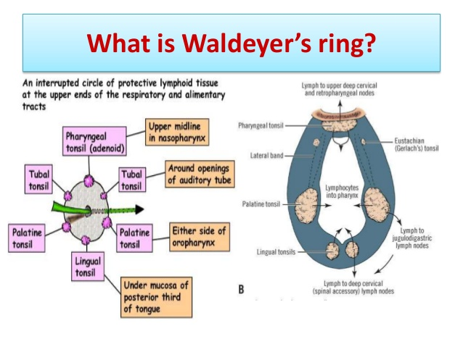

Slide 9
Head & Neck Primaries
Assign C760 for Occult Head and Neck primaries with positive cervical lymph nodes. Schema Discriminator 1: Occult Head and Neck Lymph Nodes is used to discriminate between these cases and other uses of C760.
  This is a change from prior guidelines where these types of cases were coded to C148
Two categories of ill-defined head and neck primaries
  Subsite, NOS
    Can be staged using general staging guidelines for the subsite
  True occult primaries
    Can only be staged as occult H&N
    Must be EBV and HPV (-) to stage
    Use SSDI discriminator codes

Slide 10
True Occult H&N Primaries
AJCC Chapter 6
  Applies to SCC and salivary gland carcinoma of all Head & Neck sites, except:
    Nasopharyngeal cancer (Chapter 9)
      Epstein-Barr Virus (EBV): EBV positive cancers are associated with nasopharyngeal cancer. If the EBV (EBER) test is done and is positive, the primary site should be assigned to C119 (nasopharynx, NOS) instead of C760, so that the Nasopharynx staging system can be used. Nasopharynx has a T0, for no evidence of primary tumor
    HPV-related oropharyngeal cancer (Chapter 10)
      p16: p16 positive cancers in the head and neck are associated with oropharyngeal cancer. p16 is a surrogate marker for Human Papilloma Virus (HPV).
      If the p16 test is done and positive (and EBV is negative or unknown), the primary site should be assigned to C109 (oropharynx, NOS) instead of C760, so that the Oropharynx staging system can be used. Oropharynx has a T0, for no evidence of primary tumor.
      Note: p16 is the only test that can be used for this discriminator. If there is another HPV test that is positive, the p16 would still be negative for purposes of this data item.
    Melanoma (Chapter 47)
    Mucosal melanoma (Chapter 14)
    Thyroid carcinoma (Chapters 73 & 74)
    Soft tissue sarcoma (Chapter 40)
    Eyelid (Chapter 64)

Slide 11
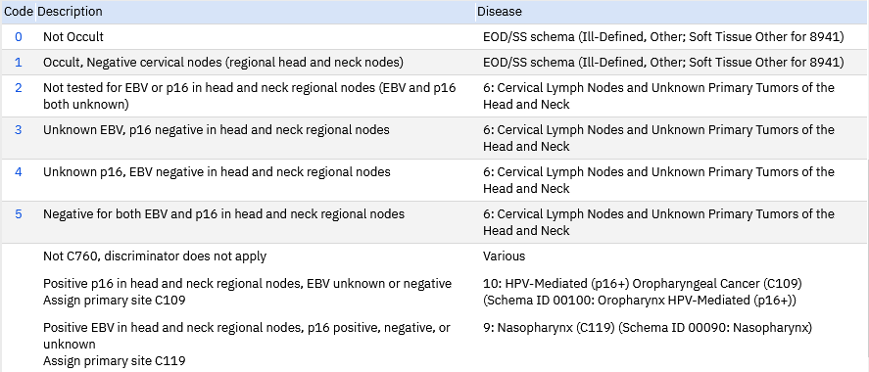
Determining H&N Site
Requires use of SSDI Manual (..\..\NAACCR References\SSDI Manuals)
  Use SSDI 1 to determine appropriate primary site
  Codes 0, 1: Ill-defined, Other; Soft tissue Other for
    8941
  Codes 2-5: Cervical lymph nodes and unknown primary of H&N

Slide 12
Head & Neck, NOS (C76.0): Example
10/26/18 Dr A 57 yo male w new dx of a SCC of RT side of the neck. PE w palpable large right-sided neck lymphadenopathy. Planned PET and Rad Onc consult. PMH-asthma, COPD, GERD,HTN, MGUS, polycythemia Social Hx-current smoker,35.00 pk history, ETOH, yes. Pancreatic ca in mother, HT5'6" WT144lbs
09/13/18CT neck, Enlarged RT side neck nodes, multiple anterior & posterior triangle of neck, lgst is in anterior triangle approx 3cm,poterior 2cm and ext to supraclavicular region. 10/30/18 PET-multiple cervical RT LN 3x2.7cm RT level 2,3.4x2.5cm level 5 conglomerate w SUV max of 8.8. 2.6cm RT level 3 cervical node, RT supraclavicular node 17x15mm w SUV 5.3. Adjacent fat stranding in RT neck soft tissues which may be seen w extracapsular spread of malignancy. No LT cervical lymphadenopathy. No suspicious mesenteric or retroperitoenal lymphadenopathy. 07/15/19 PET, Imp states increased size&# oh hypermetabolic cervical subclavian mediastinal and pulmonary parenchymal lesions c/w worsening metastatic disease
11/1/18 LARYNGOSCOPY: VOCAL CORDS MOVED WELL W/O ANY MASSES. NO OBVIOUS LESIONS ANYWHERE W/IN LARYNX, HYPO- OR NASOPHARYNX.
11/13/18 DIRECT LARYNGOSCOPY: Base of the tongue revealed hypertrophic lymphoid tissue bilaterally. One area of suspicious looking mucosa was ID'd and multiple bx's were taken from base of tongue extending from mid portion towards Rt side of the neck. Endolarynx revealed no lesions on true vocal folds and the esophageal inlet appeared to be uninvolved w/ any disease.
10/18/18 X18-4684 SP 18-005060 Bx of RT neck LN, SCC. SCC in a fibrous background. No definite LN is seen. node. The tumor is mod diff w focal keratinization. Positivity for p40, and negative staining for p16.
9/26/18 SP18-5060 LN RT NECK BX: Squamous cell carcinoma, keratinizing, moderately-differentiated, involving dense fibrous tissue. Definitive lymph node parenchyma is not identified. p40+ p16-. 11/13/18 SP18-5971 BASE OF TONGUE BX: NED.

Slide 13
Soft Tissue-Other
Chapters 40 through 45 in AJCC 8 manual
  Limited to T, N, and M only
  No stage group
  If unknown primary site, Tx is appropriate T designation
SEER Summary Stage
  GIST
  Heart, Mediastinum, Pleura
  Retroperitoneum
  Soft Tissue Sarcomas
  SEER Summary Stage 2018 manual (..\..\SEER Program Coding Manuals\2018\2018-Summary-Stage-Manual.pdf)
  SEER EOD Refer to SEER*RSA (https://staging.seer.cancer.gov/)

Slide 14
Soft Tissue, NOS (C49.9) Example
11/3/18 MRI rt hip in Florida showed a marrow replacing lesion in the lt iliac bone & bilateral femurs has appearance of mets. 11/14/18 CT c/a/p: 5cm rt pelvic mass anterior to the sacrum suspic for malig. 11/21/18 Bone scan: confirmed multifocal metastatic lesions in bilateral ribs, lt pelvis, lt scapular & lt femur. 11/14/18 MRI abd: multiple mets in lower thoracic & lumbar vertebra. 11/7/18 CT c/a/p: LUL nodule 8mm, 12.8cm fat attenuating mass involving R pectoralis musculature positioned w/in pec major or between pec major and minor.
MLH-1, PMS2, MSH2, MSH6 NO LOSS OF EXPRESSION. PD-L1 IHC test: high expression - 50%. Per MSK tumor is pos for MDM2, weakly pos for pan-cytokeratin & has retained BAF47 (INI 1 expression). Ki67 proliferation index of 15%. FISH study - no evid of amplification fo the MDM2 & CDK4 genes, unlikely to be dedifferentiated liposarcoma. WBC - 19.9; Abs neutrophils auto - 16,577; Abs monocytes auto - 1,294; GLucose – 209
HP18-4178 20181119 DIAGNOSIS A.-B. PRESACRAL MASS, CORE BIOPSY: SPINDLE CELL FIBROBLASTIC TUMOR (FAVOR SARCOMA). 12/20/18 Bx rt pelvic mass: sarcomatoid malig neoplasm, high grade. MSKCC path review: sarcomatoid neoplasm w/focal cytokerating staining, cannot further classify.
Stage IV - bone & lung mets

Slide 15
Organ System Ill-Defined Sites
C06.9, C11.9, C13.9, C24.9, C26.9, C39.0, C44.9, C47.9, C57.9, C63.9, C68.9, C72.9, C75.9
Organ system is known, specific site is unknown
Typically present with locally advanced or metastatic disease
No AJCC Staging; SEER EOD and SS 2018 have schema
Example (C269): 77 YO FEMALE W S/P POST DX LAPAROSCOPY FOR EVALUATION OF SUSPECTED CARCINOMATOSIS. NOT FOUND PRIMARY SITE. CASE WAS PRESENTED IN GI & GYN TUMOR BOARD-RX RECOMM FOLFOX R XELOX. VS CARBOPLATIN & TAXOL. TUMOR WAS FELT TO BE AN UPPER GI/PANCREAS/BILIARY TRACT OR AN OCCULT PRIMARY. 7CK WAS POSITIVE . LUNG CA AND MESOTHELIOMA WAS R/O, BREAST CA WAS R/O. THE PT HAS MESENTERIC NODULARITY IN THE UPPER ABD AS HER PRIMARY SITE OF DISEASE. THERE IS THICKENING OF THE WALL OF THE STOMACH AT THE GE JUNCTION. PT STARTED CHEMO, XELODA. UNK PRIMARY SITE,( GI TRACK, NOS). CASE WILL BE PRESENTED AT CANCER INSTITUTE AT TUMOR BOARD ON 11/07/18. SH- FORMER SMOKER, CURRENT ETOH USE. FH- NONE.

Slide 16
Organ System Ill-Defined Sites
Example: C449: 1/21/19- Ct L spine: Multiple bony lesion susp for mets. 1/31/19-PET: Extensive bony lesions including spine and pelvic bones , at least 2 nodules with activity in LUL, susp of activity in liver, intense activity in cecum ? if lesion there. 2/21/19-Ct head: No evidence of mass or hemorrhage.
2/12/19- S19-2183: Liver core bx: metastatic melanoma, PD, (+) KRAS mutation
Example: C57.9: 11/20/18 CT abd/pelvis-a necrotic appearing RT pelvic mass containing coarse calcifications measures 9.6 x 8.4 cm, previously 6.7 x 4.9 cm in 2012. Abuts posterior aspect of uterus & displaces it anteriorly. May be uterine in origin and represent possible malignant degeneration of a pedunculated leiomyoma or this could be an ovarian neoplasm. large volume ascites, peritoneal thickening and soft tissue attenuation associated w omentum, c/w carcinomatosis (for example in LT upper quadrant )No definite enlarged abdominal or pelvic LN. 11/20/18 CT head-no acute intracranial pathology.11/20/18 CT chest-No suspicious pulmonary nodules to suggest metastatic disease to lung. Small right-sided pleural effusion.03/22/19 Ct CAP-: Stable appearance of a necrotic, partially calcified right pelvis mass which again approx.. 9.6 x 8.4 cm, continues to anteriorly displace the uterus.
1/23/18 NR18-694 Dr M SR-peritoneal fluid, cytologic material and cell block, adeno ca w numerous signet ring cells. Pax8 and CK7 are positive, CK20 negative. These findings strongly support an ovarian primary (rather than a GI primary).tumor cells are strongly and diffusely positive for p53 and p16 and weakly positive for WT1, but are negative for ER and PR. These findings indicate a high-grade serous carcinoma with possible primary sites including ovary, fallopian tube and endometrium.

Slide 17

Ill-Defined, Other and Unknown
Site codes C76.0 – C76.8; C80.9
  Only SEER Summary Stage and EOD apply
  SEER Summary Stage = ‘9’
  EOD Fields all coded to 88/888

Slide 18
Ill- Defined Sites – Body System
Example C76.2): 11-5-19: ER: PT REPORTS 1 YEAR AGO SHE NOTED A LUMP AROUND HER BELLYBUTTON. GRADUALLY GREW LARGER. STATES MASS IS MOSTLY ON LEFT SIDE OF ABDOMEN. IT HAS BEEN WEEPING FOR MONTHS. SOMETIMES WHEN SHE BENDS FORWARD THE MASS WILL BLEED. 11-25-19: PT ELECTED HOSPICE CARE
11-5-19: CT CHEST/AB/PEL: LARGE 27 x 19CM COMPLEX MASS IN THE VENTRAL ABDOMINAL PELVIC WALL WHICH APPEARS TO EXTRUDE THROUGH SKIN SURFACE W/ CYSTIC COMPONENTS EXTENDING INTO THE PERITONEAL CAVITY THRU THE VENTRAL ABDOMINAL MUSCULATURE AND FASCIA. HIGHLY CONCERNING FOR MALIGNANT. SUSPECT METASTATIC DISEASE IN LUNGS, RIGHT ADRENAL GLAND AND RIGHT RECTUS ABDOMINIS MUSCLE. NO BONY LESION. NO ADENOPATHY IN CHEST.
11-6-19: MS19-6775: LEFT LOWER QUADRANT MASS BX: POORLY DIFF / UNDIFF MALIGNANT NEOPLASM, FAVOR POORLY DIFF CARCINOMA. FAVORS CARCINOMA OR SARCOMATOID CARCINOMA

Slide 19
CUP: Cancer of Unknown Primary
The site of origin of a histologically documented carcinoma is not identified clinically in approximately 3% of patients; this situation is often referred to as CUP origin or occult primary malignancy.
The definition of a CUP varies from study to study; however, at a minimum, this determination should include a biopsy of the tumor and a thorough history and complete physical examination that includes head and neck, rectal, pelvic, and breast examinations; chest x-rays; a complete blood cell count; urinalysis; and an examination of the stool for occult blood.
When these results do not reveal signs of a potential primary lesion and the biopsy is not consistent with a primary tumor at the biopsy site, a CUP must be assumed. The majority of CUP are adenocarcinomas or undifferentiated tumors; less commonly, squamous cell carcinoma, melanoma, sarcoma, and neuroendocrine tumors can also present with a primary site of origin that cannot be determined. In approximately 15% to 25% of patients, the primary site cannot be identified even at postmortem examination.

Slide 20
Unknown Primary – C80.9
Example: 8/1/19 : 46 y/o former smoker, social ETOH, found to have met CA of unk primary, referred for dx management and goals of care, started Gemcitabine and cisplatin 7/12/19, FH: no CA
5/25/19 CT: 4mm RML nodule and mediastinal adenopathy 6/16/19 CT: showed Lt hilar mass and mediastinal and bilateral supraclavicular adenopathy 8/13/19 New and increasing right hilar lymphadenopathy for instance 1.3 cm right hilar lymph node previously measured 0.9 cm. Several new right hilar lymph nodes for instance measuring 1 cm image 241 and 1.1 cm on image 177. A 1.7 cm left hilar lymph node is minimally decreased. 1.2 cm right paratracheal lymph node previously measured 1.5 cm. A 1.2 cm subcarinal lymph node previously measured 1 cm. 0.8 cm left retro-pectoral lymph node previously measured 0.5 cm. Stable left supraclavicular lymph nodes measuring up to 1 cm.
I20190015162 2019-09-11 S19-17629 COLLECTED ON 6/26/19: A. LYMPH NODE, LEFT NECK, EXCISION: FOUR OUT OF FOUR (4/4) LYMPH NODES, POSITIVE FROM METASTATIC ADENOCARCINOMA. POSITIVE FOR EXTENSIVE LYMPHOVASCULAR INVASION. 9/15/19 DN19-4543 PERICARDIAL FLUID POSITIVE FOR MALIG CELLS, 9/18/19 DN19-4608,09 RIGHTAND LEFT PLEURAL FLUID POSITIVE FOR MALIG CELLS METASTATIC ADENOCARICNOMA 9/18/19 DS19-15651 PERICARDIUM, BIOPSY: METASTATIC HIGH-GRADE ADENOCARCINOMA INVOLVING THE FULL THICKNESS OF THE PERICARDIUM WITH A PROMINENT LYMPHOVASCULAR INVASION.

Slide 21


