Slide 1
Medical-Legal Issues and Co-Occurring Care
Charles C Dike, MD, MPH, FRCPsych
Medical Director, Office of the Commissioner, CT DMHAS
September 23, 2022

Slide 2

Disclosure
Nothing: No financial relationships

Slide 3
Overview
CT statutes/laws re Substance Abuse
Working with Probation/Parole
Confidentiality Issues – 42 CFR versus HIPAA
Federal Laws – Buprenorphine etc.
CT state Laws – Buprenorphine etc.

Slide 4

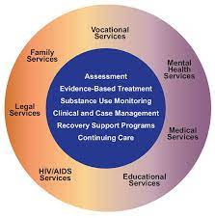



Slide 5
SUD Treatment: Standards, Regulation, DOC/DMHAS
Sec. 17a-681- broad overview of SUD Tx
Voluntary Tx preferred over Involuntary Tx
Outpatient Tx preferred over inpatient
No denial of treatment due to history of stopping Tx AMA or past relapse
Individualized Tx Plan
Continuum of coordinated care
Commissioners of DMHAS and DOC – cooperate to establish Tx program for inmates
Persons convicted of non-violent crimes/confined in lieu of bond on non-violent charges may be transferred from DOC to DMHAS if both commissioners agree

Slide 6
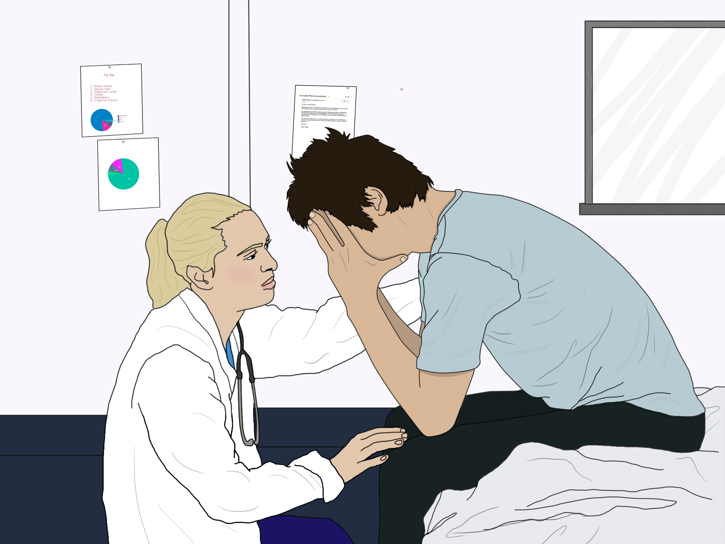
Voluntary Admission – sec 17a-682
Self application for voluntary treatment at any DMHAS facility
For minors or incompetent persons – parent, legal guardian or other legal rep may apply
Refusal of admission at a facility – refer to another DMHAS or PNP
Hospitalized pt. intends to leave AMA - encourage outpt placement and assistance with residential and support services – including transportation to home or shelter

Slide 7
Public Assistance for Intoxicated Persons Sec 17a-683
Person appears intoxicated in public – with consent, Police should assist to home or treatment facility
If incapacitated by alcohol – protective custody and take to hosp
Protective Custody is not an arrest or a crime
Reasonable effort to protect health and safety of person
Reasonable steps to protect officer
At treatment facility, med staff will determine place of treatment
If inpt. required: admit or refer for med detox OR refer to DMHAS facility for voluntary tx.
Release from hosp once no longer incapacitated or within 48hrs whichever is shorter unless pt consents to further eval/tx – 2-day paper
Inform next of kin unless prohibited by law or by pt
Assist with transfer back home or to shelter

Slide 8

Protective Custody Unit for the intoxicated

Slide 9
Emergency Treatment Sec 17a-684
Intoxicated person at time of application
Dangerous to self or others
Needs med Tx for detox for potentially life-threatening withdrawal
If incapacitated by alcohol – may be committed for emergency Tx at DMHAS facility or DMHAS approved PNP facility
Note: Requirement that person be intoxicated at the time may be waived – if a licensed MD determines the person is in immediate need of med detox/Tx for potentially life-threatening withdrawal
Refusal to accept Tx is not evidence of lack of judgment
Physician, spouse, guardian or relative may submit written application for commitment to administrator of Tx facility
Accompanied by physician certificate stating examination within the preceding 2 days and supporting rationale

Slide 10
Emergency Treatment cont.
Upon tentative approval of application and transfer of person to Tx facility, MD shall examine
Facility administrator shall accept or deny application on recommendation of MD
For admitted person, discharge person when grounds for emergency Tx no longer exists
No person admitted under this section shall be detained in the hospital facility for longer than 5 days – unless application for involuntary admission has been filed within the time frame – 5-day paper
Detain person until civil commitment hearing has occurred, but no longer than 7 business days after filing application

Slide 11
Involuntary (Civil) Commitment Sec 17a-685
Any person can apply to probate court – spouse, conservator, relative, physician or hospital administrator
The application shall state the following:
An alcohol or drug dependent person – danger to self or others when intoxicated or gravely disabled
statement from intended admitting facility – ready to admit
Includes physician certification – has examined the person within 2 days of application – including history and clinical findings
Court schedules hearing within 7 business days of the application
Court may commit person to an inpatient treatment facility for a period not less than 30 days or more than 180 day
Note: Can be any inpatient Tx facility, but facility must be able to provide adequate, appropriate treatment and likely beneficial treatment

Slide 12

Re Civil Commitment: Recommitment
At expiration of commitment, pt must be discharged automatically unless recommitment application was submitted before then
Individual may be recommitted even after the initial 180 days, if the facility applies for recommitment before the expiry date
Individuals discharged and referred to outpatient treatment facility after commitment or recommitment shall remain in outpatient tx. for a period of 12 months unless discharged earlier or recommitted to inpatient care

Slide 13



Slide 14
Working with Probation or Parole – Commissioner’s Policy
Goal: to help our patients meet conditions of probation/parole
The clinical team remains in charge of the clinical treatment.
The probation officer is not a member of the treatment team and does not participate in the full treatment planning and review process.
The supervisory responsibilities of the probation officer will be acknowledged in the Treatment Plan, including an articulation of any necessary interactions with the treatment team for which the client’s consent is required.
The treatment team will work with the client and the designated probation officer to negotiate areas of potential overlapping concern (e.g., housing, restrictions on movement, monitoring of urine toxicology screens, etc.) so that all roles and responsibilities are clear.

Slide 15




Slide 16
Confidentiality Issues
The HIPAA Privacy Rule limits use and disclosures of information found in patient records.
42 CFR Part 2 (“Part 2”) is a federal regulation that requires substance abuse disorder treatment providers to observe privacy and confidentiality restrictions with respect to patient records
Generally, 42 CFR Part 2 imposes more strict standards than does HIPAA.
Under the Part 2 general rule, providers may not disclose information in a substance abuse disorder (SUD) patient’s record, unless the provider can either obtain consent, or identify an exception to the general rule that specifically authorizes the disclosure.
https://compliancy-group.com/substance-abuse-disorder-treatment-42-cfr-part-2-and-hipaa/

Slide 17
Regarding 42CFR and private practice
42 CFR Part 2 privacy protections apply to federally assisted programs, which are substance use disorder providers and substance use disorder treatment facilities:
the care is provided in a setting that meets the definition of a program:
if they work in a standalone substance use disorder (SUD) treatment program; or
an identified SUD unit of a general medical facility; or
Facility whose primary function consists of providing SUD services.
Many practitioners in general medical facilities do not meet these criteria. Therefore, Part 2 generally does not apply to their patient records even if they have received a DATA-2000 waiver and prescribe buprenorphine. HIPAA protections still apply.

Slide 18
Exceptions to 42CFR restrictions
medical emergency.
reporting of incidents of suspected child abuse and neglect to the appropriate state or local authorities.
Communications to law enforcement agencies or officials investigating a patient’s commission of a crime on the facility or to a threat to commit such a crime.
conducting an audit or evaluation of the treatment facility that includes record review.
For Research.
Communication of info minimally necessary for qualified service organization to provide services to the facility.
When a valid court order authorizing disclosure and use of patient records is issued.

Slide 19
HIPAA vs. 42CFR Re Confidentiality
The HIPAA Privacy Rule permits disclosures without patient consent for treatment, payment, or healthcare operations. 42 CFR does not.
The two regulations also differ in the amount of privacy protections afforded or patient records in criminal and civil legal proceedings.
Under HIPAA, a provider or health plan may share protected health information if it has a court order, or, if it receives a valid subpoena from a party to the litigation requesting medical records. 42CFR’s requirements are much stricter.
Part 2 requires that a specific court order authorize disclosure of SUD records – not just a subpoena. Persons having a legally recognized interest in the disclosure – and only those persons- may apply for the court order.

Slide 20
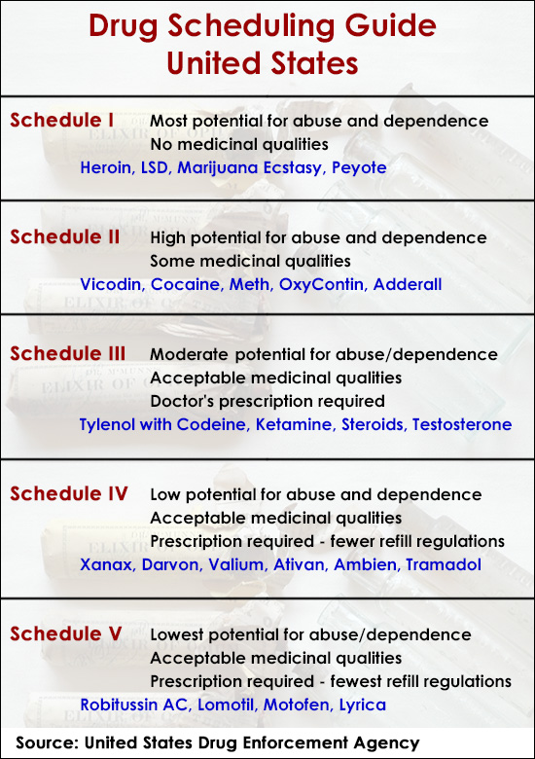
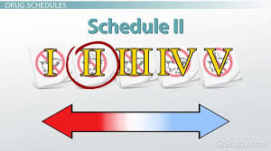


Slide 21
Brief History
1875 – illegal to smoke opium in opium dens. No ban on sale and use otherwise
1890 – federal government levied taxes on Morphine and Opium
1909 – Smoking Opium Exclusion Act – 1st federal law banning nonmedical use of illicit substances
Harrison’s Act 1914 – all parties importing, exporting, manufacturing and distributing opium (and cocaine) should register with the federal govt for tax purposes

Slide 22
Brief History
Supreme Court decisions 1919 and 1920
- doctors may not prescribe maintenance supplies of narcotics to people addicted to narcotics. However, it does not prohibit doctors from prescribing narcotics to wean a patient off the drug. It was also the opinion of the court that prescribing narcotics to habitual users was not considered “professional practice” hence it then was considered illegal for doctors to prescribe opioids for the purposes of maintaining an addiction.
Other laws: Narcotic Drug Import Export ACT 1922; Heroin Act 1924, Food Drug and Consumer Act 1938; Narcotic Control Act 1956; Drug Abuse Control Act 1965... And a host of others.

Slide 23
Controlled Substances Act 1970
Consolidation of numerous laws
places all substances that are regulated under existing federal law into one of five schedules
  - based upon the substance's medicinal value, harmfulness, and potential for abuse or addiction.
  E.G. Schedule I: No medicinal value, high abuse and addiction, lack of accepted safety for use
  Schedule II: Some medicinal value, high abuse potential, abuse may cause severe psychological/physical dependence
  Schedule III: Recognized medical value, abuse potential less than I and II, Moderate risk of physical, but high risk of psychological dependence
  Schedule IV: relative low abuse potential, of medical value, may cause dependence
  Schedule V: Low abuse potential, limited dependence, has medicinal value

Slide 24
Drug Addiction Treatment Act 2000 (DATA 2000)
It enables qualified physicians to prescribe and/or dispense narcotics for the purpose of treating opioid dependency.
DATA 2000 legislation waives the requirement for obtaining a separate DEA registration as a Narcotic Treatment Program (NTP) – currently used for methadone programs.
Opened the door for office based opioid dependency treatment
Following a 2 yr “experiment”, the FDA approved buprenorphine for the treatment of opioid addiction.
Major drawback – limits to 30 patients per practice

Slide 25
Amendments, etc.
2002– DEA reschedules buprenorphine from a schedule V drug to a schedule III drug, on October 7, 2002 - the day before the FDA approval for Suboxone and Subutex despite overwhelming objection by the medical community.
2005 - Public Law 109-56 Amends the CSA - eliminates the 30-patient limit for medical group practices but retains the 30-patient limit for an individual physician.
2006 - President Bush signed Bill H.R.6344 into law. Raised the limit to 100 patients (up from 30) by submitting an "intent" notification to the Dept. of Health and Human Services.
2016: HHS raised the limit to 275 for qualifying physicians.

Slide 26
Comprehensive Addiction recovery Act (CARA) 2016
Expands prescriber privileges to NP and PA for 5 yrs. – until 2021
NPs and PAs must complete 24 hours of training (8hrs for physicians) to be eligible for a waiver to prescribe and must be supervised by or work in collaboration with a qualifying physician if required by state law.
training through classroom situations, seminars at professional society meetings, electronic communications, or otherwise
reauthorizes a grant program for residential opioid addiction treatment of pregnant and postpartum women and their children
HHS will review need to change pt limit every 3 yrs

Slide 27
HHS Final Rule – Aug 2016
To be eligible for a patient limit increase to 275, a physician must possess a current waiver to treat up to 100 patients, must have maintained that waiver without interruption for at least one year.
reaffirm eligibility every three years by submitting a renewal Request for Patient Limit Increase form.
Only available to physicians who hold board certification in addiction medicine or addiction psychiatry or certifications by the American Osteopathic Academy of Addiction Medicine
Or
Practice in a “qualified practice setting,” meaning a practice that: has med emergency coverage, provides case mx services, has electronic med rec, is registered on state PDMP, accepts 3rd party payment for tx

Slide 28
Recent HHS Changes – April 2021
Goal: To expand access to buprenorphine for opioid use disorder treatment due to Opioid OD epidemic
Qualified practitioners may treat up to 30 pts with OUD with Buprenorphine without: a) training certification, and (b) certifying as to their capacity to provide counseling and ancillary services
Qualified practitioners include physicians, NP, PAs, Clinical Nurse Specialists, Certified Registered Nurse Anesthetist, and Certified Nurse-Midwifes.
Providers are still required to submit an application to SAMHSA designated as a “Notice of Intent” in order to prescribe buprenorphine for the treatment of Opioid Use Disorder.
Once SAMHSA approves the waiver request, DEA issues an X-waiver identification number authorizing that practitioner to treat OUD patients with buprenorphine

Slide 29
Recent HHS Changes – April 2021 Cont.
30E waiver – E for exempt
Note: Training as before is still required for those providers who wish to treat more than 30 patients after their first year of certification
(DEA) allows prescribing without a waiver under the "three-day rule“ - for the purpose of relieving acute withdrawal symptoms while arranging for the patient’s referral for treatment
Resident physicians can obtain a DATA waivers if their state allows unrestricted licenses and the resident obtains an individual DEA registration; hospital DEA registrations cannot be used for a DATA Waiver.
PAs, NPs, CNSs, CRNAs, and CNMs are required to be supervised by, or work in collaboration with, a DEA registered physician if required by State law to work in collaboration with, or under the supervision of, a physician when prescribing medications for the treatment of opioid use disorder.

Slide 30
Recent HHS Changes – April 2021 III
To apply directly for a 100-level waiver (without a year at the 30-patient level waiver):
Physicians must either possess additional credentialing in addiction psychiatry or addiction medicine .
OR
Physicians, APNAs or PAs must provide medication-assisted treatment (MAT) in a "qualified practice setting."
Practice in a “qualified practice setting,” meaning a practice that: has med emergency coverage, provides case mx services, has electronic med rec, is registered on state PDMP, accepts 3rd party payment for tx

Slide 31
Special Issue
The final rule defines a “patient” as any individual who is dispensed or prescribed covered medications by a practitioner.
Count any pt for whom a prescription is written, even if to cover another prescriber’s absence, until prescription expires
Consultation and advice without a written prescription does not count
Temporary emergency approval of increased patient limit is recognized – not for more than 6 months. An “emergency situation” is defined as a situation in which an existing State, tribal, or local system for substance use disorder services is overwhelmed or unable to meet the existing need for medication-assisted treatment as a direct consequence of a clear precipitating event. Must have an abrupt onset.

Slide 32
Head Scratchers
Scary and hyped-up legislation - but we are used to prescribing dangerous meds – Clozapine, etc.
Adderall vs Buprenorphine (schedule II vs III)
Office vs Home Induction
Combination medications – Bup. and Benzo
Though combining benzodiazepines with buprenorphine appears to increase risk for overdose and death, it also appears to decrease risk of buprenorphine treatment discontinuation.
Based on our additional review, the FDA is advising that the opioid addiction medications buprenorphine and methadone should not be withheld from patients taking benzodiazepines or other drugs that depress the central nervous system (CNS) – Sept 2017

Slide 33
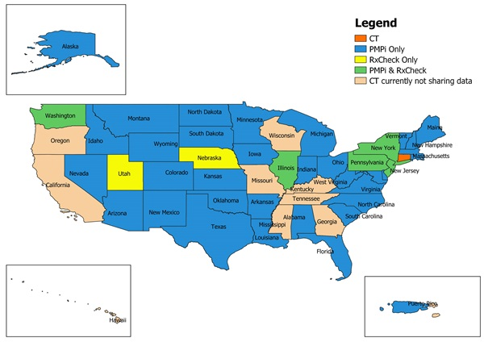

CPMRS

Slide 34
CT Laws - CPMRS
All prescribers in possession of a Connecticut Controlled Substance (CSP) Registration issued by the State of Connecticut, Department of Consumer Protection, will be required to register as a user with the Connecticut Prescription Monitoring and Reporting System (CPMRS)
Any prescribers who dispense controlled substances from their practice or facility, etc., will be required to upload dispensing information into the CPMRS Data Collection website.
Therefore, accuracy of data on the CPMRS depends on the efficiency and diligence of data upload from pharmacies and dispensing practices or facilities.

Slide 35
CT Laws – prescriber obligation
Prior to prescribing greater than a 72-hour supply of any controlled substance (Schedule II - V) to any patient, the prescribing practitioner or such practitioner's authorized agent shall review the patient's records in the CPMRS.
For continuous or prolonged treatment of any patient, prescriber, or such prescriber's authorized agent shall review CPMRS not less than once every 90 days.
PAs must complete “not less than one contact hour of training or education in prescribing controlled substances and pain management in the preceding two-year period.” This requirement must be met with the renewal of the license.

Slide 36
APRN Scope of Practice in CT
For the first three (3) years after obtaining a license in Connecticut, an APRN must practice in collaboration with a physician who is licensed in Connecticut.
"Collaboration" means a mutually agreed upon relationship between such APRN and a physician who is educated, trained or has relevant experience that is related to the work of such advanced practice registered nurse.
The collaboration shall address a reasonable and appropriate level of consultation and referral, coverage for the patient in the absence of such APRN, a method to review patient outcomes and a method of disclosure of the relationship to the patient.

Slide 37
APRN Scope of Practice in CT II
The collaboration between such APRN and a physician shall be in writing and shall address the level of schedule II and III controlled substances that such APRN may prescribe and provide a method to review patient outcomes, including, but not limited to, the review of medical therapeutics, corrective measures, laboratory tests and other diagnostic procedures that such advanced practice registered nurse may prescribe, dispense and administer.
Any APRN who elects to practice without a collaborative agreement shall maintain documentation of having engaged in the performance of advanced practice level nursing activities in collaboration with a Connecticut licensed physician for a period of not less than 3 years and not less than 2,000 hours

Slide 38
APRN Scope of Practice in CT III
Such APRN shall maintain such documentation for a period of not less than three 3 years after completing such requirements and shall submit such documentation to the Department of Public Health for inspection not later than 45 days after a request made by the department for such documentation .
Regardless of whether an APRN is currently licensed in another state, an APRN must collaborate with a Connecticut licensed physician for the first 3 years of licensed practice in Connecticut for a period of not less than 3 years and for not less than 2,000 hours.

Slide 39
Prescriptive Authority for Pharmacists
Legislation passed in 2015 also allows pharmacists to prescribe these medications, if they do the following:
complete a training and certification program approved by the Department of Consumer Protection (DCP) commissioner,
act in good faith,
train the recipient of the opioid antagonist in how to administer it,
maintain a record of the dispensing and training under the law’s record keeping requirements, and
refrain from delegating or directing another person to prescribe the medication or provide the training to the recipient (PA 15-198, codified at CGS § 20-633c).

Slide 40

Questions?

Slide 41


