Slide 1
Structural competency
Social determinants of health and the treatment of co-occurring disorders
Helena Hansen
MD, Ph.D.
UCLA
David Geffen School of
Medicine
Notes:
It is a pleasure to be invited to speak here at Mount Sinai, a school that I’ve long admired for its innovations in social medicine including its medical humanities track, and more recently it’s health and social justice interest group, with which I’ve had the pleasure of meeting.
Today I’ll be giving you an overview of an orientation to medical education and practice that I and my co-author Jonathan Metzl call Structural Competency. As I’ll explain, Structural Competency has become a movement in medical education and across disciplines to prepare clinical practitioners to make health interventions above the level of the individual doctor-patient encounter. That is, to collaborate with community organizations, non-health sectors such as criminal justice and schools, and with policy makers to improve their patients’ health.

Slide 2
Disclosure
Neither I nor my spouse has a relevant financial relationship with a commercial interest to disclose, nor do I intend to discuss any off-label investigative use of commercial products or devices.

Slide 3
Social determinants
What are Social Determinants?
Elements of social environment, outside of direct clinical care, that cause positive or negative health outcomes
These are powerful correlates of mental health, visible on population level rather than individual level
Notes:
clinicians don’t often look beyond access to treatment when they think of The causes of health disparities.
So I often start by familiarizing clinicians with the concept of social determinants of health, and its roots in epidemiological and public health research on population level patterns of disease and distress.
I offer them a definition of Social determinants of health as elements of the broader social environment, usually located outside of the clinic or hospital, that strongly correlate with health outcomes. I explain that They are most visible when looking at populations rather than individual patients, although individual patient histories will often reveal social antecedents to their illness such as traumatic events, deprivation or institutional exclusion.

Slide 4
Structure
Community organizations
Health-relevant sectors (schools, housing, law enforcement/corrections, urban planning)
Public policy
Notes:
Today I want us to expand this approach, to consider social structures as key elements of cultural process, and as drivers of health outcomes.
The word structure I borrow from the social sciences, where it refers to social systems and institutions ranging from neighborhood organizations, to institutional sectors such as education, corrections or housing, to the public policies that shape those institutions. In clinical practice, structural intervention is what is done above the level of the individual patient: for example, a psychiatrist working with a local church to help it start support groups for people who have experienced traumatic violence, or working with the schools to develop mental health prevention programs, or testifying to State legislatures in support of housing for people with severe mental illness.

Slide 5
Structural drivers of social determinants of health
EXAMPLE 1 – HOUSING STRUCTURE:
City and state zoning laws and development plans, predatory loans
(displace low income residents, create shortages of affordable housing)
SOCIAL DETERMINANT:
Insecure housing and homelessness
HEALTH OUTCOME:
Insecure housing correlated with increased risk of chronic, infectious & psychiatric disorders, high rate of rehospitalizations, comorbidities, arrests
EXAMPLE 2 - LEGAL STRUCTURE:
Law enforcement and sentencing (varies by race, SES neighborhood)
SOCIAL DETERMINANT:
Residence in targeted neighborhoods, legal involvement
HEALTH OUTCOME:
Association of incarceration with race, SES, poor psychiatric, infectious & chronic disease outcomes

Slide 6
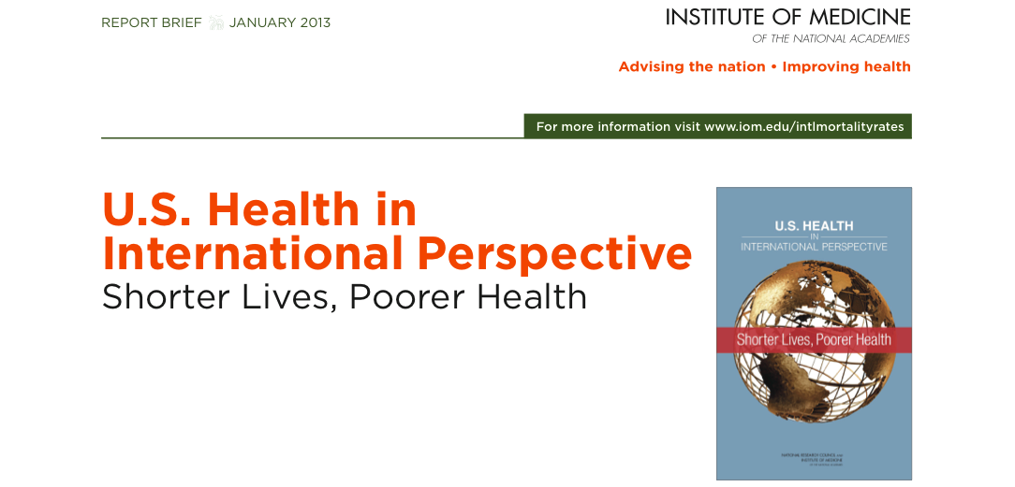
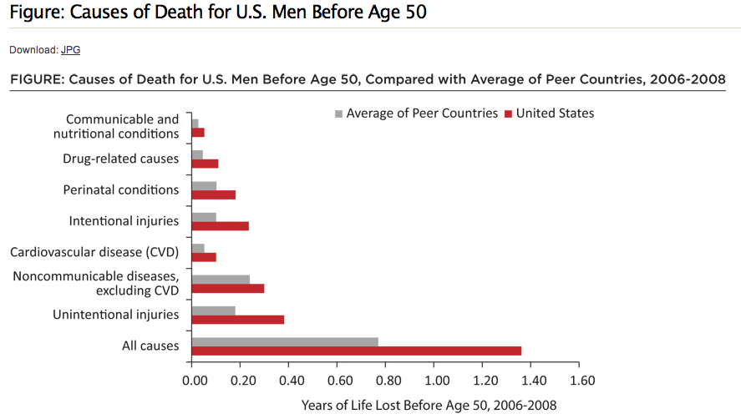
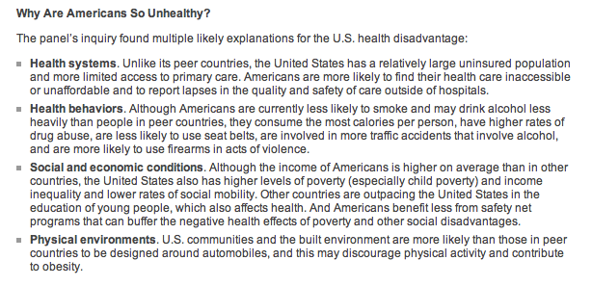
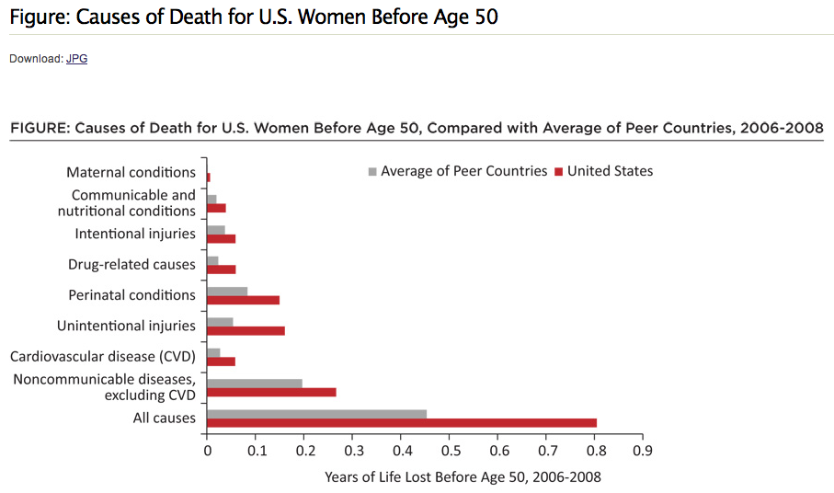
Notes:
One study that brought the health impact of social inequalities to light was a report released by the Institute of Medicine in 2013, that compared the US with 17 peer countries in Europe and Canada in terms of health spending and health indicators. The red line in these bar graphs represents the excess mortality in the U.S. compared with its peer countries, represented by the grey bars.
The sound bite from this report was that the US spends more on direct healthcare than all other peer countries, yet has the worst health outcomes, including mental health related deaths from suicide and substance use. The IOM’s explanation for this was structural: related to lack of universal health care, lack of safe, walkable public space and public transportation, and lack of public health oriented laws and institutions including those surroundnig firearms, food and abusable substances (gun laws, food deserts, war on drugs), and finally “social and economic conditions…higher levels of income inequality and lower social mobility”.

Slide 7
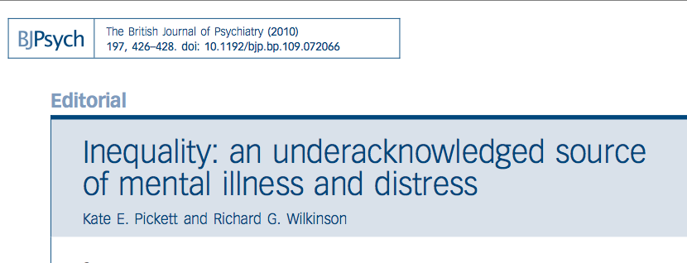
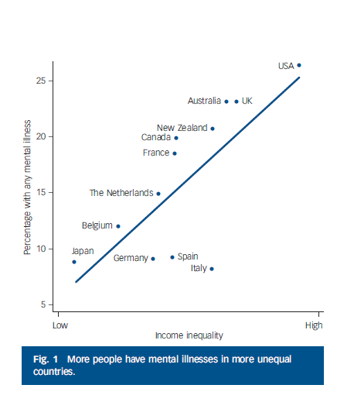
Notes:
Another international comparison that highlights structural determinants of health is the work of epidemiologists Richard Wilkinson and Kate Pickett, which showed that countries with a high index of social inequality – that is, a large income gap between rich and poor – reported the worst mental and physical health outcomes. This graph plots measures of inequality against mental health incomes, and you can see the US lands at the highest end of social inequality and the lowest end of mental health outcomes.
The unexpected finding from their study was that the wealthiest quartile of the populations in the most unequal countries studied actually had a lower life expectancy the wealthiest quartile of populations in more equal countries. The sound bite from their study was that inequality is unhealthy even for the rich – “The Spirit Level”.

Slide 8
Why U.S. Clinicians? Why Now?
U.S. has highest healthcare costs, poorest health outcomes of peer countries
National physicians survey: 80% think social drivers of health are central, but don’t know how to address them
Record levels of clinician burnout, drop out from clinical practice, citing structural constraints
Momentum of ACA’s performance based reimbursements – based on population health outcomes
Trainees demanding health justice (White Coats for Black Lives, sanctuary clinics for undocumented immigrants)

Slide 9
Structural Competency
New term – “structure” – needed to shift focus above the level of the individual – to institutions (clinical, educational, correctional, etc), communities, policies that determine health
“Competency” to indicate expanded scope of clinical intervention and responsibility: practitioners can bring symbolic, social and cultural capital to bear (in partnerships)
Notes:
Here enters structural competency. We propose new language that will lead practitioners to consider institutions, communities, policies, and other phenomena operating above the level of the individual.
The language must convey that to reduce inequalities in health, their intervention has to include systems and structures outside of the individual patient.
And we want to keep the word “competency” because the problem is the gap between our knowledge of social determinants of health, and the actions that clinical practitioners take to change the social determinants of health. “Competency” conveys a call to action, an expectation that practitioners have or develop tools to intervene at that level.

Slide 10
The Competencies
Recognizing the structures that shape clinical interactions
Rearticulating “cultural” presentations in structural terms
Observing and practicing structural intervention
Developing Structural Humility (e.g. through collaborations)
Notes:
Now to the competencies themselves: Here are the essential steps that we must take toward structural intervention.
[SLIDE THE COMPETENCIES]
Recognizing the structures that shape clinical interactions
Rearticulating “cultural” presentations in structural terms
Observing and practicing structural intervention
Developing Structural Humility (Collaborations)
The first step, learning to see structural influences, and the second step, rearticulating patient cases in structural term, are more difficult for clinicians than you might think. Nothing in clinical training prepares clinicians for them. But without training they cannot act on structural levels. To illustrate this point I am going to describe a patient that I have been following for the past five years.

Slide 12
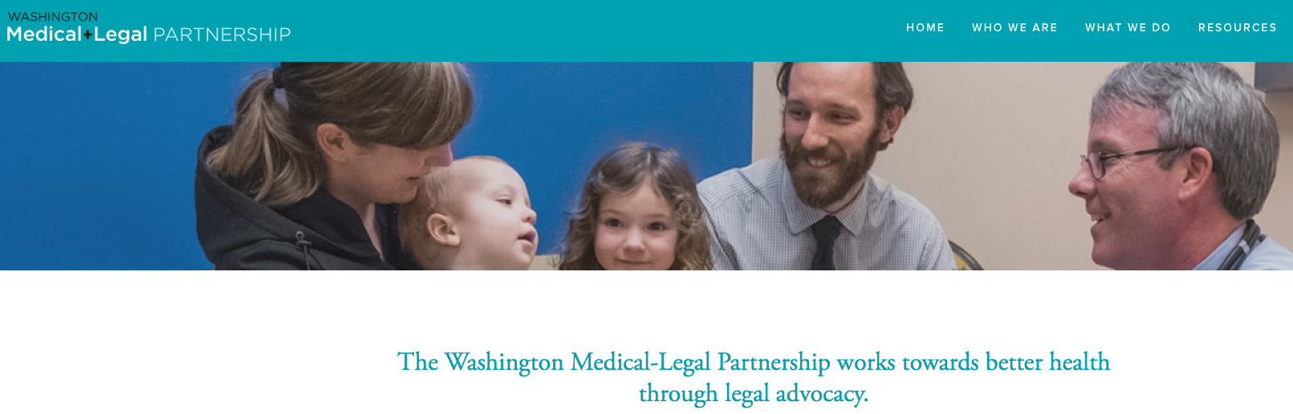

In-clinic structural intervention
Electronic Medical Records
Medical-Legal Partnerships
Social Prescribing
Peer Navigation/Community Health Workers
Notes:
So there are several levels at which clinicians can learn to think and act structurally.
The first level is within the clinic, by identifying and addressing social barriers to health among their patients.
A deceptively simple structural intervention studied by Nancy Adler and Laura Gottlieb at UCSF is the introduction of questions about social needs into Electronic Medical Records. Their study showed that prompting doctors to ask patients about their housing, their financial situation, their childcare needs and their legal concerns was associated with an increase in referrals to social services.
Medical Legal Partnerships
Another intervention that takes this a step further is an emerging model of Medical Legal Partnerships. A number of medical schools are partnering with law schools to provide clinical electives for law students, who help clinical trainees to identify patients with health-related legal needs and then work with patients to resolve them. For instance, Emory and Morehouse have an Atlanta based partnership that pairs law students and pediatric residents in medical-legal clinics. Their co-education has led to successful intervention with landlords around environmental lead exposure, and to appropriate educational services for low income children with learning disabilities. Another program is Health Leads, in which pre-med students work in hospitals where they fill “prescriptions” written by doctors for social services, such as housing and income support, which volunteers help patients to get by escorting them to relevant agencies and non profits.
The Medical-Legal partnership example comes from Jack Geiger, one of the founders of the Community Health Center movement in the 60’s who made headline news for prescribing groceries for malnourished children in the Mississippi Delta. He is considered the grandfather of modern social medicine, and he is quick to point out that the prescriptions, which were filled at local grocery stores with Federal public health service funds, were not his actual intervention against malnutrition in one of the country’s poorest regions. He used Community Health Center funds to start a cooperative farm by and for health center patients who were unemployed farmers. I have been involving Jack in our Structural Competency meetings and special issue, and he would want me to point out that Structural Competency is not new, it is a reinvention of Social Medicine in our contemporary language of mandated clinical competencies.
In fact, twenty years ago Jack led CUNY’s Sophie Davis School of Biomedical Education in building an entire clinical education around social medicine. The school recruits promising students from low income and ethnic minority communities in New York, and assigns them to do community health assessments in their home communities, in which they develop a population health profile and identify preventive health interventions for common health conditions. For instance, Sophie Davis students have measured pollutants in neighborhoods located near major highways and connected them to asthma exacerbations, which they learn to manage clinically with asthma medications, and to manage structurally with reports to the DOH and with community education.

Slide 13
Community Partnerships

Slide 14
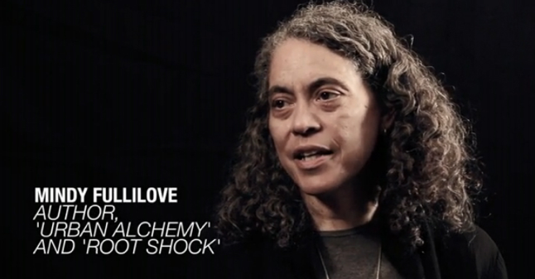
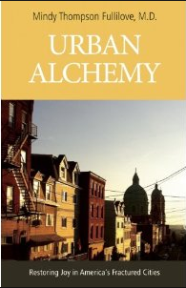
Cross-sector collaborations
Notes:
Another level of structural intervention for clinicians is to work with non-health sector agencies that nonetheless have a big impact on health.
To revisit racial housing segregation as a determinant of health, Mindy Fulllilove shows that One can take this structural thinking to its logical end and talk of doctoring not only individual patients, but entire cities. She is a psychiatrist at Columbia who is often mistaken for a sociologist, because she diagnoses and treats pathologies of urban planning. Recognizing racial segregation as the ultimate cause of racial health disparities, Mindy now looks upon residentially fragmented cities as her patients. Having researched and written the book Root Shock on the urban renewal policies, redlining practices, and planned urban shrinkage that left black and brown communities constrained to the poorest housing stock, sapped of collective capital, and trapped in the syndemics of HIV, violence, crack and heroin addiction, she went on to write another book, Urban Alchemy: Restoring Joy in America’s Sorted Out Cities, in which she offers practical steps that groups of citizens, including health professionals, can take to integrate city neighborhoods.

Slide 15
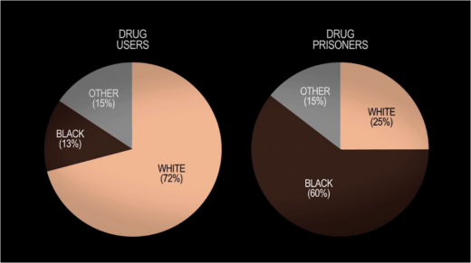
Drug War Disparities
Notes:
Finally, clinicians can act structurally by advocating for health promoting public policies.
Clinical trainees can and should take part in health policy research and advocacy. In my research on race and inequality in treatment for opiate addiction, I see the War on Drugs as a major contributor to the major health disparities we see today in the form of HIV, addiction, mental illness, violence and trauma related to discriminatory sentencing and mass incarceration.

Slide 16
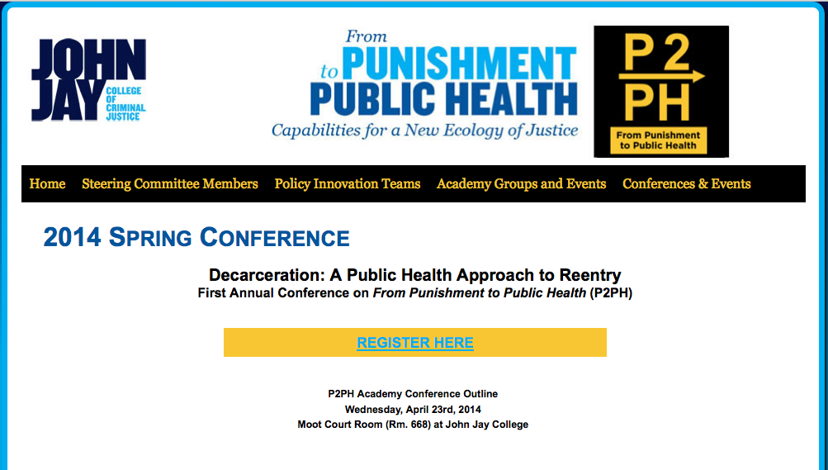
Policy advocacy
Notes:
This highlights the importance of physician involvement in advocacy. The structural competency question is, how can public policy become a part of clinical training?
Two years ago I joined a group called Punishment to Public Health, a collaboration of clinicians, public health researchers, formerly incarcerated people, and disenchanted corrections officers. The group hosts workshops and research groups that identify institutional and policy interventions to reduce inequalities in arrests, sentencing, and recidivism. I have recruited pre med and medical students, residents and faculty into this group. It is providing them hands on education in structural interventions to reduce disparities in health.
One of the recent successes of P2PH is its collaboration with NYPD to redirect people who loiter in the subway system away from arrest and toward new mental health assessment drop in centers located at major Manhattan stations. This is leading to a reduced arrest rate and higher rates of referral for psychiatric treatment. P2PH has also been active in lobbying against mandatory sentencing for drug related charges, and for state policies that redirect mentally ill arrestees from criminal sentencing toward treatment facilities. Through P2PH, psychiatrists have provided combined testimony to state legislators. This is an example of clinical practitioners using their expertise to foreground health in public policy.

Slide 17
structuralcompetency.org

