Slide 1
The Role of the Psychiatrist and other Medical Staff within a Multidisciplinary Treatment Team
Srinivas B Muvvala, MD, MPH
Associate Professor of Psychiatry
Yale University School of Medicine

Slide 2
Disclosures
Dr. Muvvala consulted for Alkermes previously

Slide 3
Objectives
Integrating care
Describe the role of psychiatrists and other medical staff in treatment of co-occurring substance use disorders
Multidisciplinary team
Recognize the importance of multidisciplinary team approach in integrating mental health and addiction treatment
Interprofessional collaboration
Discuss the factors that promote optimal collaboration among members of interprofessional team

Slide 4

The Problem
Only one in ten people with addiction receive care
5.7% with AMI and SUD receive both treatments
SAMSHA 2021
Notes:
The need for culture change is rooted in the fact that despite this massive public health crisis, only one in ten people with addiction receive care. ONE IN TEN. Could you imagine the health care and educational resources that would be mobilized if only one in ten patients with diabetes or CHF received care?

Slide 5
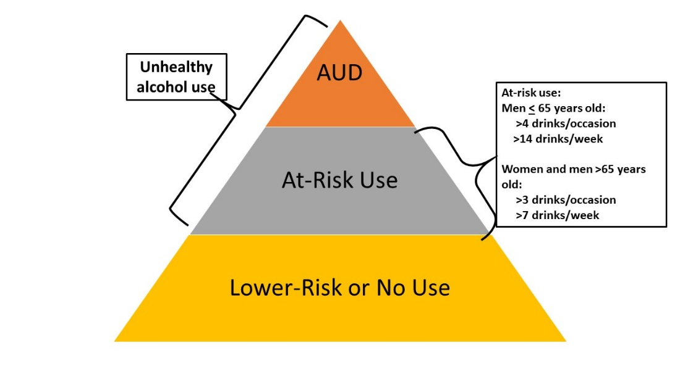
Spectrum of Alcohol Use

Slide 6
Integrating Mental Health and Addiction Treatment
Facilitators
Cost effective and Improves treatment outcomes
Patients see mental health centers as their primary treatment center
Challenges
Patients not routinely seeking treatment
Limited resources
Mental health providers are underprepared to treat substance use disorders
Stigma
Patients receive regular, chronic care
Ref: SAMSHA 2009

Slide 7


Why?
Stigma
Lack of provider education
Notes:
Why do only 1 in 10 people with addiction receive care? There are many ideas suggested for why this is but they can be boiled down to two main bucket----STIGMA and Lack of provider education

Slide 8
Role of Psychiatrists and other Mental Health Providers
1100 Addiction Psychiatrists only
Significant comorbidity of SUD’s and mental illness (anxiety, depression, ADHD, psychosis, suicide)
Psychiatrists are uniquely skilled as they can provide integrated mental health care and relapse prevention counselling
Shift of buprenorphine prescribing to primary care (Psychiatrists 92.2% in 2003 to 32.8% by 2013)
General psychiatrists and mental health providers must own and integrate addiction treatments into their routine practice
Ref: Muvvala et al, JAMAPsych 2018

Slide 9
Prescribers’ role?
Prevention
Screening/ SBIRT
Medications for Treatment
Harm reduction/ Overdose education
Multidisciplinary Collaboration
Preventing infections (Education regarding safe use, needle exchange programs)
Special populations
Medical comorbidities
Training and education (PCSS-MAT
Notes:
Early intervention, screening

Slide 10
Strategies to incorporate SUD treatment into clinical practice
Integrating prevention and treatment for SUD’s into practice
  Hospital setting
  Outpatient setting

Slide 11
Hospital setting
Starting medications for addiction treatment in the hospital
BUP initiation in ED : (78 vs 37% engagement)
Collaborating with outpatient providers for appropriate referral to treatment
Overdose prevention training and naloxone prescribing for all clients at risk
Education about risk reduction (safe use, infections)
Avoid polypharmacy
Screen for risk factors and intervene
Screen for medical problems, treat/ refer to treatment
Family involvement and education

Slide 12
Outpatient setting
Screening & Diagnosis
Treatment Planning
Medications for addiction treatment
Integrating mental health and SUD treatment
Drug screens
Screening for medical complications, referral to medical care
Prescription monitoring systems
Avoid Polypharmacy
Overdose prevention training and naloxone prescribing
Preventing infections
Counselling services/ Therapy planning
Family involvement
Recovery supports
Staff Education
Training:
Ex: Obtain waiver 8-hour training

Slide 13
Interprofessional Collaborative Practice
Psychiatrist
Other Physicians
APRN
PA
Psychologist
Social Work
Addictions counsellor
Nursing
Residents
Medical Students
Occupational Therapy
Physical Therapy
Pharmacist
Admin & other staff
Peers supporting recovery

Slide 14
Promoting interprofessional collaboration:
A CULTURE OF CARING: Synergy improves outcomes
Providing constructive feedback
Creating a positive environment
Developing ownership mentality
Sharing leadership responsibilities
Caring relationships
Working together with kindness
Strengths based practice
Valuing team members’ expertise
First and Last lines of Defense
Taking accountability and responsibility
Adapted from: ly Wei, Robin Webb Corbett, Joel Ray & Trent L. Wei (2020) A culture of caring: the essence of healthcare interprofessional collaboration, Journal of Interprofessional Care, 34:3, 324-331
Notes:
Research at Duke: Human connections among interprofessional team members are key to effective teams
Interprofessional collaborative practice (IPCP): Like team sport

Slide 15
Supervising physician’s responsibilities with nurse practitioners and physician assistants
Physician retains ultimate responsibility of the patient care rendered when required by state law
Physician is responsible for reviewing the work, records and practice of the APRN and PA
Physician is responsible to ensure that appropriate directions are given, understood and executed in treatment planning
Physicians must review the quality of care rendered by the treatment team
Ref: https://www.aafp.org/dam/AAFP/documents/news/NP_Info_GlinesNP-060710.pdf

Slide 16
Responsibilities of the team leadership
Define responsibilities of team members
Establish regular and open communication
Reduce barriers to care
Patient centered care

Slide 17
MAT Staff/schedule
CMHC: Collaboration between DMHAS and Yale University School of Medicine
Addiction psychiatrist- Dr. Oluwole Jegede, MD MPH
MAT Nurse: Jennifer Mastriano, RN
Addiction Psychiatry Fellows- HRSA grant
Trainees: medical students, psychiatry residents, and addiction fellows.
Approximately >350 unique patient schedules over 10 months

Slide 18
Community MAT consultation clinic in brief
Innovative model of addiction treatment in ambulatory settings.
Integrates SUD treatment into general psychiatry setting.
Fidelity to consultation, harm reduction and open access models.
Likely easy to replicate and scalable- studies underway.
Provide support to psychiatric providers who may not be willing or unable to treat SUDs.
Academic detailing- hub for psychiatric trainees and monthly addiction seminars.

Slide 19
Scope of MAT Consultation Service
ALL SUDs:
Opioid use disorder
Alcohol use disorder
Tobacco use disorder
Stimulant use disorder
Sedative/Hypnotic/Anxiolytic use disorder
Hallucinogen related disorders
Clinic and Home inductions of buprenorphine
Back-up for maintenance therapy of buprenorphine

Slide 20
Summary
Psychiatrists and other mental health providers are naturally equipped to treat substance use disorders
Integrated care is essential to improve mental health and SUD treatment outcomes
Treatment must be provided by multidisciplinary team and physicians/ team leadership must foster collaboration among various disciplines

Slide 21

Source: Don’t Judge Me Until You’ve Walked In My Shoes http://sumo.ly/yS6I via @tonyfahkry. Accessed 10/12/17
Notes:
Words and attitudes matter

Slide 22


Slide 23
References
Substance Abuse and Mental Health Services Administration. Integrated Treatment for Co-Occurring Disorders: Building Your Program. DHHS Pub. No. SMA-08-4366, Rockville, MD: Center for Mental Health Services, Substance Abuse and Mental Health Services Administration, U.S. Department of Health and Human Services, 2009.
Muvvala SB, Edens EL, Petrakis IL. What Role Should Psychiatrists Have in Responding to the Opioid Epidemic? JAMA Psychiatry. 2019 Feb 1;76(2):107-108
Holly Wei, Robin Webb Corbett, Joel Ray & Trent L. Wei (2020) A culture of caring: the essence of healthcare interprofessional collaboration, Journal of Interprofessional Care, 34:3, 324-331
Substance Abuse and Mental Health Services Administration. (2021). Key substance use and mental health indicators in the United States: Results from the 2020 National Survey on Drug Use and Health (HHS Publication No. PEP21-07-01-003, NSDUH Series H-56). Rockville, MD: Center for Behavioral Health Statistics and Quality, Substance Abuse and Mental Health Services Administration. Retrieved from https://www.samhsa.gov/data/ Accessed September 20, 2022
https://www.aafp.org/dam/AAFP/documents/news/NP_Info_GlinesNP-060710.pdf. Accessed September 20, 2022

