Slide 1
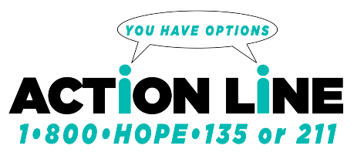


Adult Crisis Telephone Intervention and Options Network
________________________________________________
Presented by:
CT Department of Mental Health and Addiction
Services and the United Way of CT, 2-1-1

Slide 2
Overview
Description of Mobile Crisis Teams and Crisis Intervention Teams
Overview of Mobile Crisis Redesign
The development of CT’s centralized adult crisis call center
  What it is the ACTION line?
  ACTION line Implementation
  Call Data
  Marketing Materials
  Satisfaction Survey
Additional Resources and Contacts

Slide 3
Mobile Crisis Teams
Adults ages 18+
Telephone support
Mobile, in-person response
Multidisciplinary team
  Licensed social workers, licensed counselors, nurses, mental health workers, case managers, individuals with lived experience with mental health and/or substance use/addiction, psychologists, psychiatrists, etc.
Extensive training
  Suicide risk assessments, Prevention and Postventon, Recovery and Community Supports, etc.
Collaboration with local and state law enforcement

Slide 4
Crisis Intervention Team (CIT)
  CIT is a best practice model originated in Memphis, TN.
  Intended to divert individuals from incarceration, arrest and hospitalization and promote safety for persons in crisis, the community, and police who respond to crisis calls.
  DMHAS has contracted with The Connecticut Alliance to Benefit Law Enforcement (CABLE) Inc. to provide Crisis Intervention Team Training to law enforcement personnel and behavioral health clinicians.
  Every Mobile Crisis Team in the state has CIT trained clinicians who work collaboratively with police departments.
  When needed, CIT clinicians will respond to crisis calls along with the police.
  State operated Mobile Crisis Teams (MCTs) as well as some Private Non-Profit MCTs have designated CIT clinicians .

Slide 5
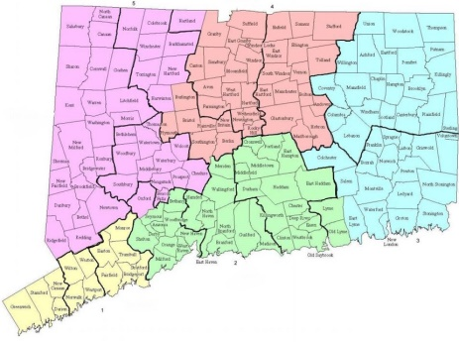
18 Mobile Crisis Teams in CT
8 DMHAS operated and 10 DMHAS funded
Region 1
  Southwest Connecticut Mental Health System- Stamford
  Southwest Connecticut Mental Health System- Bridgeport
Region 2
  BHcare- Valley
  BHCare- Shoreline
  Bridges Healthcare
  Connecticut Mental Health Center
  River Valley Services
  Rushford
  SouthCentral Counseling Services
Region 3
  Southeastern Mental Health Authority
  United Services
Region 4
  Capital Regional Mental Health Center
  Community Health Resources
  Community Mental Health Affiliates
  InterCommunity
Region 5
  Danbury Hospital/Western Connecticut Health Network
  Western Connecticut Mental Health Network- Waterbury
  Western Connecticut Mental Health Network- Torrington

Slide 6
Mobile Crisis Team
Mission
To provide persons in distress (crisis) immediate access to a continuum of crisis response services of their choice including, mobile clinical services, peer support services and community supports; to promote the prevention of crises among persons and families; and to provide postvention activities that support persons in developing a meaningful sense of belonging in their communities.

Slide 7
Mobile Crisis Teams
Services and Supports
Outreach & Education
Risk Assessment and Evaluation of Needs
Telephone Support
Critical Incident Debriefing
Information & Referral
Follow up services
Peer Support
Crisis/Safety Planning
Prevention and Postvention

Slide 8
Mobile Crisis Redesign
Stakeholder Survey
Community Wellness & Recovery Coalition (CWRC)
DMHAS Workgroup Development
Consultation from the CT Department of Children and Families (DCF)
Technical Assistance
Meetings with CEOs
Agency site visits

Slide 9
DMHAS Mobile Crisis Workgroup
Formed in October 2017
DMHAS- Office of the Commissioner (OOC) workgroup including the EBP unit, Statewide Services division, Forensics division, Prevention and Health Promotion division, Medical Director’s office, Fiscal division, a state-operated CEO, the Yale Program for Recovery and Community Health (PRCH), and the DMHAS Assistant Director of Recovery Community Affairs.
Purpose: To examine current mobile crisis services and make recommendations for enhancements.

Slide 10
CT Wellness and Recovery Coalition
A CT Team of multiple stakeholders was developed including representatives from
  CT Community for Addiction Recovery (CCAR)
  Advocacy Unlimited (AU)
  Leaders of the faith-based community
  Community organizers/educators
  Deputy Police Chief of Danbury PD
  CT Chapter-National Alliance on Mental Illness (NAMI)
  North Central Regional Mental Health Board (NCRMHB), now known as Amplify, Inc.
  Private non-profit (PNP) and state-operated (SO) mobile crisis team
Focus on creating a community of care such that people in distress have quick access to the types of services and/or support of their choice (clinical services, peer services, community supports) that will foster optimal post-traumatic healing and growth wherever they may be in the recovery process.

Slide 11
DMHAS Stakeholder Survey
In early 2019 DMHAS, in partnership with Yale PRCH, conducted a statewide survey of stakeholders regarding DMHAS mobile crisis services.
Providers, Persons in Recovery, Law Enforcement, Family members and Others
883 individuals responded across all five DMHAS regions

Slide 12
Stakeholder Survey: Recommendations
Increase Education & Training
Implement Statewide Call Center
Establish Minimum Hours of Operation
Enhance Data Collection/Outcome Measures
Advance CIT integration into MCT
Enhance Prevention/ Postvention Components
Add Recovery Support Specialists
Enhance Technology

Slide 13
Development of the Adult Crisis Call Center
November 2019- RFP released
December 2019- RFP application deadline
January 2020- United Way of CT selected as the provider of the CT centralized call center for adults in crisis
April 2020- Call center name selection process
  Surveyed the CT Suicide Advisory Board Lived Experience Committee (membership includes individuals from PRCH, NAMI-CT, AU, veterans, higher education, business marketing). Additional representatives from Amplify and CCAR provided feedback.
May 2020-present- Weekly implementation meetings between DMHAS and United Way of CT

Slide 14
ACTION line
Adult Crisis Telephone Intervention and Options Network
Centralized Adult Crisis Call Center
Available 24/7, 365 days a year
Ability to provide after hours, weekend and holiday coverage for mobile crisis teams
Staff include a combination of licensed clinicians, paraprofessionals, an individual with lived experience navigating distress and multilingual staff

Slide 15
ACTION line
United Way of CT 2-1-1
CT’s Statewide National Suicide Prevention Lifeline provider as of October 1st, 2020
Provider of Mobile Crisis Intervention Services (MCIS) for Youth (formerly known as EMPS)
Coordinate Access Network (CAN) provider
Extensive database of local resources
United Way of CT is accredited by the American Association of Suicidality. The ACTION LINE call center follows AAS/SAMSHA approved crisis intervention protocols for non-clinical risk assessment and intervention, referral, and safety planning.

Slide 16
ACTION line
Supports and Resources
By contacting the ACTION Line through 1-800-HOPE-135 or by dialing 2-1-1, ACTION line staff can facilitate direct contact with the closest adult Mobile Crisis Team (MCT) in the State.
ACTION line staff will assist callers by:
  Building rapport with the individual caller
  Determining the nature of the caller’s distress through a non-clinical assessment of their concerns and needs
  Ensuring safety planning right at the point of contact for the individual in distress
  Connecting the individual in distress with the adult MCT provider in their area for intervention during MCT hours
  Informing MCT provider of need to provide follow up services
  If needed, direct connection to 911

Slide 17
ACTION Line
Goals and Objectives
To prevent unnecessary ED visits & admissions to the hospitals
To increase easy access to mobile crisis services
To support individuals in considering their options to assist them
To prevent incarceration
To increase connection with treatment options and community supports
To provide community-based services to support persons experiencing mental health emergencies in the least restrictive environment

Slide 18
ACTION line
Four Phase Implementation Plan
Phase 1- August 12th, 2020
  CHR and WCMHN- Torrington
Phase 2- September 16th, 2020
  Danbury and WCMHN- Waterbury
Phase 3- October 21st, 2020
  CMHA, Intercommunity, United Services, SMHA and Capitol Region
Phase 4- December 2nd, 2020
  BHCare, CMHC, SCCS, Bridges, SWCMHS, River Valley and Rushford

Slide 19
ACTION line
Key Data Collection
August 12, 2020 through November 30,2020
Number of calls handled
  ACTION line– 14,528
  National Suicide Prevention Lifeline (NSPL)– 2,196
Number of calls referred to a Mobile Crisis Team (MCT) provider- 260
  Note: As of 11/30/20, only 9 out of the 18 MCT providers were receiving transfers from the ACTION line
Outcomes of calls transferred to a MCT
  Mobile without Police- 68
  Mobile with Police- 39
  Non-Mobile Telephonic Support– 153

Slide 20
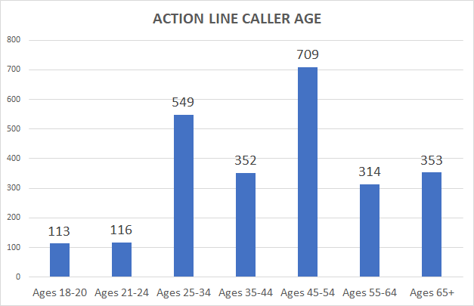
ACTION line
Caller Demographic Information Collected
Gender
Age
Race
Ethnicity
Date of Birth
Languages spoken
Veterans/Homeless/Disabled

Slide 21
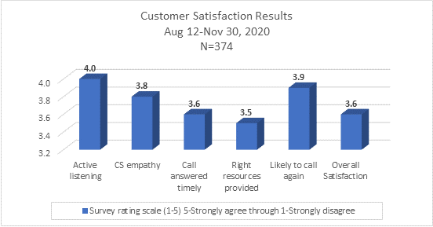
ACTION line Customer Satisfaction Survey

Slide 22
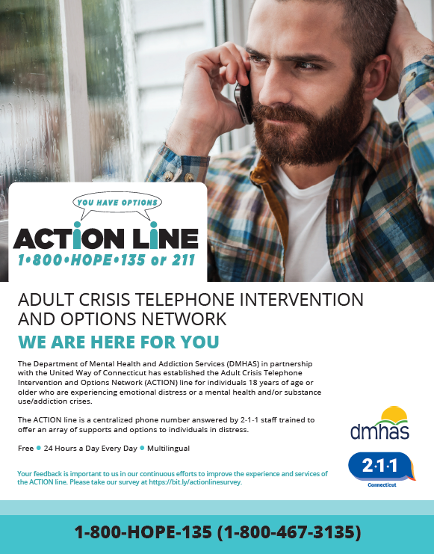
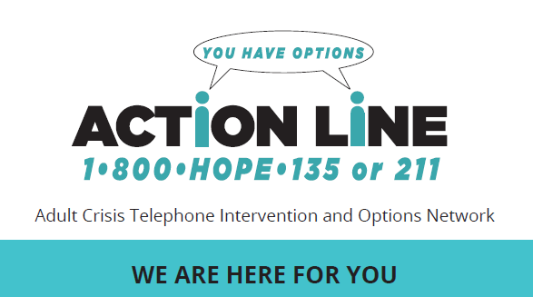
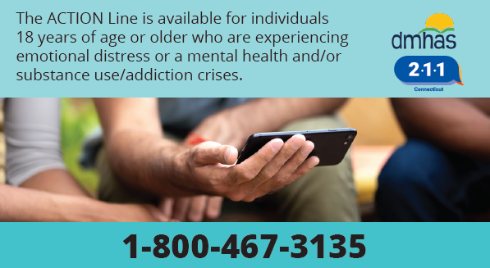
Marketing and Promotional
Materials
Brochures, wallet cards, posters, postcards, pens and stress balls
Available in English and Spanish
Requests for ACTION line materials can be made by contacting
  Jeanette.baker@ctunitedway.org
  The United Way of CT website at uwc.211ct.org/contact/uwc-materials

Slide 23


Slide 24
Additional Resources
CT Mobile Crisis Services
  https://portal.ct.gov/DMHAS/Programs-and-Services/Finding-Services/Crisis-Services
The National Suicide Prevention Lifeline
  Available 24/7 at 1-800-273-TALK (8255)
DMHAS website warm line listing:
  https://portal.ct.gov/DMHAS/Programs-and-Services/Advocacy/Warm-Lines
Parent/caregiver support:
  1-833-258-5011
  www.TalkItOutCT.com
CTSafeConnect (Domestic Violence/Intimate Partner violence support)
  Website: https://ctsafeconnect.com/
  Available 24/7, 365 days a year via:
    Voice Call/Text: 1-888-774-2900
    Email: safeconnect@ctcadv.org
    Web Chat
1-888-217-HERO
  CHR’s HERO HOTLINE provides immediate assistance to anyone who is struggling with acute stress during the ongoing coronavirus crisis
CT Alliance To Benefit Law Enforcement
  http://cableweb.wpengine.com/
CT Suicide Advisory Board
  https://www.preventsuicidect.org/
NAMI Navigating a Mental Health Crisis
  https://www.nami.org/Support-Education/Publications-Reports/Guides/Navigating-a-Mental-Health-Crisis/Navigating-A-Mental-Health-Crisis

Slide 25
Contact Information
Department Mental Health and Addiction Services
  Nydia Rios-Benitez, Director DMHAS OOC Evidence Based Practices and Grants Division
  nydia.rios-benitez@ct.gov
  Erika Cruz, Clinical Manager DMHAS OOC Evidence Based Practices and Grants Division
  erika.cruz@ct.gov
  Dana Begin, Program Manager DMHAS OOC Evidence Based Practices and Grants Division
  dana.begin@ct.gov
United Way of Connecticut, 2-1-1
  Wendy Caruso, Director 2-1-1 Contact Center Operations
  wendy.caruso@ctunitedway.org
  Sarah Camerota, Crisis Program Manager
  sarah.camerota@ctunitedway.org

