Slide 1


Optimizing policy to reduce overdose deaths
Reducing morbidity and mortality from overdose, HIV, and hepatitis C in opioid-using persons (NIDA R01)
Connecticut Model
May 14, 2024

Slide 2
Background
Strategies to reduce overdose deaths in CT
  Naloxone distribution
    Community & upon release from incarceration
    Vending machines
  Medications for opioid use disorder (MOUD)
    Community & incarceration settings
  Harm reduction centers (HRCs)
AIM: Use modeling/simulation to determine most efficient (greatest benefit per cost) resource allocation across interventions to reduce overdose deaths

Slide 3
Model Development Process
Build Structure
Debug
Enter Inputs
Debug
Run Analyses (1°, 2°)
Calibrate and Validate

Slide 4
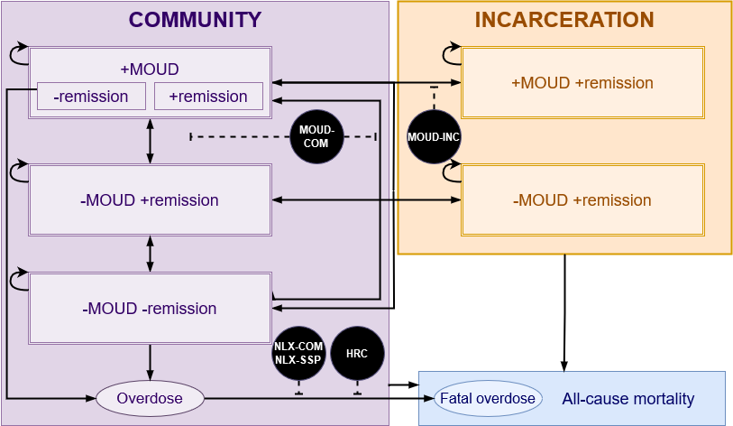
Model Schematic

Slide 5
Model Development Process
Build Structure
Debug
Enter Inputs
Debug
Run Analyses (1°, 2°)
Calibrate and Validate

Slide 6
Model inputs: Intervention effectiveness
Intervention | Comparison | Outcome | Risk reduction (95% CI) | Study design | Reference
MOUD | MOUD vs no MOUD | Opioid-related mortality | 38%* (8-59%) | Cohort; Meta-analysis of cohort studies | I) Larochelle et. Ann Internal Med. 2018 II) Sordo et al. BMJ 2017
Naloxone | Kit + no EMS vs No kit + no EMS | Probability of dying of overdose | 89% (31-100%) (plausible range) | Published expert opinion based on literature review** | Coffin PO, Sullivan SD. Ann Internal Med. 2013. Coffin PO, Sullivan SD. JOURNAL. 2022.
*Only after 4 weeks for methadone
**Quantitative synthesis not performed
Notes:
Papers cited for the estimate from Coffin for naloxone effect:
Doe-Simkins M, Walley AY, Epstein A, Moyer P. Saved by the nose:
bystander-administered intranasal naloxone hydrochloride for opioid overdose.
Am J Public Health. 2009;99:788-91. [PMID: 19363214]
Piper TM, Stancliff S, Rudenstine S, Sherman S, Nandi V, Clear A, et al.
Evaluation of a naloxone distribution and administration program in New York
City. Subst Use Misuse. 2008;43:858-70. [PMID: 18570021]
Wagner KD, Valente TW, Casanova M, Partovi SM, Mendenhall BM,
Hundley JH, et al. Evaluation of an overdose prevention and response training
programme for injection drug users in the Skid Row area of Los Angeles, CA. Int
J Drug Policy. 2010;21:186-93. [PMID: 19268564]
Stoove´ MA, Dietze PM, Jolley D. Overdose deaths following previous nonfatal
heroin overdose: record linkage of ambulance attendance and death registry
data. Drug Alcohol Rev. 2009;28:347-52. [PMID: 19594787]
Strang J, Manning V, Mayet S, Best D, Titherington E, Santana L, et al.
Overdose training and take-home naloxone for opiate users: prospective cohort
study of impact on knowledge and attitudes and subsequent management of
overdoses. Addiction. 2008;103:1648-57. [PMID: 18821875]
Tobin KE, Sherman SG, Beilenson P, Welsh C, Latkin CA. Evaluation of
the Staying Alive programme: training injection drug users to properly administer
naloxone and save lives. Int J Drug Policy. 2009;20:131-6. [PMID: 18434126]
Paper cited for the estimate from Coffin for baseline probability of survival (before effect of naloxone):
Sporer KA, Kral AH. Prescription naloxone: a novel approach to heroin
overdose prevention. Ann Emerg Med. 2007;49:172-7. [PMID: 17141138]

Slide 7
Model inputs: Vending machine
Input | Measure | Point est. (range) | Study/source type | Reference
Annual probability of receiving kit from machine* | Probability | 0.22 (0.07, 0.22) | Observational; evaluation | Arendt et al. J Am. Pharm. Assoc. 2022 Allen et al. Ann. Med. 2022. BJA Comprehensive Opioid, Stimulant, and Substance Abuse Program 2022
Annual software cost per machine | Annual cost (2021 USD) | $6480 ($600-$6480) | Observational; evaluation | Caracole 2022 National Counsel for Mental Wellbeing 2022 (harm reduction vending machine budget)
Device cost per machine | Cost (2021 USD), every 10 years** | $10000 ($8000-$12000) | Assumed; various industry sources
Annual maintenance cost per machine | Annual cost (2021 USD) | $1350 ($900-$1350) | Assumed; various industry sources
* Based on 6 machines dispensing 3,360 annual doses
** Estimated time needed before replacing based on industry sources

Slide 8
Model inputs: Harm reduction center (HRC)
Input | Measure | Point est. (range) | Study design | Reference
Overdose death rate in HRC, annual | Annual per-person rate | 0.00 (0.00-0.03) | Multiple; Retrospective cohort | Assumed; Rowe A, et al. CJEM, 2022
HRC visits per client, annual | Annual days per person | 60 (60-365) | Observational | Harocopos et al. JAMA Netw Open, 2022
HRCs | Number of HRC | 8** (1-8) | Observational | Haracopos et al. JAMA Netw Open, 2022
*Upper bound if transported to hospital
**Based on calculated probability of using HRC (60% of POUD) and lower bound estimated capacity of 613 annual clients

Slide 9
Model scenarios
Intervention maximized | Effect in model | Saturation level at maximization
Naloxone, community | Annual probability of receiving kit in community | PWID in SSP: 40% → 99%
 |  | Non-PWID & PWID SSP: 10%→ 58%
 |  | POUD via vending machine: 0 → 22%
MOUD, community | Percent on MOUD (abstinent or active) (before aging out) | 30% → 48%
MOUD, incarceration | MOUD when incarcerated, given community abstinence prior to incarceration | 1% → 100%
 | MOUD when incarcerated, given active use in community prior to incarceration | 30% → 100%
 | Abstinent when incarcerated, given MOUD in the community prior to incarceration | 57% → 0%
PWID = people who use injection drugs
POUD = people with opioid use disorder
SSP = syringe service program
Notes:
Plausible scale up scenarios (not showing inc MOUD as these results were not re-run at the time of these other CTDPH analyses)

Slide 10
Model Development Process
Build Structure
Debug
Enter Inputs
Debug
Run Analyses (1°, 2°)
Calibrate and Validate

Slide 11
Calibration
Target:
Number of opioid overdose deaths (ODDs)
Varying:
Impact of fentanyl & other synthetics on overdose risk
  Time-dependent variable
  Multiplies overdose rate among people who use injection drugs
Notes:
Vary as few things as possible when calibrate
HERE: how much fentanyl has increased the OD death rate

Slide 12
Calibration inputs
CT Historic Data Sources
# People on MOUD
SAMHSA. Treatment Episode Data Set: Admissions (TEDS-A) 2017-2019, (SAMHDA). assumed linear projections for 2020 onwards
IQVIA Longitudinal Prescription Data (2021)
# People with opioid use disorder (OUD)
2010-2014: Lipari RN and Van Horn SL (2017). The CBHSQ Report, SAMHSA, assumed stable trends post 2012
CT Historic Data Sources
Number of Naloxone Doses
Mark Jenkins Greater Hartford Harm Reduction Coalitions (GHHRC) correspondence (2020, 2022)
IQVIA Longitudinal Prescription Data (2021), assumed stable numbers post 2019 as per trend
National trends
Wheeler, E. et al & CDC (2012). Community-based opioid OD prevention programs providing naloxone 2010. MMWR
Wheeler, E. et al & CDC (2015). Opioid OD Prevention Programs Providing Naloxone to Lay persons 2014. MMWR
Notes:
Time trends data used to calibrate the model, updated since last time.
Assumed a stable trend, used 40% coverage for MOUD coverage, naloxone distribution increases.

Slide 13
Calibration results
Sources: multiple CDC WONDER datasets for Connecticut, spanning 1999-2020
Notes:
Data compiled from four CDC WONDER datasets:
Centers for Disease Control and Prevention, National Center for Health Statistics. Provisional Multiple Cause of Death on CDC WONDER Online Database, released 2021. Data are from the final Multiple Cause of Death Files, 2018-2020, and from provisional data for years 2020-2021, as compiled from data provided by the 57 vital statistics jurisdictions through the Vital Statistics Cooperative Program. Accessed at http://wonder.cdc.gov/mcd-icd10-provisional.html
Centers for Disease Control and Prevention, National Center for Health Statistics. Provisional Multiple Cause of Death on CDC WONDER Online Database, released 2021. Data are from the final Multiple Cause of Death Files, 2018-2020, and from provisional data for years 2020-2021, as compiled from data provided by the 57 vital statistics jurisdictions through the Vital Statistics Cooperative Program. Accessed at http://wonder.cdc.gov/mcd-icd10-provisional.html on Feb 3, 2022 1:27:47 PM
Centers for Disease Control and Prevention, National Center for Health Statistics. Provisional Multiple Cause of Death 1999-2020 on CDC WONDER Online Database, released 2021. Data are from the Multiple Cause of Death Files, 1999-2020, as compiled from data provided by the 57 vital statistics jurisdictions through the Vital Statistics Cooperative Program. Accessed at http://wonder.cdc.gov/mcd-icd10.html on Feb 3, 2022 1:38:08 PM
Centers for Disease Control and Prevention, National Center for Health Statistics. Provisional Multiple Cause of Death 1999-2020 on CDC WONDER Online Database, released 2021. Data are from the Multiple Cause of Death Files, 1999-2020, as compiled from data provided by the 57 vital statistics jurisdictions through the Vital Statistics Cooperative Program. Accessed at http://wonder.cdc.gov/mcd-icd10.html on Feb 3, 2022 1:45:36 PM

Slide 14
Model Development Process
Build Structure
Debug
Enter Inputs
Debug
Run Analyses (1°, 2°)
Calibrate and validate

Slide 15
Simulated Cohort: All OUD
N = 90,895
Age:
  20-29 (12%)
  30-39 (41%)
  40-49 (26%)
  50-59 (17%)
  60+ (4%)
OUD status in the community
  On MOUD, +/- remission (16.8%)
  No MOUD, not in remission, “active” (63.2%)
  No MOUD, in remission, “abstinent” (20.0%)
% OUD using injection drugs
  30% for those with incarceration history
  5% for those without incarceration history
Notes:
All have OUD
3% in incarceration at start
14% in community have incarceration history
Of those formerly incarcerated, 30% are PWID. Of hose without incarceration history, 5% are PWID.
60% of PWID use HRC.

Slide 16
Modeled policy options
MOUD levels
Current
Maximized
  Maximized incarceration
  Maximized community
Naloxone levels
Current
Maximized
  Maximized SSP
  Maximized Community
  Vending machines
    6 machines
Harm Reduction Center
No
Yes
  60 annual visits
  8 centers
Notes:
HRC: assumption that 60% of PWID utilize HRCs (equivalent to 8 lower-capacity centers with 613 clients)

Slide 17
Outcome variables
Overdose deaths (ODDs) in 5 years
Costs
  Health
  Societal
    Incarceration
    Crime
    Productivity
Costs per ODD averted

Slide 18
Preliminary results

Slide 19
Projections: Status Quo
Outcome | Mean | Median
Additional years of life | 32.7 years | 33.9 years
Life expectancy from birth | 73.3 years | N/A
 | Number
5-year overdose deaths | 5355 deaths | N/A
Notes:
From manuscript
Using pharmacy=SEP naloxone distribution as base case
Following our imaginary cohort—all OUD, 7% incarcerated
Discounted=sooner things valued higher than later things

Slide 20
Preliminary results: Overdose deaths averted, Costs (health sector and societal)

Slide 21
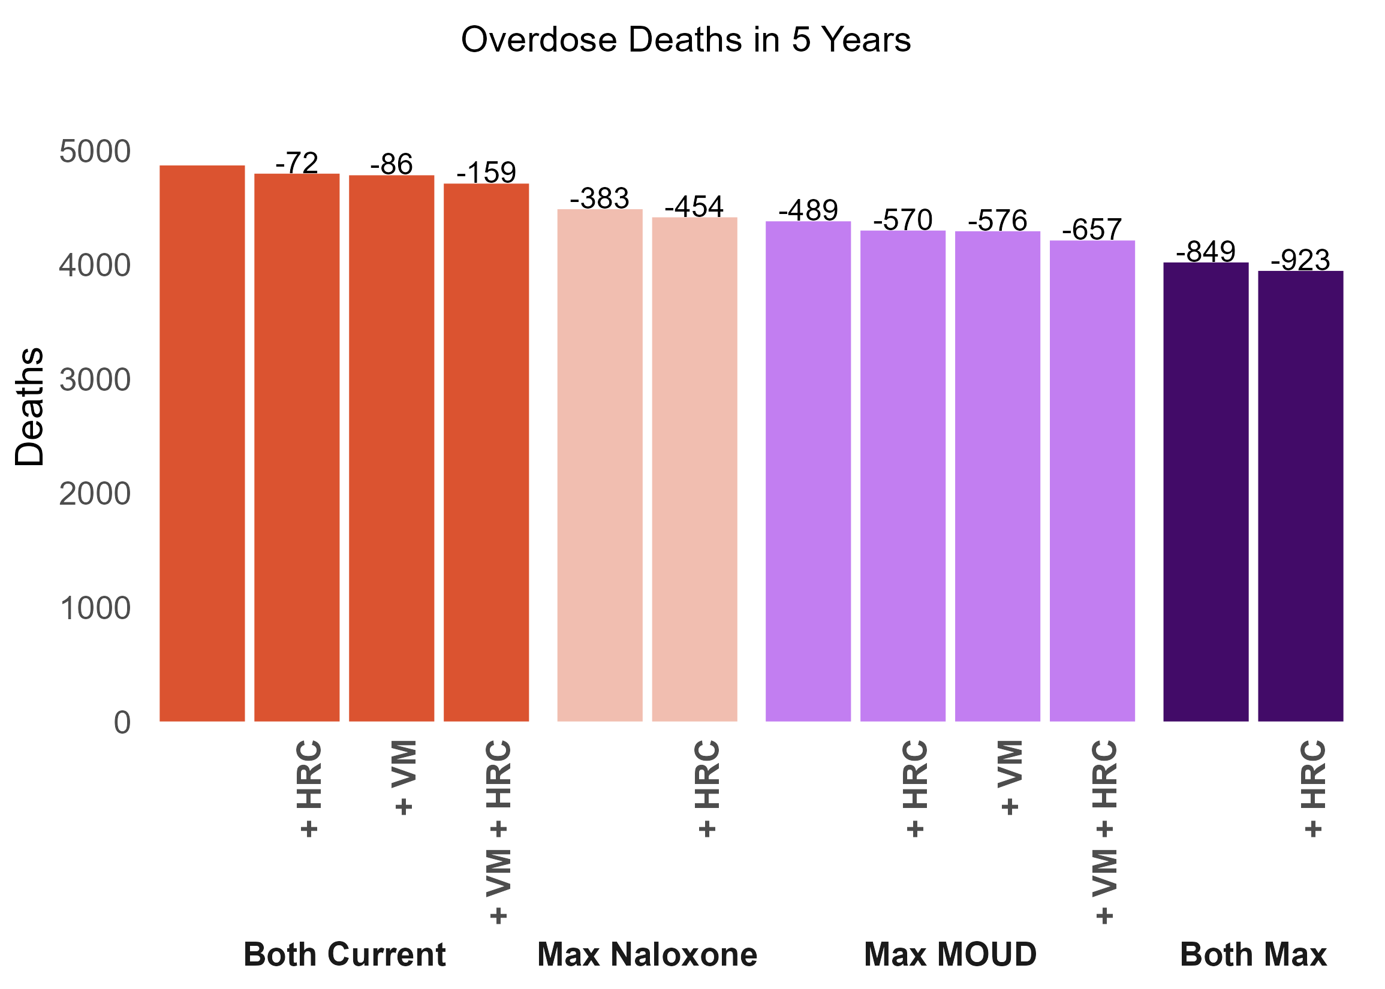
Current:
current levels of MOUD and NLX
Max:
maximized levels of MOUD and/or NLX
VM:
6 vending machines
HRC:
8 centers, 60 annual visits
*
*
*+VM not explored as saturation is already reached

Slide 22
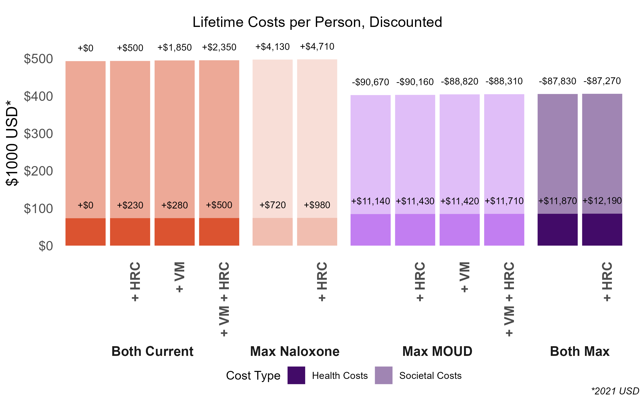
Current:
current levels of MOUD and NLX
Max:
maximized levels of MOUD and/or NLX
VM:
6 vending machines
HRC:
8 centers, 60 annual visits

Slide 23
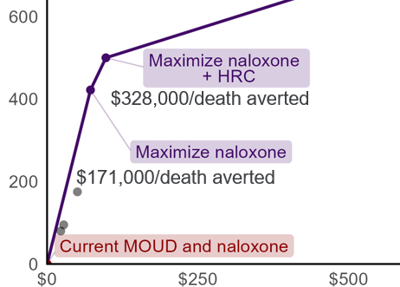
Incremental cost-effectiveness ratios and the efficient frontier
Efficient Frontier, Illustrative Example
The incremental cost-effectiveness ratio (ICER) is the incremental gain in benefit over the incremental increase in cost for an intervention compared to the next-best intervention
Overdose deaths averted
Incremental discounted cost (Million USD)*
*2021 USD, discounted at 3%
Notes:
This frontier compares the incremental discounted cost versus overdose deaths averted for interventions compared to baseline, which is on the lower left. The strategies on the frontier are cost-effective, while the strategies that aren’t are dominated because they are either more expensive, less effective, or both.
We see that adding NLX costs an additional $2,000 per person over their lifetime, gaining nearly 0.2 QALYs, meaning the incremental cost-effectiveness ratio is $9,000 per QALY compared to baseline. Adding MOUD-COM results in almost 1 QALY from baseline at a cost of about $17,000. The incremental cost-effectiveness ratio for this strategy is $19,000, as there’s a gain in about 0.7 QALYs with a cost increase of about $15,000. When we add MOUD-INC, thereby scaling all strategies, there’s a total gain of a little over 1 QALY for a little over $20,000. This is cost-effective compared to baseline, but the incremental gain from the previous strategy of MOUD-COM and NLX for an additional $3,000 means that its ICER is borderline unfavorable at $94,000/QALY.

Slide 24
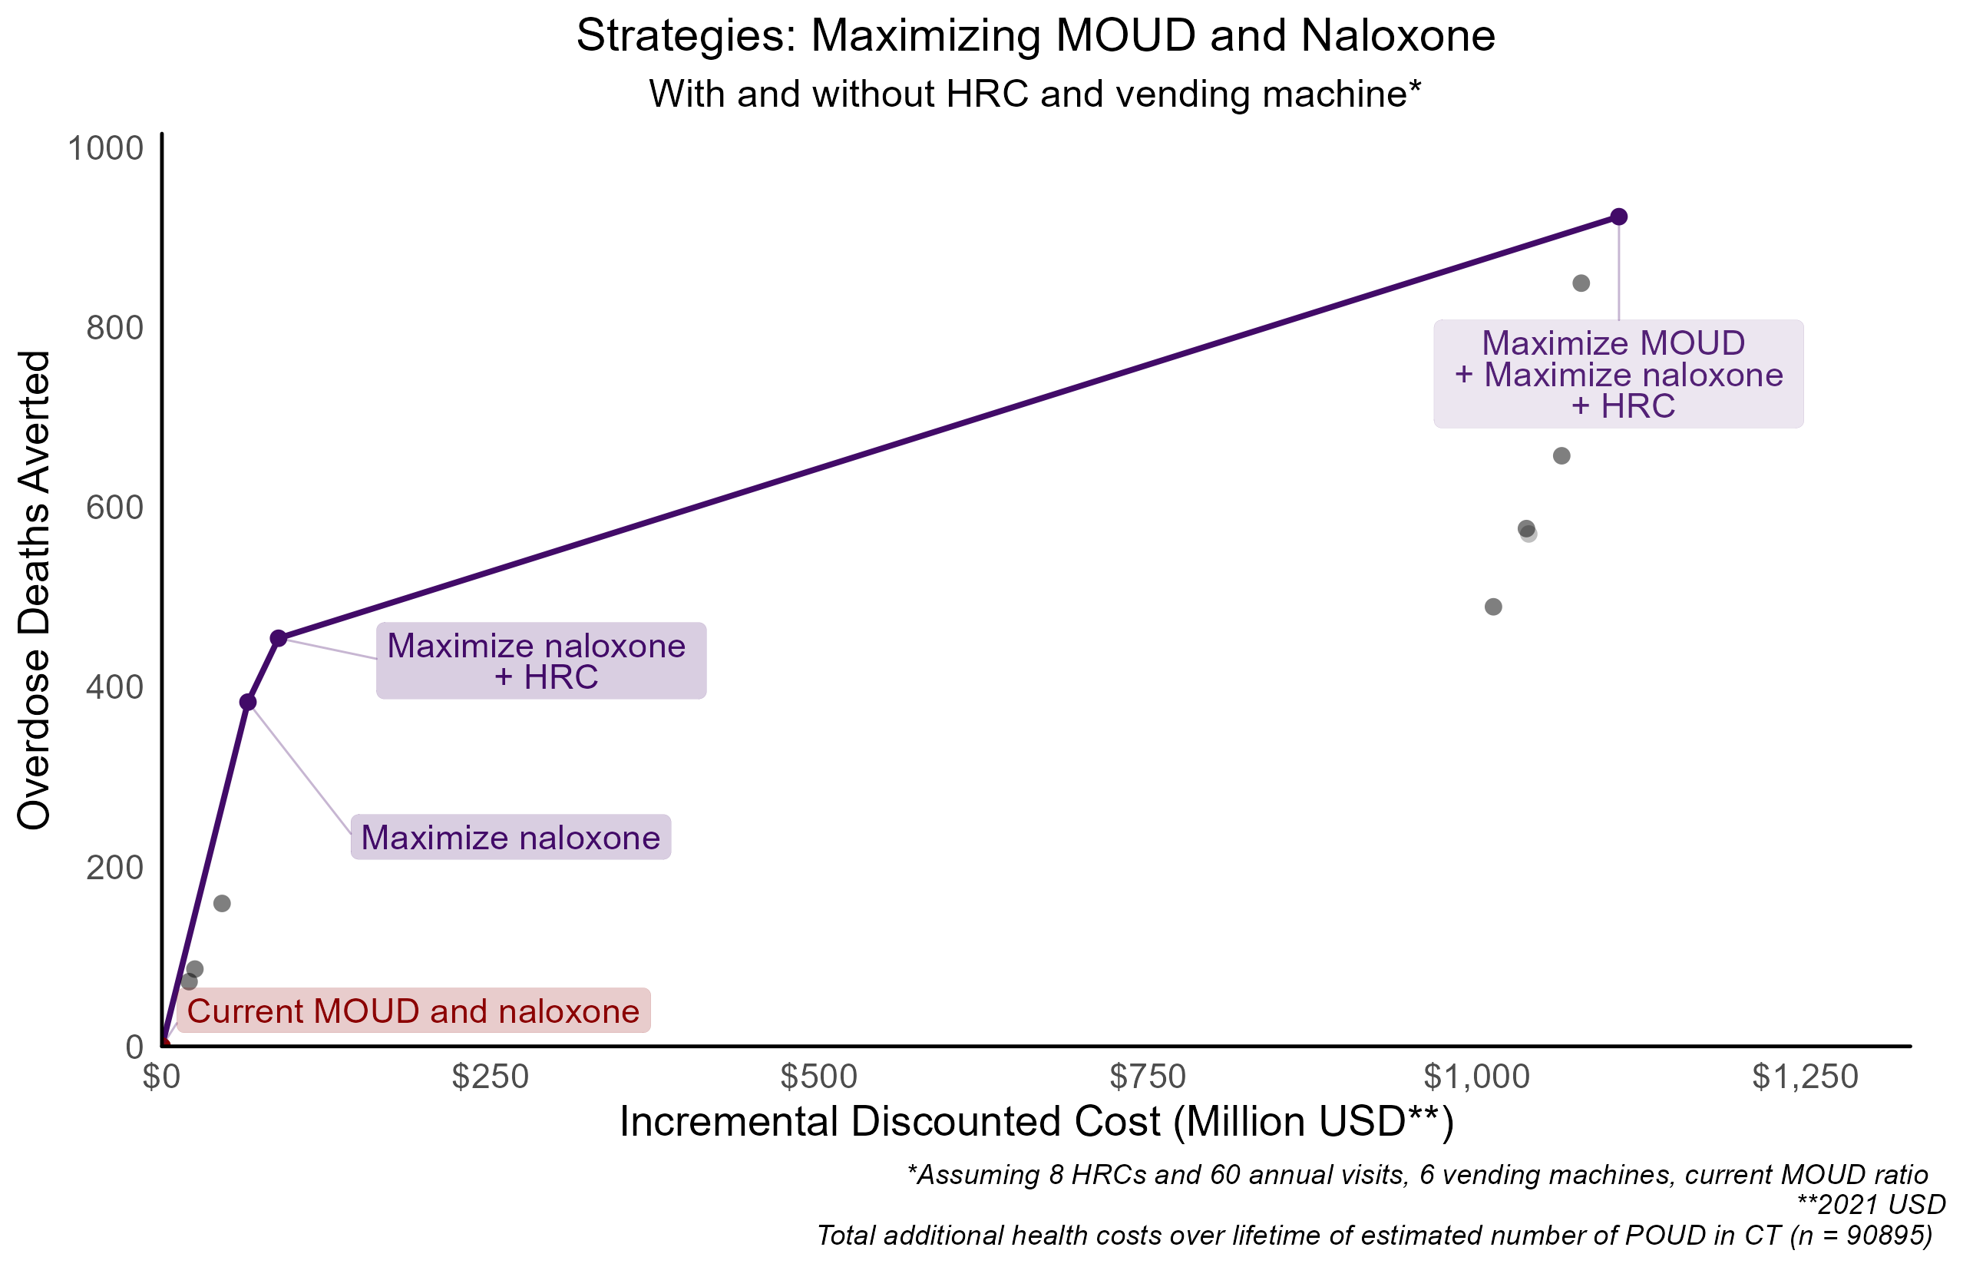
$2,173,000/death averted
$327,000/death averted
$171,000/death averted

Slide 25
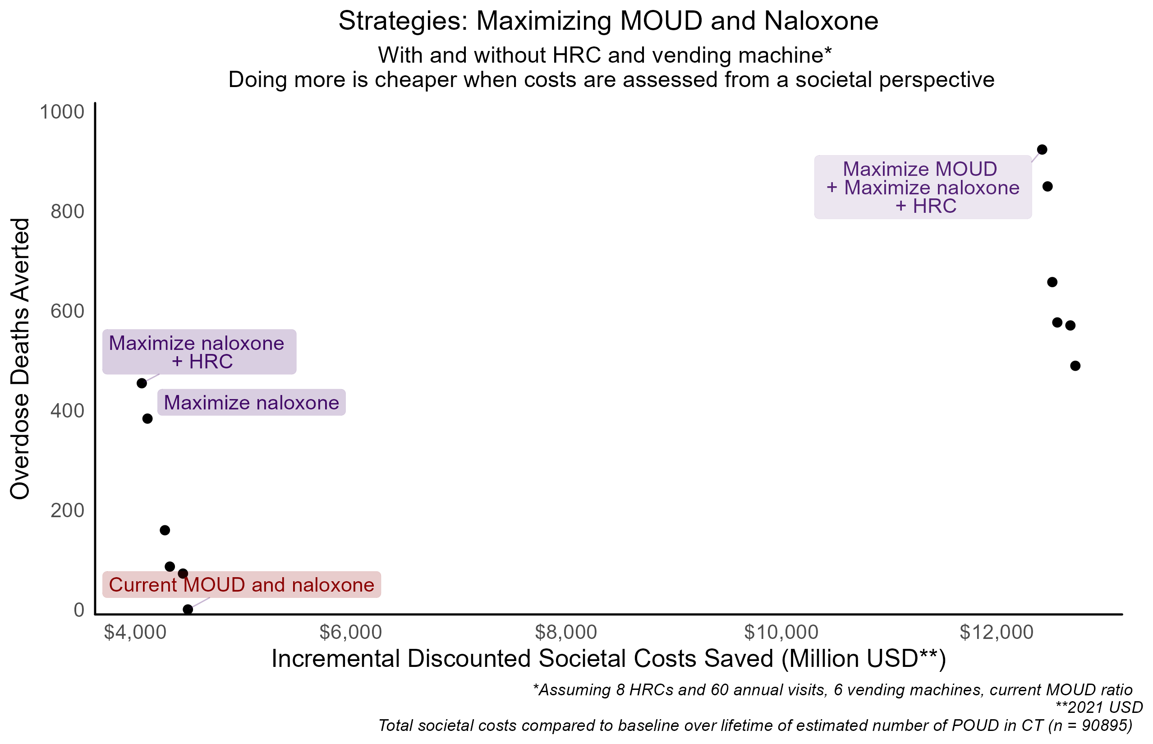

Slide 26
Conclusion: Maximizing NLX through vending and other
At current MOUD levels,
  Through 6 vending machines alone, averts 86 overdose deaths over 5 years (2% reduction from status quo)
  Through community routes alone, averts 143 overdose deaths over 5 years (3% reduction from status quo)
  Through SSPs alone, averts 240 overdose deaths over 5 years (5% reduction from status quo)
  Through all routes, at saturation, averts 383 overdose deaths over 5 years (8% reduction from status quo)

Slide 27
Conclusion: Maximizing MOUD in incarceration and community
At current naloxone levels,
  In incarceration, averts 269 overdose deaths over 5 years (6% reduction from status quo)
  In the community, averts 374 overdose deaths over 5 years (8% reduction from status quo)
  In both, averts 489 overdose deaths in 5 years (10% reduction from status quo)

