Slide 1
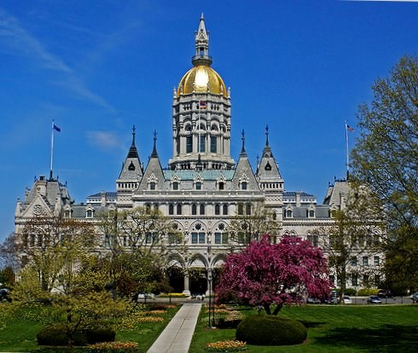
Reportable Events for Chronic & Convalescent Nursing Homes
Connecticut Department of Public Health
Facility Licensing and Investigations Section
Sep 2018

Slide 2
Reportable Events System Overview
CT DPH FLIS has overall administrative authority of the application:
  Approve facility administrators.
  Allows review of submitted reportable events and summary.
  Website hosted at CT State Data Center behind secure firewalls.
  Go-Live date is 11/01/2018 (Pilot facilities 25-Sep-2018)

Slide 3
New Features of web based DPH FLIS Reportable Events System
  Notification changed from Phone Call to Web based notification.
  Initiates a reportable event with basic information about the event which notifies DPH-FLIS.
    Facility must submit the full event within 72hrs.
  After normal business hours Duty Officers are automatically notified of an event based on the event types.
  Classification E events are not included in the events web reporting. Facilities need to maintain this registry locally.
    Separate sequential numbering for E events (For Ex: Lice#-Year-E##).
    Should not be the same as DPH FLIS events automated sequential number for other classifications.
  Bi-directional Communication with DPH FLIS team through the web based events system and retains history.
  Facility Administrators for each facility have full Admin Powers to create/delete/activate/inactivate users for their assigned facility.
  Display all Reportable Events and track them via Web Application.

Slide 4
Automated Duty Officer Notification
Events that trigger Automatic Notification:
Facility Evacuation including lateral evacuation
Any Fire or Smoke
Sprinkler impairment
Fire alarm impairment
Generator impairment
Natural/internal disaster causing facility damage
Facility evacuation
Missing resident (e.g. elopement or failure to return from LOA)
Choking resulting in death and/or need for Resuscitation
Any incident resulting in an unanticipated death
Allegation of abuse/neglect with harm and any sexual assault
Loss of Heat

Slide 5
Facility Roles
    There are 2 facility user types (administrator and user).
    A facility administrator/user will be able to see only their approved facility events
    Facility User
    All users can submit reportable events and summary through the DPH FLIS Events website.
  Facility Administrator
    Facility Administrator will be able to create, delete, activate, inactivate user accounts for their approved facility.
    Facility administrators can create only facility users and not administrators for their facility. Only DPH-FLIS has control to activate/approve facility administrators.

Slide 6
Facility Administrator Registration
Please submit the facility administrators list for your facility in the below survey link. Only these facility admins will be approved and will have access to the DPH FLIS Reportable Events System.
Survey Monkey Link: https://www.surveymonkey.com/r/eventsfacilityadmin

Slide 7
Questions?

Slide 8
Thank You

