Slide 1
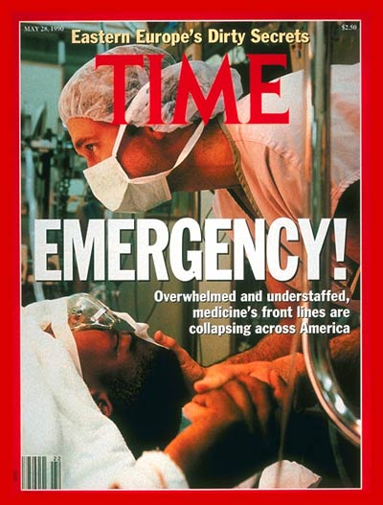
The Canary: The ED
David Marcozzi, MD, MHS-CL, FACEP

Slide 2
Disclosures
My remarks are my own and do not represent the UMMC, UMSOM, UMB or UMMS.
Prior public servant
  Federal Gov for a decade
  State Senior Advisor for COVID
  Practicing EM physician, but administrative mostly
20+ years in DoD
“ER wait times, by state” Kelly Gooch –February 24th, 2022
  According to research by IT service automation company SysAid, Maryland is the state where patients spend the longest time in the emergency department before leaving the hospital.
https://www.beckershospitalreview.com/rankings-and-ratings/er-wait-times-by-state.html

Slide 3



2006 Institute of Medicine

Slide 4
Emergency Department Benchmarking Alliance
2022 Report from the consortium of more than 1,500 EDs nationwide
Takeaways:
  Healthcare leaders should plan for ED volumes to remain stable or slowly increase over the next year, EDBA said.
  The average length of stay for all ED patients was 205 minutes in 2022, up from 182 minutes in 2019.
  In 2022, the average ED boarding time was 175 minutes, accounting for about 44 percent of the time admitted patients spent in the ED. This figure is up from 167 minutes in 2021 and 121 minutes in 2020.
  The percentage of patients who left the ED before completing treatment increased from 2.7 percent in 2019 to 4.9 percent in 2022-equates to about 7.6 million patients
https://www.beckershospitalreview.com/care-coordination/ed-boarding-times-rise-in-2022-4-notes.html?oly_enc_id=8819F0597689D3S

Slide 5
Trends in the Contribution of Emergency Departments to the Provision of Hospital-Associated Health Care in the USA
Traditional approaches to assessing the health of populations focus on the use of primary care and the delivery of care through patient-centered homes, managed care resources, and accountable care organizations.
Our study aimed to determine the contribution of EDs to the health care received by Americans between 1996 and 2010 and to compare it with the contribution of outpatient and inpatient services using National Hospital Ambulatory Medical Care Survey and National Hospital Discharge Survey databases.
We found that EDs contributed an average of 47.7% of the hospital-associated medical care delivered in the United States, and this percentage increased steadily over the 14-year study period.
EDs are a major source of medical care in the United States, especially for vulnerable populations, and this contribution increased throughout the study period.
Including emergency care within health reform and population health efforts would prove valuable to supporting the health of the nation.
Marcozzi D, Carr B, Liferidge A, Baehr N, Browne B. Trends in the Contribution of Emergency Departments to the Provision of Hospital-Associated Health Care in the USA. Int J Health Serv. 2018 Apr;48(2):267-288. doi: 10.1177/0020731417734498. Epub 2017 Oct 17. PMID: 29039720.

Slide 6
Access + Quality = Outcome

Slide 7
Why go to the ED???
Care centric
  True emergencies
Customer-centric
  One-stop process
  24-hour access
  All ages
  All conditions
  No insurance needed
  Symptom-driven model

Slide 8
The Main Problem isn’t the ED

Slide 9
Why don’t we just create more EDs?

Slide 10
Who is responsible for ED Boarding?
FEDS
States
Cities
Insurers
Hospitals
Providers
SNF/LTC
Code Leader?

Slide 11
Prioritizing ED admissions?
Good
  Less LOS
  Less Boarding
  Less LWBS
  More Access to ED care
  Payor mix changes
Bad
  Less direct admissions to the floor
  More patients referred to ED
  Payor mix changes
  Less access for complex care

Slide 12
Maryland Model
The Maryland All-Payer Model, launched in 2014, established global budgets for certain Maryland hospitals to reduce Medicare hospital expenditures and improve quality of care for beneficiaries.
Global budgets provide hospitals with a fixed amount of revenue for the upcoming year.
  A global budget encourages hospitals to eliminate unnecessary hospitalizations, among other benefits. Under the All-Payer Model, Maryland achieved significant savings for Medicare and improved quality.

Slide 13
Maryland TCOC Model
The Maryland Total Cost of Care Model (MD TCOC) builds on lessons from the Maryland All-Payer Model to establish pricing of medical services provided by hospitals, primary care doctors and specialists across all payers.
In the unique arrangement between Maryland and CMS, the state is fully accountable for the cost and quality of care for each patient with Medicare.
The model aims to improve Marylanders’ overall health, reduce avoidable hospital readmissions and emergency department visits, and improve the patient experience in health care settings.

Slide 14
HSCRC Quality-Based Reimbursement
Rate Year 2026
Quality Based Reimbursement (QBR)
Person and Community Engagement (60%) Measured Oct 2023 – Sept 2024)
  8 HCAHPS measures top box score and 4 HCAHPS measures linear score
  Timely Follow Up after Discharge (Jan-Dec 2024)
  Timely Follow Up After Discharge Disparity Metric (Jan-Dec 2024)
  ED Length of Stay (ED-1)
Safety (30%) Measured Oct 2023 – Sept 2024
  Hospital Acquired Infections (SIR) reported to NHSN
    CLABSI, CAUTI, C Difficile, MRSA Bacteremia, SSI Colon and Hysterectomy
  AHRQ PSI-90 (Jan-Dec 2024) Composite Measure
Clinical Care (10%) Measured Jan-Dec 2024)
  IP all Cause Mortality
  30 Day Mortality
  Budget Impact
  +2.0%/-2.0% at Risk Revenue Based on hospital performance compared to HSCRC scaling model
14
Notes:
Updated slide 4/19/2023 with info from “HSCRC Quality Policy Overview CY2023 and CY2024 Measurement Period” slide deck as of 4/11/2024 prepared by UMMS Reimbursement & Revenue Advisory Services
Summary of Major Changes outlined on next slide.

Slide 15
Maryland ED Measures
*ED-1 Median Time from ED Arrival to ED Departure for admitted patients
EMS Median Turnaround Times
OP-18 Median Time from ED Arrival to ED Departure for discharged ED patients.

Slide 16
States Advancing All-Payer Health Equity Approaches and Development (AHEAD) Model
On July 2, 2024, CMS announced that Connecticut, Maryland, and Vermont will be the first states to participate Advancing All-Payer Health Equity Approaches and Development (AHEAD) Model.
A new voluntary, state total cost of care (TCOC) model: the States Advancing All-Payer Health Equity Approaches and Development Model (“States Advancing AHEAD” or “AHEAD” Model).
CMS’s goal in the AHEAD Model is to collaborate with states to curb healthcare cost growth, improve population health, and advance health equity by reducing disparities in health outcomes.
CMS will support participating states through various AHEAD Model components that aim to increase investment in primary care, provide financial stability for hospitals, and support beneficiary connection to community resources.

Slide 17
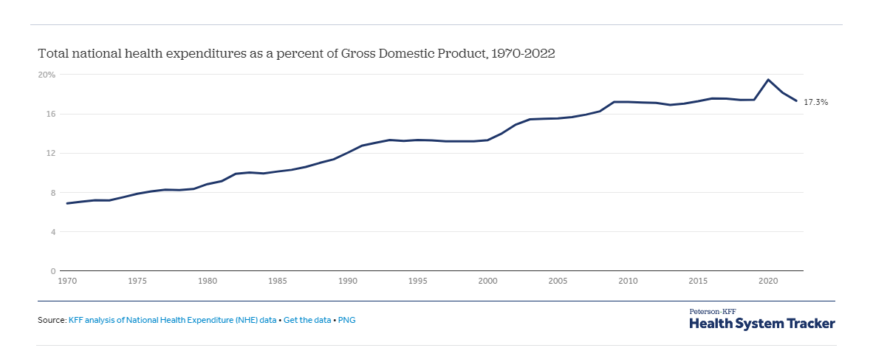
NHE

Slide 18
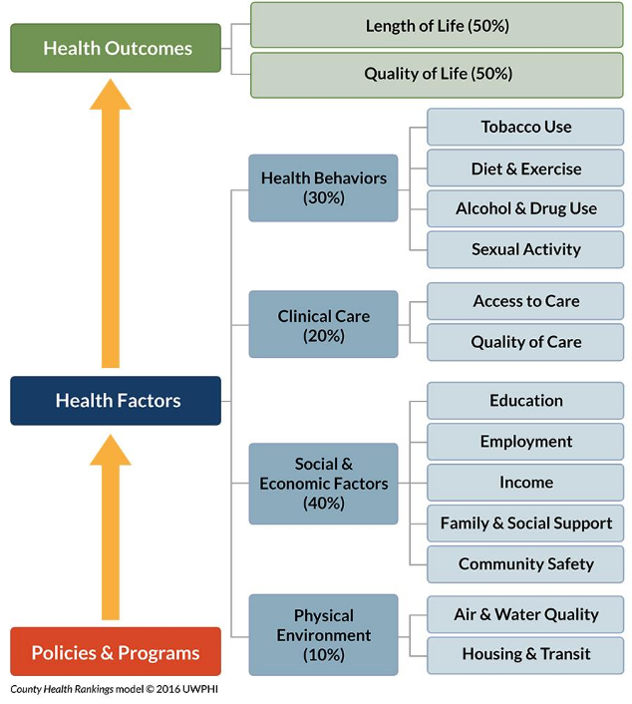
Magnan, S. 2017. Social Determinants of Health 101 for Health Care: Five Plus Five. NAM Perspectives. Discussion Paper, National Academy of Medicine, Washington, DC.

Slide 19
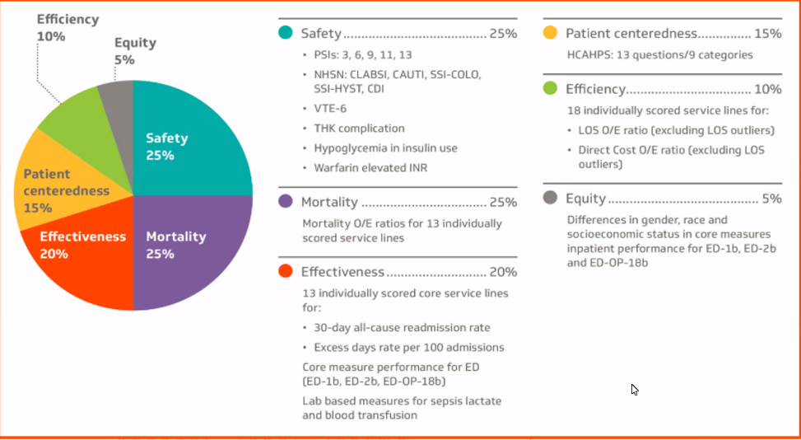
Vizient

Slide 20
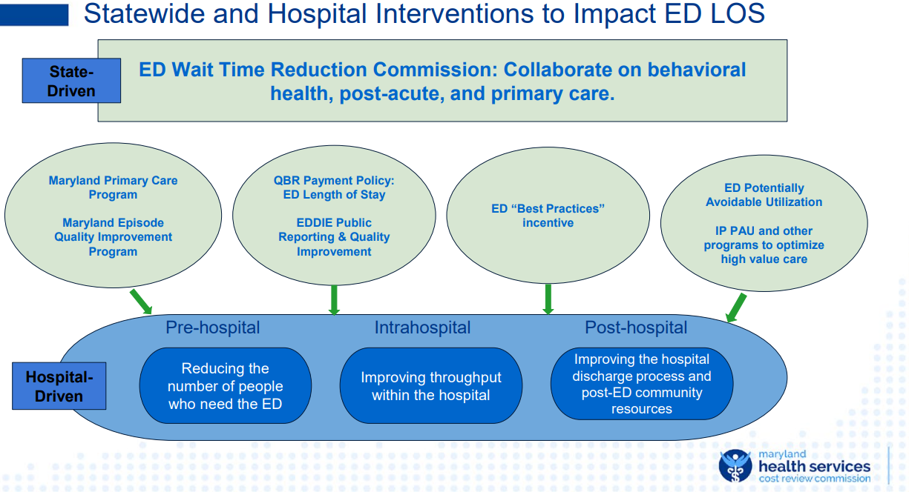

Slide 21
Past Due for Change
The status quo can’t be
Continued study is needed, but action is required
Don’t do one thing; consider and do many
  It isn’t solved with one measure
Define the accountable actor for the change
Every action has a reaction and unintended consequence
Be evolutionary and revolutionary
  Small changes will create little change
Be bold

Slide 22
The Coal mine: The System
Conduct population-based needs analysis
  AMB access
  SNF/LTC beds
  Hospital IP capacity
Transitions of Care
  Incentive SNF/LTC to accept patients from hospitals
  Encourage adoption of RPM and telehealth opportunities
  Improve the efficiency of prior authorization models for placement
  Establish evaluation/treatment ‘go-teams’ for LTC patients (POC labs/IVF/Meds)
Ambulatory access
  Explore/encourage safe procedural opportunities for outpatient management
  ‘One Day Earlier’ concept
  Create different clinic hours
  Timely follow-up measure
  Increase clinic capacity
Hospitals
  Conduct a procedural constraint analysis (round trip processes)
  Examine hospital bed ratios (ICU:IMC:floor:ambulatory) for improved flow and timely follow-up
    Report capacity to include ED Boarders
  Prioritize ED-admitted bed assignments
  Track ED disposition time for non-admitted patients
  Surgical smoothing
  Consider needed weekend capabilities to impact flow
  Estimated Day of Discharge and Discharge By Noon measures
  Meds to Bed programs
Cities/States/Feds
  Establish measures linked to incentives c/w national measures
  Data-public reporting-ED wait times? Boarding?
  Incentivize innovative out-of-hospital care models
    Pilot projects with expectations for scaling
  Establish health/civic planner partnerships to address SDOH challenges
  Ensure SDOH analyses guide investments
  Track ED Boarders and % in hospitals
  Assist with the translation of SDOH data into deliverables outside “healthcare”
  Factor in ED boarders within a healthcare capacity assessments
  Midnight census?
Insurers
  Incentivize models-AMB call to first visit
  Partner to encourage flow, access to providers (telehealth), RPM reimbursement
  Consider all payor models
  Evaluate SDOH reimbursement/support opportunities with the greatest impact on health (transport)
  Establish meds-to-home mechanisms
Providers/education
  Encourage a broader workforce and innovate the healthcare workforce
  Ensure APPs/pharmacists/nurses/etc practice at top of license
  Community health workers
  Examine HCW projected needs and ensure that school capacity ensures needs are met

Slide 23
Thank you

