Slide 1
Trauma-informed care in a time of covid-19: promoting healing
Sheri Gibson, Ph.D.
www.DrSheriGibson.com

Slide 2

A Shattered World
Notes:
The coronavirus has infected millions of people and has killed tens of thousands across the globe. A vaccine is perhaps a year away and the long haul we face begs the question: how will people respond to and bounce back from adversity as the pandemic waxes and wanes? What will “post pandemic” look like and will our society prove to be a resilient one?
While scientists are continually trying to understand the multiple layers of physical illness associated with COVID-19, the stressors associated with the pandemic are also likely to have serious mental health consequences. It is quite normal to experience distress as a result of chronic stress of this magnitude.

Slide 3

“One size does not fit all”
Notes:
Losses that are real (of loved ones, without the opportunity for a ritual funeral)
Losses that are symbolic (graduation celebrations, mother’s day, father’s day, milestones)
Grief for many, and unresolved grief for some
There will be no one size fits all response to this crisis.

Slide 4
Individual Responses are Multifaceted
Pre-pandemic circumstances and resources
  Prior exposure to adversity
  Physical and mental health vulnerabilities
  Economic and social supports
Exposures encountered since the pandemic:
  Illness of a family member
  Loss of job or health insurance
  Job status – essential health care workers
  Time immersed in social media, news, over-exposure to information
  Community-level stressors – e.g., “Hot spots”
Notes:
Community level stessors:
Did the person live in a “hot spot”? Did shops and restaurants close, never to reopen? Was there unambiguous guidance from your state’s governor that was backed by the best science?
Emotional and behavioral responses to this ongoing crisis will be multidetermined but not random. Meaning that psychological science has isolated risk factors that can guide health care providers and social service organizations to identify the most psychologically vulnerable among us. So, when we talk about trauma response, I am referring to not only the residents and families that you are charged with serving, but also your staff and your colleagues at the leadership level.

Slide 5
Trauma-Informed Care
SAMHSA’s Trauma-Informed Approach:
  Behavioral Health is essential to health
  Prevention works
  Treatment is effective

Slide 6
Trauma Informed Care Elements
Understanding the prevalence of trauma
Recognizing how trauma impacts individuals
Putting this knowledge into practice
to actively resist re-traumatization
SAMHSA

Slide 7
Approach is Key
Notes:
The underlying question is not “What’s wrong with you?” but “What happened to you?”
• What are often called symptoms are actually adaptations to traumatic events.
• Healing happens in relationships.
Possible Video: Power of Empathy

Slide 8
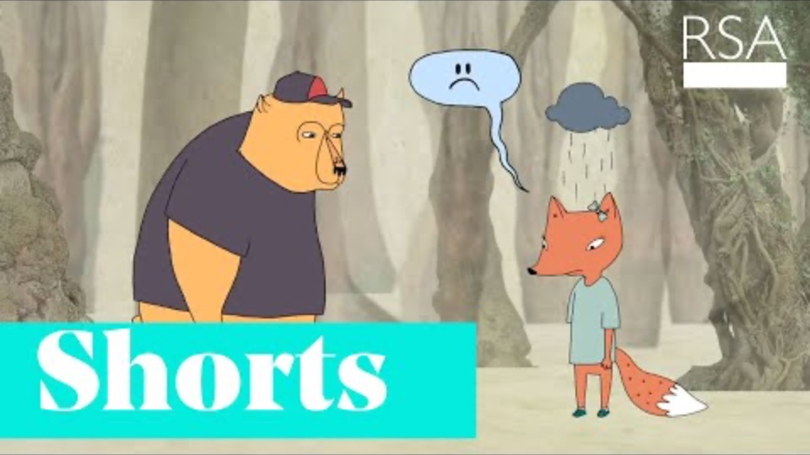
Prevalence of Trauma: Approach
Video: Power of Empathy

Slide 9
What is Trauma?
Individual trauma results from an event, series of events, or set of circumstances experienced by an individual as physically or emotionally harmful or life threatening and that has lasting adverse effects on the individual’s functioning and mental, physical, social, emotional, or spiritual well-being
Notes:
This framework for understanding trauma was developed by a working group of researchers, practitioners, trauma survivors, and family members convened by SAMHSA.
It is important because it creates a framework for understanding the complex nature of trauma
• The focus on events places the cause of trauma in the environment not in some defect of the individual. This is what underlies the basic credo of Trauma Informed approaches: “It’s not what’s wrong with you, but what happened to you.”
• The focus on experience highlights the fact that not every child or adult will experience the same events as traumatic.
• The identification of a broad range of potential effects reminds us that our response must be holistic—it’s not enough to focus on symptoms or behaviors. Our goal is to support a child to learn and grow or an adult to live a satisfying life.

Slide 10
Potential Traumatic Events
Abuse
Emotional
Sexual
Physical
Domestic violence
Witnessing violence
Bullying
Cyberbullying
Institutional
Chronic Stressors
Poverty
Racism
Invasive medical procedure
Community trauma
Historical trauma
Family member with substance use disorder
Loss
Death
Abandonment
Neglect
Separation
Natural disaster
Accidents
Terrorism
War
Notes:
There is a very wide range of events that can potentially cause trauma.
• Trauma can be caused by events that the individual doesn’t remember, such as events that occurred in early childhood.
• Trauma can be caused by events that are well-intentioned and necessary, such as medical procedures.
• Trauma can be caused by an event that didn’t happen to the person but to a group that he or she identifies closely with—as in slavery or the Holocaust or the genocide of the Native American people.
• Over time, chronic stressors can accumulate to cause trauma.
INSTRUCTOR GUIDANCE
It is particularly important to emphasize that many people experience multiple traumatic experiences over the lifespan. While the immediate focus might be on a recent event, the individual’s reaction to that event may be affected by earlier experiences.
**Ask participants for an example describing how people they serve may experience multiple sources of trauma

Slide 11
Prevalence of Trauma
Exposure to trauma is ubiquitous: seven out of ten respondents worldwide and nine out of ten adults in the USA report experiencing one or more lifetime traumas.
Fink, Galea, 2015
Notes:
The majority of persons exposed to trauma endure mild to moderate
psychological distress followed by a return to pre-trauma
health shortly thereafter [7]. Nevertheless, a substantial proportion
of persons exposed to traumatic events develop chronic
pathological symptoms that may be debilitating and last for
several years.
Psychopathology in response to trauma represents a consequence of the complex
accumulation and interaction of life experiences that
range from social to biological factors that occur over the life
span—from gestation to death and across generations
Trauma can be cumulative.

Slide 12

Impact of Trauma

Slide 13
Impact of Trauma on the Brain
The brain has a bottom-up organization
Experiences build brain architecture
Fear activates the amygdala and shuts down the frontal lobes of the cortex.
Toxic stress derails healthy development, and interferes with normal functioning
Perry, 2006
Notes:
• The brain has a bottom-up organization.
• The bottom regions (i.e., brainstem and midbrain) control the most simple functions such as respiration, heart rate and blood pressure regulation.
• The top areas (i.e., limbic and cortex) control more complex functions such as thinking and regulating emotions.
• At birth, the human brain is undeveloped. Not all of the brain's areas are organized and fully functional.
• During childhood brain matures and the whole set of brain-related capabilities develop in sequence. For example, we crawl before we walk, we babble before we talk.
• The development of the brain during infancy and childhood follows the bottom-up structure.
• The most regulatory, bottom regions of the brain develop first; followed, in sequence, by adjacent but higher, more complex regions.
• The process of sequential development of the brain and is guided by experience.
• The brain develops and modifies itself in response to experience.
Note: This information is from the work of Bruce D. Perry, M.D., Ph.D., an internationally recognized authority on brain development and children in crisis. (www.ChildTrauma.org).
Chronic or severe trauma can activate flight or fight reflex, and can leave it on, without activating relaxation response.

Slide 14
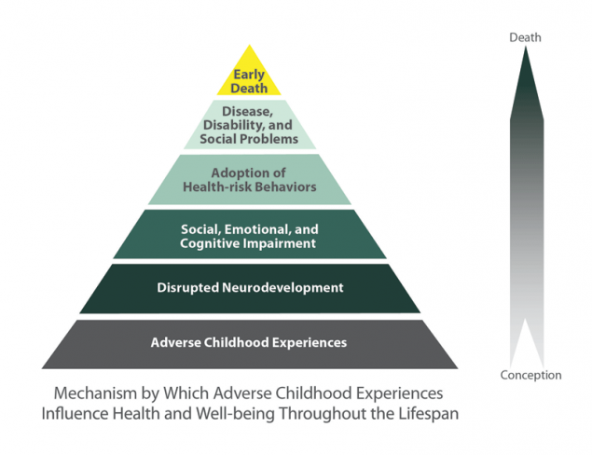
Impact of Trauma:
Adverse Childhood Experiences
CDC
Notes:
TALKING POINTS
• Perhaps one of the largest, if not the largest, ongoing health risk studies that established this relationship between trauma exposure and physical health is the ACE Study, organized by the CDC and Kaiser Permanente in San Diego, CA
• Researchers surveyed more than 17,000 insured individuals from 1995-1997 about their history of ACEs.
• The ACE Study uses the ACE Score, which is a count of the total number of ACEs respondents reported, to assess the total amount of stress during childhood.
Findings:
• Childhood abuse, neglect, and exposure to other traumatic stressors (ACEs) are common.
• Almost two-thirds of study participants reported at least 1 ACE, and more than 1 in 5 reported 3 or more ACE.
• The short- and long-term outcomes of these childhood exposures include a multitude of health and social problems.
• As the number of ACEs increases, the risk for the types of health problems on the previous slide increases in a strong and graded fashion and with that a direct, negative impact on mortality and longevity.

Slide 15
Impact of Trauma
The effect of trauma on an individual can be conceptualized as a normal response to an abnormal situation

Slide 16
Impact of Trauma:
Problems OR Adaptations?
“Non-compliant, combative”
OR
Struggling to regain or hold onto personal power
Fight
“Treatment resistant, uncooperative”
OR
Disengaging, withdrawing
Flight
“Passive, unmotivated”
OR
Giving in to those in power
Freeze
Notes:
• The fight, flight or freeze responses are activated by danger. Some common behaviors of trauma survivors—behaviors that are often labeled as “problems” by the mental health system—can be linked to these responses and to the effects that trauma has on the brain.
• This slide lists three sets of “problems” that are often attributed to people in the mental health system and shows how the behavior may be a survival mechanism tied to a flight, flight or freeze response.
• First is the fight response. In the mental health system, someone who struggles too hard to hold onto personal power may be labeled as non-compliant or combative.
• Second is the flight response. In the mental health system, anyone who emotionally withdraws or disengages too much may be labeled as treatment resistant or uncooperative.
• Third is the freeze response. In the mental health system, anyone who gives in too easily to authority may be labeled as passive or unmotivated.
• Many of the people we serve have survived circumstances we can hardly imagine. What we often label as pathological may be the very things that helped them to survive.
• When we take a Trauma Informed approach, we recognize “symptoms” and “problem behaviors” as adaptations to trauma, frequently including the feelings of helplessness and loss of control trauma often causes.

Slide 17
Impact of Trauma:
Signs of Trauma Responses
Flashbacks or frequent nightmares
Sensitivity to noise or to being touched
Always expecting something bad to happen
Not remembering periods of one’s life
Feeling emotionally numb
Lack of concentration
Irritability
Excessive watchfulness, anxiety, anger, shame or sadness
Additional Signs
Notes:
• None of these signs is always associated with trauma.
• Each of these signs can be adaptations to the neurobiological changes that we discussed earlier.
• Each of these behaviors can in fact play an important role in the person’s life—they may protect the person or help them to survive.

Slide 18
Practice of
Trauma Informed Care during COVID-19

Slide 19
Trauma Brain = Dysregulated Behavior
As residents’ anxiety increases, their “thinking” brains become less engaged and behavior becomes more dysregulated.
YOU can develop skills to help residents regulate and related by becoming calmer and more connected.
This is achieved by:
  Warmth
  Validation
  Flexibility
  Structure
  Hope for the future
  Humor
  Being part of a connected community

Slide 20

Who best to do that?
Notes:
A calm and regulated staff

Slide 21

Skill Development

Slide 22
Eleven things never to say to anyone
Come here.
You wouldn’t understand.
Because those are the rules.
It’s none of your business.
What do you want me to do about it?
Calm down.
What’s your problem?
You never (or) you always.
I’m not going to say this again.
I’m doing this for your own good.
Why don’t you be reasonable?

Slide 23
Statements:
Reflection, Empathy, Validation
Verbally reflect another’s emotional state:
  “It sounds like you feel very angry about this.”
Offer the ultimate empathic statement:
  “Let me be sure what I heard is what you just said.”
Validate the person’s emotions:
  “You had to wait three days for me to return your call, and your question was really important to you. I understand why you’re made about this.”

Slide 24
Be Concise
When persons are agitated, their ability to process verbal information may be compromised; thus, use short sentences and simple vocabulary.
Give the individual time to process what has been been said to him/her and to respond before providing additional information.

Slide 25
Repetition is essential
Persistently repeat your message until it is heard.
Repetition is essential whenever making request, setting limits, offering choices, or proposing alternatives.
Combine this skill with assertiveness skills such as active listening and agreeing with the individual’s position whenever possible.

Slide 26
Identify Wants and Feelings
Whether or not a request by the individual can be fulfilled or granted, all persons need to be asked what their request is:
  “I really need to know what you expected when you came here” and,
  “Even if I cannot provide it, I would like to know so we can work on it.”

Slide 27
Use Active Listening
Convey through verbal acknowledgement, conversation, and body language that you are really paying attention to the individual, and what they are saying and feeling.
Use clarifying statements such as, “Tell me if I have this right…”
This does not mean you agree with the individual, but that you understanding what he/she is saying.

Slide 28

It’s not about the nail

Slide 29
Agree or Agree to Disagree
Find something about the person’s position with which you can agree. Three ways to agree:
  Agree with the truth. (“Yes, it is warm in here; let me see if I can adjust the temperature”)
  Agree in principle. (“I believe everyone should be comfortable or free from discomfort.”)
  Agree with the odds. (“There are probably other people here who are also warm.”)
Agree as much as possible – it’s important to acknowledge (in delusional situations) that you have never experienced what the person is experiencing but you believe they are having that experience.
If you can’t honestly agree, then agree to disagree.

Slide 30
Limit Setting: Done in a reasonable and respectful manner
Setting limits demonstrates your intent and desire to help but not to be abused by the person.
If the person is making you feel uncomfortable, this must be acknowledged.
Often times, telling the person that his/her behavior is frightening or provocative is helpful if it is matched with an empathic statement that the desire to help can be interrupted or derailed if you feel angry or fearful.

Slide 31
Coach the Person in How to Stay in Control
Use gentle confrontation with instruction:
“I really want you to sit down; when you pace, I feel frightened, and I can’t pay full attention to what you are saying. I bet you could help me understand if you were to calmly tell me your concerns.”

Slide 32
Offer Choices and Optimism
Offer things that will be perceived as an act of kindness, such as a blanket, magazine, and access to a phone.
Food and drink may be a choice the person is willing to accept that will stall aggressive behaviors.
Be mindful that these choices must be realistic – never deceive a person by promising something that cannot be provided.

Slide 33

See what sticks.

Slide 34
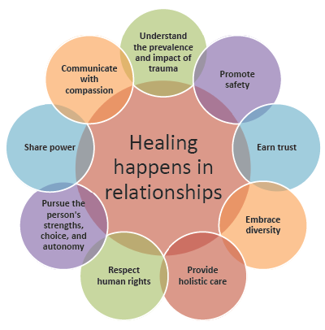

Slide 35

Thank you

Slide 36
Trauma Informed Care:
Further Reading
Judith Herman (2015) Trauma and Recovery
Linda Sanford (1991) Strong at the Broken Places
Robert Sapolsky (2004) Why Zebras Don’t Get Ulcers
Bessel Van Der Kolk (2014). The Body Keeps the Score
Notes:
Fink, D and Galea, S (2015). “Life Course Epidemiology of Trauma and Psychopathology in Civilian Populations” Curr Psychiatry Rep 17:31.

Slide 37
Trauma Informed Care:
Bibliography
Alameda County Behavioral Health Care Services. Trauma Informed Care. alamedacountytraumainformedcare.org
Brown, D. W., Anda, R. F., Tiemeier, H., Felitti, V. J., Edwards, V. J., Croft, J. B., & Giles, W. H. (2009). Adverse childhood experiences and the risk of premature mortality. American Journal of Preventive Medicine, 37, 389–396.
Centers for Disease Control and Prevention. About the CDC-Kaiser ACE Study. https://www.cdc.gov/violenceprevention/acestudy/about.html
Notes:
Fink, D and Galea, S (2015). “Life Course Epidemiology of Trauma and Psychopathology in Civilian Populations” Curr Psychiatry Rep 17:31.

Slide 38
Trauma Informed Care:
Bibliography
Felitti, Vincent J.; Anda, Robert F.; Nordenberg, Dale; Williamson, David; Spitz, Alison; Edwards, Valerie; Koss, Mary; and Marks, James. (1998) Relationship of Child Abuse and Household Dysfunction to Many of the Leading Causes of Death in Adults. American Journal of Preventive Medicine, 14:4, 245-258.
Fink, David S., and Galea, Sandro. (2015). Life Course Epidemiology of Trauma and Related Psychopathology in Civilian Populations. Curr Psychiatry Rep, 17:31.
Lieberman, Leslie. “Walking the Walk: Modeling Trauma Informed Practice in the Training Environment.” Multiplying Connections.
Notes:
Fink, D and Galea, S (2015). “Life Course Epidemiology of Trauma and Psychopathology in Civilian Populations” Curr Psychiatry Rep 17:31.

Slide 39
Trauma Informed Care:
Bibliography
Mueser, K.T., Salyers, M.P., Rosenberg, S.D., Goodman, L.A., Essock, S.M., et al. (2004). Interpersonal Trauma and Posttraumatic Stress Disorder in Patients With Severe Mental Illness: Demographic, Clinical, and Health Correlates. Schizophrenia Bulletin, 30 (1), 45-57 Read et al, 2008
National Center for PTSD. http://www.ptsd.va.gov/public/pages/ptsd_substance_abuse_veterans.asp
Perry, B. D. (2006). Applying principles of neurodevelopment to clinical work with maltreated and traumatized children: The neurosequential model of therapeutics. In Boyd- Webb, N, ed. Working with traumatized youth in child welfare. New York: Guilford Press.
Notes:
Fink, D and Galea, S (2015). “Life Course Epidemiology of Trauma and Psychopathology in Civilian Populations” Curr Psychiatry Rep 17:31.

Slide 40
Trauma Informed Care:
Bibliography
Substance Abuse and Mental Health Services Administration, Center for Mental Health Services, National Center for Trauma Informed Care. SAMHSA’s Trauma Informed Approach: Key Assumptions and Principles Curriculum.
Substance Abuse and Mental Health Services Administration. SAMHSA’s Concept of Trauma and Guidance for a Trauma Informed Approach. HHS Publication No. (SMA) 14-4884. Rockville, MD: Substance Abuse and Mental Health Services Administration, 2014.
SAMHSA (2011). Current Statistics on the Prevalence and Characteristics of People Experiencing Homelessness in the United States. http://homeless.samhsa.gov/ResourceFiles/hrc_factsheet.pdf
SAMHSA (2009) Substance Abuse Treatment: Addressing the Specific Needs of Women. Treatment Improvement Protocol (TIP) Series, No. 51. Center for Substance Abuse Treatment. Rockville (MD): Substance Abuse and Mental Health Services Administration.
Notes:
Fink, D and Galea, S (2015). “Life Course Epidemiology of Trauma and Psychopathology in Civilian Populations” Curr Psychiatry Rep 17:31.

Slide 41
Trauma Informed Care:
Bibliography
Wisconsin Department of Health Services. Trauma Informed Care Skill Development. Wisconsin Department of Health Services, Division of Mental Health and Substance Abuse Services. https://www.dhs.wisconsin.gov/tic/skilldev.pdf
Notes:
Fink, D and Galea, S (2015). “Life Course Epidemiology of Trauma and Psychopathology in Civilian Populations” Curr Psychiatry Rep 17:31.

