Slide 1
Trauma During COVID-19:
Healing Through Relationships
Dr. Sheri Gibson
www.DrSheriGibson.com

Slide 2
Intent of this Training
To Share
To Explore
To Identify
To Answer
Most Importantly – To Remind

Slide 3
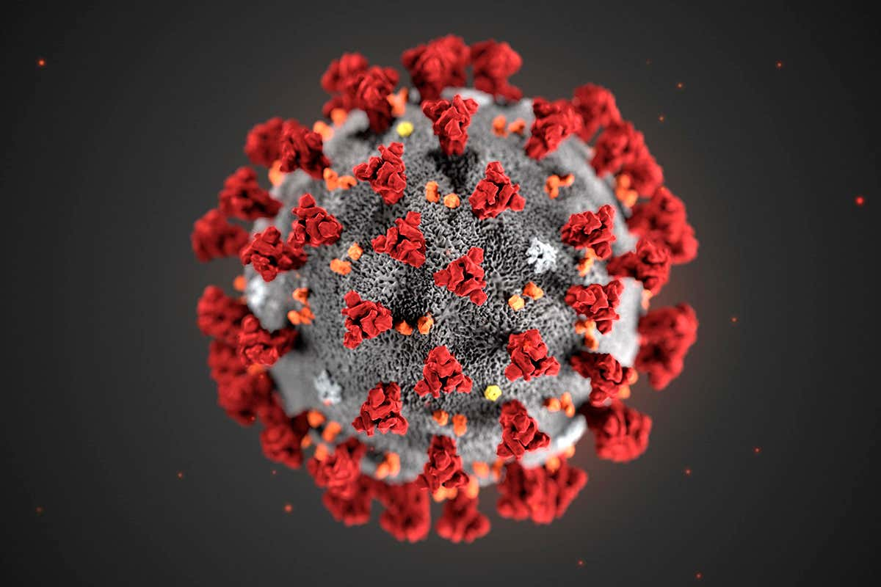
COVID-19
Notes:
Across the globe and across our nation, a large number of cases have been reported, thousands of people have died and hundreds of thousands have been affected. But, no matter the number, each person is an individual which reinforces the need for person centered care.

Slide 4

“One size does not fit all”
Notes:
Losses that are real (of loved ones, without the opportunity for a ritual funeral)
Losses that are symbolic (graduation celebrations, mother’s day, father’s day, milestones)
Grief for many, and unresolved grief for some
There will be no one size fits all response to this crisis.

Slide 5
Individual Responses are Multifaceted
Pre-pandemic circumstances and resources
  Prior exposure to adversity
  Physical and mental health vulnerabilities
  Economic and social supports
Exposures encountered since the pandemic:
  Illness of a family member or a resident
  Loss of job or health insurance
  Job status – essential health care workers
  Time immersed in social media, news, over-exposure to information
  Community-level stressors – e.g., “Hot spots”
Notes:
Community level stessors:
Did the person live in a “hot spot”? Did shops and restaurants close, never to reopen? Was there unambiguous guidance from your state’s governor that was backed by the best science?
Emotional and behavioral responses to this ongoing crisis will be multidetermined but not random. Meaning that psychological science has isolated risk factors that can guide health care providers and social service organizations to identify the most psychologically vulnerable among us. So, when we talk about trauma response, I am referring to not only the residents and families that you are charged with serving, but also your staff and your colleagues at the leadership level.

Slide 6
Trauma-Informed Care
SAMHSA’s Trauma-Informed Approach:
  Behavioral Health is essential to health
  Prevention works
  Treatment is effective

Slide 7
Trauma Informed Care Elements
Understanding the prevalence of trauma
Recognizing how trauma impacts individuals
Putting this knowledge into practice
to actively resist re-traumatization
SAMHSA

Slide 8
Prevalence of Trauma: Approach
Notes:
The underlying question is not “What’s wrong with you?” but “What happened to you?”
• What are often called symptoms are actually adaptations to traumatic events.
• Healing happens in relationships.
Possible Video: Power of Empathy

Slide 9

Prevalence of Trauma: Approach
Video: Power of Empathy

Slide 10
What is Trauma?
Individual trauma results from an event, series of events, or set of circumstances experienced by an individual as physically or emotionally harmful or life threatening and that has lasting adverse effects on the individual’s functioning and mental, physical, social, emotional, or spiritual well-being
Notes:
This framework for understanding trauma was developed by a working group of researchers, practitioners, trauma survivors, and family members convened by SAMHSA.
It is important because it creates a framework for understanding the complex nature of trauma
• The focus on events places the cause of trauma in the environment not in some defect of the individual. This is what underlies the basic credo of Trauma Informed approaches: “It’s not what’s wrong with you, but what happened to you.”
• The focus on experience highlights the fact that not every child or adult will experience the same events as traumatic.
• The identification of a broad range of potential effects reminds us that our response must be holistic—it’s not enough to focus on symptoms or behaviors. Our goal is to support a child to learn and grow or an adult to live a satisfying life.

Slide 11
Potential Traumatic Events
Abuse
Emotional
Sexual
Physical
Domestic violence
Witnessing violence
Bullying
Cyberbullying
Institutional
Chronic Stressors
Poverty
Racism
Invasive medical procedure
Community trauma
Historical trauma
Family member with substance use disorder
Loss
Death
Abandonment
Neglect
Separation
Natural disaster
Accidents
Terrorism
War
Notes:
There is a very wide range of events that can potentially cause trauma.
• Trauma can be caused by events that the individual doesn’t remember, such as events that occurred in early childhood.
• Trauma can be caused by events that are well-intentioned and necessary, such as medical procedures.
• Trauma can be caused by an event that didn’t happen to the person but to a group that he or she identifies closely with—as in slavery or the Holocaust or the genocide of the Native American people.
• Over time, chronic stressors can accumulate to cause trauma.
INSTRUCTOR GUIDANCE
It is particularly important to emphasize that many people experience multiple traumatic experiences over the lifespan. While the immediate focus might be on a recent event, the individual’s reaction to that event may be affected by earlier experiences.
**Ask participants for an example describing how people they serve may experience multiple sources of trauma

Slide 12
Prevalence of Trauma
Exposure to trauma is ubiquitous: seven out of ten respondents worldwide and nine out of ten adults in the USA report experiencing one or more lifetime traumas.
Fink, Galea, 2015
Notes:
The majority of persons exposed to trauma endure mild to moderate
psychological distress followed by a return to pre-trauma
health shortly thereafter [7]. Nevertheless, a substantial proportion
of persons exposed to traumatic events develop chronic
pathological symptoms that may be debilitating and last for
several years.
Psychopathology in response to trauma represents a consequence of the complex
accumulation and interaction of life experiences that
range from social to biological factors that occur over the life
span—from gestation to death and across generations
Trauma can be cumulative.

Slide 13

Impact of Trauma

Slide 14
Impact of Trauma on the Brain
The brain has a bottom-up organization
Experiences build brain architecture
Fear activates the amygdala and shuts down the frontal lobes of the cortex.
Toxic stress derails healthy development, and interferes with normal functioning
Perry, 2006
Notes:
• The brain has a bottom-up organization.
• The bottom regions (i.e., brainstem and midbrain) control the most simple functions such as respiration, heart rate and blood pressure regulation.
• The top areas (i.e., limbic and cortex) control more complex functions such as thinking and regulating emotions.
• At birth, the human brain is undeveloped. Not all of the brain's areas are organized and fully functional.
• During childhood brain matures and the whole set of brain-related capabilities develop in sequence. For example, we crawl before we walk, we babble before we talk.
• The development of the brain during infancy and childhood follows the bottom-up structure.
• The most regulatory, bottom regions of the brain develop first; followed, in sequence, by adjacent but higher, more complex regions.
• The process of sequential development of the brain and is guided by experience.
• The brain develops and modifies itself in response to experience.
Note: This information is from the work of Bruce D. Perry, M.D., Ph.D., an internationally recognized authority on brain development and children in crisis. (www.ChildTrauma.org).
Chronic or severe trauma can activate flight or fight reflex, and can leave it on, without activating relaxation response.

Slide 15
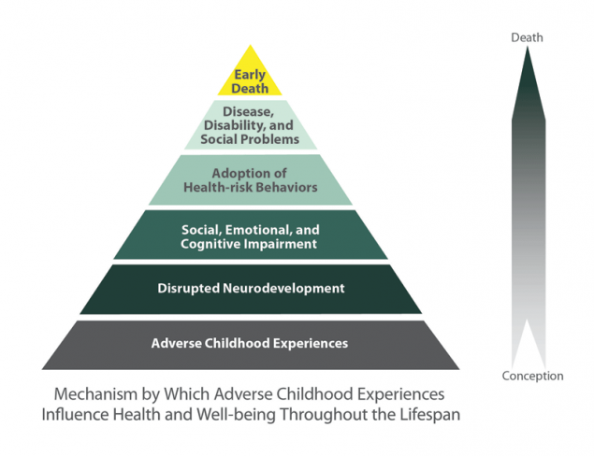
Impact of Trauma:
Adverse Childhood Experiences
CDC
Notes:
TALKING POINTS
• Perhaps one of the largest, if not the largest, ongoing health risk studies that established this relationship between trauma exposure and physical health is the ACE Study, organized by the CDC and Kaiser Permanente in San Diego, CA
• Researchers surveyed more than 17,000 insured individuals from 1995-1997 about their history of ACEs.
• The ACE Study uses the ACE Score, which is a count of the total number of ACEs respondents reported, to assess the total amount of stress during childhood.
Findings:
• Childhood abuse, neglect, and exposure to other traumatic stressors (ACEs) are common.
• Almost two-thirds of study participants reported at least 1 ACE, and more than 1 in 5 reported 3 or more ACE.
• The short- and long-term outcomes of these childhood exposures include a multitude of health and social problems.
• As the number of ACEs increases, the risk for the types of health problems on the previous slide increases in a strong and graded fashion and with that a direct, negative impact on mortality and longevity.

Slide 16
Impact of Trauma
The effect of trauma on an individual can be conceptualized as a normal response to an abnormal situation

Slide 17
Impact of Trauma:
Problems OR Adaptations?
“Non-compliant, combative”
OR
Struggling to regain or hold onto personal power
Fight
“Treatment resistant, uncooperative”
OR
Disengaging, withdrawing
Flight
“Passive, unmotivated”
OR
Giving in to those in power
Freeze
Notes:
• The fight, flight or freeze responses are activated by danger. Some common behaviors of trauma survivors—behaviors that are often labeled as “problems” by the mental health system—can be linked to these responses and to the effects that trauma has on the brain.
• This slide lists three sets of “problems” that are often attributed to people in the mental health system and shows how the behavior may be a survival mechanism tied to a flight, flight or freeze response.
• First is the fight response. In the mental health system, someone who struggles too hard to hold onto personal power may be labeled as non-compliant or combative.
• Second is the flight response. In the mental health system, anyone who emotionally withdraws or disengages too much may be labeled as treatment resistant or uncooperative.
• Third is the freeze response. In the mental health system, anyone who gives in too easily to authority may be labeled as passive or unmotivated.
• Many of the people we serve have survived circumstances we can hardly imagine. What we often label as pathological may be the very things that helped them to survive.
• When we take a Trauma Informed approach, we recognize “symptoms” and “problem behaviors” as adaptations to trauma, frequently including the feelings of helplessness and loss of control trauma often causes.

Slide 18

What skills can you develop to help others?

Slide 19
Trauma Informed Care Skill Development:
Identifying and Validating Feelings
People who have experienced traumatic events, particularly at the hands of a significant caregiver, were given contradictory messages, dismissed, ignored, silenced, abandoned, blamed, shamed, told they had no rights to feel, etc.
You have repeated opportunities to offer corrective experiences.

Slide 20
Trauma Informed Care Skill Development:
Identifying and Validating Feelings
Look for non-verbal emotional cues, e.g., eye contact, facial expression, tone of voice, body posture, movement and gestures, rhythm and rate of voice.
Reflect other’s emotional state. “It sounds like you feel very angry about this.”
After reflecting feelings, I am able to validate the emotion. “You had to wait three days to get an answer, and your question was really important to you. I understand why you’re mad about this.”

Slide 21
Trauma Informed Care Skill Development:
Regulating Feelings
A significant outcome of having an overwhelmed nervous system is emotional dysregulation. This can make it harder to use skills learned in the past.
Dementia can also undermine accessing skills to regulate emotions.

Slide 22
Trauma Informed Care Skill Development:
Regulating Feelings
When a person starts to feel overwhelmed, how can they bring themselves back to emotional balance?
What brings you back to balance when feeling stressed?
Use GROUNDING strategies
-Focus on breathing
-Redirection
-Distraction

Slide 23
Trauma Informed Care Skill Development:
Understanding the Stress Response
The nervous system’s most important function is to keep us alive by alerting us to danger.
Many people are under and/or over responsive to even the slightest perception of danger. Behaviors may include violence, running away, self- abuse or shutting down.

Slide 24
Trauma Informed Care Skill Development:
Appreciation
The survival brain becomes preoccupied with pain & danger but can be distracted when redirected and reminded of pleasure, fun, security, belonging, joy, beauty, humor, etc.

Slide 25
Trauma Informed Care Skill Development:
Reason for Being
Trauma triggers can illicit existential questions bout life and death, about good and evil.
What aspects of your life do you have a deep connection to?
What brings purpose and meaning to your life?
Be able to talk to other people about what makes them unique and to help them connect with activities that promote a sense of hope and value.
Help others identify aspects of their lives that bring meaning and purpose.

Slide 26
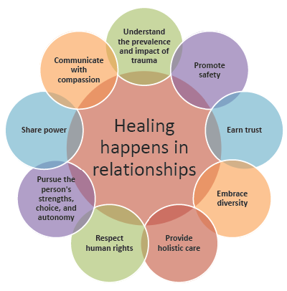

Slide 27

Thank you

Slide 28
Trauma Informed Care:
Further Reading
Judith Herman (2015) Trauma and Recovery
Linda Sanford (1991) Strong at the Broken Places
Robert Sapolsky (2004) Why Zebras Don’t Get Ulcers
Bessel Van Der Kolk (2014). The Body Keeps the Score
Notes:
Fink, D and Galea, S (2015). “Life Course Epidemiology of Trauma and Psychopathology in Civilian Populations” Curr Psychiatry Rep 17:31.

Slide 29
Trauma Informed Care:
Bibliography
Alameda County Behavioral Health Care Services. Trauma Informed Care. alamedacountytraumainformedcare.org
Brown, D. W., Anda, R. F., Tiemeier, H., Felitti, V. J., Edwards, V. J., Croft, J. B., & Giles, W. H. (2009). Adverse childhood experiences and the risk of premature mortality. American Journal of Preventive Medicine, 37, 389–396.
Centers for Disease Control and Prevention. About the CDC-Kaiser ACE Study. https://www.cdc.gov/violenceprevention/acestudy/about.html
Notes:
Fink, D and Galea, S (2015). “Life Course Epidemiology of Trauma and Psychopathology in Civilian Populations” Curr Psychiatry Rep 17:31.

Slide 30
Trauma Informed Care:
Bibliography
Felitti, Vincent J.; Anda, Robert F.; Nordenberg, Dale; Williamson, David; Spitz, Alison; Edwards, Valerie; Koss, Mary; and Marks, James. (1998) Relationship of Child Abuse and Household Dysfunction to Many of the Leading Causes of Death in Adults. American Journal of Preventive Medicine, 14:4, 245-258.
Fink, David S., and Galea, Sandro. (2015). Life Course Epidemiology of Trauma and Related Psychopathology in Civilian Populations. Curr Psychiatry Rep, 17:31.
Lieberman, Leslie. “Walking the Walk: Modeling Trauma Informed Practice in the Training Environment.” Multiplying Connections.
Notes:
Fink, D and Galea, S (2015). “Life Course Epidemiology of Trauma and Psychopathology in Civilian Populations” Curr Psychiatry Rep 17:31.

Slide 31
Trauma Informed Care:
Bibliography
Mueser, K.T., Salyers, M.P., Rosenberg, S.D., Goodman, L.A., Essock, S.M., et al. (2004). Interpersonal Trauma and Posttraumatic Stress Disorder in Patients With Severe Mental Illness: Demographic, Clinical, and Health Correlates. Schizophrenia Bulletin, 30 (1), 45-57 Read et al, 2008
National Center for PTSD. http://www.ptsd.va.gov/public/pages/ptsd_substance_abuse_veterans.asp
Perry, B. D. (2006). Applying principles of neurodevelopment to clinical work with maltreated and traumatized children: The neurosequential model of therapeutics. In Boyd- Webb, N, ed. Working with traumatized youth in child welfare. New York: Guilford Press.
Notes:
Fink, D and Galea, S (2015). “Life Course Epidemiology of Trauma and Psychopathology in Civilian Populations” Curr Psychiatry Rep 17:31.

Slide 32
Trauma Informed Care:
Bibliography
Substance Abuse and Mental Health Services Administration, Center for Mental Health Services, National Center for Trauma Informed Care. SAMHSA’s Trauma Informed Approach: Key Assumptions and Principles Curriculum.
Substance Abuse and Mental Health Services Administration. SAMHSA’s Concept of Trauma and Guidance for a Trauma Informed Approach. HHS Publication No. (SMA) 14-4884. Rockville, MD: Substance Abuse and Mental Health Services Administration, 2014.
SAMHSA (2011). Current Statistics on the Prevalence and Characteristics of People Experiencing Homelessness in the United States. http://homeless.samhsa.gov/ResourceFiles/hrc_factsheet.pdf
SAMHSA (2009) Substance Abuse Treatment: Addressing the Specific Needs of Women. Treatment Improvement Protocol (TIP) Series, No. 51. Center for Substance Abuse Treatment. Rockville (MD): Substance Abuse and Mental Health Services Administration.
Notes:
Fink, D and Galea, S (2015). “Life Course Epidemiology of Trauma and Psychopathology in Civilian Populations” Curr Psychiatry Rep 17:31.

Slide 33
Trauma Informed Care:
Bibliography
Wisconsin Department of Health Services. Trauma Informed Care Skill Development. Wisconsin Department of Health Services, Division of Mental Health and Substance Abuse Services. https://www.dhs.wisconsin.gov/tic/skilldev.pdf
Notes:
Fink, D and Galea, S (2015). “Life Course Epidemiology of Trauma and Psychopathology in Civilian Populations” Curr Psychiatry Rep 17:31.

