Slide 1




VOICES 2022
Back to the Basics
Back to the Basics

Slide 2

Pledge of Allegiance
I pledge allegiance to the flag of the United States of America and to the Republic for which it stands; one Nation under God, indivisible with Liberty and Justice for ALL.

Slide 3

Welcome
Mairead Painter
State Long-Term Care Ombudsman

Slide 4
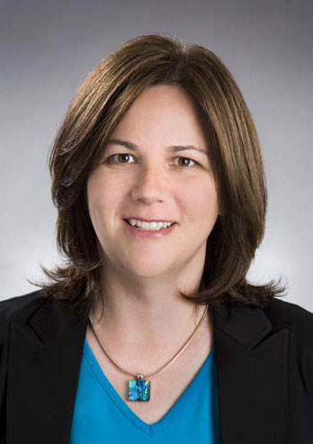
Opening Remarks
Commissioner Amy Porter
Department of Aging
and
Disability Services

Slide 5
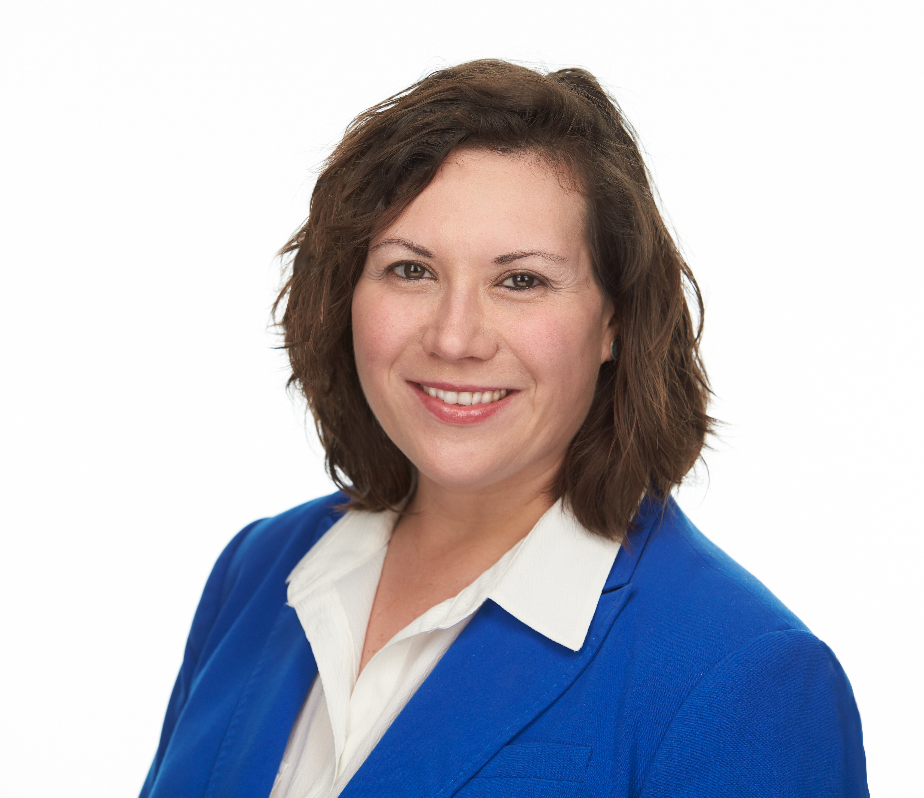
Back to Basics: Care Planning
Back to Basics:
Care
Planning
Voices Forum
September 16, 2022
Regional Ombudsman, Lindsay Jesshop
www.portal.ct.gov/ltcop

Slide 6
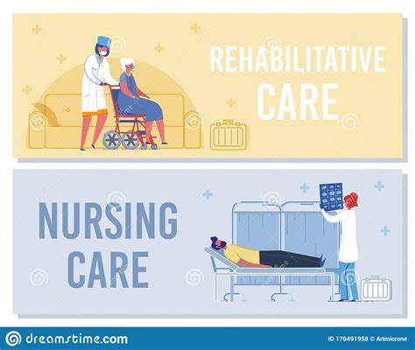
What Is A Care Plan?
A care plan is a tool utilized by the nursing home team, in partnership with an individual and the individual’s desired friends and family members, that details what a person’s needs are and what care services a person in the nursing home will receive. Care plans are required for all individuals living in the nursing home regardless of a person’s length of stay in the nursing home.

Slide 7
Information Included in a
Care Plan
What kind of services an individual may need or benefit from
Which health care providers will provide the services
How often an individual will require or need the service
What type of supplies or equipment will be needed to appropriately care for the person
What medications a person takes and when they receive them
Any specialized dietary requirements an individual may have
A person’s goals and how the plan will assist someone in reaching his or her goals

Slide 8
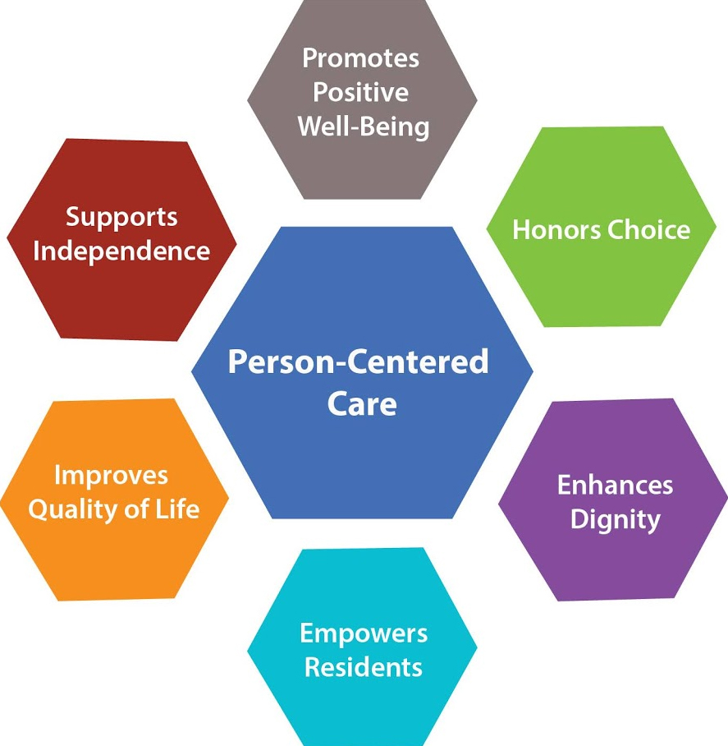
What’s Missing?

Slide 9
What is Person-Centered Care Planning?
“Person-centered care” means that individuals’ values and preferences are elicited and, once expressed, guide all aspects of their health care, supporting their realistic health and life goals. Person-centered care is achieved through a dynamic relationship among individuals, others who are important to them, and all relevant providers. This collaboration informs decision-making to the extent that the individual desires.
The American Geriatrics Society Expert Panel on Person-Centered Care. (2015). Person-Centered Care: A Definition and Essential Elements. In Journal of the American Geriatrics Society . American Geriatrics Society.

Slide 10
Importance of Incorporating Person-Centered Care Planning
The person establishes their care and services and how they are received.
The emphasis is not purely medical, but also focuses on the person’s environment, culture, perceptions, quality of life and experiences.
Creates a pathway for continuous collaboration and communication between an individual, their desired support persons, and the interdisciplinary team.
Inherently integrates an individual’s right to choice, risk, respect, and dignity

Slide 11

Preferences to Consider
Daily routine; desired schedule
Meal preferences, including likes and dislikes
Interests; desired activities
Religious and cultural practices
Preference in providers/caregivers

Slide 12
Care Plan Chart
It is important to me… | to accomplish this, I… | The outcome I want from this is…
that to have a good day I…
that you know these are the important people in my life…
my important people can support me…
that I can do the thing that make me happy like…
that when I eat…
in the next 6 months my goal/s of …

Slide 13
What is a Care Plan Meeting?
A care plan meeting is a time for an individual, the individual’s desired support persons, and the nursing home care team to review all components of a person’s life and care at the nursing home.
The meeting allows for a person/s to share information about one’s background, preferences, needs, how things have been going, and to express any concerns or ask questions. Participation in care plan meetings helps to integrate person-centered planning, which can assist in achieving quality care.

Slide 14

When are Care Plans Developed and How Often are Care Plan Meetings?
• Baseline Care Plan --- within 48 hours of admission; written summary given to resident and his or her desired support person or representative.
• Comprehensive Assessment --- initial within 14 days of admission; annual at least every 12 months, or within 14 days of a major change in person’s physical/mental status (decline or improvement).
Comprehensive Care Plan --- within 7 days of any Comprehensive Assessment.
• Quarterly Review Assessments and Care Plans --- once every 3 months.
• Care Plan Meetings --- every 3 months, or when there is a major change in resident’s condition.

Slide 15
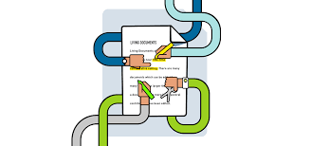
Care Plans are Living Documents!
Care plans can always be changed or amended, especially in terms of preferences.
An individual always has the right to request a meeting to discuss his or her care and to address any questions or concerns they may have

Slide 16
Example of Care Plan Meeting Request Form
Example of a Care Plan Meeting Request Form
Care Plan Meeting Request
Today’s date:
Individual’s name:
Meeting requested by:
Reason for meeting: ☐ Concern/s to be addressed
☐ Quarterly meeting
☐ Change in condition / status
☐ Follow-Up meeting
☐ Other
People requested to attend meeting:
Proposed meeting date:
Proposed meeting time:
Question/s and concern/s to address:.

Slide 17
Example of Care Plan Meeting Invitation
Example of a Care Plan Meeting Invitation
Care Plan Meeting Invitation
A meeting has been scheduled to discuss your care and address any concerns and questions that you may have.
This meeting is for:
Meeting Date:
Meeting Time:
Meeting Location:
Confirmed Attendees:
Link to attend virtually:
Virtual meeting ID:
Virtual meeting password:
Conference telephone number to dial-in:
Invitation provided to the following people:

Slide 18
Best Practices for Care Plan Meetings
Before the Meeting
  Re-arrange the time or reschedule so that resident and desired representatives can attend
  Ask for a copy of current care plan / list of medications
  Seek input from physician /physician services
  Provide staff with any questions or agenda items you would like to discuss at the meeting
  If you would like specific staff at the meeting request this prior to meeting
  Meetings do not have to be 15 minutes – if you would like longer pre-arrange with nursing home staff
During the Meeting
  Carefully review your preferences - request that preferences are explicitly stated in the plan of care
  Discuss plans for discharge , goals, and interventions
  Ask what other services can be offered (rehab and other contracted services)
  If all your questions have not been answered during the timeframe, request a day and time to follow-up with key personnel
After the Meeting
  Request a copy of the care plan
  Determine if care plan is being followed; determine if discussed interventions are occurring
  Request follow-up meeting if needed

Slide 19
Federal Nursing Home Regulations 483.24 –
Quality of Life
Each resident must receive, and the facility must provide the necessary care and services to attain or maintain the highest practicable physical, mental, and psychosocial well-being, consistent with the resident’s comprehensive assessment and plan of care.
(a) Based on the comprehensive assessment of a resident and consistent with the resident's needs and choices, the facility must provide the necessary care and services to ensure that a resident's abilities in activities of daily living do not diminish unless circumstances of the individual’s clinical condition demonstrate that such diminution was unavoidable.
Person Centered Care Planning is a Requirement!

Slide 20
Additional Resources
National Consumer Voice
Basics of Individualized Quality Care
  https://theconsumervoice.org/uploads/files/issues/basics-of-individualized-quality-care-factsheet-final.pdf
Assessment and Care Planning: The Key To Quality Care
  https://theconsumervoice.org/uploads/files/issues/assessment__care_planning-final.pdf
Individualized Assessment and Care Planning with Behavior Symptoms
  https://theconsumervoice.org/uploads/files/issues/individualized-assessment-with-behavioral-symptoms-factsheet-1.pdf
6 Steps for Quality care handout
  https://theconsumervoice.org/uploads/files/long-term-care-recipient/5._6_Steps_to_Getting_Quality_Care_in_a_Nursing_Home.pdf
Advocacy Suggestions for Nursing Home Residents and Their Families
  https://theconsumervoice.org/uploads/files/family-member/Advocacy_Suggestions_for_Nursing_Home_Residents_and_their_Families.pdf

Slide 21
Additional Resources
Center for Medicare Advocacy
  Nursing Home / Skilled Nursing Facility Care - Center for Medicare Advocacy
Massachusetts Advocates for Nursing Home Reform
  !Care Plans_final_9.26.19_2_onepage (manhr.org)
Justice in Aging
  Updated for COVID-19: 25 Common Nursing Home Problems & How to Resolve Them – JUSTICE IN AGING
Long Term Care Community Coalition
  Family & Ombudsman Resource Center - NursingHome411

Slide 22
Awards

Slide 23
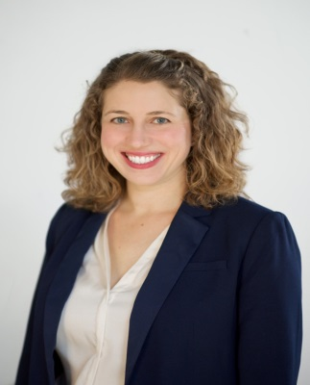
Carol Rosenwald Spirit of Advocacy Award Slide
Carol Rosenwald Spirit of Advocacy
Anna Doroghazi
Associate State Director
Advocacy and Outreach AARP Connecticut

Slide 24
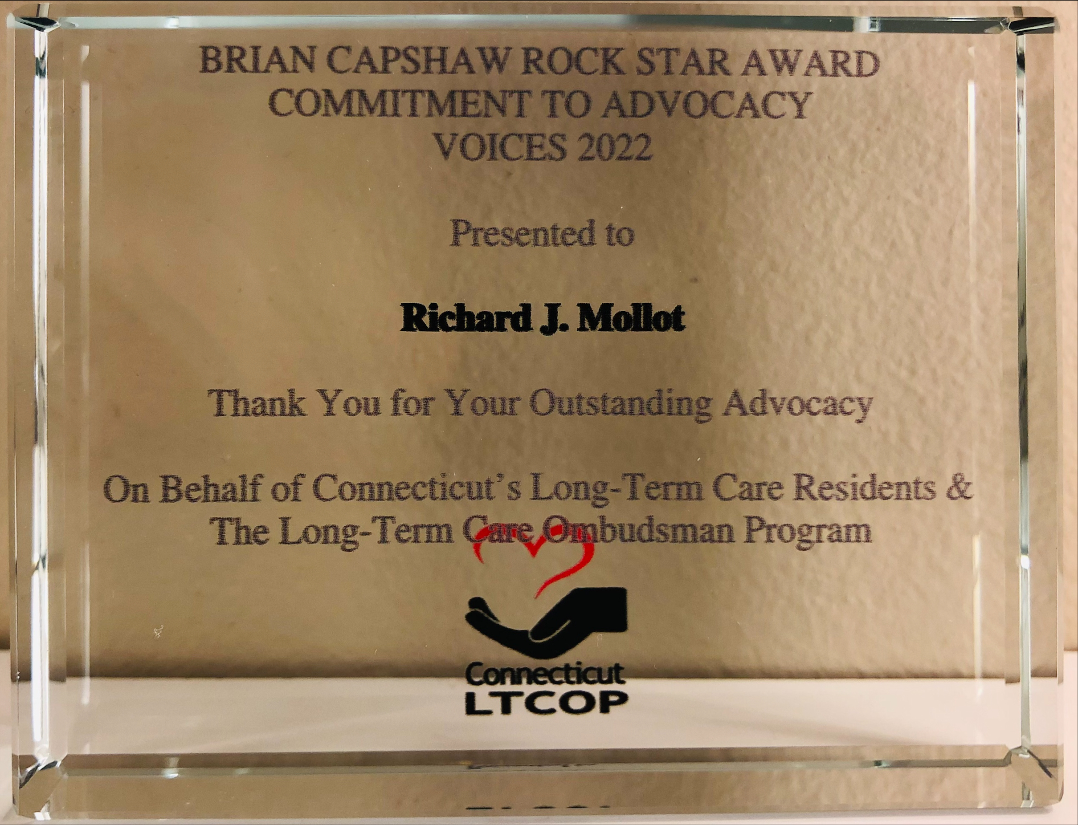
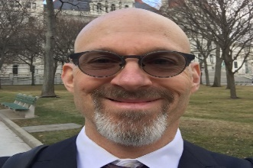
Brian Capshaw Rockstar Award
Richard Mollot
Executive Director
Long Term Care Community Coalition

Slide 25
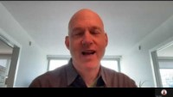
Video of Award Acceptance Speech

Slide 26

Legislative Update

Slide 27

Legislative Update

Slide 28


CMA Slide
Know Your Medicare Rights
Judy Stein
Executive Director/Attorney

Slide 29

Resident council basics
Presented By:
John Balisciano Jr.;
The Statewide Coalition of Presidents
of Resident Councils
VOICES Forum: September 16, 2022

Slide 30

What is a resident council?
An independent, organized group of people living in a long-term care facility that meets on a regular basis to discuss concerns and develop suggestions to improve services or resolve differences within the facility.

Slide 31

Rights of Resident Councils
The Federal Nursing Home Reform Law Says:
• The facility must provide a resident council with a private space for meetings.
• The facility must take reasonable steps, with the approval of the resident council, to make residents aware of upcoming meetings in a timely manner.
• The resident council meetings are closed to staff, visitors, and other guests. For staff, visitors, or other guests to attend, the resident council must invite them.
• The facility must provide a designated staff person who is approved by the resident council and the facility to provide assistance and respond to written requests from the resident council.
• The facility must consider the views of a resident council and act promptly upon grievances and recommendations of the resident council concerning issues of resident care and life in the facility.
• The facility must be able to demonstrate their response and rationale for their response.

Slide 32
Purpose of resident council
To give residents participation in affairs within the facility
To give residents a forum for discussion of concerns within the facility
To serve as a line of communication between residents and staff
To serve as an informational forum
To empower residents to advocate on issues that affect their home, community, quality of care and life
To discuss concerns to determine patterns and allow for formal resolution
Ensures that the nursing home is working to residents’ best interest and creating homelike environments based on resident preferences

Slide 33
Benefits of a Resident council
To Residents:
To the Home:
A resident council is an organized and ongoing support mechanism for residents
Through shared experiences, residents are able to draw strength from one another
Residents feel comfortable discussing their concerns and or/wishes in a safe environment.
Resident Councils also provide an opportunity for resident interaction and engagement with their peers
Resident Councils allow for greater communication between residents and staff
Resident councils provide discussion opportunities for a collaboration between resident & staff
A mechanism to address concerns to improve the quality of life and care in the facility.

Slide 34

Model resident Council
Residents run the council; residents fill key positions such as President, Vice President, Treasurer, Secretary
The council receives no interference from the facility staff
Residents feel comfortable speaking freely, raising issues and concerns
Residents are treated in a dignified manner
Resident issues and concerns are taken seriously
Issues and concerns are promptly addressed by the appropriate department

Slide 35
Resident Council Best Practices
Resident Council meetings are marketed and advertised; consider invitations
Council meetings are consistent; same day, time, and location each month
Each meeting has a prepared agenda with input from Council members
Council is governed by By-Laws that are unique to the Home/Community; by-laws detail election process
Minutes are taken, reviewed, and approved by Council members
Council Communication Form is utilized; passed on to appropriate departments; resolution indicated; signed off by both Administration and Resident Council
Meetings are accessible to all residents wishing to participate; use of adaptive technology and recording meetings for those that cannot come in person
Resident Council and Food Committee are separate and distinct meetings

Slide 36
Keys to Success
Self-interest ----- Encourage those who have concerns to address them during the resident council meeting. Residents will want to be involved if the council is discussing an issue that is important to them. It may be helpful to identify the issues of interest for the council members and focus on those issues.
Results----- Getting results is a big motivator for residents to continue to attend the council meetings. Thus, the council is viewed as a forum for resolving concerns, implementing new ideas, and sharing suggestions
Recognition----- recognize council members who provide helpful solutions, or make important contributions to the council

Slide 37
the Statewide Coalition of Presidents of Resident Councils

Slide 38
To our Resident Advocates who selflessly volunteer their time advocating on behalf of nursing home residents.
Thank You!
Volunteer | Facility
Ann Marie Fumo | Middlesex Healthcare Center
Auline Kong | Trinity Hill
Brenda Fife | Geer Nursing and Rehabilitation Center
Colleen Mcdermott | Touchpoints of Farmington
Deb Ciofi | Bayview Health Care Center
Aishwarya Sreenivasan | West Haven Center for Nursing and Rehab
Haley B Brennan | Greentree Manor
Jennifer Glick | Chelsea Place
Joyce Werden | Norwich Sub-Acute (Norwichtown)
Karen Haabestad | Apple Rehab Mystic
Kathleen Gilbride | Bride Brook Health and Rehab
Linda Rosen | Governor’s House
Meg Dee | Parkway Pavillion
Susan Williams | Touchpoints at Chestnut

Slide 39
Lunch

Slide 40

    Open Microphone
    & Panel Discussion
Patty Bausch - Statewide Coalition of Presidents of Resident Councils, Vice President
William Gui Woolston - Connecticut Medicaid Director, DSS
Nicole Godburn - Fiscal Manager, Office of Reimbursement and CON, DSS
Kim Hriceniak R.N. - Public Health Services Manager, DPH
Kate McEvoy, JD - Milbank Memorial Fund Program Officer

Slide 41

Question and Answers Slide

Slide 42
    Open Microphone
    & Panel Discussion
Patty Bausch - Statewide Coalition of Presidents of Resident Councils, Vice President
William Gui Woolston - Connecticut Medicaid Director, DSS
Nicole Godburn - Fiscal Manager, Office of Reimbursement and CON, DSS
Kim Hriceniak R.N. - Public Health Services Manager, DPH
Kate McEvoy, JD - Milbank Memorial Fund Program Officer

Slide 43

    Closing
Mairead Painter
State Long-Term Care Ombudsman

Slide 44
LTCOP Contact Info Slide

Slide 45
