Slide 1


2024 Manager’s Day
11:30 A.M.
Registration and Networking
12:00 P.M.
Welcome: CT MAC
12:05 P.M.
Ned Lamont – Governor
Nicholas Hermes– Deputy Commissioner of DAS
Jeffrey Beckham – Secretary of OPM
12:30 P.M.
Luncheon
1:15 P.M.
United Way
1:30 P.M.
Distinguished Managerial Service Awards
2:00 P.M.
Keynote Speaker – Erica Cuni
3:15 P.M.
Closing Remarks and Raffles
Rediscover Your Spark

Slide 2
Distinguished Managerial Service Award Nominees 2024

Slide 3

The Distinguished Managerial Service Award is an opportunity for us to recognize the accomplishments of a manager from state government.

Slide 4
Selection Criteria:
The nominee’s service to his/her agency, including performance as a supervisor and/or mentor
The nominee’s service to the people served by the agency
The nominee’s record of career growth and development
Volunteer services performed by the nominee

Slide 5
Distinguished Managerial Service Award Nominees
Kristofer Gilman
Nathan Wilson
Raffaella Calciano
Seweryn Borecki
Sharonda Carlos
Shawn Burns
Tammy Kreyer
Thomas Wydra
AnnMarie Ritter
Avon Johnson
Brian Sexton
Chris Drake
Debra Notarino
Donald Wilkerson
Grisel Cuascut
Jennifer Padula
Jennifer Tokarczyk

Slide 6
AnnMarie Ritter
Statewide HR Program Manager
Department of Administrative Services
“She does not shy away from change, she embraces it.”
She “leads her team with a clear vision, helping us to achieve our best.”
She “has recognized and rewarded her team members for their contributions, boosting morale and encouraging teamwork.”

Slide 7
Avon Johnson
Statewide HR Program Manager
Department of Mental Health and Addiction Services (DMHAS)
She “makes herself available to all staff in the building whenever needed.”
“She is approachable, knowledgeable, dependable, friendly, and client centered.”
“She has continued to keep the agency's mission to become anti-racist, in the forefront of the work that is being done and the work that is being discussed.”

Slide 8
Brian Sexton
Social Services Operations Manager
Department of Social Services
“His mentorship has cultivated a new generation of leaders, ensuring a legacy of skilled, knowledgeable and dedicated professionals within the Department.”
“Within the agency, he leads special projects that go beyond his routine responsibilities, further demonstrating his commitment to service.”
“His leadership during crises has been particularly impressive, demonstrating his ability to lead through challenging times with resilience and empathy.”

Slide 9
Chris Drake
Director of Business Services Division
Office of the Secretary of State
“He makes himself available to all staff. His office door is always open.”
“The measure of a great manager is the amount of admiration his staff has for him and Chris is by far everyone's favorite person in the office.”
He is dedicated to public service through his job at the Office of Secretary of the State as well as in his own community.

Slide 10
Debra Notarino
MV Division Chief
Department of Motor Vehicles
“The employees of our agency trust Deb, they seek her out for advice and to assist them with questions.”
“She will not give up on an issue until she has it resolved.”
She treats her employees fairly and is “respected by everyone in the agency.”

Slide 11
Donald Wilkerson
Assistant Division Director
Office of the State Comptroller
He “has improved efficiency and accountability within the Retirement Services Division.”
He “willingly works early, late and on weekends to ensure that all state employees retiring receive their first check accurately and on time.”
He “played a key part in the retirement surge and was integral in ensuring that all retirements were completed on time.”

Slide 12
Grisel Cuascut
Assistant Division Director
Office of the State Comptroller
She “is professional, hard-working, reliable, dedicated, and committed to achieving success through her efforts.”
She is instrumental in the development of processes, has increased productivity through efficiencies and collaboration with both internal and external teams.
She shows her dedication to the agency through sharing her knowledge by training new employees.

Slide 13
Jennifer Padula
Agency Legal Director
Department of Administrative Services
“Her leadership is marked by a deep commitment to fostering a collaborative and productive work environment.”
She “has been instrumental in guiding her team through complex projects and initiatives, providing clear direction, and supporting professional development.”
She “has exemplified what it means to lead with integrity, empathy, and determination.”

Slide 14
Jennifer Tokarczyk
Human Resources Generalist 2
DAS/DEEP
“She is a champion for employee rights and well-being, and demonstrates compassion, understanding, and patience with everyone she encounters within the agency.”
“She is always the first to volunteer for any training opportunities and works hard to build upon not only her strengths, but also areas where she needs or wants improvement.”
“She is always willing to help anyone and put in as much work as is needed”, and “she is always available whenever called upon.”

Slide 15
Kristofer Gilman
CP Director
Office of Consumer Protection
Kristofer gets the job done while keeping his team motivated.
He is able to work under tremendous pressure, while meeting the deadline.
Under his leadership, the Gaming Division was able to, in record time, draft legislation, develop regulations, and vet online gaming apps.

Slide 16
Nathan Wilson
Director of Operations
Department of Agriculture
“He jumps in on any challenge, with a positive ‘can-do’ attitude, that helps bring people together to accomplish a task.”
He “offers an opportunity for members of the team to express concerns and be heard by senior leadership in the agency” and “then works to address them in a fair and professional manner.”
“He lifts everyone around him up with his positive energy and his focus on solutions and outcomes.”

Slide 17
Raffaella Calciano
Director, Office of Emergency Medical Services
Department of Public Health
“As a manager she is a true people person who cares about her staff and encourages their self-improvement.”
“She has faith in her employees and is a perfect combination of manager, friend, and mentor.”
Over the years she has streamlined, established, overseen, and chaired many programs, processes, and committees that have affected services available through the Department of Public Health today.

Slide 18
Seweryn Borecki
Director of Operations
Department of Mental Health and Addiction Services (DMHAS)
He “is always willing to be a team player.”
He “is able to look at issues and problem solve and develop systems to streamline processes and reduce unnecessary work.”
He “is an innovative thinker, always coming up with new and improved ways of 'doing business’.”

Slide 19
Sharonda Carlos
Deputy Commissioner
Department of Correction
“She mentors staff and is always willing to lend a helping hand regardless of area of supervision.”
“She is thorough, efficient, professional, respectful, accountable,” and “she is a great role model and teacher at heart.”
“She wants to see people do well and grow professionally and personally,” and “she is a great active listener who always keeps her word.”

Slide 20
Shawn Burns
Regional Manager
Commission on Human Rights and Opportunities
He “goes out of his way to meet all of his performance objectives…while being very kind and supportive to his staff.”
“He regularly steps in to fill voids throughout the agency, providing guidance and assistance to his colleagues throughout the state.”
“His actions demonstrate his commitment to civil rights, to his team, and to the people of CT.”

Slide 21
Tammy Kreyer
Gaming State Program Manager
Consumer Protection
“Tammy is an inspiring leader who motivates her team.”
It is impressive how she “assembles her team, encourages them with humor and affirmation as they work through the task at hand.”
She “finds ways to boost the morale of her division.”

Slide 22
Thomas Wydra
Director, Wage and Workplace Standards Division
CT Department of Labor
He improved “interpersonal and professional dynamics of the unit, ultimately resulting in positive impacts.”
He is trustworthy and demonstrates “steady leadership to his team,” and he identifies and mentors others to leadership positions.
He “has spent a lifetime dedicated to public service”, “has embraced many challenges”, and “remains committed” to the agency, his team, and the people the DOL serves.

Slide 23
Congratulations to all the nominees and thank you for your state service.

Slide 24
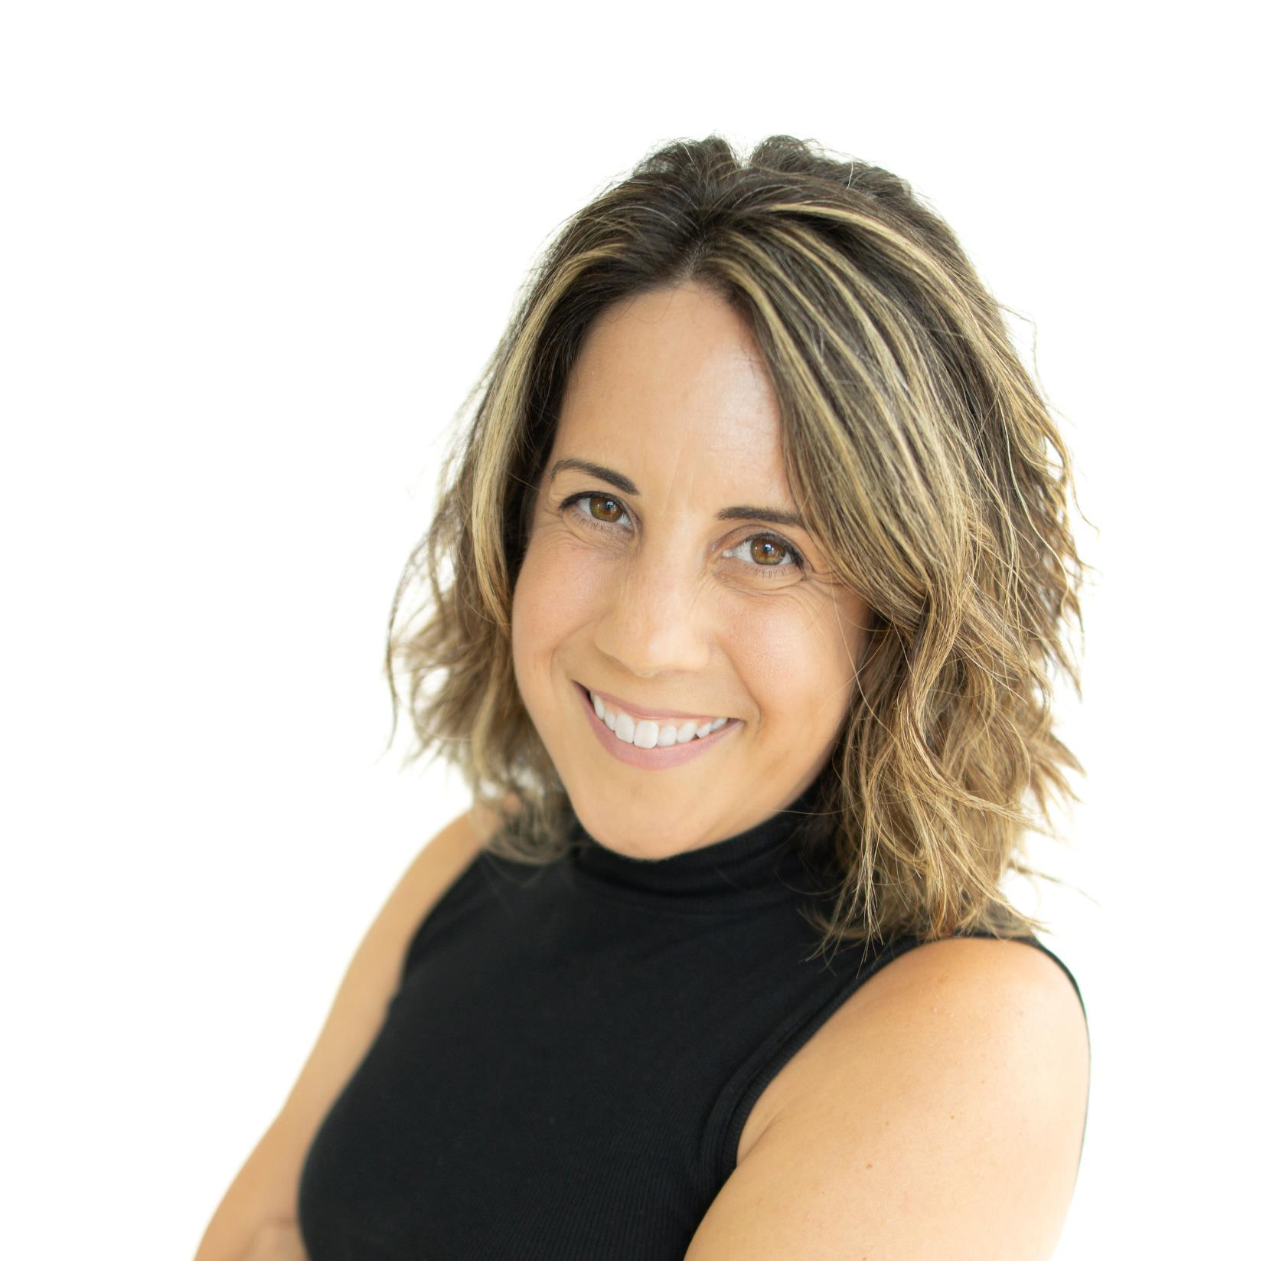
Keynote Speaker
Erica Cuni, LMFT, CIMHP, also known as "The Burnout Professor"
She is a leading Integrative Mental Health and Trauma Therapist, Keynote Speaker, and Fellow Burnout Survivor. She is on a mission to empower people worldwide with the life-changing skills to successfully navigate change, overwhelm, and burnout so they can stress better, live better and feel better. Join her community on www.theburnoutprofessor.com.
Burnout is everywhere. The feeling of being constantly stressed and overwhelmed is at an all-time high. And contrary to popular opinion, you can love what you do and still burn out. In this relatable, empowering, interactive speech, Erica will take you beyond "positive thinking" with actionable steps that you can start to implement right away. She will show you how to befriend stress, navigate your nervous system, and rediscover your spark when working in the human services field.

Slide 25
We would now like to take the time to recognize the different heritages that are celebrated this month.

Slide 26


Slide 27

Filipino American History Month (FAHM) in 2024 is celebrated in October, with the theme "Struggle, Resistance, Solidarity, and Resilience". The month commemorates the first recorded evidence of Filipinos in North America, which occurred in Morro Bay, California on October 18, 1587.
FAHM celebrates the history, culture, and contributions of Filipino Americans to the United States. It also serves to connect Filipinos in the U.S. with those in the Philippines.

Slide 28

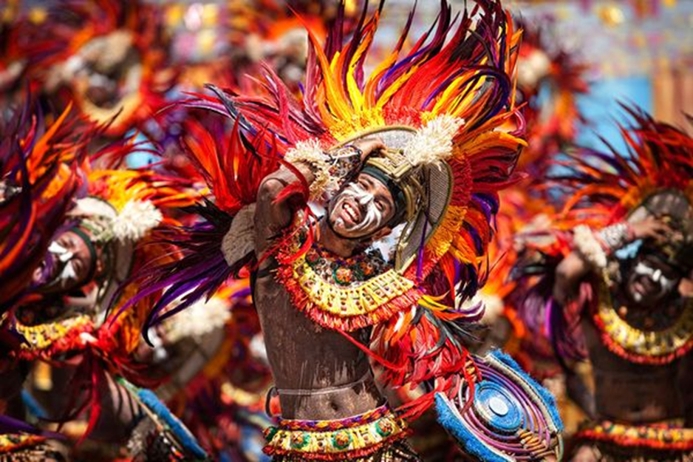
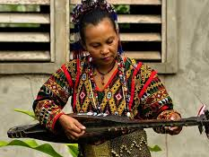
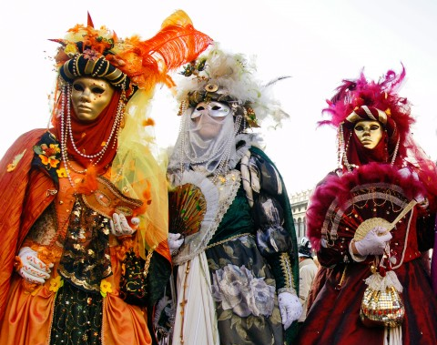
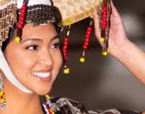

Slide 29




Traditional Filipino Food & Drinks

Slide 30

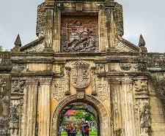
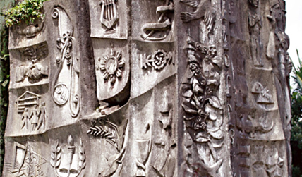
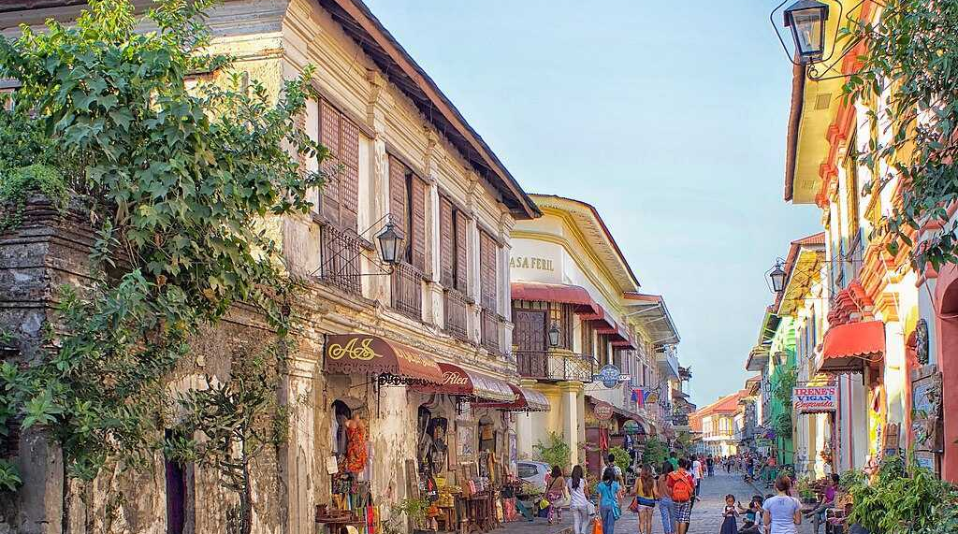
Filipino Heritage – The Arts and Landmarks

Slide 31


Slide 32


German American Heritage Day is October 6.
It all started back in October 1683, when a group of German families established Germantown, Pennsylvania, marking one of the first major German settlements in America.
The idea of celebrating German-American heritage on a national scale began to take shape in 1983. That year, on the 300th anniversary of Germantown’s founding, President Ronald Reagan proclaimed October 6th as German-American Day.

Slide 33

It’s estimated that 50 million Americans have German ancestry, around 17% of the population.
Milwaukee is the most German of major American cities, and Germans have constituted Milwaukee’s largest immigrant group.
Pennsylvania, with 3.5 million people of German ancestry, has the largest population of German-Americans in the U.S.
German Americans make up 10% of the population in CT.

Slide 34



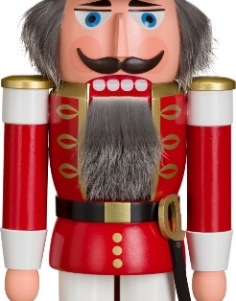
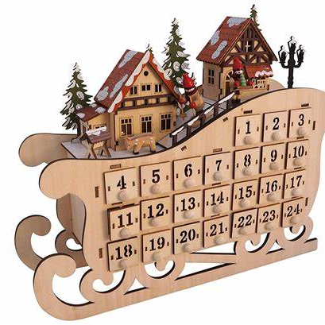

German Traditions brought to America

Slide 35
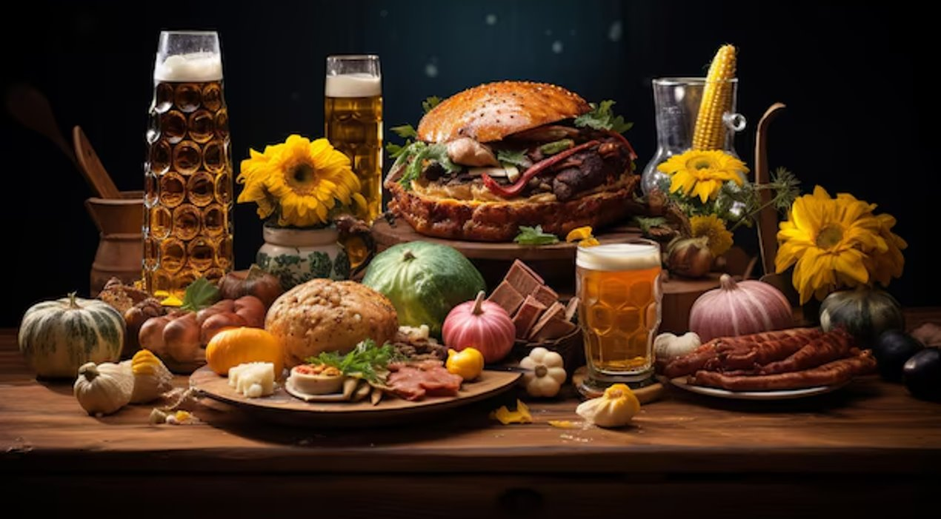
Feast of Oktoberfest: A Taste of Traditional German Cuisine

Slide 36

Famous German Americans
Eberhard Anheuser, Anheuser-Busch Companies Inc.
John Jacob Astor, American Fur. Co
John Jacob Bausch, Bausch + Lomb
Dwight D. Eisenhower, Soldier and U.S. President
Adolphus Busch, Anheuser-Busch Companies Inc.
Henry J. Heinz, H. J. Heinz Company
Richard Hellmann, Hellmann’s Mayonnaise
Henry Kissinger, Statesman
Frederick Miller, MillerCoors
Levi Strauss, Levi Strauss & Co.
Heinrich E. Steinweg, Steinway & Sons
Sandra Bullock, Actress
Doris Day, Actress & Singer
Leonardo Wilhelm DiCaprio, Actor
Heidi Klum, Model & Actress

Slide 37


Slide 38
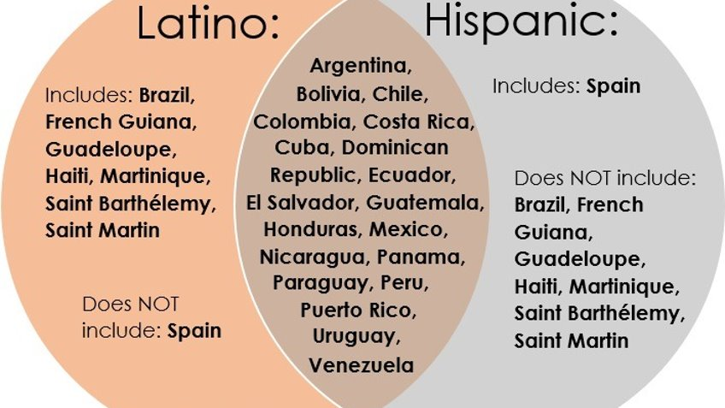

Slide 39
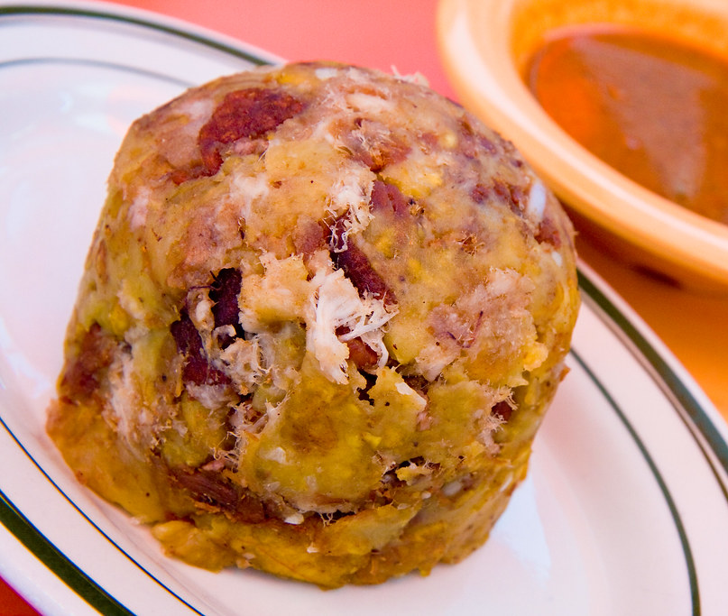
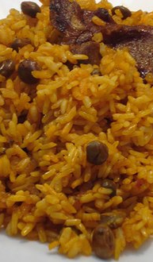
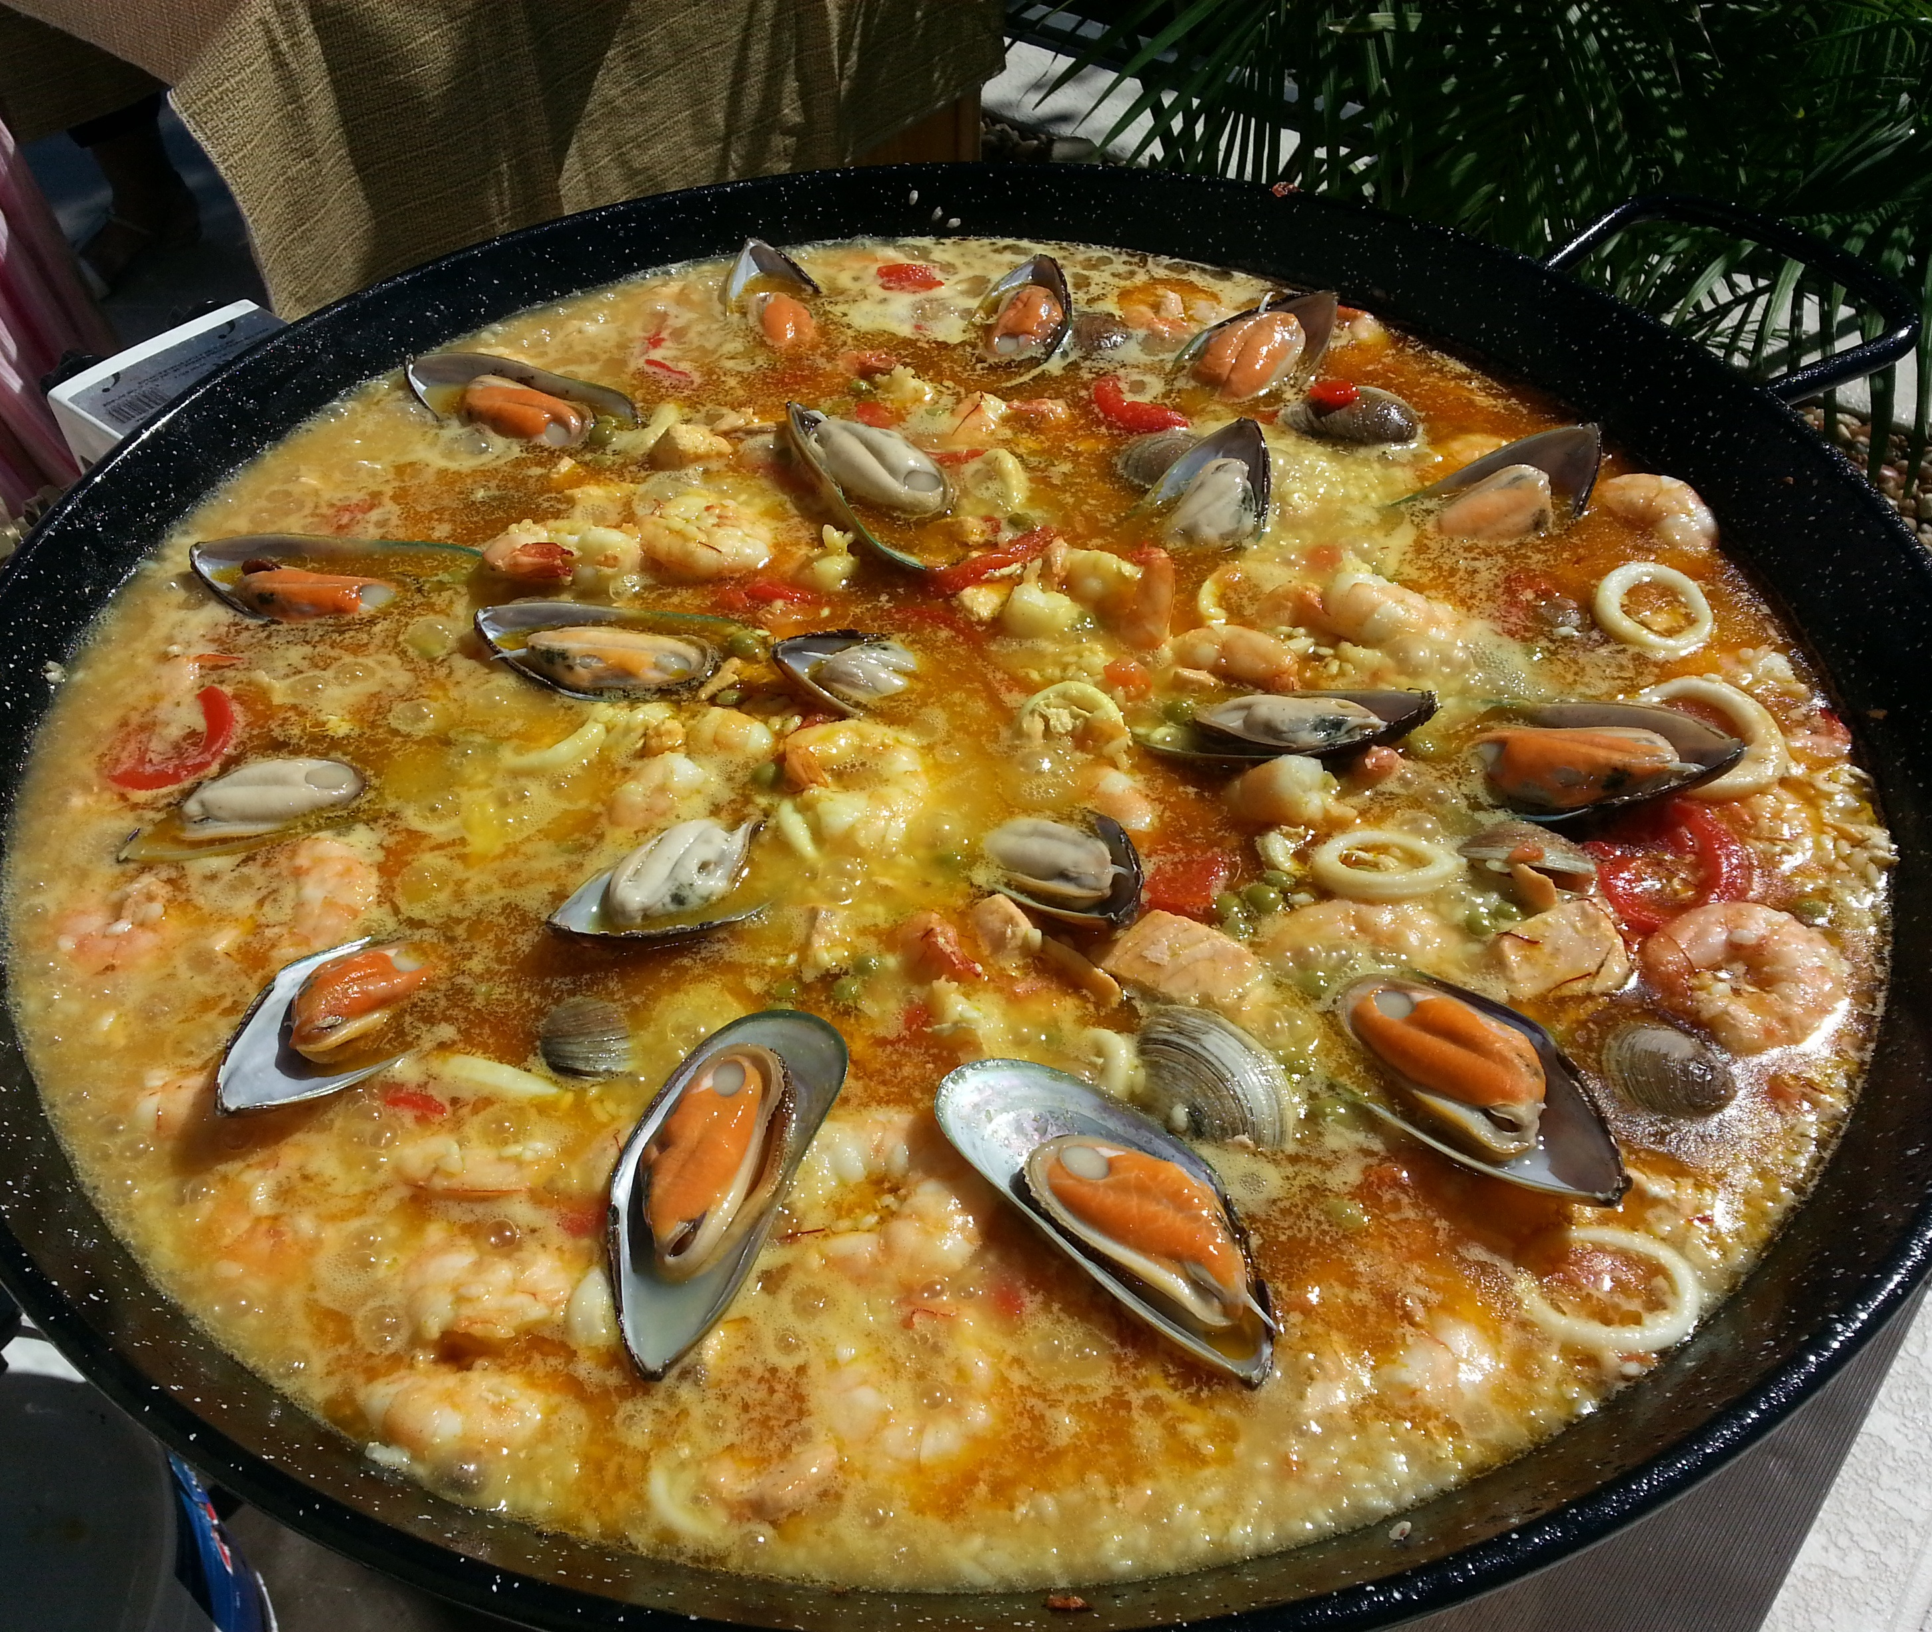

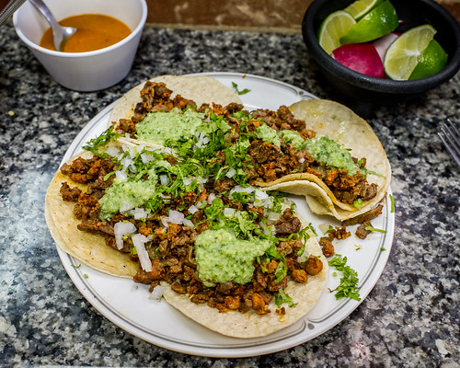

Slide 40
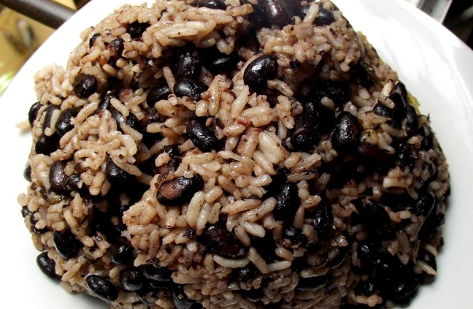

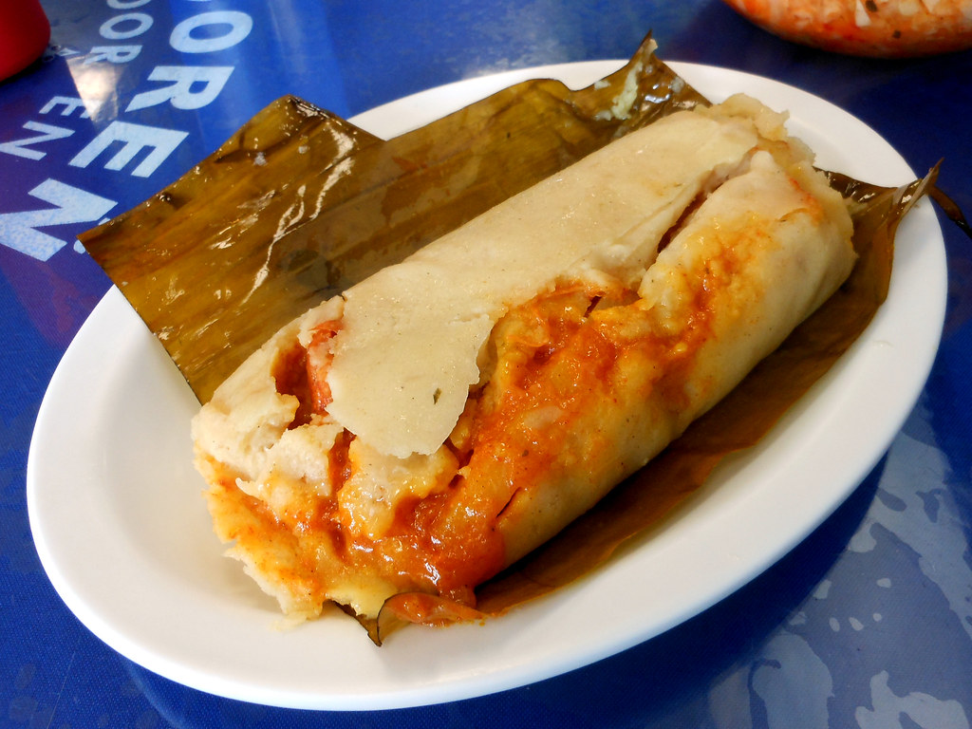



Slide 41

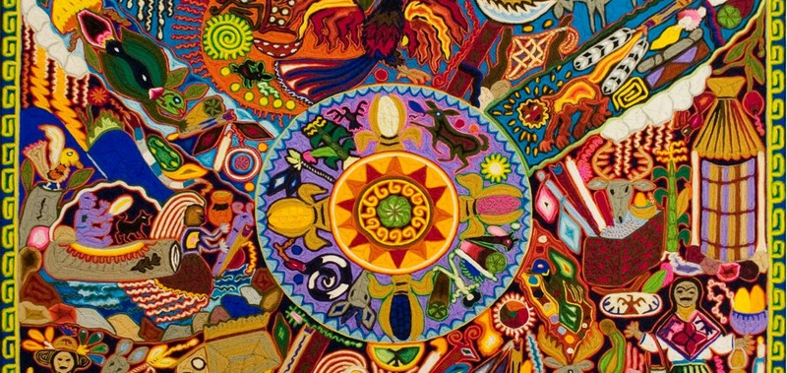

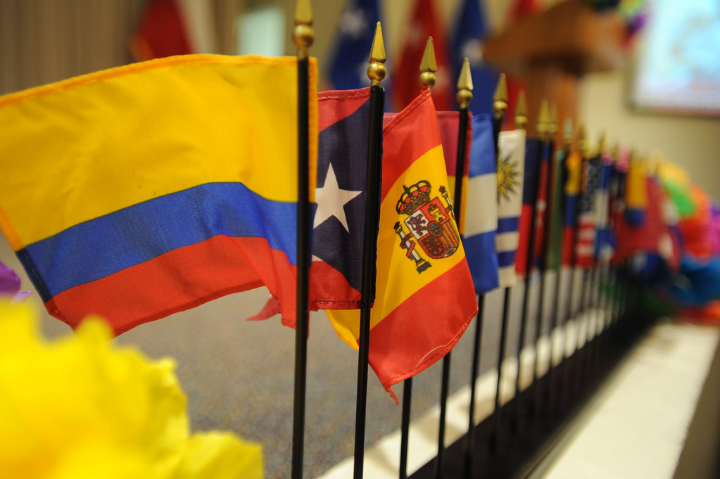
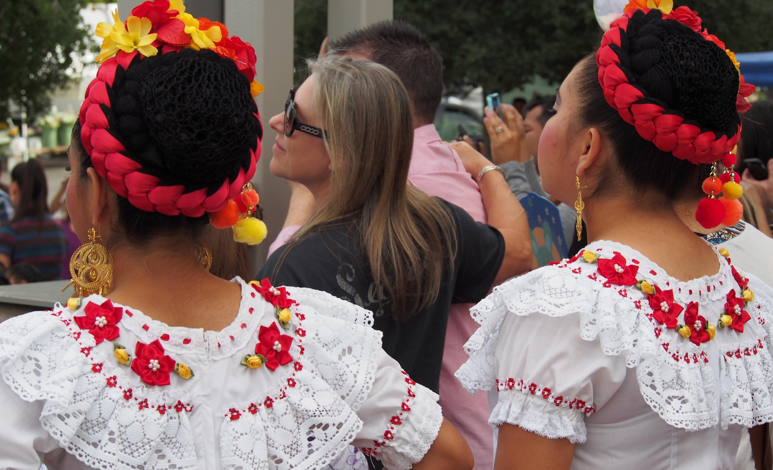

This Photo by Unknown Author is licensed under CC BY-SA

Slide 42
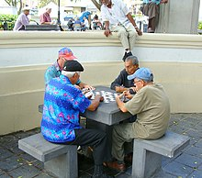
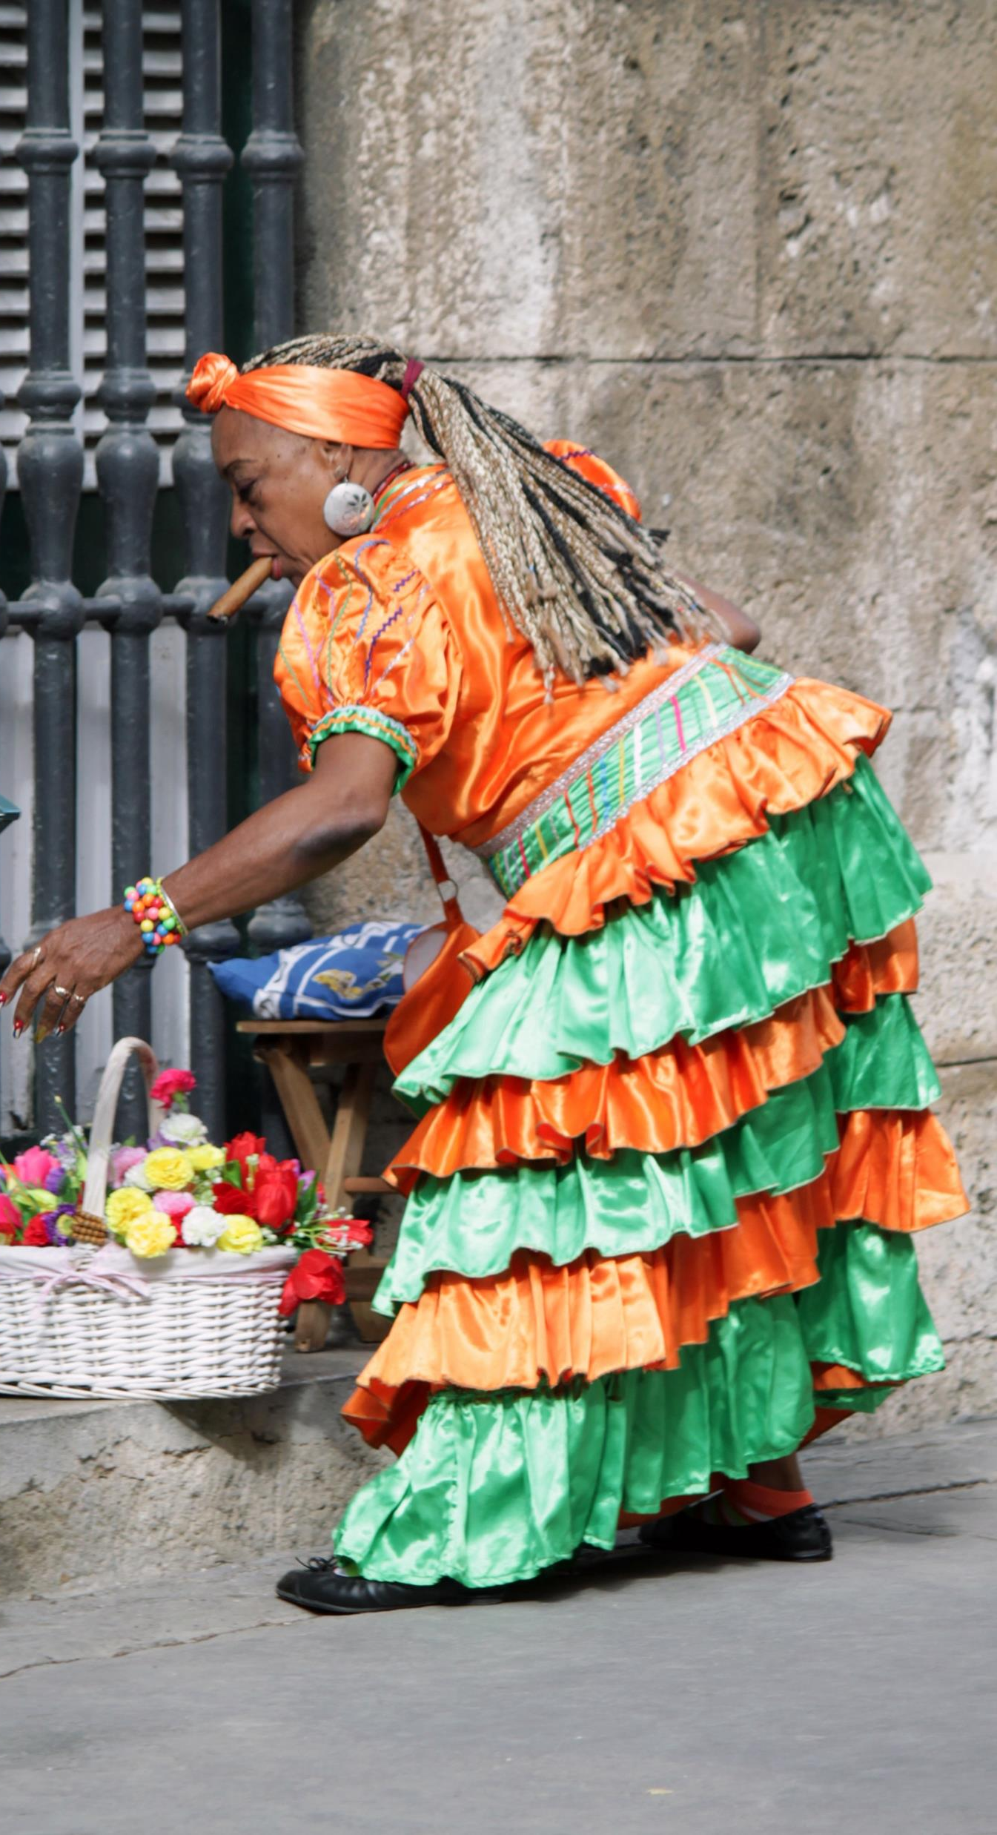

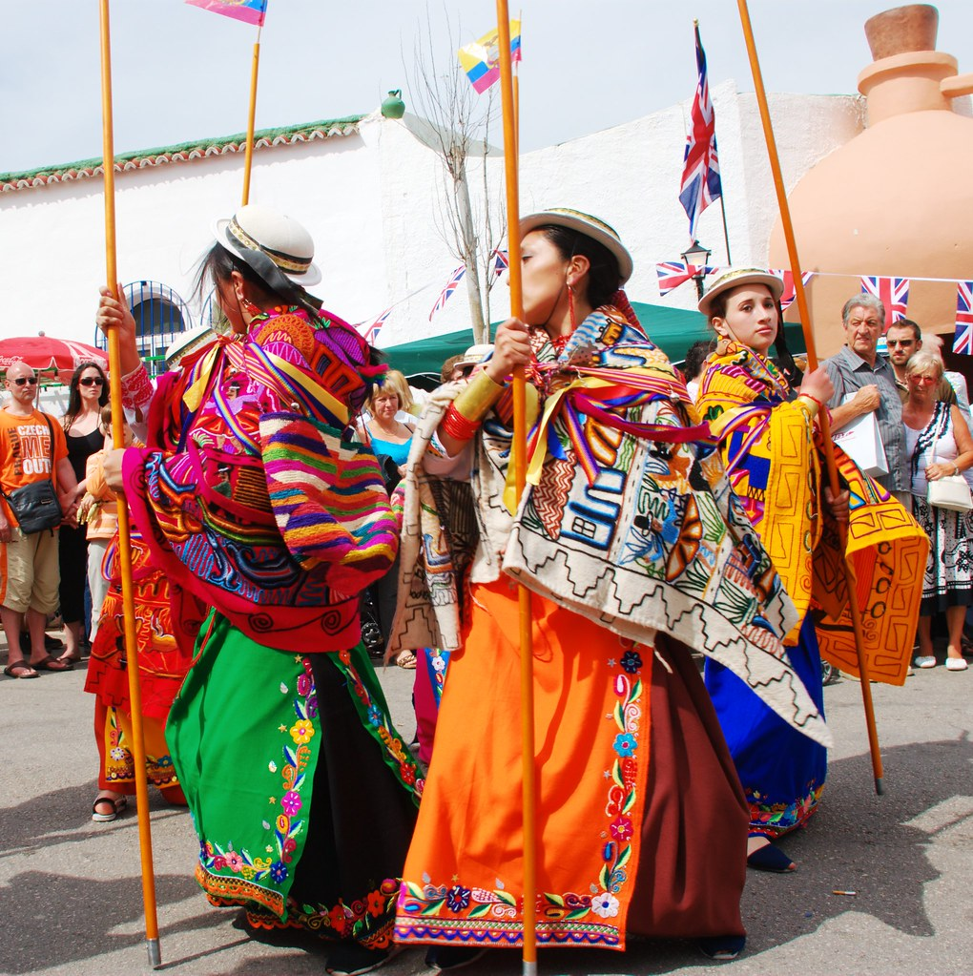
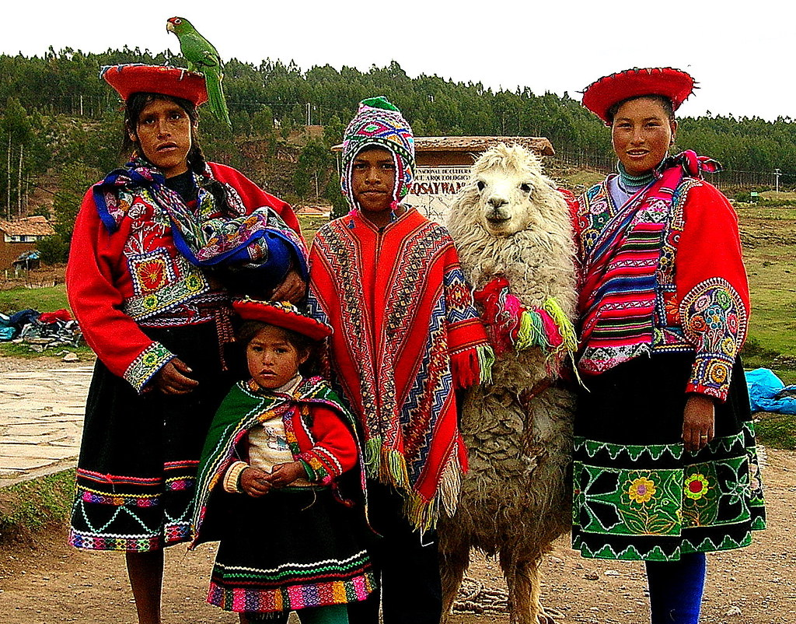
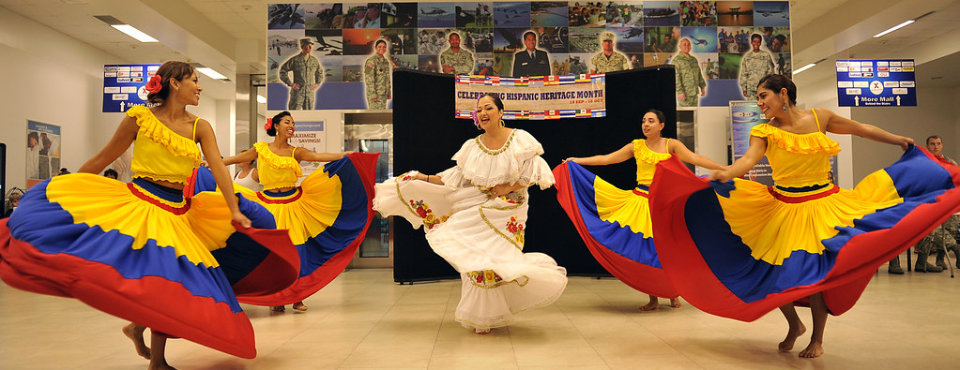

Slide 43
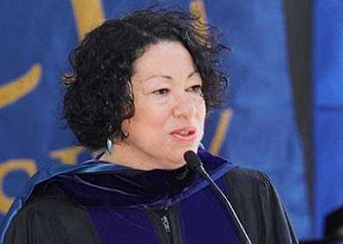
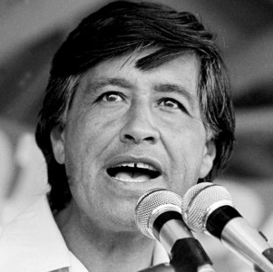
Sonia Sotomayor is an associate justice of the Supreme Court of the United States, upon which she has served since 2009. Appointed by then-President Barack Obama following the retirement of Justice David Souter, Sotomayor is the first Latina (Puerto Rican) Supreme Court justice in United States history, as well as the first woman of color to serve on the Supreme Court. Sotomayor previously served as a U.S. District Court judge starting in 1992 and was elevated to the 2nd Circuit Court of Appeals in 1998.
LAW AND ACTIVISM
Cesar Chavez – Labor and Civil Rights Leader
Cesar Chavez employed nonviolent means to bring attention to the plight of farmworkers and formed both the National Farm Workers Association, which later became United Farm Workers. As a labor leader, Chavez led marches, called for boycotts and went on several hunger strikes. It is believed that Chavez's hunger strikes contributed to his death on April 23, 1993, in San Luis, Arizona.

Slide 44


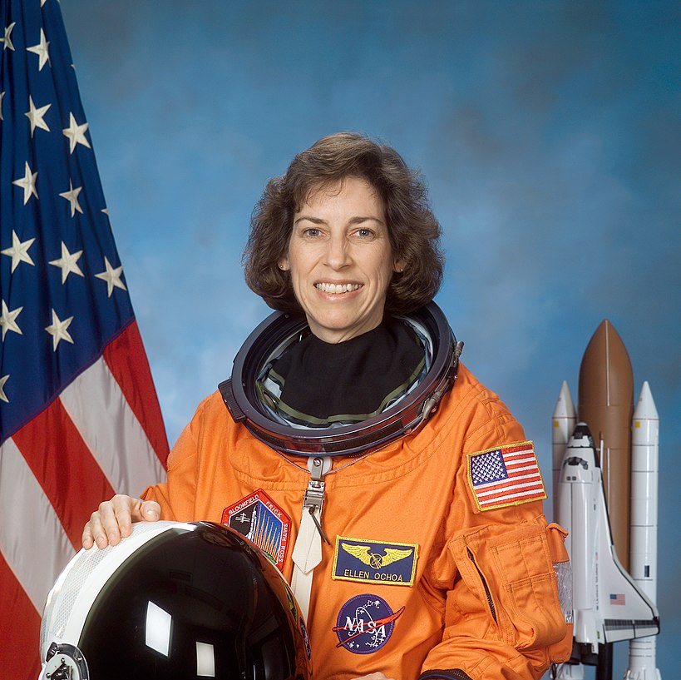
Earthquake Sensing Technology
Because of University of Chile professor Arturo Arias Suárez, scientists have the ability to measure the risks of damage related to a possible earthquake in a given location. Arias Suárez served as director of Chile’s Instituto de Investigación y Ensayos de Materiales (Materials Research and Testing Institute /IDIEM) from 1958 through 1965. In 1970, he developed the “Instrumental Seismic Intensity” or “Arias Intensity” (AI) method, a mathematical formula that assesses the strength of earthquake tremors by measuring their seismic waves. With the Arias Intensity formula, building engineers can design buildings that are better equipped to withstand seismic activity.
SCIENCE
Color TV
The upgrades from black-and-white to color television began in the 1960s, thanks to a patent filed in 1940 for a “chromoscopic adapter for television equipment” by Guillermo González Camarena of Mexico. Camarena, an electrical engineer who specialized in electronics at the National Polytechnic Institute of Mexico, created the first Trichromatic Field Sequential System, a technology that transmits moving images in variations of red, green and blue to achieve a spectrum of color. Prior to González Camarena’s invention, televisions only broadcast images in monochrome.
Ellen Ochoa (born May 10, 1958) is a Hispanic engineer, former astronaut and former director of the Johnson Space Center.^{[1]} In 1993, Ochoa became the first Latina woman to go to space when she served on a nine-day mission aboard the Space Shuttle Discovery.^{[2]} Ochoa became director of the center upon the retirement of the previous director, Michael Coats, on December 31, 2012.^{[3]} She was the first Latina director and the second female director of Johnson Space Center.
This Photo by Unknown Author is licensed under CC BY-SA

Slide 45
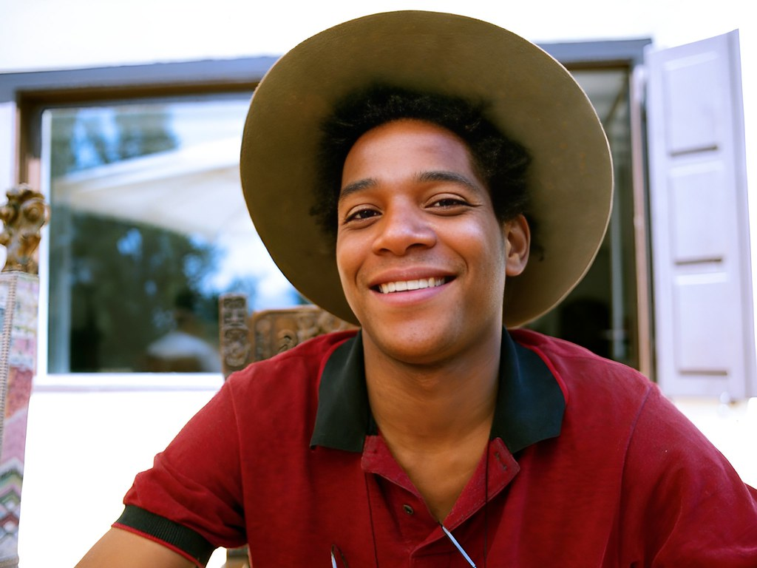
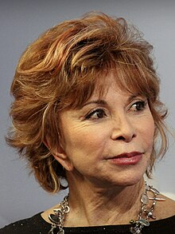
Writers and Artists
There are many famous Latino authors and Hispanic writers. Some of the famous Hispanic poets and writers include Diana Gabaldon, Gary Soto, Sandra Cisneros, Luis Alberto Urrea, Rudolpho Anaya, Pat Mora, and Ana Castillo1. Some of the most renowned Hispanic authors of all time include Junot Díaz, Benjamin Alire Sáenz, Carlos Ruiz Zafón, and Yuri Herrera2. Other famous Latin American authors include Jorge Luis Borges, Octavio Paz, Pablo Neruda, Roberto Bolaño, Gabriela Mistral, Gabriel García Márquez, Julio Cortázar, and Isabel Allende.
Isabel Allende
Isabelle Allende is one of the most famous writers of magical realism and an iconic voice in Latin American literature. She’s been called the most widely-read Spanish language writer in the world: Her novels have been translated into more than 42 languages and sold more than 77 million copies. The Chilean author’s best-known book is The House of the Spirits, which is set in Chile during the Pinochet dictatorship. A little-known fact is that she’s related to actor Pedro Pascal. In 2014, President Obama awarded her the Presidential Medal of Freedom.
Jean-Michel Basquiat
Jean-Michel Basquiat is one of the most famous American artists. He painted in New York City in the 80s, where he fostered a close friendship with fellow artist Andy Warhol. He was born in Brooklyn to a Haitian-American father and a Puerto Rican mother.
His paintings explore Black and Latino identity, combining bold colors, recurring iconography and text to make political statements. His most famous motifs are crowns, dinosaurs and skeletal figures. Although he died at only 27, his influence on the art world and on street fashion is still felt today, found on designs ranging from Uniqlo to Tiffany.

Slide 46
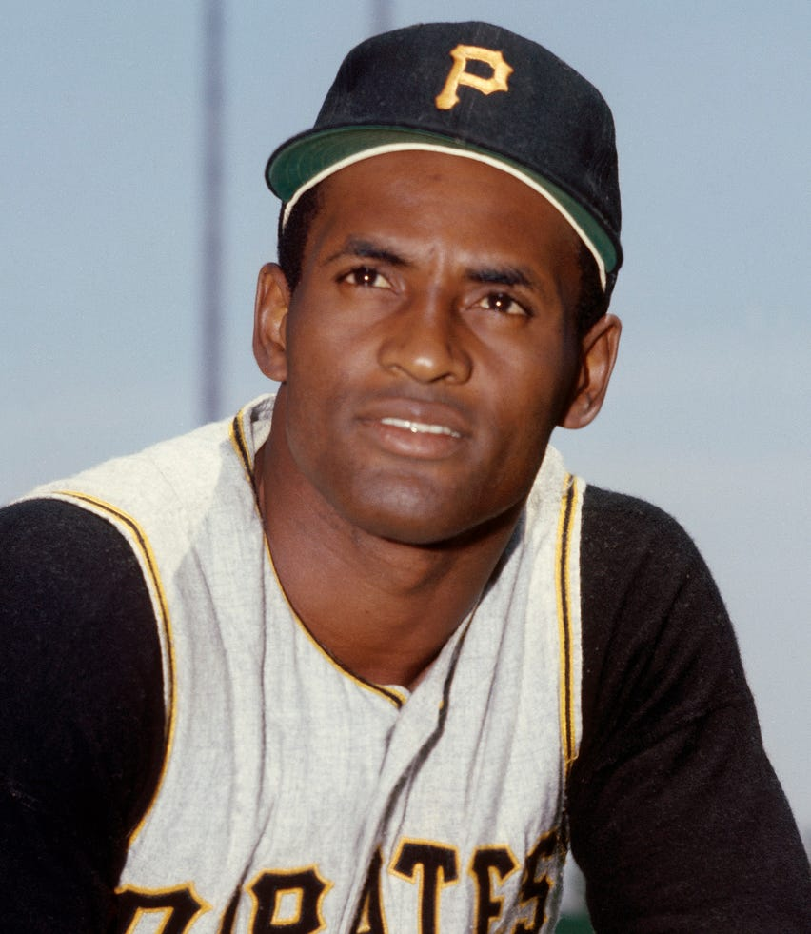
SPORTS
Roberto Clemente
Today, Major League Baseball touts names like the Toronto Blue Jays' Vladimir Guerrero Jr. and the Yankees' Nestor Cortes. But before they were setting records, Roberto pioneered the way for Hispanic players. Throughout his 18-season career, the Puerto Rican native became the first Latino to achieve 3,000 career hits. Though he died at the young age of 38 in a plane crash, he continues to be remembered for his sportsmanship and community outreach.

Slide 47
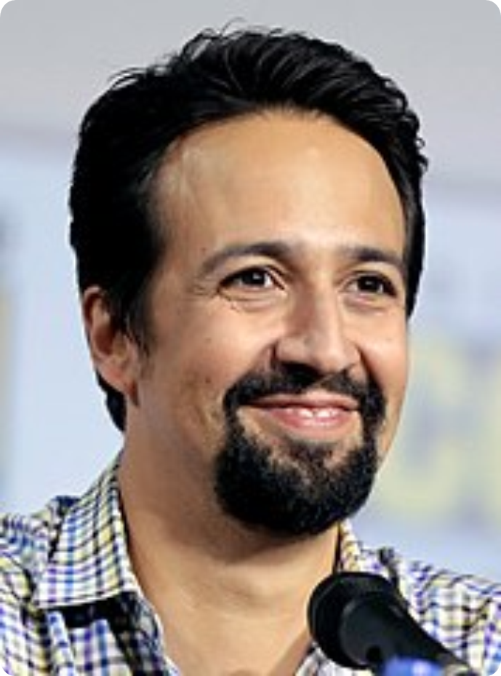
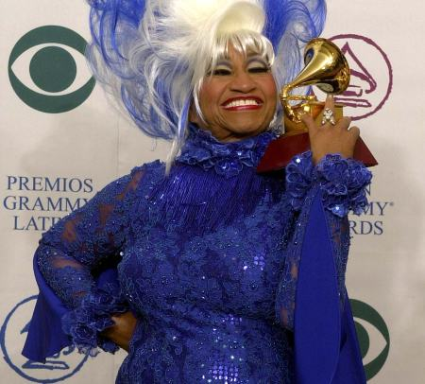
Lin-Manuel Miranda is an American songwriter, actor, singer, filmmaker, rapper, and librettist. He created the Broadway musicals In the Heights (2005) and Hamilton (2015), and the soundtracks for the animated films Moana (2016), Vivo, and Encanto (both 2021). He has received numerous accolades including a Pulitzer Prize, three Tony Awards, two Laurence Olivier Awards, two Primetime Emmy Awards, and five Grammy Awards, along with nominations for two Academy Awards. He received the Kennedy Center Honors in 2018.
THEATRE AND MUSIC
Celia Caridad Cruz y Alfonso known as Celia Cruz, was a Cuban singer and one of the most popular Latin artists of the 20th century. Cruz rose to fame in Cuba during the 1950s as a singer of guarachas, earning the nickname "La Guarachera de Cuba". In the following decades, she became known internationally as the "Queen of Salsa" due to her contributions to Latin music.^{[1][2][3]} She had sold over 10 million copies, making her one of the best-selling Latin music artists.^{[4]}

Slide 48
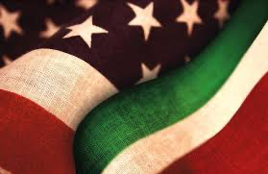
We’d also like to take the time to recognize the different heritages that are celebrated throughout this month.
Italian-American
Heritage Month
October

Slide 49
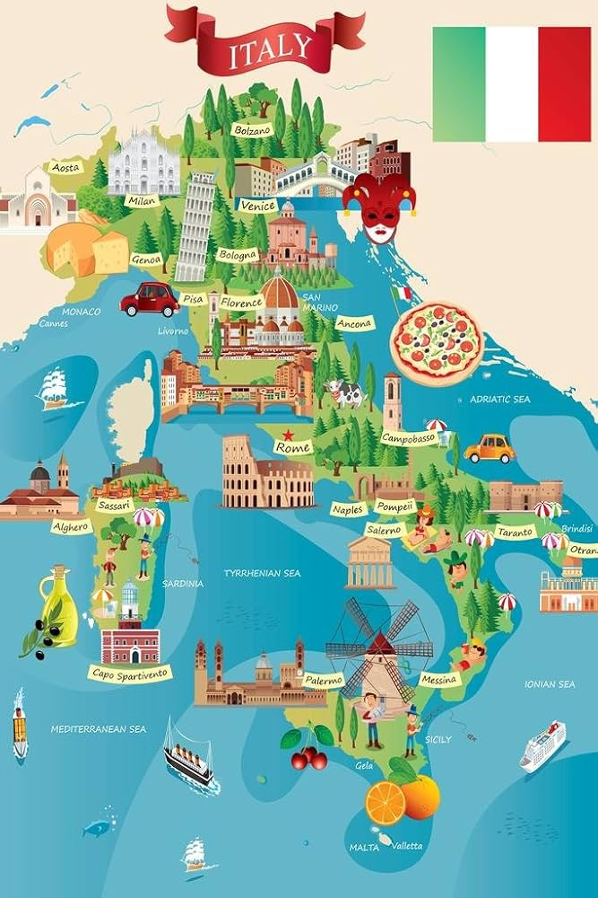
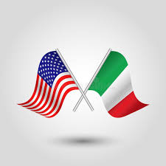
Over 584,000 Italian-Americans call CT home!
Italian-Americans make up 16.1% of CT’s population, this is the highest % of all 50 states.
The top 3 cities for
Italian Americans in CT are:
North Branford - 43.9%
East Haven, - 43.6%
North Haven – 41.2%
Data from US Census & NBC CT, 2023

Slide 50
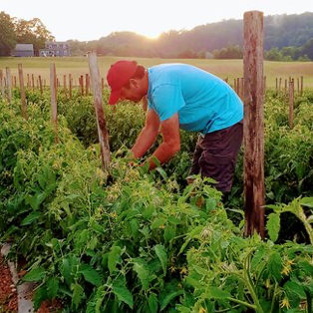

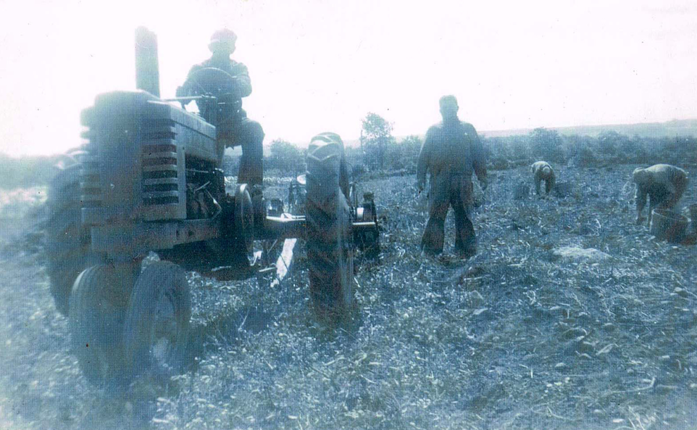
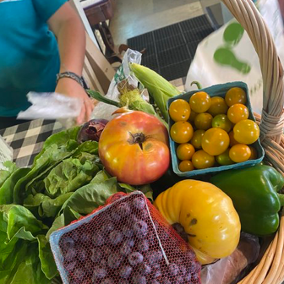
ITALIAN-AMERICAN AGRICULTURE IN CT
Since the early 1900's Italian-American's have been a vital influence on CT's vibrant farming and agriculture.
Notes:
On Wednesday, May 22, U.S. Congresswoman Rosa DeLauro, representing Connecticut’s Third District, entered a statement into the Congressional Record declaring “New Haven the Pizza Capital of the United States.”

Slide 51
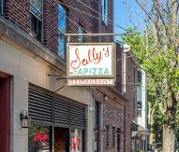
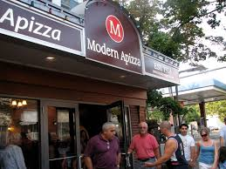
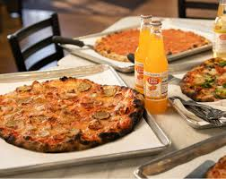
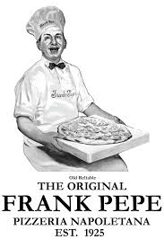
NEW HAVEN IS THE PIZZA CAPITAL OF THE U.S.
On May 22,2024 U.S. Congresswoman Rosa DeLauro, representing CT’s Third District, entered a statement into the Congressional Record declaring “New Haven the Pizza Capital of the United States.
Notes:
On Wednesday, May 22, U.S. Congresswoman Rosa DeLauro, representing Connecticut’s Third District, entered a statement into the Congressional Record declaring “New Haven the Pizza Capital of the United States.”

Slide 52
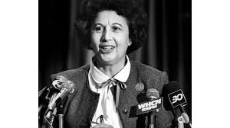
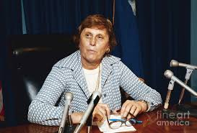
NOTABLE CT ITALIAN-AMERICANS
Antonina “Ann” Uccello, the first woman to become mayor of Hartford (served 1967-1971).
Ella Grasso, elected the 83rd Governor of Connecticut (1975-80) was the first woman to become governor in the United States.

Slide 53


Slide 54
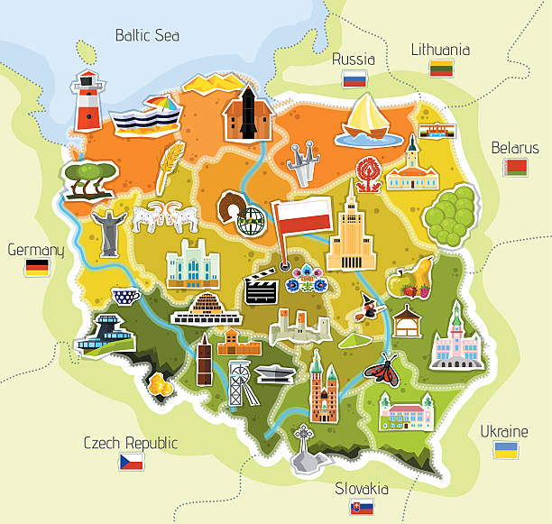
The first Polish settlers arrived at Jamestown, Virginia, in 1608.
Polish American Heritage Month was first established in 1981.
The shift from August to October as the Polish American Heritage Month was strategic, allowing schools to participate more actively in the celebration. It also coincides with the historical arrival of the first Polish settlers in Jamestown, Virginia, in October, marking the beginning of Polish contributions to American society.

Slide 55

It’s estimated that 9 million Americans have Polish ancestry, around 3% of the population.
Chicago is considered the biggest Polish city in the U.S.,
(New Britain is not too far behind ☺)
New York is the state with the largest Polish American population.
Polish Americans make up about 6% of the population in CT.

Slide 56
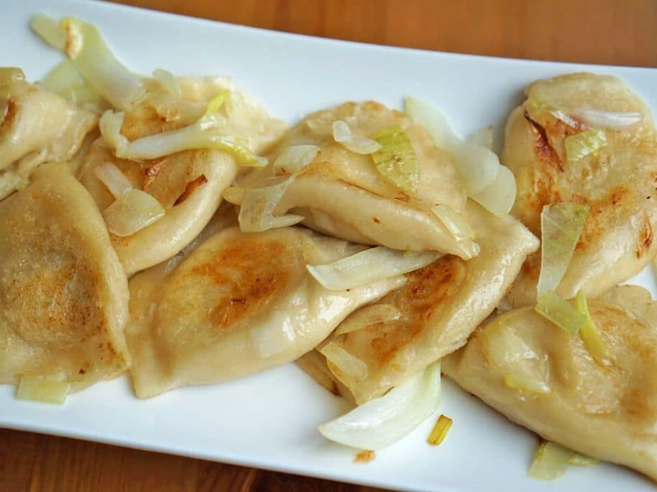



Slide 57
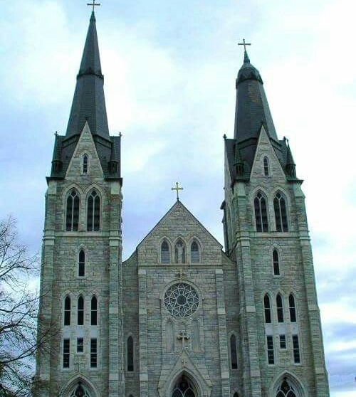

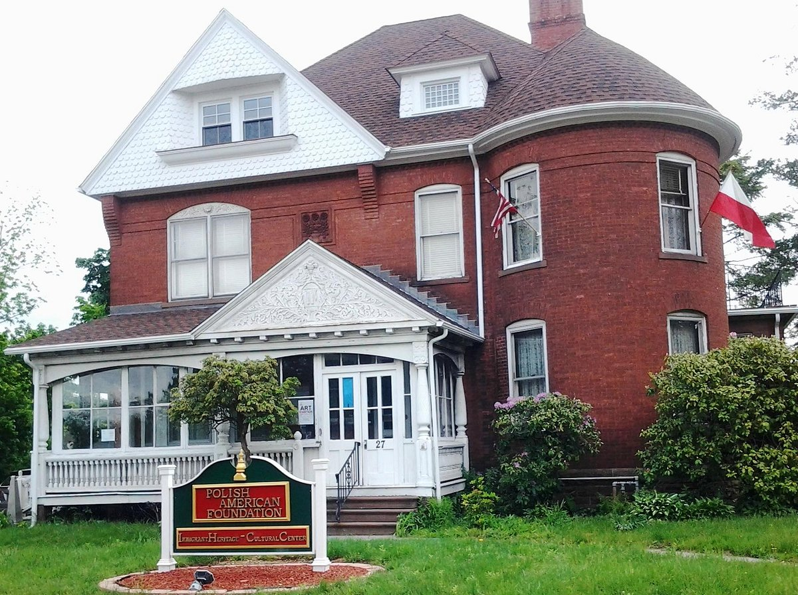


Experiencing Poland in CT
In 2008, New Britain’s common council passed a resolution designating Broad Street as “Little Poland.” Currently, Broad Street boasts over 100 businesses with the majority being Polish.
Haller Post acts as a social club, entertainment venue, and meeting place for the Polish community.
Sacred Heart Parish is one of the oldest Polish-American Roman Catholic parishes in New England in the Archdiocese
of Hartford.
The Polish American Foundation of CT is a premier cultural and service organization that promotes Polish cultural heritage.
Polmart is the largest Polish themed store on the East Coast.
Roly Poly Bakery is a unique experience in traditional Polish food.

Slide 58




Curtis Sliwa founded the Guardian Angels.
Notable Polish-Americans
Leo Gerstenzang invented the Qtip.
Ruth Handler cofounded the Mattel toy company and created the Barbie doll.

Slide 59
Big THANK YOU to this year’s Planning Committee
Karolina Wytrykowska (DMHAS) – Planning Committee Chair Erica Blackmon (MIL)
Talitha Coggins (DSS)
Susan Cunningham (DCF)
Valerie Lilley (DCF)
Maribel Martinez (DCF)
Kimberly Paluska (OEC)
Jean Stack (DDS)
Camise Turner-Evans (DMHAS)

