Slide 1




Municipal Coronavirus Relief Fund (CRF) Program and
Portal Instruction Review Session
October 14, 2020

Slide 2
Municipal Coronavirus Relief Fund (CRF) Program
Agenda
Municipal CRF Program Review and Updates
Portal Instruction Review
Question and Answer Period
https://portal.ct.gov/OPM/Coronavirus/Coronavirus-Relief-Fund/Municipal-CRF-Program

Slide 3
Municipal CRF Program Website Documents
Municipal CRF Program – PowerPoint General Overview
FEMA -COVID-19 Eligible Emergency Protective Measures Fact Sheet (3.19.20)
Municipal COVID-19 Funding and Tracking Letter 4.22.20
Municipal Data Request Letter 4.22.00
Municipal Data Estimates by Town (revised 10/01/20)
CT Division of Emergency Management and Homeland Security(DEMHS) – FEMA Assistance
Municipal Chief Financial Officer Portal Demonstration video
Municipal CRF Program Claim Instructions (PDF)
Municipal Chief Executive Officer Presentation (PDF) 5.11.20
Municipal Chief Executive Officer Video 5.11.20
Municipal CRF Program Q&A 10.09.20
Municipal CRF Program and Portal Instruction Review Session 10.14.20

Slide 4
Eligibility Conditions for Use of CRF
Under federal law, eligible uses must meet three conditions. They must be:
“Necessary expenditures incurred due to the public health emergency with respect to … COVID–19”
    Funds may not be used to substitute for lost government revenue
Not budgeted as of March 27, 2020 when the CARES Act was enacted
    May not supplant state or municipal spending
Incurred on or after March 1, 2020, up to December 30, 2020

Slide 5
FUNDING GUIDE
Municipality (non-education related) Relief Funding:
Apply first to FEMA
Apply to Department of Public Health for local health districts
Apply to Department of Housing Small Cities CDBG and ESG Funding for sheltering and congregate housing
Apply last to CRF
Educational Funding Relief for Municipal Boards of Education:
Apply to CSDE first for ESSERF
Whatever is not covered by ESSERF, should be submitted to the municipality so they can then submit those uncovered costs to FEMA, then CRF on behalf of the Board of Ed
Educational Funding Relief for Non-Municipal Boards of Ed (Regional or private schools)
Apply to CSDE first for ESSERF
Then the educational institution will apply DIRECTLY to FEMA (does not apply through a muni)

Slide 6
FEMA ACCEPTANCE
  The Municipal CRF Program does not need a FEMA denial in order to submit your claim. However, you must claim eligible items to FEMA first.
  Refer to FEMA guidance information for eligible items on Municipal CRF Program website.
  If applying for 25% reimbursement, your FEMA approval letter must be submitted with your claim.
  Note that a denial by FEMA does not automatically make the claim eligible for CRF. It must meet the requirements of CRF.
  If you have not heard back from FEMA with an acceptance letter by our claim period close October 30th, you should submit just your non-eligible FEMA items to the Municipal CRF Program. You will not be able to claim the 25% reimbursement for your FEMA claim.

Slide 7
FEMA GUIDANCE
This is for guidance only and information does not comprise a final eligibility decision concerning specific Public Assistance projects or activities.
FEMA only provides such eligibility decisions through formal, written determinations through the Public Assistance application process.
Furthermore, FEMA is currently preparing a policy document concerning the eligibility of work and costs under Public Assistance Category B for COVID-19 and, as a result, the preliminary and nonbinding guidance above may change.
Applicants may then either remove these costs from their FEMA projects, or continue with a formal determination memorandum while simultaneously applying to the CRF. If costs are paid under the CRF, it is up to the Applicant to then withdraw those costs from their FEMA projects to ensure there is "no duplication of benefits."

Slide 8
FEMA GUIDANCE
1. Disinfection of Schools and Other Public Facilities. You have asked whether the is infection of school and other government buildings (including purchase and provision of necessary supplies and equipment) would be eligible under Public Assistance Category B. The answer is likely no. FEMA will provide financial assistance for disinfecting public facilities only when that public facility is performing eligible emergency protective measures and it is necessary to disinfect that public facility to facilitate that eligible work.
2. Personal Protective Equipment (PPE) for Government Employees. You have asked whether the purchase of PPE (e.g., N95 masks, cloth face coverings, aprons, face shields, etc.) for schoolteachers, election poll workers, town or city clerks, public works employees, medical staff, and all other government employees to perform their day-to-day duties would be eligible. The answer is likely no. FEMA will only provide financial assistance for an applicant to purchase PPE for government employees when an employee is performing an eligible emergency protective measure and needs the PPE to facilitate that eligible work.

Slide 9
FEMA GUIDANCE
3. Temperature Screening and Other Measures in a Public Facility. You have asked whether the purchase of thermometers for temperature screening and installation of temporary physical barriers (such as plexiglass barriers) and other temporary measures in a public facility to help prevent the spread and transmission of COVID-19 in that facility would be eligible under Public Assistance Category B. The answer is likely no. FEMA will only provide financial assistance for temperature screening and temporary physical barriers and other temporary measures in a public facility where an employee is performing eligible emergency protective measures and needs the PPE to facilitate that eligible work.
4. Face Masks for the Public. You have asked whether the purchase of face masks (including cloth facial coverings, costs of distribution, and storage space) would be eligible under Public Assistance Category B. The answer is likely no. FEMA will only provide financial assistance for an applicant to purchase cloth face masks for government employees when an employee is performing an eligibility protective measure and needs the face mask to facilitate that work.
5. Testing. You have asked whether the testing of members of the public would be eligible under Public Assistance Category B. The answer is likely no. FEMA will only provide financial assistance for testing performed by an eligible applicant (such as a local government hospital) in the provision of medical care.

Slide 10
Allowable Municipal CRF Program Related Expenditures
FEMA Disaster Declaration
  25% Match against FEMA 75%
  Difference between cost and FEMA approved
  Requires document upload
Cleaning Supplies
Cleaning/disinfection of public buildings
Equipment (IT, teleworking, etc.)
Support of the local EOC and Response
School distance learning, to the extent not funded from other sources
Food Programs
Hazard Pay - additional pay for performing hazardous duty or work involving direct COVID-19 exposure risk
Legal Fees
Local Health Department to the extent not funded from other sources
Shelter costs to the extent not funded from other sources
Office Modification (signs, shields, etc.)
  Not full rebuilds where a lower cost option is available
Overtime Related to Response
Postage due to office closure
PPE (masks, gloves, etc.)
Training
  Education-related
  Linkage to COVID

Slide 11
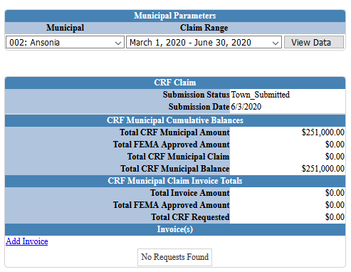
OPM PORTAL – ONLINE CLAIM SUBMISSION
Municipalities will log onto the OPM Portal to complete their certification of expenses and submission of their claim to OPM.
The March 1 – June 30, 2020 claim period filing deadline is October 30th.
Please use Firefox or Chrome instead of Internet Explorer when using the OPM Portal.

Slide 12
OPM PORTAL – HELPFUL TIPS
  Uploading your claim data:
  You can enter invoices at any time as they can be edited/removed.
  Invoices must be dated by June 30, 2020.
  Do not finalize (submit/certify) your claim until you are completely done.
  Certification and Filing Claim:
  Do not submit your final claim until you have entered all invoices for the claim period.
  Once you submit and certify the claim, you cannot adjust or edit invoices or claim.

Slide 13
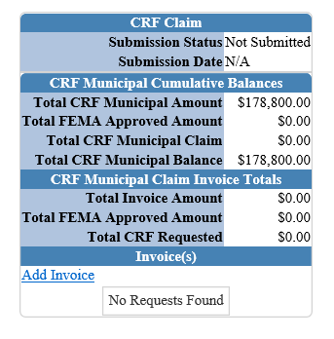
OPM PORTAL – ONLINE CLAIM SUBMISSION – ADD INVOICE
Home Screen
Add Invoice
Add invoice information
Save Invoice
Add Line Item
Save Line Item
Return to Home Screen
Repeat

Slide 14
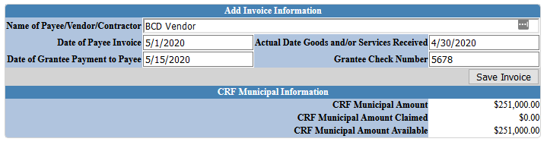
OPM PORTAL – ONLINE CLAIM SUBMISSION – ADD INVOICE
Add Invoice Information
Save Invoice

Slide 15
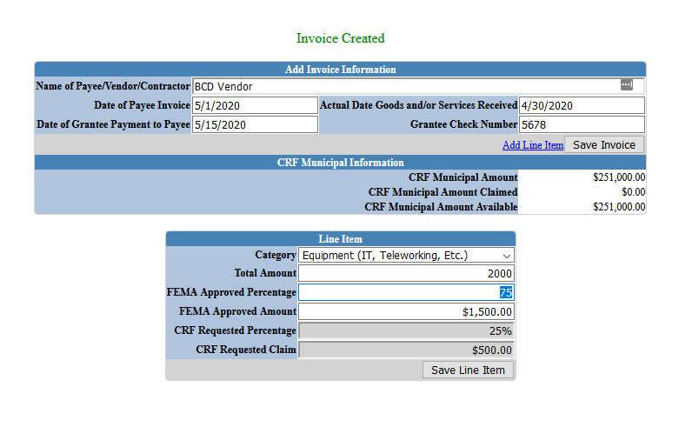
OPM PORTAL – ONLINE CLAIM SUBMISSION – ADD INVOICE LINE ITEM

Slide 16
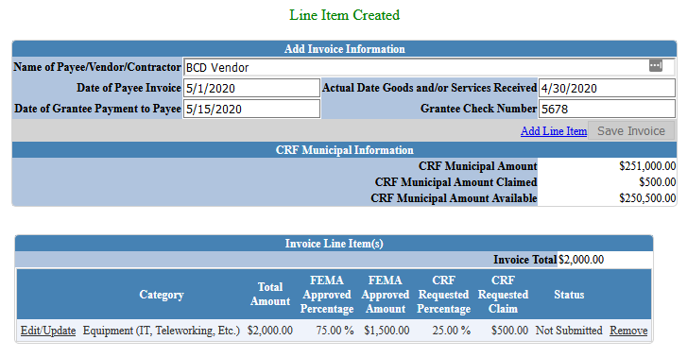
OPM PORTAL – ONLINE CLAIM SUBMISSION – LINE ITEM SUMMARY

Slide 17
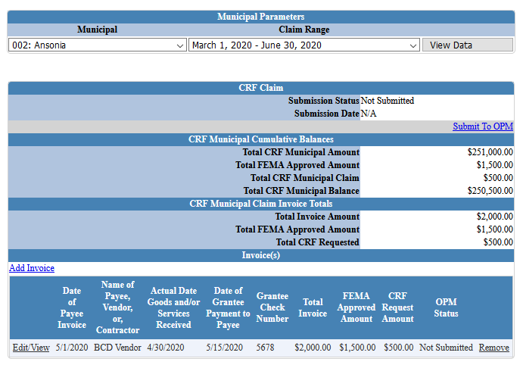
OPM PORTAL – ONLINE CLAIM SUBMISSION -
CLAIMS SUBMISSION PRE-CERTIFICATION

Slide 18

OPM PORTAL – REQUIRED DOCUMENTS
FEMA Approval Letter indicating approval amounts. This is not an email; it is an actual letter:
Transaction Detail from your municipal finance system (i.e. MUNIS check register)
No invoices or additional documents should be uploaded.
Documents only accepted in PDF format.

Slide 19
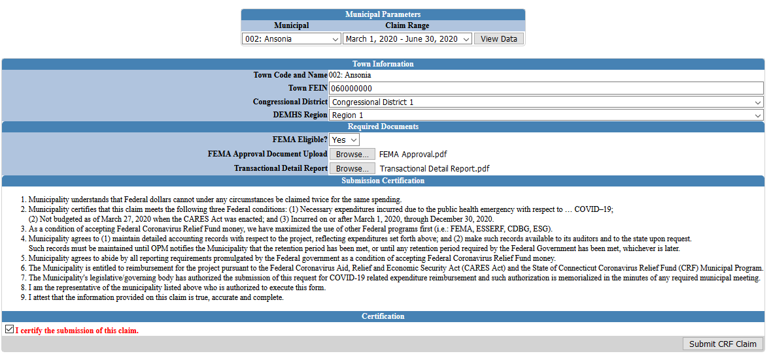
OPM PORTAL
ONLINE CLAIM SUBMISSION- CERTIFICATION

Slide 20


Municipal Coronavirus Relief Fund (CRF) Program
QUESTIONS

