Slide 1
PREPARING STUDENTS FOR SUCCESS:
NEW TESTS. NEW RESULTS.

Slide 2
PREPARING STUDENTS FOR SUCCESS
NEW TEST. NEW RESULTS
We owe it to our kids to make sure that they receive an education that prepares them to thrive in a global economy and civic life.
That’s why Connecticut raised the bar and issued a new instructional roadmap that will prepare our kids for college and careers.

Slide 3
PREPARING STUDENTS FOR SUCCESS
NEW TEST. NEW RESULTS
New standards.
Our new roadmap, the Connecticut Core Standards, sets learning expectations for what students should learn and be able to do at each grade level so that by the time they graduate from high school, they are prepared to succeed in college and careers.
[District name] has spent years preparing for the new academic standards. Today, teachers across the district are using it in their classrooms.
Notes:
Curriculum documents and lesson plans are still selected and developed by our local teachers and educators.
This is an opportunity to highlight specific steps that the district took to get to the first operational year of the Connecticut Core Standards.

Slide 4
PREPARING STUDENTS FOR SUCCESS
NEW TEST. NEW RESULTS
New standards.
New tests.
New scores.
Notes:
The adoption of new standards initiates a cascade of other changes.
The adoption of new standards means we need new tests to measure student progress.
With the new tests, our students will receive new scores based on their new learning goals.

Slide 5
PREPARING STUDENTS FOR SUCCESS
NEW TEST. NEW RESULTS
New tests.
With these new learning expectations, Connecticut needs new ways to measure student progress.
This year, the Smarter Balanced assessments will replace our old statewide tests, the Connecticut Mastery Test (CMT) and Connecticut Academic Performance Test (CAPT), in English language arts and math.
Notes:
We need new tests that will assess student learning relative to the new standards.
Schools will no longer administer our old tests, the Connecticut Mastery Test (CMT) and Connecticut Academic Performance Test (CAPT) in English language arts and math.
Students will, however, continue to take the new CMT/CAPT Science exams in Grades 5, 8, and 10.

Slide 6
PREPARING STUDENTS FOR SUCCESS
NEW TEST. NEW RESULTS
Smarter Balanced assessments
The Connecticut Core Standards focus on critical thinking and problem-solving—the skills students need to be successful in college and careers.
The Smarter Balanced assessments will be administered on computers and are designed to measure these skills through reading comprehension, writing, and math questions that require students to demonstrate that they truly understand the content.

Slide 7
PREPARING STUDENTS FOR SUCCESS
NEW TEST. NEW RESULTS
90% of Connecticut districts already have one successful administration of the Smarter Balanced test completed.
  It helped familiarize students and staff with the new types of questions and with taking the tests on the computer-based testing system.
  The feedback was generally positive and most schools’ technology proved ready.
Notes:
Smarter Balanced field test
The field test was a test of the test. As such, there are no student, school, district or state level scores.
Even without scores, the field test did provide considerable value to the state (or district) and our students.
The flexibility to administer the field test instead of the CMT/CAPT test allowed the state (or district) to:
supported districts’ (our) transition by allowing them (us) to ease into the era of the Connecticut Core Standards;
avoided “double-testing” students so that teachers can reclaim instructional time that would have otherwise been lost to redundant testing and focus on teaching the new standards;
provided districts (us) the opportunity to test their (our) technology readiness for the new computer-based tests in a low-stakes environment; and
enabled students to experience the new content and types of questions, become familiarized with the new computer-based testing system, and meaningfully informed item selection for the 2014-15 state assessment—the first operational year.

Slide 8
PREPARING STUDENTS FOR SUCCESS
NEW TEST. NEW RESULTS
Assessments are like academic checkups.
It helps teachers and parents see how on-track students are to where they need to be.
Results help inform decisions around classroom instruction.
Notes:
Helps to assess student strengths and weaknesses. Districts use results to monitor schools to provide intervention or support, if necessary.
Tests are not the only measure of student learning, but they are useful and important.
What the Smarter Balanced scores can tell parents and teachers is how the student is performing at that moment in time during the school year.
The results of the test can illuminate subject areas where the student is excelling. It can also help to reveal subject areas where the student could benefit from extra help and additional instruction.
Tests are one tool in the toolbox that helps inform decisions about teaching and learning. The State Department of Education is providing parents with resources for each grade level to be able to help children with the standards at home. Visit CTCoreStandards.org.

Slide 9
PREPARING STUDENTS FOR SUCCESS
NEW TEST. NEW RESULTS
New scores.
With the new tests, students will receive new scores.
Results will be different.
  In many cases, the scores will look lower on the Smarter Balanced tests than what we are used to seeing on the CMT/CAPT exams.
This is to be expected because we are using a different ruler.

Slide 10
PREPARING STUDENTS FOR SUCCESS
NEW TEST. NEW RESULTS
New scores.
The shift is like going from centimeters on the CMT/CAPT to inches on the new exams.
CMT/CAPT:
(4 centimeters)
Smarter Balanced:
(4 inches)
This analogy has limitations. Whereas we can convert centimeters to inches, we cannot convert CMT/CAPT scores to Smarter Balanced scores.
Notes:
Much more distance needs to be covered to reach 4 inches than it does to reach 4 centimeters.
Reaching a “4” along the CMT/CAPT measuring stick is not the same as reaching a “4” along the Smarter Balanced measuring stick.
(These lines are not drawn to scale.)

Slide 11
PREPARING STUDENTS FOR SUCCESS
NEW TEST. NEW RESULTS
New scores.
Comparing scores on CMT/CAPT to SBAC is like comparing apples to oranges.
Given that the ruler is changing, and that the exams are testing different content and skills, we won’t be able to compare scores.

Slide 12
PREPARING STUDENTS FOR SUCCESS
NEW TEST. NEW RESULTS
New scores.
In the beginning, fewer students may score at higher levels than we are used to seeing.
This does not mean that students are learning less. Rather, it reflects that we setting a new baseline from which our students will grow.
Notes:
The initial shift in Connecticut’s scores might be jarring for some.

Slide 13
PREPARING STUDENTS FOR SUCCESS
NEW TEST. NEW RESULTS
Early adoption states
Based on the example of states that transitioned to new tests early, we anticipate that scores will steadily improve in the coming years as students and teachers gain more classroom experience with the standards.
For example, in Kentucky the percentage of high school graduates ready for college and careers has increased from 38 percent to 62 percent in just four years.
Notes:
States that made the transition to college- and career-ready standards early did see a drop in scores, but they are seeing improvements year-to-year.
But like the early adoption states, we anticipate that scores will steadily improve in the coming years as students and teachers gain more classroom experience with the standards.
Another example of an early adoption: New York City
NYC administered a new Common Core Exam in 2013 for the first time.
3-8 Math: Percent of students at or above proficient
2012 (last year of old test): 60.0%
2013: 29.6%
2014: 34.2%
3-8 English: Percent of students at or above proficient
2012 (last year of old test): 46.9%
2013: 26.4%
2014: 28.4%

Slide 14
PREPARING STUDENTS FOR SUCCESS
NEW TEST. NEW RESULTS
Notes:
In Kentucky, the percentage of high school graduates ready for college and careers has increased from 38 percent to 62 percent in just four years.
That’s 24.5 percentage points, representing a 64% increase.

Slide 15
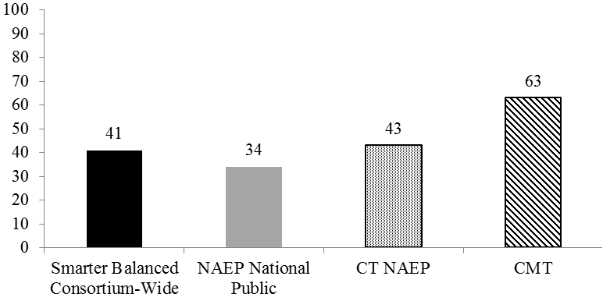
PREPARING STUDENTS FOR SUCCESS
NEW TEST. NEW RESULTS.
New scores.
Grade 4 Reading
This graph illustrates the similarities between the Smarter Balanced and NAEP performance at or above level 3 in Grade 4 reading.
Notes:
Based on the experiences of these states, we can also reasonably expect that the first results from the new tests will resemble Connecticut’s scores on the National Assessment of Educational Progress (NAEP).
ABOUT NAEP: Known as the “Nation’s Report Card,” NAEP is the largest nationally representative and continuing assessment of students’ knowledge in reading and math on a state-by-state basis. The NAEP test is periodically (not annually) administered to a representative sampling of students. The state level results are derived by the performance of this representative sample.
You can see that these scores will look different than what we are used to seeing. Again, this is to be expected and it does not reflect that our students are learning less.
We know that when we raise the bar, our students will rise to meet it.
Grade 4 Reading:
Percentage of students performing at Smarter Balanced Level 3 and above in 2013-14
Percentage of students performing at or above the NAEP "proficient" level in 2012-13
Percentage of students performing at or above CMT Goal in 2012-13

Slide 16
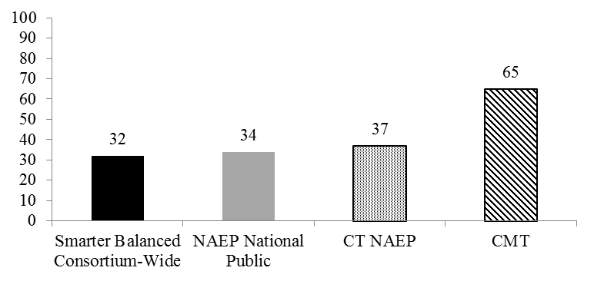
PREPARING STUDENTS FOR SUCCESS
NEW TEST. NEW RESULTS
New scores.
Grade 8 Mathematics
This graph illustrates the similarities between the Smarter Balanced and NAEP performance at or above level 3 in Grade 8 mathematics.
Notes:
It is also important to remember that we cannot compare the CMT and NAEP, because they are not measuring the same thing.
Grade 8 Mathematics:
Percentage of students performing at Smarter Balanced Level 3 and above in 2013-14
Percentage of students performing at or above the NAEP "proficient" level in 2012-13
Percentage of students performing at or above CMT Goal in 2012-13

Slide 17
PREPARING STUDENTS FOR SUCCESS
NEW TEST. NEW RESULTS
New standards. New tests. New scores.
This is certainly a big shift for our students and teachers—but one that holds great promise for our children. By making this transition, we are better preparing our kids to meet the demands of college and the 21st century workforce.

Slide 18
PREPARING STUDENTS FOR SUCCESS
NEW TEST. NEW RESULTS
We will continue to work together with teachers and parents to provide all our students with the support they need to succeed.
In addition, the Connecticut State Department of Education has many resources available online at CTCoreStandards.org. There is a page devoted for resources for parents and guardians, including ways to help with the new standards at home.

Slide 19
PREPARING STUDENTS FOR SUCCESS
NEW TEST. NEW RESULTS
Change is difficult. In the beginning, it might seem that students have a long way to go to reach the new expectations. But [insert district name]teachers and administrators are committed to working together to support students with great instruction and resources to meet these new expectations.

Slide 20
PREPARING STUDENTS FOR SUCCESS
NEW TEST. NEW RESULTS

