Slide 1
General System Navigation
Notes:
The CSDE is excited to present the CT-Special Education Data System or CT-SEDS. This comprehensive system supports the IEP and Section 504 processes and a variety of required data collections. A tremendous amount of strategic planning and collaboration has resulted in a multifaceted system of training and technical assistance designed to support our educators, parents, and other stakeholders in our community. The CT-SEDS Expert Training is a major component of this system of support. We welcome your partnership and thank you for your willingness to serve in this important role.
This training presentation is relevant for all users who are going to utilize the Referral/Evaluation, IEP, 504, and Services Plan modules.

Slide 2
Agenda
Role of a CT-SEDS Expert
General System Navigation and Orientation

Slide 3

CT-SEDS Expert Role
Training and Support Lead for your School/District
  Use training videos and resources available on the CT-SEDS Home Page
  Frequently Asked Questions Documents
  Quick Guides
  Work with your District CT-SEDS System Administrators
Notes:
CT-SEDS expert were trained this summer to help turnkey training to support existing and new staff in the district use the data system. is to become a training and support lead for your school/district.
There are many resources made available on the CT-SEDS home page and the CSDE website, including all of the user manuals for each process are available. There are also videos, which we see during this training today, and PowerPoint slides available to support you.
As questions come in, Frequently Asked Questions and short Quick Tips guides will also become available and be posted on the CT-SEDS Home page so you can learn these updates and distribute the information.

Slide 4

CT-SEDS Experts Role in Supporting Users
Provide answers to District process questions
Provide updated information to your users when issued by CSDE or PCG
Who to call in your school or district
District CT-SEDS Expert CONTACT LIST
Other district resources
CSDE website: https://portal.ct.gov/SDE/Special-Education/New-IEP/New-IEP-CT-SEDS
Notes:
CT-SEDS Experts will be supporting users in your district or school by providing answers to district level process questions. You will also have an important role in providing updated information to users in your district or school when it is issued by CSDE or PCG.

Slide 5
Topics Covered
Logging In
Home Page
  Widgets, Announcements, Resource Documents
Main Menu
  Tools, My Account, Reporting
Caseloads
  Caseload Setup Wizard
Student Search
Student Menu
  Student Info: Personal Info, Team, Parents, Contact Log
  Admin: Student History, Create/View Documents
Module Overview and Basic Navigation
Notes:
The topics covered in this section of the presentation are: Logging In, the Home Page, the Main Menu, Caseloads, Student Search, the Student Menu, and an overview of basic navigation in modules.

Slide 6
Logging In
District/LEA site, Aggregate Site
Notes:
We will begin with logging in.

Slide 7
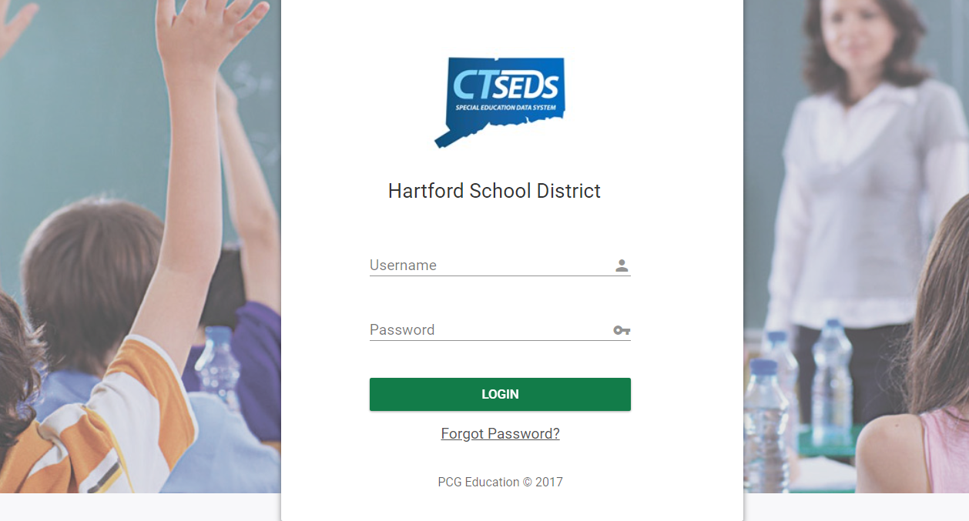
Notes:
Most users will login directly to their district site. Each district received a URL link to their district site page. The Login Page is unique for each district and asks for the User’s Username and Password. The username will be the user’s email address. The first time a user logs in they will use a temporary password distributed to them by their administrator.

Slide 8
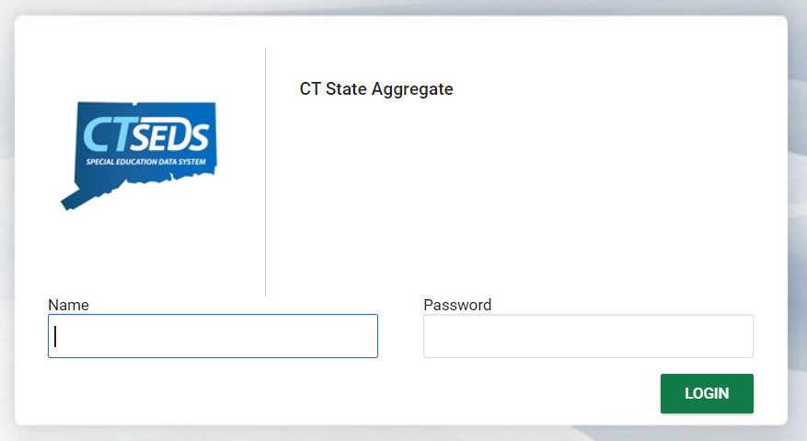
Notes:
For “Aggregate” users who have access to multiple district sites, they will be provided with a URL to login to the CT State Aggregate site. The Name that users will use to login is their email address. If aggregate users have more than one email address, contact your district contact to find out which email address you login with. Again, the first time the user logs in they will use a temporary password distributed to them by their district administrator or contact.

Slide 9
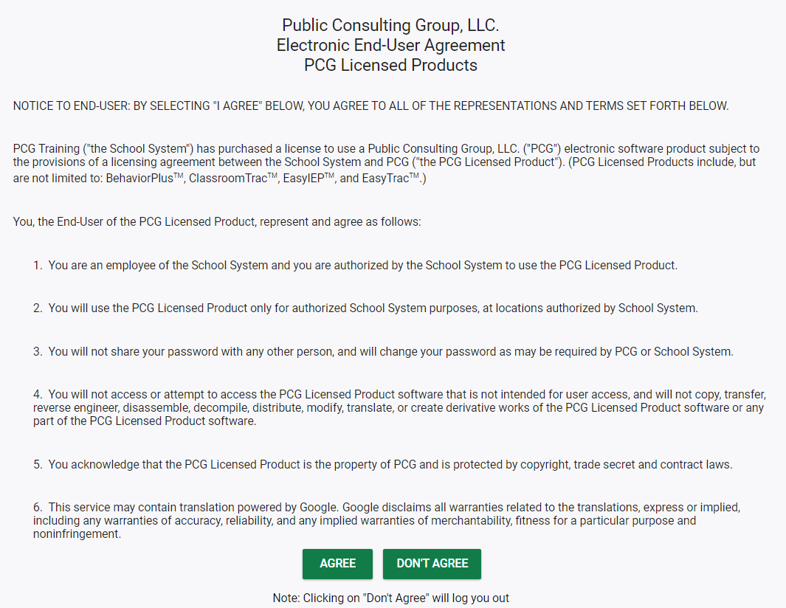
Notes:
Upon first login, the user will be prompted to accept the Electronic End-User Agreement. If the user does not accept this agreement, they will not be allowed further into the CT-SEDS system.

Slide 10
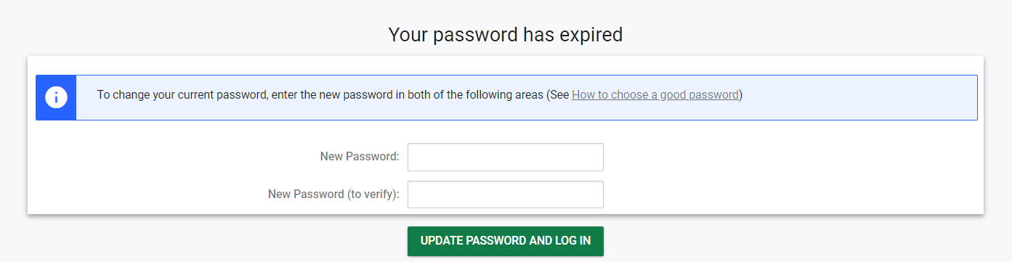
Notes:
The first time the user logs in with the temporary password, and any time their password is reset by an administrator, the user will also be prompted to update their password. At a minimum, passwords must be at least 8 characters long and require at least one uppercase letter, one lowercase letter, one special character, and one number.

Slide 11
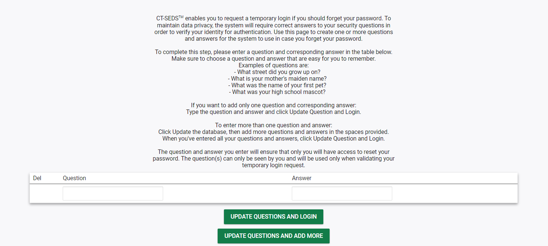
Notes:
The first time the user logs in, they will also be prompted to create a ‘Forgot Password Question’(s) so the user will be able to reset the password if needed in the future.

Slide 12
Home Page
Widgets, Announcements, Documents
Notes:
Now, we are going to review the CT-SEDS System Home Page.

Slide 13
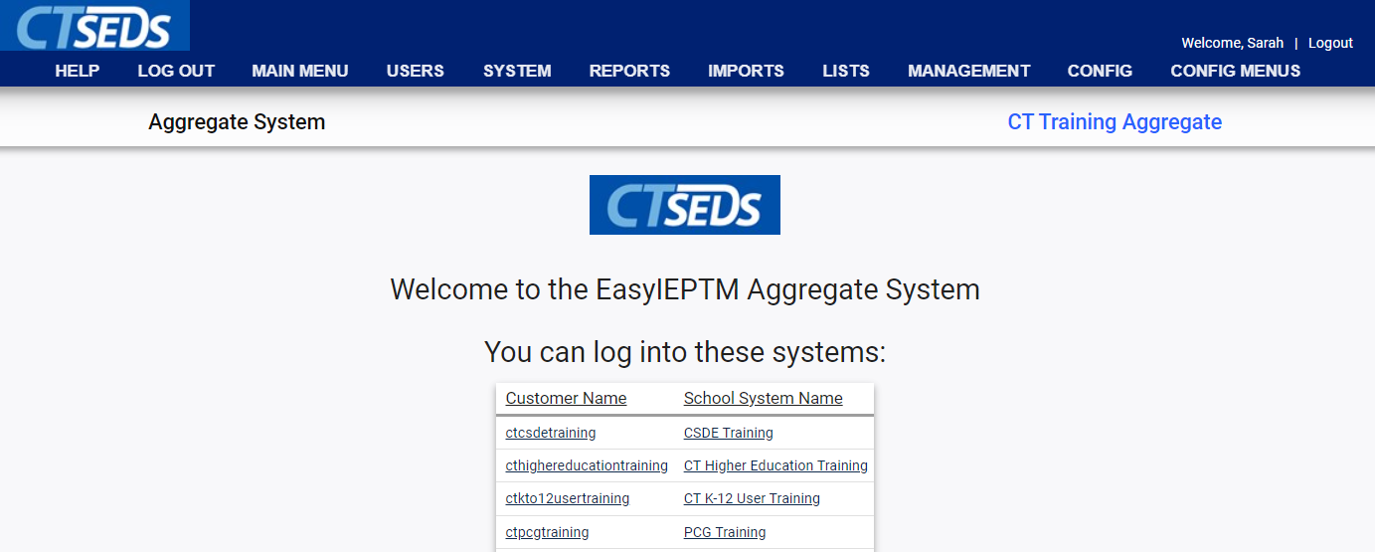
Notes:
Upon logging in, aggregate users who are associated with multiple districts will see the Aggregate Landing Page. They will be able to click into districts they are associated with to access each district site Home Page.

Slide 14
District Site Login Page
URL: Varies by LEA/District
Username: Email Address
Aggregate Site Login Page
URL: https://ctseds.ct.gov/~ctstate/
Name: Email Address
Notes:
There are two different ways that users login to CT-SEDS. Most users will login directly to their DISTRICT SITE. Each district received a URL link to their district site page. Each district/LEA has a unique site link. The Login Page is will say the name of the district and asks for the User’s Username and Password.
The username will be the user’s full email address. PLEASE NOTE THAT IF THE EMAIL ADDRESS ORIGINALLY SUBMITTED TO THE CSDE IS INCORRECT, THE USER WILL HAVE TO ENTER THE INCORRECT ADDRESS TO ACCESS THE SYSTEM UNTIL IT CAN BE CHANGED.
For users who have access to multiple district sites, they will login to the AGGREGATE site and will be provided with a URL to login to the CT State Aggregate site. Their assigned user type would include the word “aggregate” in it. The URL is the same for all Aggregate Users.
If aggregate users have more than one email address, contact your district contact to find out what email address you login with. The first time the user logs in, they will use a temporary password distributed to them by their administrator and then will be prompted to change their password.
It is important that users are logging into the correct site.

Slide 15
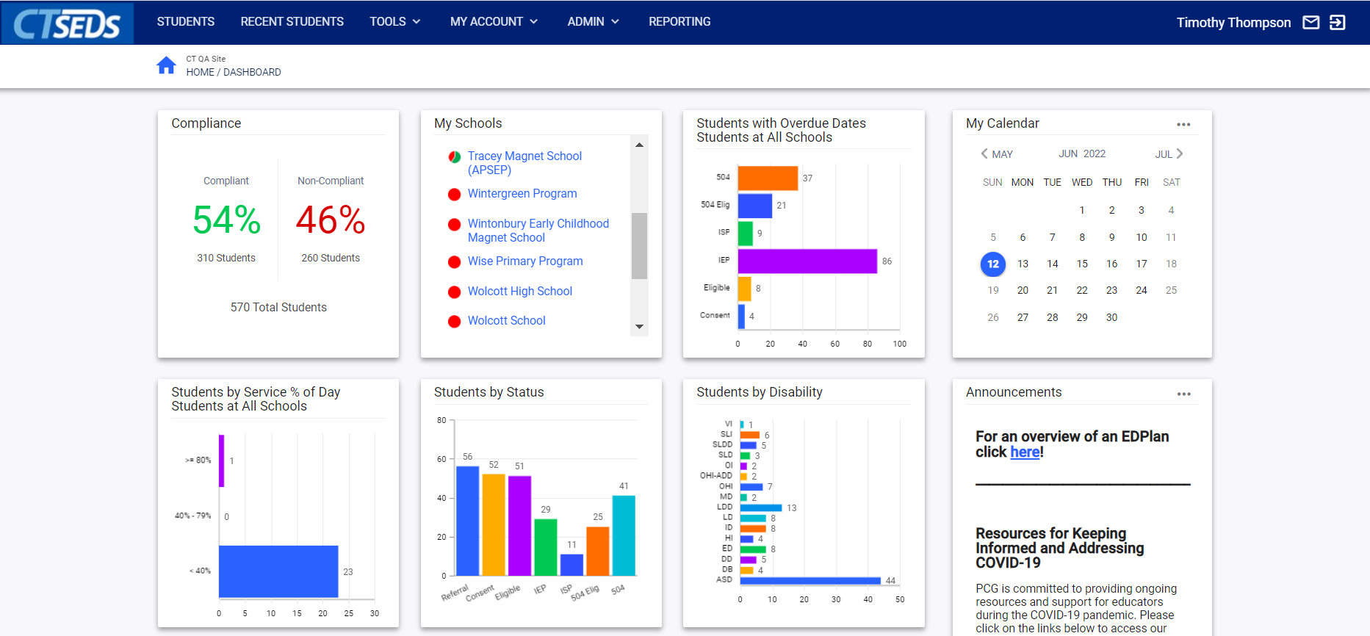
Notes:
Upon logging in to a district site, either directly from the site login page or from clicking the site Aggregate link, district users will see the CT-SEDS Home Page.

Slide 16
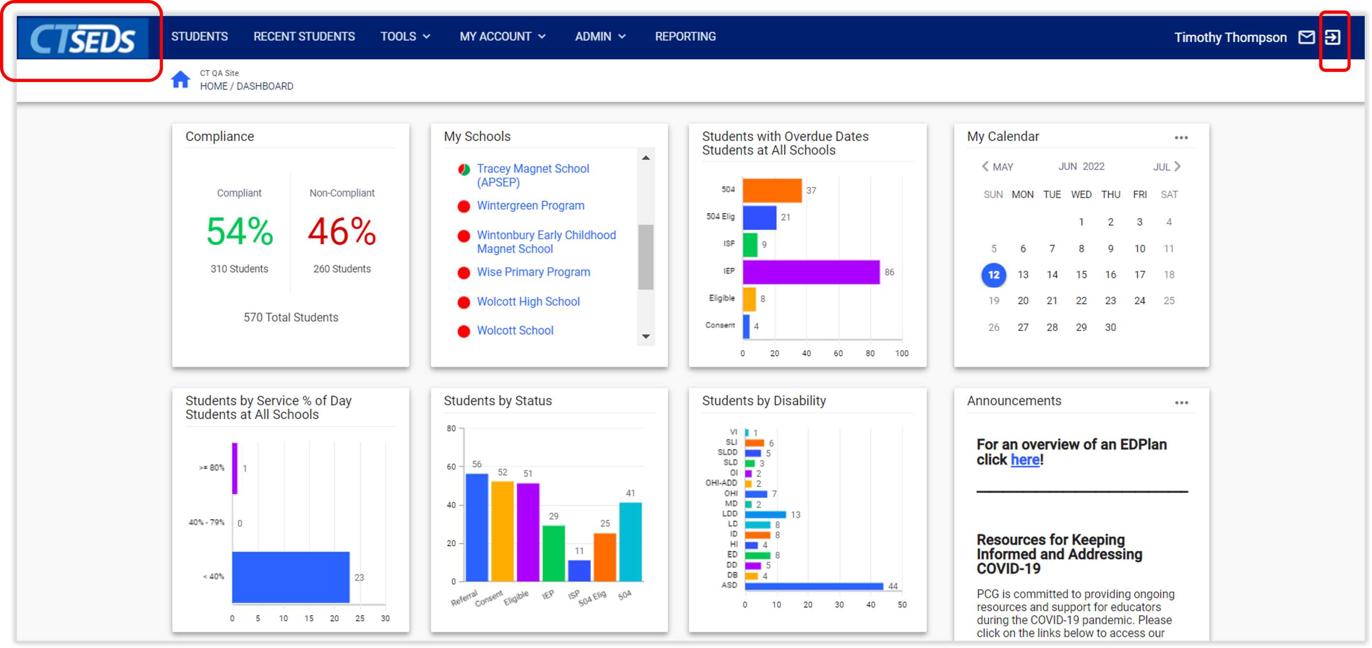
Notes:
The dark blue Main Menu Navigation Bar is visible on all pages within CT-SEDS. Use the tabs here to navigate the system and perform various functions. To return to the Home Page, click the CT-SEDS logo in the top left. To log out, click the logout arrow in the top right.
The Home Page contains a series of dashboard widgets providing quick, relevant information. These Dashboard Widgets display relevant information based on user type permissions. Please note, different User types will have different views and permissions in the system. When most users first log in, they will notice that you don’t have any information yet in your widgets – because you don’t yet have any students assigned to your caseload. My Calendar, Announcements, and Helpful Documents Widgets are available for all user types.
Clicking a date on the My Calendar Widget displays any scheduled appointments along with a ‘New Appointment’ button. Clicking New Appointment allows the user to schedule a meeting, flag it in various categories/colors for organizational purposes and add other CT-SEDS users.

Slide 17
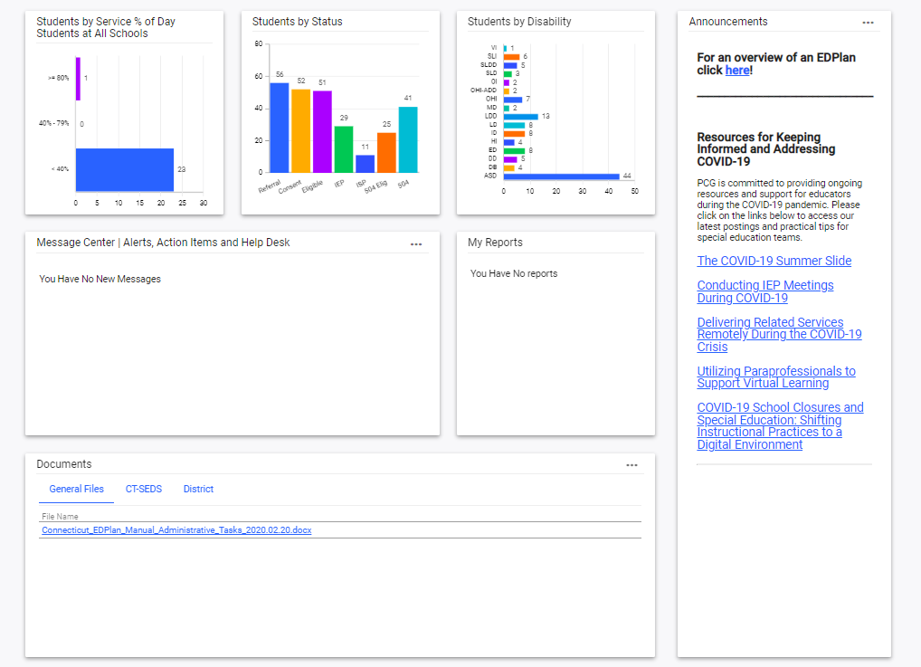
Notes:
The Documents Widget at the bottom of the Home Page contains documents such as user manuals and other helpful documents organized under relevant tabs. Note the Announcement widget. PCG will use this to announce anything that needs attention including system updates and changes.

Slide 18
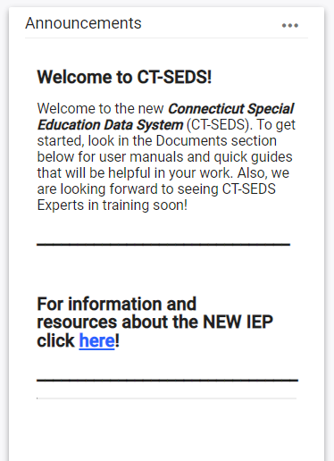
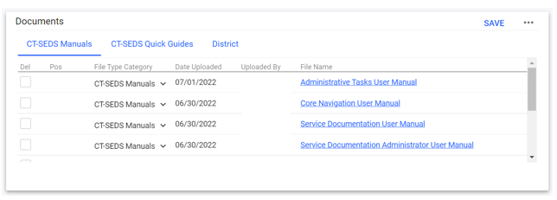
User Manuals and Quick Guides
CT-SEDS Manuals and Videos available in the Documents Widget on the Home Page.
Notes:
Please note, all of the Modules have a specific user manual that will help with navigation as well as processes for using the system. The general Core Navigation user manual is also very useful for people as they are starting out in the system. All of the manuals are found in the Documents widget on the home page under the CT-SEDS Manuals tab.
Links to training videos are posted to the Documents widget on the home page under the CT-SEDS Quick Guides heading.
Please also note there are also additional Quick Guides posted under CT-SEDS Quick Guides. Quick guides are short ‘how-to’ instructions to help with common tasks. The Caseload Wizard quick guide is a good one to put into users hands as they are just starting out as most will need to have students on their caseloads to get started in their work. The guide also includes instructions for the Caseload Admin wizard, which Administrative users will have access to. This wizard works similarly to the one end users use, but it allows a person with administrative rights the ability to manage other caseloads as well as copy and move caseloads from one user to another. Other current quick guides include Adding and Inactivating Users, School and District calendars, and the Parent Portal Quick Start Guide for Parents.
Please also ensure that you are watching the Announcements board in the system. As more quick guides are created and other modules are released, announcements will be made and documents will be posted. Quick guides are often created from questions that come from users, so we strongly encourage you to pay attention to the Announcements widget. Please note, if you have a suggestion or request for a new guide, you can use the message board to request one.

Slide 19
Main Menu
Wizards, My Account, Reporting

Slide 20
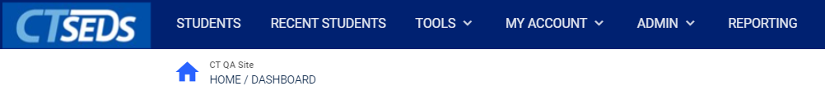
Main Menu
Notes:
The dark blue Main Menu navigation bar includes six options: Students, Recent Students, Tools, My Account, Admin, and Reporting. Students will take you to Student Search, which will be discussed shortly. Recent Students shows students you have clicked on recently.

Slide 21
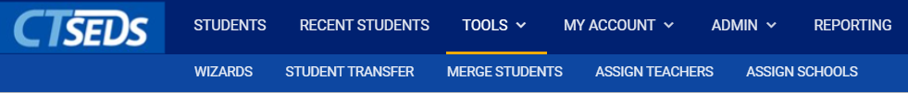
Tools
Notes:
The Tools menu item is a drop-down that when clicked will open up options in a light blue sub menu bar. The options depend on your user type. Wizards are tools that help a user complete tasks in the CT-SEDS system. Some of the common wizards will be discussed later in this training. Other options are available to Administrators and will be discussed further in the training for Administrators.

Slide 22
My Account
Notes:
From any page, clicking My Account will reveal a sub menu that will allow the user to navigate to several tools and areas specific to their account. Within this tab, the user can edit their Calendar, view all documents that they have created, adjust their personal information including updating their password, view messages, and view reports they have created.

Slide 23
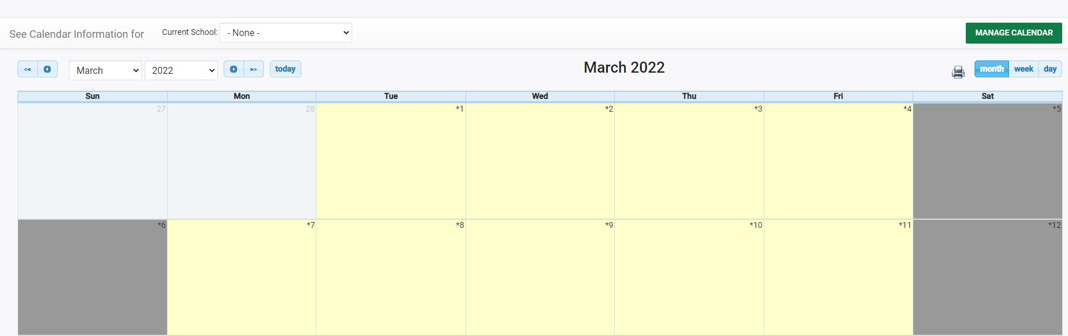
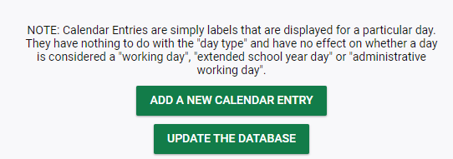
My Calendar
Notes:
The My Calendar page will show your calendar. Please note, this is the same calendar shown in the My Calendar Widget on the home page. Users can add appointments to their CT-SEDS calendar by clicking on the date of appointment, which will bring open a page to ADD A NEW CALENDAR ENTRY.

Slide 24
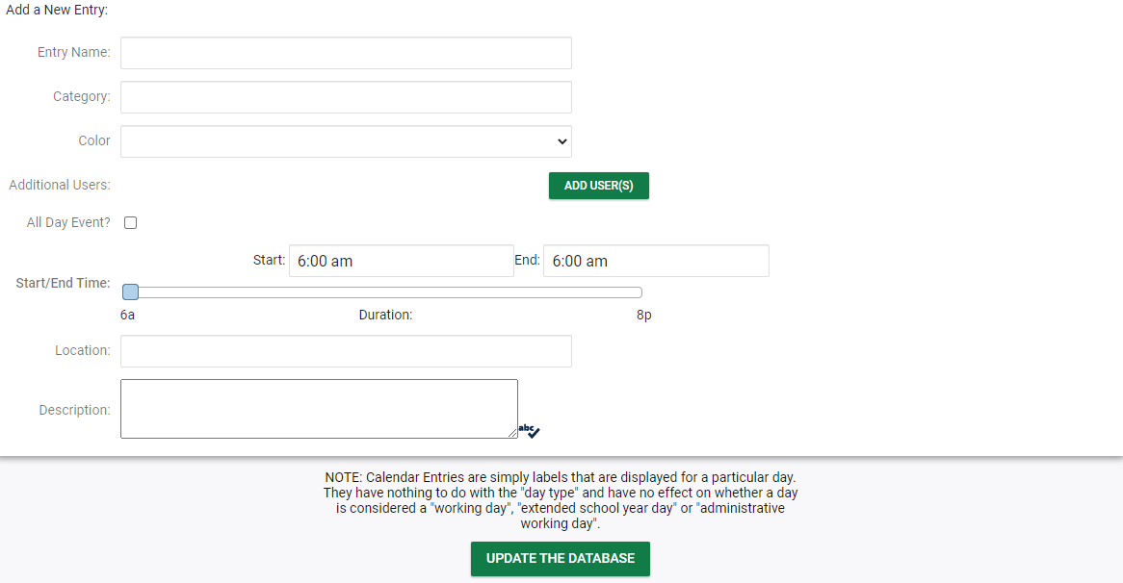
My Calendar
Notes:
Appointments can be color coded by topic and additional CT-SEDS users can be included by clicking the ADD USERS and selecting the user within the system. When users are added, they will receive a notification in the CT-SEDS Message Center with the new appointment invitation. Please note, Calendars in CT-SEDS are contained within the system and do not automatically sync to outside calendars like google calendars or outlook calendars.

Slide 25
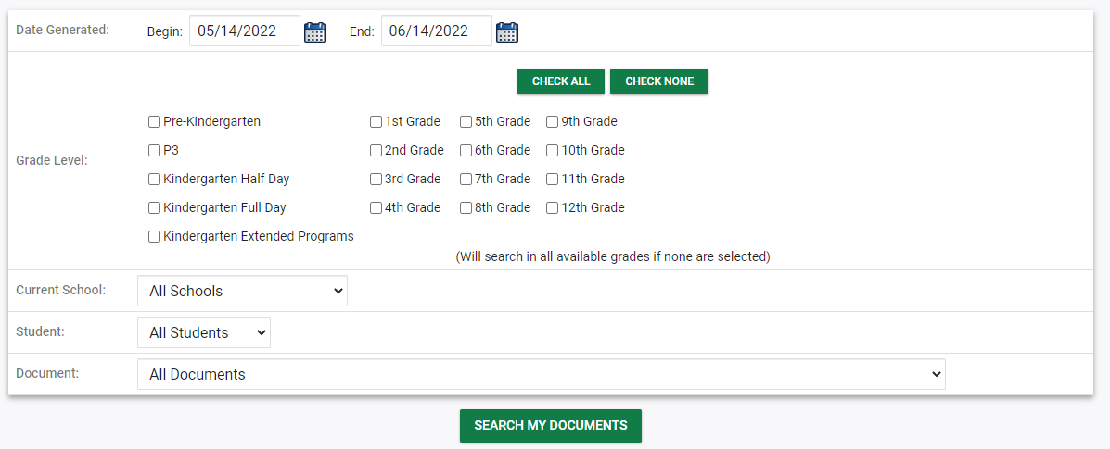
My Docs
Notes:
The My Documents page displays all student documents for students on a user's caseload. The user can filter by date, grade, school, etc., click SEARCH MY DOCUMENTS to see all documents. To open a document, the user needs to click on the Document Title. To batch documents into a single PDF, select the Batch checkbox next to the desired documents and click VIEW DOCUMENT BATCH at the bottom of the page. This will allow the user to open multiple documents in one PDF.

Slide 26
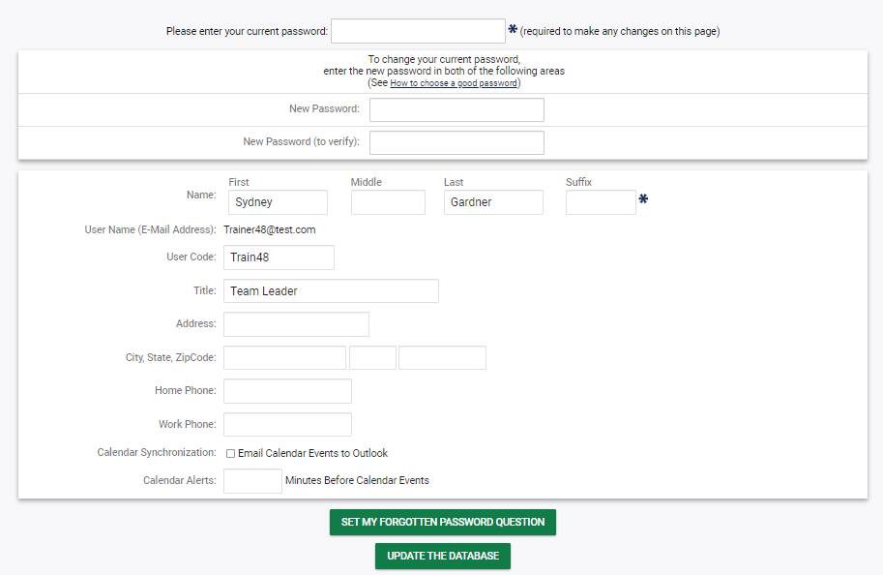
My Info Page, Password Reset and Title
Notes:
A user can change their password, update forgotten password questions, and update personal information using the My Info page. Please note, the user must enter their current password at the top of the page before being allowed to make any changes. Information entered here could be available elsewhere in the system. For example, if the user is a student’s case manager, the phone numbers, title, and address entered here may be added to documents. For any user, it is strongly recommended to use school or work contact information on this page. Upon getting started in CT-SEDS, users will not have a title listed in system. Users should add their title/job description here so that this can pull into the system and documents where relevant. When updates have been completed, click Update the Database in order to save.

Slide 27
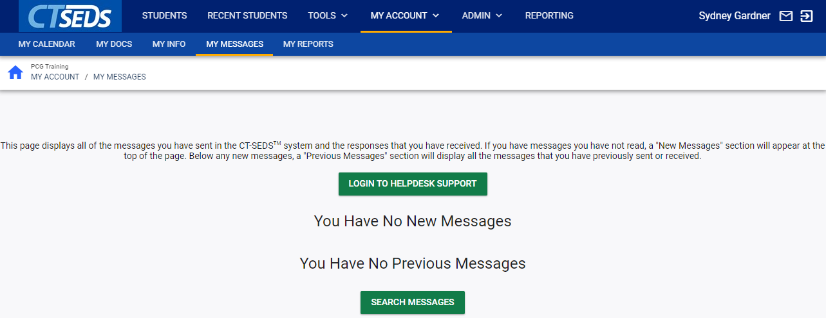
My Messages
Notes:
The My Messages tab is means for users to access the message strings that have occurred within the CT-SEDS system. It also allows users to search for historic message strings.

Slide 28
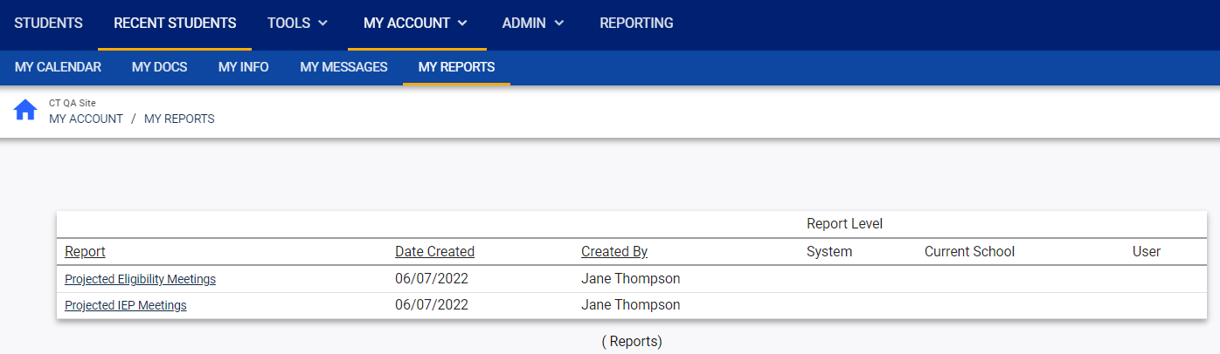
My Reports
Notes:
The My Reports tab allows users to see and access the reports they have generated. Different user types have access to different reports and some users do not have access to run reports.

Slide 29
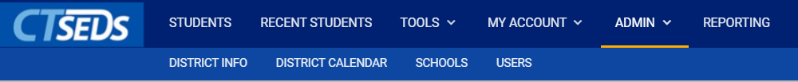
Admin User Functions
Notes:
The Admin menu item is a drop-down that will have different options depending on your user type. Some users will be able to edit these pages and others will only be able to view. The District Info page shows general information about the district, the District calendar shows the calendar set for the district as a whole, Schools shows the district schools, and Users has user information. Functionality of most of these items is for Administrators and will be discussed further in the training for Administrators.

Slide 30
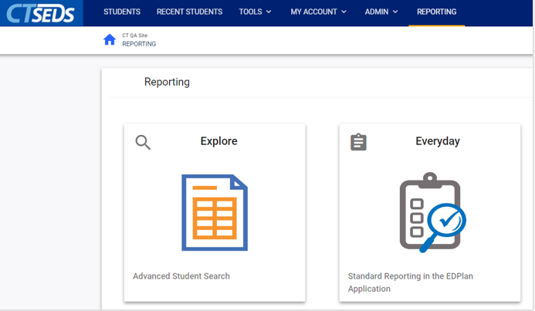
Notes:
To see reporting options, navigate to the Reporting tab where there are standard reports available. Please note, different user types will have different reporting access and some users will not have the ability to generate reports.

Slide 31
Caseloads

Slide 32
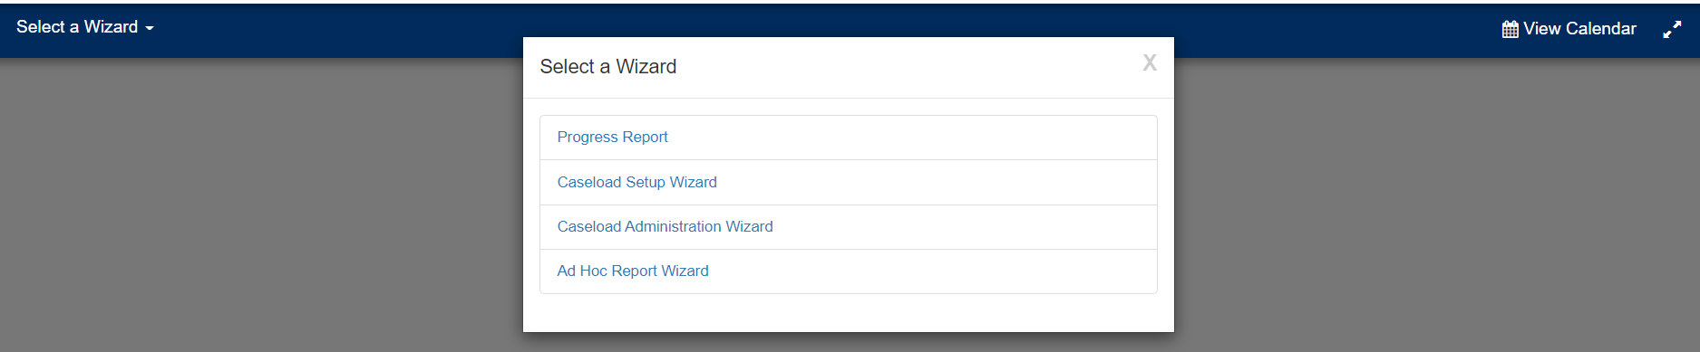
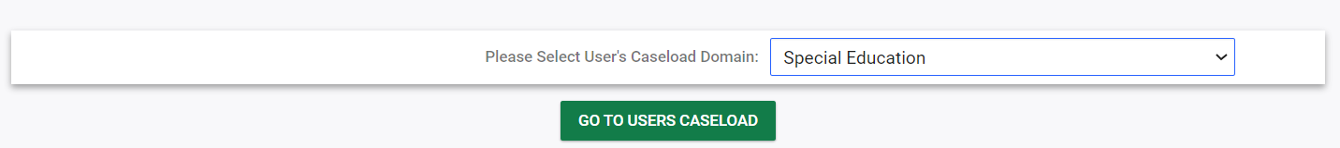
Notes:
Students are associated to users in the system through a function called Caseloads. When users get started in the system, they will not have any students on their caseload. For many user types, when they are not connected to a student via a caseload, they cannot view or edit the student’s information so setting up caseloads is a priority as users are getting started in the system.
To set up a caseload, click on Tools at the top of the page in the dark blue navigation bar. Click on “Wizards” in the light blue navigation bar. The Caseload Setup Wizard will allow users to easily set up their caseloads. Please note, most User Types will have access to the Caseload Setup Wizard and will be able to set up their own caseloads, but the School Personnel User Type does not have this access. Please note, Administrators will also have access to the Caseload Administration Wizard, which is very similar but allows the Administrator to set up caseloads for other users. How to use this Wizard will be covered in the Administrator Trainings. We will cover how users set up their own caseloads using the Caseload Setup Wizard.
After selecting the Caseload Setup Wizard, the user will be prompted to select a caseload domain of either Special Education or Section 504.

Slide 33
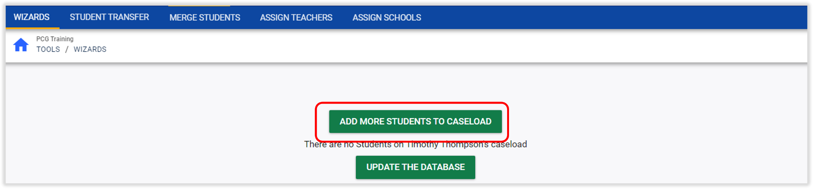
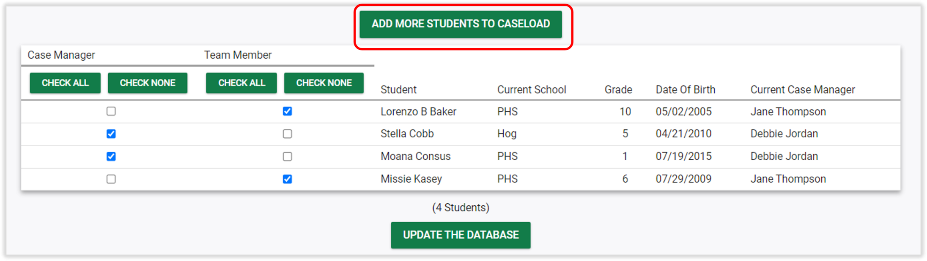
Caseload without Any Students Added
Caseload with Students Added
Notes:
To add students to a caseload, click on the “Add More Students to Caseload” button. This button will appear at the top of the screen whether the user has students added or not.

Slide 34
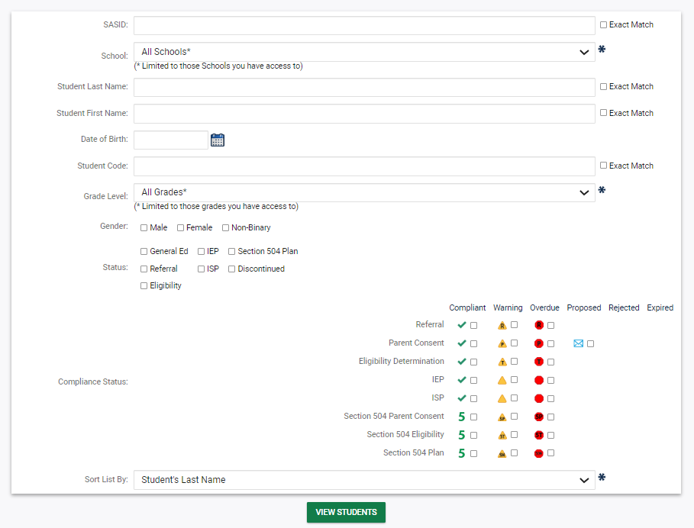
Notes:
The user will be brought to a search page to search for students to add to their caseload by providing criteria such as SASID, School, student name, or grade level. Click View Students to view results. Please note, results of this search are limited by the user’s access.

Slide 35
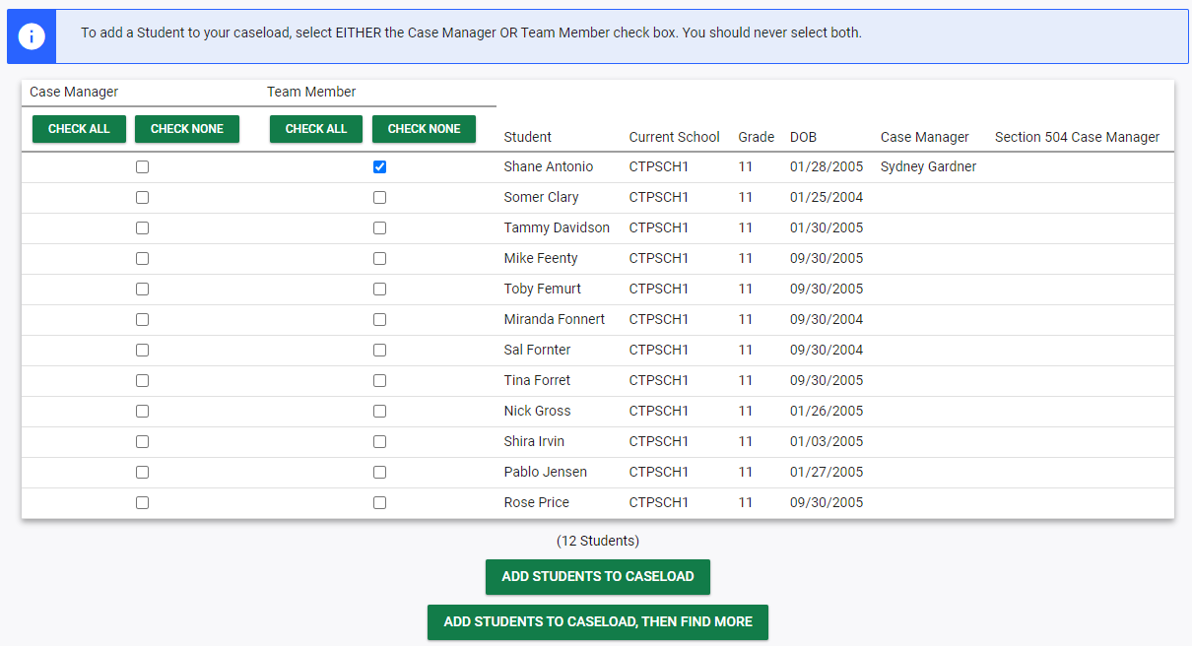
Notes:
Select the student(s) to add to the caseload by selecting the appropriate check box based on whether the user is a team member or the student’s case manager. Please note, there can only be one case manager for a student. If the student already has an IEP Team Case Manager or Section 504 Case Manager, the names will appear on this page. If the user selects Case Manager and a Case Manager already exists, the user will remove the student from that person’s caseload. If the student has both an IEP and a 504 plan, then the student can have a different case manager for each. There can be multiple Team Members for each student. If the user is not sure whether they should be a Case Manager or a Team Member, it is suggested to start by adding yourself as a Team Member. Who is the case manager for a particular student can always be adjusted on the Teams page for each Student, which will be addressed later in this training. Once the appropriate students have been selected, scroll to the bottom of the page and click Add Students to Caseload to save the selection(s). If the user would like to add students and then conduct another student search to add more students, click Add Students to Caseload, Then Find More.

Slide 36
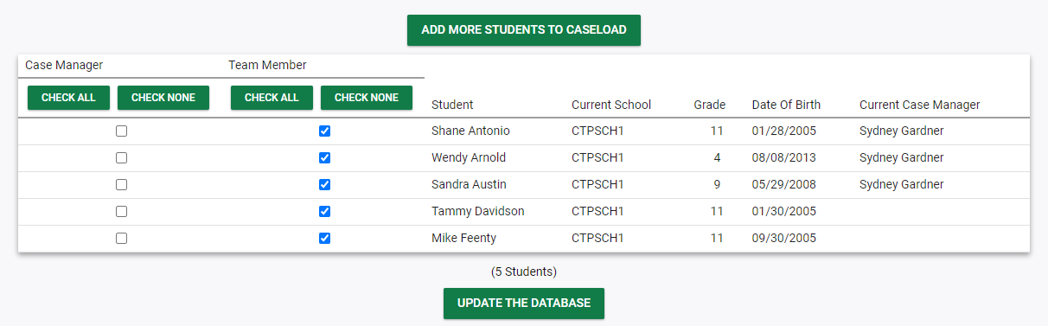
Notes:
The user will be brought to back to review their caseload with any new students added. The user can also make changes on this page changing their status as Case Manager or Team Member. To remove a student from the caseload, uncheck the box next to the student’s name and click Update the Database.

Slide 37
Student Search

Slide 38
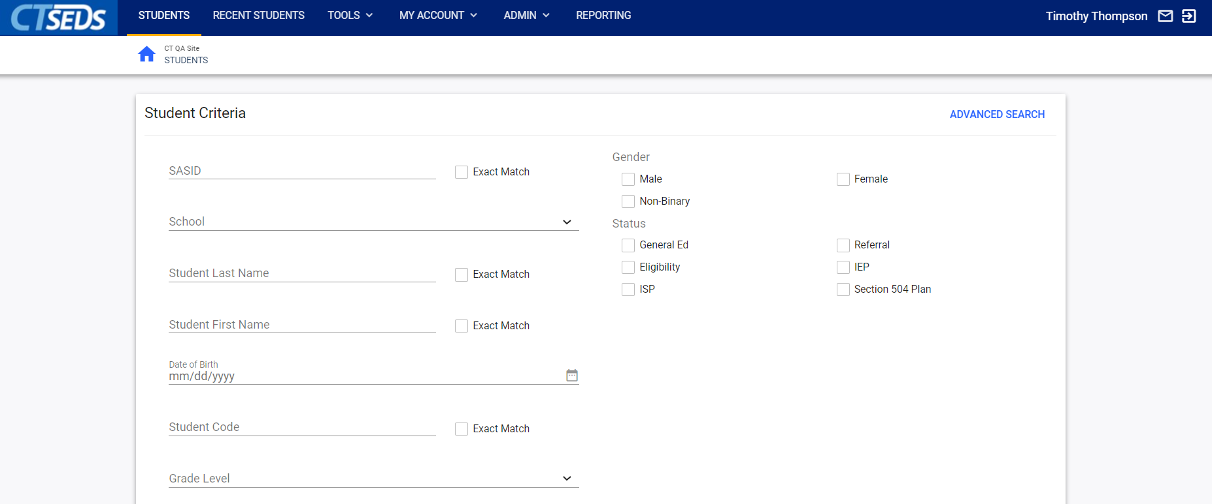
Notes:
Now we are going to transition to reviewing Student Search. In the dark blue main menu navigation bar, click on the ‘Students’ tab to see the Student Search Page. Users can search by a variety of criteria including SASID, School, Name, and Grade. Please note, each item you select will filter (or narrow) your results.

Slide 39
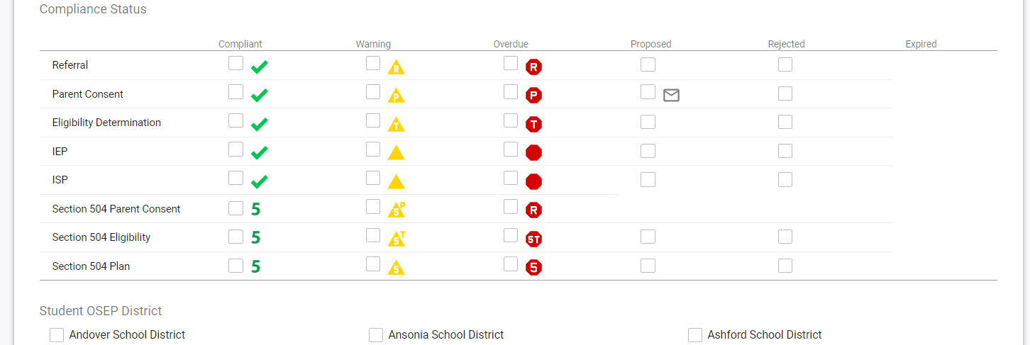
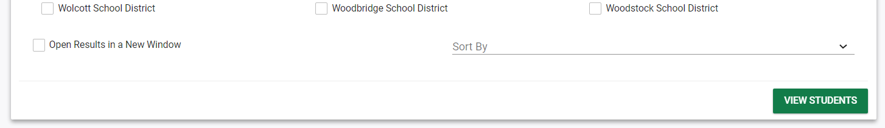
Notes:
Scrolling down the student search page, the user can also search students by Compliance status to show lists of students with upcoming or overdue action items or search by Student OSEP district. After having selected criteria, click View Students. Please note, the maximum number of students you can search for at a time is 500 so if you have not selected a narrow enough criteria you will receive an error telling you to further narrow your search.

Slide 40
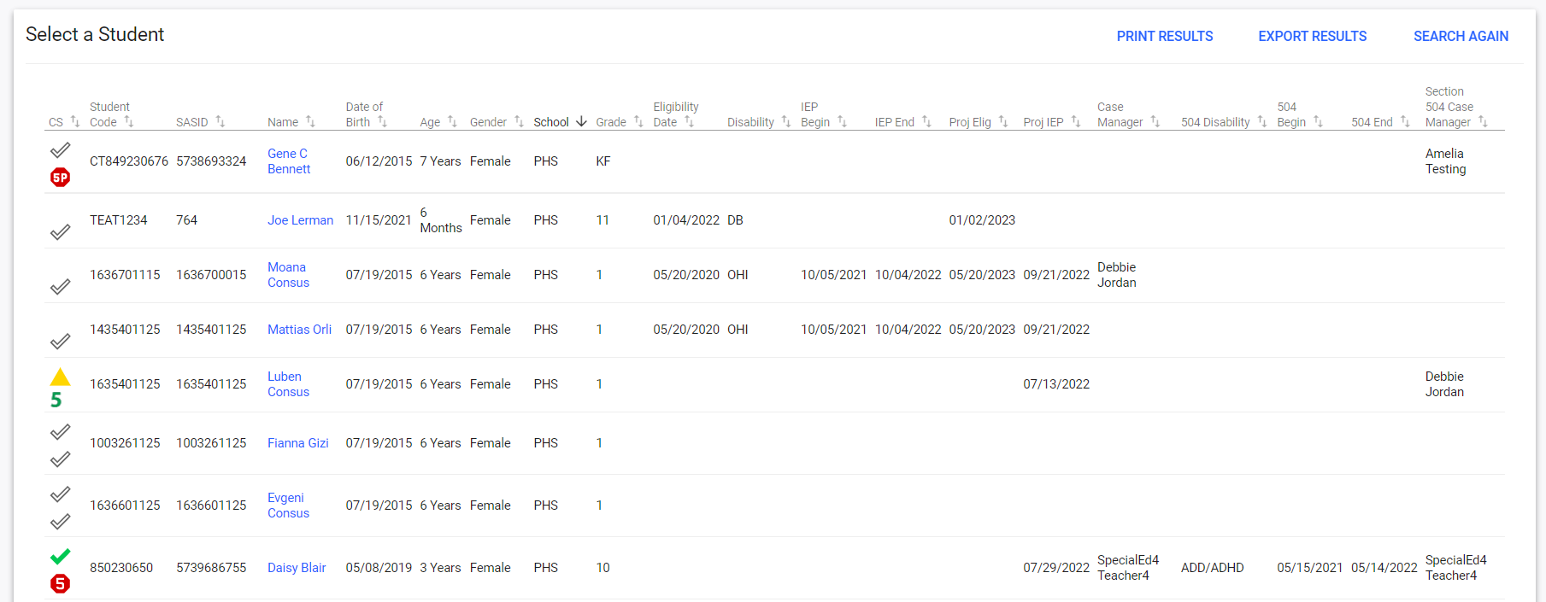
Notes:
After making selections and clicking the View Students button, the results will appear. Please note, all information shown in this training is testing data and does not represent any real students.
The user can sort by any of the column headers by clicking on the column header and can generate a report containing all the listed information directly from this page. Clicking PRINT RESULTS generates a report in PDF format, while EXPORT RESULTS generates a report in Excel format. Depending on user type, some users will just see their caseload. To select a student and view their record, click on the student’s name.

Slide 41
Student Menu
Personal Info, Team, Parents, Contact Log, Student History, Create/View Documents

Slide 42
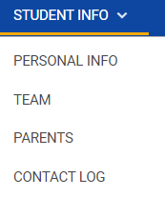
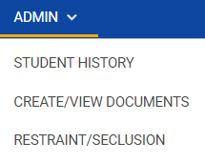
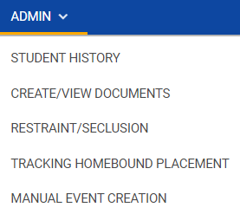
Student Submenu
Student Info drop-down
Admin drop-down
Notes:
After the user selects a student and clicks into the student record, the user will see the light blue student submenu. Depending on the student and the permissions that a user has, different modules and menu items will appear. Most users have the menu items: Student Info, Referral and Evaluations, IEP Process, SP Process, 504 Process, and Admin. Two of these menu items are drop-down lists: Student Info and Admin. Student Info droop-down includes the Personal Info, Team, Parents, and Contact Log pages and is the same for all users. The Admin menu will be different based on user type. Most users will have access to Student History, Create/View Documents, and Restraint/Seclusion. Administrative Users will also have access to Tracking Homebound Placement and Manual Event Creation. Please note, to indicate what student’s record the user is in the student’s first initial and last name will appear in the dark blue main menu.

Slide 43
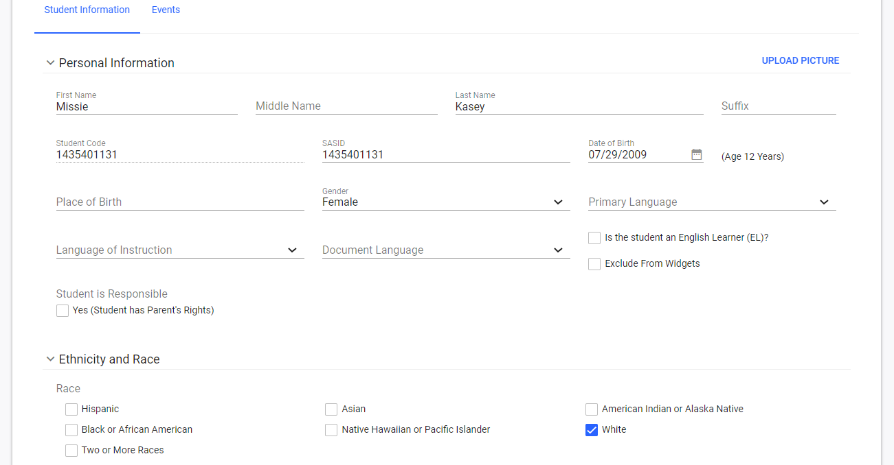
Notes:
The Personal Info page contains basic demographic information about the student and information about their enrollment. Most of the data on this page will not be editable by most users. If something is incorrect, it may need to be changed in PSIS or changed by an administrator. Student information comes into the system on a nightly import from PSIS. Please note, Document Language refers to the language of translated documents in CT-SEDS and can be set by some users.

Slide 44
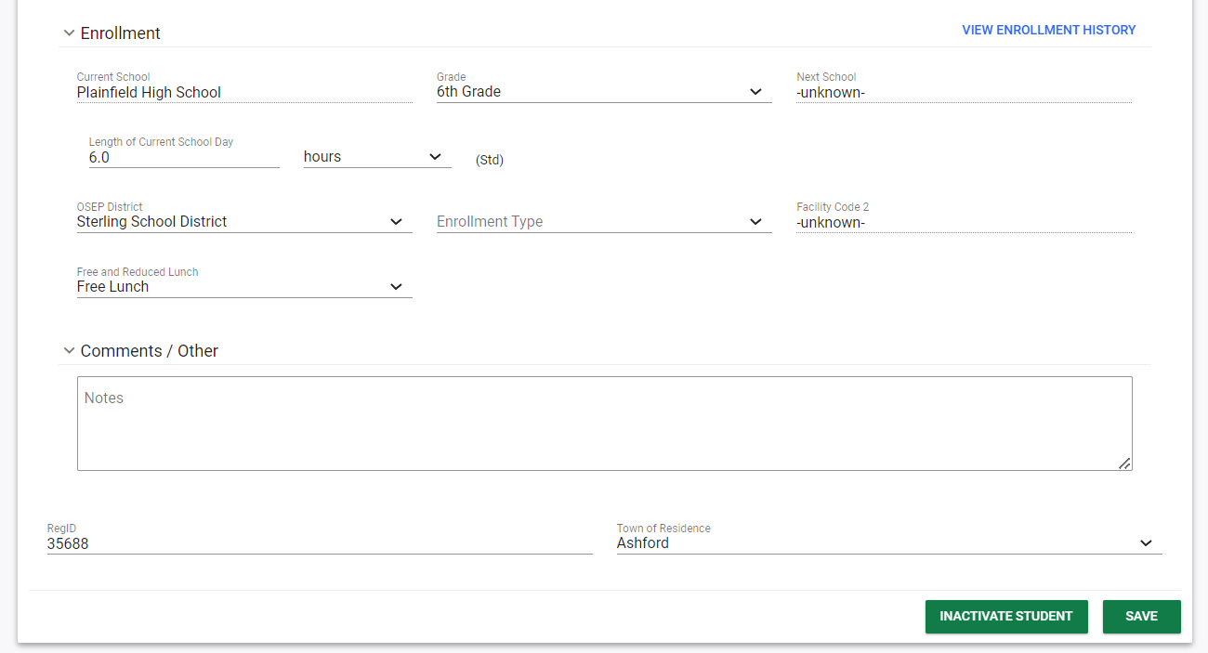
Notes:
Scrolling down on the Personal Page, you will see where the OSEP District can be added. Click Save to update any changes.

Slide 45
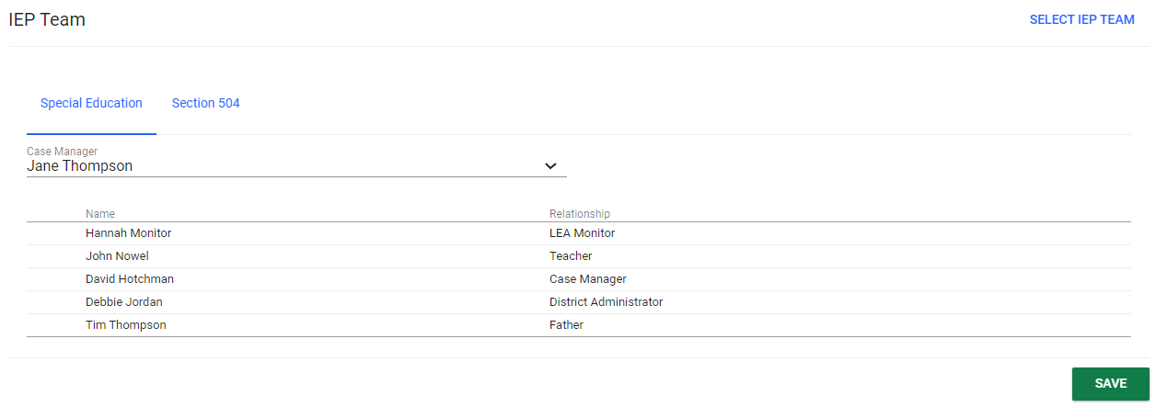
Notes:
The Team page manages staff and parents who are members of the student’s team. The default team is the Planning and Placement Team (i.e., IEP team), but students with a Section 504 plan will need to have a Section 504 Team. If this student was added to a user’s caseload using the Caseload Setup or Caseload Administration Wizards, the user’s name will appear here as either a case manager or team member. Team members can also be added directly on this page and will then show up on the user’s caseload. To add additional team members, click the blue Select IEP Team link in the upper right corner of the Team page.

Slide 46
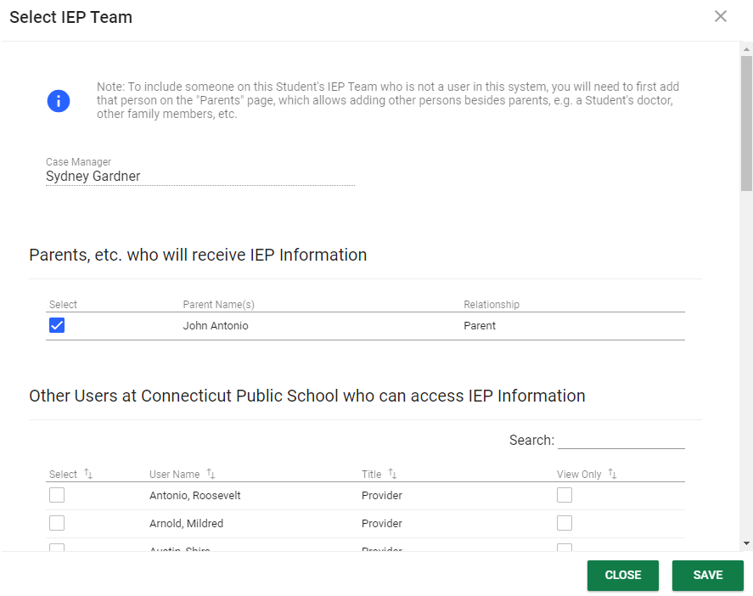
Notes:
This will open a window that will list staff in the same school as the student and any available parents or guardians which will be discussed further shortly. Use the check boxes to add or remove team members. Click Save when finished.

Slide 47
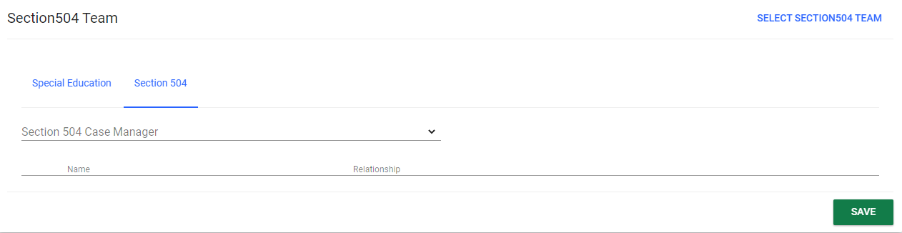
Notes:
To update the 504 Team, click on the blue link for Section 504 on the Teams page. The blue link in the upper right will change to say Select Section 504 Team and the user can click there to select the appropriate team members and click save.

Slide 48
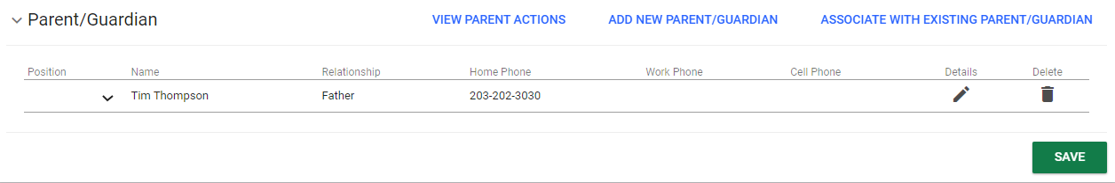
Notes:
The parents page manages guardians for each student, which are referred to as parents in CT-SEDS. To Add a New Parent click on Add New Parent/Guardian. To edit or view any existing parent or guardian’s information, click on the pencil icon under Details. Like student demographic information, the data on this page may or may not be editable by some users. Please note, if your LEA has signed up for Data Exchange, this information will be populated for students from your SIS once the Data Exchange is implemented. Once this happens, if information is incorrect, changes must be made in the source system, the SIS, for this data.

Slide 49
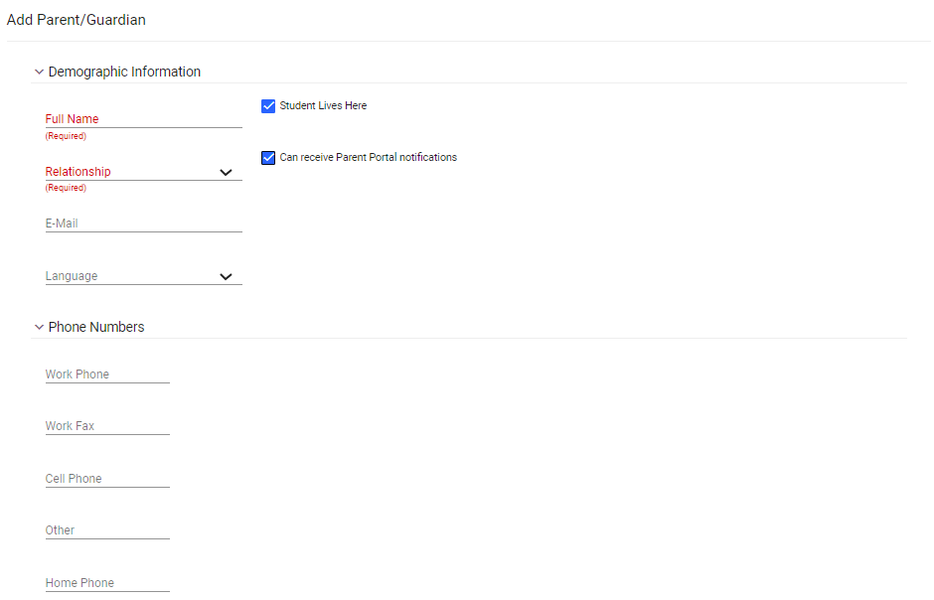
Notes:
Adding or Editing Parent information will bring you to the same page. When adding a new parent, a full name and relationship are required. Please note, for the parent to be able to access the online Parent Portal, an email and a phone number is also needed. Home Phone should indicate the Parent’s main phone number. It is important to note that for the parent or guardian to appear on certain documents in IEP or 504 plan, the checkbox for Can receive Parent Portal notifications, which indicates Guardian Responsibility, must be checked. If this is not checked, the user will receive an error that a parent has not been added to the Team.
If the LEA has signed up for Data Exchange with their SIS and included this field, then the Can receive Parent Portal notifications checkbox can be updated via import. If this is not occurring, the field will need to be updated manually.

Slide 50
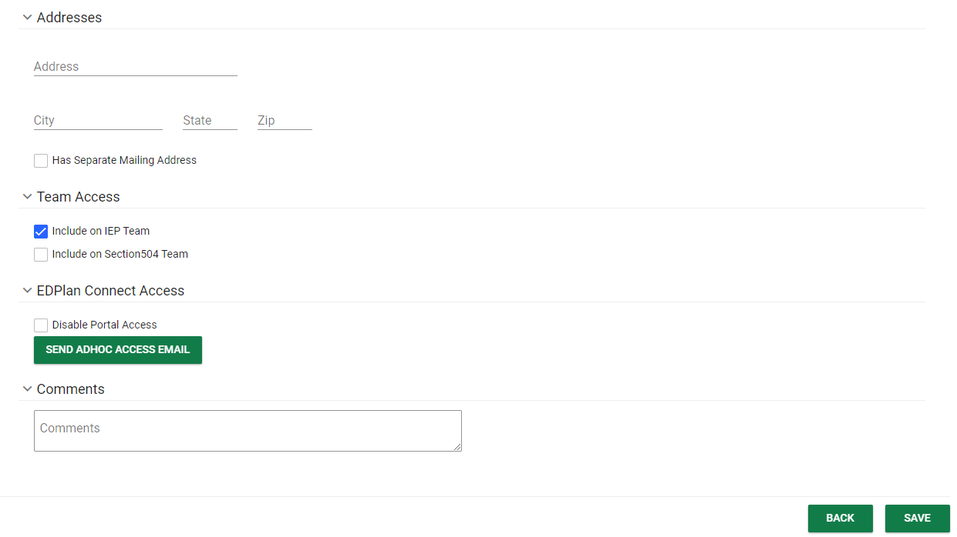
Notes:
At the bottom of the Parent’s page, please note the Team Access and EdPlan Connect Access sections. Under Team Access, checking Include on IEP Team or Include on Section 504 Team will include this parent or guardian on the Team. The checkbox does default to Include on IEP Team, but should be adjusted as needed.
EdPlan Connect Access refers to the Parent Portal. Documents can be sent to an online Parent Portal for parents and guardians to access. When the Can receive Parent Portal notifications field is checked indicating guardianship, the parent or guardian can receive email notifications to access the Parent Portal. To send the parent or guardian a link to access the portal, click on the green SEND ADHOC ACCESS EMAIL button. Links to access the Parent Portal are automatically sent to parents when parental consent documents are created in the system to be sent to the Parent Portal, but Ad Hoc Parent Portal access can be sent using this button at any time. If a user needed to turn off a parent or guardian’s access to the Parent Portal, check the Disable Portal Access box and click SAVE.

Slide 51
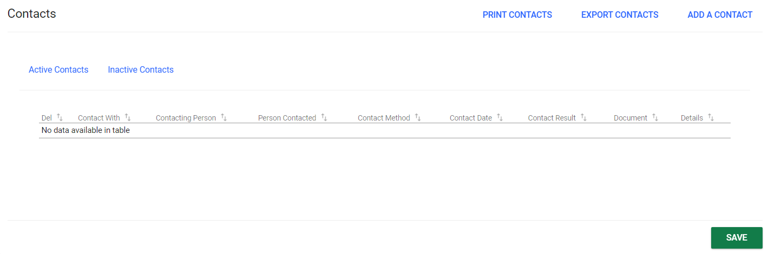
Notes:
The purpose of the Contact Log page is to provide a place for the district to document contact attempts that were made between team members and the parents/guardians of the student. The contact log can be printed or exported for use outside of the CT-SEDs system. Contacts will be organized by school year. To add a new contact, click the blue Add a Contact link in the upper right corner of the list of recorded contacts.

Slide 52
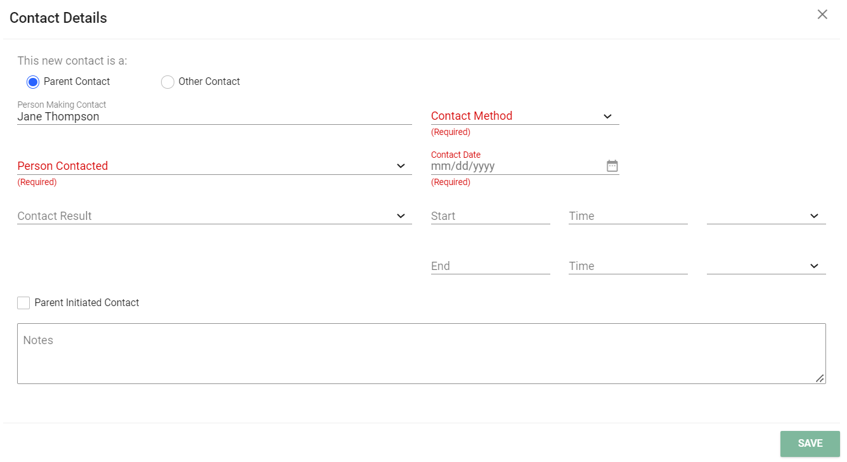
Notes:
Select the Contact Method, the Person Contacted, Date and other information to document the communication. When finished, click Save and the contact log will be complete and listed on the main contact log page.

Slide 53
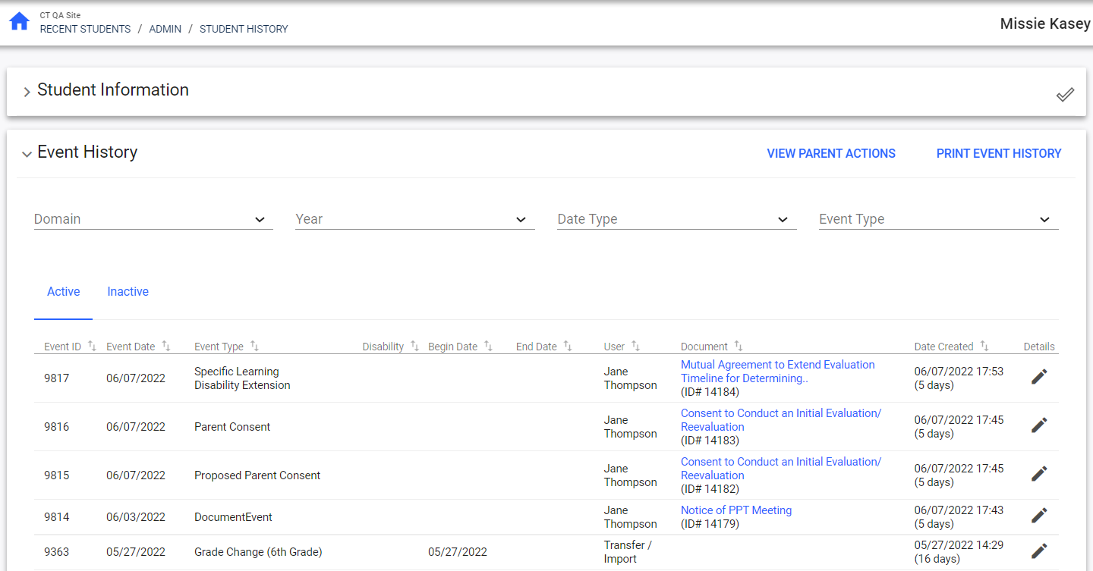
Notes:
In the Admin drop-down menu, the Student History page is a record of all the system events and documents associated with those events such as the IEP, the Section 504 Plan, and Parental consents. This page can be searched using the drop-down menus for domain, year, date type, and event type. This page is an important summary of the student record.

Slide 54
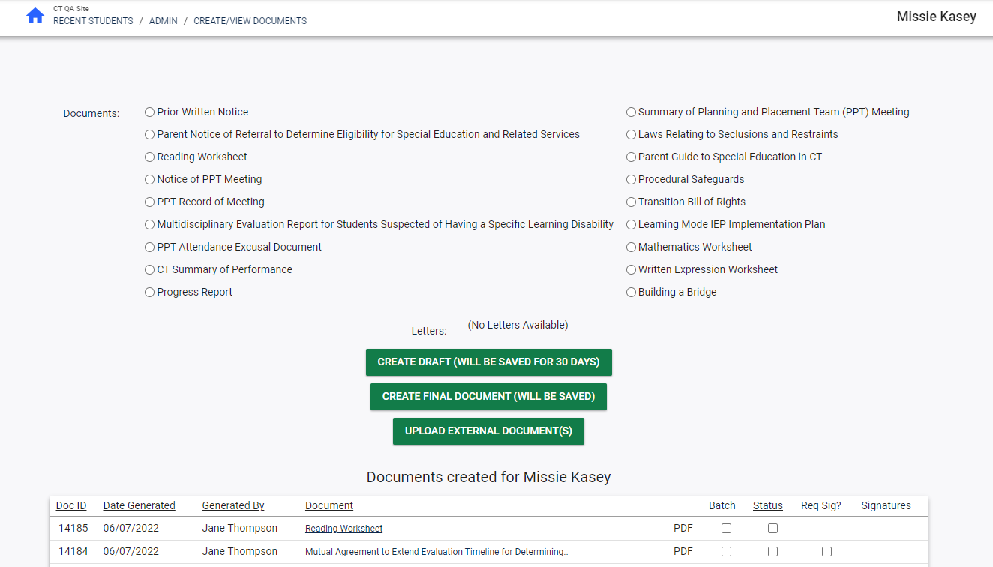
Notes:
In the Admin drop-down menu, the Create/View documents page shows all documents for a student. Please note, the majority of student documents are created as users work through system processes, but certain documents can be created outside the processes in the system. To create a Document outside of a system process, navigate to the Create/View documents page, select the radio button next to the document, and click Create Draft or Create Final. Creating a draft first is best practice as drafts are only temporarily saved in CT-SEDS and Finals are saved permanently and few have the permission to delete if an error is found.​ Each document has its own document creation page to collect any relevant data needed to populate the document. Complete the required information and generate the document.​ Once created, documents appear in the table at the bottom of the page. To open a document and save it to the user’s computer or print, click the document name.​ To batch multiple documents into one PDF, select the documents in the batch column and click View Document Batch.
To attach a document created outside CT-SEDS, click Upload External Documents. Enter a Name for the document(s) to appear in the documents table. If left blank, the filename will display.

Slide 55
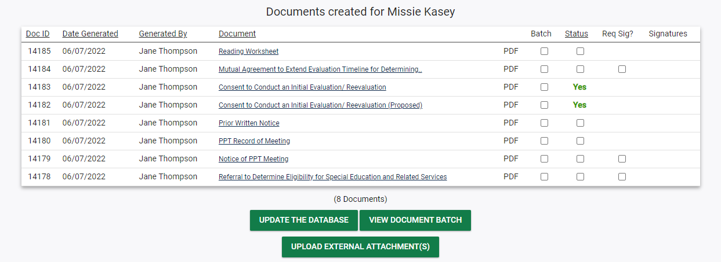
Notes:
To attach an external document to a document created inside CT-SEDS, click the Upload External Attachments button. Choose the CT-SEDS document to attach the external document to by selecting the radio button at left. ​Browse for the file on the user’s computer and provide a name to display in the Documents table.

