Slide 1
Progress Report

Slide 2
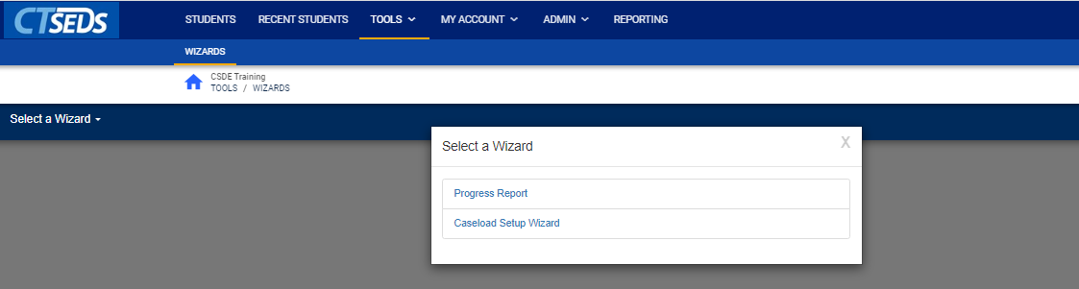
Notes:
To find Progress Report, click on Tools in the dark blue main menu navigation bar and then Wizards in the light blue submenu.
The user will then see the wizards they have access to based on their user type. We review the Caseload Setup Wizard and the Caseload Administration Wizard in the this Core Navigation presentation.

Slide 3
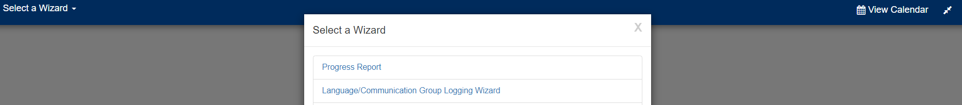
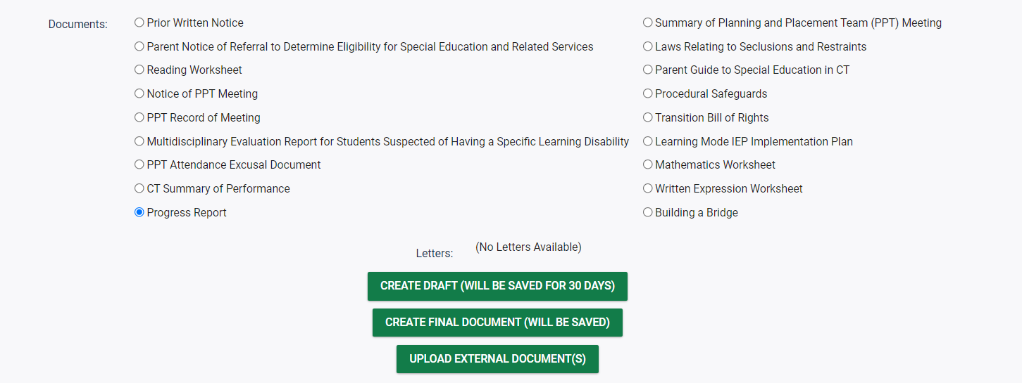
Notes:
Progress Reports are used to capture the results of goals and objectives laid out in the IEP Process. They can be created either through Create/View Documents page or through the Wizards. Using the wizard is recommended since users can access all students on their caseload.

Slide 4

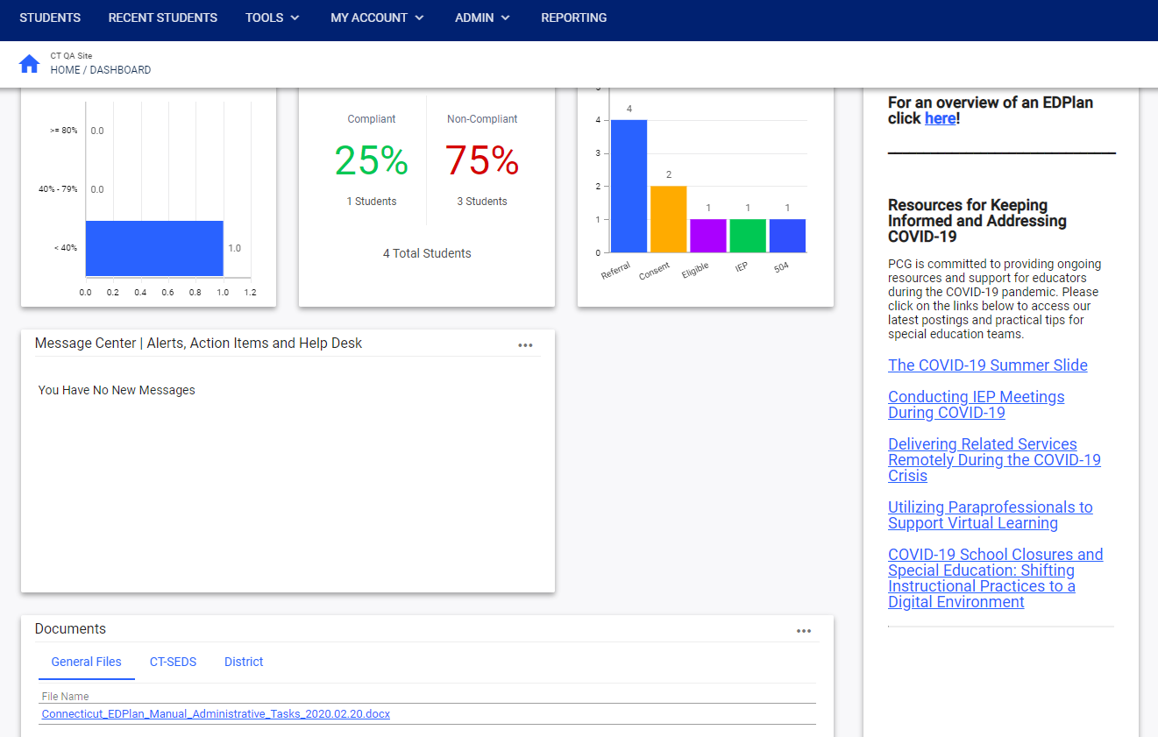
Notes:
Please note that a Progress Report can only be created for a student who has a finalized active IEP that was written in CT-SEDS.
If your student does not yet have an IEP with goals written in the new format inside the CT-SEDS system, the user will not be able to use the Progress Report feature and will see an error saying that there is no current IEP for the student or a message saying there are no annual goals on this student’s IEP.
For progress reporting before student IEPs are written in CT-SEDS, there is a Microsoft Word template available on the resources section of the Home Page or some districts are continuing with their current IEP vendors.

Slide 5
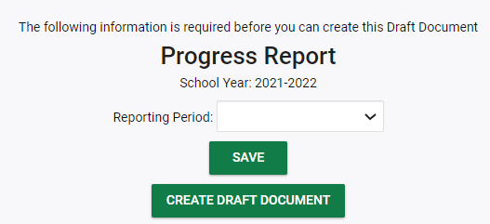
Notes:
In order to create a Progress Report from the Create/View Documents tab, the user will go to go to a specific student record, click on Create/View Documents and select Progress Report and create a draft or final depending on their needs.

Slide 6
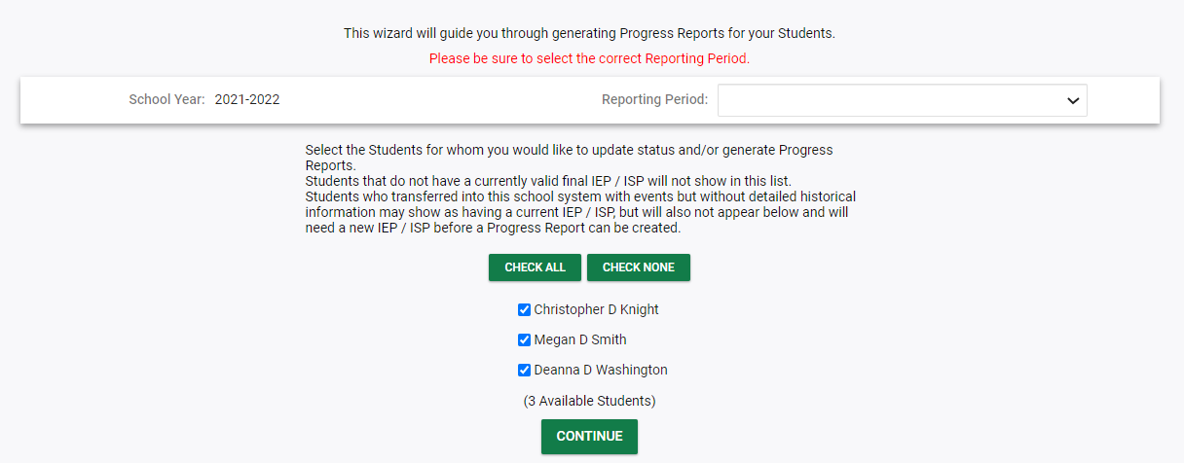
Notes:
The Reporting Period must be selected. The student(s) that the progress report(s) will be created for should be selected from the names at the bottom of the page. There is an option to pull multiple progress reports for various students by clicking the green CHECK ALL button or the user can click the CHECK NONE button to clear out all checkboxes. After selecting students click the green CONTINUE button to move forward.

Slide 7
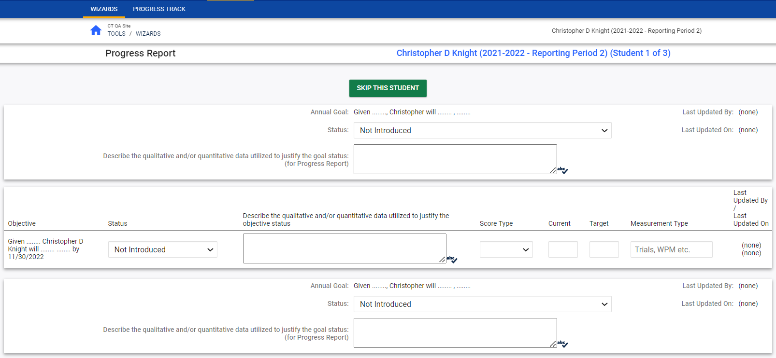
Notes:
After clicking continue, the progress report page will open for the user to enter details. If multiple students are selected the green SKIP THIS STUDENT button will be available to bypass this report to go to another student’s progress report. Multiple users can contribute to the progress report and save Drafts. Some users will only have the ability to create draft progress reports and will not be able to create finals.

Slide 8
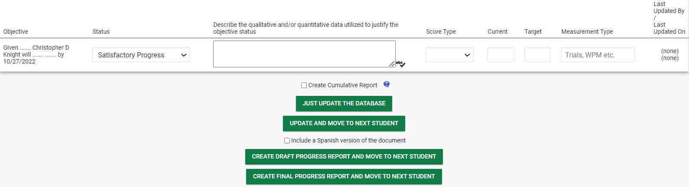
Notes:
The green buttons at the bottom of the page allow the user a variety of options. The user can click JUST UPDATE THE DATABASE, which will save the information entered and allow the user to remain on the page. If the user clicks UPDATE AND MOVE TO THE NEXT STUDENT, the information entered will be saved and the user will move to the next student’s progress report without creating a draft or final document. If the user clicks CREATE DRAFT PROGRESS REPORT AND MOVE TO NEXT STUDENT, a draft document will be created and saved on the student’s Create/View Documents page and the user will move to the next student. If the user clicks CREATE FINAL PROGRESS REPORT AND MOVE TO NEXT STUDENT, the final progress report will be created and saved on the student’s Create/View Documents page and the user will move to the next student.

