Slide 2
Referral And Evaluation Module

Slide 3
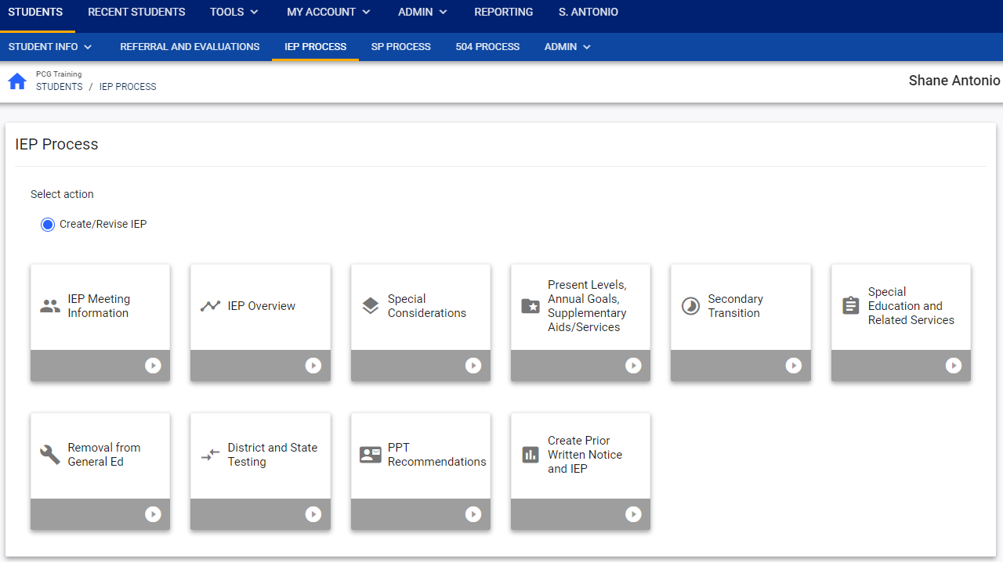
Notes:
Now, we are going to transition to a general introduction to the basic navigation and functions Referral and Evaluation module.
Basic navigation and functionality of Referral and Evaluation, IEP Process, Services Plans Process, and 504 Process is the same or very similar.
To begin, click into the first tile and proceed through the panels and tiles sequentially. Although you may navigate to different tiles out of sequence, in order to learn the workflow and the rules of completion, we recommend going through the process sequentially to be able to troubleshoot any errors.
Let’s begin with the Referral and Evaluation Process. [NEED to INSERT THE SCREENSHOT OF TILES FOR THE REFERRAL EVALUATION MODULE]

Slide 4
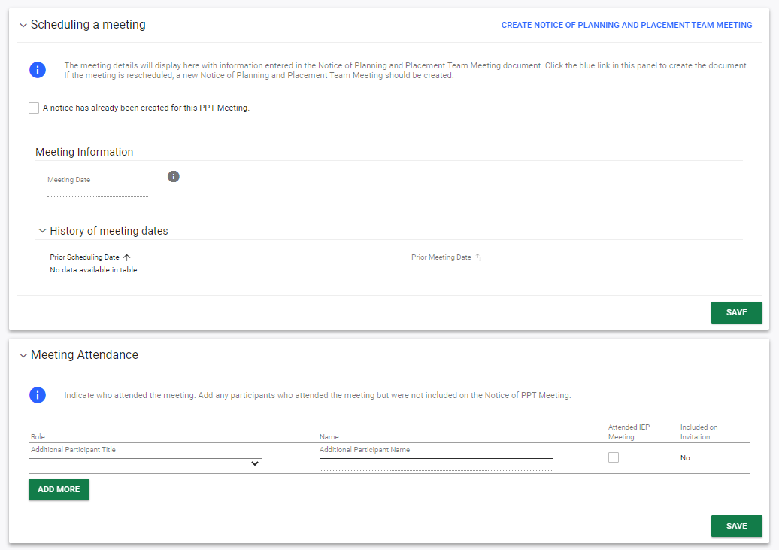
Notes:
After clicking into a tile, the user is brought to a page. In our example here, this is the IEP Meeting Information page, which is the first step in the IEP Process. The user will see a variety of Panels on the page with different instructions and steps to complete. Here the first panel is the Scheduling a Meeting panel. There is a blue information icon that calls out important information or guidance for the user to read. To complete this panel, the user would either check the box and select an existing PPT meeting or more likely, click on the blue link in the upper right corner to Create a new Notice of Planning and Placement Team Meeting. Anytime the user clicks on the blue links, they will be brought to a pop-up panel where they will either create a document or enter information. Please note, most panels have a Save button in the bottom right corner. Users should assume that information is not saved until they click the green Save button. While the system does at times auto-save, and the user will see a green Saved flash on their screen, it is safe to assume that information does not save until you click save. Clicking save on a panel may also trigger new panels to open further down on the page depending on the information the user entered so it is important to consistently click save.

Slide 5
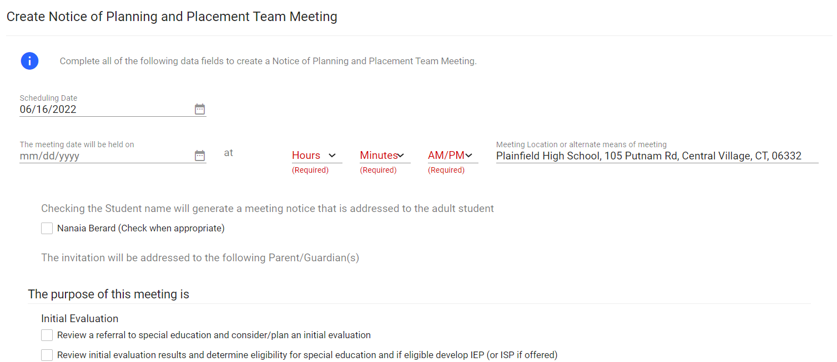

Notes:
Clicking to Create Notice of Planning and Placement Team Meeting, we are going to demonstrate the standard functionality of creating documents in the system. The user would complete the details on the page. Required fields are often noted in red for the user and scheduling dates typically default to the current date, but can be adjusted as needed.
After completing the document, at the bottom of the page the user has options. Close will close this pop-up panel and return the user to the previous page without saving. Save will save the user’s work and keep the user on this page. Create Draft will create a draft document for the user to review. It is advised that the user click CREATE DRAFT to look at the document and check it for any typos or mistakes. The document will pop-up in a separate screen for the user to review and the user will note that it is a draft due to the DRAFT watermark. The user can download and print the draft document or exit the page after reviewing. When the user is satisfied that all information is correct, click Create Final to create the final document. The final document will pop-up in a separate screen where the user can download, print, or exit the page.
Please note, only certain administrative users can remove finalized documents, so the draft feature should be used to check work before creating a final document.

Slide 6
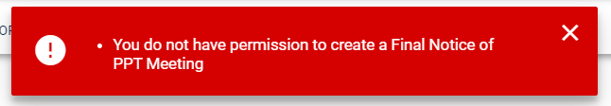
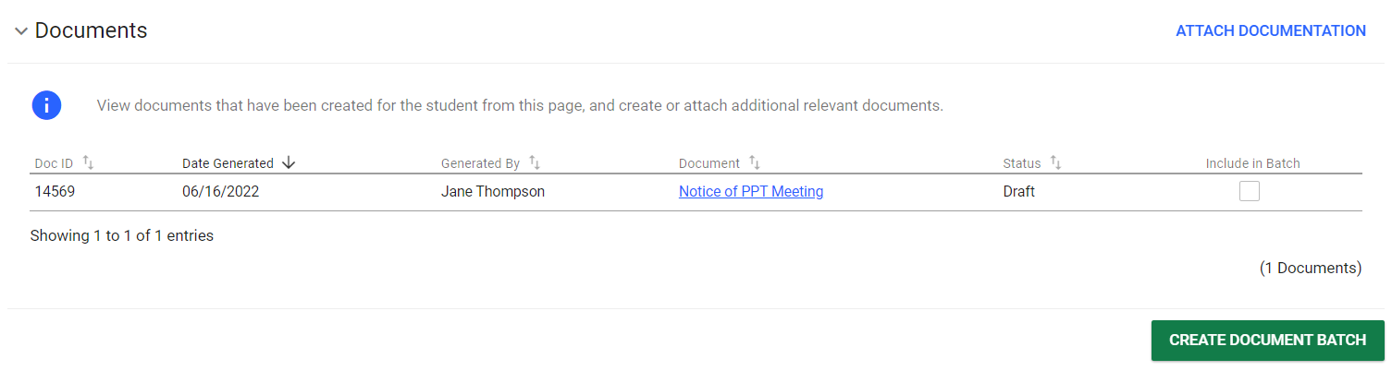
Notes:
Some user types do not have the ability to create certain draft or final documents and will receive a red error message telling them that they do not have the permission to create the draft or final document when they click on the Create Draft or Create Final button.
Both draft and final documents will save in the Documents section at the bottom of most pages in the process. Each time the user clicks CREATE DRAFT the new draft document will replace the previous draft. When the user creates a final document, the final version will replace the draft document here and will be saved in CT-SEDS as part of the student’s history. It can be viewed on the Create/View Documents page we reviewed in the video earlier.
Please note, any final document could go to parents via the Parent Portal.

Slide 7
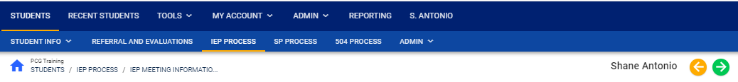
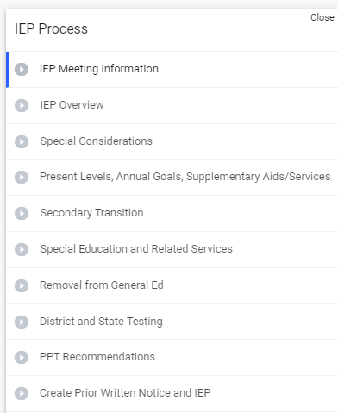
Notes:
Basic navigation in CT-SEDS is also the same throughout all the processes. On all pages in the process, the user will see an orange and green arrow at the top right of the page. The green arrow is the Save and Continue button. It will save everything on the page and complete error checks, called rules of completion, for any required fields that have not been completed on the page. If all fields have been successfully completed, clicking the green arrow will save all information on the page and move the user to the next page in the process. If all fields have not been successfully completed, clicking the green arrow will save all the information on the save and the user will see a red error message telling them what needs to be completed or corrected on the page before moving forward. The orange arrow in the upper right pointing to the left is the Back button, which will take the user to the previous page in the process, but will NOT SAVE the data entered on the page.
If the user wishes to navigate to another page without filling out all required fields, the user may do so by clicking the blue box with an arrow on the right side of the page to open up the Side Navigation Panel. The Side Navigation Panel shows all the page options in the process and the user can click into any page. The page the user is currently on is indicated by a blue line. Please note, using the Side Navigation Panel does not run the error check or save information so should only be used when the user needs to skip ahead in the process.

