Slide 1
Restraint and Seclusion

Slide 2
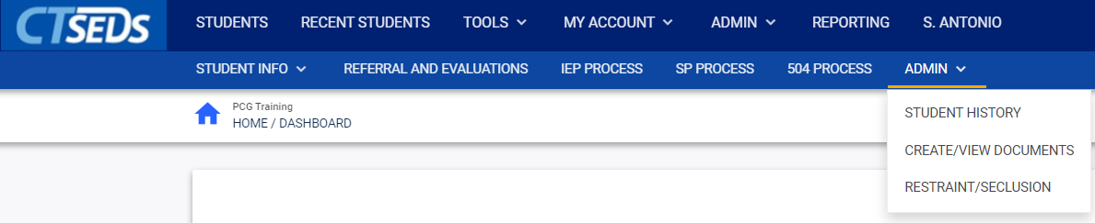
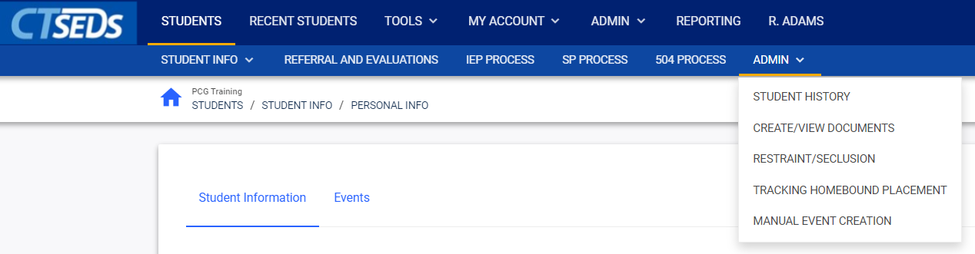
Notes:
The Restraint/Seclusion Module can be navigated to by clicking into a student record and selecting Admin from the menu bar and RESTRAINT/SECLUSION from drop-down.
Only certain user types are able to draft or finalize a restraint or seclusion incident report as shown on the following two slides.

Slide 3
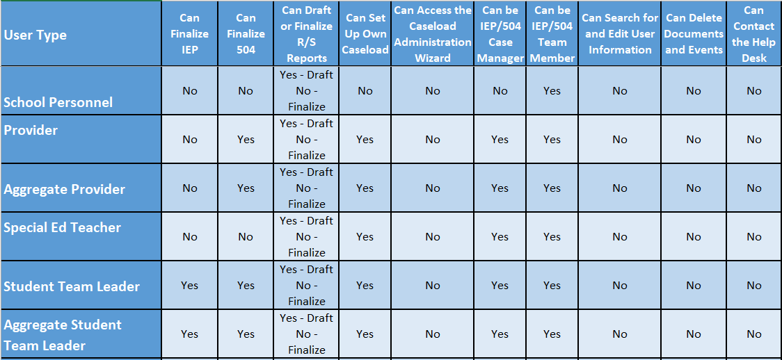
Notes:
These are the non-administrative user types.

Slide 4
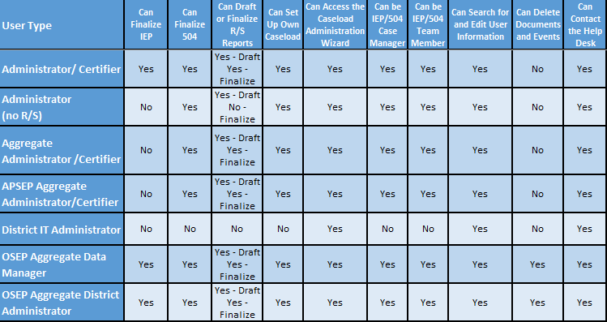
Notes:
These are the Administrative User Types.

Slide 5
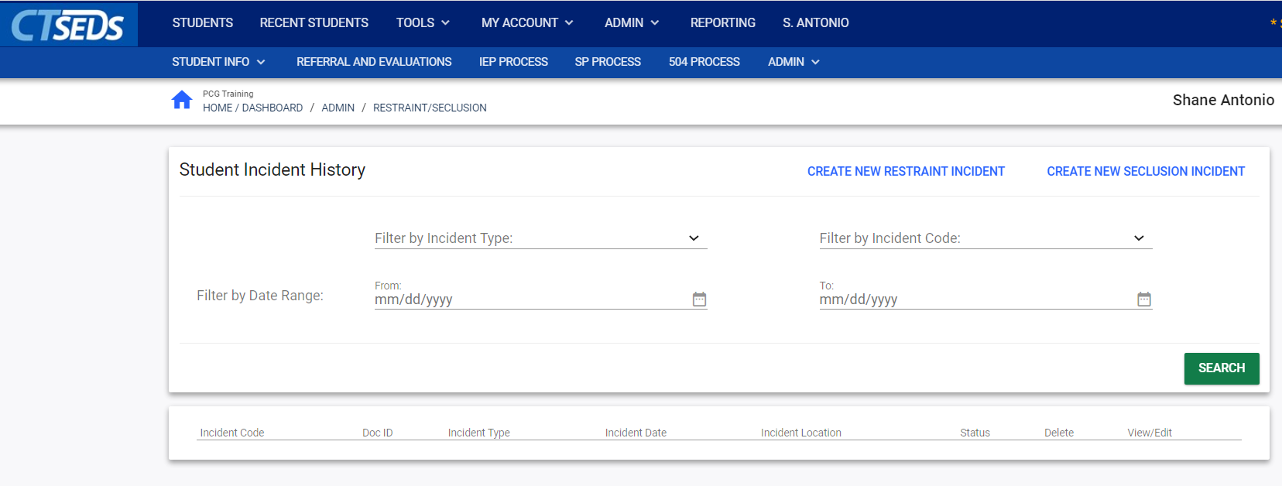
c
Notes:
The first page in the Restraint/Seclusion module is the Student Incident History Page. The top panel allows the user to search incidents. The user should select a filter and click SEARCH in order to see any past incidents. The user can create new restraint or seclusion incidents by clicking the CREATE NEW RESTRAINT INCIDENT button or the CREATE NEW SECLUSION INCIDENT button.
The user can search for previous incidents by Incident Type, Incident Code, or a Date Range. To search by Incident Type or Incident Code, the user would select an option from the drop-down menu and click the SEARCH button to populate all matching incidents in the panel below. If no incidents exist, no search results will appear. To search by Date Range, the user would enter a date in the “From” field and the “To” field and click the SEARCH button to populate all matching incidents in the panel below.

Slide 6
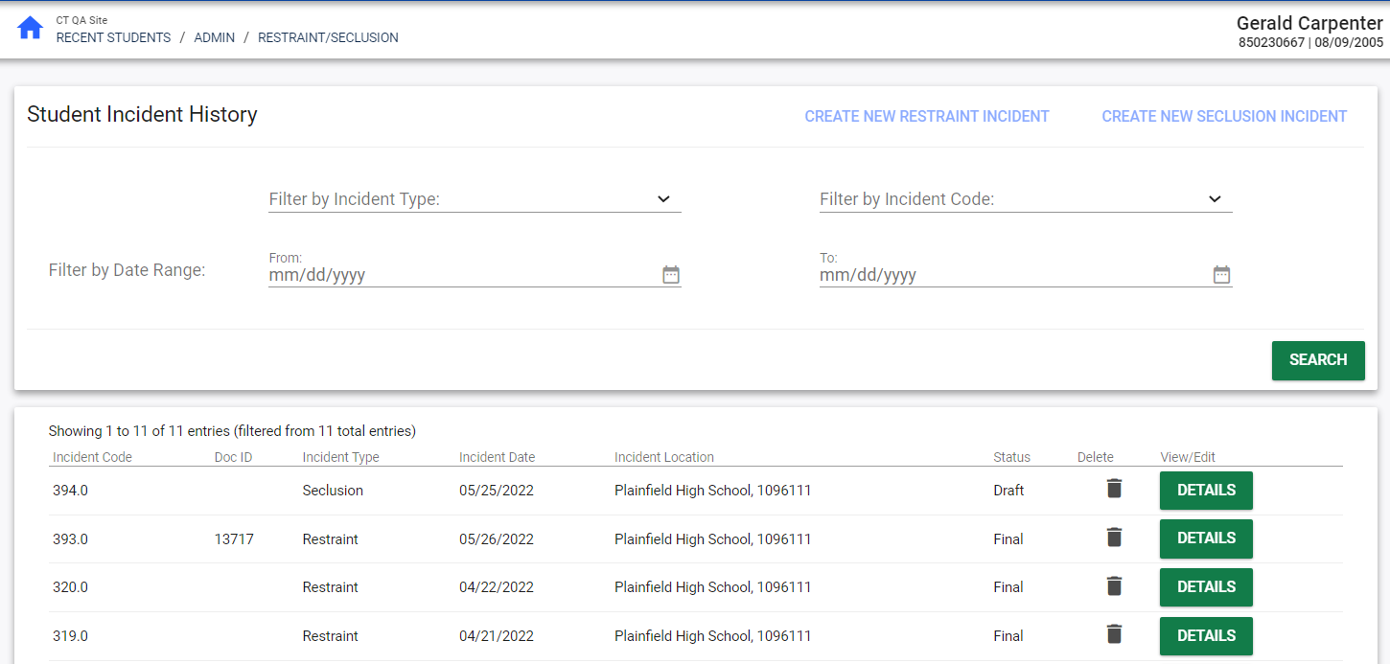
c
c
Notes:
The search results will include any finalized results that meet the search criteria. If the user created a draft, the draft will also appear if it meets the search criteria. If no incidents exist, no search results will appear.
Please note that only one restraint or seclusion draft can be created at any given time. If there is already a certain type of incident in draft, the CREATE NEW RESTRAINT INCIDENT and the CREATE NEW SECLUSION INCIDENT will be grayed out until the corresponding draft incident already in process is finalized.
Please note, Restraint/Seclusion incident finalized documents are not sent to the Parent Portal.

Slide 7
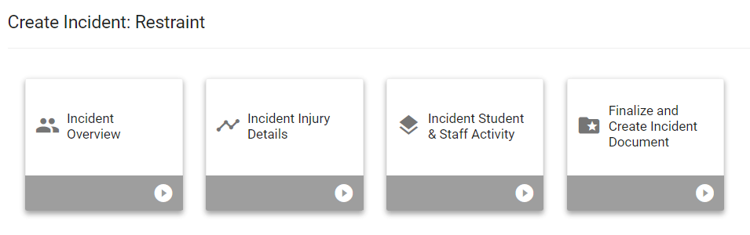
Notes:
To create a new Restraint or Seclusion incident, the user would click on the CREATE NEW RESTRAINT INCIDENT or CREATE NEW SECLUSION INCIDENT buttons. The process is very similar for each. We will be demonstrating creating a restraint incident.
After clicking CREATE NEW RESTRAINT INCIDENT, the user will see the tiles for the process to create a Restraint Incident. There are four tiles: Incident Overview, Incident Injury Details, Incident Student & Staff Activity, and Finalize and Create Incident Document. Please note, not all user types have access to the Finalize and Create Incident Document tile so may not see this.

Slide 8
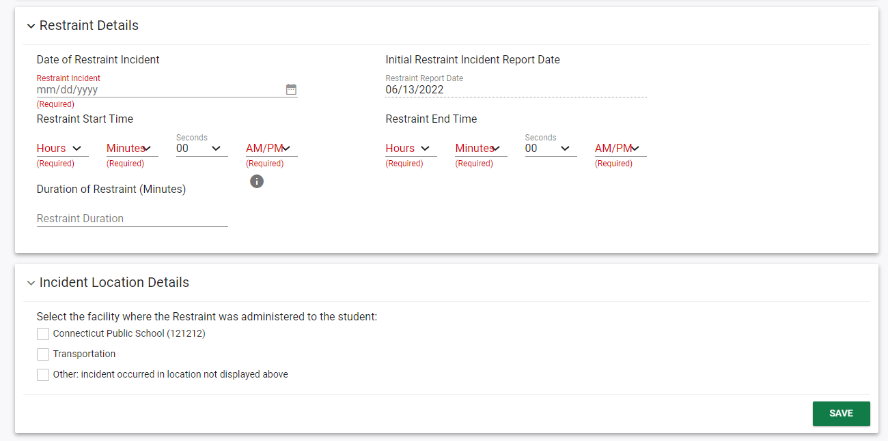
Notes:
Clicking into the Incident Overview tile, the user will see a page including demographic and parent information and panels on restraint details and incident location details. The user will need to enter the Date of Restraint Incident, Restraint Start Time, and Restraint End Time. The Initial Restraint Incident Report Date defaults to the current date. The Seconds of the Restraint Start Time and Restraint End Time defaults to 00, but can be adjusted if needed. Users can enter the date using the calendar icon or by typing it in. The Duration of Restraint (Minutes) will be populated automatically.

Slide 9
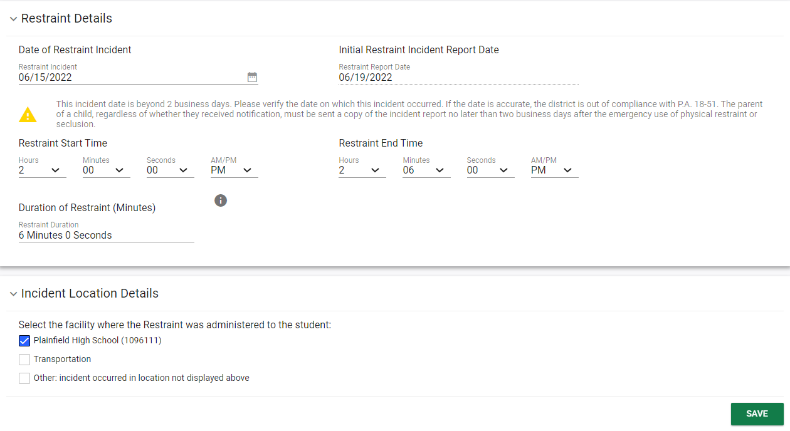
Notes:
If the Date of Restraint Incident entered is more than 2 business days prior to the Initial Restraint Incident Report Date, a warning will appear telling the user they are out of compliance. The user should continue to complete the incident reporting process.
The Incident Location Details panel allows the user to select the location where the restraint happened. Please note if Other is selected, a blank text field will appear that the user must fill out. A warning will appear telling the user CSDE will follow-up on all incidents reported using 'other' as the location, to verify that the location is reported accurately. After selecting a location, click SAVE.

Slide 10
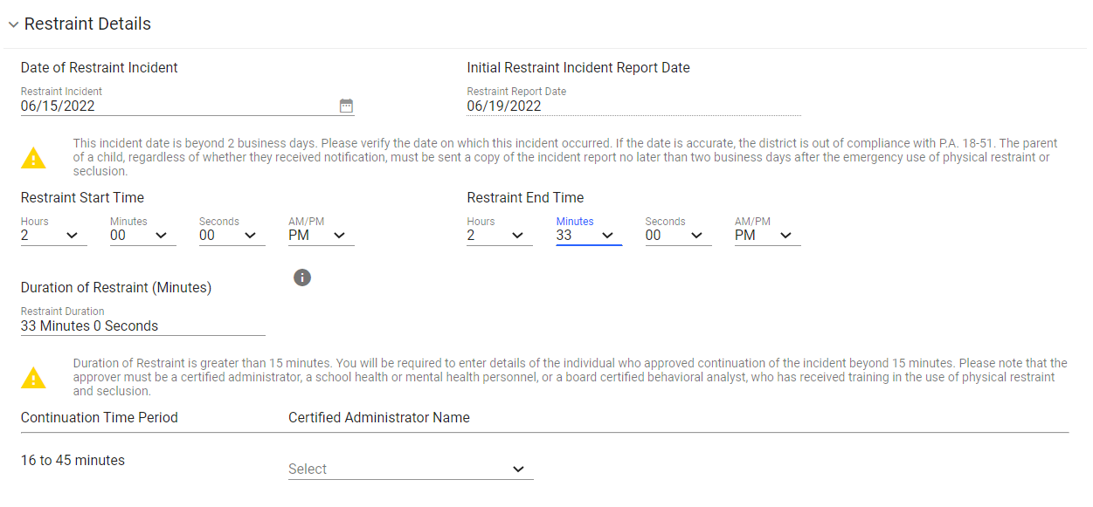
Notes:
If the Duration of Restraint entered was over 15 minutes, additional fields will appear after SAVE is clicked on the Restraint Details Panel. The user should select the Certified Administrator who approved the restraint for longer than 15 minutes from the drop-down menu.

Slide 11
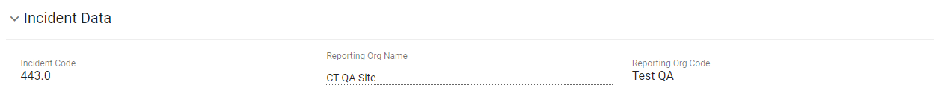
Notes:
The user will notice that an Incident Data panel has appeared that auto populates the Incident Code, the Reporting Organization Name, and the Reporting Organization Code. The user will not perform any actions on this panel.

Slide 12
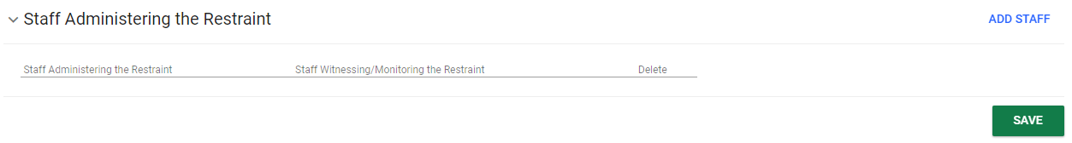
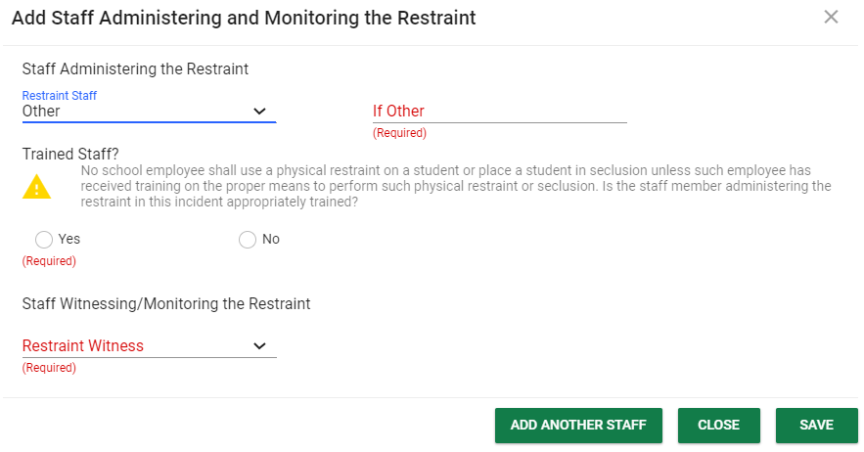
Notes:
The next panel is the Staff Administering the Restraint. This data is required to proceed with the process. Click on the blue link in the upper right corner ADD STAFF.
This will open a pop-up panel allowing the user to select the Staff Administering the Restraint and the Restraint Witness from drop-down menus. The drop-down menus populate with the staff on the student’s team or Other can be selected and a field will appear to type the staff member’s name. After selecting the Staff Administering the Restraint, the user will be prompted to answer if the staff member has been trained Yes or No. Under Staff Witnessing/Monitoring the Restraint, None can be selected if applicable for Restraint, but should not be selected for Seclusion.
Once the fields are completed, the user can click SAVE to save and return to the main page or ADD ANOTHER STAFF to save and continue to add additional staff. The CLOSE button is available at any time to close the pop-up panel.

Slide 13
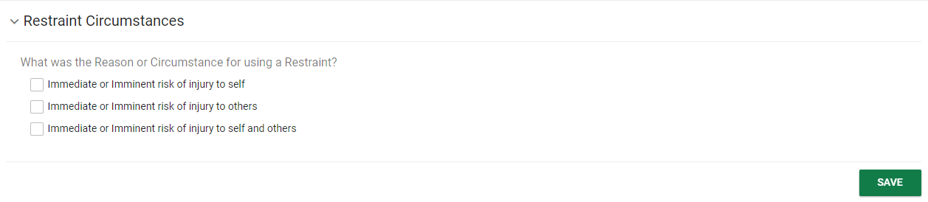
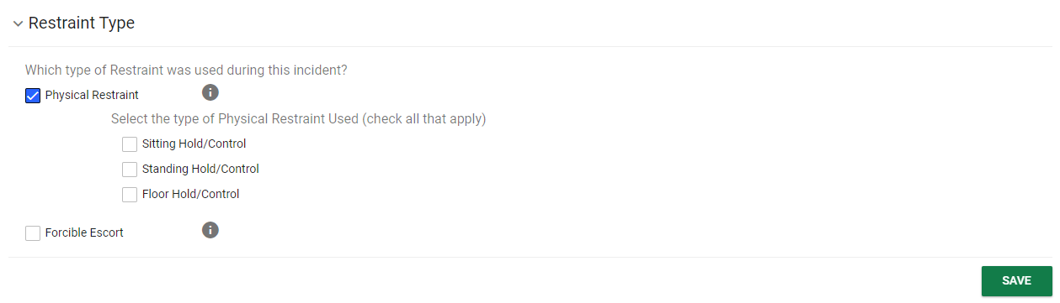
Notes:
The next panel on this page is the Restraint Circumstances panel. This panel lets the user select the Reason or Circumstance for using a Restraint. Check the appropriate box and click SAVE. The next panel is the Restraint Type panel. Either Physical Restraint or Forcible Escort can be selected. If Physical Restraint is chosen, either Sitting Hold/Control, Standing Hold/Control or Floor Hold/Control must be selected. After checking the appropriate box(es), click SAVE.

Slide 14
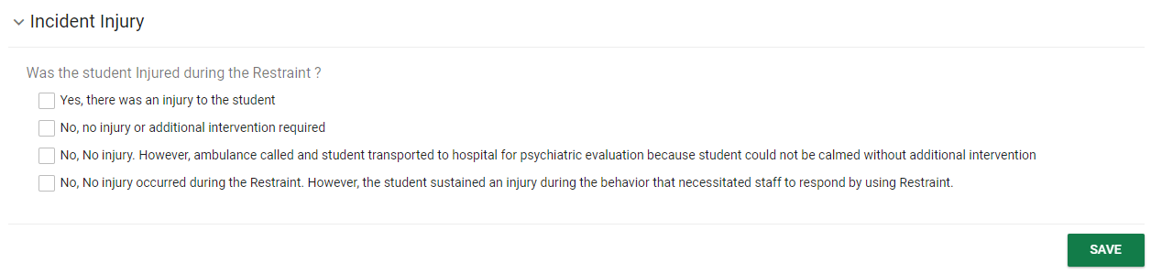
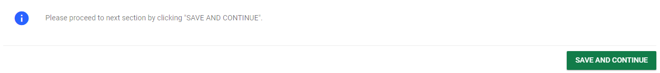
Notes:
The final panel on this tile is Incident Injury panel. If an injury is selected, the next page which is Injury Details will populate. If no injury is selected, the next page will have a message advising the user to bypass the Injury Details Page

Slide 15
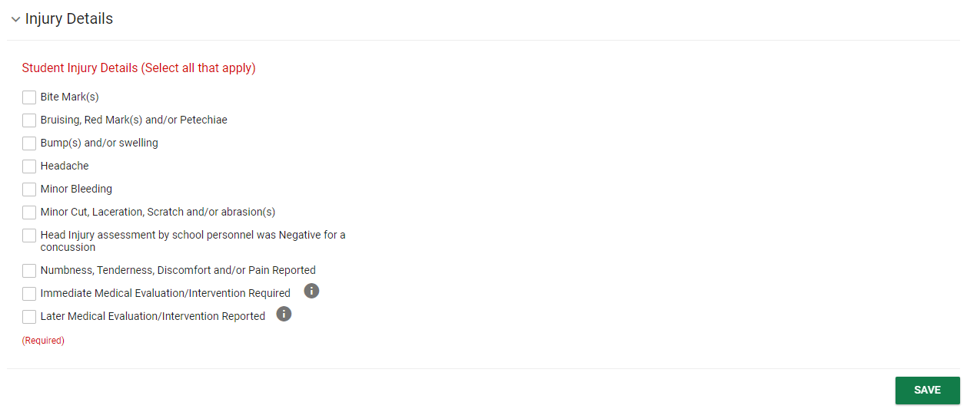
Notes:
If the user selected that there was an injury to the student on the Incident Injury panel of the Incident Overview page, the user will need to complete this page. The first panel is the Injury Details panel where the Student Injury Details can be selected. The user should select all that apply and click SAVE. Please note, if a serious injury is selected (indicated by a gray information icon), the Injury Result Panel will populate further down the page.

Slide 16
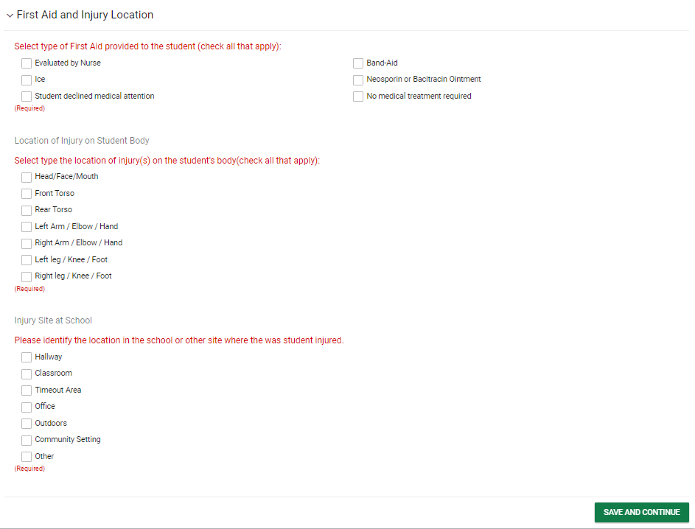
Notes:
The next panel is the First Aid and Injury location where the First Aid provided, Location of Injury and Injury Site can be selected. Please note that if Other is selected for Injury Site, a blank text box will appear that will need to be completed to continue the process. If there was no serious injury selected, the user should click SAVE AND CONTINUE at the bottom of the First Aid and Injury Location panel and will be brought to the next page in the process.

Slide 17
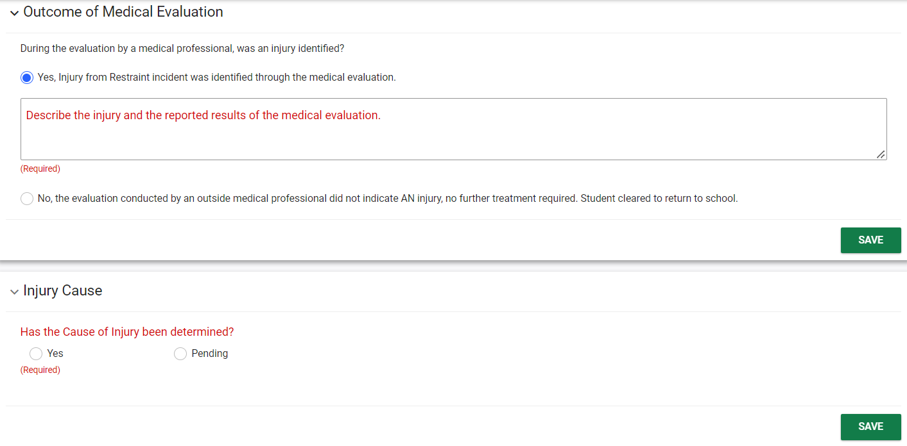
Notes:
If a serious injury was selected, the next panel that appears is the Outcome of Medical Evaluation panel. This allows the user to select the outcome of the medical evaluation. If yes is selected, a blank text box will appear where a description and reported results of injury can be captured. The user will also need to fill out the Injury Cause, Injury Result, and Investigation of Incident panels, and click Save and Continue.

Slide 18
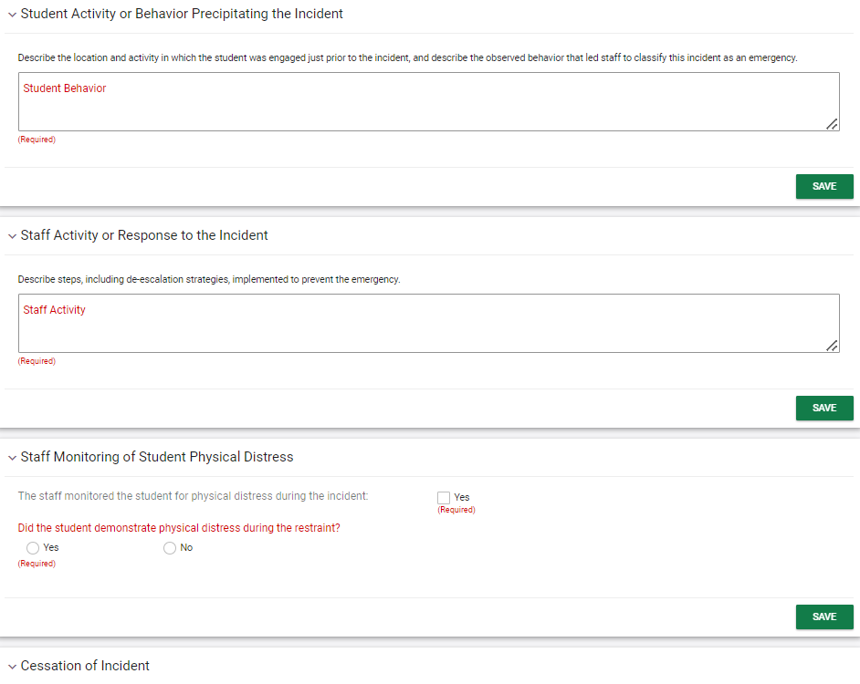
Notes:
The next page is the Incident Student and Staff Activity Panel where the Activity of both Student and Staff prior, during and after the incident can be captured. Please note on the Staff Monitoring of Physical Distress panel, the staff member will need to attest that they monitored the student by clicking Yes and then answer whether the student demonstrated physical distress during the incident. After completing all fields, the user will click Save and Continue to run the error check and move to the next page if all fields were completed.

Slide 19
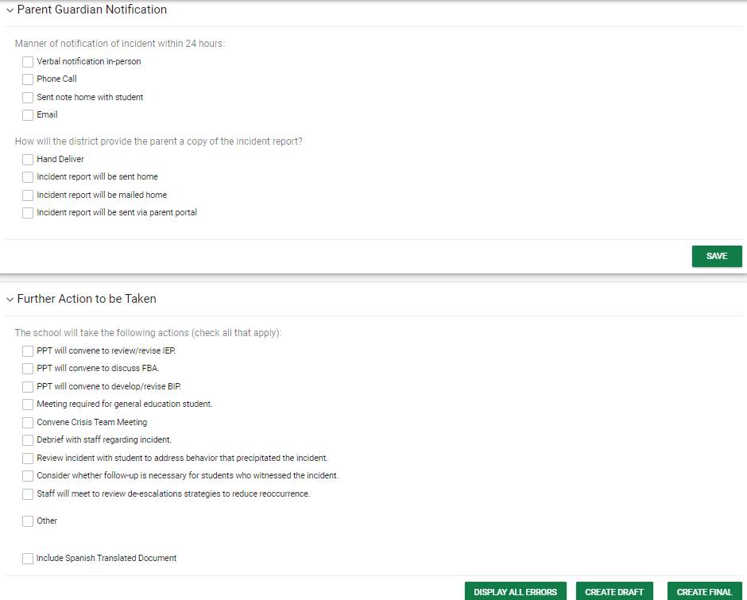
Notes:
The final page in the process is Finalize and Create Incident Document. Please note, not all user types will have access to this page.
After completing the panels, the user should click the DISPLAY ALL ERRORS button. This will show any errors in the process that need to be completed. The CREATE DRAFT button will create a draft document of the incident. The CREATE FINAL button will create a final document of the incident. The ability to create a finalized document varies by user type so some users will not have this ability.

Slide 20
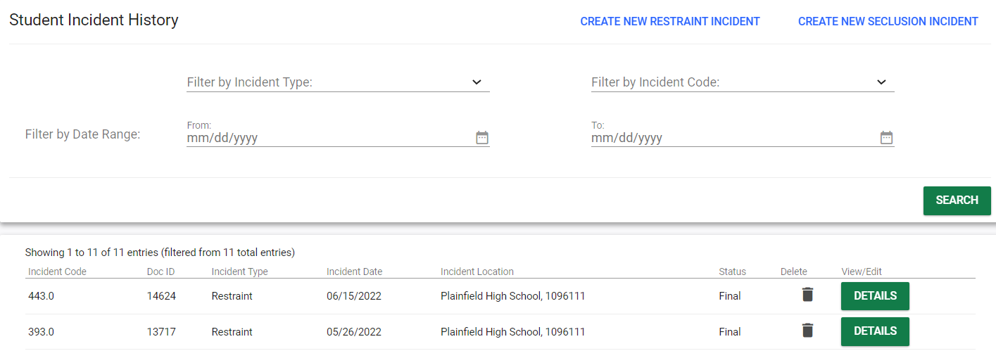
Notes:
After incidents have been finalized or a draft has been created, the user may need to view, modify, or finalize an already created incident. To do this, navigate to the Student Incident History page in Restraint/Seclusion and search for an incident.
If the user has a draft document that needs to be viewed, modified, or finalized, click the DETAILS button. Once DETAILS is clicked, the user can navigate to the correct tile and make any changes before creating a final document on the last page of the process. If the user wants to view a finalized incident, click the DETAILS button. By default, a finalized incident opens in a view only mode.

Slide 21
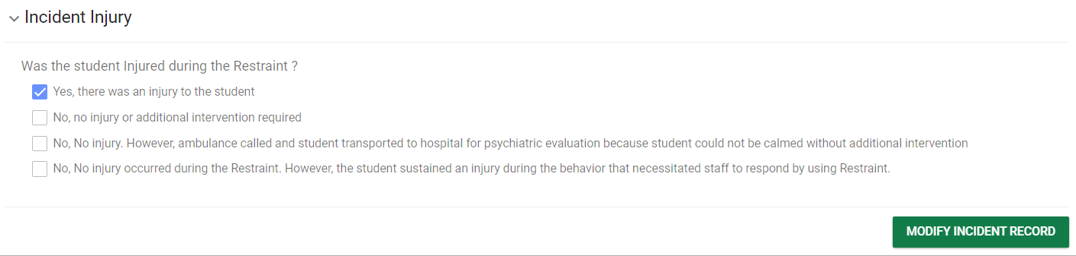
Notes:
If the user needs to modify a finalized incident, click into the Incident Overview tile and scroll down to the last panel on the page, Incident Injury, and the user will have access to a button MODIFY INCIDENT RECORD. Once this button is clicked, the system saves a Draft version of this incident. When an incident is in a Draft mode, no new incidents can be created. The draft incident must be finalized before another incident can be created/modified.

Slide 22
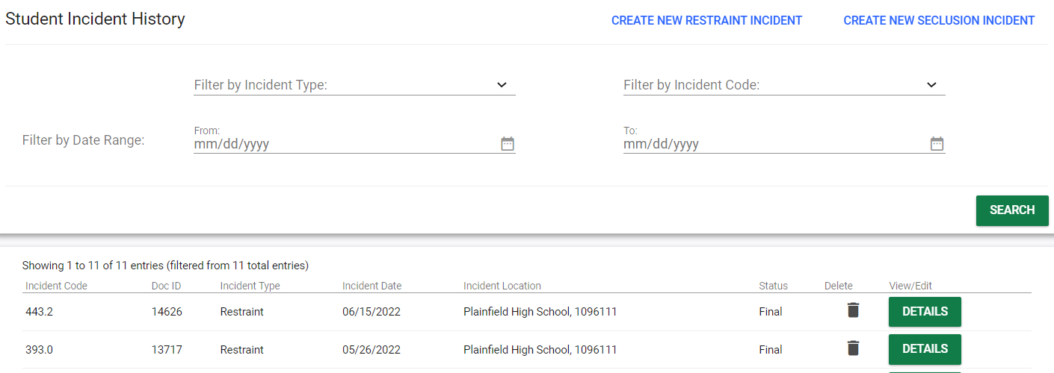
Notes:
Please note, the incident code on the Student Incident History reveals of the number of modifications that have taken place on an incident. For example, Incident Code 393 in this screenshot has never been modified indicated by the Code of 393.0. Incident Code 443 has been modified twice already as notated by Incident Code 443.2. Only the most recently finalized version of any finalized incident is accessible. Once finalized, the modified incident replaces the original incident in the system and on the Student Incident History page.

