Slide 1
Service Documentation

Slide 2
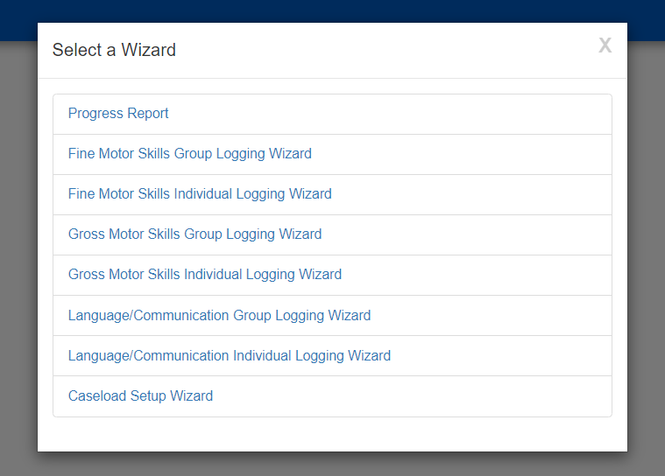
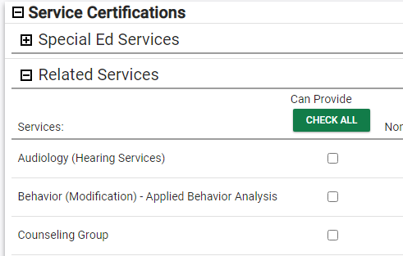
Notes:
It is optional for districts to be able to log services in CT-SEDS and any district can document services provided to students in CT-SEDS. Data from documenting these interactions can be used for Medicaid claiming and generally monitoring service implementation for all students. Those districts working with PCG on Medicaid will need to log services.
In order to log services, users go to Tools and then Wizards and select the appropriate logging wizard. A few examples are shown here.
Please note, before any clinicians can use the Logging Wizards, information must be entered by CT-SEDS SYSTEM ADMINISTRATORS in the Service Certifications table in the user personal page. Administrators will need to:
select the therapy disciplines the user (related service provider) can provide and
indicate if the user can approve their own service logs or if a supervisor sign off is needed.
If the student does not have an IEP or Section 504 plan written in CT-SEDS, service level information must be imported or manually entered before service providers can use the service logging wizards. Once student IEPs and Section 504 Plans are created in CT-SEDS, this information will be automatically available.

Slide 3
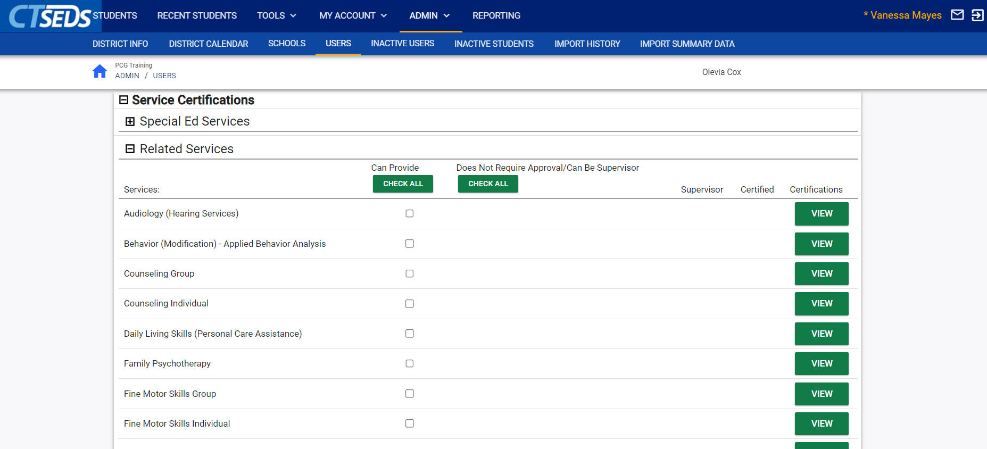
Notes:
It is optional for districts to be able to log services in CT-SEDS and any district can document services provided to students in CT-SEDS. Data from documenting these interactions can be used for Medicaid claiming and generally monitoring service implementation for all students. Those districts working with PCG on Medicaid will need to log services.
In order to log services, users go to Tools and then Wizards and select the appropriate logging wizard. A few examples are shown here.
Please note, before any clinicians can use the Logging Wizards, information must be entered by CT-SEDS SYSTEM ADMINISTRATORS in the Service Certifications table in the user personal page. Administrators will need to:
select the therapy disciplines the user (related service provider) can provide and
indicate if the user can approve their own service logs or if a supervisor sign off is needed.
If the student does not have an IEP or Section 504 plan written in CT-SEDS, service level information must be imported or manually entered before service providers can use the service logging wizards. Once student IEPs and Section 504 Plans are created in CT-SEDS, this information will be automatically available.

Slide 4
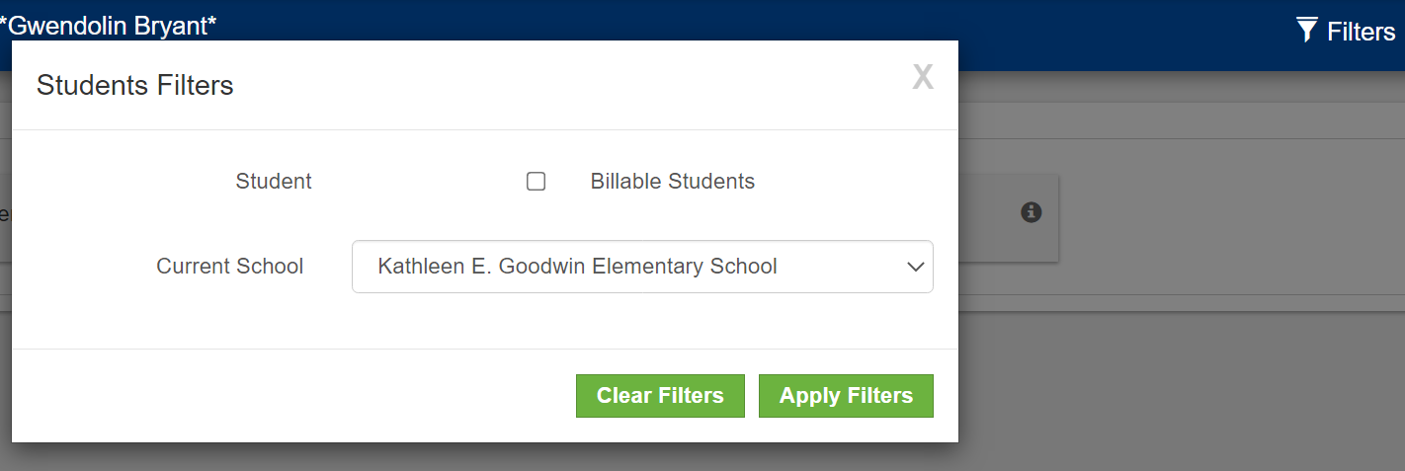
Notes:
After selecting a logging wizard, on the next screen you will see a listing of the students on your caseload with services available for logging. You can filter your caseload to help identify which students you want to document for (i.e., by school).

Slide 5
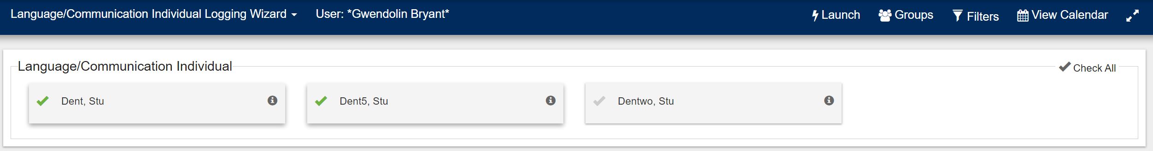
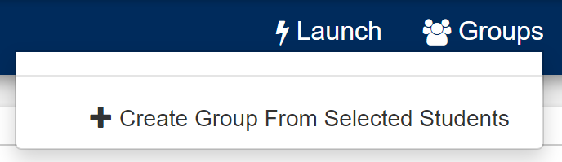
Notes:
Groups can be created within the Logging Wizards for easy selection of the same students. To set up a group, select more than one student by clicking on the student’s name. The users will see the checkmark to the left of the student’s name turn green once selected. You will see another button appear next to the Filter button called “Groups”. Click the button, then click “Create Group from Selected students”. Name the group whatever you like, then click Save to save the group of students. Groups can also be overwritten with new students, or deleted by clicking the Groups button. Once you have pre-built your groups, you can easily use the “Groups” button to select that group of students again and log services for that group together.

Slide 6
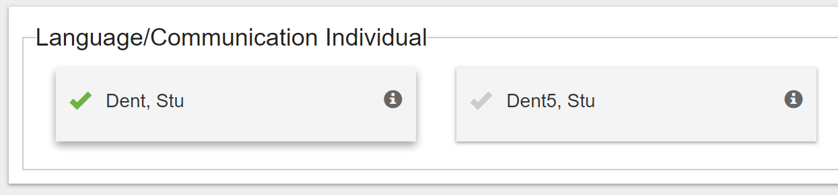
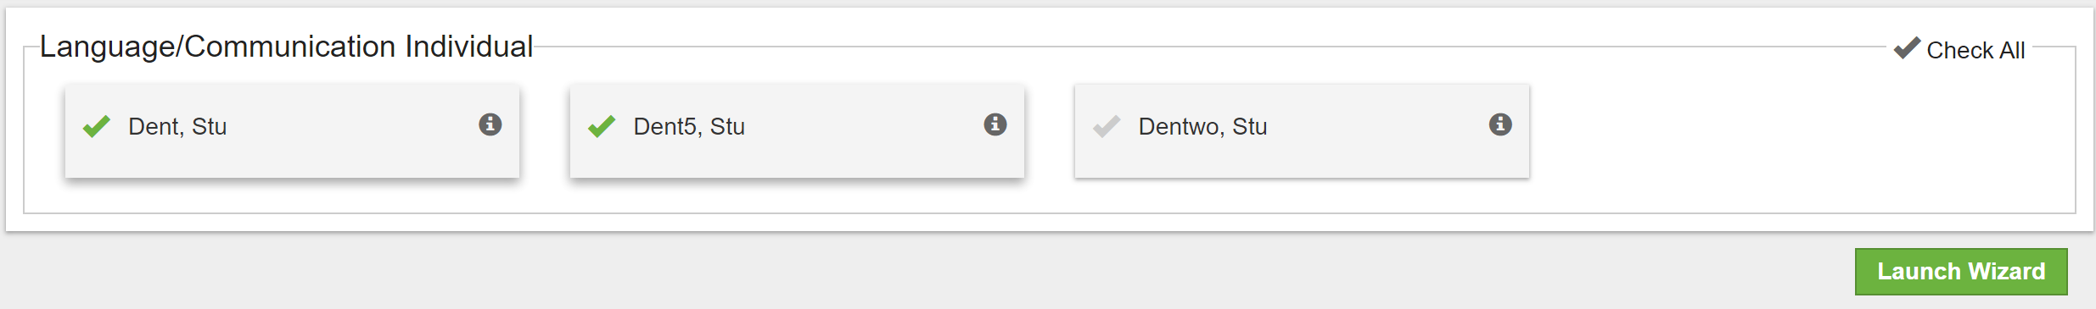
Notes:
Select the students you want to document for by clicking on each student’s name, which will turn the check mark next to the student’s name green indicating they are selected. The gray information icon can be clicked on to view applicable service information for the student.
Once you have selected the student(s) you want to document for, click the “Launch Wizard” button located at the bottom of the screen.

Slide 7
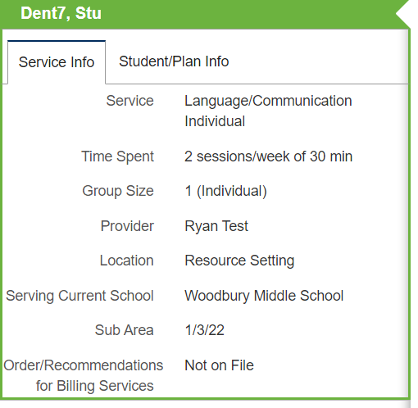
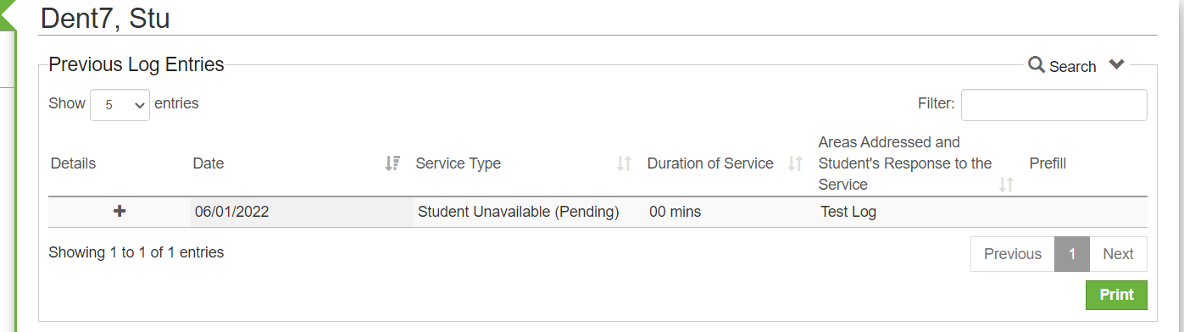
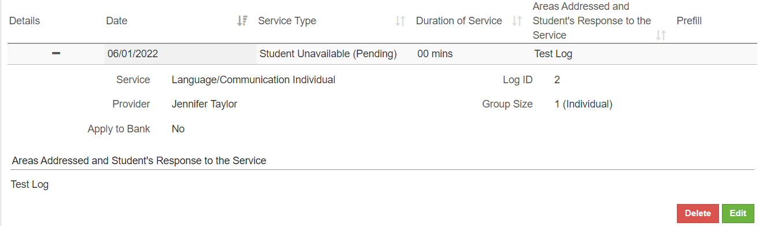
Notes:
Service Information and Student/Plan Information about the students selected for documentation on can be located next to their name on the left hand of the screen in the green navigation bar on the left of the screen. Any previously logged sessions on this student by you or another clinician in your discipline will appear above the logging wizard in the Previous Log Entries section. Additionally, you can search, sort, and filter for specific sessions. To view more information about a previous log, click the “+” button to expand the session.

Slide 8
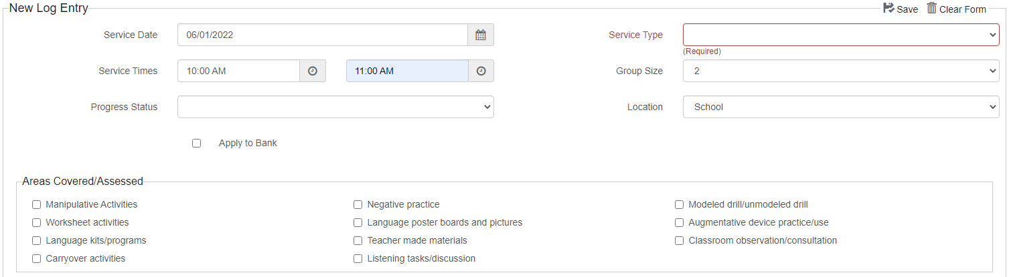
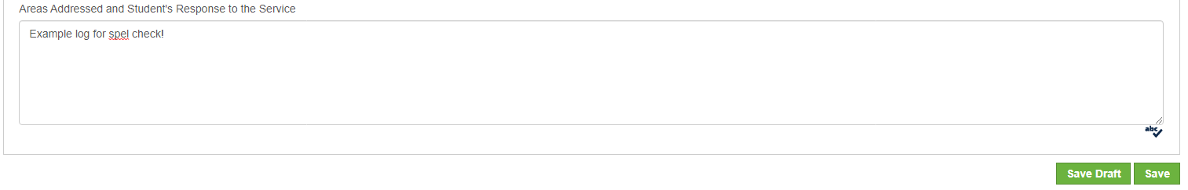
Notes:
Enter required information into the logging wizard. Date, service type, and duration of service are required fields. The service type drop down menu is where you select the service that was delivered whether it was treatment, an assessment, an absence, or other types of services. The Location field will allow you to account for a different Service Location. For example, if the service was delivered in School or Telehealth.
Additional fields will appear in red with a required notation, depending on the service type selected.
An open text field is available to enter information regarding the Student’s Response to the service in the logging wizard. Spell check is available for you to use under the comments text box. Once you are done entering service information for a student, click the “Save” button in the lower right corner below the “Student’s Response to the service ” box, or you can continue to log for additional students on this screen if you selected more than one student to document on. Once you are done logging all services, click the “Save All” button at the bottom of the screen.

Slide 9
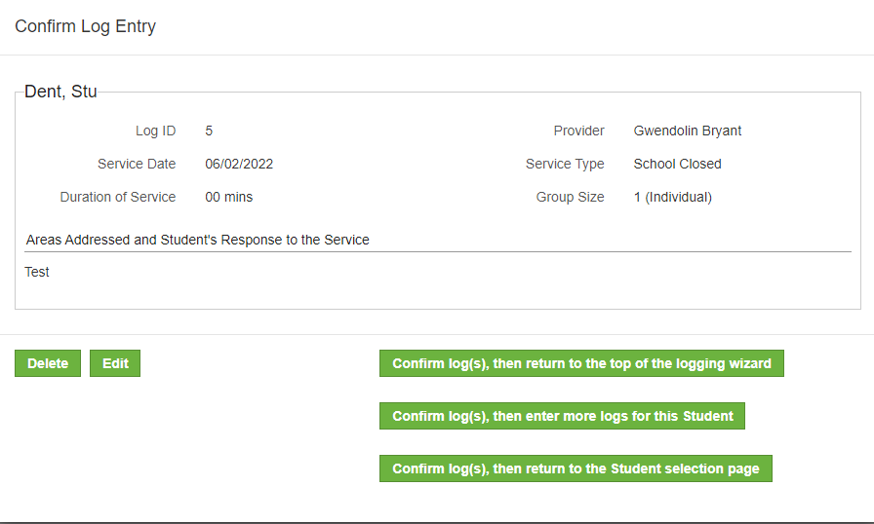
Notes:
A confirmation message will display asking you to confirm the information you entered. You have the option to delete or edit the note, confirm the note and return to the top of the logging wizard, confirm the log and enter more logs for the student you are working on. When multiple student shave been selected you will also see “confirm the logs and return to the student selection page.”

Slide 10
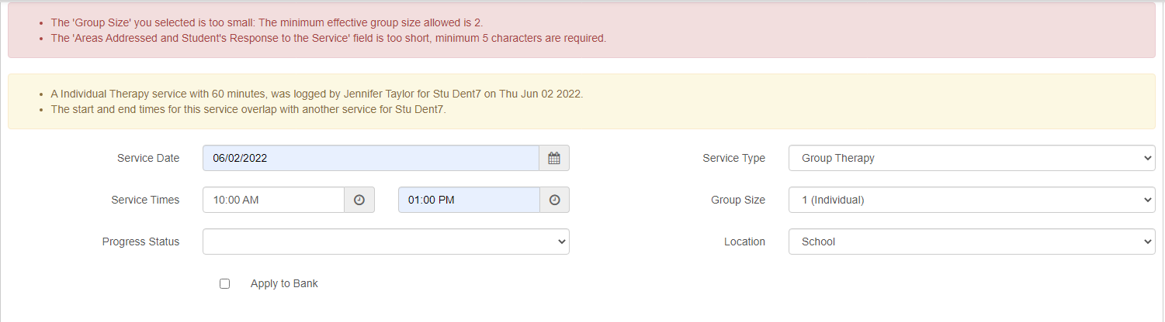
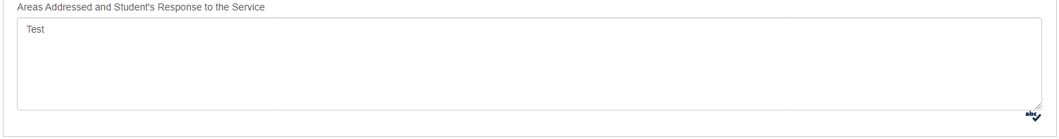
Notes:
If there are any warnings, they will be shown in a yellow text box and will not prevent you from saving your log, but serve as a reminder that there may be additional data required elsewhere for this student. Errors show up in red and will prevent you from saving the log. Once all errors are cleared, you can save the entry.

Slide 11
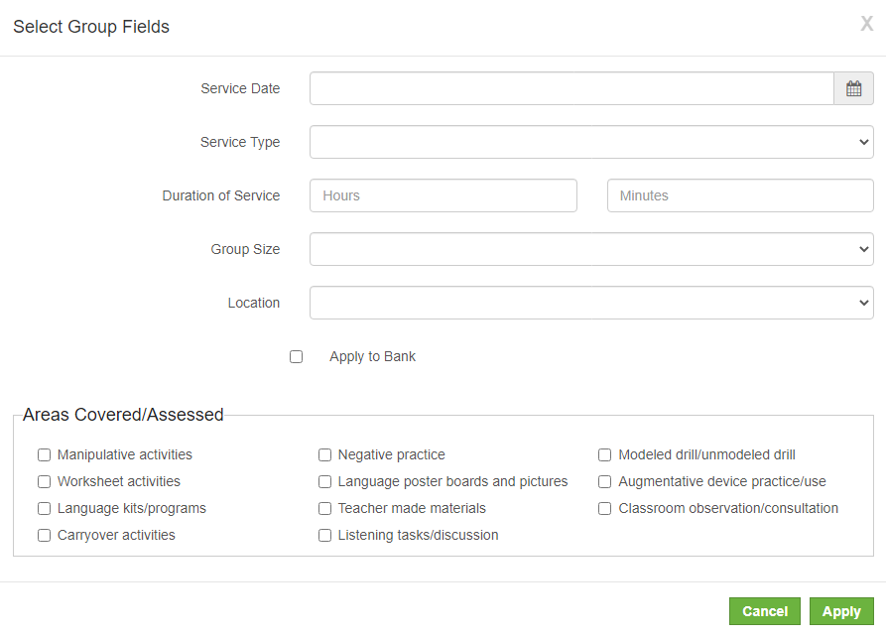
Notes:
To document services using the Group Logging Wizard, click on the “Group Logging” button located at the top of the logging wizard. A different pop up panel will guide you through a documentation screen where you will enter service information that pertains to all students in the group session. If available, Areas covered/assessed selections on this screen should be applicable to the entire group. When you are finished, click the “Apply” button. The information you entered pertaining to all selected students in the “group” will be prepopulated in the logging wizard for the students selected. This information can be edited or changed at any time. Next, enter individual information for each student in the group session, including service notes in the “Student’s Response to the service” box. When you are done, click the “Save All” button located either at the very bottom of the screen, or in the blue menu bar.

Slide 12
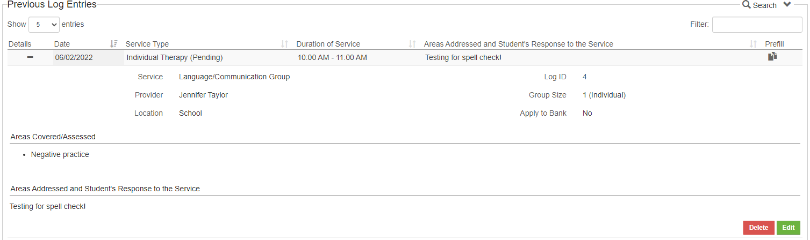
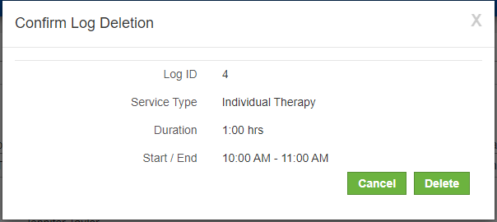
Notes:
To delete a service log, first find it in the “Previous Log Entries” table. Next, expand the entry with the “+” button. Once you have the correct service selected in this table and expanded, you should see a red button titled “Delete”, click this button and you will be prompted to confirm the deletion of the log.

Slide 13
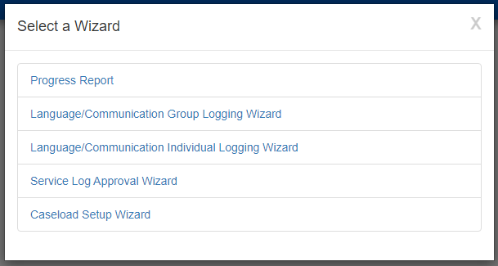
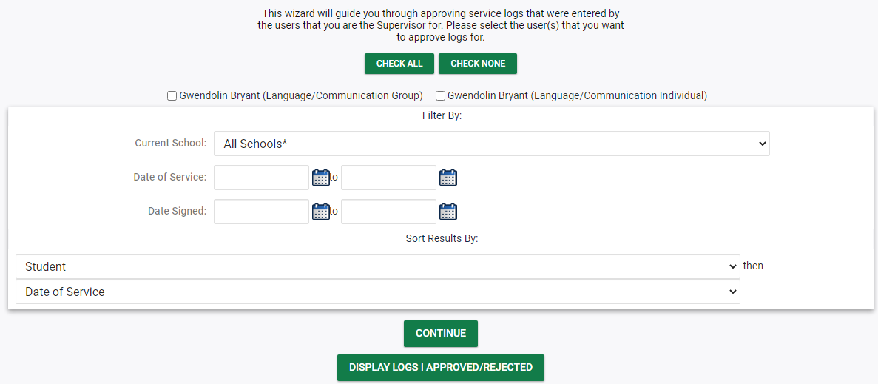
Notes:
The Service Log Approval Process is used for those therapists who require a supervisor to approve their service logs. The setup of Supervisor-Supervisee relationships may be found in more detail in the Service Documentation Administrator manual. After a supervisee has entered a log through the Wizards, the supervisor will navigate to the “Service Log Approval Wizard.” Once the “Service Log Approval Wizard” is opened, the Supervisor can filter by numerous parameters to look only at a subset of services to approve such as: schools, date range by service, and date range by signed date.

Slide 14
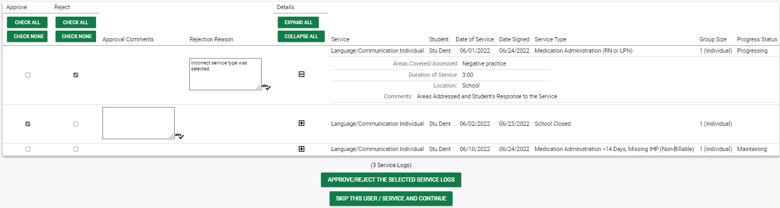
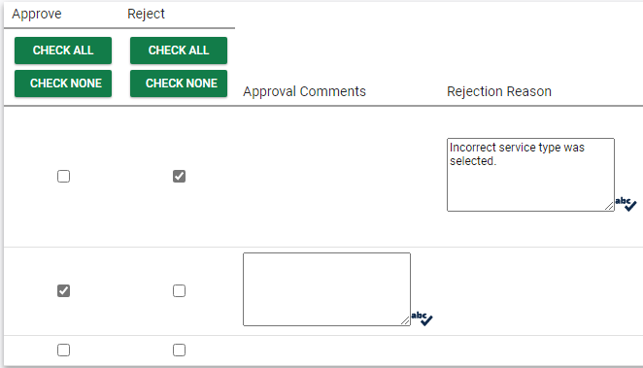
Notes:
Once you have selected your parameters click the “Continue” button. If logs are rejected, the Supervisor can enter a reason before sending the log back to the Supervisee. The provider will need to make corrections and resubmit.
This concludes our introduction to Service Documentation. More information can be found in the Service Documentation User Manual if needed.

