Slide 1
Services Plan Process

Slide 2
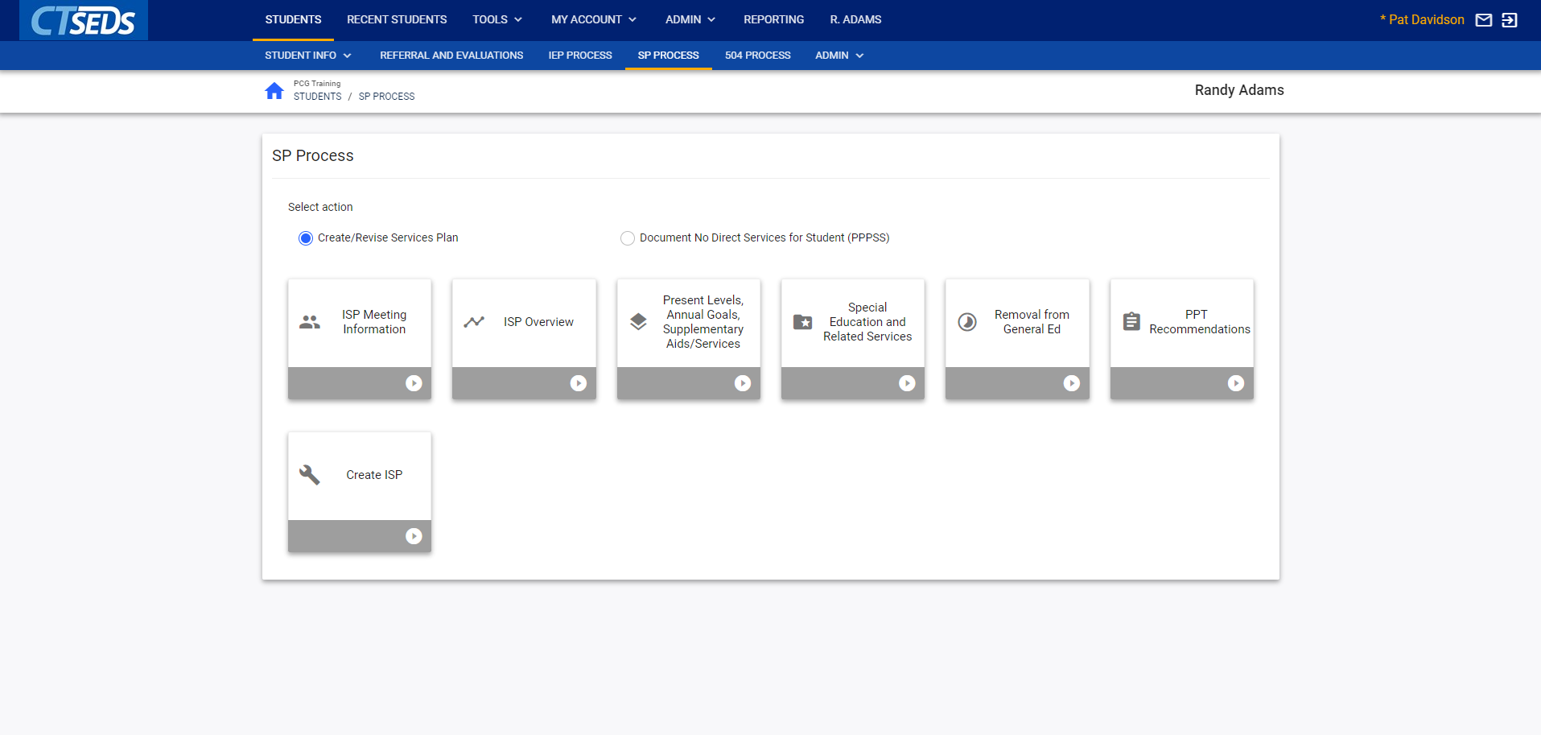
Use this Slide for Screenshots
Notes:
The Services Plan module is used to document services for eligible students who attend private schools in the district. To begin a Services Plan, navigate to the SP Process tab in the blue taskbar at the top of the CT-SEDs page. Two choices will be available: Create/Revise Services Plan or Document No Direct Services for Parentally Placed Private School Student (PPPSS).
In order to create or revise an Individual Services Plan (ISP), the user should select the Create/Revise Services Plan option. This will reveal the SP Process tiles, which are similar to the IEP Process.

Slide 3
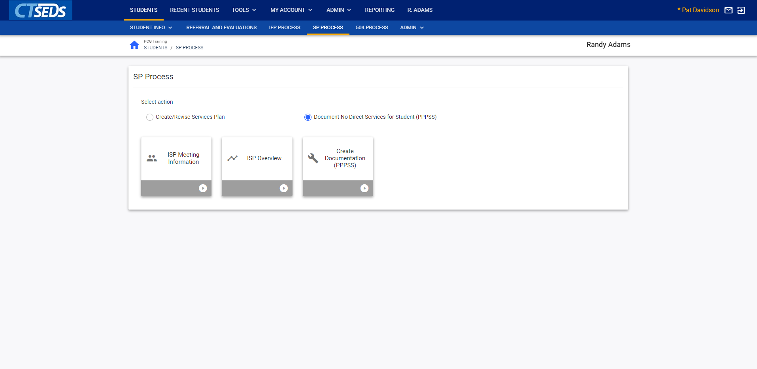
Notes:
The second option in the SP Process is to Document no Direct Services for Student (PPPSS). This option allows the user to document that although the student was found eligible, no direct services will be provided to the student. The three tiles available in this option are ISP Meeting Information, ISP Overview, and Create Documentation (PPPSS).

Slide 4
Notes:
We will demonstrate the Create/Revise Services Plan option. As you can see, many of the tiles here are similar to those found in the IEP process. Functionally there is much the same between the two so we will not go through each step of the process. Let’s look at the Special Education and Related Services tile.

Slide 5
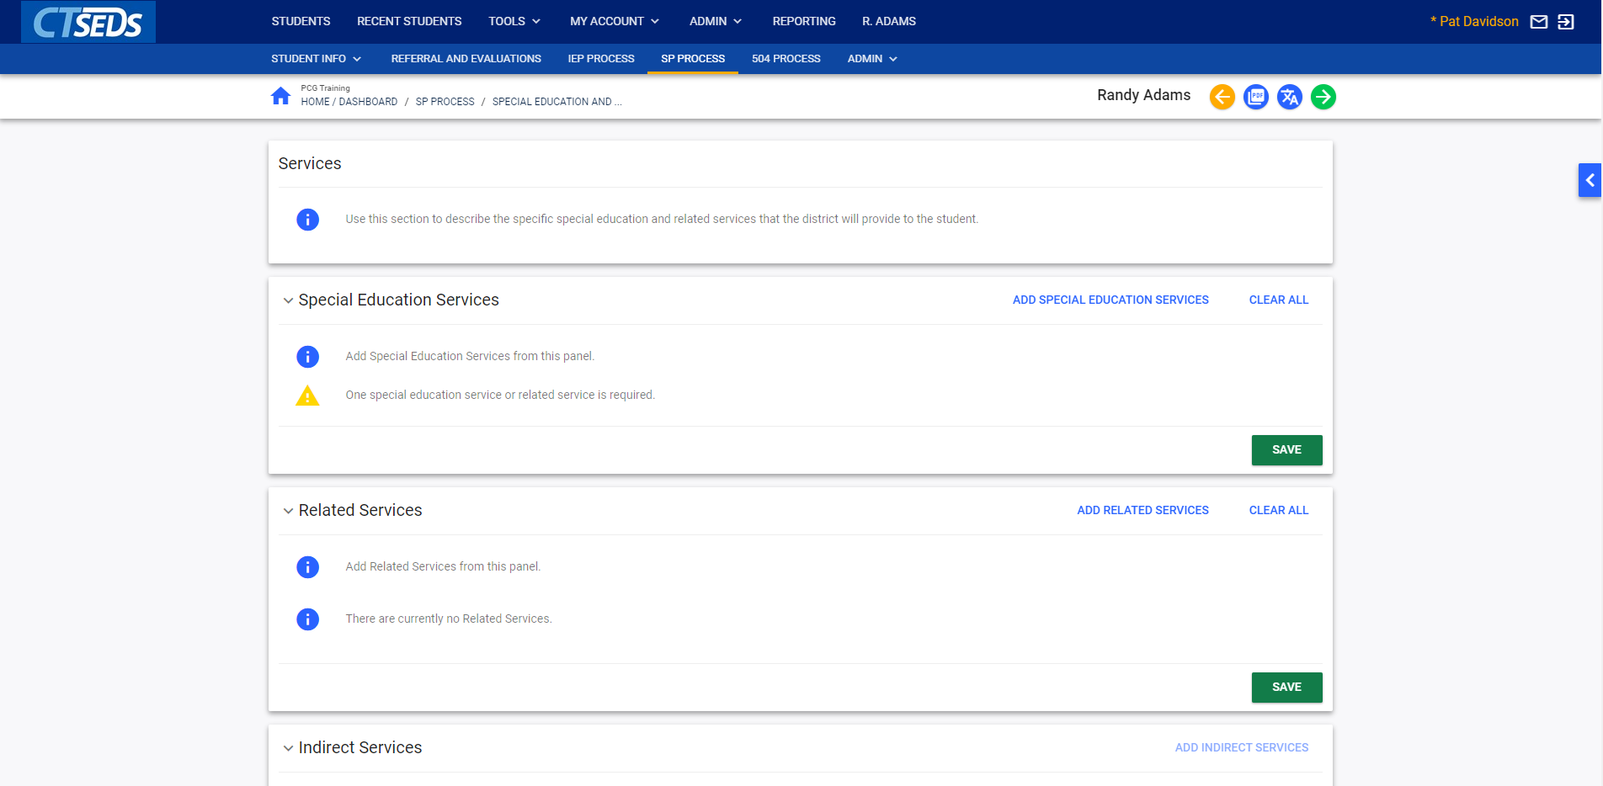
Notes:
This page is where the user documents the specific special education, related services, indirect services, and/or transportation services that the district will provide to the student. Please note that one special education service or related service is required.
The Special Education Services panel allows the user to click on the blue link in the upper right ADD SPECIAL EDUCATION SERVICES to add services. Please note, there is also the option to click CLEAR ALL to clear out the services added.

Slide 6
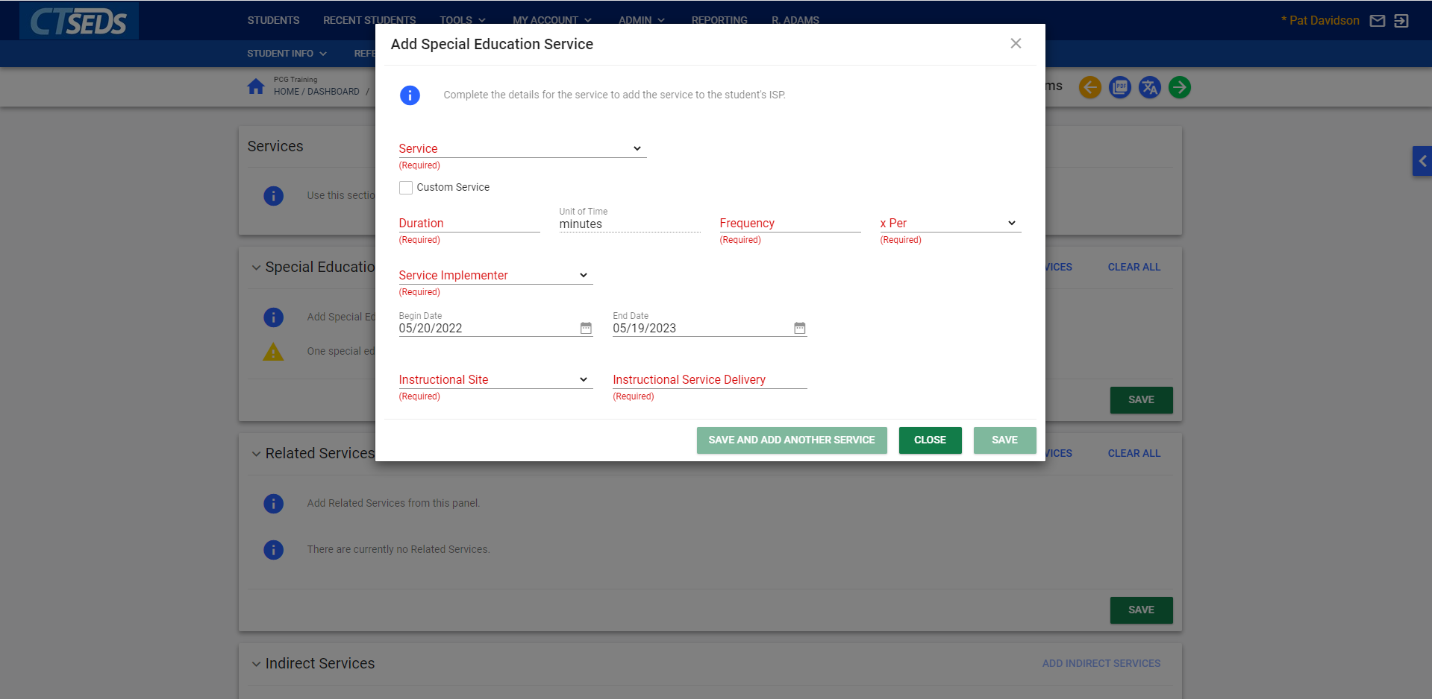
Notes:
When the user clicks ADD SPECIAL EDUCATION SERVICES, a pop-up panel will appear that requires the user to select the Service, Duration, Frequency, x Per, Service Implementation, Instructional Site and Instructional Service Delivery. The Begin Date and End Date will auto-populate based on the ISP Begin and End Date but can be adjusted using the calendar icon. After completing the required fields, the user will be able to click SAVE or SAVE AND ADD ANOTHER SERVICE. The CLOSE button will close the pop-up panel without saving.

Slide 7
Notes:
The Related Services panel allows the user to add any related services for the student by clicking the blue link in the upper right corner ADD RELATED SERVICES. There is also a blue link CLEAR ALL that will clear out the services added.

Slide 8
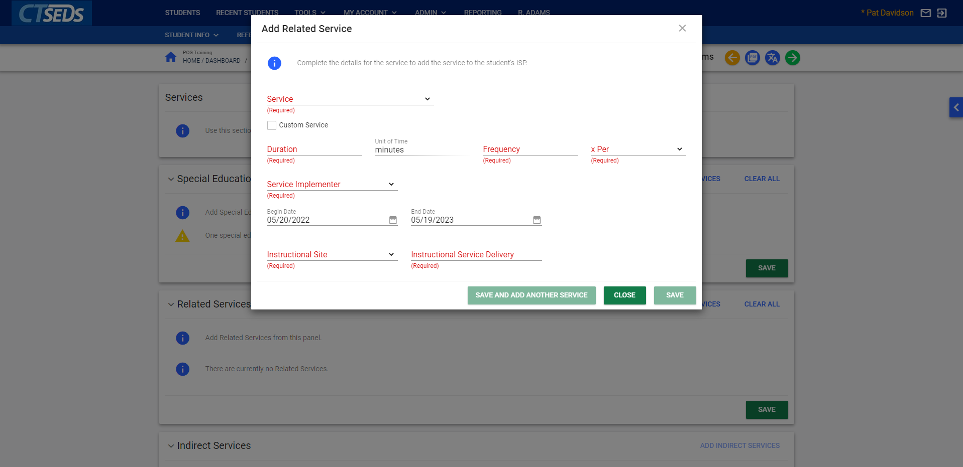
Notes:
The pop-up panel that will appear will require the user to select the Service, Duration, Frequency, x Per, Service Implementation, Instructional Site and Instructional Service Delivery. The Begin Date and End Date will auto-populate based on the ISP Begin and End Date but can be adjusted using the calendar icon. After completing the required fields, the user will be able to click SAVE or SAVE AND ADD ANOTHER SERVICE. The CLOSE button will close the pop-up panel without saving.

Slide 9
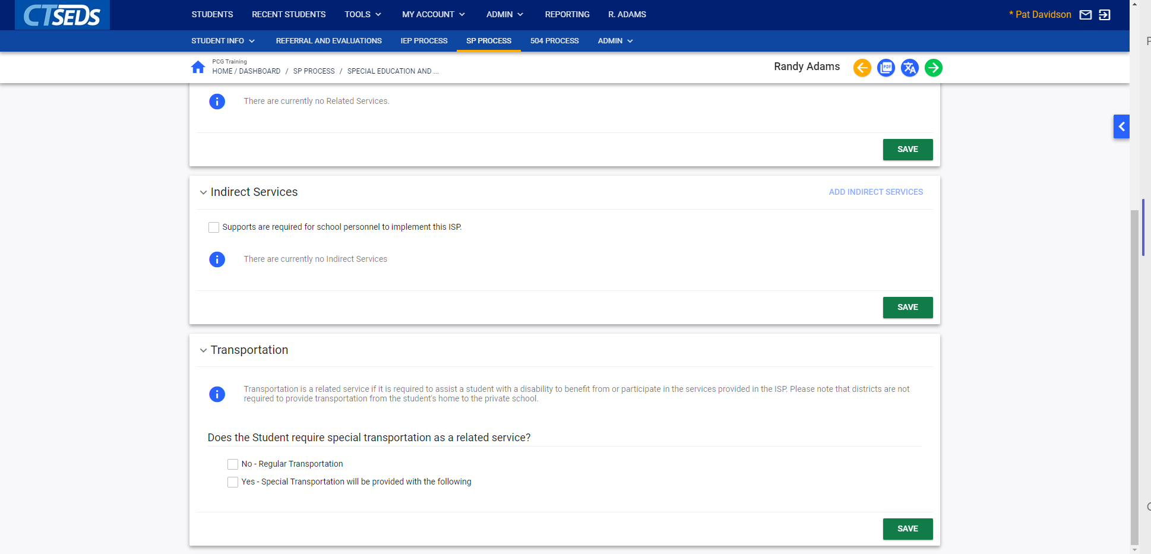
Notes:
The Indirect Services Panel allows the user to add Indirect Services. To add indirect services, the user should select the checkbox Supports are required for school personnel to implement this ISP and click SAVE. Then, the user should click on the blue link in the upper right corner ADD INDIRECT SERVICES. Indirect Services are provided to the adult(s) who are working with the student and support the implementation of the ISP. Most commonly, indirect services include: specific staff training, classroom-level support, consultation, collaboration, and specific parent training.

Slide 10
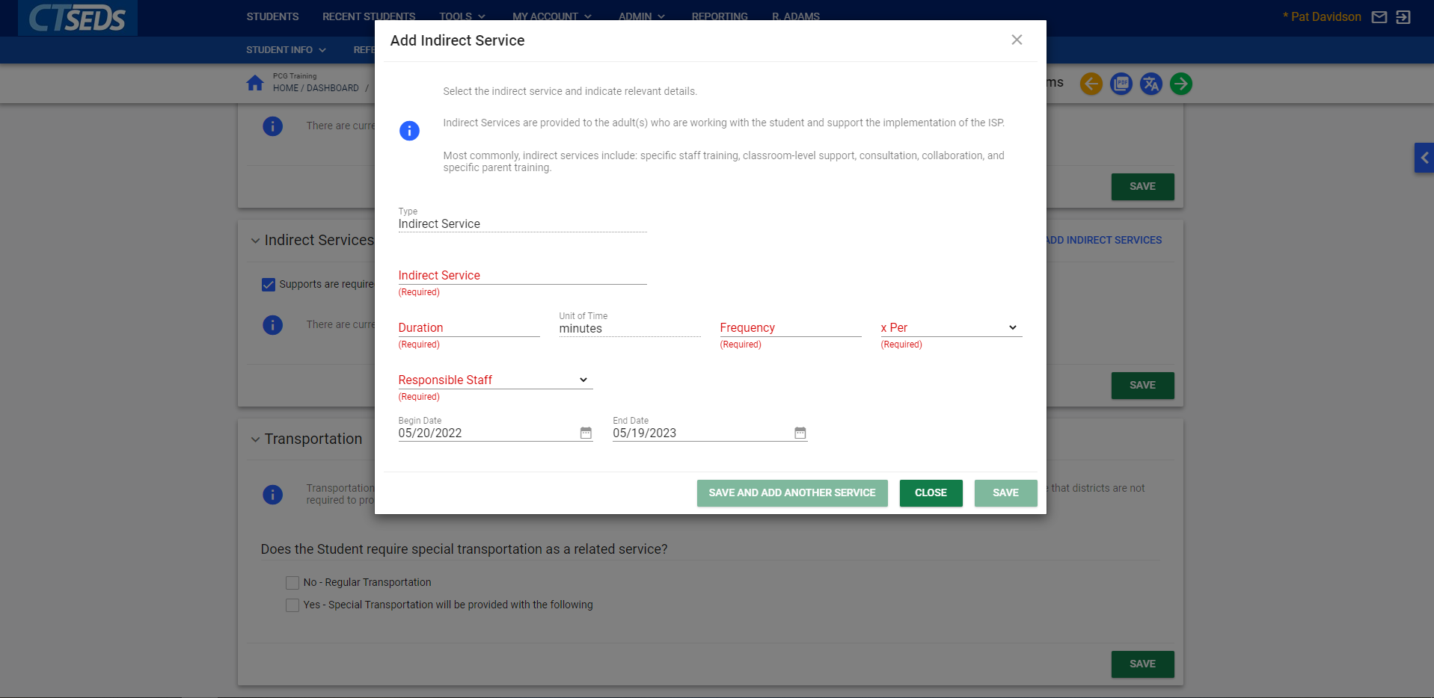
Notes:
The pop-up panel requires the user to type in the Indirect Service and select the Duration, Frequency, x Per, and Responsible Staff. The Begin Date and End Date will auto-populate based on the ISP Begin and End Date. After completing the required fields, the user will be able to click SAVE or SAVE AND ADD ANOTHER SERVICE. The CLOSE button will close the pop-up panel without saving.

Slide 11
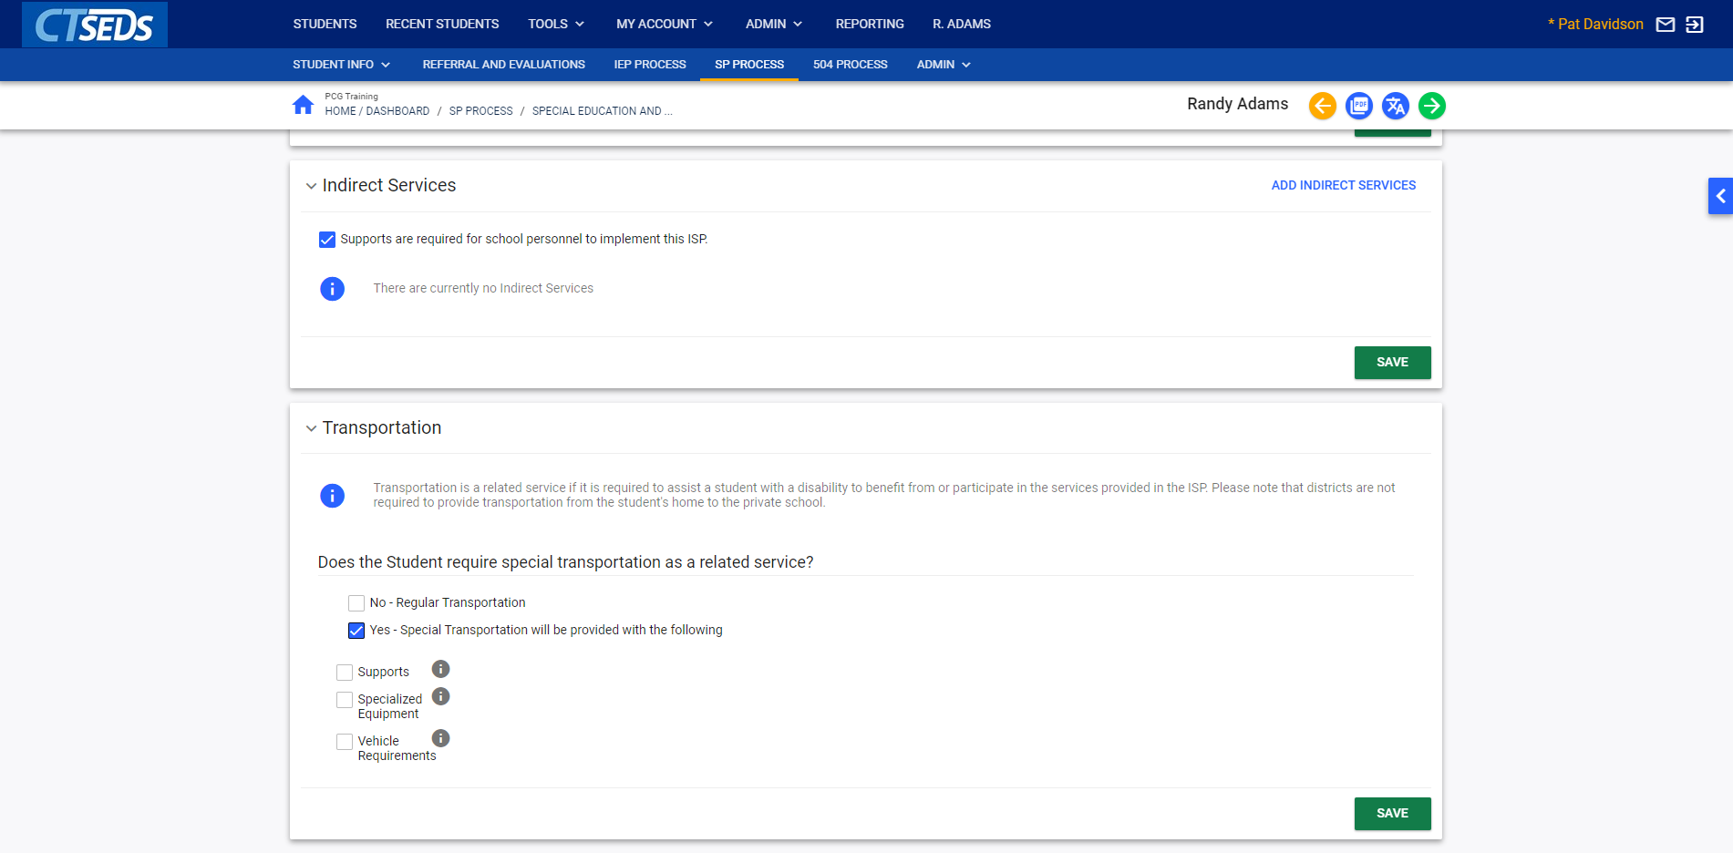
Notes:
The Transportation panel allows the user to capture if the student needs special transportation. Transportation is a related service if it is required to assist a student with a disability to benefit from or participate in the services provided in the ISP. Please note that districts are not required to provide transportation from the student's home to the private school. Please note that if a Yes checkbox is selected as shown here, the user will need to indicate the specific supports, specialized equipment, and/or vehicle requirements and type in the details.

Slide 12
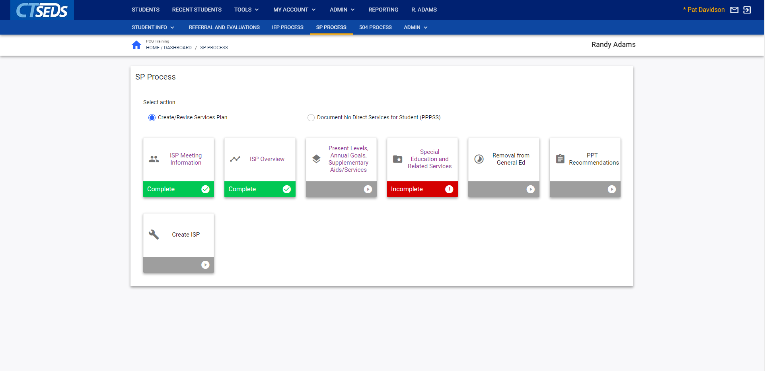
Notes:
Similar to the IEP Process, when all tiles are complete the user will visit the last page in the process, Create ISP, in order to finalize the document. The user should click the green DISPLAY ALL ERRORS button to see if they missed anything in the process. If there are no errors, the user will be able to move forward to finalize the Services Plan. If there are errors, it will display all errors from the entire process in a red box for the user to make corrections. The system requires the user correct any errors before finalizing so errors will also appear when clicking the green create final button if there are errors in the process. The green CREATE DRAFT and CREATE FINAL buttons will create either a draft Services Plan or a Finalized Services Plan. Creating a finalized Services Plan will complete the process for the student.

