Slide 1

The Digital Readiness Check

Slide 2
Digital Readiness Check Screen-by-Screen
Purpose
Ensure testing devices meet technical requirements.
Ensure BluebookTM is installed correctly.
Complete Exam Set-Up process.
  Review privacy policy and use of this app statement.
  Provide (optional) test taker information.
  Opt into BigFuture School and Connections opportunities if desired.
  Add Free Score Sends for SAT.
Explore platform functions and universal accessibility features.
Receive Test Preview with sample questions and see how to access Full-Length Practice Tests equipped with student’s specific accommodations if applicable.
5 – 10 Minutes
Required before testing
Recommended 20 Minutes - Optional

Slide 3
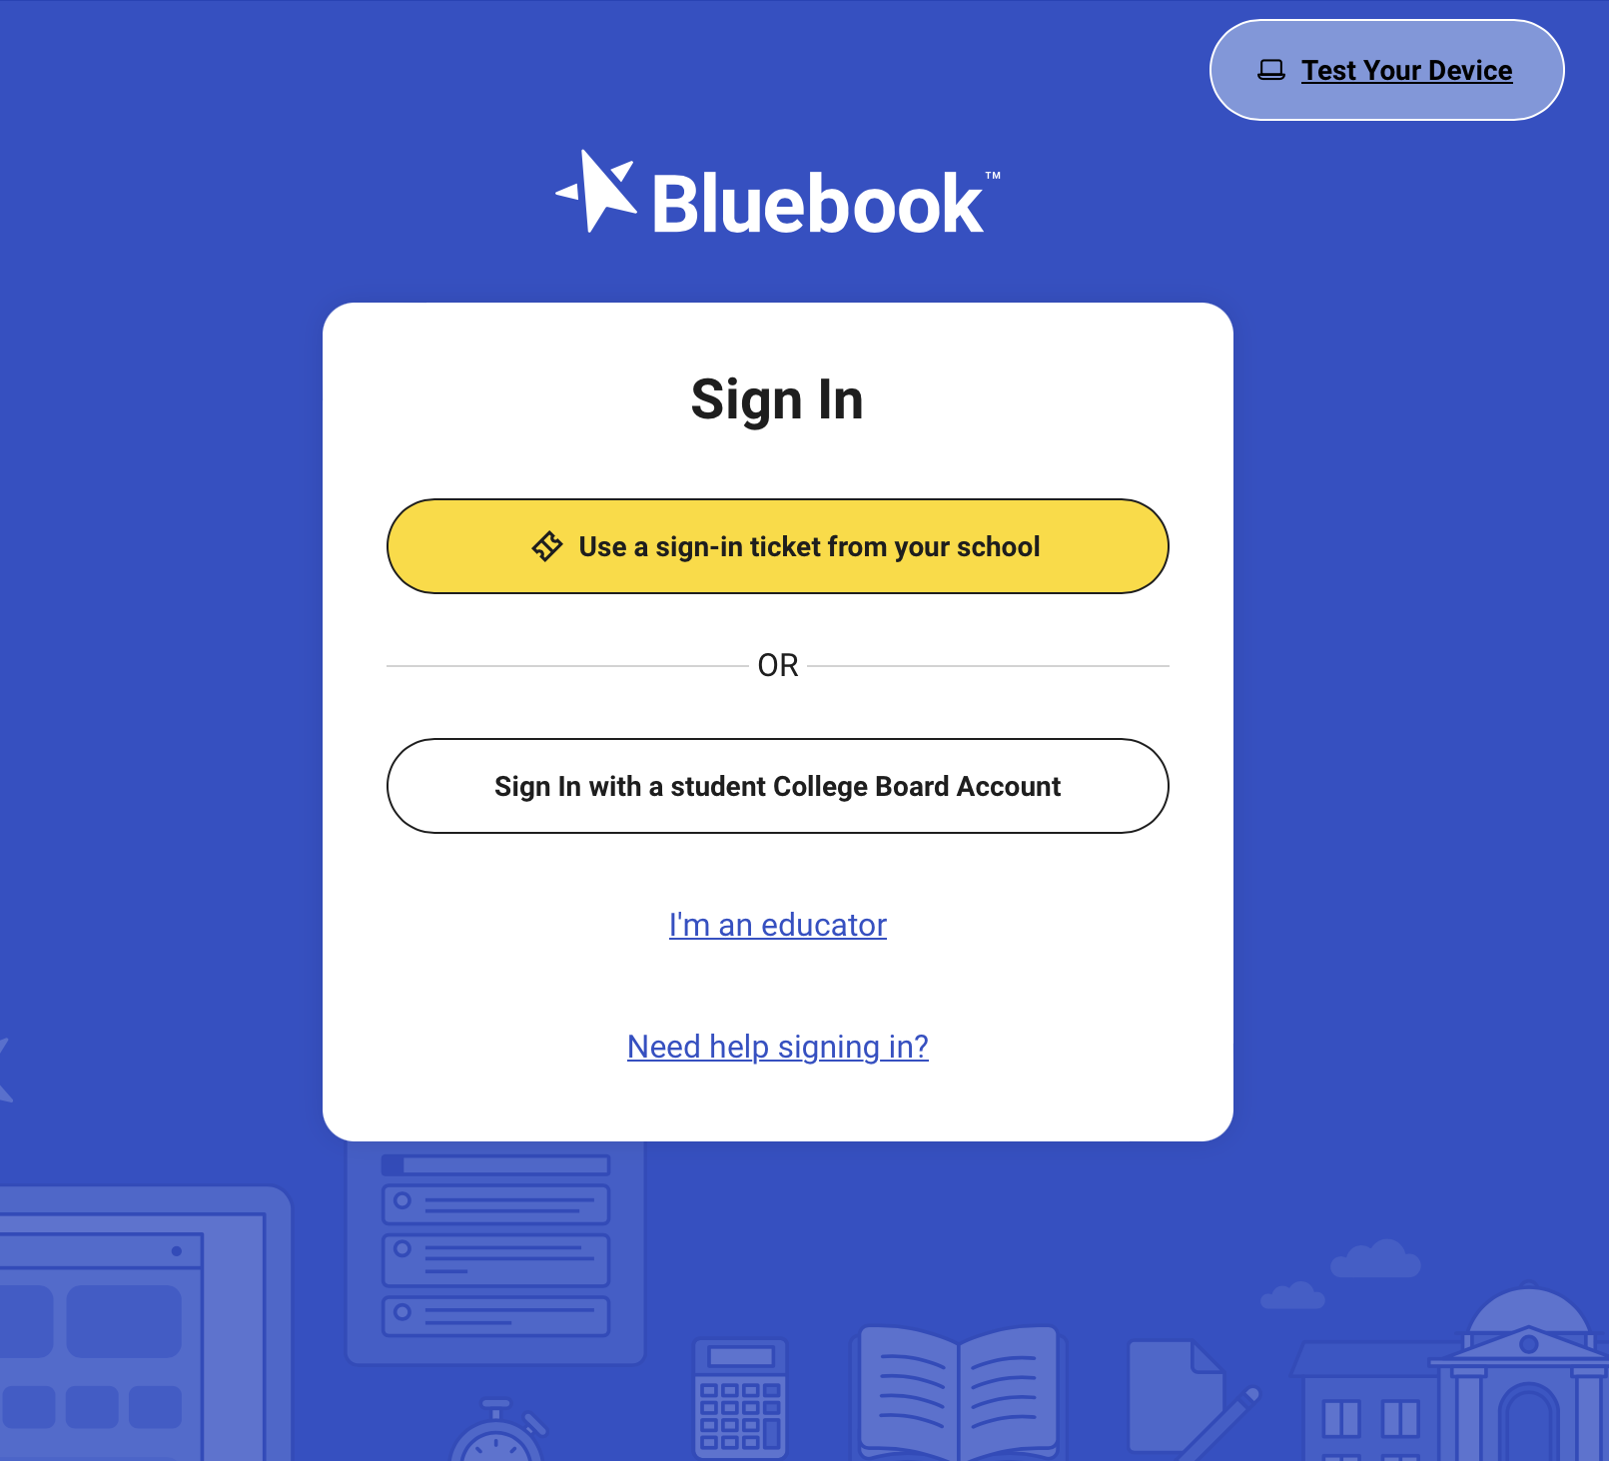
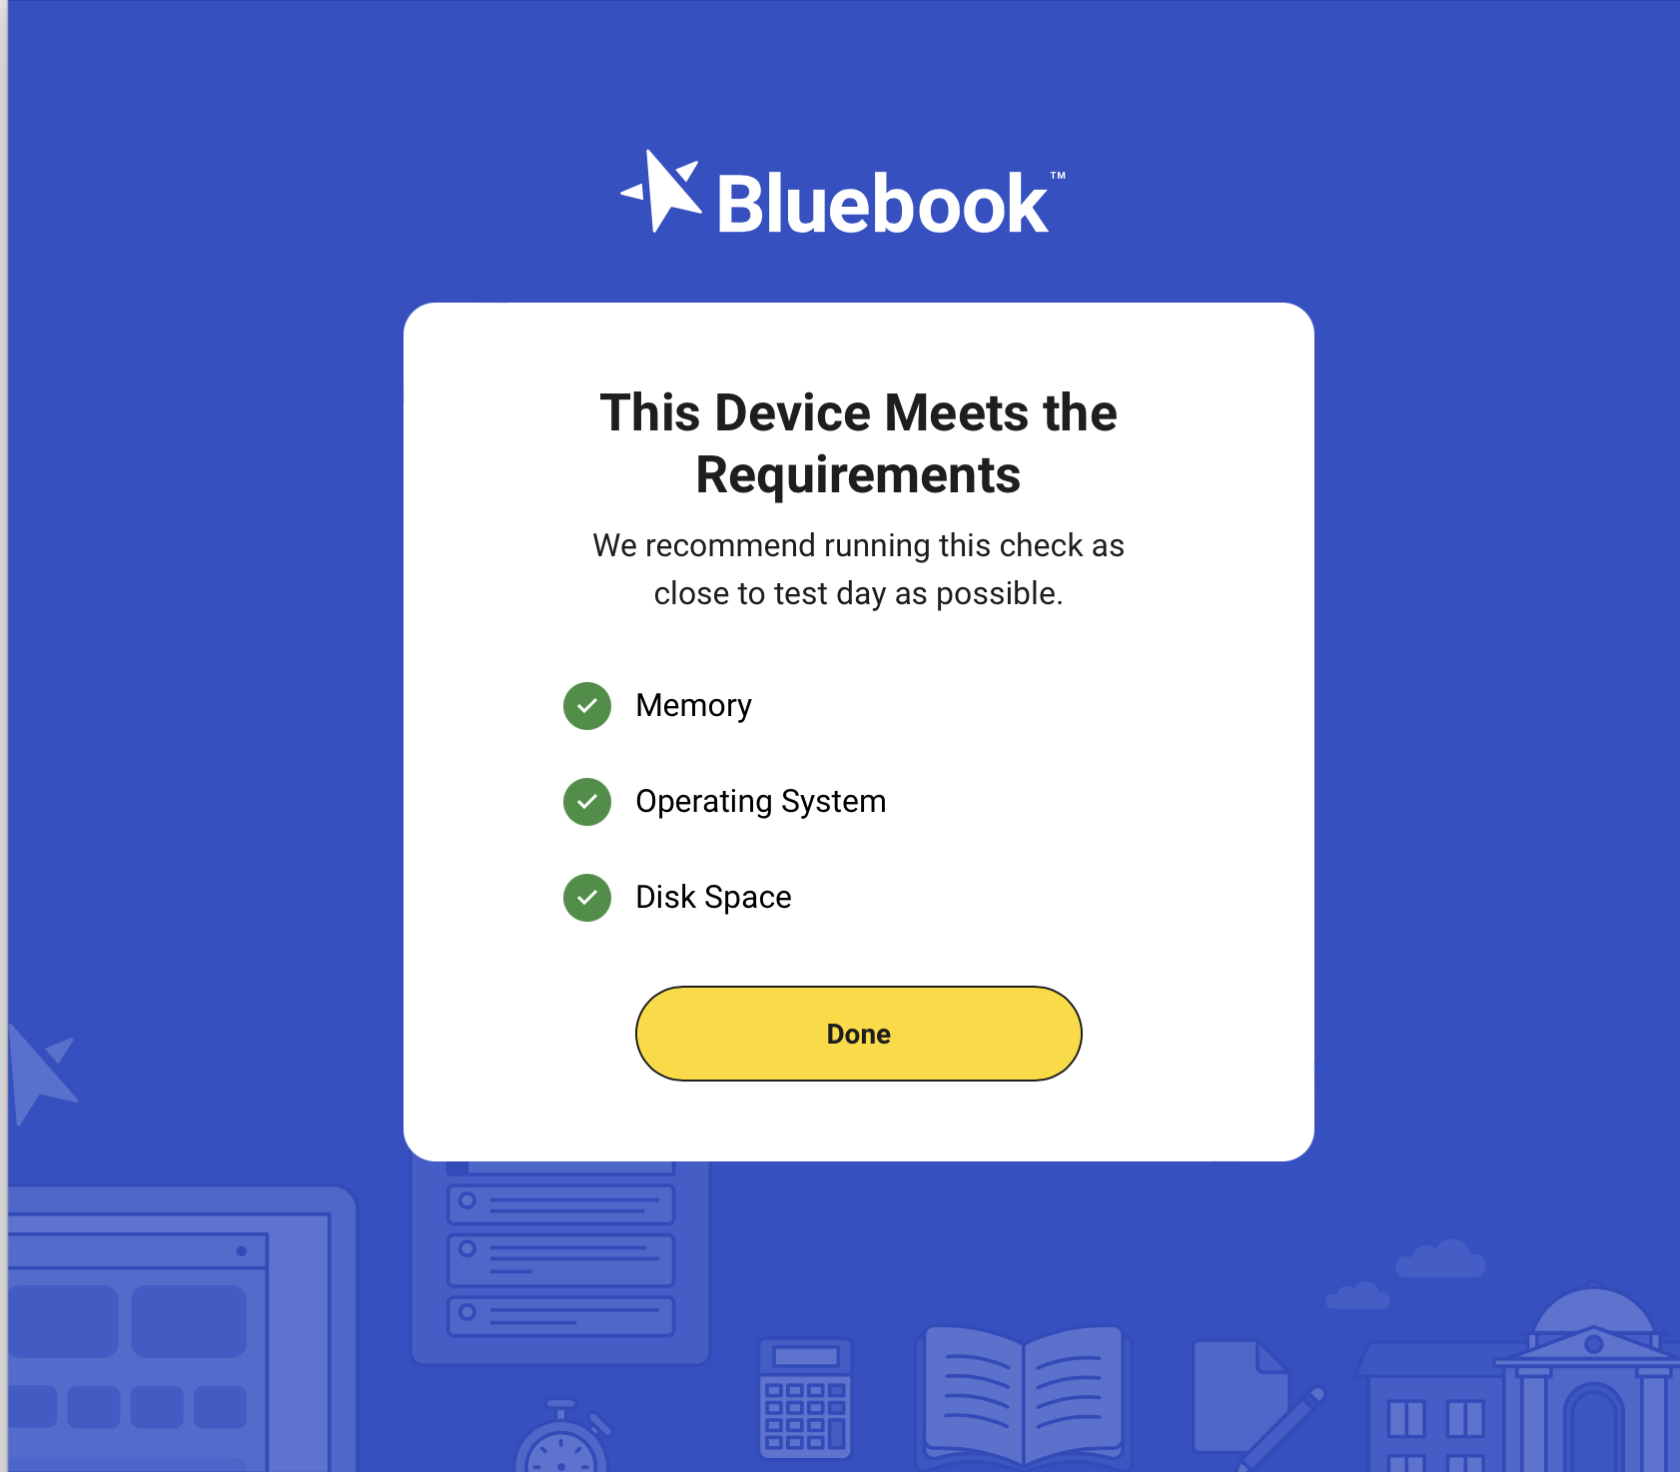
Digital Readiness Check Screen-by-Screen
1. Test Devices

Slide 4
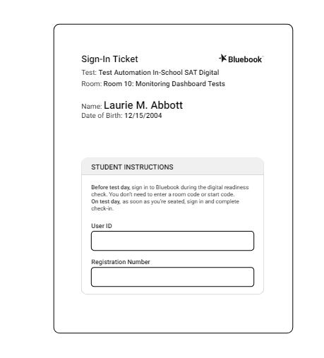
Digital Readiness Check Screen-by-Screen
2. Distribute Sign-In Tickets

Slide 5
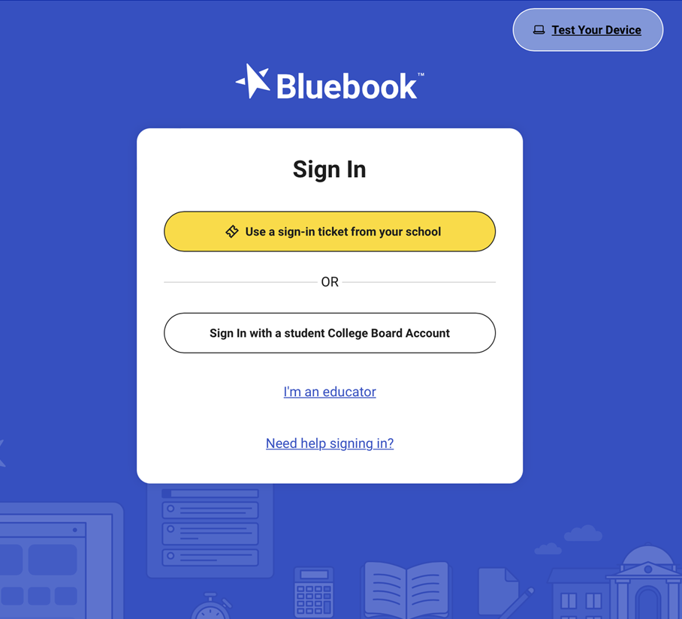
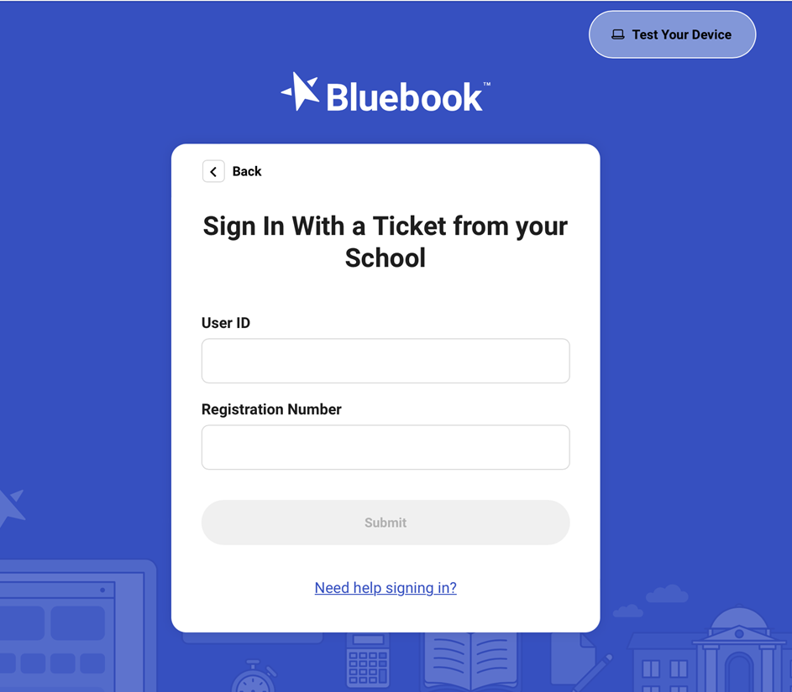
Digital Readiness Check Screen-by-Screen
3. Student signs into BluebookTM using Sign-In Ticket Credentials

Slide 6
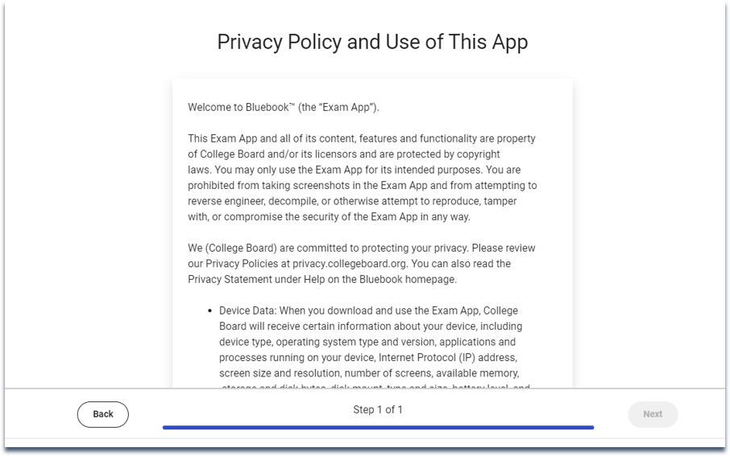
Digital Readiness Check Screen-by-Screen
4. Review privacy policy and use of this app statement

Slide 7
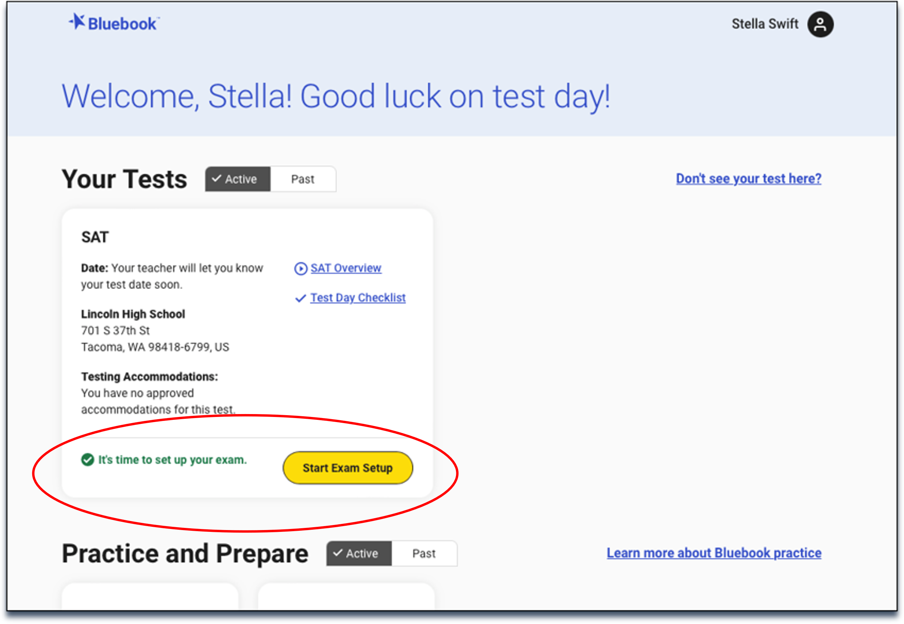
Digital Readiness Check Screen-by-Screen
5. Start Exam Set-Up

Slide 8
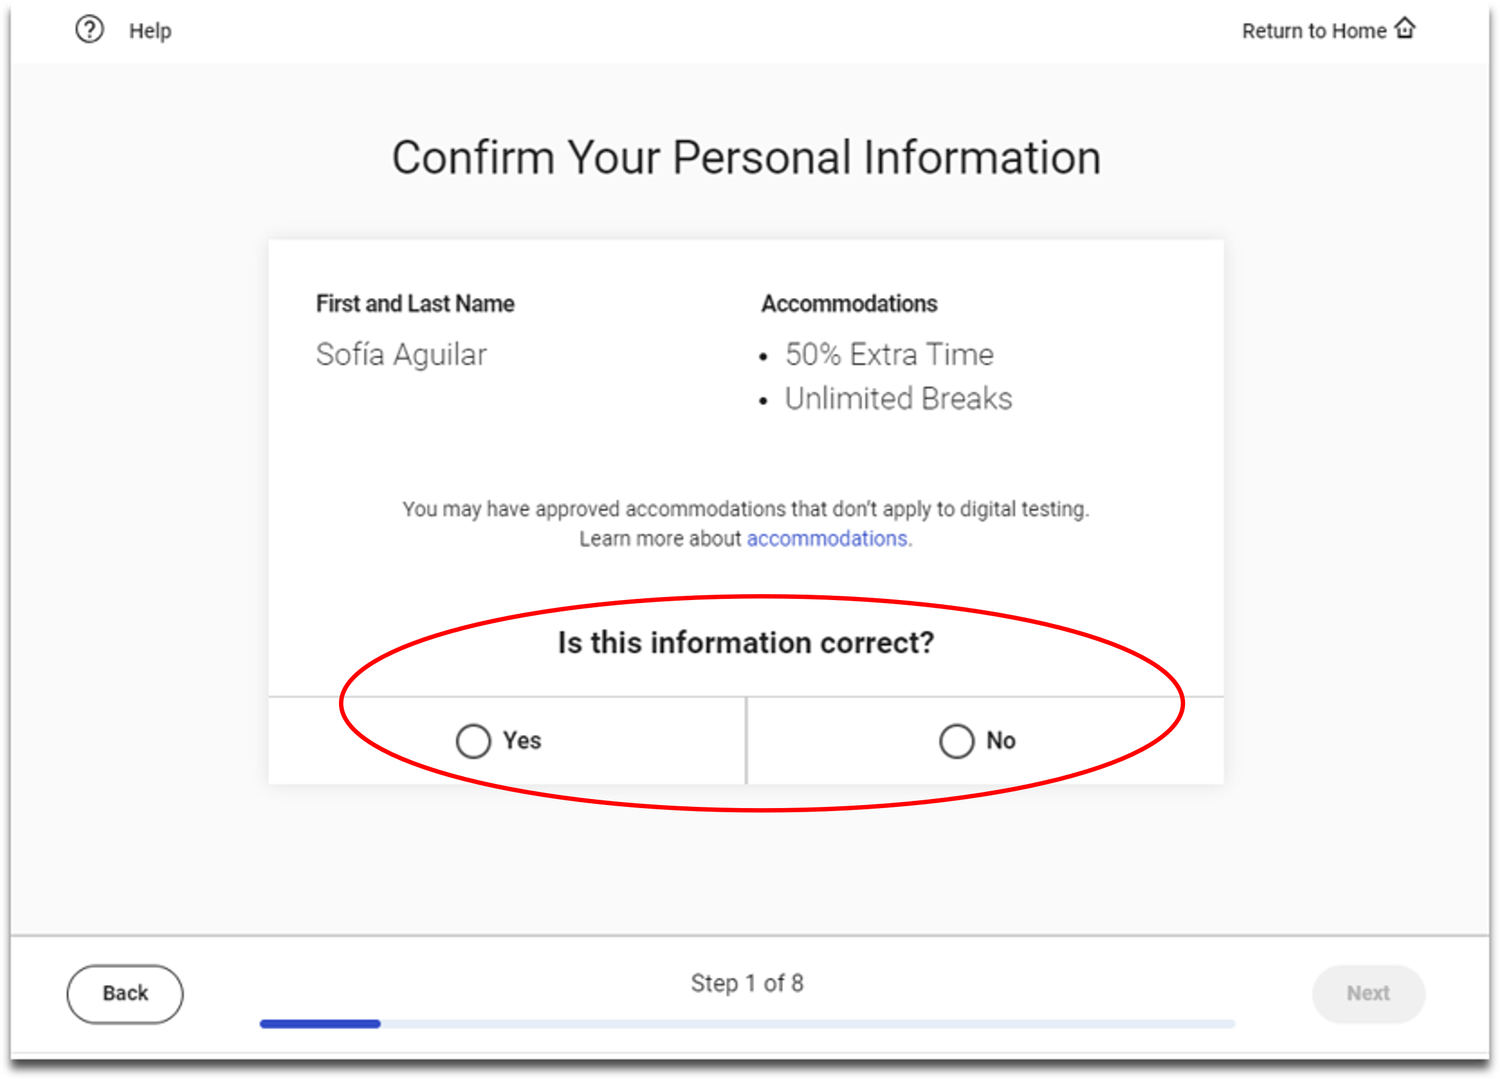
Digital Readiness Check Screen-by-Screen
6. Students Confirm Personal Information

Slide 9
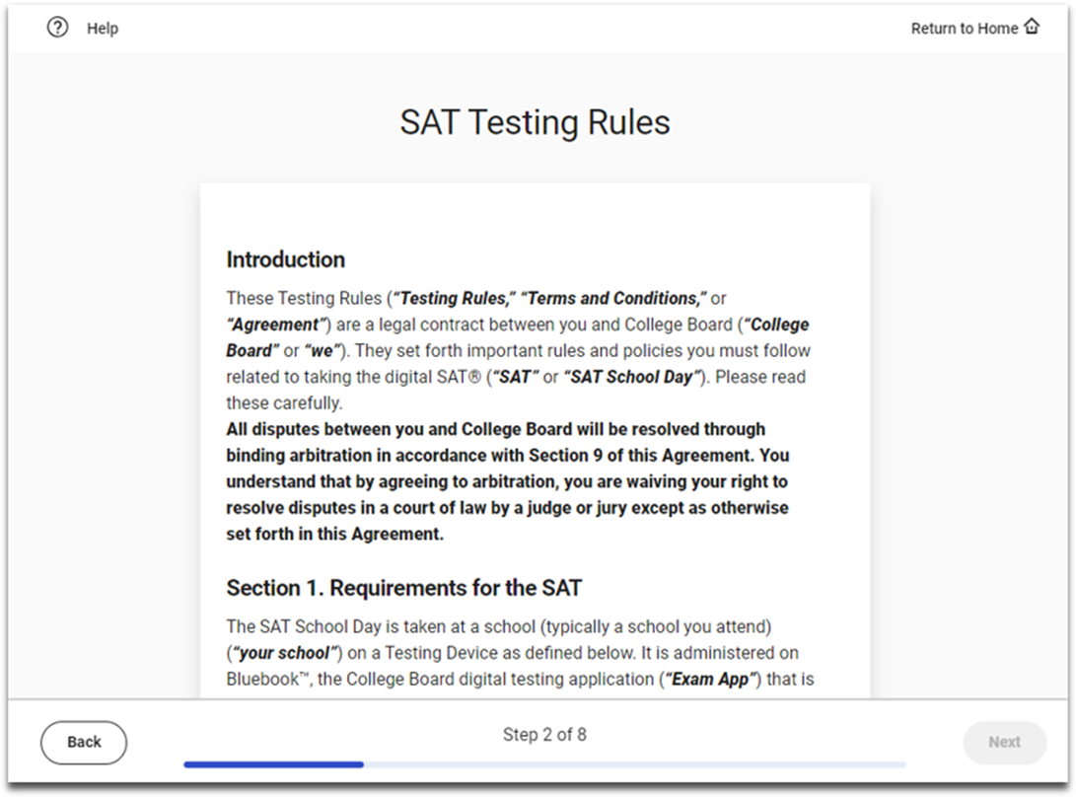
Digital Readiness Check Screen-by-Screen
7. Review & Agree to Test Taker Rules
NOTE:
Students taking PSAT 10 and PSAT 8/9 will see the rules for those assessments.

Slide 10
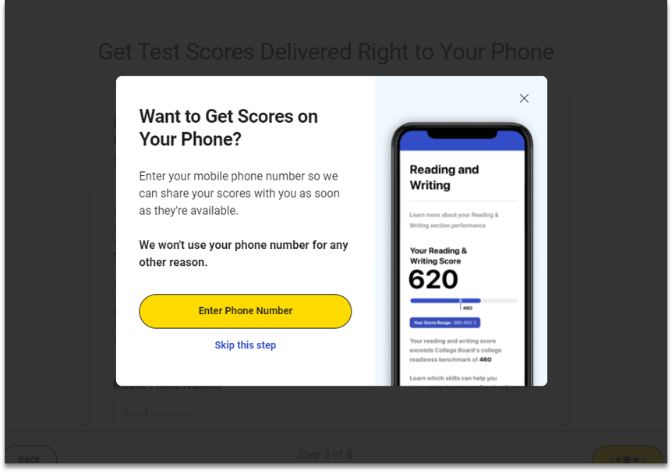
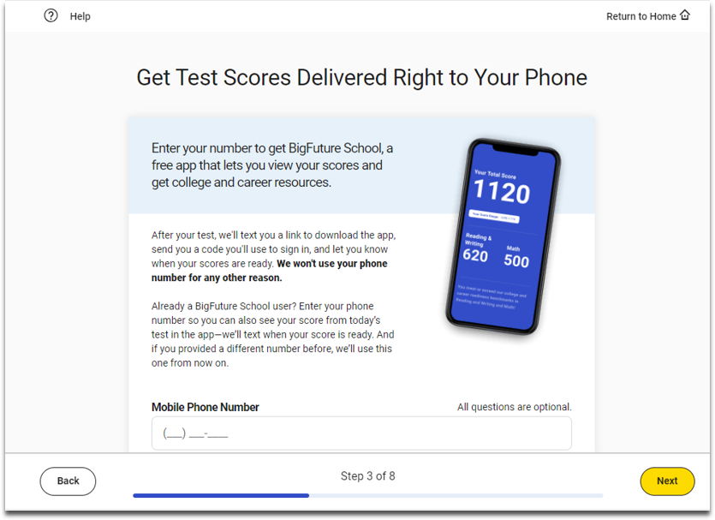
Digital Readiness Check Screen-by-Screen
8. BigFuture School Participation (Opt-In Opportunity)
NOTE:
Students taking PSAT 8/9 will not see this screen.
Students who click “skip this step” will not see this screen.

Slide 11
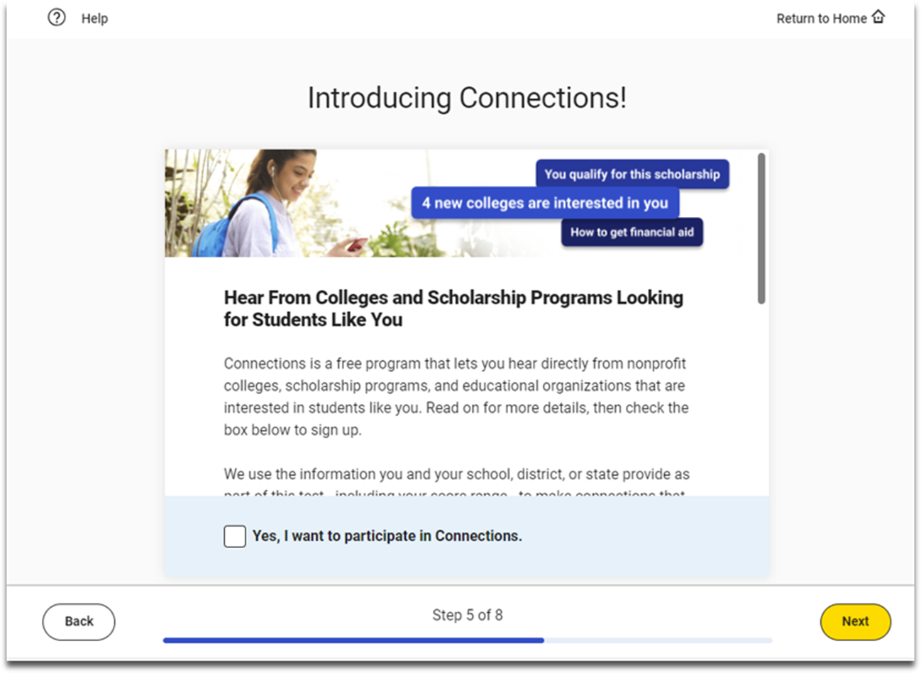
Digital Readiness Check Screen-by-Screen
9. Connections Opt-In- THIS IS OPTIONAL FOR STUDENTS
NOTE:
Students taking PSAT 8/9 will not see this screen.

Slide 12
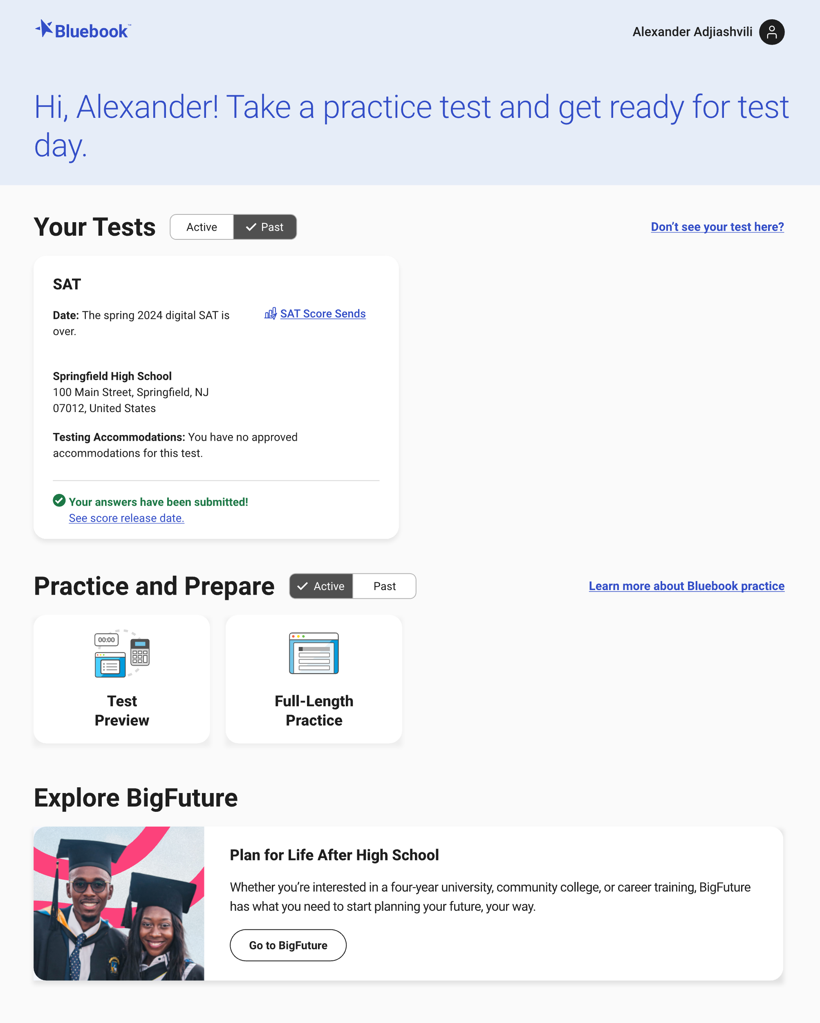
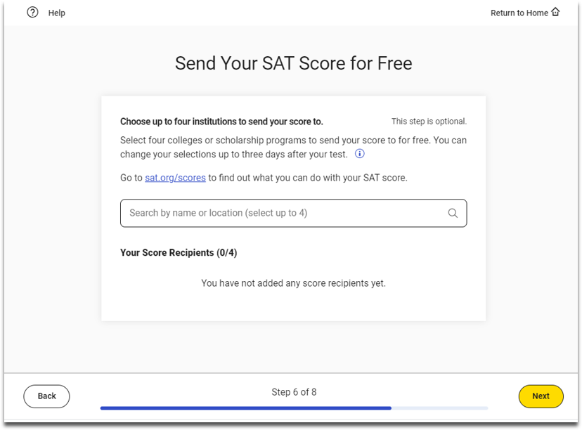
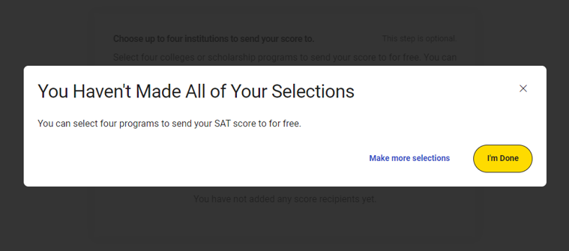
Digital Readiness Check Screen-by-Screen
10. SAT Free Score Sends
Students can change whether and where their scores are sent up to 3 days after testing by using their sign-in ticket credentials to log back into Bluebook.
NOTE: Students taking PSAT 8/9 and PSAT 10 will not see this screen.
Students can request up to 4 free sends.
Students will be prompted to confirm if they skip this service.

Slide 13
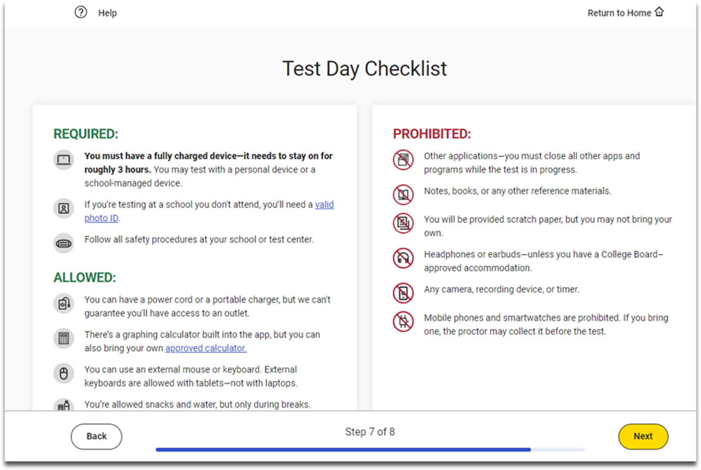
Digital Readiness Check Screen-by-Screen
11. Review Test Day Checklist

Slide 14
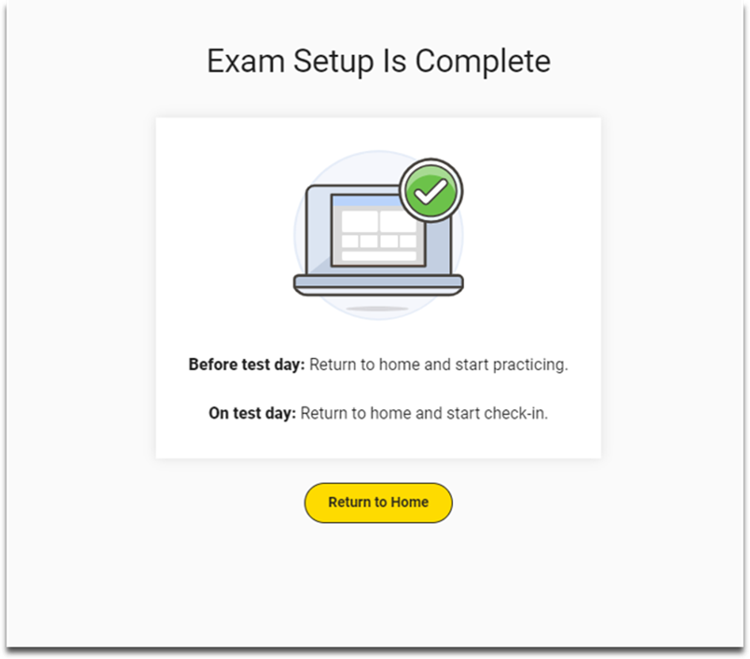
Digital Readiness Check Screen-by-Screen
Exam Set-Up Complete
Recommended:
Take 20 minutes after exam set-up is complete to enable students to use the Test Preview provided in BluebookTM with your support and/or guidance.
Be certain to point out the full-length practice tests that are available.

Slide 15
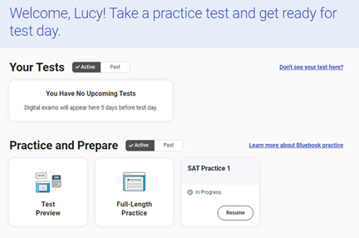
SAT BluebookTM Practice Tests
Accessing Full-Length Practice Tests
Four full-length practice tests are available anytime of the year by signing into BluebookTM with College Board account credentials (anyone can create a College Board account at www.collegeboard.org), and are also available Spring 2025 by signing into BluebookTM with that student’s Sign-In Ticket credentials printed out by you from Test Day Toolkit.
Single-click access is always from the student’s home screen in BluebookTM .
No time lost for exiting
and coming back.
Retake as often as you want.
4 Full-Length Linear (nonadaptive) Practice Tests are also available for download and print HERE.

Slide 16
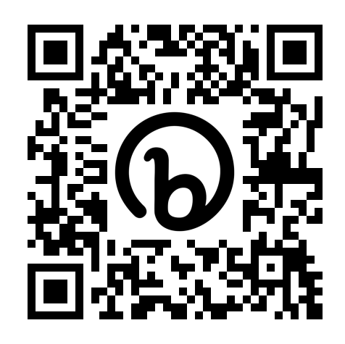
SAT BluebookTM Practice Tests
Accessing Full-Length Practice Test Scores
After completing the full-length practice test, students can sign in to My Practice to:
View practice score results and practice exam questions, answers, and explanations.
Access progress bars representing knowledge of all the content domains on the test.
Use practice test scores to inform the following activities in College Board’s Question Bank:
  Filter questions by domain, skill, and difficulty, allowing targeted practice in areas with the most opportunity to grow.
  Generate a set of Practice Specific Questions based on practice test results to provide additional review in the areas with the greatest opportunities for improvement.
Similarly, use scores to inform you official College Board test prep with Khan Academy.
To provide your students with a full tour of all these resources, please share this QR Code:

Slide 17
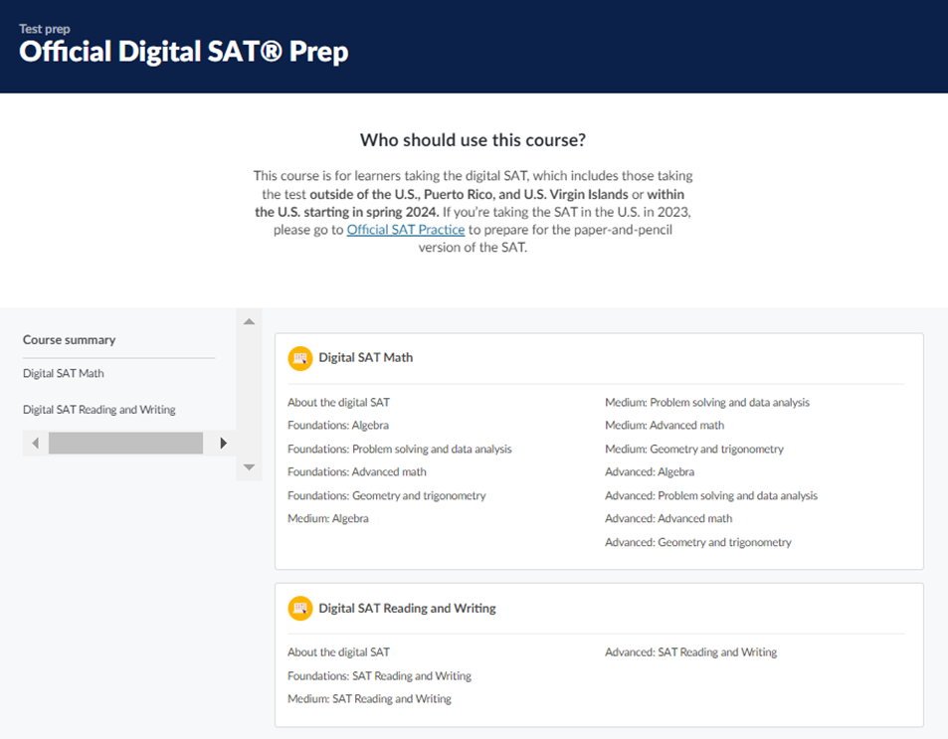

SAT BluebookTM Practice Tests
Khan Academy Official College Board SAT Prep
Once students have identified the knowledge and skills they need the most support on in My Practice, they can also start Official Digital SAT Prep on Khan Academy®.
Khan Academy® includes thousands of practice questions, videos, lessons, and hints to help students build the skills needed.

