Slide 1
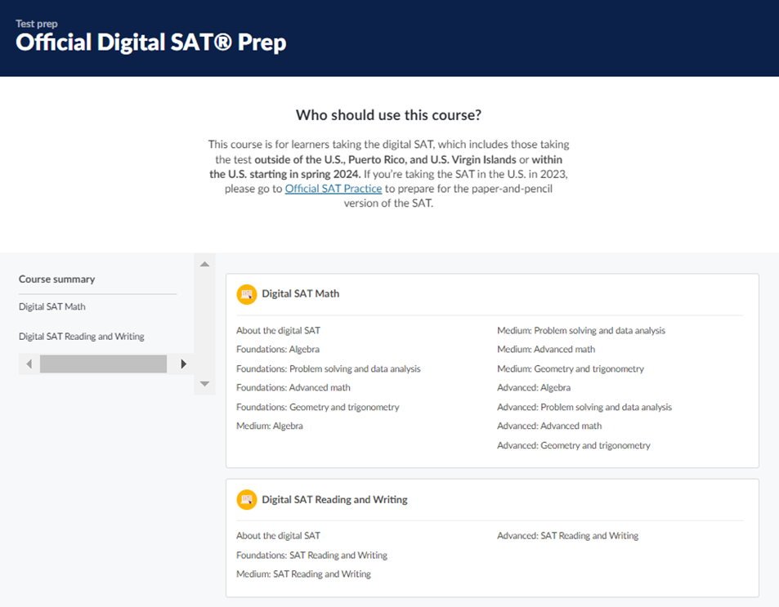


SAT BluebookTM Practice Tests
Khan Academy Official College Board SAT Prep
Once students have identified the knowledge and skills they need the most support on in My Practice, they can also start Official Digital SAT Prep on Khan Academy®.
Khan Academy® includes thousands of practice questions, videos, lessons, and hints to help students build the skills needed.

Slide 2
Proctors’ Test Day
Screen-by-Screen

Slide 3
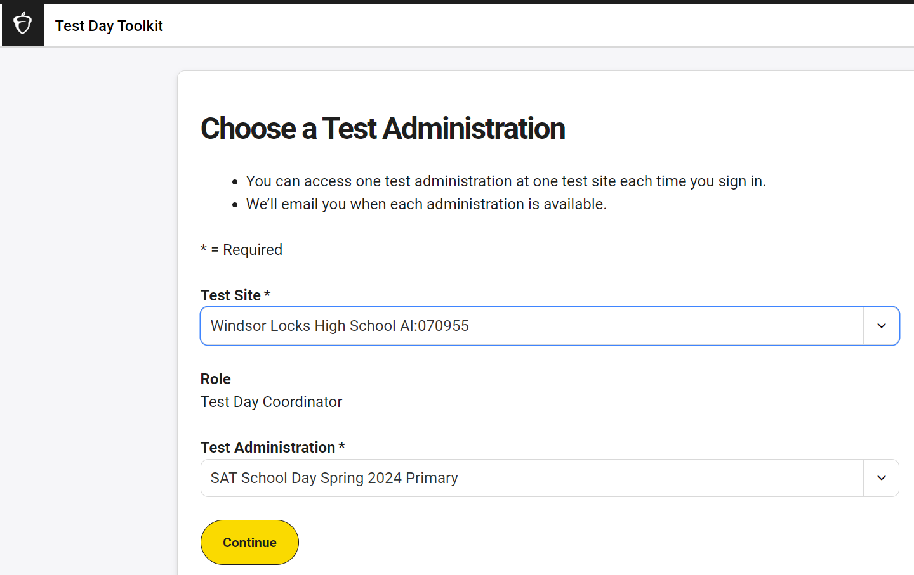
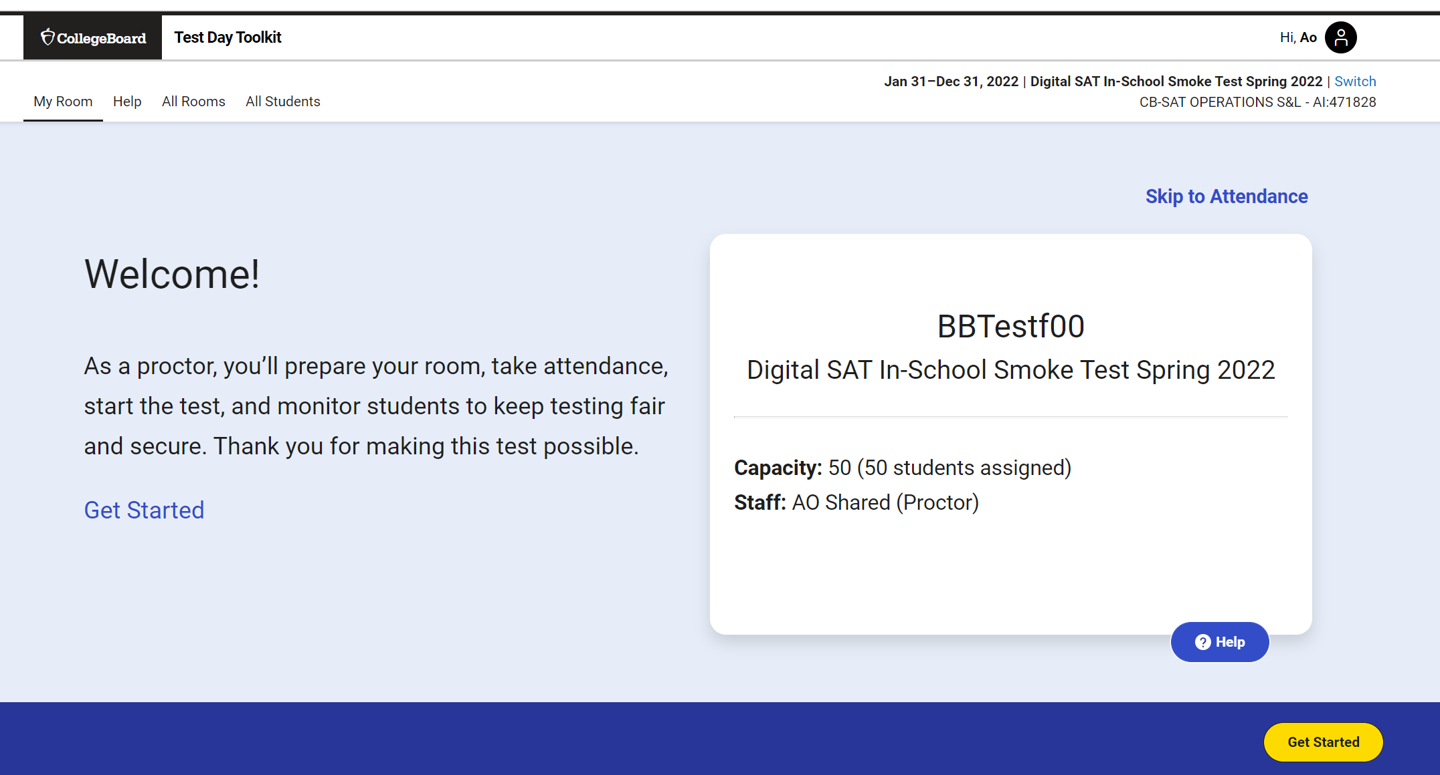
Test Day Toolkit: Proctor Screen-by-Screen
1. Proctor Home Page: Select Test Site and Test Administration
After logging in, use the drop downs to select the Test Site (match your AI Code) and Test Administration you wish to manage, then the yellow button to “Continue.”
Verify your assignment using the information on the proctor home page.
Room 101

Slide 4
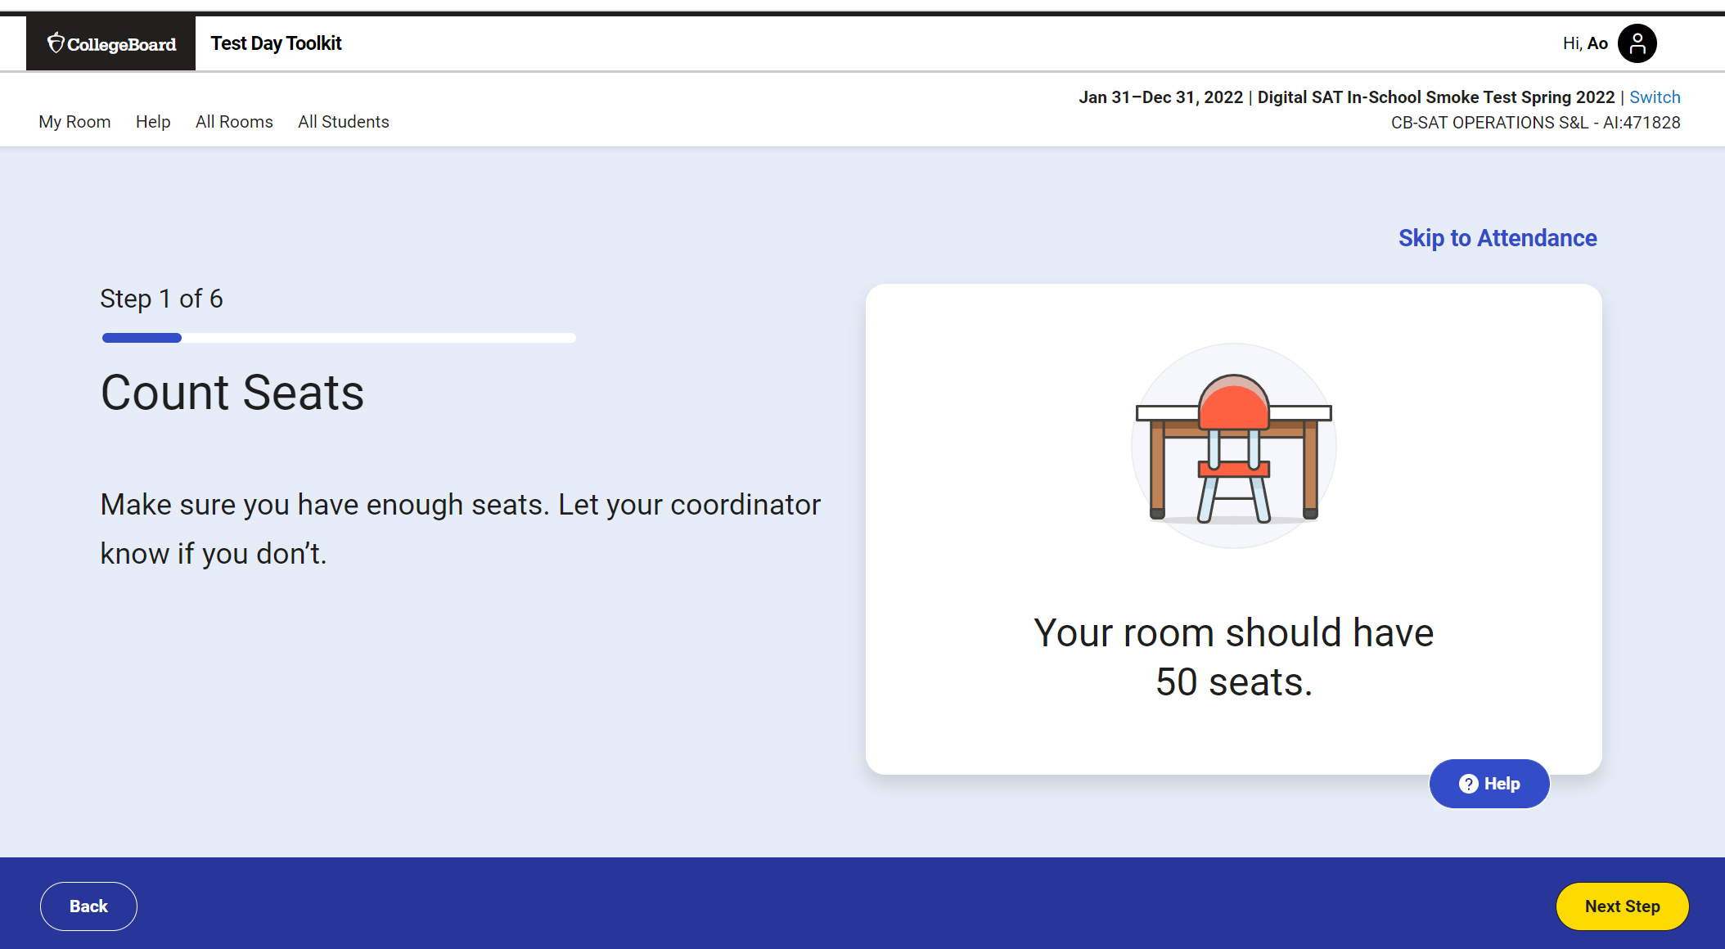
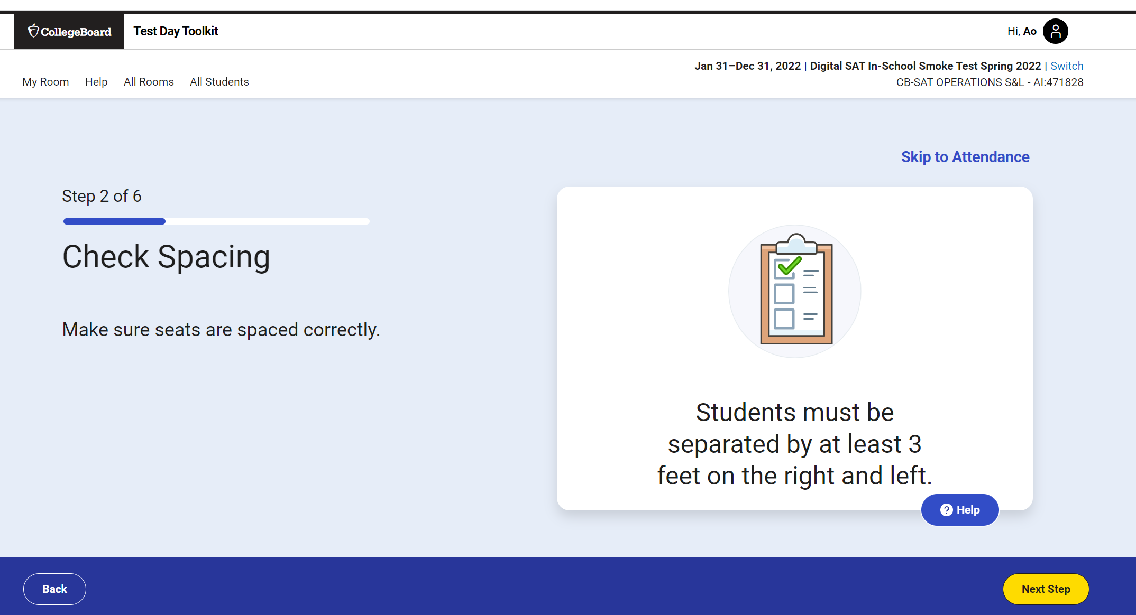
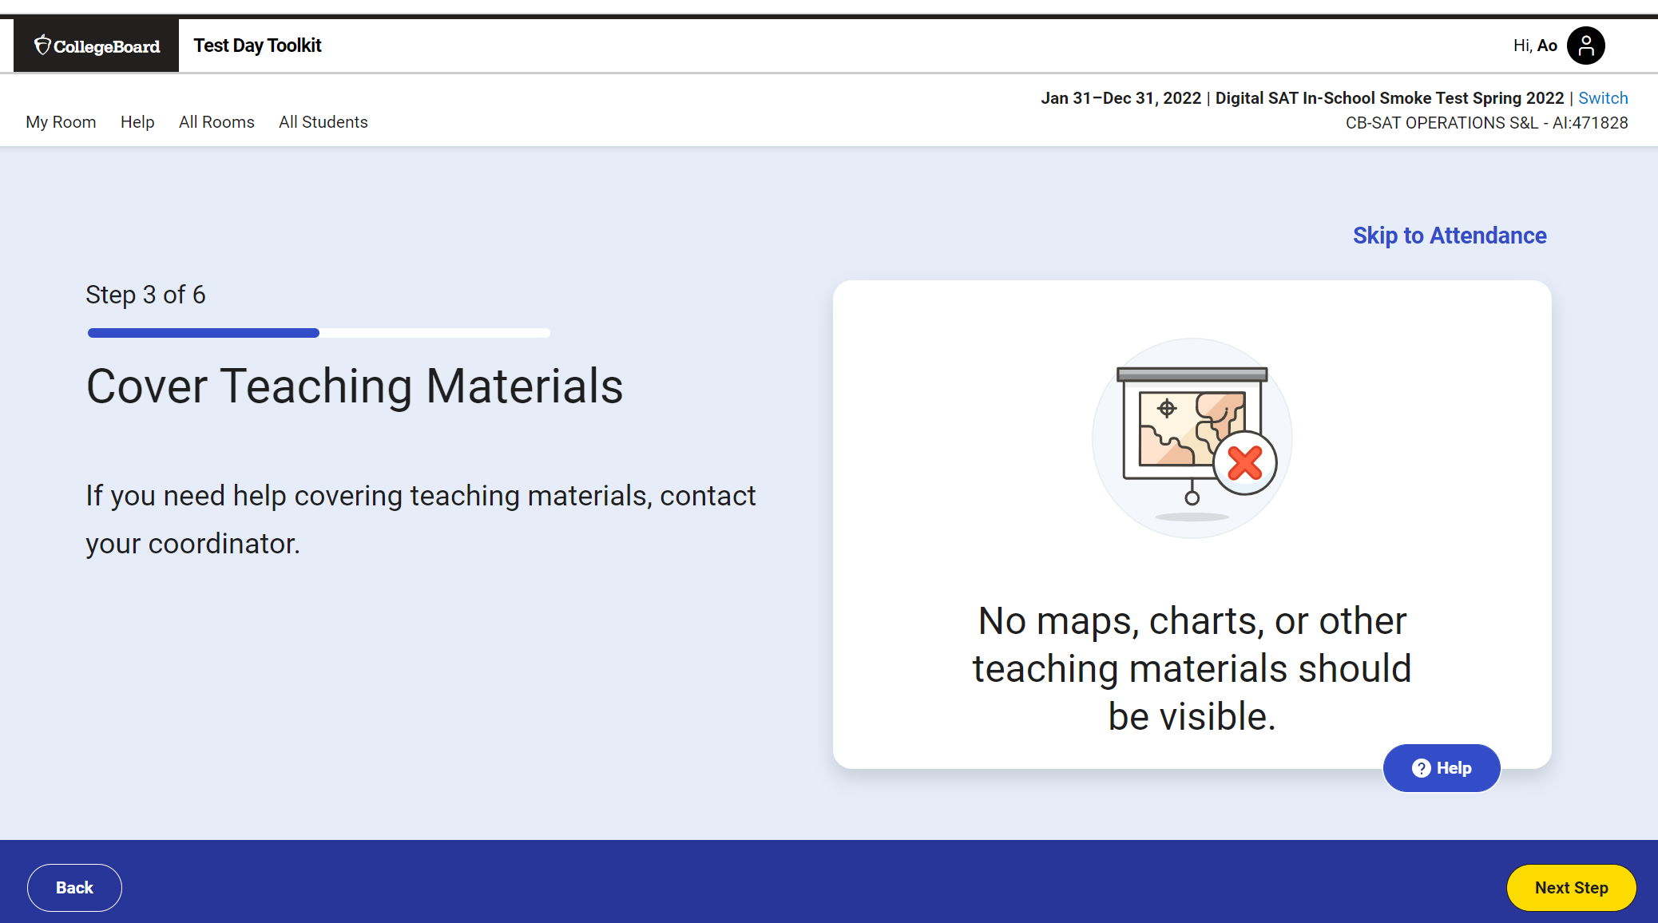
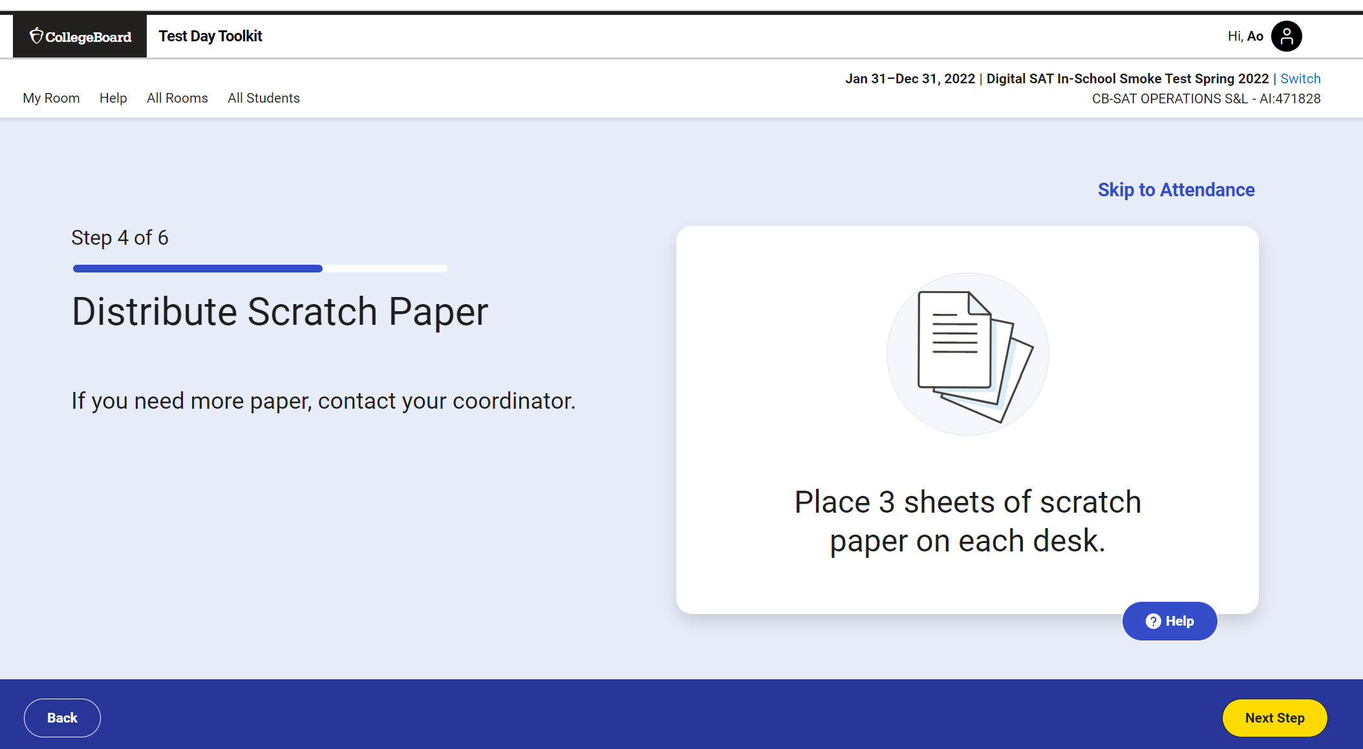
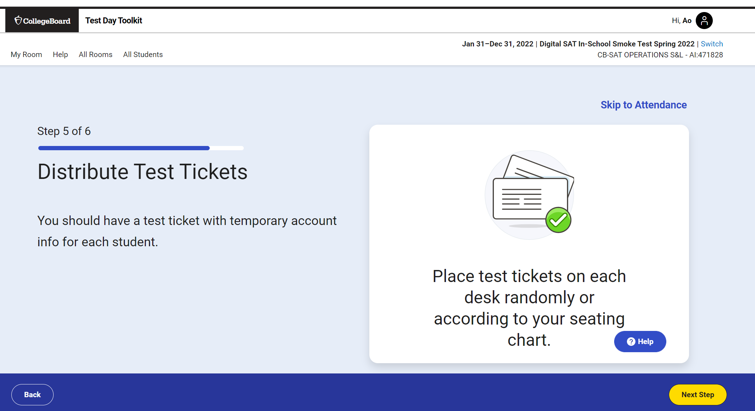
Test Day Toolkit: Proctor Screen-by-Screen
2. Confirm Room Setup (5 Screens)

Slide 5
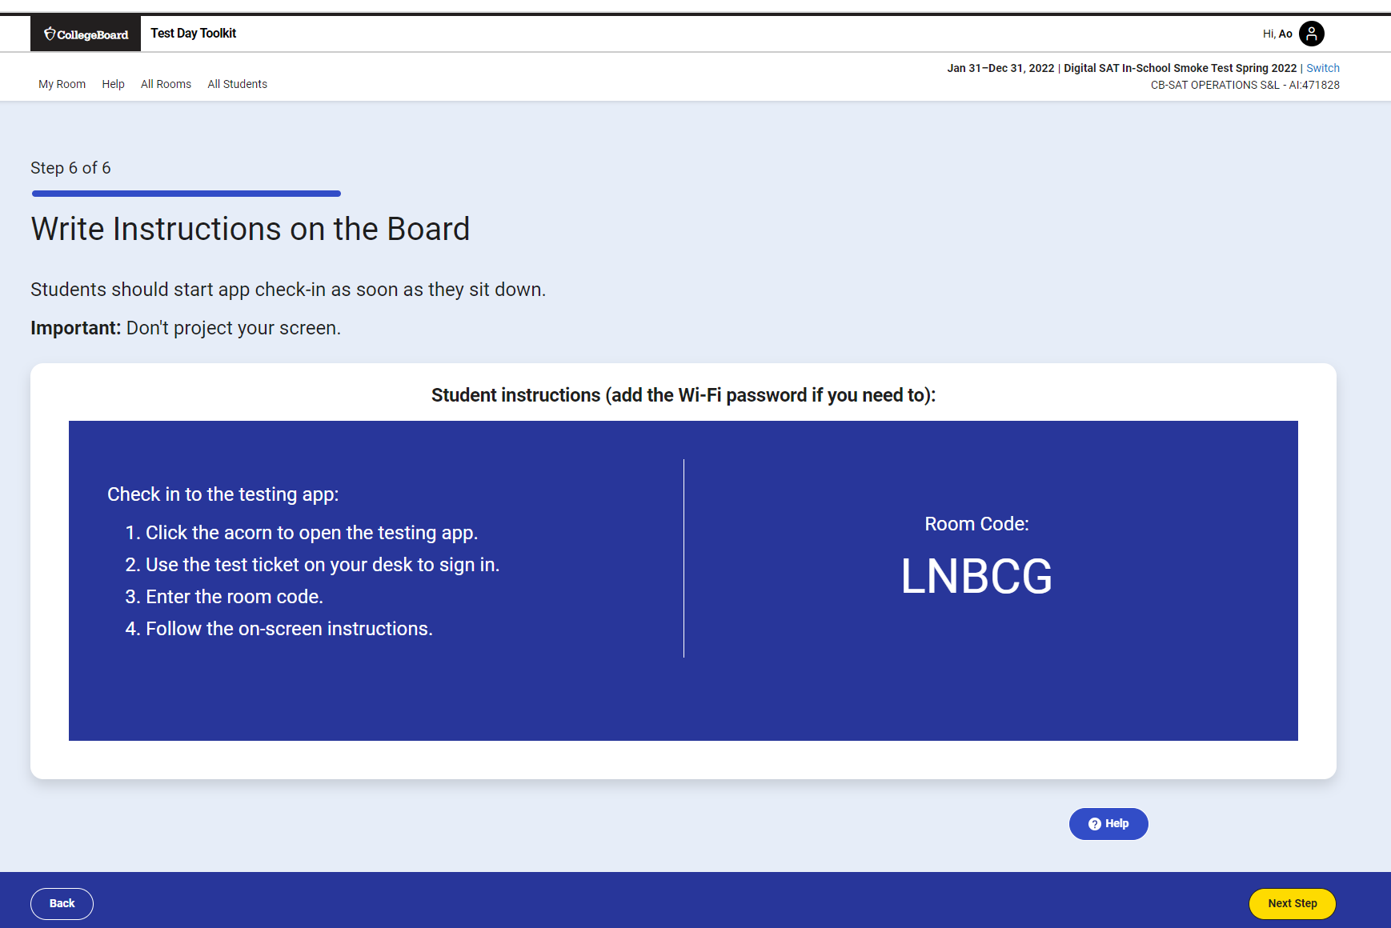
Test Day Toolkit: Proctor Screen-by-Screen
3. Write Instructions on Board and Provide Room Code

Slide 6
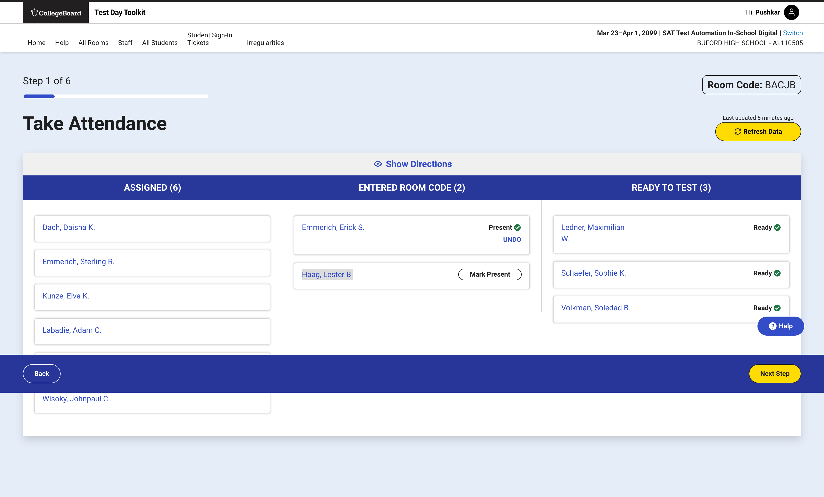
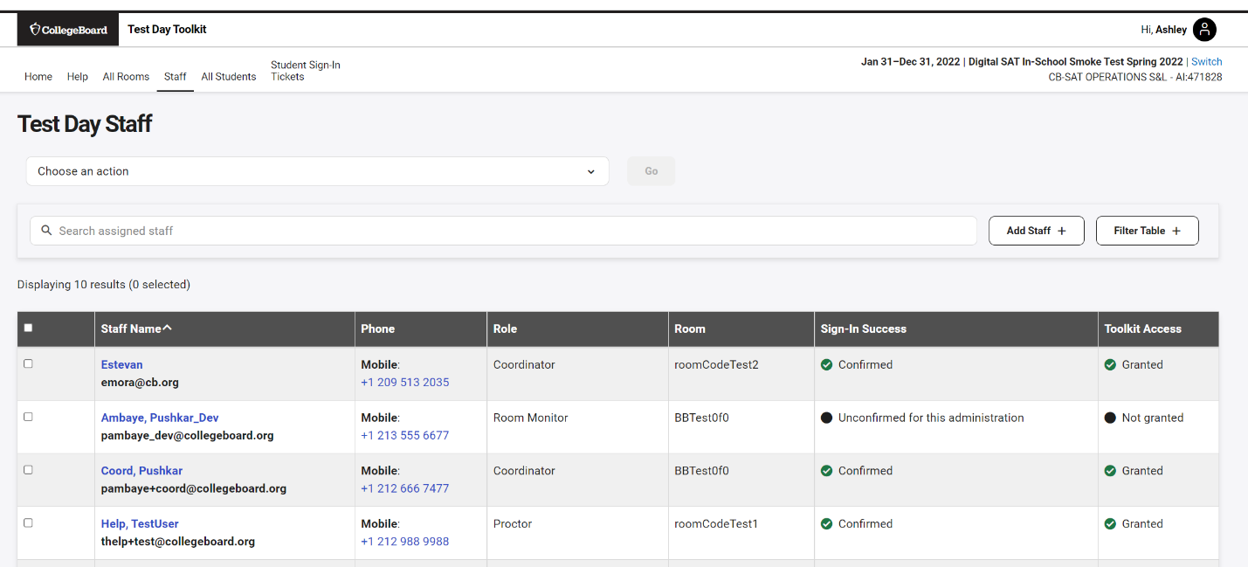
Test Day Toolkit: Proctor Screen-by-Screen
4. Take Attendance
Only students pre-assigned to this room (optional) will appear here.
All students (pre-assigned or not) who enter this room’s code will appear here. Mark them as present once you visually confirm they are there.
As soon as students complete all pre-test activities in BluebookTM they will appear under “ready to test.”

Slide 7
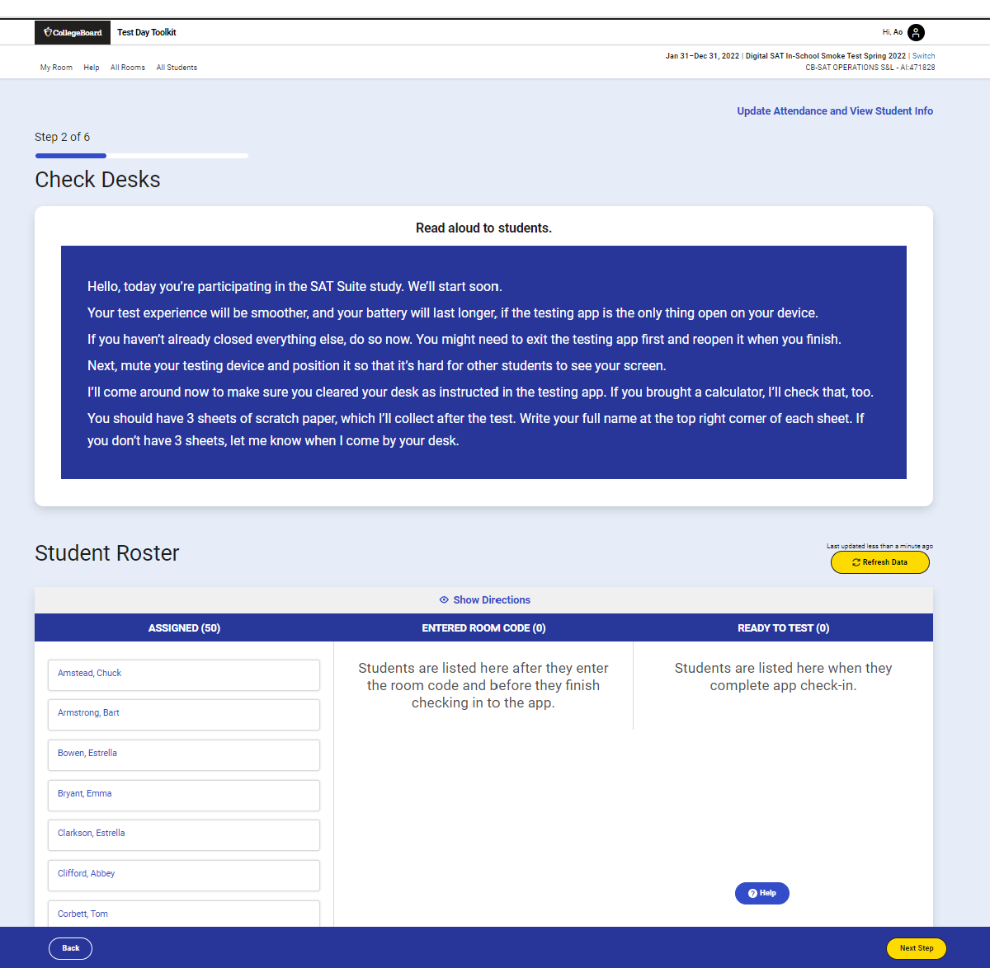
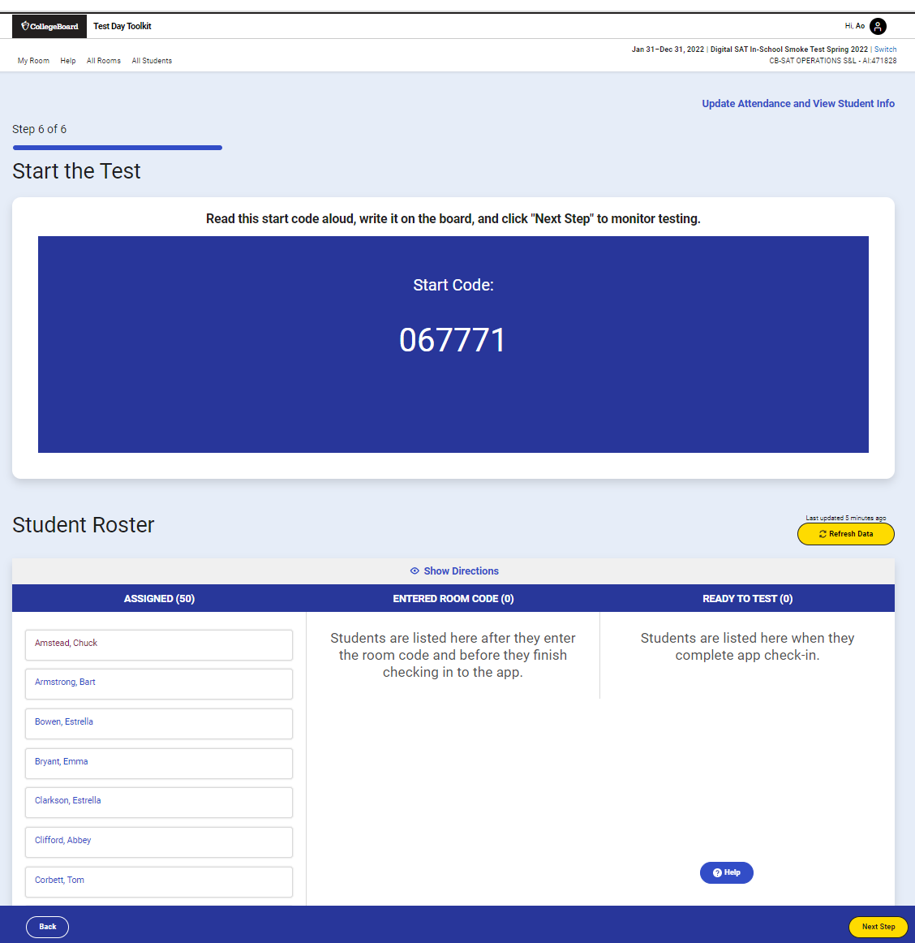
Test Day Toolkit: Proctor Screen-by-Screen
5. Read the Script and Provide Start Code

Slide 8
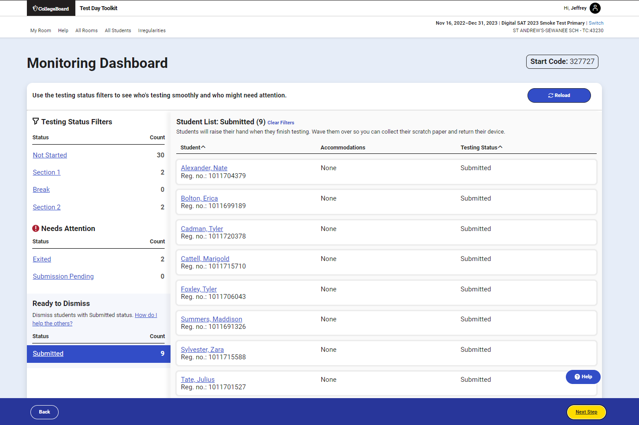
Test Day Toolkit: Proctor Screen-by-Screen
6. Monitor Student Progress – Test Day Toolkit troubleshooting
Note that there has been a help tab on every screen, which provides technical FAQs and tips for troubleshooting.
However, Test Day Toolkit has rarely demonstrated technical issues.
More common are unresolved pre-test registration and accommodations issues only being noticed on test day, or test-day loss of internet.
Please use Test Day Toolkit before test day to ensure all information therein is correct, and remember, students can continue testing even with the loss of the internet and connection to Test Day Toolkit.

Slide 9
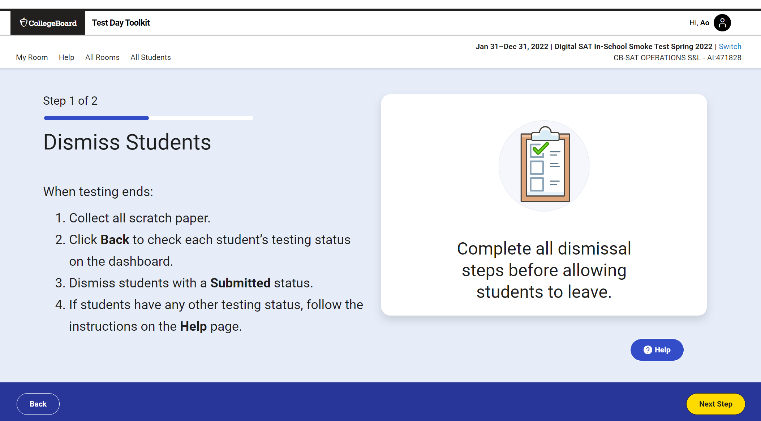
Test Day Toolkit: Proctor Screen-by-Screen
7. Dismiss Students at the End of Testing

Slide 10
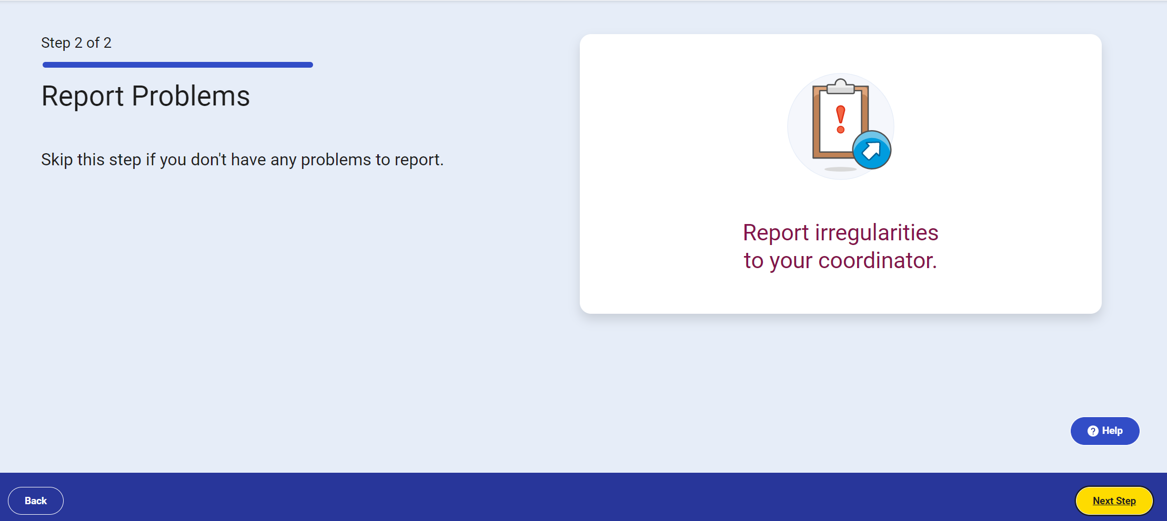
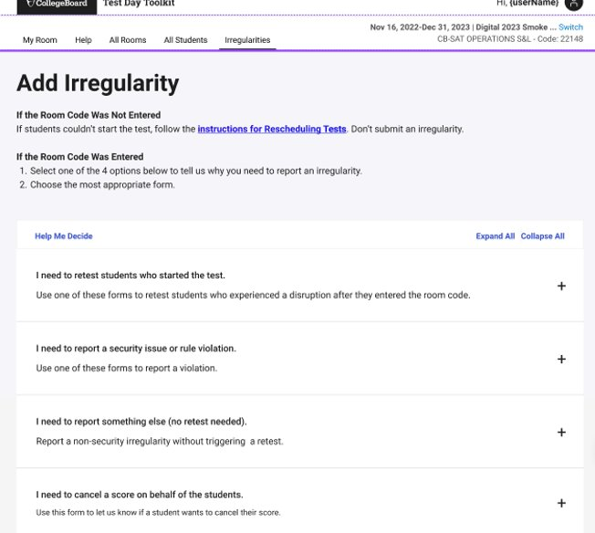
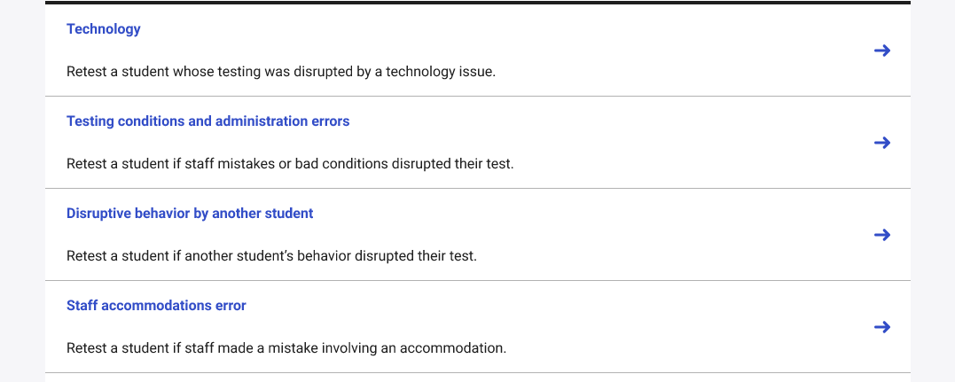
Test Day Toolkit: Proctor Screen-by-Screen
8. Report Irregularities
Click circled box at right.
Click the “+” sign next to the best general description of the problem.
Click the best specific description of the problem and then complete the prompts.

Slide 11
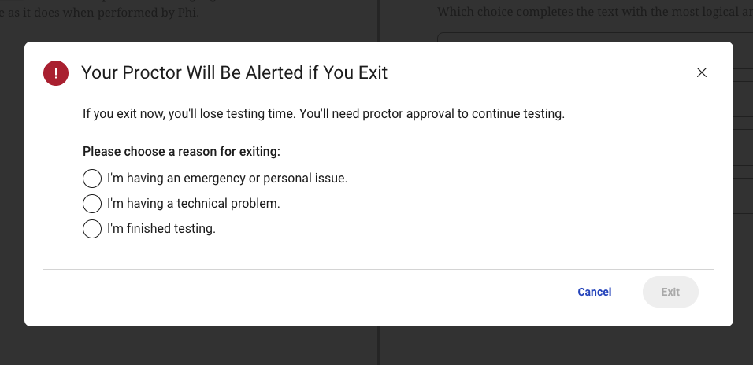
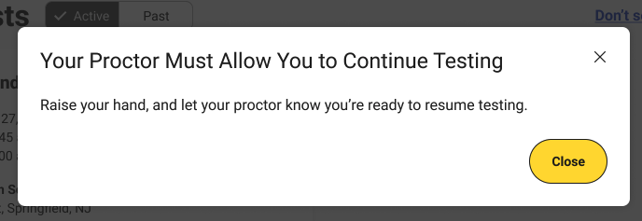
Test Day Toolkit
Proctor Approval of Student Re-Entry into Testing
The student will see this pop-up that requires them to give a reason if they click to exit the test, which will also alert the proctor.
After exiting the test, the student will see this pop-up

Slide 12
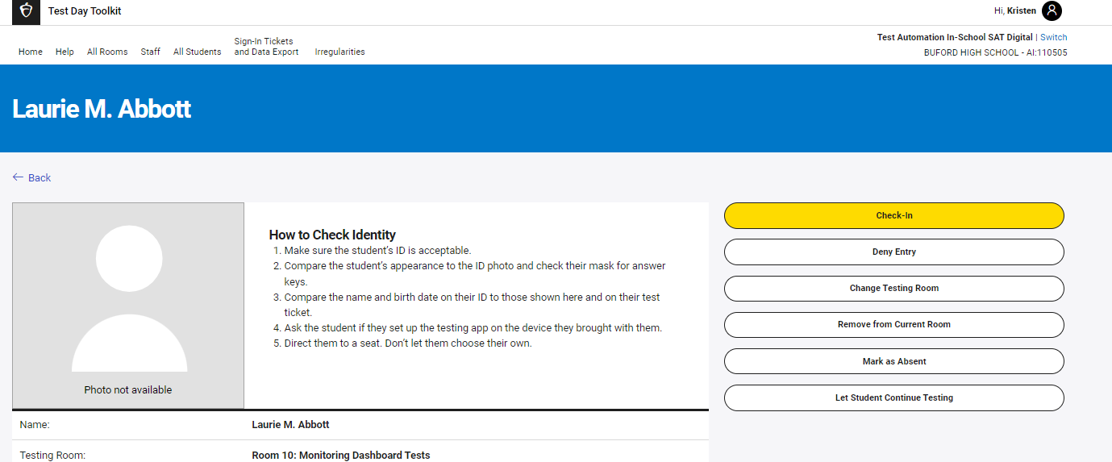
Test Day Toolkit
Proctor Approval of Student Re-Entry into Testing
The proctor would then have to click on that student’s name in Test Day Toolkit to see their profile, and then click “Let Student Continue Testing” based on whether their continuing the test is both requested and permitted under the circumstances.

