Slide 1

Students’ Test Day
Screen-by-Screen

Slide 2
Student Test Day Experience Screen-by-Screen
Overview
If a Digital Readiness Check was not performed before test day, that screen-by-screen process will be required first.
  5 – 10 minutes to complete, unless you also provide the optional test preview (additional 20 minutes)
Sign-in with ticket (same credentials as during the Digital Readiness Check).
Begin check-in.
Enter proctor-provided room code.
  This commences the test download.
Complete check-in.
Enter proctor-provided start code.
  Students can continue testing after this point even if the internet is lost and the proctor loses Test Day Toolkit access.
Test.
Submit responses (internet required).

Slide 3
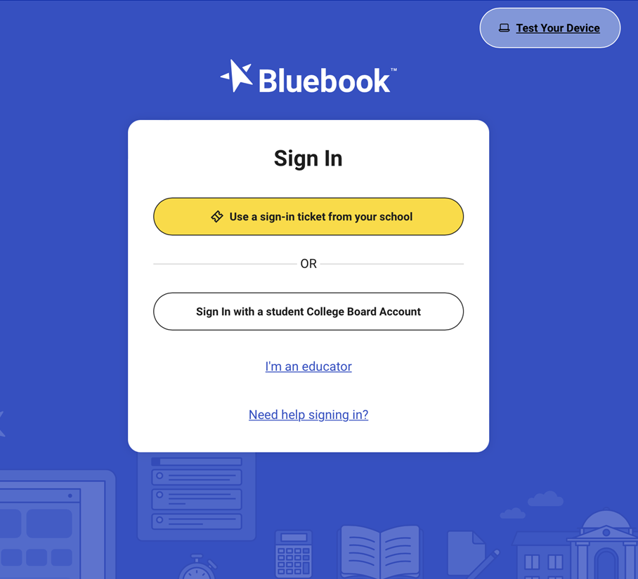
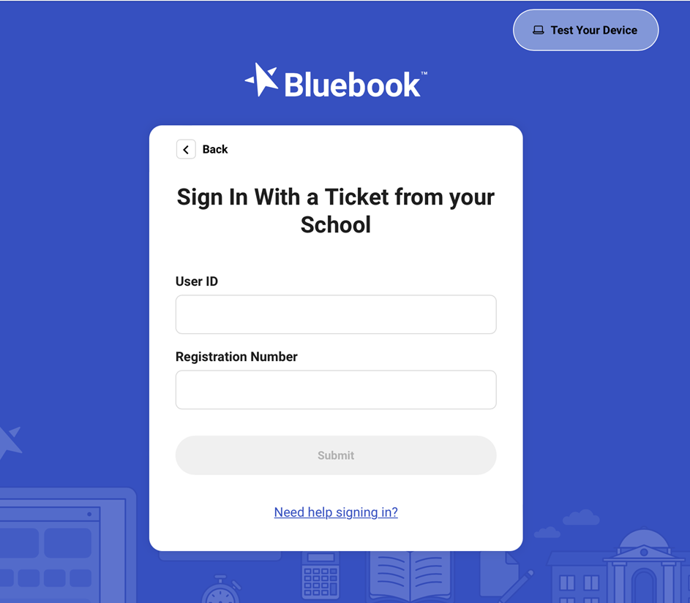
Student Test Day Experience Screen-by-Screen
1. Sign-in with ticket-provided credentials

Slide 4
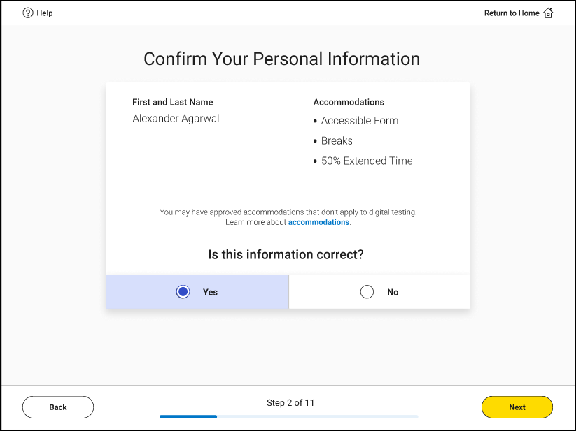
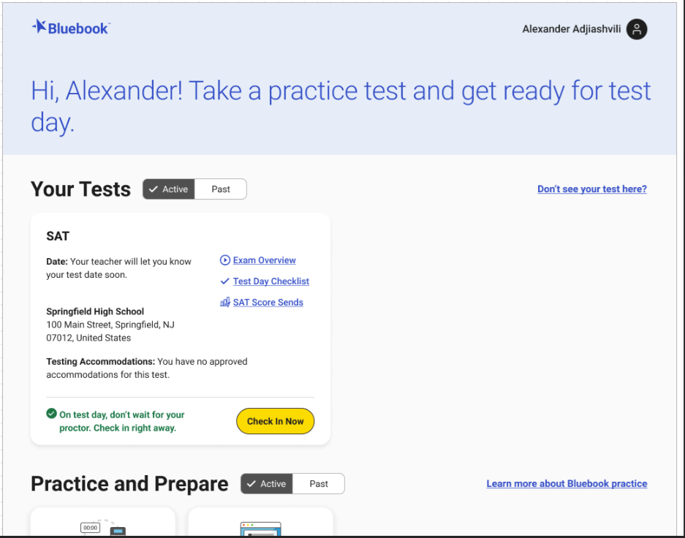
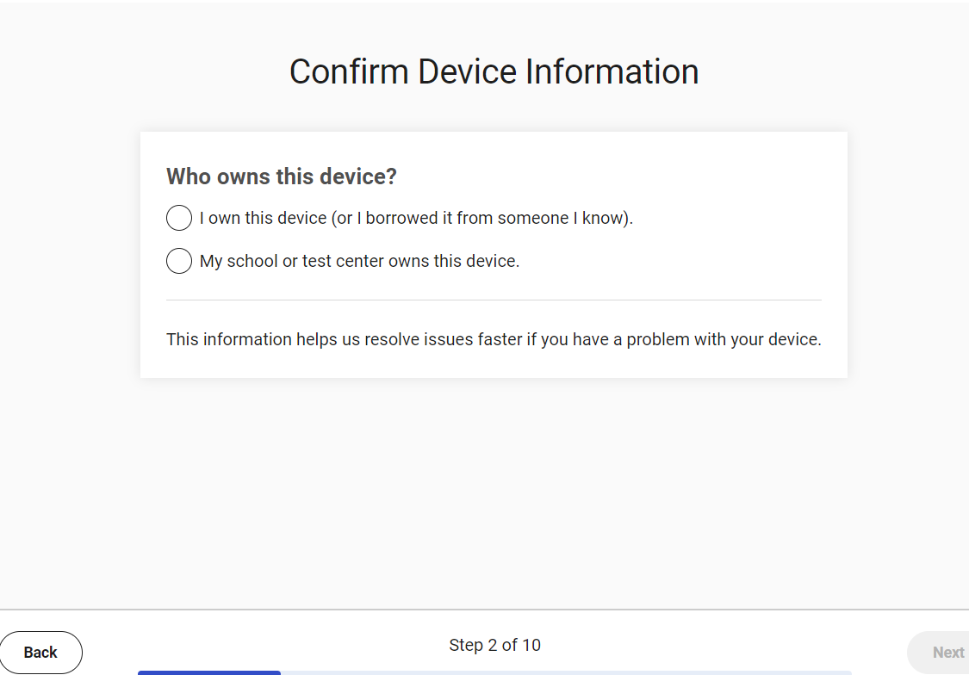
Student Test Day Experience Check Screen-by-Screen
2. Begin Check-in

Slide 5
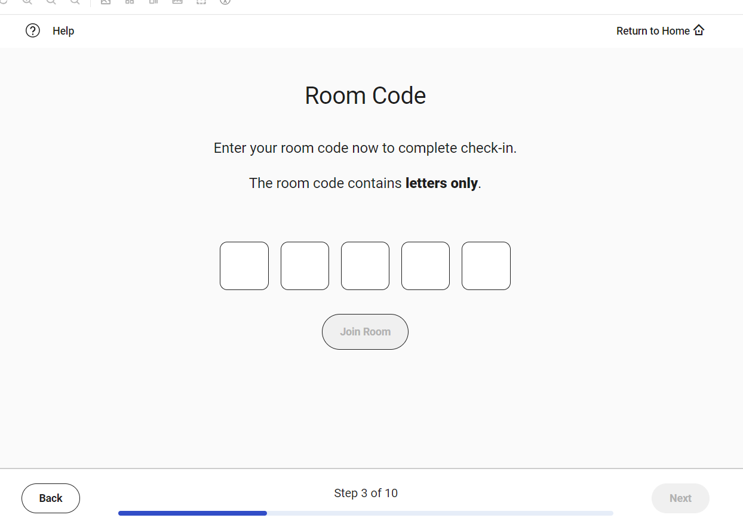
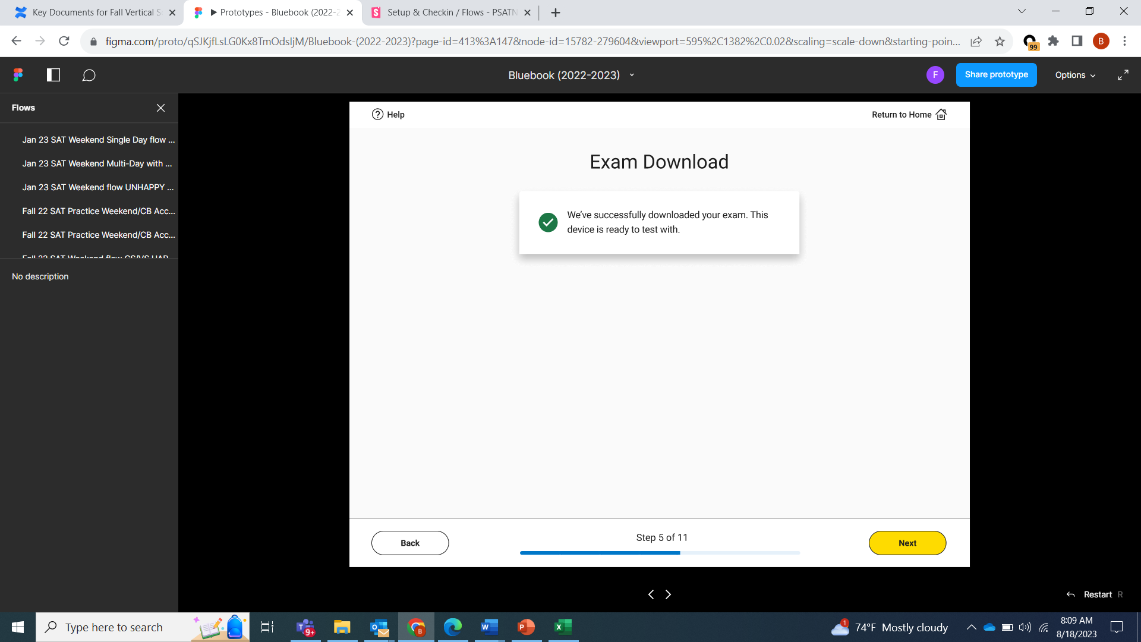
Student Test Day Experience Screen-by-Screen
3. Enter proctor-provided room code – Test Downloads

Slide 6
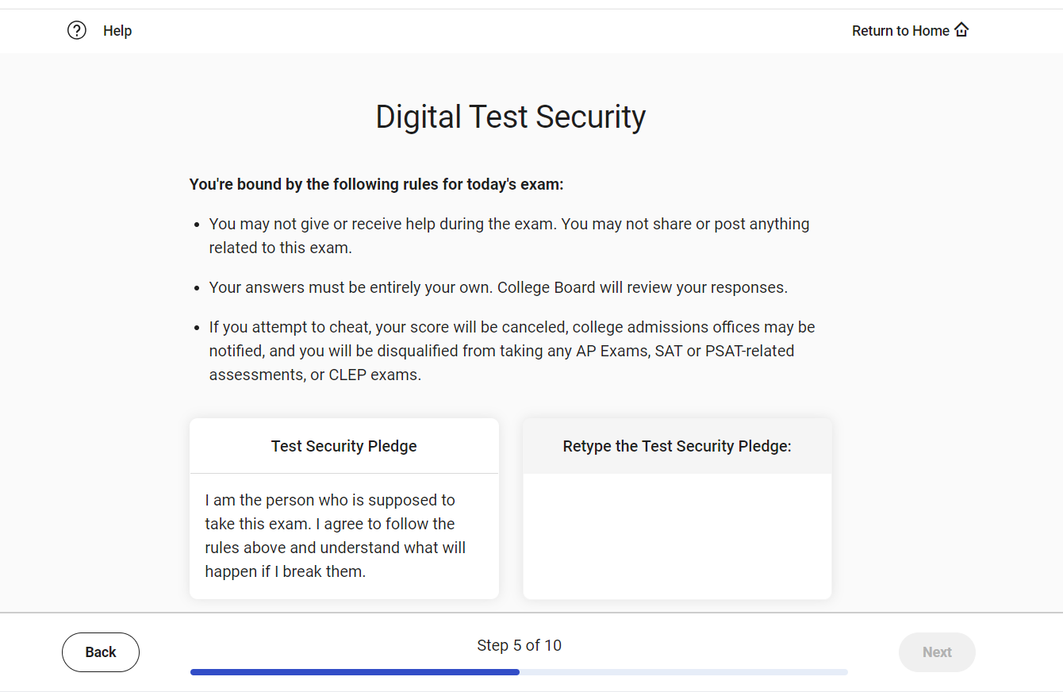
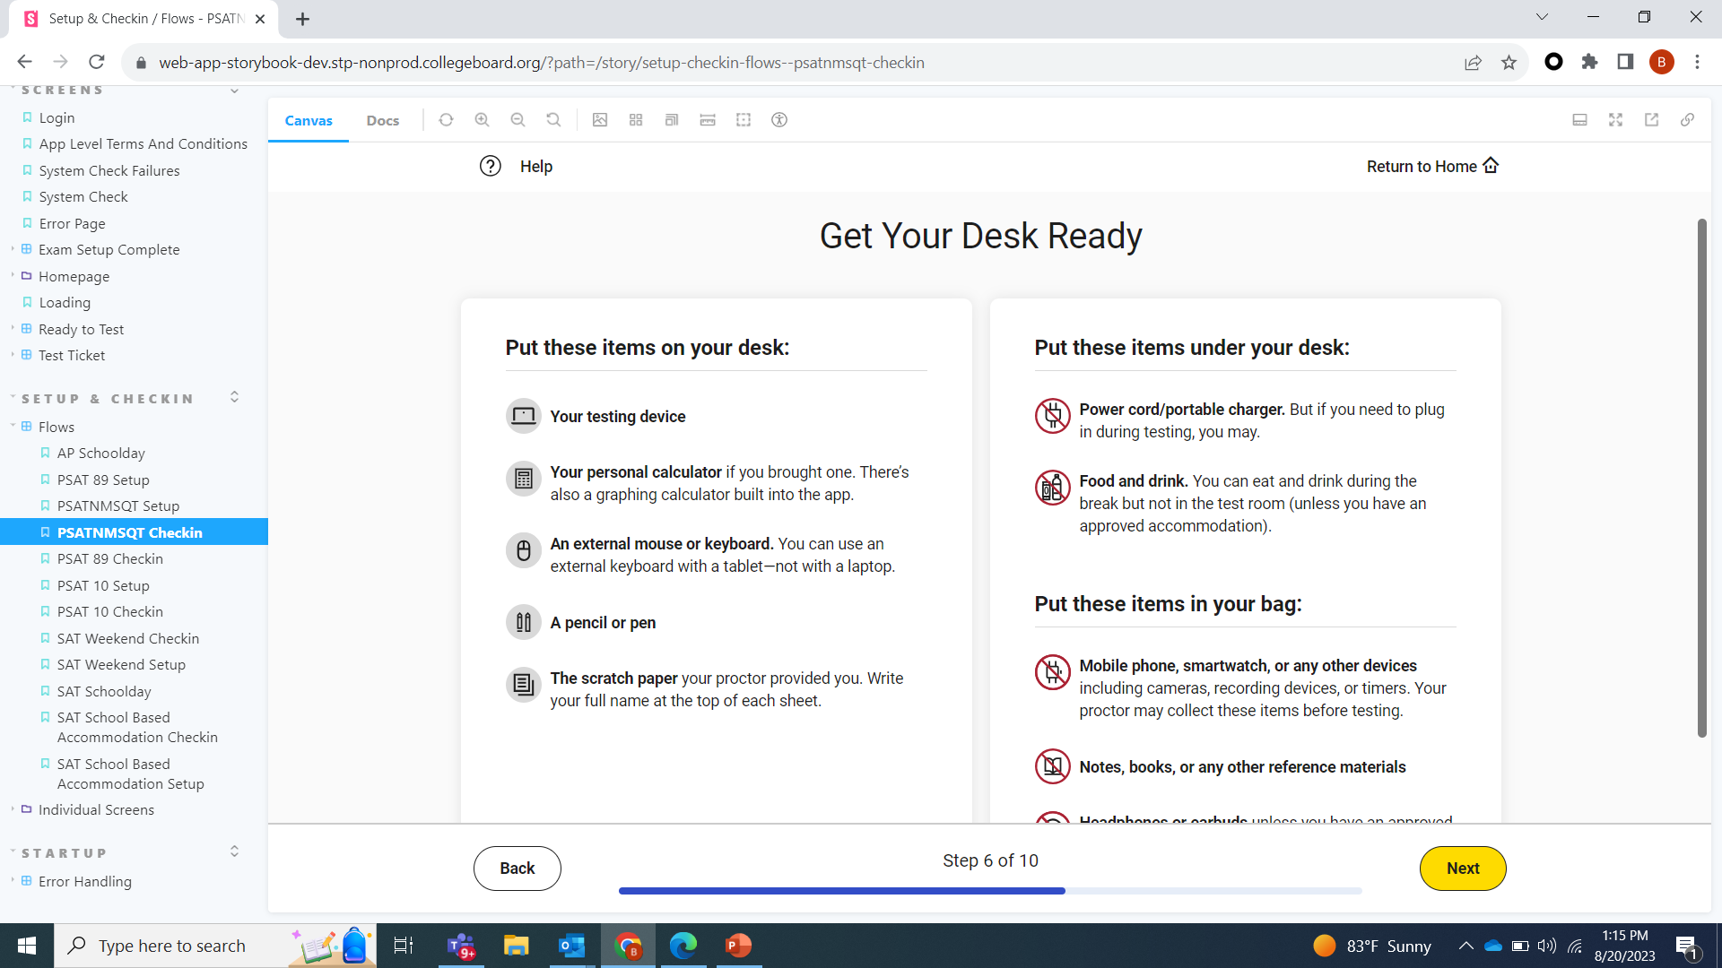
Student Test Day Experience Screen-by-Screen
4. Completing Check-in: Security Pledge & Getting Desk Ready

Slide 7
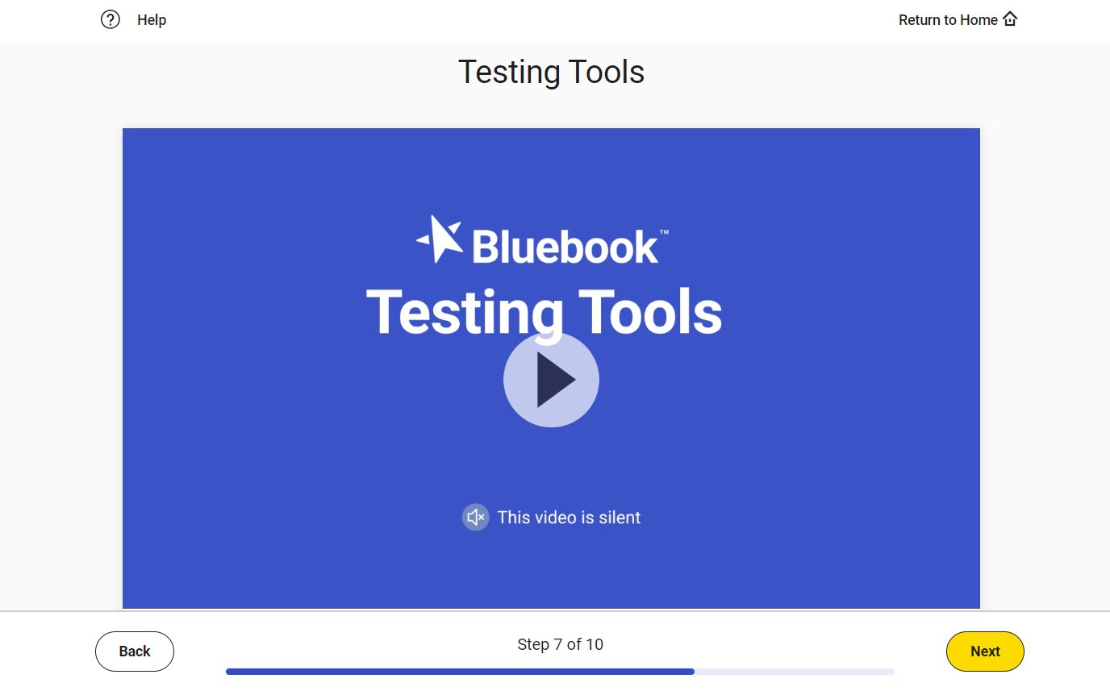
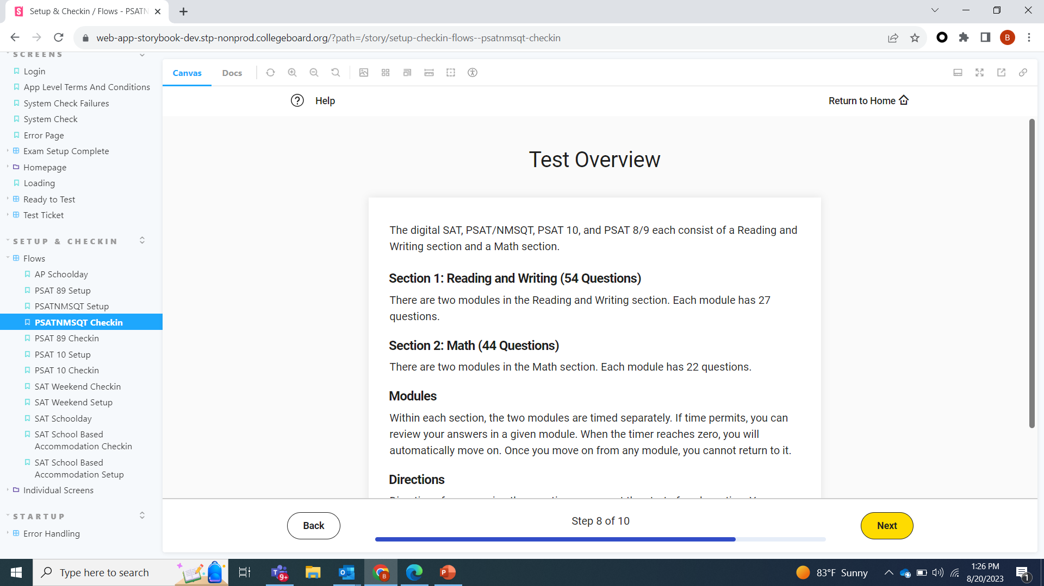
Student Test Day Experience Screen-by-Screen
5. Completing Check-in: Video reminder of in-platform tools and written “test overview”

Slide 8
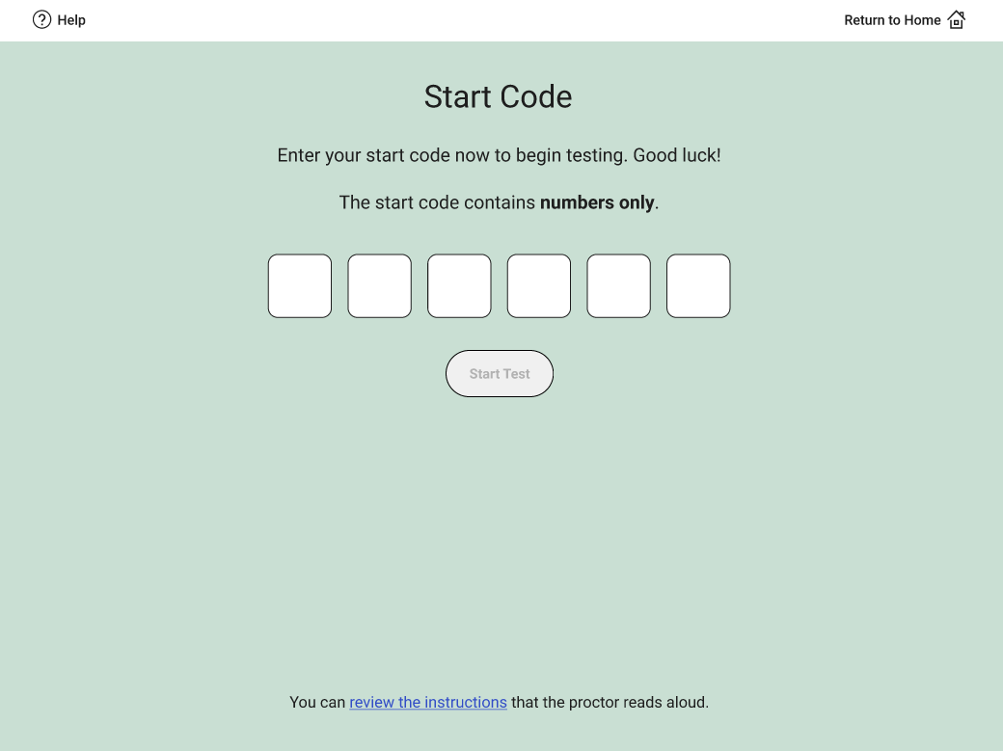
Student Test Day Experience Screen-by-Screen
6. Enter proctor-provided start code

Slide 9
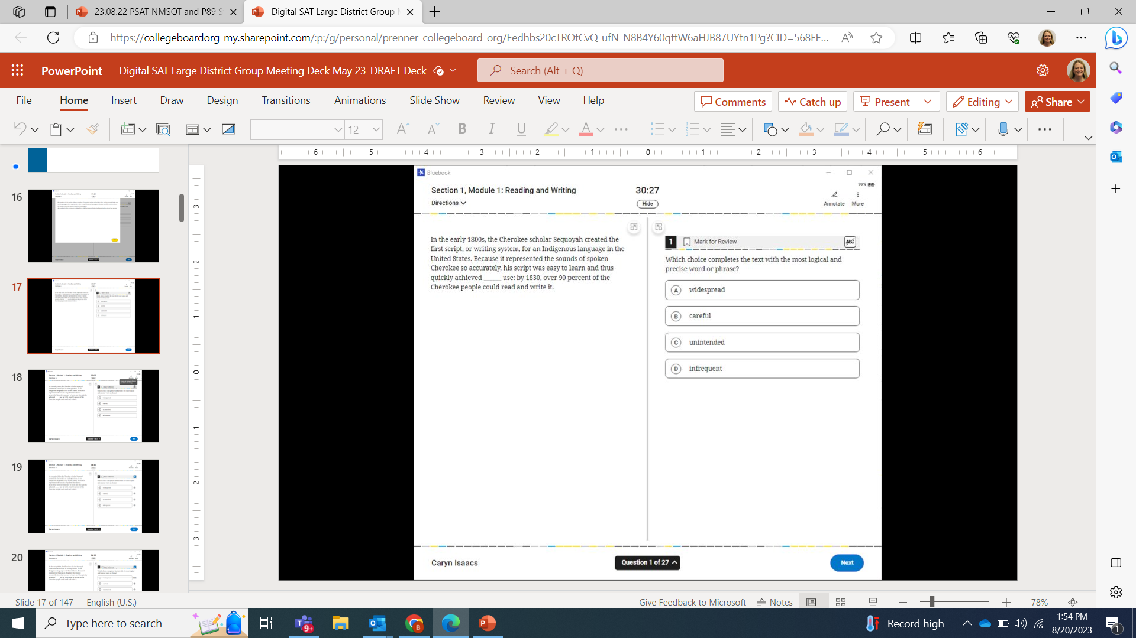
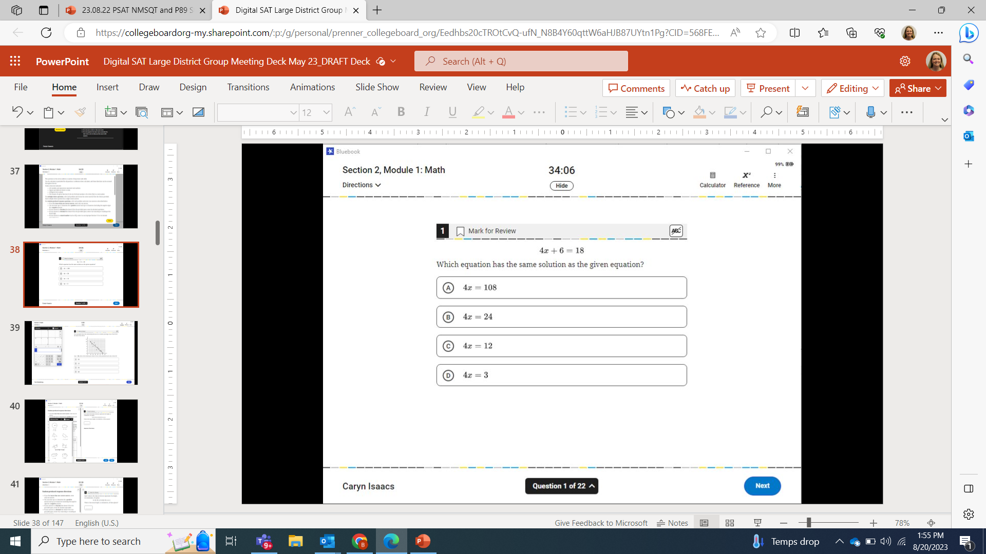
Student Test Day Experience Screen-by-Screen
7. Testing

Slide 10
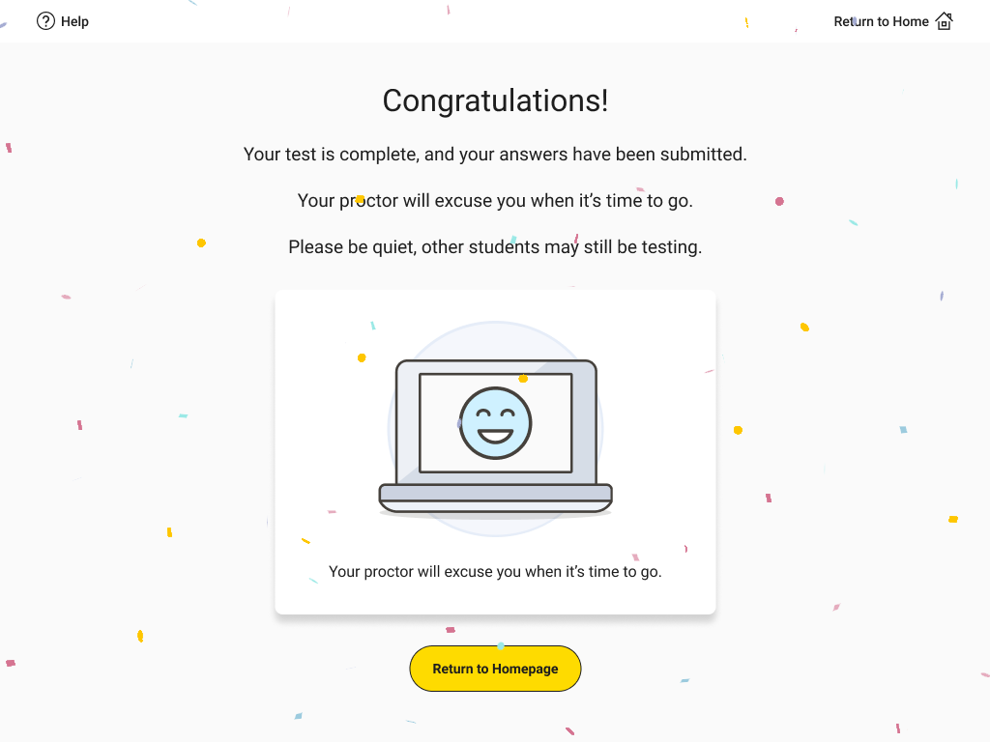
Student Test Day Experience Screen-by-Screen
8. Submit Responses

