Slide 1
TEAM
District Facilitator Orientation

Slide 2

Agenda
Welcome
TEAM Overview
TEAM Roles and Responsibilities
TEAM DF Timeline – Actions and Dashboard
  Participants
  Assigning mentors and administrators
  Module Process
  District Program Oversight and Accountability
  EDS and TEAM Completions
  Allocations
Best Practices
Notes:
Some of you are new to this role and we have a few experienced DFs with us as well.
We will do a quick overview of the TEAM program and requirements. Gady will share information with you about how teachers are entered into TEAM and we will review TEAM entry dates, expected completion dates, and deadlines.
The roles and responsibilities of the various TEAM participants is important to fully understand as the DF. The DF is always the first line of communication with all of the various participants.
To help prepare you for all of your responsibilities as the DF, we will first review what you need to be attentive to and we will walk you through some of the tools and resources available to assist you in managing all of it.
Finally, we want to share some best practices that DFs are using to support their teachers and mentors.
Then we will open it up to questions.
As we are presenting, if you need us to provide any additional information, let us know. We want this webinar to be interactive, so please feel free to ask questions as we go along- you don’t necessarily need to wait to the end.

Slide 3
The TEAM Program Overview
TEAM is designed to be a district-base program, supported by the CSDE to
ensure beginning teachers are provided with the induction and mentoring support they need to be successful,
accelerate their professional growth, and
reduce the rate of new teacher attrition.
Notes:
Districts have a great deal of flexibility as long as they adhere to the core requirements.
They can:
set their own timeline and deadlines.
set requirements for mentor recruitment.
choose to do in-district or regional reviews.
choose to have teachers demonstrate completion of a module through reflection papers or projects.

Slide 4
The Purpose of TEAM
Provide all beginning teachers with the support they need to develop as effective educators;
Ease the beginning teacher’s transition into the teaching profession in order to retain effective teachers;
Develop teachers who are reflective practitioners, able to critically assess their practice against CT’s teaching standards, and are committed to continuous professional learning;
Cultivate an understanding of the professional responsibilities of an educator;
Foster collaborative learning communities for all educators; and
Provide excellent teachers the opportunity to develop as educational leaders.
Notes:
Although many of you have been involved in TEAM even prior to taking on this new role, we want to take a few moments to remind everyone about the real purpose behind TEAM.
Research tells us that teachers, new to the profession, need guided support to help ease their transition from preparation to professional practice. While we want teachers who are classroom ready when they begin their first year, we know that they have a great deal to learn.
The most important role TEAM plays is helping our newest teachers to develop as professional educators who embrace a mind-set that learning is a life-long skill that leads to improved practice and student growth. I want to emphasize the importance of professional learning as the basis of TEAM.
The entire TEAM module process is designed to support professional learning and growth. Long before CT adopted our professional learning standards, TEAM was built on the belief that professional learning must be personal, relevant, sustained, part of a learning community of practice, data driven, and provide a learning structure that enhances educator growth.
TEAM has a broad impact on more than just beginning teachers - it promotes leadership in mentors.

Slide 5

TEAM Program
Continues to be recognized both regionally and nationally for its positive impact on teacher retention, mentor training and on-going professional development that promotes positive classroom environments, establishing strong relationships and emphasis on culturally responsive pedagogy and instruction.

Slide 6
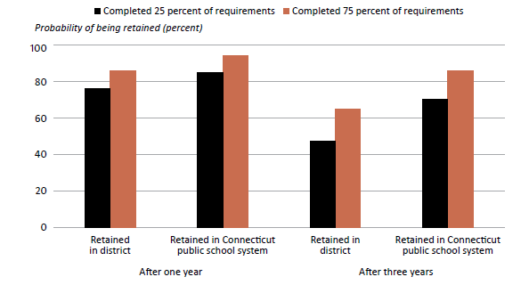
Teachers who completed more TEAM requirements were more likely to stay in the same district and in the CT public school system after 1 and 3 years of teaching
(2012/13–2017/18)

Slide 7

What Is the TEAM Program?
Legislatively mandated multi-year induction program for all beginning teachers
Teachers are paired with experienced, trained mentors
Teachers work with their mentors to create
Professional Growth Action Plans that correspond
to instructional modules
Districts assign mentors and are responsible for implementing the TEAM program
Completion of the TEAM program is required for teachers to advance to the next teacher certification level

Slide 8

Roles and Responsibilities
Superintendent
TEAM Coordinating Committee
District Facilitator
Administrator
Mentors
Beginning Teachers
Reviewers
Notes:
TEAM was designed to be a district based program. In order for the program to run effectively, the roles and responsibilities of everyone involved in TEAM must be clearly defined. Let’s review each of these roles.

Slide 9

Superintendent
Appoints the DF Annually
Verifies TEAM Completions
  Appoints an individual to the role of EDS LEA TEAM as their designee to enter TEAM completions in EDS
Ensures TCC, DF and Administrators Support TEAM
Notes:
Ultimately, the superintendent has the responsibility to ensure that TEAM is being implemented with fidelity to the requirements. Therefore, the superintendent is required to appoint or reappoint a DF who acts as the liaison between the superintendent and everyone else. When teachers have completed all of their TEAM requirements, the superintendent must verify the completion. In some districts, the superintendent relies on the DF to facilitate this task.

Slide 10
TEAM Coordinating Committee
Legislation requires districts to form a local or regional TEAM coordinating committee or committees (TCC) to oversee, plan, implement, and monitor the district’s TEAM Program under the direction of the DF.
Must include a minimum of four certified professional employees including representation from, but not limited to, a trained mentor teacher, an administrator, and representatives of the exclusive bargaining representative for certified employees, based on district size.
Notes:
The TCC is responsible to oversee, plan, implement, and monitor the district’s TEAM Program under the direction of the DF. Consider how the TCC can assist you with all of the responsibilities you have. Are there individuals on the TCC who can take on one of the tasks that needs to be accomplished.

Slide 11
District Facilitator (DF)
Leads the TEAM Coordinating Committee
Functions as liaison between the CSDE, the district, the beginning teachers, and the mentors regarding requirements of the TEAM program.
Assigns mentors to beginning teachers generally within 30 days of hire (including late hires);
Monitors beginning teachers’ progress on the modules and mentor support including mentoring logs;
Ensures adherence to established deadlines for module completion; and
Ensures superintendent is notified about TEAM completions that they are entered in EDS.
Notes:
Legislation calls for districts to establish a committee to oversee TEAM implementation. The DF is the lead facilitator of the TCC. The TCC is responsible to oversee, plan, implement, and monitor the district’s TEAM Program under the direction of the DF.
It is your responsibility to ensure that the TCC meets regularly, knows your district TEAM plan, revises it as required, monitors BTs participation, identifies prospective mentors, ensures training is updated, matches BT and mentors as soon as possible, selects reviewers, monitors mentoring hours, approves stipends and coordinates training and support as needed.

Slide 12

Administrator
Instructional leader:
Can help the teacher make connections between TEAM, teacher evaluation, and professional learning.
Signs off on the PGAP
Determines if the district and the school can support the identified professional learning activities in the PGAP or helps the teacher to find alternative activities or resources for those that cannot be supported.
Notes:
The administrator also plays a crucial role in the implementation of TEAM. The administrator is an instructional leader who can support a BT’s professional learning by sharing resources, providing feedback, helping the BT leverage TEAM to support yearly goals.
The administrator is required to sign-off on a teacher’s professional learning growth plan (PGAP). The purpose is not to approve the PGAP, but to determine if she or he can support the teacher’s plan and requested resources. This is a good opportunity for the administrator to engage the BT in a learning focused conversation, The administrator can suggest additional resources and guide the teacher in his or her professional growth.

Slide 13

Mentors
Teachers selected by the district to support beginning teachers through the induction phase of their careers.
Provide guidance to the beginning teacher throughout the year by helping them manage routine tasks, problems or challenges, and complete the TEAM program requirements.
Notes:
Mentors are the key support for BTs - not only in completing TEAM, but in coaching and guiding the BT throughout the first years of induction into the profession. A BT’s needs change throughout the year and they need someone they trust to provide an ear to listen or someone to collaborate with, or bounce ideas off.
As the DF, you want to try to make good matches that will results in trusting and supportive relationships. You may also need to intervene in matches that do not seem to be working. It is important that you check in with BTs and mentors frequently to gauge how things are going. BTs are often reluctant to speak up, so it is important that you are aware of what is happening at all times. When DFs don’t do this, we find teachers who are at the end of their time in TEAM, have not had the benefit of a good mentor relationship and may be facing a loss of their certification.
In some instances, it may be a BT who is not willing to work with a mentor. These situations need to be addressed as soon as possible. Extensions cannot be granted to teachers who simply didn’t participate in TEAM.
As the DF you should have a plan in place for these kinds of situations. You should talk with your superintendent or HR director about the protocol for addressing these types of circumstance.
Mentors need to build trusting relationships, so often there is a fine line that needs to be carefully navigated. Having a plan in place before you encounter one of these situations can help make handling it much easier.

Slide 14
Mentors
TCC must have a process for the recruitment and selection of prospective mentors/cooperating teachers.
Mentors/cooperating teachers must possess a provisional or professional educator certificate and have a minimum of three years of teaching experience, including at least one year of experience in the district in which they are presently employed.
All mentors/cooperating teachers must be TEAM-trained and updated every three years.
The district must assign a TEAM trained mentor to all beginning teachers required to participate in TEAM.
The CSDE strongly encourages districts to assign a mentor within the first 30 days of hire.
Mentors may be assigned 2 BTs, 3 with special approval from CSDE.
Mentor must provide a minimum of 50 hours of mentor support with the expectation of approximately 10 hours of support for each professional growth module completed.
Notes:
Do you have enough mentors in your district?
Do you have the right mentors to meet the needs of your teachers?
How are you recruiting new mentors? Consider not only demonstrated experience, but also race, culture, ethnicity when selecting new mentors. You want to have a pool of mentors who will meet the needs of your beginning teachers.
2 BTs can be assigned to a mentor. If a 3rd needs to be assigned, you must contact us (Claudine Primack) to get special approval.

Slide 15

Beginning Teachers
Early career teachers working under an initial educator certificate, interim initial educator certificate, or a non-renewable interim initial educator certificate in an endorsement area applicable to TEAM.
  The legislation calls for the successful completion of five modules for teachers in Category I and two modules for teachers in Category II.
Notes:
TEAM Categories are listed in the TEAM Manual – Appendix B – we suggest that you print this out and keep it posted for your reference.
Module 5 is not required for Category II teachers but is highly recommended.

Slide 16
August - September
Task | Details
Develop a Calendar | Meetings with beginning teachers and mentors Beginning Teacher Orientation Professional learning, activities Dates for module submission
Verify Mentors | Check the mentor list on the TEAM dashboard: Newly hired veteran teachers who are TEAM trained mentors. Mentors selected by TCC in spring who were trained over summer. Verify that new mentors are added to mentor lists on your dashboard. Check training expiration dates. Notify mentors who need to complete Mentor Update- Professional Learning Units (PLUs).
Check on Beginning Teachers | Check new hire lists daily Check the TEAM dashboard for beginning teachers. Teachers new to the district will not be on your BT list until they have been entered in EDS.

Slide 17
August - September
Task | Details
Assign mentors | Contact building principals to make mentor assignments The DF will make the matches on the dashboard. Arrange for new teachers and mentors to meet before school begins. Prepare and issue registration letters to beginning teachers
Check Deadline Dates | Teachers with a Feb. 15th deadline date will need to complete TEAM by then.
Conduct Orientation | SDE provides PPT and notes – add own content where appropriate
Check for Communications | Communications are posted to the DF Dashboard throughout the year

Slide 18
Who Participates in TEAM
Certification Requirements | Assignment
Initial Educator Interim Initial Educator Nonrenewable Interim Initial Educator AND Endorsement from Category 1 or 2 | Working with students in an assignment that is in compliance with their endorsement
Notes:
In order to be eligible to participate in TEAM, teachers must meet specific requirements. First, they must have the appropriate certification. Column 1 lists those certifications that teachers must possess in one of the endorsement areas that TEAM is required (see next slide for endorsements). Column 2 speaks to the position the teacher holds or is assigned in their school, which must be in alignment with the certification. Teachers who are teaching in a grade that is outside of their certification, for example, would not be in compliance. A teacher who is teaching in a content area that is different from the endorsement on their certification, would be out of compliance.
In order for the system to pick up a teacher who is eligible and required to complete TEAM, both of the requirements in the first two columns must be met. The duration refers to the length of the time in a specific position. Any teacher, with an initial certification, working under that certification either full or part-time, will be required to do TEAM.
However, a teacher who is working in a substitute position under an initial certification must be in the same position for the full year- 10 months.

Slide 19
Category I (5 modules) | Category II (2 modules) | TEAM Program NOT required
Teachers certified and teaching under the endorsements below will participate in the Five-Module Program | Teachers certified and teaching under the endorsements below will participate in the Two-Module Program | Endorsement areas NOT participating in the TEAM program
> English (#015) > History/Social Studies (#026) > Mathematics (#029) > Biology (#030) > Chemistry (#031) > Physics (#032) > Earth Science (#033) > General Science (#034) > Art (#042) > Health (#043) > Special Education (#165, 265) > Elementary (#013, 112 & 113 -excludes birth to age 3-, 305) > Montessori Primary, Birth-K (#512) > Montessori Elementary, Grades 1-6 (#511) > Middle School 4-8 (#215, 226, 229, 230, 231, 232, 233, 234, 235) > Music (#049) > Physical Education (#044) > Bilingual Education (#902, 915, 926, 929, 930, 931, 932, 933, 934, 966, 967, 968, 969, 970, 971, 972, 973, 974) > World Languages (#018, 019, 020, 021, 022, 023, 024, 101,317,318) >Remedial Reading/Remedial Language Arts (#102) >Teaching English to Speakers of Other Languages [TESOL] (#111) | > Business Education (#010) > Agriculture (#040) > Vocational Agriculture (#041) > Home Economics (#045) > Technology Education (#047) > Partially Sighted (#055) > Deaf and Hard of Hearing (#057) > Blind (#059) > School Library Media Specialist (#062) > Teacher-Coordinator Marketing Educator (#089) > Occupational Subj. in Technical High Schools (#090) > Trade and Industrial Occupations in Comprehensive H.S. (#098) > Health Occupations - Comp. High School (#103) > Health Occupations in a Technical High School (#109) >Dance, Grades Pre-K through 12 (#483) >Theatre and Drama, Grades Pre-K through 12 (#485) > Teachers assigned as Content Coaches participate in Category II independent of the endorsement. | > Driver Education (#035) > Speech and Language Pathologist (#061) > School Counselor (#068) > School Psychologist (#070) > School Social Worker (#071) > School Nurse-Teacher (#072) > Vocational Technical Administrator (#082) > School Business Administrator (#085) > English to Non-English Speaking Adults (#088) > Intermediate Administrator/ Supervisor (#092) > Superintendent of Schools (#093) > Reading and Lang. Arts Consultant (#097) > Teacher Coordinator Co-op Work Edu/Diversified Occup. (#104) > Department Chairperson (#105) > H.S Credit Diploma Program (#106) > Ext. Diploma Prog. Non-credit Mandated Prog. (#107) > Practical Nurse Education Instruction (#108)
Notes:
Appendix B
These are the endorsement areas for certification. Category I and II are required to participate in TEAM. Teachers in category I will complete 5 modules, teachers in category II will complete 2 modules from modules 1, 2, 3, and 4. Module 5 will not count as one of their two modules. We strongly encourage districts to have all teachers participate in Module 5. However, it won’t count as one of the two module requirement.

Slide 20
Do Substitute Teachers Participate?
Long-term substitute teachers that hold an initial certificate with a 10-month assignment (in the same position) will participate.

Slide 21
Category I (Five Modules) Entry Dates and Completion Dates
Hire Date | Entry Date | Expected Completion Date | Deadline (optional third year if needed)
Between February 15, 2021, and October 31, 2021 | September 1, 2021 | September 1, 2023 | September 1, 2024
Between November 1, 2021, and February 14, 2022 | February 15, 2022 | February 15, 2024 | February 15, 2025
Between February 15, 2022, and October 31, 2022 | September 1, 2022 | September 1, 2024 | September 1, 2025
Notes:
Entry Dates: When teachers are entered into the state Educator Data System (EDS) and they meet the requirements to be participate in TEAM, they are assigned an entry date. All teachers hired and entered into EDS prior to October 31, are given a September 1 entry date, Teachers who are hired and entered into EDS beginning on November 1 until February 14 are given a February 15 entry date. Any teacher hired and entered into EDS on February 15 and after will be given a September 1 entry date in the following year.
Expected Completion Dates: Category I teachers are expected to complete TEAM in 2 years. They have a third year built in that allows extra time if needed for situations such as a maternity or sick leave, or personal family crisis that may have prevented them from completing TEAM in the two years. DFs do not need to check with the state or request the extra year, you can grant that time as needed. On word of caution, there is no extra stipends in the third year if the full stipend was paid out over the two years. If a teachers has been out or has not worked on TEAM, you may want to reduce the stipend to half or 0 for that year and reserve the money for the extra year that will be needed.
Deadline: The deadline is the end of the 3 years that is provided. If a teacher has not completed TEAM requirements by the end date, he or she will no longer be able to renew his or her certification. If there were extenuating circumstances that prevented the teacher from completing TEAM in the 3 years, the DF can initiate a request for an extension of a deadline. There must be third party documentation to support the request. More information can be found in the TEAM program manual.

Slide 22
Category II (Two Modules) Entry Dates and Completion Dates
Hire Date | Entry Date | Expected Completion Date | Deadline (optional second year if needed)
Between February 15, 2021, and October 31, 2021 | September 1, 2021 | September 1, 2022 | September 1, 2023
Between November 1, 2021, and February 14, 2022 | February 15, 2022 | February 15, 2023 | February 15, 2024
Between February 15, 2022, and October 31, 2022 | September 1, 2022 | September 1, 2023 | September 1, 2024
Notes:
Category II entry dates reflect 1 year to complete TEAM with the option of a second year if needed.

Slide 23
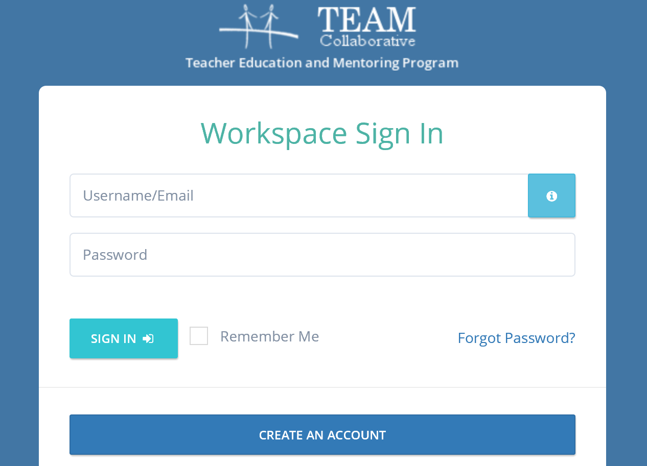
Using the TEAM Dashboard
Notes:
URL: https://modules.ctteam.org/
Step 1: create an account
Step 2: ask the superintendent to confirm the appointment as DF to the SDE
Step 3: log in and verify that the permissions have been updated

Slide 24
Assign Mentors and Administrators to Beginning Teachers

Slide 25
The TEAM Module Workspace, Dashboard, and Tools
Dashboard was established for multiple purposes:
Information/Communication – Provides program participants with program documents and prompt and timely communications from the CSDE.
Training – The website provides beginning teachers and their mentors with a link to a list of professional learning opportunities (PD Registration) and the ability to register for a selected course.
Professional Growth Module Workspace – Provides access to the web-based tools and resources that allow for the completion of the professional growth module process and communication with mentors, DFs, and administrators.
TEAM Tasks – DFs assign mentors and administrators, monitor progress of BTs and hours of mentorship, as well as track reviews and check training dates to ensure mentors and reviewers are current.
Notes:
Review the DF dashboard to locate where each of these tools/resources can be found.

Slide 26
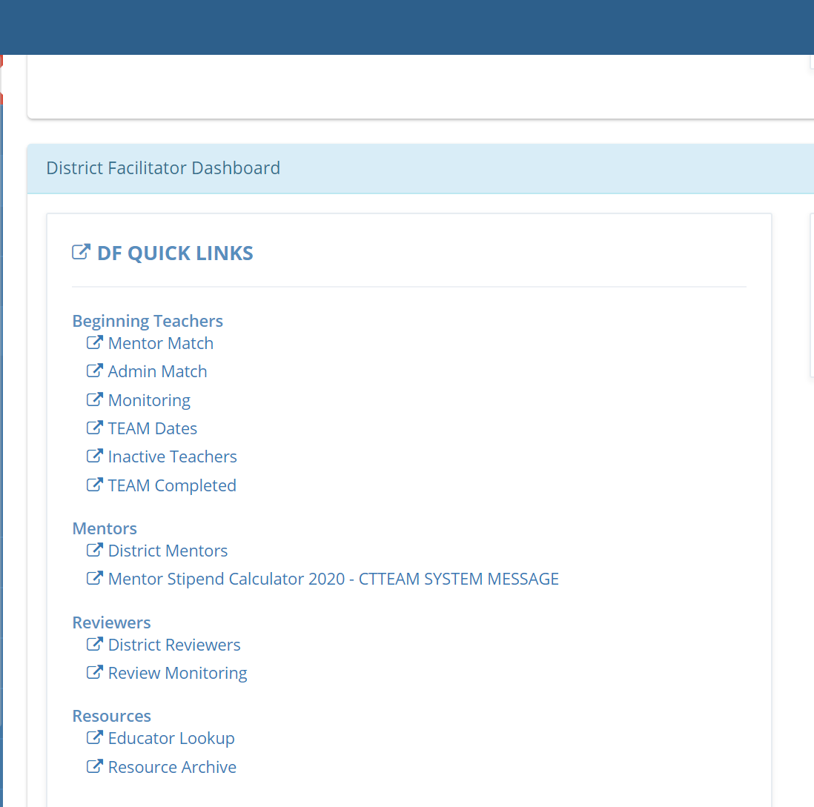
Mentors
Notes:
All district mentors are listed on the DF dashboard
You can monitor their training history here and the number of BTs assigned to each mentor

Slide 27
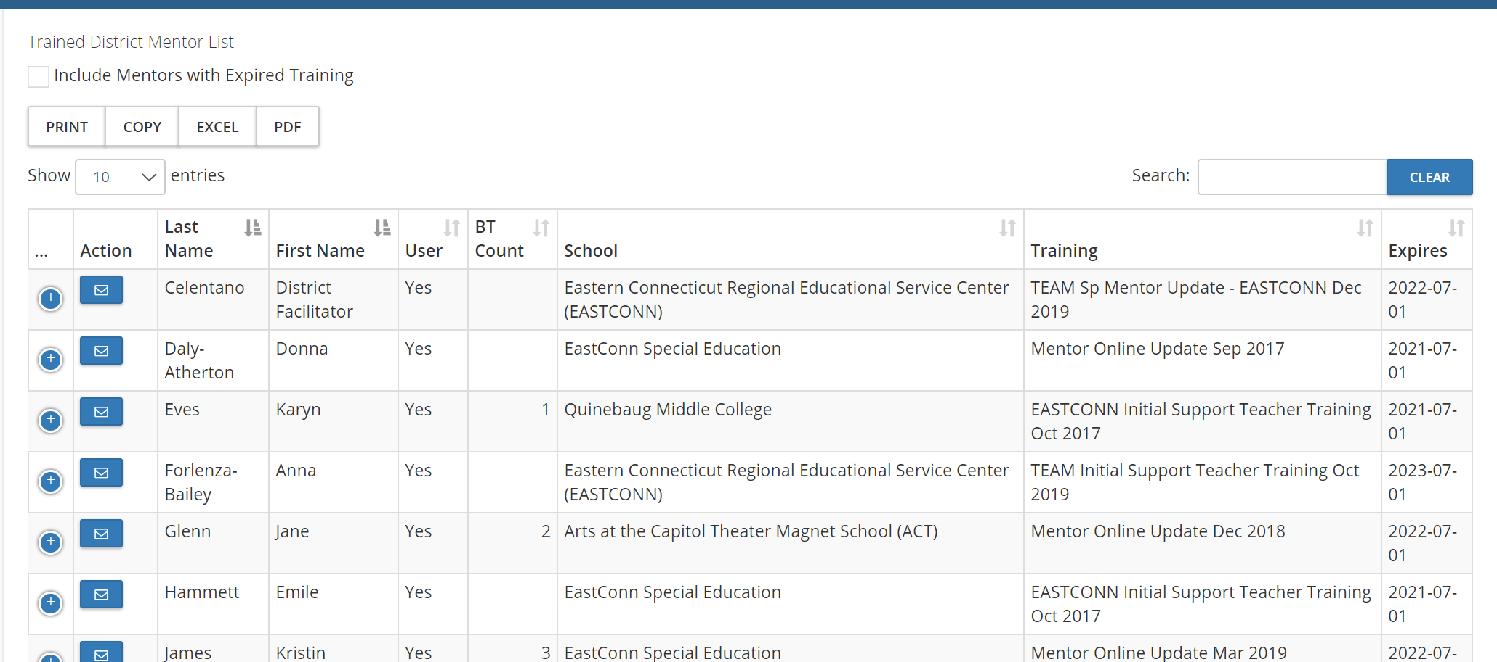
Mentors
27
Notes:
You can print out this list.
The right column shows the expiration date of the mentor training. Mentors need to complete update every three years. If they do not, then they must complete the full IST.
You can also click the box that say Include Mentors with Expired Training

Slide 28
Assigning Mentors
Notes:
All district mentors are listed on the DF dashboard
Assign mentor to BT within 30 days of hire

Slide 29
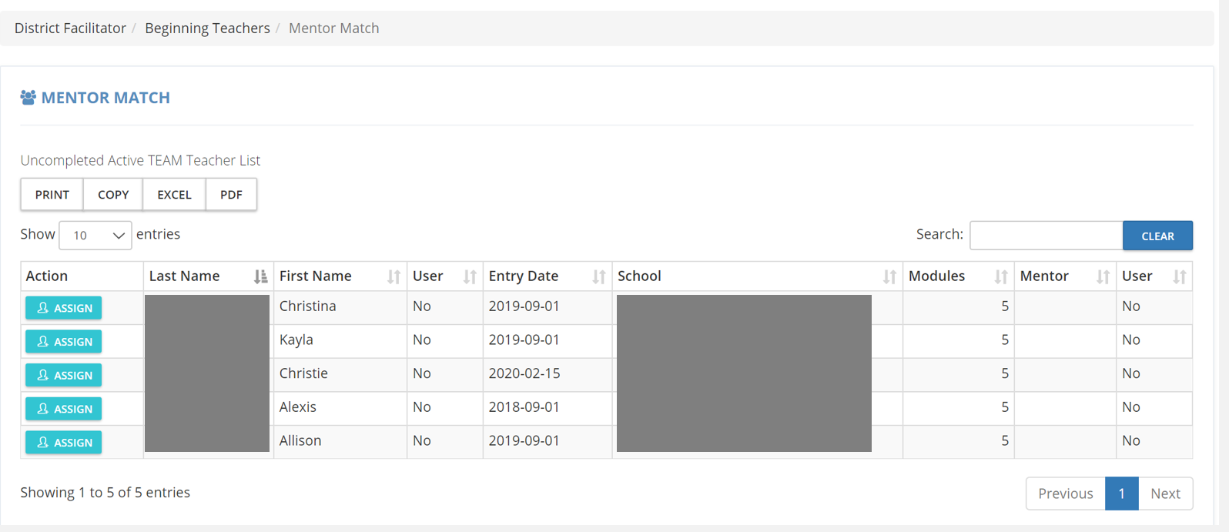
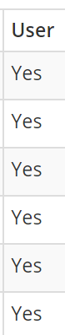
Mentor Match
Notes:
Click Assign on the left of the beginning teacher to assign a mentor. Once you click this the next screen will open with the list of mentors who can be assigned.

Slide 30
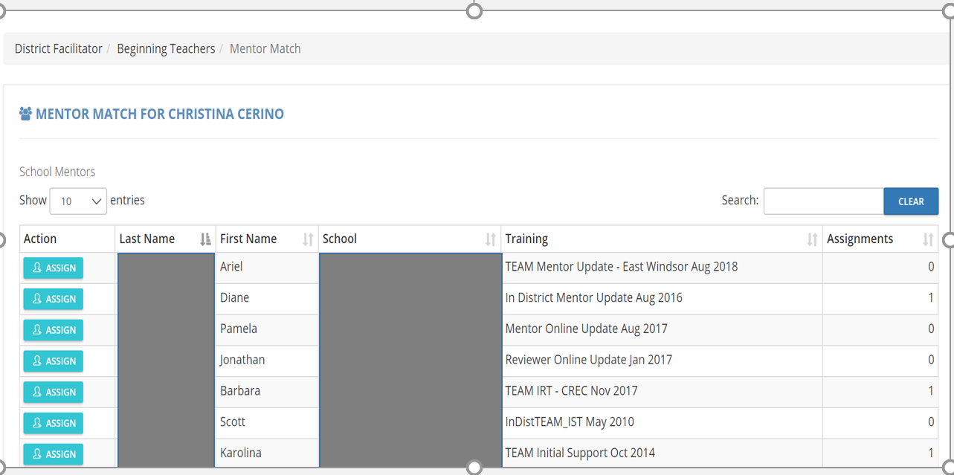
Mentor Match
MENTORS
Notes:
This is the list of mentors. To assign a mentor to the teacher, click ASSIGN. Note the number of assignments a mentor already has in the far right column.

Slide 31
Assigning Administrator
Notes:
To assign an Administrator click Admin Match

Slide 32
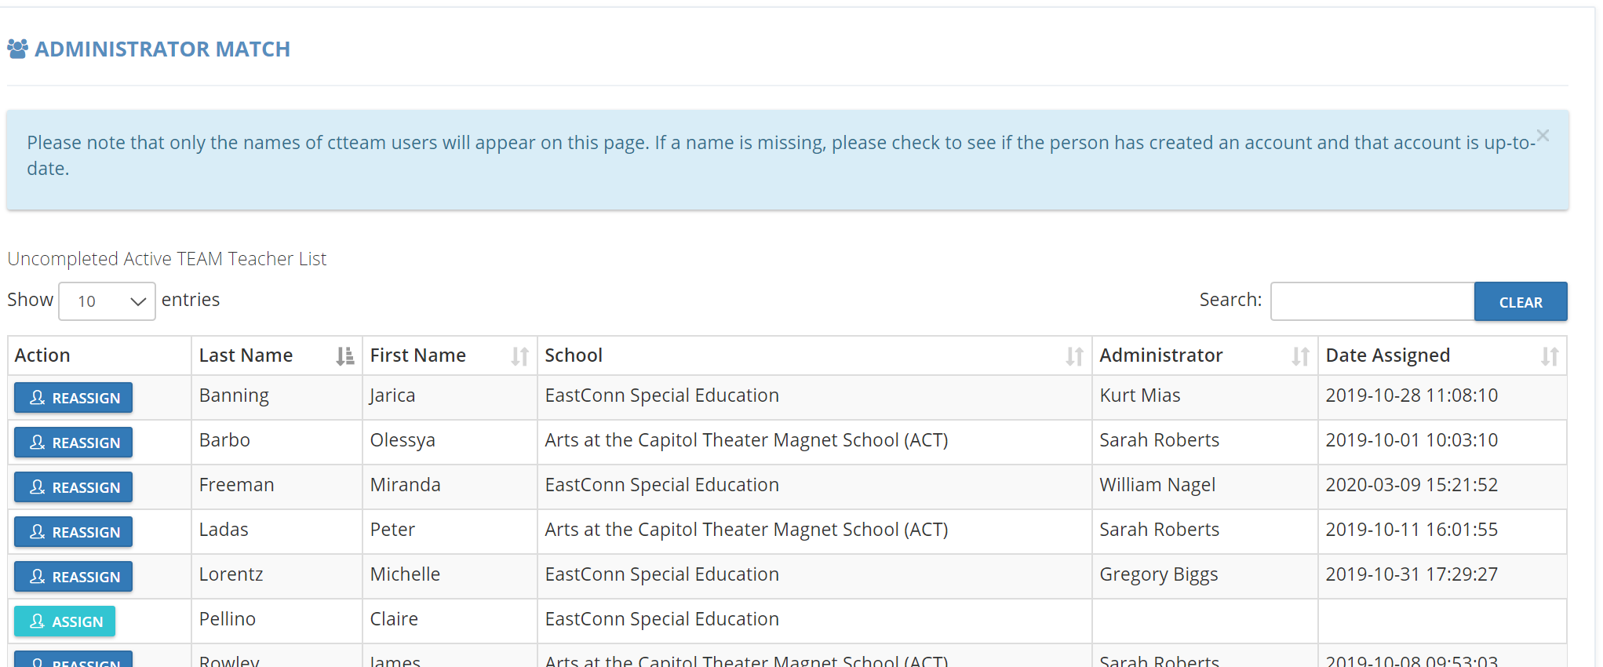
Assigning Administrator
Notes:
The same process used to assign a mentor is used to assign the administrator. If you do not see the administrator that you want to assign, make sure the administrator has created an account. If they have created an account but are not visible on this page, please contact Gady Weiner for assistance.

Slide 33
Orientation to the TEAM Program
The DF must provide an orientation to the TEAM Program that familiarizes teachers with the requirements for TEAM and includes:
  an overview of the TEAM Program requirements,
  an introduction to TEAM module process,
  a review of the district’s three-year TEAM support plan,
  timelines for TEAM completion, including any district-specific requirements, and
  a schedule for district-based support.
Notes:
See the August memo with a link to the PowerPoint.

Slide 34
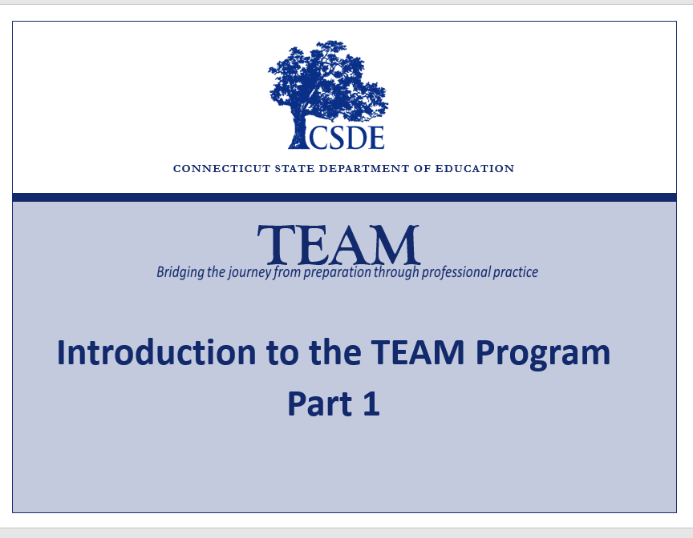
TEAM Orientation
Notes:
Part 1 – Overview of TEAM
Part 2 – TEAM Module Process

Slide 35
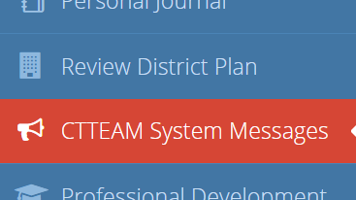
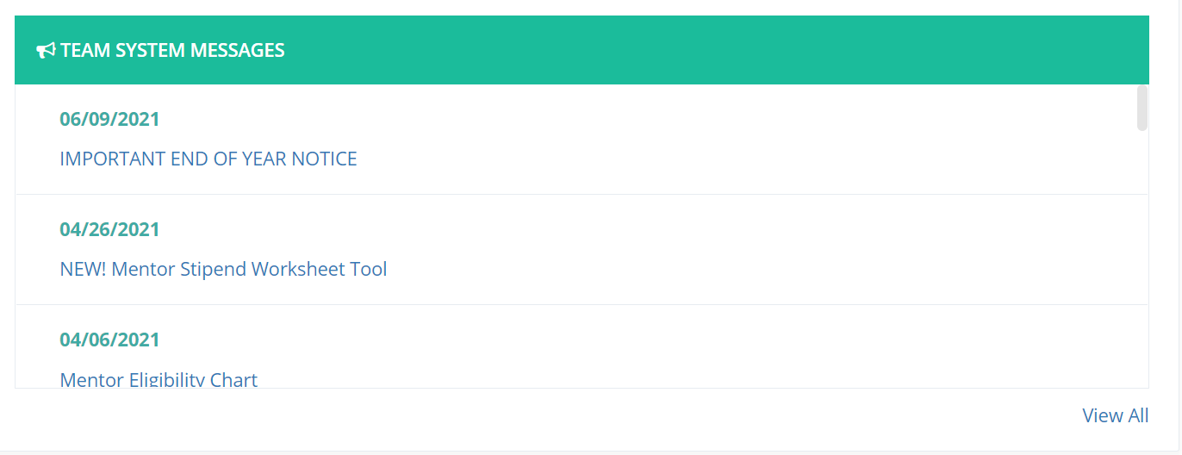
TEAM Communications

Slide 36
October - November
Task | Details
Verify all users have activated their TEAM account | Check the dashboard to see if BTs, mentors and administrators have activated their accounts. Send reminders to returning BTs, mentors and administrators reminding them to log in to their TEAM accounts.
Begin the Module Process | Part two of the Orientation is specifically about the module process. This would be a good time to bring beginning teachers and their mentors together and share part two of the orientation. Have BTs complete their Beginning Teacher Support Plans Returning BTs should review and update their existing plans
Check Reviewer Capacity | Regional Review - must contribute the number of reviews equal to the number of reflection papers that will be submitted to the regional review. We recommend 1 reviewer per 5 modules.

Slide 37
Verify Users
Notes:
Click Assign on the left of the beginning teacher to assign a mentor. Once you click this the next screen will open with the list of mentors who can be assigned.

Slide 38
Beginning the TEAM Program

Slide 39
The TEAM Modules
The TEAM Program is designed around five professional growth modules that provide a framework of support for new teachers.
The five modules focus on five of the six domains of Connecticut’s Common Core of Teaching, which can also be accessed online at www.ctteam.org under module resources.
Module 1: Classroom Environment, Student Engagement and Commitment to Learning aligns with the CCT Domain 2
Module 2: Planning for Active Learning aligns with the CCT Domain 3
Module 3: Instruction for Active Learning aligns with the CCT Domain 4
Module 4: Assessment for Learning aligns with the CCT Domain 5
Module 5: Professional Responsibilities aligns with the CCT Domain 6
Notes:
Depending on the BT’s endorsement and assignment (Gady will address that in a few minutes) he or she will complete 5 or 2 modules.
The modules align with the CCT which sets the standards and articulates the knowledge, skills, and dispositions CT teachers must have. It is the foundation of effective teaching. Teacher prep programs are based on those standards, educator evaluation is based on those standards and TEAM is based on those standards.
Modules 1-4 require a reflection paper

Slide 40
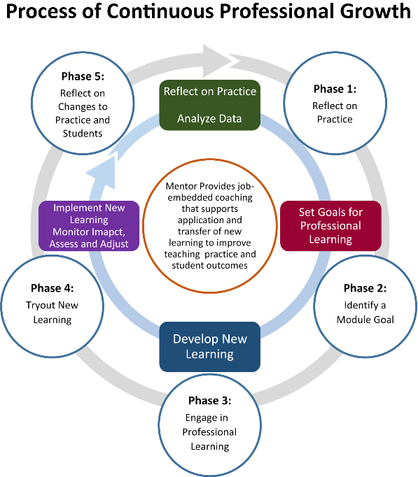
Module Process

Slide 41
New Professional Learning Resources
Educators will have access to professional learning resources, aligned directly to the CCT Performance Profiles, and collaborative discussion rooms where participants can connect with their mentors and other program participants as they work through each module:
  • Classroom Environment, Student Engagement, and Commitment to Learning
  • Planning for Active Learning
  • Instruction for Active Learning
  • Assessment for Learning
  • Professional Responsibilities and Teacher Leadership
The goal is to support and bridge the learning of the knowledge and skills that can directly be implemented in the classroom.

Slide 42
Review of Projects/Reflection Papers
Regional/In-district Option
Module Reviewers
  educators selected by the district to review beginning teacher projects/reflection papers
  must attend Initial Review Training and complete annual Update Training (online) to maintain eligibility to review modules
A ratio of at least 1 reviewer per 5 modules (regional review option)
Notes:
Regardless of the option a district chooses, all reviewers must participate in an Initial Reviewer Training and be updated regularly.
For district participating in the regional review - A number of district educators trained to review modules (the number of reviewers in a district that need to be trained will be proportionate to the number of beginning teachers in the district who are participating in the program.
Those who selected the in-district option need to be sure that there are enough reviewers available to ensure confidentiality of the BT. If not, you may consider changing to the regional review.

Slide 43
TEAM Criteria for Success – Reflection Paper or Project
Module Process Expectations | Criteria for Success What does the beginning teacher need to include to be successful in the module process? | Rating and Feedback
1. Development of New Learning Teachers engage in professional learning to develop new knowledge and skills to improve their practice so they can help students achieve. | Describes how the teacher developed new learning (e.g., activities and resources, etc.), and Explains what the teacher learned from the selected activities and resources and/or thinking more deeply about his/her practice. | [ ] Meets the criteria for Development of New Learning The paper/project describes how you developed new learning and explains what the teacher learned - terrific! Continue to engage in and reflect on new learning to enhance practice and student achievement. [ ] Does not yet meet the criteria for Development of New Learning The paper/project does not describe the resources and/or activities used to develop new learning. Describe specifically what you did to develop new learning during the module. The paper/project does not explain what you learned from the selected activities and resources. Explain specifically what you learned from the selected activities and resources and/or thinking more deeply about your practice. The paper/project includes a vague or general explanation of what you learned from the selected activities and resources. Explain more specifically what you learned from selected activities and resources and/or thinking more deeply about your practice.
Notes:
Regardless of whether teachers are writing reflection paper or completing projects, the criteria for review is the SAME.

Slide 44
TEAM Criteria for Success – Reflection Paper or Project
Module Process Expectations | Criteria for Success What does the beginning teacher need to include to be successful in the module process? | Rating and Feedback
2. Impact on Practice Teachers apply new knowledge and skills learned to improve teaching. | Explains, using specific examples/evidence, how the teacher’s practice is different. | [ ] Meets the criteria for Impact on Practice The paper/project includes specific examples/evidence to explain how your practice is different as a result of the learning you acquired in this module - way to go! Continue to implement and reflect on changes in your practice to positively impact student outcomes. [ ] Does not yet meet the criteria for Impact on Practice The paper/project does not include specific examples/evidence to explain how your practice is different. Provide specific examples/evidence of what you did differently in your practice during the 8 - 10 week module process. The paper/project includes vague or general examples/evidence to explain how your practice is different. Provide specific examples/evidence of what you did differently in your practice during the 8 - 10 week module process. The paper/project describes changes in practice that took place over the course of the year, not during the 8-10 week module time frame. TEAM modules focus on a short period of time so you can recall and reflect on specific examples that demonstrate how your practice changed, i.e., how you made different choices related to content, outcomes, activities, etc. Provide specific examples/evidence of what you did differently in your practice during the 8-10 week module time frame.

Slide 45
TEAM Criteria for Success – Reflection Paper or Project
Module Process Expectations | Criteria for Success What does the beginning teacher need to include to be successful in the module process? | Rating and Feedback
3. Impact on Students Student learning and achievement improve as a result of teachers applying the new knowledge and skills learned. | Explains, using specific examples/evidence, how student performance/learning has improved as a result of changes in the teacher’s practice. | [ ] Meets the criteria for Impact on Students The paper/project includes specific examples/evidence to explain how student performance/learning has improved as a result of changes in your practice - well done! Continue to reflect on specific examples/evidence of the impact of your practice on student outcomes to maximize learning. [ ] Does not yet meet the criteria for Impact on Students The paper/project does not include specific examples/evidence of improved student performance/learning. Provide specific examples/evidence of how student performance/learning has improved as a result of your change in teaching practice during this module. The paper/project includes vague or general examples/evidence to explain how student performance/learning have improved. Provide specific examples/evidence of how student performance/learning has improved as a result of your change in teaching practice during this module. The paper/project describes changes in practice that took place over the course of the year, not during the 8-10 week module time frame. TEAM modules focus on a short period of time so you can recall and reflect on the daily impact on student learning. Provide specific examples/evidence of improved student performance/learning during the 8-10 week module time frame.
Notes:
The planning module has slightly different criteria because we are looking for teachers to explain their thinking about planning instruction. Often they tell us about the instruction rather than the planning.
Student Outcomes therefore, can only be anticipated while they are thinking about the plan and should not be actual student outcomes.
We often hear teachers say that if they wrote their reflection paper in future tense, it would have been successful. This is a deep misunderstanding. We want it in present tense, so we can learn about how they think as they plan for future instruction. It is a metacognitive process that we are looking for.

Slide 46
Module 5:
Professional Responsibility
By design, this module will serve to educate new teachers about their professional responsibility in regard to:
    1) expectations for ethical and moral integrity and
    2) making connections beyond the classroom to the larger school/district educational community and to the community of student and families.
To fulfill Module 5 requirements, teachers must engage in district-facilitated conversations that focus on ethical and professional dilemmas for teachers, and complete an online questionnaire, available on their dashboard.
A project/reflection paper is not required for Module 5.
Notes:
Module 5 is different
It does not require a project/reflection paper
Module 5 is designed to be a facilitated discussion around ethical dilemmas that teachers might face
Teachers must complete a short online survey and submit it from their workspace in order for it to be complete

Slide 47
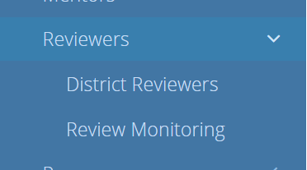
Check Reviewer Capacity

Slide 48
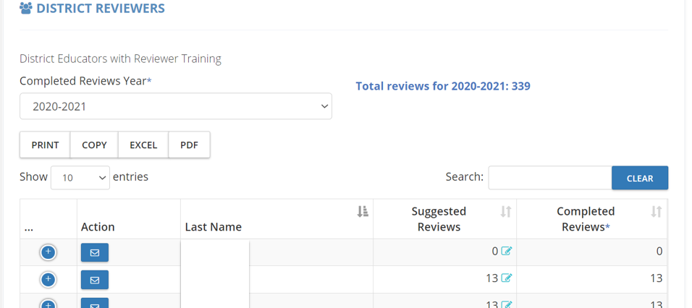
Check Reviewer Capacity

Slide 49
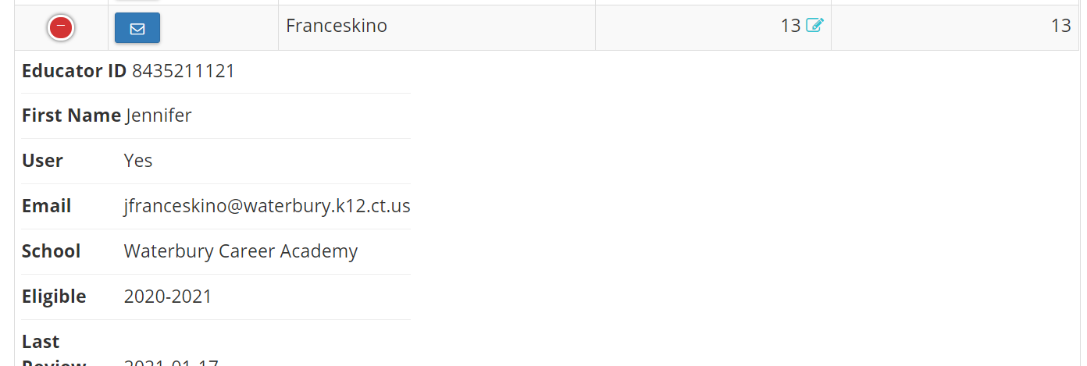
Check Reviewer Capacity

Slide 50
December - January
Task | Details
Monitor progress meter for each BT | Regular monitoring will help you catch problems early and give you an opportunity to address them before they become big problems. It is better to be proactive.
Monitor meeting logs and meeting times. Meeting logs | Meeting logs can be an indicator of how a mentoring relationship is going. If there are few meetings being logged, it would be good practice to check in with the BT and mentor.
Check to be sure administrators sign off on PGAPs in a timely manner | Reach out to administrators if necessary and remind them to sign-off on PGAP Sign-off is not approval of PGAP – it indicates that the district can support the activities/resources
First Module Submission | Most BTs submit their first module between December and January
Confirm BT List for Allocation | Download the list of BTs eligible for an allocation and notify the Talent Office of any discrepancies

Slide 51
Monitoring
51
Notes:
One of your key responsibilities is monitoring if a teacher is on track to complete TEAM by their deadline date. The dashboard gives you tools to monitor module completion, mentor meeting logs, mentor training, and reviewers. The CSDE sends out a notification to the district facilitators 6 months before the deadline.

Slide 52
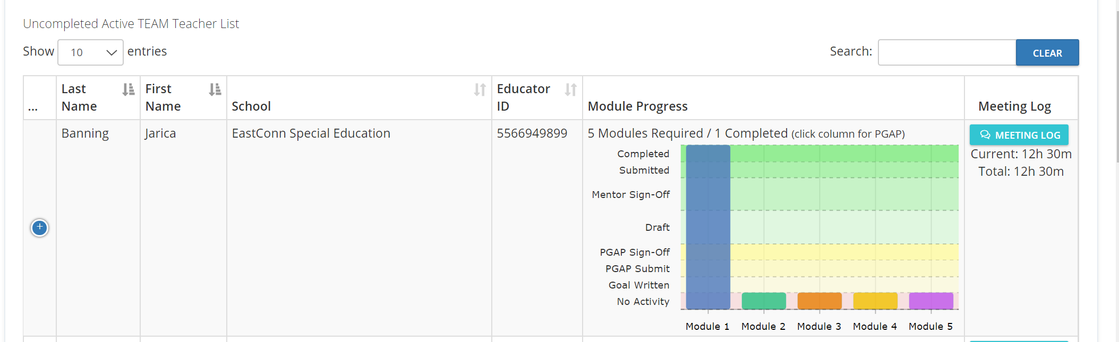
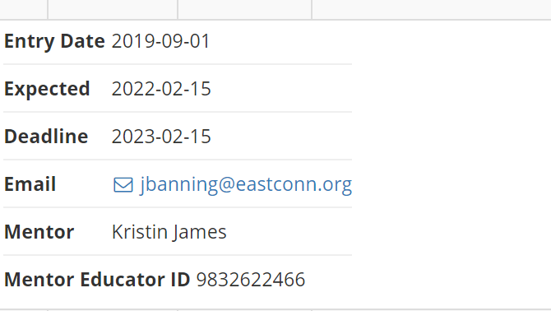
Monitoring
52
Notes:
You can see a bar graph that shows where a teacher is in the module process. In this instance, the teacher has completed Module 1 successful. The teacher has not yet begun another module.
On the right you can see the hours of mentoring provided in the current year and a total over all years. In this case, the 12h 30m is appropriate for the one module that has been completed.
On the left side, if you click the + another box will open that displays the teacher’s entry date, and completion dates. Also, you can see their email, mentor and the mentor’s EIN.
If the teacher was nearing their deadline date and had completed only this one module, you would want to check in with the teacher to see if there was a problem and remind them that their deadline date is approaching and they could be in jeopardy of losing their eligibility for certification.

Slide 53
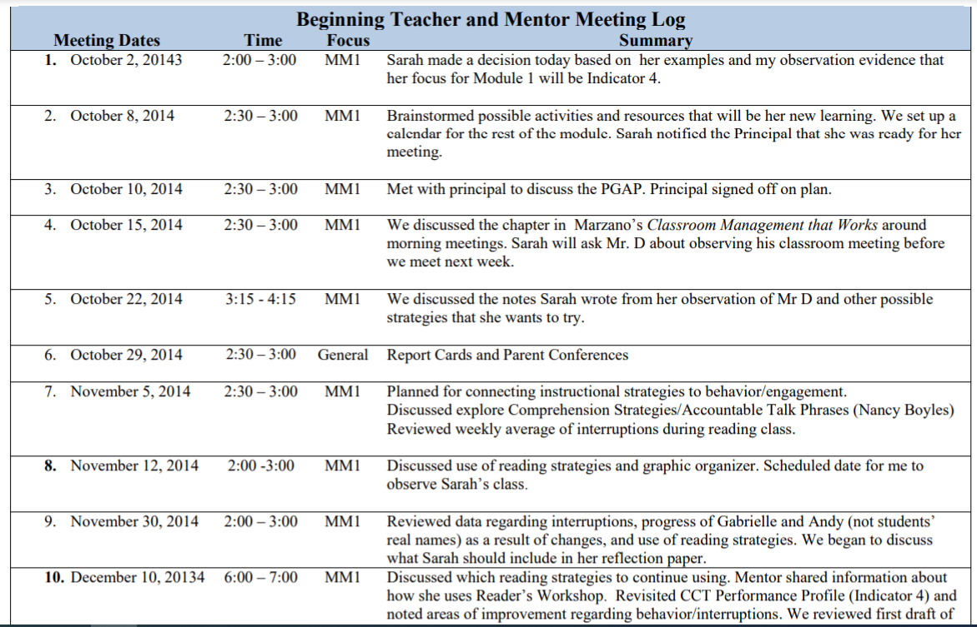
Sample Mentor Meeting Log
Notes:
This is a sample of a log, Mentors should log all of the work they engage in with the BT including helping the BT set up the classroom for the beginning of school, assisting in planning parent conferences, and other general mentoring tasks. Mentorship in not only about TEAM. It is about inducting early career teachers into the profession.

Slide 54
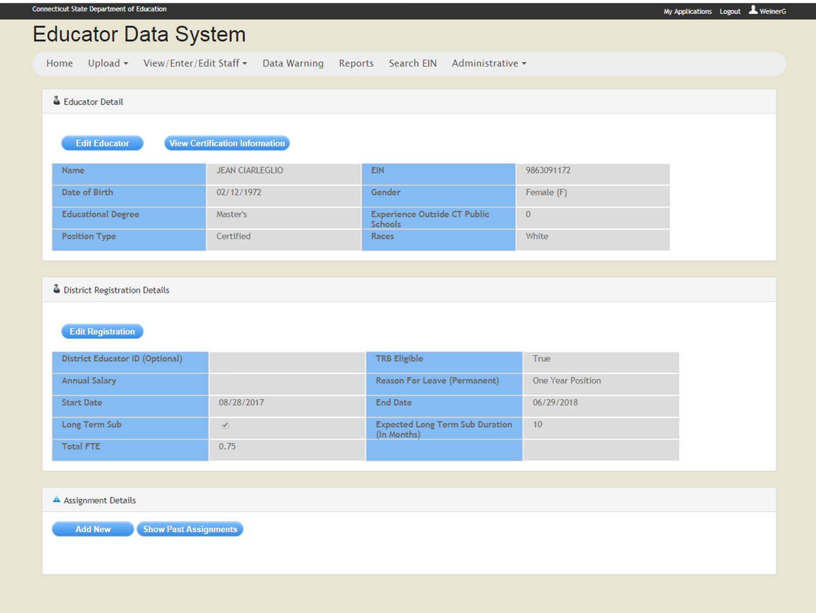
Notes:
A common data entry issue that causes teachers to be excluded from TEAM is missing assignment information or incorrect info that will cause a compliance error. In this screenshot of EDS, there is no assignment information so the teacher’s compliance cannot be determined and TEAM status is not available.

Slide 55
TEAM Allocations
TEAM Allocations are provided to districts by the State Department of Education to help offset the cost of implementing the TEAM program.
  mentor stipends,
  mentor training,
  beginning teacher/mentor professional development.
Allocations are based on the total number of beginning teachers who are actively enrolled in TEAM.
Districts will receive an Allocation for all of their beginning teachers participating in TEAM based on the data in EDS.
Allocations are not based on the number of years a teacher is in TEAM.
Notes:
TEAM budget is a fixed amount but since the number of beginning teachers varies every year, the allocation per teacher changes by school year.

Slide 56
February - March
Task | Details
Monitor progress meter for each BT | Regular monitoring will help you catch problems early and give you an opportunity to address them before they become big problems. It is better to be proactive.
Monitor meeting logs and meeting times. Meeting logs | Meeting logs can be an indicator of how a mentoring relationship is going. If there are few meetings being logged, it would be good practice to check in with the BT and mentor.
Begin Next Module | While teachers wait for results, they can begin the next module
Enter TEAM Completions in EDS | Check for BTs TEAM completion date Notify the person assigned the role EDS LEA TEAM of the completion date Verify that the completion date was entered into EDS

Slide 57
Entering TEAM Completions
The superintendent assigns an individual to the EDS LEA TEAM role.
DF notifies EDS LEA TEAM individual of the date of successful completion of TEAM.
EDS LEA TEAM logs into EDS and enters the date the teacher completed TEAM.

Slide 58
Monitoring – TEAM Completion

Slide 59
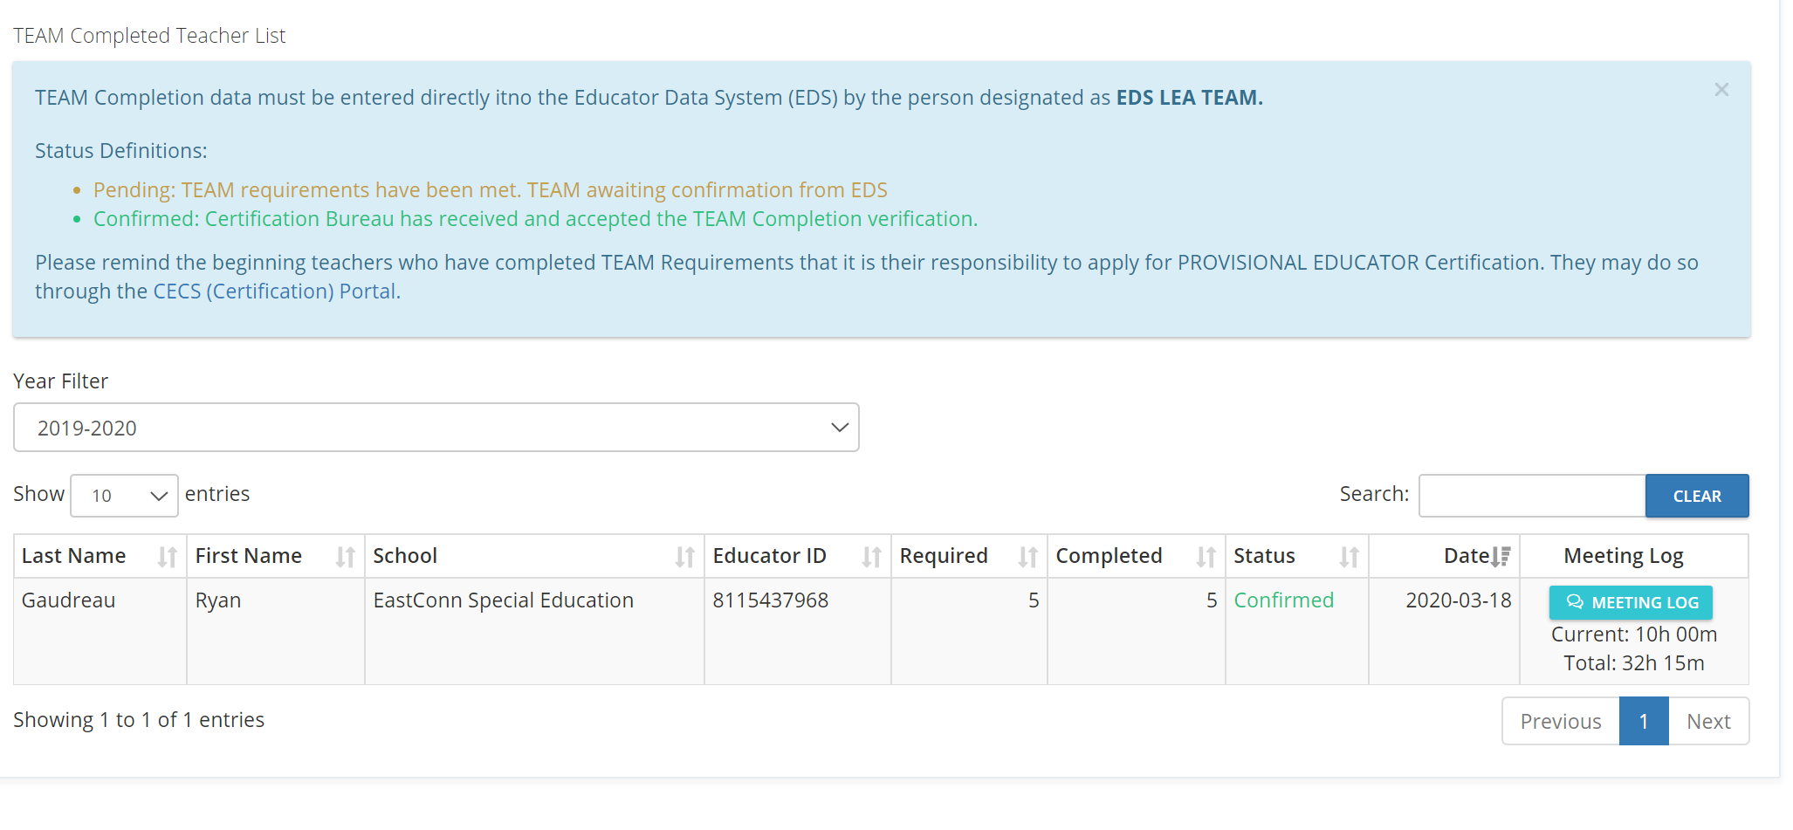
TEAM Completion
Notes:
The TEAM completion records provide you with the status of teachers who have completed all requirements successfully. You can also the number of mentoring hours. In this instance there were only 10 hours provided in the current year. That might be a problem if the teacher completed two modules over the course of the year. However, if the teacher only needed to complete one module, then the time would be fine.

Slide 60
Entering TEAM Completion in EDS

Slide 61
April - June
Task | Details
Continue to monitor BT progress and mentor meeting logs | Regular monitoring will help you catch problems early and give you an opportunity to address them before they become big problems. It is better to be proactive.
Prepare Stipend Worksheet | Mentor Stipends come from the district $500 per BT annually Mentors must provide legislatively mandated hours of support – approximately 10 per module Stipends are based on hours of mentoring – NOT module completion Stipend can be reduced if mentoring is not provided
End of Year Activities | Celebrate successes Recognize mentors for their work Remind mentors about training updates Meet with TCC and prepare final activities report

Slide 62
Mentor Stipends
Mentors shall receive a minimum of a five-hundred-dollar annual stipend for each beginning teacher assigned to such mentor from the local or regional board of education for participation in the teacher education and mentoring program. Such stipend shall be included in a person's total earnings for purposes of retirement.
Each mentor is required to provide a minimum of 50 contact hours over two years for Category I –beginning teachers required to complete the five-module process; or
a minimum of 20 contact hours over one year for Category II beginning teachers required to complete the two-module process
Mentors who do not fulfill obligations for mentoring hours may not be eligible to receive the full payment from the district. A district may reduce a stipend if the number of hours provided to a beginning teacher is significantly less than the requirements.
62
Notes:
Per state statute, mentors receive a $500 annual stipend
However, only if they meet the minimum requirements of mentoring hours.
Stipends cannot be based on module completion. They must be based on the number of mentoring hours provided.

Slide 63

Why is TEAM so Important?
On-Going Support
Formative Process
Continuous Professional Growth

Slide 64
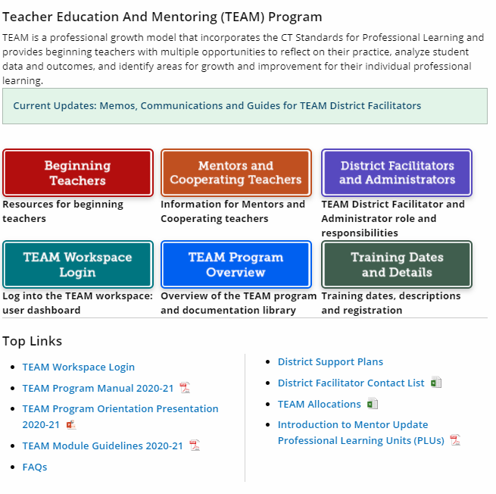
The TEAM Website –
Resources and Documents
Notes:
https://portal.ct.gov/SDE/Talent_Office/Talent-Office-home-page/TEAM-Program

Slide 65
Best Practices
Match mentors and Beginning Teachers within 30 days of hiring
Check in with Mentor/BT to make sure that the match is working
Establish Individual Building TEAM Facilitators
Monthly TEAM Professional Learning Events
  Establish a calendar of topics
  Partner with another district
  Mentor support sessions
Establish district timelines with specific due dates
  These are monitored by the building TEAM facilitator
All teachers new to the district participate in Module 5
  Or, all staff on a yearly basis
Notes:
Districts who have developed processes to ensure TEAM is fully implemented and that all BTs are given full support in their first few years in the profession, are seeing success with their teachers.

Slide 66

Notes:
Thank you for all that you do for CT teachers. Without your support, TEAM would not function as well as it does.

Slide 67


Slide 68


Slide 69
CSDE TEAM Program Contacts
You can find answers to most of your questions in the FAQs at https://portal.ct.gov/SDE/Talent_Office/Talent-Office-home-page/TEAM-Program.
Claudine Primack: TEAM Program Manager
claudine.primack@ct.gov 860-713-6826
Gady Weiner: Data Manager
gady.weiner@ct.gov 860-713-6836

