Slide 1
Part 1
TEAM
Introduction to the TEAM Program
Notes:
(Please customize this page for your district)
This introduction to the TEAM program is intended to provide an overview that can be used during the required orientation to TEAM. The introduction is broken into two parts. You will find part two begins on slide 24. You have the option of doing the entire introduction in one session or breaking it into two sessions. Part 1 provides a general introduction to TEAM. Part 2 focuses on the module process. We suggest that Part 2 be done at the beginning of October prior to teachers beginning to work on modules. September should be devoted to induction activities.
The facilitator may want to have the following materials for this session: copies of the CCT (district rubric if applicable), the TEAM Program Manual or a link to it, the TEAM Module Guidelines, Sanford Inspire and TEAM Crosswalk, Beginning Teacher Support Plan Timeline Form, and any samples you may want to share, as well as any district specific materials.
We suggest that you ask participants to bring a computer or other device with them to be able to access various resources throughout the session. It is recommended that mentors join their beginning teachers during this orientation. It provides an opportunity for everyone to hear the same information and develop common understandings. It also provides the mentor and beginning teacher an opportunity to begin building their relationship. Mentors should record participation in their mentoring logs.
1. Welcome participants: ask them to introduce themselves and share something about themselves- why they chose teaching, what they are feeling at the moment, etc., or use an ice breaker activity.
2. You may want to ask them what they know about TEAM. If there are mentors in the group, you may want to ask them to share something about a positive experience they’ve had working with BTs. Many mentors are TEAM graduates, you may want to ask them to share a positive experience about having completed TEAM.
3. Explain: TEAM is a collaborative endeavor focused on teacher reflection and professional growth that will impact student achievement. It brings together beginning teachers and trained mentors. The framework for TEAM is embedded in Connecticut’s Common Core of Teaching, which provides the opportunity for teachers to examine their own practice across a continuum. By lending their experience and expertise, mentors assist beginning teachers as they become more skilled and effective and move along the continuum of practice at a quicker pace than would be accomplished alone.

Slide 2

Learning Targets
1. Participants will know:
  The mission and goals of the TEAM Program;
  The expectations of the TEAM Program and their district; and
  What supports are available from the district.
2. Participants will be able to:
  Discuss the Process of Continuous Professional Growth with their mentor;
  Articulate the district’s expectations for TEAM completion; and
  Develop a two-year plan mentoring plan.
Notes:
Share with participants that these learning targets frame the orientation.
There is a lot of information in this session, but the most important thing for them to know at the end of the session are the expectations of both the TEAM program and the district (refer to your district three-year support plan) and tell them where to find support. Their mentor will be their number one resource and will be providing assistance. The DF is also another good resource. Provide DF’s contact information for them.
Review the learning targets for part 1 of the orientation. Let teachers know that part 2 will go into more detail. If you are going to do part 2 at another time, let them know when. Reassure them that do not need to start modules right away.
What is TEAM?
What do I need to do?
What’s in it for me? Data to support the benefit
Who is going to help me?

Slide 3
Introduction
Connecticut has long understood the importance of supporting beginning teachers in their first years of teaching.
  Learning to teach is a developmental process that begins during preservice and continues throughout a teacher’s career.
  In their first years in the profession, beginning teachers face the challenge of translating theory from teacher preparation programs into practice.
Notes:
CT has had an induction program for over 30 years. We have been a leader in the country for our high-quality induction program. TEAM is intended to be about professional growth. Teachers who approach it as an opportunity to learn and grow are far more successful and effective.

Slide 4

What is the Mission of the TEAM Program?
The mission of the TEAM Program is:
to promote excellence, equity and high achievement for Connecticut students by engaging teachers in purposeful exploration of professional practice through guided support and personal reflection.
Notes:
Ask participants to identify the key words and phrases in the mission statement. Discuss each word or phrase they pick out. Responses should include: excellence, equity, high achievement for students, purposeful exploration of professional practice, guided support and reflection.
Share the following:
The CT Department of Education is committed to ensuring that all students have an excellent teacher in every classroom.
Learning to teach is a developmental process that begins during preservice and continues throughout a teacher’s career. Research shows that it can take three to five years for a teacher to become fully proficient and be able to maximize student achievement. It is critical that teachers receive support in those early years to help them deal with the day to day tasks, routines, and challenges both instructionally and personally. Teaching is hard work.
All teachers need access to support. Regardless of where teachers are teaching, every teacher is provided equitable access to the support they need to become excellent teachers. The TEAM program is designed to provide the support based on their individual needs.
The TEAM program is intended to help beginning teachers engage in critically assessing their practice and student learning, making cause and effect connections between their actions/choices and student outcomes, and identifing their own professional growth needs. Becoming an excellent teacher requires a lifelong commitment to continuous professional learning.
Emphasize that TEAM is intended to help teachers develop as professionals and to develop a mindset that professional learning is continuous throughout their career. Acknowledge that it is acceptable to ask questions. They are not expected to know everything.
Successful completion of the TEAM Program is required for eligibility to move from an Initial Educator Certificate to a Provisional Educator Certificate.

Slide 5

TEAM Program
Continues to be recognized both regionally and nationally for its positive impact on teacher retention, mentor training and on-going professional development that promotes positive classroom environments, establishing strong relationships and emphasis on culturally responsive pedagogy and instruction.
Notes:
The TEAM program has been recognized as one of the most comprehensive in the country. The fact that we require all beginning teachers to participate in TEAM for multiple years ensures that teachers are supported as they transition from preparation to practice.

Slide 6
New Teacher Center’s (NTC’s)
2018 Review of State Policies on New Educator Induction
Only three states meet NTC’s most important criteria for a high-quality system of new teacher support:
  Connecticut, Delaware and Iowa are the only states that require schools and districts to provide multi-year support for new teachers,
  Require teachers to complete an induction program for a professional license, and
  Provide dedicated funding for new teacher induction.
Notes:
A third of beginning teachers quit within their first three years on the job.
In 2019-20, SDE engaged the services of the Regional Educational Laboratory to conduct a study of TEAM. The report released in 2021 showed a strong correlation between completing TEAM and retaining teachers. Teachers who completed more modules were more likely to remain in the classroom.

Slide 7

What Is the TEAM Program?
Legislatively mandated multi-year induction program for all beginning teachers
Teachers are paired with experienced, trained mentors
Teachers work with their mentors to create
Professional Growth Action Plans that correspond
to instructional modules
Districts assign mentors and are responsible for implementing the TEAM program
Completion of the TEAM program is required for teachers to advance to the next teacher certification level
Notes:
The TEAM program is legislatively mandated for all beginning teachers. It requires teachers to be paired with a mentor while they complete 5 modules. TEAM must be successfully completed to be eligible to move to the next level of certification- provisional.

Slide 8

Why is TEAM so Important?
On-Going Support
Formative Process
Continuous Professional Growth
Notes:
Teachers who participate in induction programs develop into more effective teachers earlier in their careers. Critical to a quality induction program is the support beginning teachers receive.
Mentors are assigned to beginning teachers to provide support and guide them along a path of professional growth. The mentor-beginning teacher relationship is a collaborative one leading to mutual learning for both the teacher and the mentor.
TEAM is a model of continuous professional growth and it is formative in nature. It provides novice teachers with ongoing opportunities to reflect on current practice, identify their needs for growth, engage in new learning, use their new learning to improve practice, and realize positive outcomes for students.
2. Introduce your district’s requirements for completion of a module. You may want to add a slide with your requirements.

Slide 9
Who are the TEAM Program Players?
Beginning teachers who hold an initial or interim initial certificate.
District Facilitator
TEAM Coordinating Committees
Administrators
Trained Mentors
Trained Reviewers
CT Department of Education (CSDE)
Regional Education Service Centers (RESCs)
Notes:
The next few slides will provide details on each of these groups and how they will support beginning teachers. You can refer to Section 2 of the TEAM Program Manual (TPM), roles and responsibilities pp. 12-13
You do not need to spend a lot of time on the roles, but give them a sense of who is involved. Many new teachers may not know about these roles and responsibilities.
Briefly explain the CSDE and RESCs. (They are not covered on the next slides. Only district supports are covered)
RESC’s provide training and support to districts.
CSDE oversees the program and supports districts in implementing TEAM.

Slide 10
How will my District Support the TEAM Program?
District Facilitator
  An individual appointed to serve as a liaison between CSDE, district, beginning teachers, and mentors regarding requirements of the TEAM program
TEAM Coordinating Committee
  A district committee that plans, implements and monitors the district’s TEAM Program
Notes:
Explain the DF role and how the DF can be contacted.
Take some time with this slide to explain your district process and who is on the TCC and how they can contact the DF and TCC if needed. You might want to provide either a link to your District Three-year Mentoring Plan, and a contact sheet for the TCC members.
Explain that TEAM is a district based program, which means that the district TCC is responsible for developing their own plan. The plan is required, by law, to include: timelines, processes for module completion, mentor recruitment and assignment, etc.

Slide 11
How will my District Support the TEAM Program?
Administrator
  An instructional leader who can provide guidance and support to help teachers grow professionally
  The individual who will review and sign-off on the Profession Growth Action Plan (PGAP), indicating that he or she can support the agreed upon activities and/or resources
  Can help the teacher make connections between TEAM, teacher evaluation, and professional learning
Notes:
It is important to remind teachers that their administrators are a valuable resources. Administrators are required to be instructional leaders of their buildings. They have deeper insights into a teacher’s practice through goal setting conferences and classroom observations. Their insights offer additional information to inform the module process.
The administrator’s insights from observations and knowledge of the teacher’s student learning goals/objectives can inform the discussion and the administrator may suggest additional resources to support the teacher’s individual professional learning needs.
The administrator signs-off on the Professional Growth Action Plan (PGAP). It is not an approval of the PGAP, but it is an agreement that he or she will support the activities or resources requested. The administrator should determine if the district and the school can support the identified professional learning activities (e.g. provision of substitute coverage for the mentor to observe the beginning teacher or the teacher to observe the mentor or another teacher, attendance a professional learning workshop, etc.) or help the teacher to find alternative activities or resources for those that cannot be supported.

Slide 12
How will my District Support the TEAM Program?
TEAM Mentor
  An accomplished teacher who has been selected by the school district and has completed the TEAM Program Initial Support Teacher Training
  The person responsible for providing support and guidance to the beginning teacher as he or she progresses through the year and the TEAM Program requirements
Reviewer
  Educator selected by district and trained to read and review reflection papers or projects
Notes:
Explain how mentors will be assigned in your district and what the expectation is for mentorship. See TPM pp. 13-15
Explain your district’s reviewer requirements and process. You may want to add a slide with your specific requirements.

Slide 13
What is the Design of the TEAM Program?
TEAM is designed as a continuous professional growth process aligned with the five domains of Connecticut’s Common Core of Teaching (CCT):
  Classroom Environment, Student Engagement and Commitment to Learning
  Planning for Active Learning
  Instruction for Active Learning
  Assessment for Learning
  Professional Responsibilities and Teacher Leadership
Notes:
This slide provides a general overview- 5 modules are aligned with the CCT- the professional standards that define the knowledge and skills expected of all CT teachers. The CCT is the basis for teacher preparation, TEAM, teacher evaluation and professional learning.
Teachers who did not complete their preparation in CT will need a clear explanation of the CCT. You may want to provide the link to the CCT or copies.

Slide 14
The Common Core of Teaching Emphasizes:
High Student Achievement and success for all students
Differentiation of instruction to support all students
Collaboration with colleagues and families to meet the diverse needs of all students
Commitment to the analysis of teaching and continuous professional growth and learning
Notes:
This is intended to provide the big picture for them. Tell them that they will be exploring the CCT in more detail with their mentors.

Slide 15
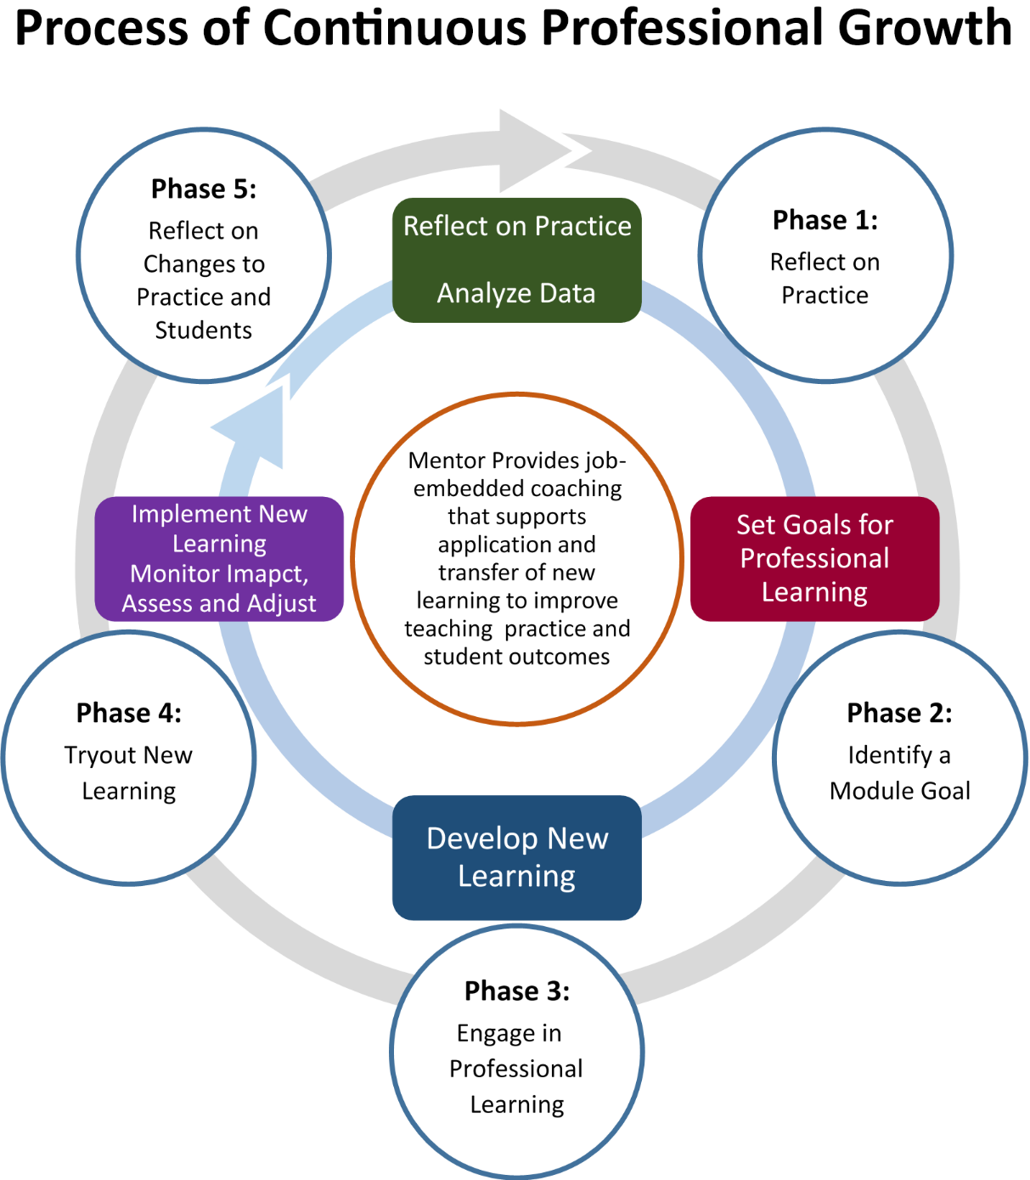
TEAM Module: Process of Continuous Professional Growth
Cycle of Continuous Growth is based on Learning Forward – Cycle of Continuous Improvement
Notes:
Now that participants have a general overview of the mission and goals, the focus is now on the Process of Continuous Growth. This slide is animated to show how the module process and the process of continuous professional growth align.
Phase 1: The process begins with the beginning teacher and mentor collaboratively analyzing a variety of data related to students’ learning needs and the teacher’s pedagogical practices to determine a focus area for professional learning.
Phase 2: The teacher then sets a goal for professional growth and develops a professional growth action plan (PGAP), which is shared with the administrator.
Phase 3: The teacher then develops new learning around the selected focus area by engaging in professional learning activities/resources to acquire and develop new practices, or refine, expand, or extend their existing practice to build on their content and pedagogical skills.
Phase 4: Next, the teacher applies new learning within the classrooms, evaluates the impact of their professional learning on their practice and student learning. Throughout the process, the teacher continues to collaborate with the mentor to assess and adjust subsequent instruction as needed or develop additional new learning.
Phase 5: In the last step of the process, the teacher again reflects, this time on the whole process and identifies specific examples/evidence of new learning, the impact on their practice, and positive outcomes for students. At the culmination of the module process, the teacher draws on these reflections and uses examples/evidence to create a reflection paper or a project that documents what was learned at each of these steps.
The TEAM Module Guidelines provide a detailed overview of each step in the process. The TEAM Module Guidelines are available on the TEAM website. You may want to copy it and distribute as a handout.

Slide 16
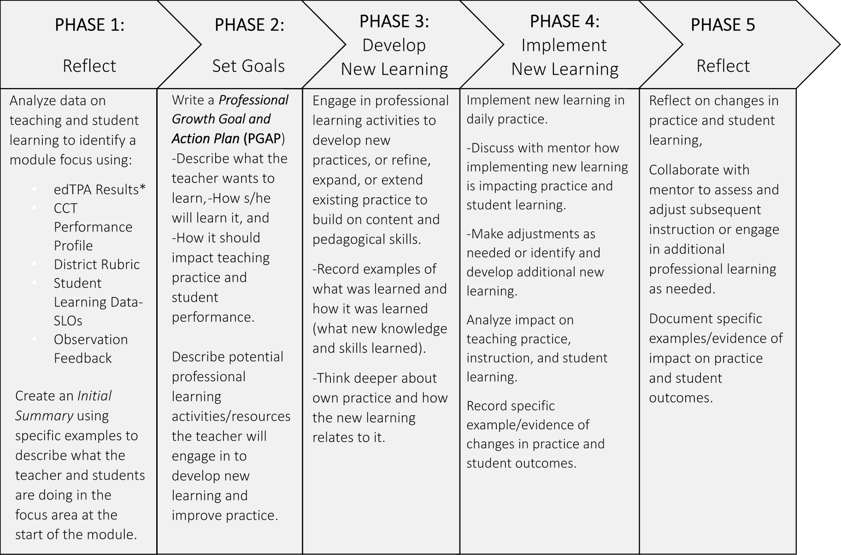
The TEAM Modules:
A Process for Continuous Professional Growth
Notes:
Although the process is an iterative one, we break each phase down to show what occurs at each point in the process. The process is iterative, not linear.
You may want to provide this as a handout.
*Teachers can cut out each phase of the process. Punch a hole at the top of each phase and put them on a circular clip so that each phase can be flipped. This will help to convey that the process is continuous. It is not lock step. It is important to note that the cycle of continuous professional growth is not a linear process. Teachers will move back and forth throughout developing, implementing, analyzing and reflecting on new learning and it’s impact on practice.
The next series of slides (20 – 34) explain the process in more detail. These may be used in a separate presentation to introduce the first module, or with mentors to remind them of the process they will engage in with their beginning teachers.

Slide 17



Module Five is Different
Modules 1-4 require [a reflection paper or a project] to be submitted for review at the end of the 8-10 week professional learning experience.
Module 5 is a facilitated conversation using scenarios that prompt honest discussions about possible ethical dilemmas regarding:
  Relationships with students
  Professional ethics
  Culturally Responsiveness
  Community and family
  Bullying
Upon completion of the facilitated conversation, teachers complete a questionnaire.
Notes:
Customize this slide to the district’s requirements for module completion
Explain that this module is different than the other four:
The Code of Professional Responsibility for Educators is a set of principles which the education profession expects its members to honor and follow. These principles set forth, on behalf of the education profession and the public it serves, standards to guide conduct and the judicious appraisal of conduct in situations that have professional and ethical implications.
The Code adheres to the fundamental belief that the student is the foremost reason for the existence of the profession. The education profession is vested by the public with a trust and responsibility requiring the highest ideals of professionalism. Therefore, the educator accepts both the public trust and the responsibilities to practice the profession according to the highest possible degree of ethical conduct and standards. Such responsibilities include the commitment to the students, the profession, the community and the family.
If the district is not using the online TEAM dashboard, explain how teachers will submit the questionnaire.

Slide 18


Professional Learning
Why do educators need professional learning?
Didn’t they learn what they need to know in college?
Notes:
Beginning teachers need to know that the TEAM process is a valuable professional learning opportunity and not just an act of compliance. When approached as a part of their own professional growth, teachers realize great benefits to their own practices as well as their student outcomes. In a survey of TEAM completers, these are some of the positive outcomes that teachers have reported after participating in the TEAM program.

Slide 19

Professional Learning
Preparation programs provide the basic knowledge and skills teachers need to be ready to enter the classroom
Notes:
Beginning teachers need to know that the TEAM process is a valuable professional learning opportunity and not just an act of compliance. When approached as a part of their own professional growth, teachers realize great benefits to their own practices as well as their student outcomes. In a survey of TEAM completers, these are some of the positive outcomes that teachers have reported after participating in the TEAM program.

Slide 20

Continuous Improvement of Practice
For educators, and especially teachers, the commitment to and participation in ongoing professional learning is essential to increasing effectiveness and improving student success
Notes:
Beginning teachers need to know that the TEAM process is a valuable professional learning opportunity and not just an act of compliance. When approached as a part of their own professional growth, teachers realize great benefits to their own practices as well as their student outcomes. In a survey of TEAM completers, these are some of the positive outcomes that teachers have reported after participating in the TEAM program.

Slide 21
What Teachers Say About TEAM
Beginning teachers say that participating in TEAM has:
92.6% - Positively influenced my practice
83.6% - Helped me recognize the link between my new learning and the impact on my students' learning
93.8% - Made me a more reflective educator
89.1% - Made me a more effective teacher
90.1% - Improved my students’ achievement
96.1% - Helped me design more effective lessons that engage students deeper in the content
Notes:
Beginning teachers need to know that the TEAM process is a valuable professional learning opportunity and not just an act of compliance. When approached as a part of their own professional growth, teachers realize great benefits to their own practices as well as their student outcomes. In a survey of TEAM completers, these are some of the positive outcomes that teachers have reported after participating in the TEAM program.

Slide 22



What Teachers Say About TEAM
I believe that reaching out to my coworkers for assistance, researching strategies in publications, and keeping a willingness to learn from others will contribute to my professional growth and a long, successful career in teaching.
When I started this module, my classroom was almost 100 percent teacher driven. By the end of the module, there was a noticeable sharing of classroom responsibilities and a greater participation by the students in the learning process.
Reviewing the CCT Performance Profile was extremely helpful in examining and identifying my teaching practices prior to this process.
Notes:
Now that teachers have a general understanding of the TEAM program and the module process, you will want to spend a little time reviewing the Support Plan that they will need to submit to the DF and the TCC. The forms can be found in Appendix K of the TPM. You may want to provide the forms at this orientation, where they may begin to fill it in.
Purpose of the Support Plan: The support plan serves two purposes: first it informs the DF and the TCC of the BTs plan and possible need for a third year. Second, it helps the beginning teacher think about how to structure her or his own schedule in order to meet the requirements of TEAM. By planning how what they need to accomplish over the next two years, teachers are more likely to complete all of the TEAM requirements within their allotted time.
If you have teachers in Category II (two modules) explain that their support plan will be for one year only. Appendix B of the TPM lists all of the endorsements by category of participation.
Your district may have specific requirements for module completion and due dates. Remind BTs to use the district timeline to complete the plan. The plan also asks BTs if there are circumstance that may require them to use the third year. This is important to know. so that the mentor stipend can be distributed over the 3 years.
You may want to have copies of this to hand out at this orientation. You may tell them that should meet with their mentors to complete their plan and return it to you by a specific date.

Slide 23
TEAM TWO-YEAR BEGINNING TEACHER SUPPORT PLAN
Anticipated timeline of participation
Module(s) that will be completed during the 2018-19 school year
Module(s) that will be completed during the 2019-20 school year
Anticipated circumstances, such as a planned leave of absence (i.e., maternity leave, planned medical leave, etc.). that may require a third year
Notes:
Now that teachers have a general understanding of the TEAM program and the module process, you will want to spend a little time reviewing the Support Plan that they will need to submit to the DF and the TCC. The forms can be found in Appendix K of the TPM. You may want to provide the forms at this orientation, where they may begin to fill it in.
Purpose of the Support Plan: The support plan serves two purposes: first it informs the DF and the TCC of the BTs plan and possible need for a third year. Second, it helps the beginning teacher think about how to structure her or his own schedule in order to meet the requirements of TEAM. By planning how what they need to accomplish over the next two years, teachers are more likely to complete all of the TEAM requirements within their allotted time.
If you have teachers in Category II (two modules) explain that their support plan will be for one year only. Appendix B of the TPM lists all of the endorsements by category of participation.
Your district may have specific requirements for module completion and due dates. Remind BTs to use the district timeline to complete the plan. The plan also asks BTs if there are circumstance that may require them to use the third year. This is important to know. so that the mentor stipend can be distributed over the 3 years.
You may want to have copies of this to hand out at this orientation. You may tell them that should meet with their mentors to complete their plan and return it to you by a specific date.

Slide 24

Questions?
For questions, please contact your District Facilitator. The District Facilitator is your first line of contact and can answer most questions. If there is a question that your District Facilitator cannot answer, he or she will contact the appropriate parties to find the answer to your question.
41
Notes:
Districts may want to change the contact information and include your own contacts and the protocol for contacting you.

Slide 25

The most valuable resource that all teachers have is each other. Without collaboration, our growth is limited to our own perspectives.”
Robert John Meehan
rockmyclass.com

Slide 26
Part 2
TEAM
Introduction to the TEAM Program
Notes:
Part 2 of the introduction to the TEAM program focuses on the phases of the module process.
The facilitator may want to have the following materials for this session:
Copies of the CCT
The TEAM Program Manual (or a link to it)
Sample CCT Performance Profiles (or district rubric is applicable), PGAP, papers or projects
Feedback and criteria for review
You may ask participants to bring a computer device with them to be able to access various resources throughout the session. It is recommended that mentors join their beginning teachers during this orientation. It provides an opportunity for everyone to hear the same information and develop common understandings. It also provides the mentor and beginning teacher an opportunity to begin building their relationship.
Explain: The framework for TEAM is embedded in Connecticut’s Common Core of Teaching, which provides the opportunity for teachers to examine their own practice across a continuum of practice. By lending their experience and expertise, mentors assist beginning teachers as they become more skilled and effective and move along the continuum of practice at a quicker pace than would be accomplished alone.

Slide 27
Learning Targets
1. Participants will know:
  The mission and goals of the TEAM Program;
  The expectations of the TEAM Program and their district; and
  What supports are available from the district.
2. Participants will be able to:
  Discuss the Process of Continuous Professional Growth with their mentor;
  Articulate the district’s expectations for TEAM completion; and
  Develop a two-year plan mentoring plan.
Notes:
The learning targets are the same as they frame the orientation.
There is a lot of information in this session, but the most important thing for them to know at the end of the session are the expectations of both the TEAM program and the district.
This introduction will answer the big questions:
What is TEAM?
What do I need to do?
What’s in it for me?
Who will be able to help me?

Slide 28

Why is TEAM so Important?
On-Going Support
Formative Process
Professional Growth and Development
Notes:
TEAM is a professional growth program and it is formative in nature. It provides novice teachers with ongoing opportunities to reflect on current practice, identify a need or opportunity for growth, engage in new learning to improve practice and realize positive outcomes for students.
Mentors are assigned to beginning teachers to provide support and guide them along a path of professional growth. The mentor-beginning teacher relationship is a collaborative one leading to mutual learning for both the teacher and the mentor.

Slide 29
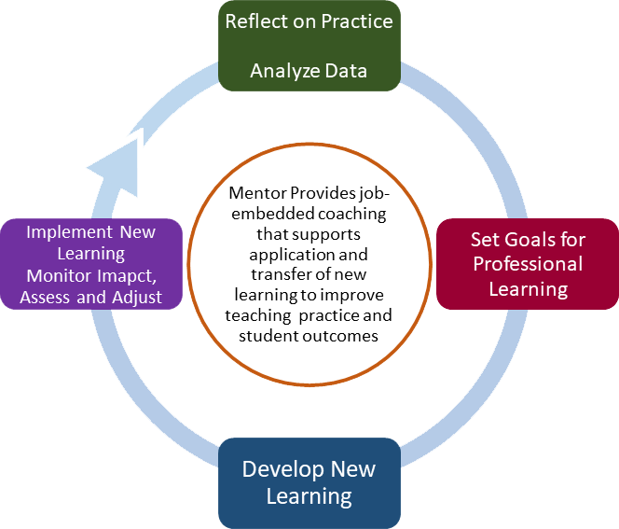
Cycle of Continuous Professional Learning
(Based on Learning Forward – Cycle of Continuous Improvement)
Notes:
Cycle of Professional Learning
We reviewed this cycle in part 1 and talked about the role of the mentor in guiding and coaching new teachers through this process.

Slide 30
The CCT as the Foundation
CT
Common Core of Teaching (CCT)
2010
Student Teacher
Evaluation
CCT
Performance
Profiles
TEAM
CCT Rubric For Effective Teaching
CCT Rubric for Effective Service Delivery
edTPA
Notes:
You may want to provide a copy of the CCT or ask them to open it on their computer
(https://portal.ct.gov/-/media/CA1519B5964A47DBA11BC29CE99E857E.pdf) as a reference.
Ask how many of them are familiar with the CT Common Core of Teaching. Have they seen it? What do know about it?
The CCT is linked by state law and regulations to requirements across a teacher’s career including preparation, induction and teacher evaluation.
The Common Core of Teaching (CCT) articulates the knowledge and skills of effective teaching; it provides the framework for the TEAM Program, the modules and the professional growth process.
The CCT is at the heart of the CT teacher evaluation process. Additionally, all teacher preparation programs in Connecticut align their student teacher evaluations to the CCT.
edTPA, the assessment student teachers are required to complete, is also aligned with the CCT.

Slide 31

Common Core of Teaching
Introduction
Six Domains with Indicators
Code of Professional Responsibility
Notes:
CT Common Core of Teaching CCT
Materials: Common Core of Teaching
Share: The CCT is a document that articulates what an effective teacher in Connecticut should strive for on a daily basis. It also provides the foundation for a professional path of continuous learning during teacher preparation, TEAM, and district evaluation.
We will take a few minutes to revisit this important document which is used in teacher preparation, TEAM and educator evaluation.
Point out Page 1 and ask them to read all of page 1 and the top of page 2 and page 4.
Give the Participants five-seven minutes to review the CCT, it’s domains and indicators.

Slide 32
The Common Core of Teaching Emphasizes:
High Student Achievement and success for all students
Differentiation of instruction to support students
Collaboration with colleagues and families to meet the diverse needs of all students
Commitment to the analysis of teaching and continuous professional growth and learning
Notes:
Ask participants after they finished reading the CCT – what does the CCT emphasize on pages 1 thru the top of page 2? What strikes them as they refresh their memories about this document that sets the standards for effective teaching in CT?
Highlight the three bullets on the bottom of the page. These bullets are aligned to the purpose of the TEAM program. They describe what effective teaching is.
♦a deep commitment to student achievement and the belief that all students should be challenged to achieve,
♦ a willingness to work in collaboration with colleagues and families to meet the diverse learning needs of all students, and
♦ a commitment to analysis of one’s teaching and continuous professional development.
Page 2 contains the teaching standards and describes the two levels of effective knowledge, skills and qualities
Facilitators Note: Page 4 gives an overview of the domains, pages 5-10 gives a detailed version of each domain, pages 11-13 is the Code for Professional Responsibility. Domain 1 is not a TEAM module because it is in assessed by edTPA and Praxis II.
Answers may include:
The CCT (CCT) articulates the knowledge, skills and qualities that Connecticut teachers need in order to prepare students to meet the challenges of the 21st century.
The effectiveness of Connecticut schools depends upon skillful teaching. Teacher quality is one of the most significant contributors to student learning and achievement; what teachers know and do directly influences what students learn.
The philosophy behind the CCT is that teaching requires more than simply demonstrating a certain set of technical skills. It requires command of subject matter and pedagogical skills combined with caring deeply about students and their successes, a willingness to work in collaboration with colleagues and families to meet the diverse learning needs of all students, and a commitment to analysis of one’s teaching and continuous professional development.

Slide 33
What is the Design of the TEAM Program?
TEAM is designed as a continuous professional growth process aligned with the five domains of Connecticut’s Common Core of Teaching (CCT). The five modules include:
  Classroom Environment, Student Engagement and Commitment to Learning
  Planning for Active Learning
  Instruction for Active Learning
  Assessment for Learning
  Professional Responsibilities and Teacher Leadership
Notes:
This slide provides a general overview- 5 modules are aligned with the CCT- the professional standards that define the knowledge and skills expected of all CT teachers.
Teachers who did not complete their preparation in CT may need more explanation of the CCT.

Slide 34
Aligning TEAM to CT Common Core of Teaching
CT Common Core of Teaching | TEAM Program Modules
Domain 1 Content and Essential Skills | EMBEDDED
Domain 2 Classroom Environment, Student Engagement and Commitment to Learning | MODULE 1
Domain 3 Planning for Active Learning | MODULE 2
Domain 4 Instruction for Active Learning | MODULE 3
Domain 5 Assessment for Learning | MODULE 4
Domain 6 Professional Responsibilities and Teacher Leadership | MODULE 5
Notes:
1. The Modules are aligned to the CCT. The diagram demonstrates the alignment. Point out that the module numbers do not reflect the Domain numbers.
The CCT contains teaching standards which describe effective knowledge, skills, and qualities and the foundational skills and competencies that pertain to all teachers, regardless of the subject matter, field or age group they teach.
You can mention that all teacher evaluation rubrics are required to be aligned to these same standards. In other words, teachers will be evaluated on the same standards no matter where they are teaching. Their TEAM work can help them to improve their practice and positively impact their evaluation.

Slide 35

NEW - Beginning Teacher Survey
NEW – Beginning with first-year teachers in fall 2021:
  Complete a short survey about your teacher preparation, both coursework and clinical experiences, and how well prepared you were for your first teaching assignment.
  This survey will help the beginning teacher think about their own strengths and areas for growth based on their preparation. Data from the survey will also inform improvements to educator preparation programs.
Notes:
This is a new part of the module process. Each Module, including Module 5, will begin with a short survey that asks teachers to reflect on their educator preparation and how prepared they feel they are for their first teaching assignment. This new process will begin with all year 1 teachers this year and will continue as they progress through all of the modules and new teachers begin TEAM.
The survey serves two purposes.
Inform focus area for module: It aligns directly with the CCT and TEAM modules. Teachers will reflect on their preparation, both coursework and clinical experiences. They will then talk with their mentor about their areas of strength and areas for growth. This along with other data sources will help the BT identify an appropriate area of focus for the module.
Inform improvements to educator preparation programs (EPPs): the survey data will be shared in the aggregate with EPPs so they can identify where their programs’ strengths lie and where improvements may be necessary., NO NAMES OR PERSONALLY IDENTIFYING INFORMATION WILL BE SHARED.

Slide 36
Phase 5:
Reflect on Changes to Practice and Students Learning
Phase 1:
Reflect on Practice
Mentor Provides job-embedded coaching that supports application and transfer of new learning to improve teaching practice and student outcomes
Reflect on Practice
Analyze Data
Set Goals for Professional Learning
Develop New Learning
Implement New Learning
Monitor Imapct, Assess and Adjust
Phase 4:
Tryout New Learning
Phase 2:
Identify a Module Goal
Phase 3:
Engage in Professional Learning
Notes:
Let’s look at the TEAM Module process and how it aligns with the process of continuous professional learning.
The next several slides go through the various phases of the process. You may want to have teachers/mentors refer to the Module Guidelines 2021-22.

Slide 37
The TEAM Modules:
A Process for Continuous Professional Growth
Notes:
Materials: A copy of this slide
Emphasize that the process is an iterative one, but this slide breaks each phase down to show what generally occurs at each phase of the process.
*If you did not do this in part 1 of the orientation- you may want to provide this as a handout. Teachers can cut out each phase of the process. They can then punch a hole at the top of each phase and put them on a circular clip so that each phase can be flipped. This will help to convey that the process is continuous.
It is not a lock-step process, rather it is an iterative process. It is important to note that the cycle of continuous professional growth is not a linear process. Teachers will move back and forth throughout developing, implementing, analyzing and reflecting on new learning and it’s impact on practice.

Slide 38
Phase 1:
Reflect on Practice
Mentor Provides job-embedded coaching that supports application and transfer of new learning to improve teaching practice and student outcomes
Reflect on Practice
Analyze Data
Set Goals for Professional Learning
Develop New Learning
Implement New Learning
Monitor Imapct, Assess and Adjust
Notes:
In Phase 1 of the Module process you will reflect on your preparation, your practice and student performance, explore the CCT Performance Profile and select an indicator of focus for the module, record examples of evidence and write an Initial Summary .
The next slide explains this phase of the process in more detail.

Slide 39

Notes:
It is important to remind new teachers that they are not expected to be expert teachers. They have completed their teacher preparation program, but there is still a lot to learn. It is ok not to know. They should be encouraged to ask questions. Their mentor is there to support them.

Slide 40
Teacher Preparation Survey
Instructions:
Before beginning this module, we ask that you reflect on your educator preparation.
Consider both coursework and clinical experiences, including student teaching. To what degree do you feel the training that you received in your educator preparation program prepared you for the classroom?
As you reflect on your training, consider your strengths and areas for growth.
After completing the survey, you may discuss your reflection and responses with your TEAM mentor to support and inform your TEAM module goal setting and work.
Notes:
These instructions come at the beginning of each module. Encourage teachers to answer honestly.
Let them know that beginning teachers, they do not need to be experts. They are still learning. Their mentor is there to guide them, not judge or evaluate them. The more honest they are in their reflections, the more meaningful each module will be.

Slide 41
Sample Survey Questions
Module 1:
Classroom Environment, Student Engagement and Commitment to Learning
My preparation program coursework and/or clinical experiences provided me with sufficient opportunities to learn how to: | Preparation Program Coursework |  |  |  | Clinical Experiences
 | Strongly Disagree | Disagree | Agree | Strongly Agree | Strongly Disagree | Disagree | Agree | Strongly Agree
Use classroom management strategies that foster a safe and supportive learning environment and establish appropriate standards and norms for behavior
Use strategies to appropriately and effectively address challenging student behaviors
Create a class climate that is responsive to and respectful of the learning needs of students with diverse backgrounds (e.g., racial, cultural, linguistic) and performance levels, including students with disabilities, gifted students, and English learners
Notes:
This is the entire survey for Module 1. Point out how the statements align with the CCT. The CCT serves as the foundation across a teacher’s career including preparation, induction, professional learning, and teacher evaluation.
Point out that the survey is very short and takes very little time to complete. You may want to ask teachers to think about the 3 statements in relation to their own preparation. Have them select one and talk about it with their table or person sitting next to them. Ask if anyone wants to share their key takeaways from their discussion.

Slide 42
TEAM Module Process
Phase 1
Reflect on Practice
Analyze data on teaching and student learning to identify a module focus using:
Explore CCT Performance Profile using your data and reflect on strength and areas for growth
Select one indicator for professional growth and development
Record specific examples/evidence of practice
Create an Initial Summary using specific examples to describe what the teacher and students are doing in the focus area at the start of the module.
Examples of Data Sources
Beginning Teacher Survey edTPA Results (what are your areas of strength and areas for growth) Observation Feedback (from mentor and administrator) Student Work Samples | Student Assessment Results Assignments Lesson Plans District Rubric Student Learning Data-SLOs
Notes:
You may want to provide each participant with a copy of the TEAM Module Guidelines or give them the link so that they may access it as you review the module process with them.
1.The process begins with the beginning teacher and the mentor collaboratively analyzing a variety of data related to students’ learning needs and the teacher’s practices to determine an area of focus for the module.
2. Analyze data on teaching and student learning from a variety of sources to identify a specific area of focus for the module – the teacher preparation survey, edTPA results, observation feedback from mentor or evaluator, lesson/unit plans, sample student work, or student assessments (formative and summative) and annual student learning goals.
Data can come in many forms. It may be quantitative or qualitative. Data is NOT only test scores. Some examples of data are provided on the slide. Discuss what other forms of data a teacher might use to reflect on his or her practice.
New teachers may want to review their edTPA results and other assessment data from their ed prep program along with the teacher preparation survey to identify areas that may have presented a challenge or opportunities for growth.
The feedback from a mentor’s or administrator’s observation is data about the teacher’s performance and can help the teacher identify where he/she falls on the CCT Performance Profile.
Student work samples – grades with comments- or sample assignments, anecdotes about things that are happening in the classroom are all good types of data that a teacher can analyze to make decisions about which area to focus.
BT’s may also consider feedback they have received from their classroom observations and their SLOs for the year. Together the BT and the mentor can discuss how to connect TEAM with the teacher’s evaluation. Evaluation can and should inform their TEAM work.
Anecdotal evidence from conversations with the mentor on student or teacher performance
Let’s explore the CCT Performance Profile – next slide

Slide 43
CCT Performance Profile
Profiles available on ctteam.org
Read the Performance Profile going across from left to
right.
Note language changes as you move across the continuum
Domain 1: Teachers promote student engagement, independence and interdependence in learning by facilitating a positive learning community by:
CCT Indicators | Continuum of Effective Teaching Practice
1. Creating a class climate that is responsive to and respectful of the needs of students with diverse backgrounds, interests and performance levels | o Little indication that the students’ backgrounds, interests and skill levels are considered in selecting content and creating learning opportunities. | Considers students’ backgrounds, interests and skill levels in making connections to the content and creating learning opportunities. Treats students as individuals respecting their diverse needs and recognizes that the background of each student may differ dramatically within the classroom and school. | Designs learning opportunities which build upon students’ diverse backgrounds, interests and skill levels. Creates a classroom environment in which individual students are treated with respect regardless of differences in backgrounds, interests and skill levels. | Designs learning opportunities which capitalize on students’ diverse backgrounds and interests to enrich the learning community. Creates a classroom environment which supports students in becoming role models for treating others with respect and dignity.
Notes:
NOTE: IF YOUR DISTRICT USES YOUR RUBRIC INSTEAD OF THE PERFORMANCE PROFILES, YOU SHOULD INSERT YOUR RUBRIC HERE.
Explain that each module, except module 5, has a performance profile with several indicators that they will use to reflect and analyze their teaching.
Use the next 4 slides to introduce and review the Performance Profiles.
It is especially important to point out that the stem of the Domain is a part of the indicator.
Please note that this is only one indicator of Module 1. You may want to provide a copy of the entire Performance profile for Module 1. You can ask them to compare it to the survey items
The next slides are animated, you can click each one and it will point to the specific part of the profile.

Slide 44
CCT Performance Profile
Profiles available on ctteam.org
Read the Performance Profile going across from left to
right.
Note language changes as you move across the continuum
Domain 1: Teachers promote student engagement, independence, and interdependence in learning by facilitating a positive learning community by:
CCT Indicators | Continuum of Effective Teaching Practice
1. Creating a class climate that is responsive to and respectful of the needs of students with diverse backgrounds, interests and performance levels | o Little indication that the students’ backgrounds, interests and skill levels are considered in selecting content and creating learning opportunities. | Considers students’ backgrounds, interests and skill levels in making connections to the content and creating learning opportunities. Treats students as individuals respecting their diverse needs and recognizes that the background of each student may differ dramatically within the classroom and school. | Designs learning opportunities which build upon students’ diverse backgrounds, interests and skill levels. Creates a classroom environment in which individual students are treated with respect regardless of differences in backgrounds, interests and skill levels. | Designs learning opportunities which capitalize on students’ diverse backgrounds and interests to enrich the learning community. Creates a classroom environment which supports students in becoming role models for treating others with respect and dignity.
The indicator begins with the Domain stem statement
Notes:
Reading the performance profile: Begin with the Domain and the stem within this box.
The stem of the Domain is where you begin to read the indicator. It is the core of the domain.

Slide 45
CCT Performance Profile
Profiles available on ctteam.org
Read the Performance Profile going across from left to
right.
Note language changes as you move across the continuum
and the includes indicator
Domain 1: Teachers promote student engagement, independence and interdependence in learning by facilitating a positive learning community by:
CCT Indicators | Continuum of Effective Teaching Practice
1. Creating a class climate that is responsive to and respectful of the needs of students with diverse backgrounds, interests and performance levels | o Little indication that the students’ backgrounds, interests and skill levels are considered in selecting content and creating learning opportunities. | Considers students’ backgrounds, interests and skill levels in making connections to the content and creating learning opportunities. Treats students as individuals respecting their diverse needs and recognizes that the background of each student may differ dramatically within the classroom and school. | Designs learning opportunities which build upon students’ diverse backgrounds, interests and skill levels. Creates a classroom environment in which individual students are treated with respect regardless of differences in backgrounds, interests and skill levels. | Designs learning opportunities which capitalize on students’ diverse backgrounds and interests to enrich the learning community. Creates a classroom environment which supports students in becoming role models for treating others with respect and dignity.
Notes:
Notice how the language in the indicator completes the Domain stem statement.

Slide 46
CCT Performance Profile
Profiles available on ctteam.org
Read the Performance Profile going across from left to
right.
Note language changes as you move across the continuum
Domain 1: Teachers promote student engagement, independence and interdependence in learning by facilitating a positive learning community by:
CCT Indicators | Continuum of Effective Teaching Practice
1. Creating a class climate that is responsive to and respectful of the needs of students with diverse backgrounds, interests and performance levels | o Little indication that the students’ backgrounds, interests and skill levels are considered in selecting content and creating learning opportunities. | Considers students’ backgrounds, interests and skill levels in making connections to the content and creating learning opportunities. Treats students as individuals respecting their diverse needs and recognizes that the background of each student may differ dramatically within the classroom and school. | Designs learning opportunities which build upon students’ diverse backgrounds, interests and skill levels. Creates a classroom environment in which individual students are treated with respect regardless of differences in backgrounds, interests and skill levels. | Designs learning opportunities which capitalize on students’ diverse backgrounds and interests to enrich the learning community. Creates a classroom environment which supports students in becoming role models for treating others with respect and dignity.
And the performance descriptors across the continuum
Notes:
Notice how the continuum of practice changes as you move across left to right.
ASK: What do you notice about the changes as you move across the continuum?
Participants should note that the level of performance increases and students become more independent. They may note that it looks like a rubric. While that is true, explain that the intent is not to focus on rating their practice, as in teacher evaluation. Rather, the focus is on helping them identify where they are on the continuum and how they can grow.
Tell them to look across one indicator and place themselves on the continuum.
While they can place themselves now, ask them what data they may want to bring to a meeting with their mentor to help them make a more informed decision about their practice?
Ask: Why is it important to use data to complete this phase of the process?
Emphasize that it is important to be honest with themselves and it is acceptable to admit they are still learning. No one is going to criticize them. In fact, even experienced teachers may find themselves on the left side of the continuum if they are teaching a new grade or new content. As professionals, we are always growing. Teachers may feel they are more on the left at the beginning of the year and move toward the right as the year progresses.
For each Domain, they will examine their data and then place themselves on the continuum. It is recommended that this activity be completed with their mentor. The mentor and the BT can engage in conversation about the reasons why the teacher places her/himself in a specific cell. The mentor can help the BT analyze their data and make informed decisions about their practice. BT’s may also consider feedback they have received from their classroom observations and their SLG/Os for the year. Together the BT and the mentor can discuss how to connect TEAM with the teacher’s evaluation.

Slide 47

Initial Summary
The Initial Summary should include specific examples/evidence of:
What is the teacher doing at the start of the module?
What are the students doing at the start of the module?
Be
Notes:
Once the teacher has identified the focus area for the module, they will write an Initial Summary.
Explain: The Initial Summary sets the stage for the module. Teachers should be sure to include details about what is currently happening as these will be useful places to contrast how their practice has changed by the end of the module. Teachers who have unique situations may want to include some context for their classroom or their students’ specific learning needs. This may assist the reviewer in developing a clearer understanding of the teacher’s module work.
You may want to consider pulling up an example from the TEAM website module resources to illustrate what an initial summary looks like and what it includes.

Slide 48
Mentor Provides job-embedded coaching that supports application and transfer of new learning to improve teaching practice and student outcomes
Reflect on Practice
Analyze Data
Set Goals for Professional Learning
Develop New Learning
Implement New Learning
Monitor Imapct, Assess and Adjust
Phase 2:
Identify a Module Goal
Notes:
In Phase 2 the teacher and mentor will discuss the module goal and a plan for professional learning to address the goal.

Slide 49

TEAM Module Process
Phase 2
Set a Professional Growth Goal and write a
Professional Growth Action Plan (PGAP)
Set a Professional Growth Goal for the Module that is achievable within an 8-10 week timeframe.
Create a Professional Growth Action Plan (PGAP).
Determine and record the Anticipated Timeline for Module Completion and Proposed Meeting Dates with the mentor.
Share the Professional Growth Action Plan (PGAP) with the building administrator.
Notes:
Phase 2
In this part of the process the teacher sets a professional growth goal and determines the professional learning activities/resources the teacher will engage in to develop new learning and improve practice.
The teacher will complete the Professional Growth Action Plan (PGAP) and then submit it to their administrator.
*** Teachers should not submit more than one PGAP at a time to the administrator. The module process is intended to be an 8-10 week process. Once the PGAP has been sent to the administrator, the BT can begin developing new learning.
Administrators have been asked NOT to sign-off on multiple PGAPs at one time.
Note: The administrator’s sign-off on the PGAP indicates that she/he will work with the beginning teacher and mentor to support the plan. It is not a guarantee that the requested resources will be provided. It also is not an approval of the goal.

Slide 50
Professional Growth Action Plan (PGAP)
created online by entering of the following components: Goal, Activities/Resources, Anticipated Timeline, and Proposed Meeting Dates
Goal (Related to CCT, addresses a relevant and achievable teacher learning need and includes outcomes for students)
Teacher Learning Activities/Resources To be discussed with administrator
Activities | Resources Needed
Anticipated Timeline for Module Completion (Recommend 8-10 week period)
Proposed Meeting Dates
Notes:
Review the parts of the PGAP- Be sure that you explain how the PGAP is not an actual form if your district is subscribing to the TEAM Collaborative/dashboard.
What resources and activities will the teacher engage in order to develop new learning?
Refer participants to the TEAM Module Guidelines, page 4 for a sample PGAP. Remind them that the PGAP is done via their TEAM dashboard, not on a form as the sample suggests.

Slide 51
TEAM Module Process
Phase 2
Set a Professional Growth Goal
The goal should:
  Connect to the selected CCT Performance Profile Indicator.
  Be achievable within an 8-10 week timeframe and describe the following:
    What the teacher wants to learn in order to improve teaching practice, and
    The anticipated positive impact on students.
  I will learn _____________, as a result, students will ___________.
Notes:
Phase 2
The goal should
Connect to the selected indicator (CCT) NOTE: If your district is using your rubric, the goal should connect to the specific indicator in the rubric.
Teachers should develop a goal that is achievable within an 8-10 week timeframe and that describes the following:
What the beginning teacher wants to learn in order to improve teaching practice, and
The anticipated positive impact on students.
Explain that this stem is provided to help guide the development of the goal. (I will learn _____________, as a result students will be able to do___________.)
CONNECTING TEAM AND TEACHER EVALUATION: Teachers set SLOs for their evaluation. Those goals are focused on student learning whereas the TEAM goal focuses on what the teacher wants to learn and how that learning will impact student outcomes.
While the SLO is a yearlong goal, and the TEAM goal is an 8-10 week goal, it can inform the TEAM module goal. Teachers may work with their mentors to break down the SLO into smaller parts that will help the teacher to achieve their SLO.
For example, a teacher who has an SLO to increase students reading skills, may focus on a particular strategy that will contribute to the increase in reading skills.
The next slide provides an sample goal.

Slide 52
TEAM Module Process
Phase 2
Sample Professional Growth Goal
Classroom Environment
  I will learn __________________________________
  and as a result, students will
  _________________________________________
new strategies for fostering appropriate student behavior,
  interrupt less and be more actively engaged during reading instruction.
Notes:
Phase 2
This slide is animated. The blanks fill in on a click of the mouse, providing time to examine the two parts of the goal:
The two parts of he goal focuses on-
What the beginning teacher wants to learn in order to improve teaching practice, and
The anticipated positive impact on students.
In this example, the teacher is working in Module 1 – Classroom Environment and has selected the indicator 4 - Fostering appropriate standards of behavior that support a productive learning environment for all students
Using the stem provided, the teacher sets a goal to improve student behavior so that students are more engaged in learning during reading instruction. Refer to the specific goal on the slide.
(I will learn _____________, as a result students will be able to do___________.)
You may wish to share some additional examples from the TEAM Module resources on the TEAM website or samples that your district may have collected.

Slide 53
TEAM Module Process
Phase 2
Create a Professional Growth Action Plan (PGAP)
Explore a range of potential professional learning activities such as:
  Sanford Inspire professional learning modules (aligned to specific indicators within each module), observe colleagues, engage in academic conversation with mentor and colleagues, attend workshops, engage in in-person or online courses, use grade-level or subject-area team meetings, seek support from specialists, read professional articles or a relevant section/chapter of a book, watch an instructional video, etc.
List the specific resources needed to support the professional learning activities.
Notes:
Teachers and their mentors should explore the various types of professional learning activities available to develop new learning.
If there are mentors present, have them share some of the activities and resources prior mentees have engaged in to develop new learning.

Slide 54
TEAM Module Process
Phase 2
Select Professional Learning Resources
TEAM Program & Sanford Inspire Modules Crosswalk
Free, research-based, on-demand modules that provide targeted support and professional development aligned to the CCT indicators.
Notes:
Central Connecticut State University (CCSU), in partnership with Connecticut’s Department of Education, and Sanford Inspire* provides beginning teachers with access to free research-based, on-demand modules that provide targeted support and professional development aligned to specific indicators of the CCT. The CSDE has aligned the Sanford Inspire Modules with each the indicators in each TEAM module.
As teachers and their mentors are looking for resources to develop their new learning focused on a specific indicator for a module, they should begin by exploring these Sanford Inspire Modules. There are several modules on social emotional learning.
*Sanford Inspire modules were developed with the generous support of renowned entrepreneur and philanthropist, T. Denny Sanford and developed by educators at the Mary Lou Fulton Teachers College at Arizona State University.
Let’s take a closer look at these resources…

Slide 55
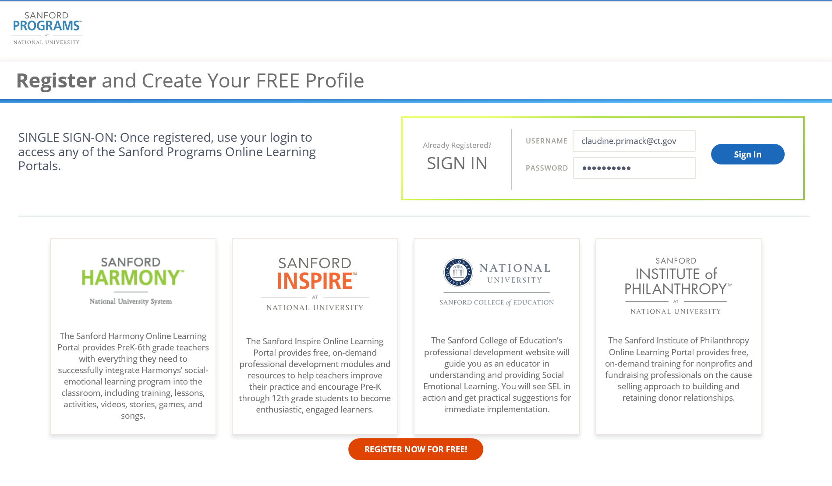
Sanford Inspire Modules and TEAM Crosswalk
Notes:
To access the Sanford Inspire Modules, teachers will first need to create a free account. This will allow access to all of the online learning modules.
This slide is animated – click once and an arrow will appear pointing to the register now button. If teachers have their computers or other devices with them, you may want them to register now.
Notice there are four options (click the mouse for arrows)– The first two Sanford Harmony and Sanford Inspire are where teachers will find all of the professional learning resources that align with the TEAM modules.
Once teachers have created their account, they can click on either Harmony or Inspire. Let’s look at Inspire…

Slide 56
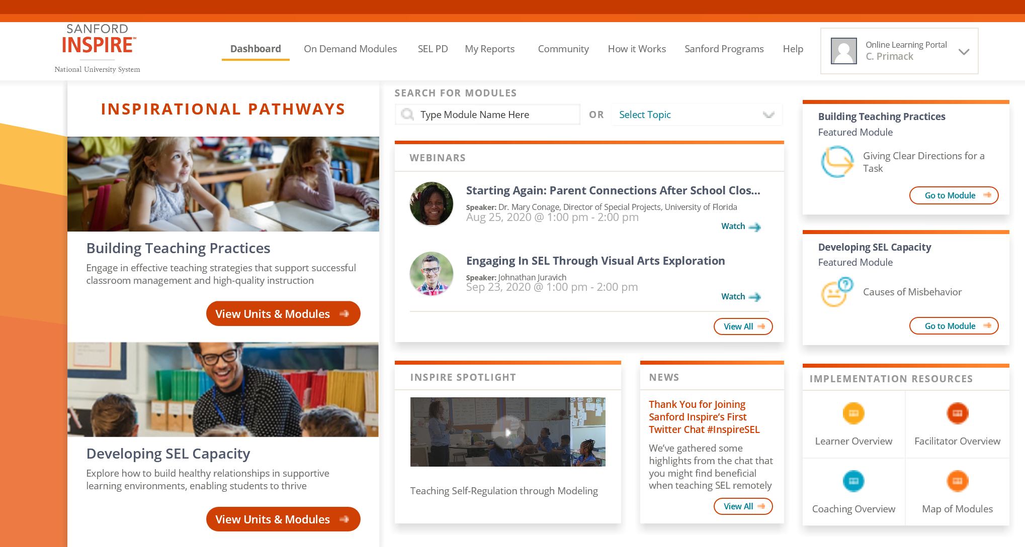
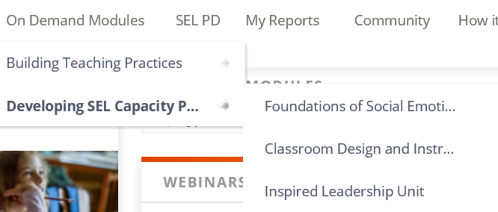
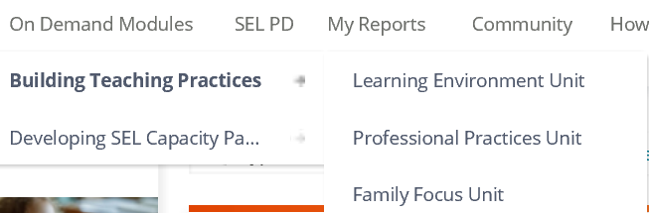
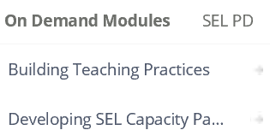
Sanford Inspire Modules and TEAM Crosswalk
Notes:
This slide is animated. Alternatively, you may go directly to the Sanford site and demonstrate the following:
There are multiple resources available on this site, but let’s look at the On Demand Modules (click mouse and a circle will appear around the link).
Click mouse again and a drop down menu appears - The On Demand Modules are divided into two pathways – Building Teaching Practices – which focuses on effective teaching strategies that support successful classroom management and high-quality instruction, and Developing Social Emotional Learning (SEL) Capacity – which focuses on how to build healthy relationships in supportive learning environments, enabling students to thrive.
Let’s look at Building Teaching Practices - Click mouse again and the menu expands to show three units: Learning Environment, Professional Practices, and Family Focus.
Let’s look at Building SEL Capacity – Click mouse again and the SEL Capacity menu expands to show three units: Foundations of Social Emotional Learning, Classroom Design and Instruction and Inspired Leadership.
Click mouse again – a box appears- notice that the units and modules can be accessed here as well. Let’s look at Building Teaching Practices

Slide 57
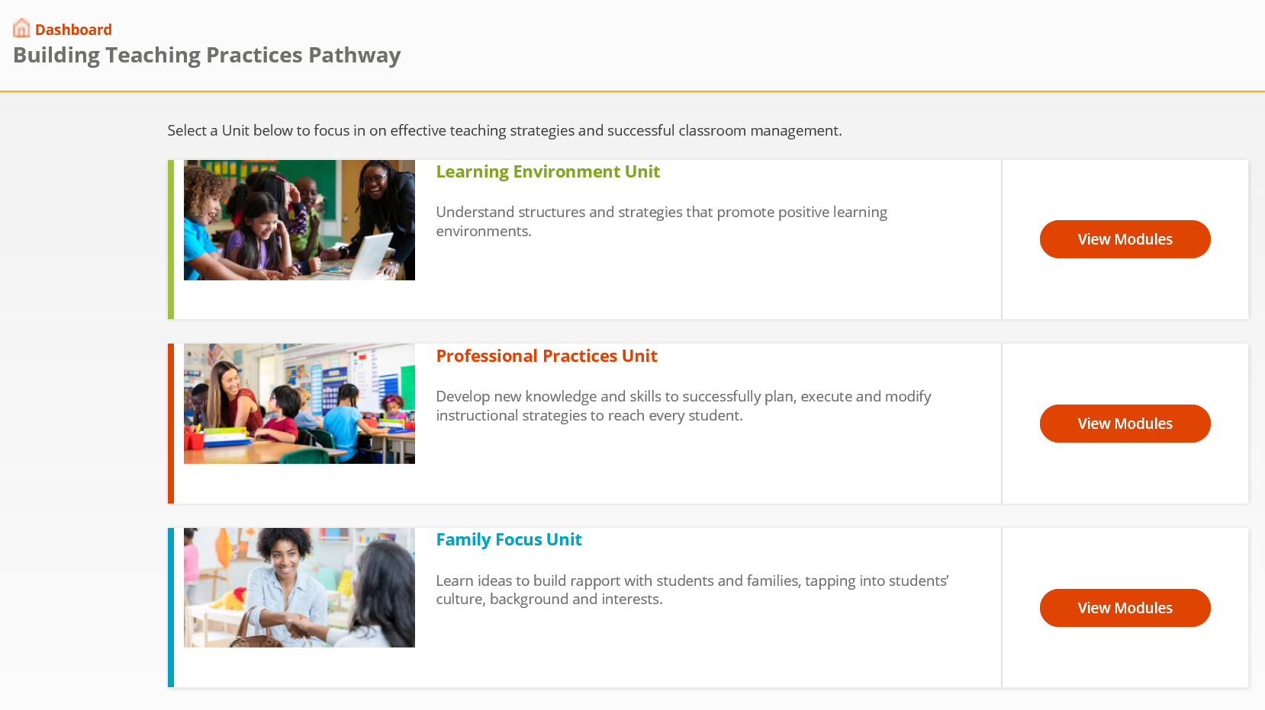
Sanford Inspire Modules and TEAM Crosswalk
Notes:
When you click on Building Teaching Practices a new window opens showing three pathways. Let’s look more closely at the Learning Environment Unit.

Slide 58
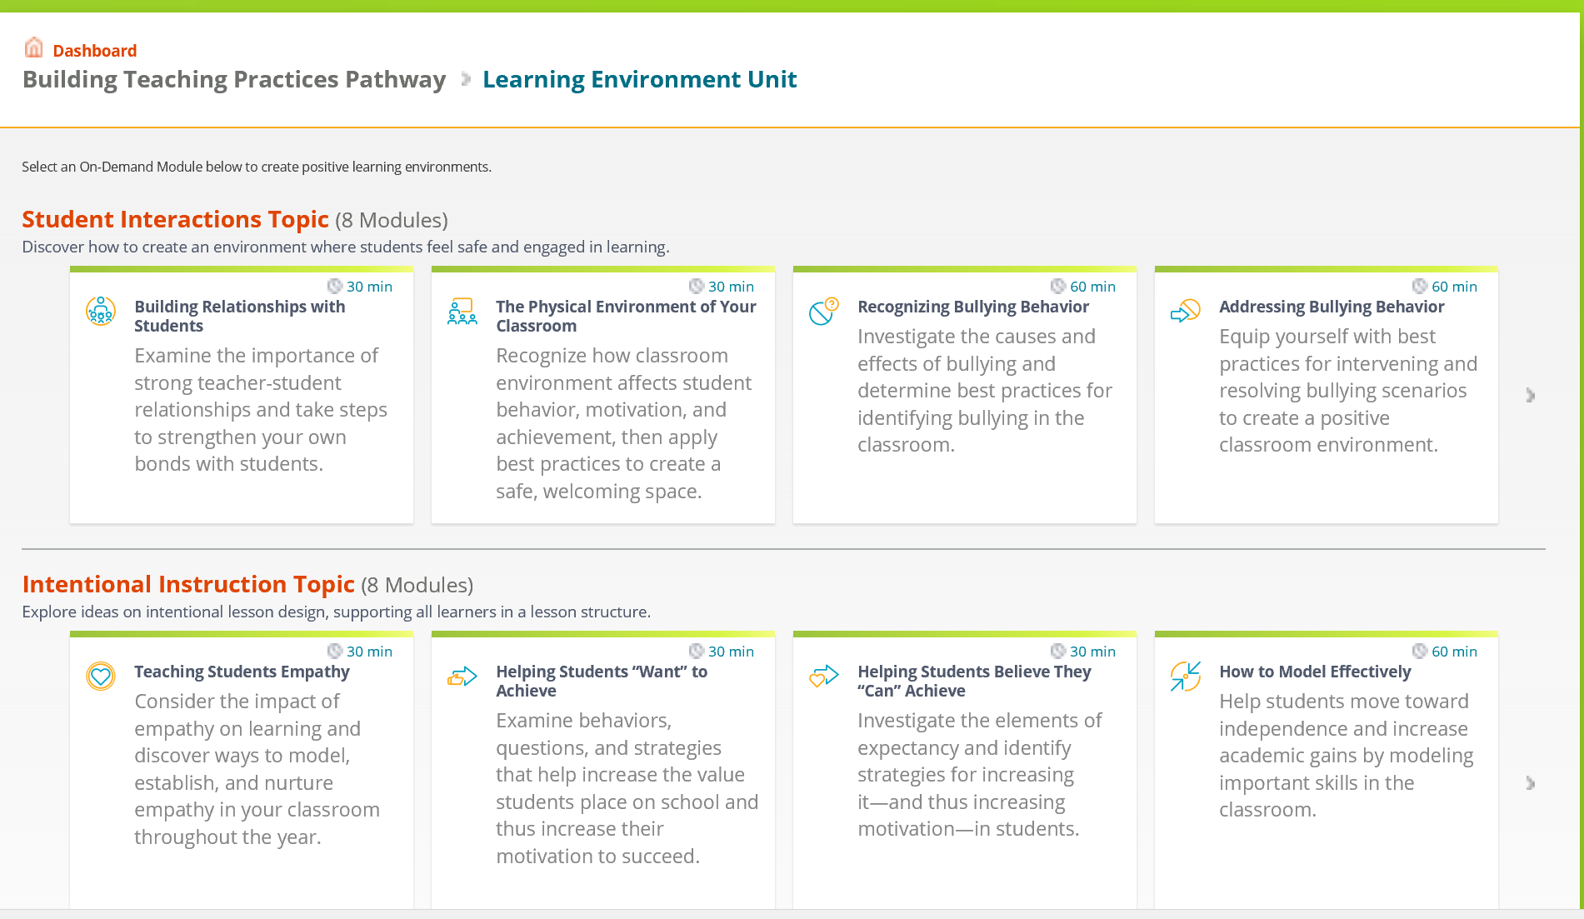
Sanford Inspire Modules and TEAM Crosswalk
Notes:
Notice that there are two sections – Student Interactions which includes 8 modules on how to create an environment where students feel safe and engaged in learning and Intentional Instruction which also includes 8 modules which focus on lesson design that supports all learners.
These modules align with the CCT and the TEAM modules. The CSDE provides a crosswalk that connects these resources directly to the TEAM module and CCT indicators.

Slide 59
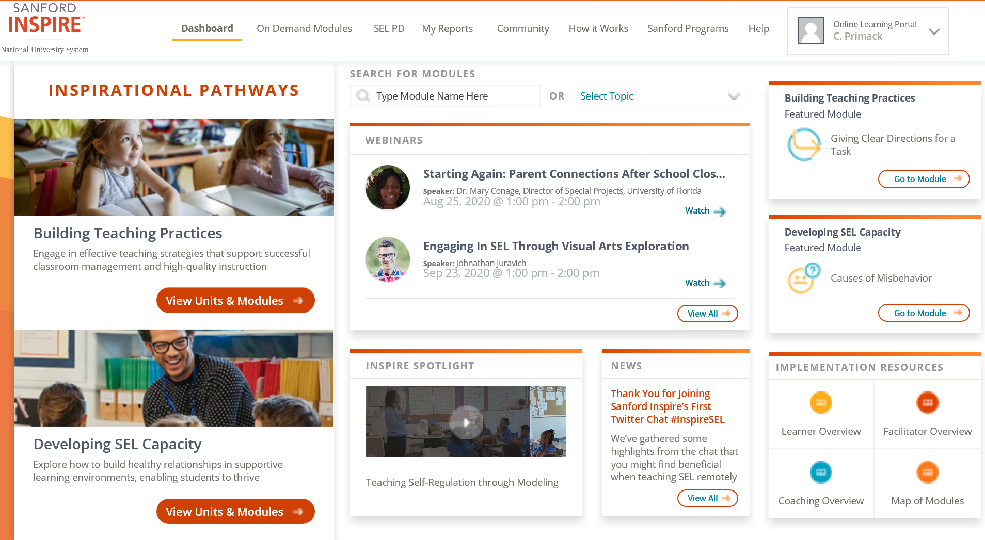
Sanford Inspire Modules and TEAM Crosswalk
Notes:
The fastest way to find a specific module is to use the SEARCH FOR MODULES (click mouse for arrow pointing to the search feature).
Enter the name of the module where it say Type Module Name Here.
Share either a handout of the crosswalk or an electronic version. Provide participants with the link to the Sanford Inspire Modules.
If you have time, you can go to the site and demonstrate or have teachers spend some time exploring the various resources.

Slide 60
Mentor Provides job-embedded coaching that supports application and transfer of new learning to improve teaching practice and student outcomes
Reflect on Practice
Analyze Data
Set Goals for Professional Learning
Develop New Learning
Implement New Learning
Monitor Imapct, Assess and Adjust
Phase 3:
Engage in Professional Learning
Notes:
In Phase 3, the teacher engages in developing new learning.

Slide 61
TEAM Module Process
Phase 3
Develop New Learning
Engage in professional learning activities to develop new practices, or refine, expand, or extend existing practice to build on content and pedagogical skills.
Record specific examples of what was learned and how it was learned (what new knowledge and skills learned).
Think deeper about own practice and how the new learning relates to it.
Notes:
Phase 3- emphasize the importance of taking time to really engage in the activities to build their new learning.
Explain to BTs that the module process is not about writing a college term paper or a mere act of compliance; it is about professional growth. If they have chosen resources that are not helpful, they should find something else. The goal is to grow professionally.
Their new learning should be helping them to improve their current practices, to help think more deeply about their practice, and to discuss what they are learning with their mentor. They should consider how their new learning connects to what they are doing already or what they might try to do as a result.
Encourage them to talk to their mentor about what they are learning about the topic and what it means for their own practice. How are they thinking about what they have been doing and what they might do differently as a result of this new learning.
They should document their thoughts as they develop new learning. The better they document the outcomes in their journals, the easier the reflection paper or project will be to complete. They will be able to draw from their journal to reflect on the entire process and the outcomes.
One of the reasons a module is unsuccessful is the lack of specific details. Carefully documenting the process as they proceed, will help teacher capture those specifics as they occur. It is often difficult to remember later what specifically happened.

Slide 62
Mentor Provides job-embedded coaching that supports application and transfer of new learning to improve teaching practice and student outcomes
Reflect on Practice
Analyze Data
Set Goals for Professional Learning
Develop New Learning
Implement New Learning
Monitor Imapct, Assess and Adjust
Phase 4:
Tryout New Learning
Notes:
In Phase 4, the teacher tries out the new learning.
The teacher will monitor and adjust as they implement changes to practice based on their new learning. They may need to go back to develop additional learning and try that out. This is an iterative process. Conversations with the mentor are critical at this point in the process.

Slide 63
TEAM Module Process
Phase 4
Implement New Learning
Implement new learning in daily practice.
Discuss with mentor how implementing new learning is impacting practice and student learning.
Make adjustments as needed or identify and develop additional new learning.
Analyze impact on teaching practice, instruction, and student learning.
Record specific example/evidence of changes in practice and student outcomes.
Notes:
Phase 4- As they develop the new learning, teachers should be trying it in their classrooms to see how it works and documenting what they see regarding changes to their own practice and student outcomes. Ideally, they should be meeting with their mentor as they have implement their new learning. Encourage them to ask their mentor to observe them implementing the new learning. Feedback is important at this phase of the process.
It is important to note that the cycle of continuous professional growth is not a linear process. Teachers may move back and forth throughout developing, implementing, analyzing and reflecting on new learning and it’s impact on practice. There may be a need to do additional learning with different sources. Their mentor can be a great resource as they reflect on how things are going.
The better they document the outcomes in their journals, the easier it will be to reflect on the process in a reflection paper or project. They will be able to draw from their journals to use specific examples in their reflection paper or project.
One reasons that modules are most frequently unsuccessful is the lack of specific details. Carefully documenting the process as they proceed, will help the teacher capture those specifics as they occur. It is often difficult to remember later what specifically happened.

Slide 64
TEAM Module Process
Phase 4
Implement New Learning – For Module 2 Planning
In the Planning Module, you will tryout your new learning to plan a lesson or series of lessons.
Discuss with your mentor how you are implementing your new learning about planning and what you anticipate the impact on student learning will be as a result of the planned instruction.
Make adjustments as needed or identify and develop additional new learning.
Record specific example/evidence of changes in planning practice and what you anticipate student will be able to do as a result of the planned instruction, strategies, and activities.
Notes:
Phase 4- Module 2 – Planning is different. Teachers are asked to focus on how they plan instruction. They should be encouraged to NOT teach the lesson before completing their paper or project.
Remind teachers that as they reflect they should consider the cause and effect between changes in how they plan instruction and what they anticipate what students will be able to do.
The better they document the their new learning and implementation of it in their journals, the easier it will be to reflect on the process in a reflection paper or project. They will be able to draw from their journals to use specific examples in their reflection paper or project.
One reasons that planning modules are most frequently unsuccessful is that teachers focus on the actual teaching rather that the thought process that they use to plan instruction. Carefully documenting their thinking process as they proceed, will help the teacher capture those specifics as they occur. It is often difficult to remember later what they were thinking.
Because the teacher is planning and not yet teaching the lesson(s), there is not an actual impact on students. Instead, the teacher should describe what they think students will be able to do as a result of the planned lesson(s).

Slide 65
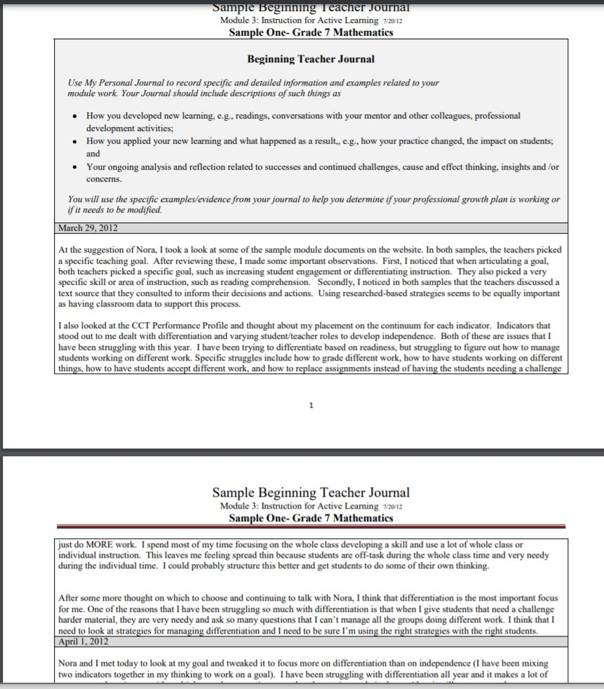
Sample Beginning Teacher Journal
Notes:
Documenting the module:
The better you document the outcomes in your journal, the easier it will be to reflect on the process in a reflection paper or project. You will be able to draw from your journal to use specific examples in your reflection paper or project.
One reasons that modules are most frequently unsuccessful is the lack of specific details. Carefully documenting the process as you proceed, will help you to capture those specifics as they occur. It is often difficult to remember later what specifically happened.

Slide 66
Phase 5:
Reflect on Changes to Practice and Students Learning
Mentor Provides job-embedded coaching that supports application and transfer of new learning to improve teaching practice and student outcomes
Reflect on Practice
Analyze Data
Set Goals for Professional Learning
Develop New Learning
Implement New Learning
Monitor Imapct, Assess and Adjust
Notes:
Phase 5 asks teachers to reflect on the entire module process and how changes in their practice or planning have led to changes in student outcomes or anticipated outcomes. If the outcomes for students is not positive, teachers are not ready for Phase 5. They should discuss with their mentors what adjustments need to be made to achieve positive outcomes for students. Make adjustments as needed or identify additional new learning needs. (This process may be repeated several times as the teacher refines the new learning and his or her teaching or planning practice).

Slide 67
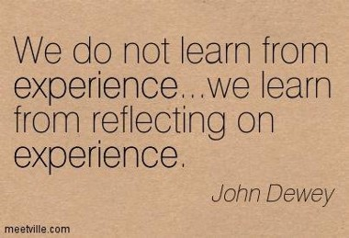
TEAM Module Process
Phase 5
Reflect on Practice
Reflect on changes in practice and student learning,
Collaborate with mentor to assess and adjust subsequent instruction or engage in additional professional learning as needed.
Document specific examples/evidence of impact on practice and student outcomes.
Notes:
Based on what your district requires – a reflection paper or project - the most important thing to remember is that it must meet the same success criteria. This means that BTs will document how they developed new learning and what that new learning was, how that new learning led to chances in their practice and how those changes led to improved student performance/learning.
Whatever your district is using as the demonstration of module completion, it is important to emphasize that the final product will be reviewed based on the same criteria.
This is a good place to add any additional slide that will explain your district process and expectations for teachers.

Slide 68
TEAM Module Process
Phase 5
Document Specific Examples/Evidence
Document the module process and outcomes. The minimum requirements for a Project or Reflection Paper include:
  A description of how new learning was developed: the specific learning activities and resources the teacher used to develop new learning;
  An explanation of what the teacher learned from the learning activities and resources related to own practice;
  Specific examples/evidence of how the teacher used new learning to improve teaching practice;
  Specific examples/evidence of what impact the changes in teaching practice had or will have on students; and
  A comparison of the changes in teaching practice and positive outcomes for students to what was described in the Initial Summary.
Notes:
Based on what your district requires – a reflection paper or project - the most important thing to remember is that it must meet the same success criteria. This means that BTs will document how they developed new learning and what that new learning was, how that new learning led to chances in their practice and how those changes led to improved student performance/learning.
Whatever your district is using as the demonstration of module completion, it is important to emphasize that the final product will be reviewed based on the same criteria.
This is a good place to add any additional slide that will explain your district process and expectations for teachers.

Slide 69
TEAM Module Process
Phase 5
Mentor Sign-off
Share draft(s) of the Reflection Paper or Project with the mentor for feedback and sign-off.
  Mentor sign-off indicates that the Reflection Paper or Project is consistent with on-going work between the mentor and the teacher.

Slide 70
Module Submission
Teachers submit each module when the mentor has signed-off.
The module process is expected to take between 8-10 weeks to complete.
Please Note: No more than one reflection paper/project should be submitted within a four week period.
Notes:
Teachers should not wait to submit modules. The intent of the program is to develop professionally through an 8-10 week process. As the teacher engages in the professional growth module, each step should be completed and submitted appropriately. Teachers should not submit multiple modules at the same time.

Slide 71

Three Criteria for Success
Development of New Learning
Impact on Practice
Impact on Students
Notes:
The next few slides will review the criteria for review of a reflection paper or a project. Regardless of whether the district requires a reflection paper or a project, the criteria are the same.

Slide 72
Criteria I
Development of New Learning –
Teachers engage in professional learning to develop new knowledge and skills to improve their practice so they can help students achieve.
Describes how the teacher developed new learning; and
Explains what the teacher learned from the selected activities and resources and/or thinking more deeply about her/his practice.
Notes:
NOTE: You may want to share a few examples of what this looks like. If you are requiring reflection papers, you can use the samples provided. If you are requiring projects, you may want to collect samples of successful projects to share as examples. Do this for all three criteria.
Teachers should discuss how they developed their new learning. Did they observe a colleague, attend a data team meeting to review student data, participate in an online workshop, read a journal. Then they should explain what they learned and how it relates to their own teaching.
For example, a teacher might have participated in an online workshop about differentiated instruction and learned that students’ needs should determine the way the teacher designs instruction. As a result of that new learning, the teacher realizes that he has not been considering the varying needs of his students and has been designing instruction geared to the whole class. OR- you can provide examples of your own here.
You may want to share an example of what this looks like. There are many examples on the TEAM site which include explanations about what makes the paper successful and includes examples for each of the three criteria. You can access the resources at this address: https://portal.ct.gov/SDE/Talent_Office/Talent-Office-home-page/TEAM-Program
The key is that the teacher needs to reflect on and think more deeply about his/her own practice in relationship to the new learning.

Slide 73

Criteria II
Impact on Practice
Teachers apply new knowledge and skills learned to improve teaching.
Explains, using specific examples/evidence how the used new learning to improve teaching or planning practice.
Notes:
Reviewers are looking to see how the teacher is doing something different as a result of the new learning. The BT should use their journal to document daily what is happening as a result of the new learning. This will help them to recall the specific examples later. The mentor and the BT can also focus their conversations around the daily reflections the BT records.
You may want to share an example of what this looks like. There are many examples on the TEAM site which include explanations about what makes the paper successful and includes examples for each of the three criteria. You can access the resources at this address: https://portal.ct.gov/SDE/Talent_Office/Talent-Office-home-page/TEAM-Program
Be sure to share a sample planning paper.

Slide 74

Criteria III
Impact on Students
Student learning and achievement improve as a result of teachers applying the new knowledge and skills learned.
Explains, using specific examples/evidence, how student performance/learning has improved as a result of changes in the teacher’s practice or will improve as a result of planning.
Notes:
Reviewers are looking for positive outcomes on student performance. If a strategy that a teacher tried did not work, it is ok to include it, but what is very important to include is what else did the teacher do to improve his/her practice that then resulted in improved student outcomes.
You may want to share an example of what this looks like. There are many examples on the TEAM site which include explanations about what makes the paper successful and includes examples for each of the three criteria. You can access the resources at this address: https://portal.ct.gov/SDE/Talent_Office/Talent-Office-home-page/TEAM-Program

Slide 75
Module Results
What happens if my Reflection Paper or Project does not meet the criteria for successful completion?
C onsider doing t he fol lo wing
Read sample PD Papers found on the TEAM website under “Module Specific Resources.”
Go back to the journal for additional data.
Engage in additional professional growth activities.
Collect additional data.
Continue to engage in discussions with mentor.
Submit revised Reflection Paper or Project.
Notes:
If the BT is careful to address each of the criteria, she/he should be successful. However, if there is any criteria that is not successful, the BT can revise the paper or project and resubmitting it.
Let the participants explore the site using their device and find the links for what is listed.

Slide 76
What if my Module is Unsuccessful?
An unsuccessful module can be revised and resubmitted.
Talk to your mentor about the feedback you get with your results.
Go back to your journal to look for additional evidence to support an unsuccessful criteria. Remember that general, vague statements are not specific evidence. Add more specificity to any area that is unsuccessful
Resubmit your module.
Caution! Do not wait until your TEAM deadline date to submit papers, you may run out of time to revise any unsuccessful module.

Slide 77

TEAM Completion
What happens when a I successfully complete all the required modules?
Your DF will notify your superintendent of your completion
Your completion will be entered into the state Educator Data System (EDS) and the certification file will be update with your completion.
You are now eligible to apply for a provisional certification.
Notes:
Once the TEAM modules have been successfully completed, the DF will notify the superintendent. A verification of completion is entered by the an individual in the district who has the role of EDS LEA TEAM. This individual will enter the date of completion into the state educator data system EDS. The certification office receives the updated data every evening.
REMINDER: Teachers should apply for certification at least 6 weeks prior to the expiration date on their certificate.
If a first or second-year participant in TEAM will not complete TEAM by the expiration date listed on their Initial Educator Certificate but expects to complete TEAM within three-months, they may be eligible for a grace period during which their certification will not lapse as long as they have an application on file.
A third-year participant in TEAM must fulfill TEAM requirements before their TEAM deadline date and apply for a provisional educator certificate before the expiration date on their initial educator certificate. They are not eligible for a grace period.

Slide 78
TEAM Completion
What happens if I do not successfully complete all the required modules by my deadline date?
Failure to successfully complete TEAM will result in the inability to advance your initial certificate to a provisional certificate.
You will not be able to renew your initial certificate and upon expiration, will no longer be able to teach in a CT public school.
In order to renew your initial certification, you will need to complete an Intervening Study and Experience and meet all new requirements at the time of certification.
*Please see the TEAM Program Manual for additional details.
Notes:
There have been relatively few individuals who have not successfully completed TEAM requirement by their deadline. Those individuals were not successful because they did not complete all of the TEAM program requirements within their allotted timeframe. Teachers who have extenuating circumstances that prevent them from completing TEAM within the time allotted, can ask the DF to request an extension of time. However, if there are no documented extenuating circumstances, an extension will not be possible. Therefore, it is critical that teachers pay attention to their due dates.
See Section 3 of the TPM for a detailed explanation of the consequences.

Slide 79

A Web-Based Program
Beginning teachers and mentors will have an online dashboard and workspace to access tools to assist in completing TEAM requirements:
CCT Performance Profiles (self-analysis)
Professional Growth Action Plan (PGAP)
Beginning Teacher and Mentor Meeting Log
Journal for Beginning Teacher
Journal for Mentor
Reflection Paper
Notes:
The following slides explain the online tools that the teacher will use to complete TEAM.

Slide 80
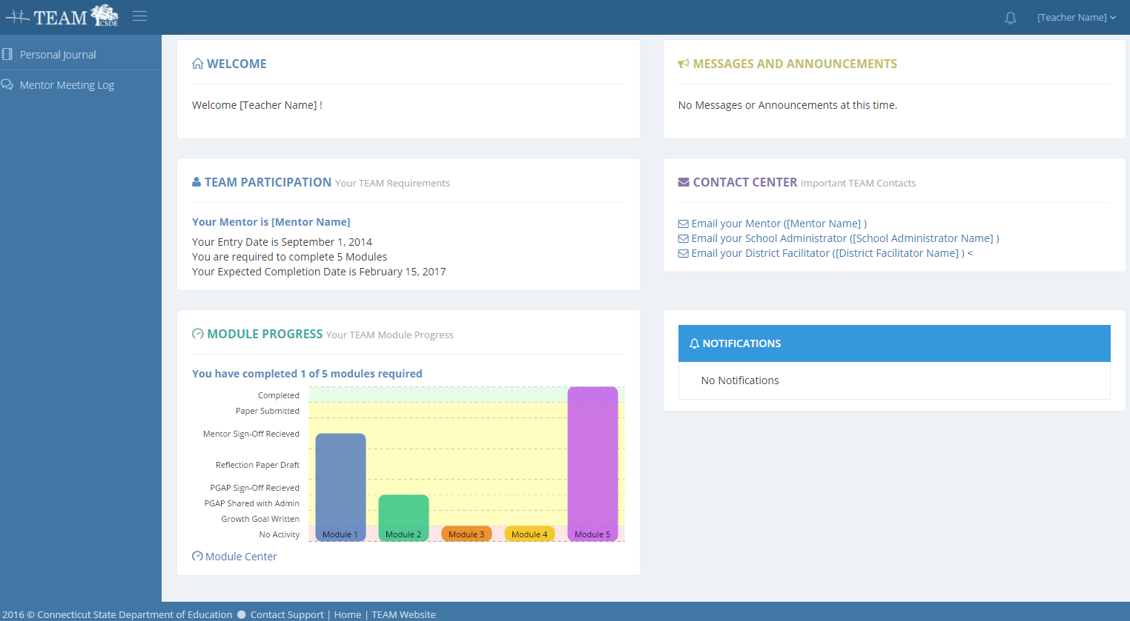
Beginning Teacher Dashboard

Slide 81
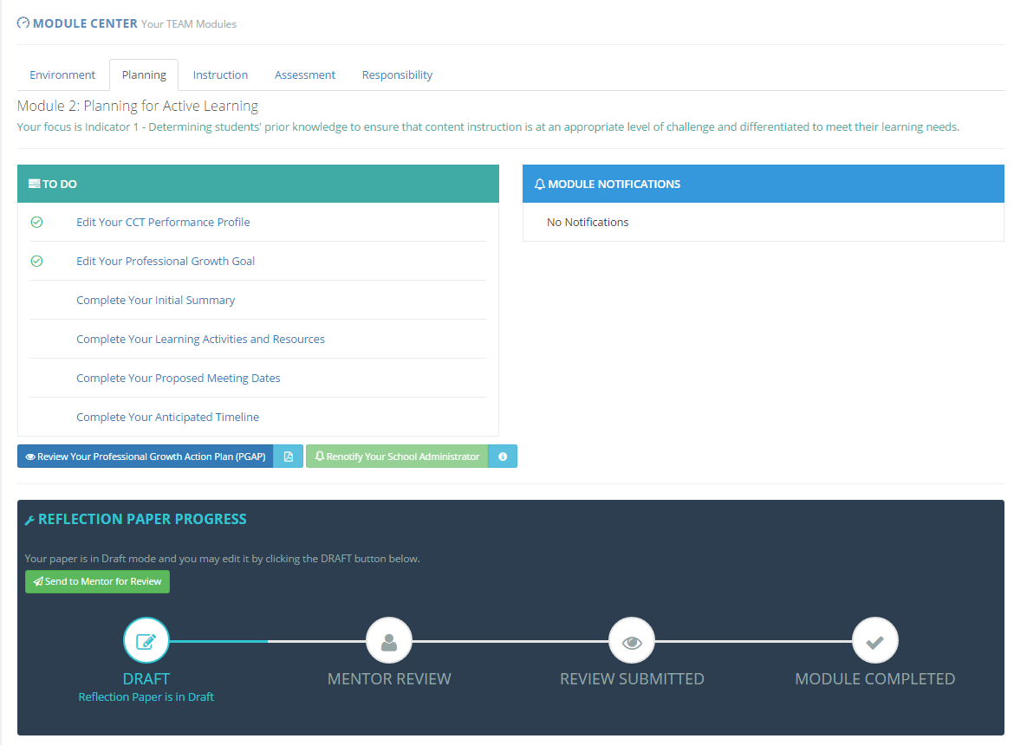
Beginning Teacher Module Center

Slide 82
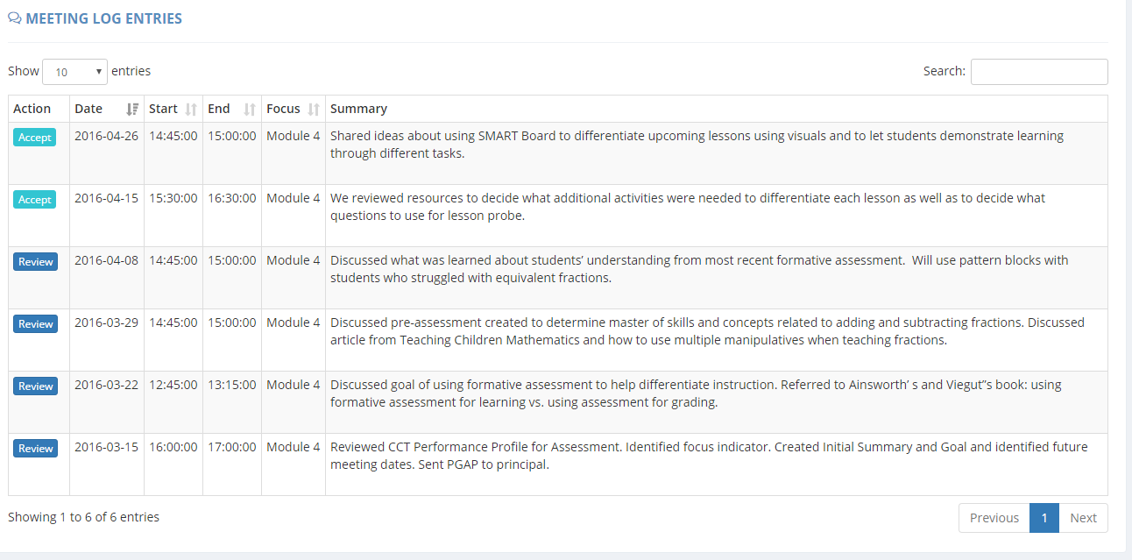
BT/Mentor Meeting Log
Note: Mentors are responsible for documenting meetings with their beginning teacher in the meeting log. Beginning teachers verify the accuracy of the meetings.

Slide 83
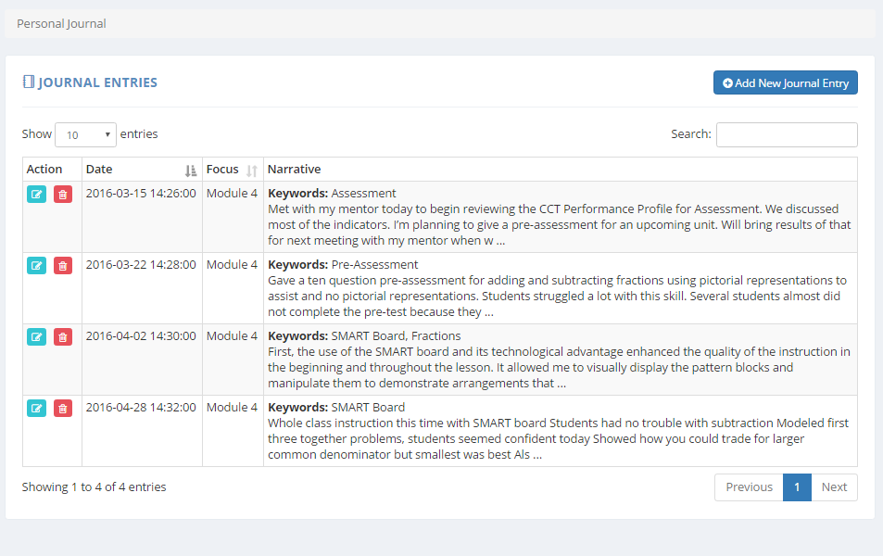
My Personal Journal

Slide 84
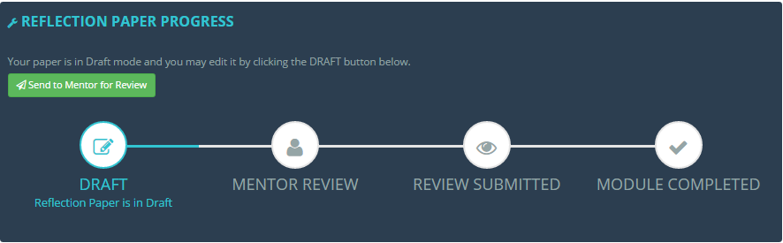
Reflection Paper Tracker

Slide 85
Additional Tools/Resources
Sample Module Documents
Sample Reflection Papers
Reflection Paper Criteria and Feedback
Recommended Resources
Sample District Support Plans
Online Orientations
Monthly Electronic Communications
Notes:
You may want to display the TEAM website (https://portal.ct.gov/SDE/Talent_Office/Talent-Office-home-page/TEAM-Program) and show them where to find these resources.

Slide 86
TEAM TWO-YEAR BEGINNING TEACHER
SUPPORT PLAN
Anticipated timeline of participation
Module(s) that will be completed during the 2016-17 school year
Module(s) that will be completed during the 2017-18 school year
Anticipated circumstances, such as a planned leave of absence (i.e., maternity leave, planned medical leave, etc.). that may require a third year
Notes:
Now that teachers have a general understanding of the TEAM program and the module process, you will want to spend a little time reviewing the Support Plan that they will need to submit to the DF and the TCC. The forms can be found in Appendix K of the TPM. You may want to provide the forms at this orientation, where they may begin to fill it in.
Purpose of the Support Plan: The support plan serves two purposes: first it informs the DF and the TCC of the BTs plan and possible need for a third year. Second, it helps the beginning teacher think about how to structure her or his own schedule in order to meet the requirements of TEAM. By planning how what they need to accomplish over the next two years, teachers are more likely to complete all of the TEAM requirements within their allotted time.
If you have teachers in Category II (two modules) explain that their support plan will be for one year only. Appendix B of the TPM lists all of the endorsements by category of participation.
Your district may have specific requirements for module completion and due dates. Remind BTs to use the district timeline to complete the plan. The plan also asks BTs if there are circumstance that may require them to use the third year. This is important to know. so that the mentor stipend can be distributed over the 3 years.

Slide 87
Connecting the Dots
TEAM
Educator Evaluation and Support
Team and
Evaluation
All Educators
Year-long Process
Evaluated through Analysis of:
Performance and Practice
Student Growth and Development
Whole-school Learning
Parent or Peer Feedback
Early Career Teachers
Mentor Support
8-10 Week Modules (incremental learning)
Success Determined by:
Teacher Learning
Impact on Practice
Outcomes for Students
High-Quality Professional Learning
High-Quality Professional Learning
Teacher Outcomes
Collaboration
High-quality Feedback
Standards-Based Professional Learning
Data-based Decisions
Student Outcomes
Data-based Decisions
Improved student learning
Local and regional boards of education shall coordinate the teacher education and mentoring program and the teacher evaluation and support program, provided they are kept separate.
Notes:
While TEAM may not be used to make decisions regarding employment, there are appropriate ways that evaluation can inform TEAM.
Explain to teachers that they will also be required to participate in the district’s evaluation and support plan. It might feel overwhelming when you think about these as separate requirements. However, if you can see how each can support the other, it makes it less overwhelming. This slide is intended to show the relationship between TEAM, evaluation and professional learning.
TEAM is a professional growth model. TEAM should not be a stand-alone task. The more teachers understand how their day to day work is connected, the more successful they will be. Teachers who approach TEAM as an act of compliance, fail to see how TEAM can help them grow professionally and how it supports student achievement and growth. Evaluation goals can be broken down into smaller goals for TEAM, classroom observation feedback from an administrator can inform the focus of professional learning, TEAM is about professional growth.
Ask: What connections does TEAM have to their work (TEVAL, PLC, Data Teams, Formative/Summative Process, etc.)? For example, how are the goals for TEAM similar and different to the goals written for TEVAL? This will help them to process the TEAM content that was presented.
Refer to TPM pp. 19.
The CSDE and RESC Alliance are providing new resources in the fall that can extend this discussion and help teachers and mentors to see the connections between TEAM, evaluation, and professional learning.

Slide 88

Connecting TEAM, Evaluation and Support and CCS
One teacher’s thinking…
Grade 8: History
Teacher Reflections: As I worked with my mentor I realized that if I wanted my students to think more deeply about content and be more independent learners, I needed to think differently about my practice.
As a result, I drafted possible goals for my TEAM Modules that supported my student learning goal that I developed as part of my teacher evaluation and support plan.
Notes:
This is an actual quote from a TEAM participant.

Slide 89
Connecting TEAM, Evaluation and Support and CCS
.
Evaluation- Student Learning Goal (Broad): Students will improve their competence in reading comprehension of informational texts using the concepts, themes and information presented in history.
Possible TEAM Module Goals
Module One: Classroom Environment | Module Two: Planning | Module Three: Instruction | Module Four: Assessment
I will learn and apply a variety of strategies to create a learning environment where students feel invited to share their views without fear of judgment. CCS Application: Students will logically and objectively prove their views with authentic evidence and supporting facts. | I will learn about and incorporate a variety of strategies into my planning to teach academic vocabulary in history. I anticipate that my students will be able to proficiently use historical terms in their writing. CCS Application: Students will use academic vocabulary to build students’ ability to access more complex texts for reading and writing. | I will learn about and apply research-based instructional strategies in my history lessons so that my students will be able to demonstrate a deeper understanding of the unit on slavery. CCS Application: Students will read carefully and grasp information, arguments, ideas and details based on text evidence. | I will learn about, create and communicate assessment criteria so that students can self-assess a practice performance task that combines literacy and history. CCS Application: Students will base their writing on evidence from texts using established criteria.
Notes:
Here are a few examples of how a goal can inform the modules in TEAM.
The teachers SLG/Os can be broken down into smaller parts for TEAM goals. Review the ways in which these goals have been broken down. You might want to suggest that the BT share his or her SLG/O with the mentor at the start of the year, so they can think about ways that TEAM modules can support the SLG/O.

Slide 90
Contact Information
CSDE Contacts
Claudine Primack Program Manager | 860-713-6841 claudine.primack@ct.gov
Gady Weiner Data Manager | 860-713-6836 gady.weiner@ct.gov
41
Notes:
Please add your own contact information to this slide.

Slide 91

Notes:
You may want to ask them to complete an exit ticket or a feedback form.

