Slide 1


Instructional Practice: From In-Person to Remote Learning
December 21, 2020
Connecticut State Department of Education
Notes:
Hello and Welcome to today’s POP Up PD, Instructional Practice: From In-person to Remote Learning. I’m Carole Dibble from the CSDE Turnaround office and I am joined by my colleague Greg Dresko a consultant from the Turnaround Office. As you know, POP UP PDs are designed to be quick timely professional learning to meet the needs of the schools we serve. Today’s PD is a quick learning kick-off to highlight 10 effective instructional strategies and how to bring them to life in a remote setting. We hope you will make a plan today to take professional learning on instructional strategies back to your staff.

Slide 2

Learning Targets
For Our Series
Examine effective instructional strategies
Exchange ideas for bringing these instructional strategies to the virtual classroom
Learn from one another
Connecticut State Department of Education
Notes:
Here are our learning targets for our series of Effective strategies for in-person and remote learning.

Slide 3
Learning Targets
For Today
Consider effective instructional strategies
Familiarize ourselves with professional learning tools to promote effective instructional strategies
Learn from one another
Connecticut State Department of Education
Notes:
Today we will focus on a quick overview of ten instructional strategies. We will then share ideas for introducing the instructional tools to your staff with one another.

Slide 4

An Overview of the Series
Two Pre-Recorded POP Up PD on Demand Sessions to share with your staff
  -Overview of 5 in-person strategies in each session
  -Ideas for bringing each strategy to remote learning
  -Self-assessment for teachers to consider their own practice
PD On-Demand Playlist
POP Up PD in early 2021 highlighting educators in action with these strategies
Connecticut State Department of Education
Notes:
Today kicks off a series of professional learning. Which will be available this week on the Turnaround Office Website under Profession Learning tab, you will find 2 pre recorded POP Up PD on Demand Sessions. Each of these asynchronous sessions will include 5 effective instructional strategies, a reflection rubric, and ideas for implementing these instructional strategies in the remote classroom, as well as an on demand PD Playlist available at the CT Educator Learning Hub. We will also be talking later in the session about how you and your teachers can share the innovative and effective instructional strategies implemented in a remote setting.

Slide 5



The Importance of Effective Instructional Strategies
Why?
Connecticut State Department of Education
Notes:
We always begin with the why. John Hattie’s work looked at a variety of influences on student learning and found one of the greatest impacts on student outcomes to be collective teacher efficacy. Teachers make the difference! Teacher effectiveness is dependent on teachers having a deep knowledge and understanding of subject matter and pedagogical ability. Around the country schools have shown significant gains and narrowed achievement gaps by focusing on high-leverage, researched teaching strategies that work. Closing the gap and creating conditions for student success is why we must focus on high impact instructional strategies!

Slide 6

Why?
Instructional strategies and practice influence:
Behavior
Attendance
Engagement
These strategies can be brought to the remote setting to impact student outcomes!
Connecticut State Department of Education
Notes:
The best way to impact behaviors like low attendance and student engagement is to use effective instructional strategies that engage and excite students about learning. (Click) In 2020 it has become even more important employ these effective teaching strategies to reach our students in person and in remote classrooms. All of the effective instructional strategies are transferable to the remote teaching setting. The product of the use of effective teaching strategies, rather in-person or remote, is improved student outcomes.

Slide 7

What are effective instructional strategies?
10 Examples that Enhance Instruction
Connecticut State Department of Education
Notes:
There are many effective instructional strategies. When you go to the PD On-Demand Playlist there are articles, podcasts, and videos that highlight many different strategies. For our POP Up PD we have chosen 10 strategies to focus on during this professional learning. These strategies were chosen because of their transformative impact on teaching and learning. As you participate today, you may say we have left off a must do for your school. Every school has many needs and we encourage you to continue with the strategies that get results for your students. If it is not getting results, we challenge you to consider if it is time for a change. Let’s take a look at ten effective instructional strategies that will be highlighted in the upcoming professional learning series for teachers.

Slide 8

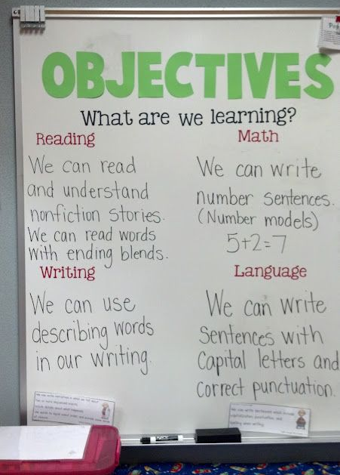
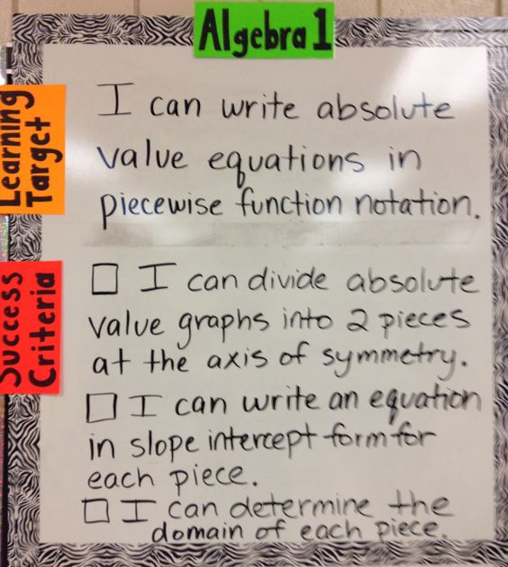
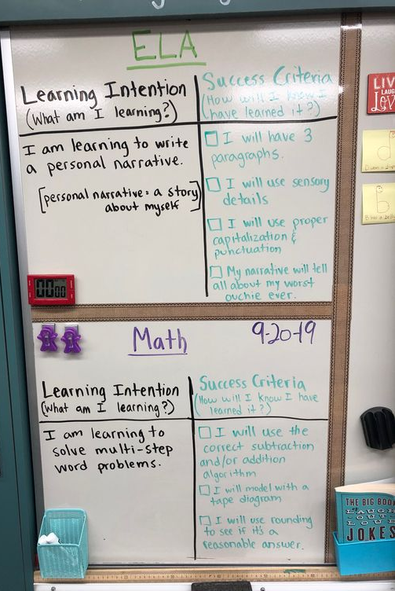
Setting Instructional Goals with Learning Targets
Connecticut State Department of Education
Notes:
Setting the learning goal. Teachers may call them objectives, learning targets, or learning intentions. Regardless of what they are called, learning goals are at the heart of the lesson. This is the intended learning outcome, what students will know, understand, or be able to do as a result of today’s learning. Without a clear picture of the learning goal, the lesson will surely fall flat and seem like a series of tasks. The goals should be communicated and students should understand how today’s learning fits into the bigger picture of the learning unit. Adding the criteria for success helps the goals come to life and let’s students know what they must achieve to be successful. Posting learning targets in kid friendly language will keep students informed about the learning goal. These targets should be standards-based, grade-level aligned and referred to often to help students see how it fits in the big picture. In the remote setting the learning targets should present throughout lesson slides, visible in the background of the video or posted at the top of all online learning assignments.

Slide 9

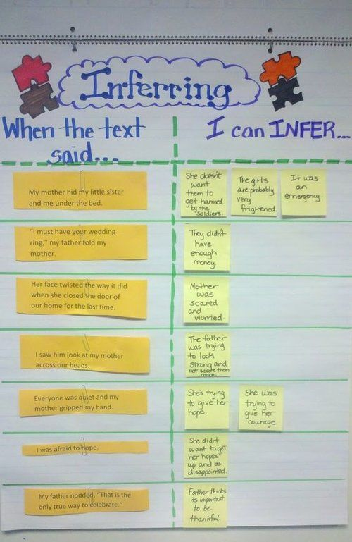
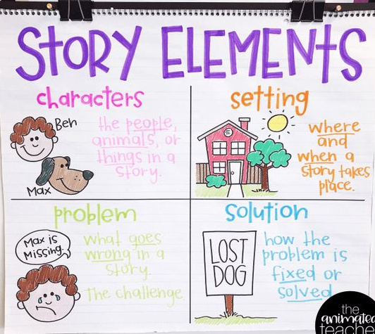
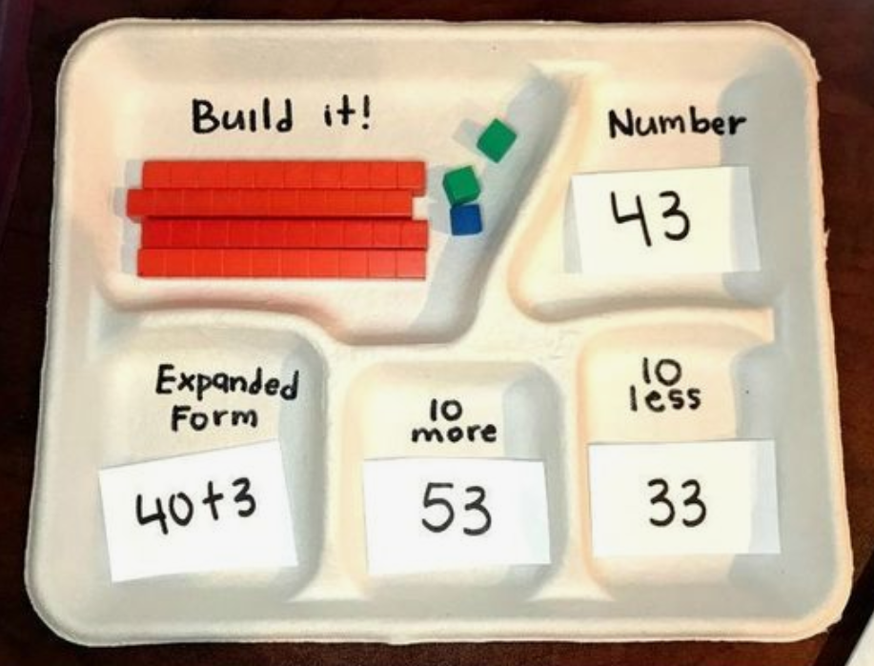
Visuals to Support Explanations
Connecticut State Department of Education
Notes:
Visual supports might be anchor charts, models, or using manipulatives. These supports help students anchor their learning and provide references to reinforce new or previously learned concepts. Models help students use concrete tools to understand more abstract ideas. Many students need the visual reference to connect with the words they hear to develop understanding. Visual models can foster learner independence and self-efficacy which supports the development of a student’s academic identity. We want students to see themselves as capable, independent learners. As many schools move to remote learning, we find there are many visual tools and manipulatives available on the internet to support teaching and learning.

Slide 10

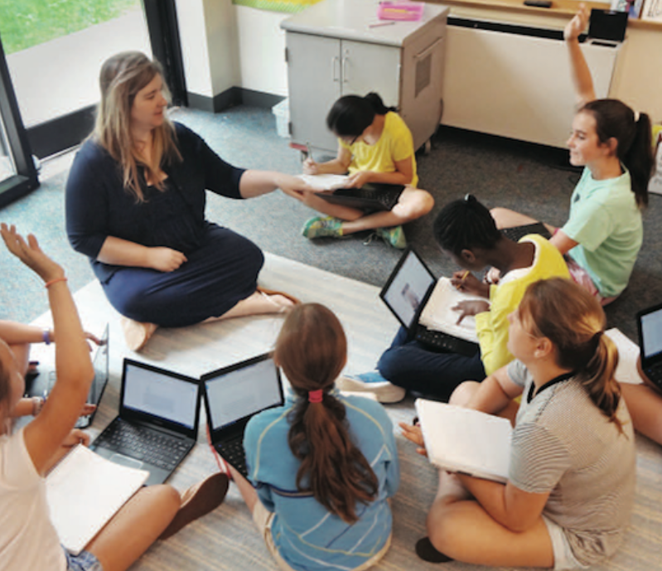


Explicit Teaching
Mini-Lessons
Flipped Classroom
Conferring
Small-group
instruction
Connecticut State Department of Education
Notes:
Allowing students to construct understanding and make meaning is important and so is explicit teaching!.
Explicit teaching is not standing at the head of the class and giving a lecture for 30 to 45 minutes leading to unengaged students and bad behavior. Research tells us that only 10% of information is retained when active engagement does not occur every 20 -30 minutes. Explicit teaching may come in many forms, a mini-lesson to kick off learning, creating a short instructional video for students to watch before they come to class, meeting with a small group to give targeted instruction based on the needs identified in the exit ticket from a lesson, or even conferring with individual students with a planned learning focus. All of these forms of instruction bring on explicit instruction. This is where you show, tell, explain, define, and connect information and guide students to develop a new understanding. The platforms lke Peardeck, Google Classroom or Meets, to name a couple, we are using i our schools for remote learning serve as tools for explicit teaching.

Slide 11
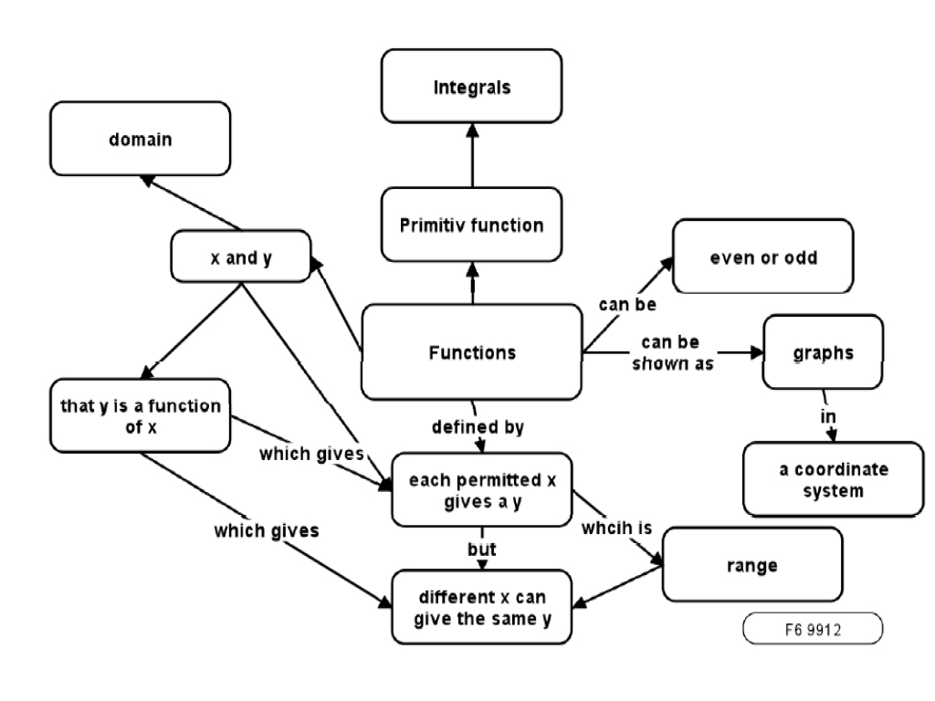
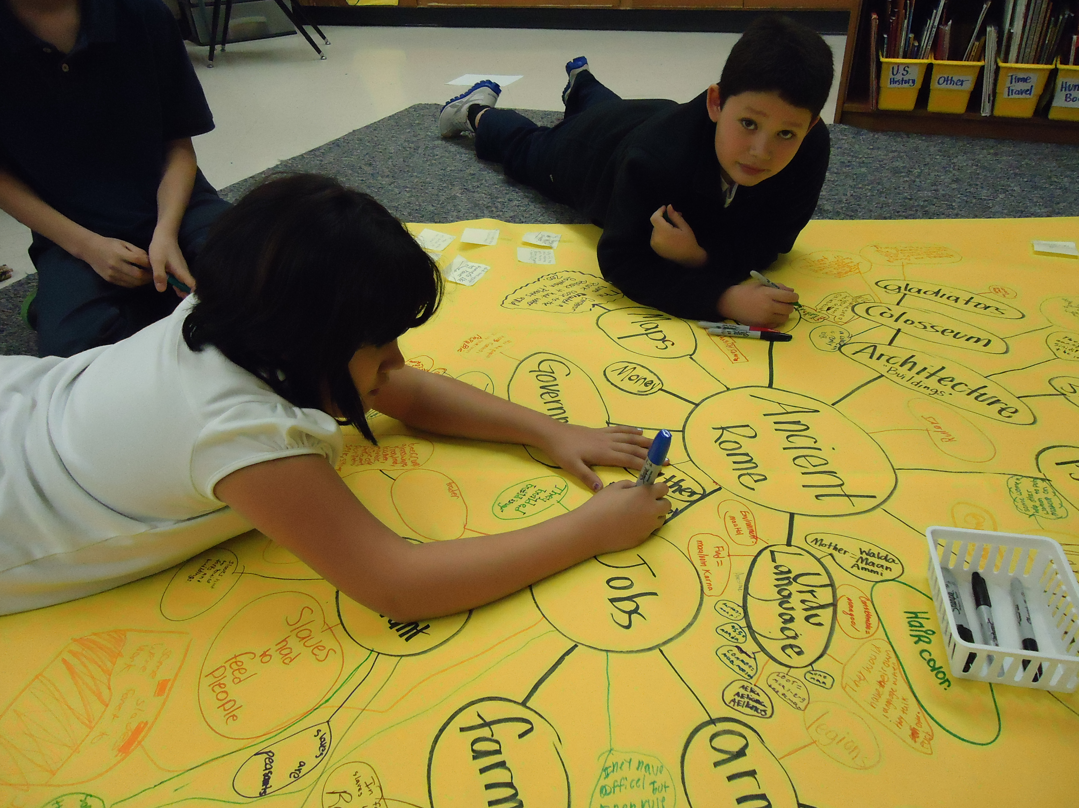
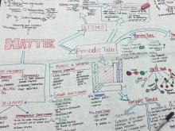

Concept Maps
Connecticut State Department of Education
Notes:
Concept maps created by students help them connect new learning and ideas. It helps them make meaning of new information and consider how this information is important to them and to other concepts. Deeper meaning and understanding comes from deeper connections. There are concept maps available for free that can be used in virtual learning and they are ready for every subject.

Slide 12
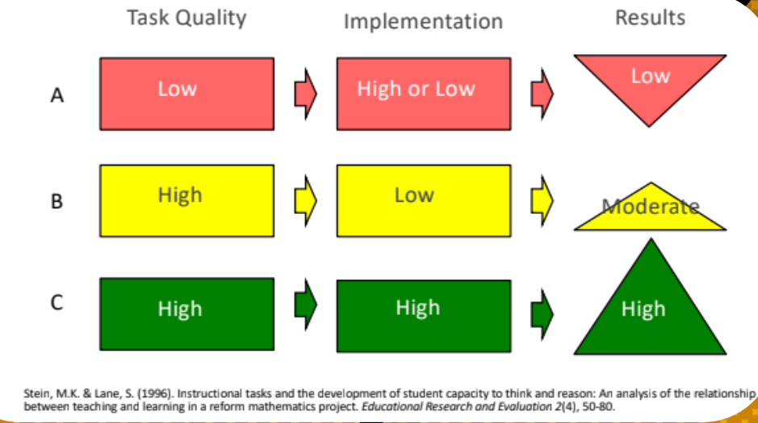

Tasks that Promote Reasoning, Problem Solving, and Productive Struggle
Connecticut State Department of Education
Notes:
High quality tasks that promote reasoning, problem solving and productive struggle is our next instructional strategy. Research shows us that great teaching and poor quality tasks will lead to low performing results, but a great task and good teaching will result in high student learning. Even low level teaching and a great task will lead to moderate learning results. It is important to provide students with great tasks that are aligned to grade level standards, that require problem solving and reasoning, and that adequately challenge students in productive struggle. Too easy and no learning is happening; too hard and students can’t engage in the task. Offering more open-ended tasks with easy access and a high-ceiling for complexity is a great way to offer students challenging and attainable tasks. High quality tasks can be brought to the online classroom using the instructional platforms schools are using.

Slide 13
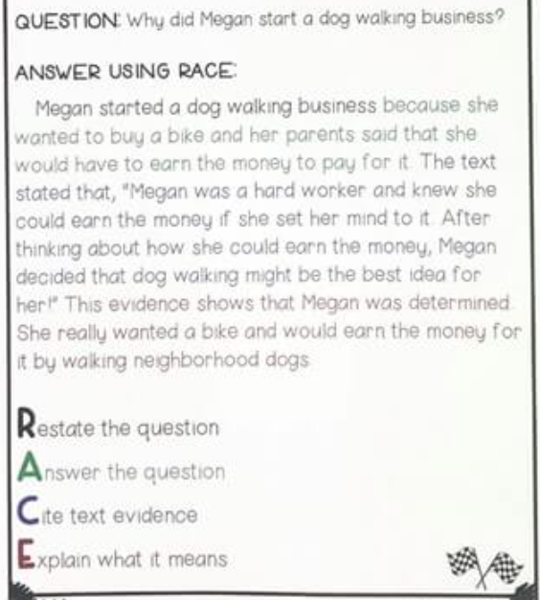
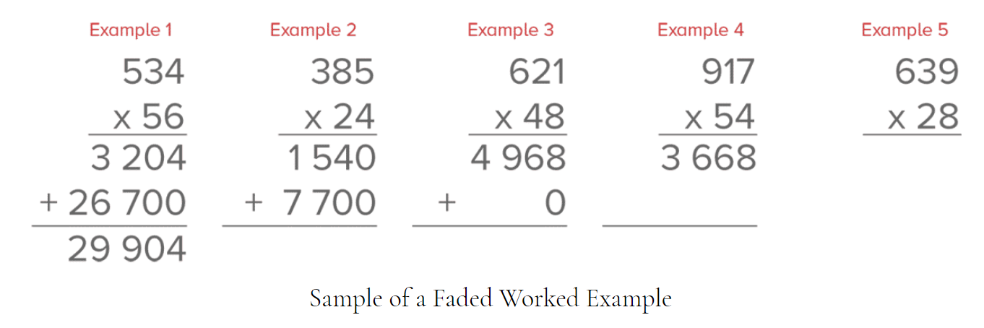

Worked Examples
Connecticut State Department of Education
Notes:
Providing students with work examples helps them understand what success looks like. It also helps them reason about the way the work is done to develop their own “rules” and understanding. Exemplars set the expectation bar of what good work looks like. Examples can be used a s a tool to help students develop a procedural understanding of a concept in a step-by-step way as seen on the right. Teachers can create videos of the methods and processes of the exemplars they create for students to review for additional information and help.

Slide 14
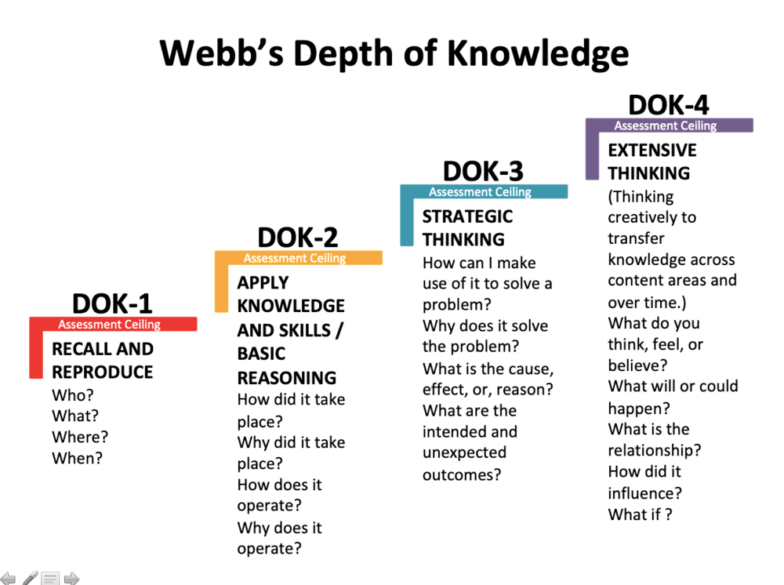
Questioning – Beyond Right Answers to Understanding
Tell me more…
What is the evidence from the text?
Does that remind you of something?
What have we done before
that might help us solve this?
Connecticut State Department of Education
Notes:
Right answers are necessary, but not sufficient. Asking questions where there is only a right answer doesn’t challenge students to develop and share their thinking and understanding of a problem. Wrong answers should be met with probing questions to uncover misunderstandings and challenges, Bloom’s Taxonomy and Webb’s DOK can guide teachers to plan for and include a variety of questions to develop meaning and sense-making. Students should not be allowed to just give a right answer, but be challenged to explain their thinking and make connections to prior learning or the world. There are many platforms for teachers to post questions and students to engage and respond. Every remote learning platform includes a chat feature that can support great questioning.

Slide 15

Students need practice doing
Problem solving
Reading
Responding to text
Fluency
Developing and using vocabulary
Writing
Collaborating
Developing persuasive arguments
Understanding scientific phenomena
Connecticut State Department of Education
Notes:
Yes! Students need practice. They don’t need 30 of the same problem with different numbers to practice today’s learning. They need to practice conceptual tasks that develop and provide evidence of understanding of the day’s learning target and completion of the success criteria. The learning platforms used for remote learning offer students the opportunity to engage in independent practice that can be monitored by teachers to see that students are developing understanding and teachers can respond quickly with appropriate and effective feedback.

Slide 16
Feedback to Students that is
Learning Forward
Be Specific
Concentrate on One Ability
Connect Feedback to Learning Targets
Be Timely
Confer
Use a Notebook to Keep Track of Progress
Use Post It Notes
Coach Students to Critique Their Own Work
I Noticed…
Connecticut State Department of Education
Notes:
Feedback impacts students learning, positively or negatively. Not all feedback to students needs to be evaluative. In fact, the goal of most feedback should be to help students learn. What are they missing? What are they doing well? To positively impact learning, be timely with feedback and be specific so students can correct, develop, and improve. Feedback should not be a gotcha, but a way to coach students to understanding. Many of our remote learning platforms allow us to give feedback interactively in the moment to support student learning.

Slide 17



Classroom Discussions
I heard you say…
I disagree because…
Tell me more about…
I agree…
I know my answer is
correct because…
My strategy is…
I would like to add…
Connecticut State Department of Education
Notes:
Humans are social and many of us are social learners. Talking through new ideas helps us make connections and develop a deeper understanding. Collaborative conversations aid in developing understanding. Staff to students, peer-to-peer, and small group conversations all play a role in development of ideas and development as citizens. (Click) Explicitly teaching students to engage in collaborative conversations creates the conditions for productive classroom conversations. Breakout rooms, chats, online discussions and group projects are available in remote learning formats.

Slide 18
An Overview of the Series
Two Pre-Recorded POP Up PD on Demand Sessions to share with your staff
  -Overview of 5 in-person strategies in each session
  -Ideas for bringing each strategy to remote learning
  -Self-assessment for teachers to consider their own practice
PD On-Demand Playlist
POP Up PD in early 2021 highlighting educators in action with these strategies
Connecticut State Department of Education
Notes:
These are 10 instructional strategies we are highlighting in our POP Up PD on Demand. Two professional learning sessions are available on The CSDE Turnaround Office Website under the professional learning tab highlighting these 10 strategies and ideas for bringing these instructional strategies to the virtual classroom.

Slide 19


Instructional Leadership
How might you use these professional learning tools to support teacher growth?
Connecticut State Department of Education
Notes:
Let’s take a moment to consider these instructional strategies and the tools we are providing. How might you use these tools with your staff to support teacher growth?
You might share the teacher video for them to watch before a team meeting. As they come to the team meeting they discuss and choose an effective strategy to implement within the next week. They can plan to share out their experiences at the next team meeting.
After teachers have participated in the POP Up PD ask them to share at staff meetings their positive experiences with implementing new teaching strategies.

Slide 20
Instructional Leadership
Consider the “must see” instructional practices in your building and how can you highlight these practices within this learning?
Connecticut State Department of Education
Notes:
In our live sessions one principal shared that their school was focused on the ABC+ learning targets that are actionable, behavior focused, create conditions for learning, and the + is “in order to do…” Now she will share with her staff adding the criteria for success.
Maybe a “must-see strategy” from your building was not among these 10 strategies. How can you highlight this strategy and bring it into the learning?
If one of your must see strategies is small group instruction. Consider how you might bring in strategies discussed today to support that small group instruction. For example, explicit teaching, high quality tasks, classroom discussion are effective strategies that enhance small group instruction.

Slide 21
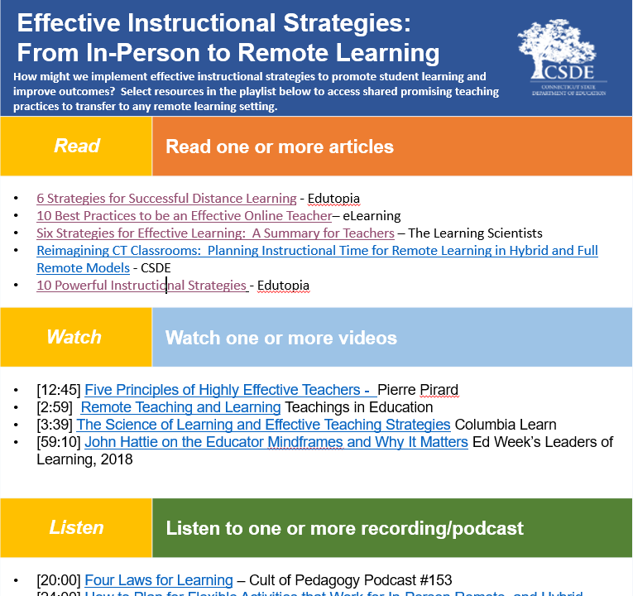
Check out the PD Playlist for Teachers
Available on the
CT Learning Hub
Go to Teacher’s Learning Hub
Select PD On-Demand Playlist
Select Effective Instructional Strategites
Connecticut State Department of Education
Notes:
Do you want more learning for your teachers about Effective Instructional Strategies? Check out the PD Playlist on the Teachers CT Learning Hub. Teachers can use this tool to guide their learning. You can support them through staff discussions after teachers engage in the learning.

Slide 22



Call to Action
Greg.Dresko@ct.gov
Connecticut State Department of Education
Notes:
As you engage in the work with your staff, we want you to look for opportunities to celebrate the work of your teachers and staff. When you see examples of these instructional strategies in the remote learning environment take a quick video, snap a picture, or write a quick description and share it with us. We will be gathering these examples from the field in follow-up POP Up PD in February. We know great things are happening in Connecticut and we want to showcase the work of your teachers and their effecting instructional strategies in the remote learning environment for all to see and learn.

Slide 23
THANK YOU FOR JOINING US! carole.dibble@ct.gov  greg.dresko@ct.gov
Connecticut State Department of Education
Notes:
Thank you for joining us today! Coming in February the two of us will be hosting a POP Up PD Effective Assessments it the Remote learning environment and we hope you will join. Also a new POP Up PD Series will begin January 20th Building Community: Promoting Relationships Virtually and In Person. It will include great information for building community in 2021.
We have included our emails and invite you reach out with any questions or if we can assist you in your work as you bring this professional learning to your staff.
Please stay tuned for our final slide highlighting the resources we used to prepare this PD. Thank you again for joining us and stay safe in the snow today!

Slide 24

References
Evidence-based Teaching: Six Strategies Explained
High Impact Teaching Strategies
Using Effective Instructional Strategies – ThoughtCo
Connecticut State Department of Education

